Slide 1




Gap filling in air temperature series by matrix completion methods
Benoît Loucheur
Pierre-Antoine Absil (UCLouvain) , Michel Journée (IRM)
23 May 2022

Slide 2
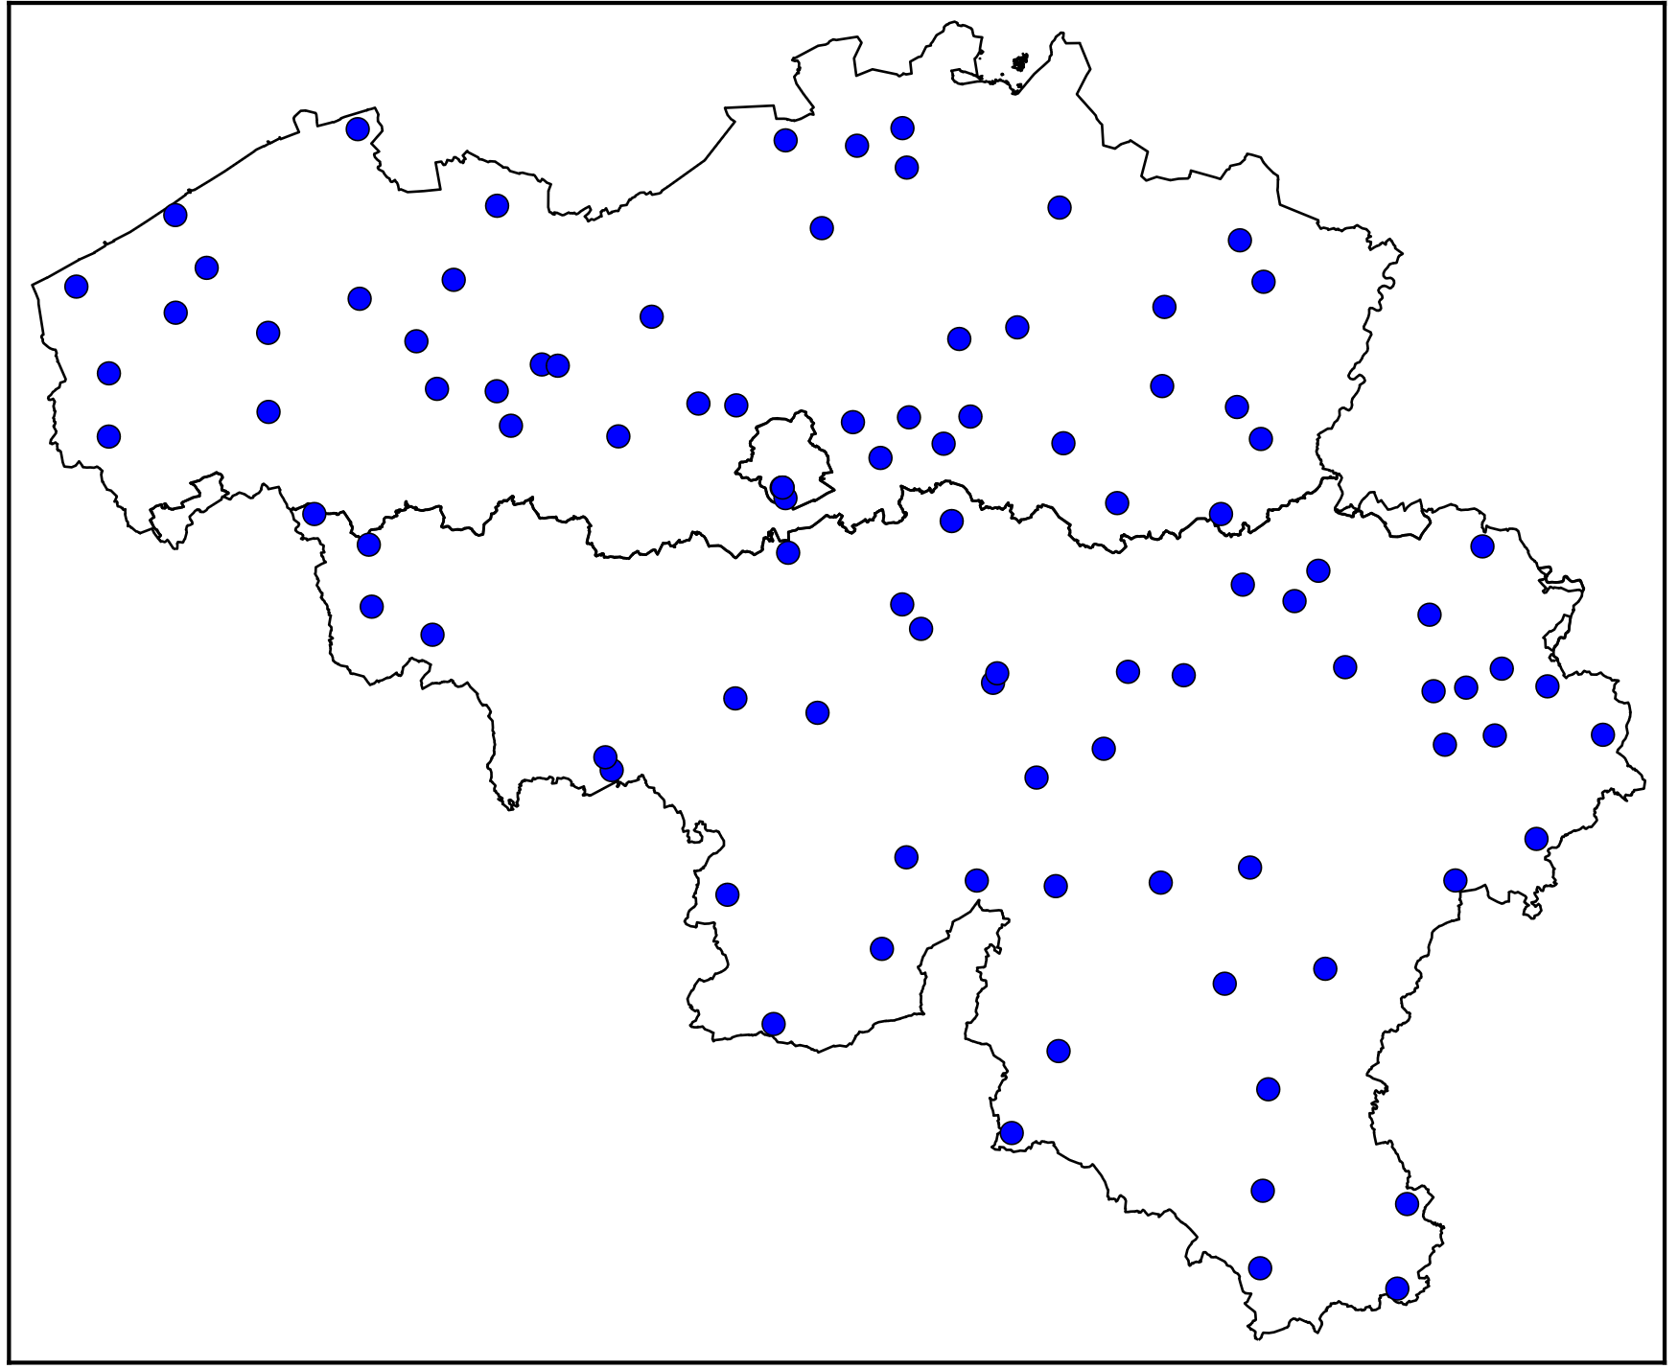
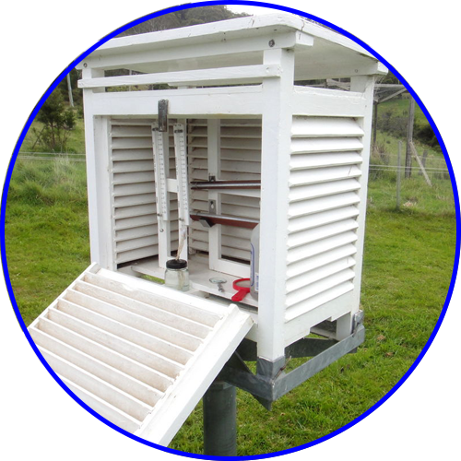
Context
Manual Station
The oldest climate network in Belgium
Minimum and Maximum daily temperature

Slide 3
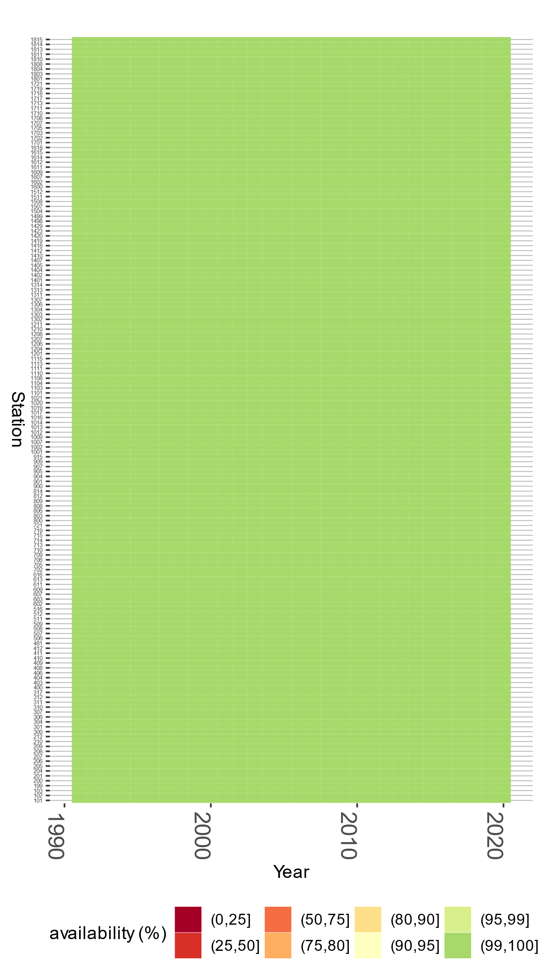
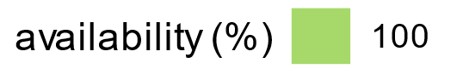
Data availability : Dream

Slide 4
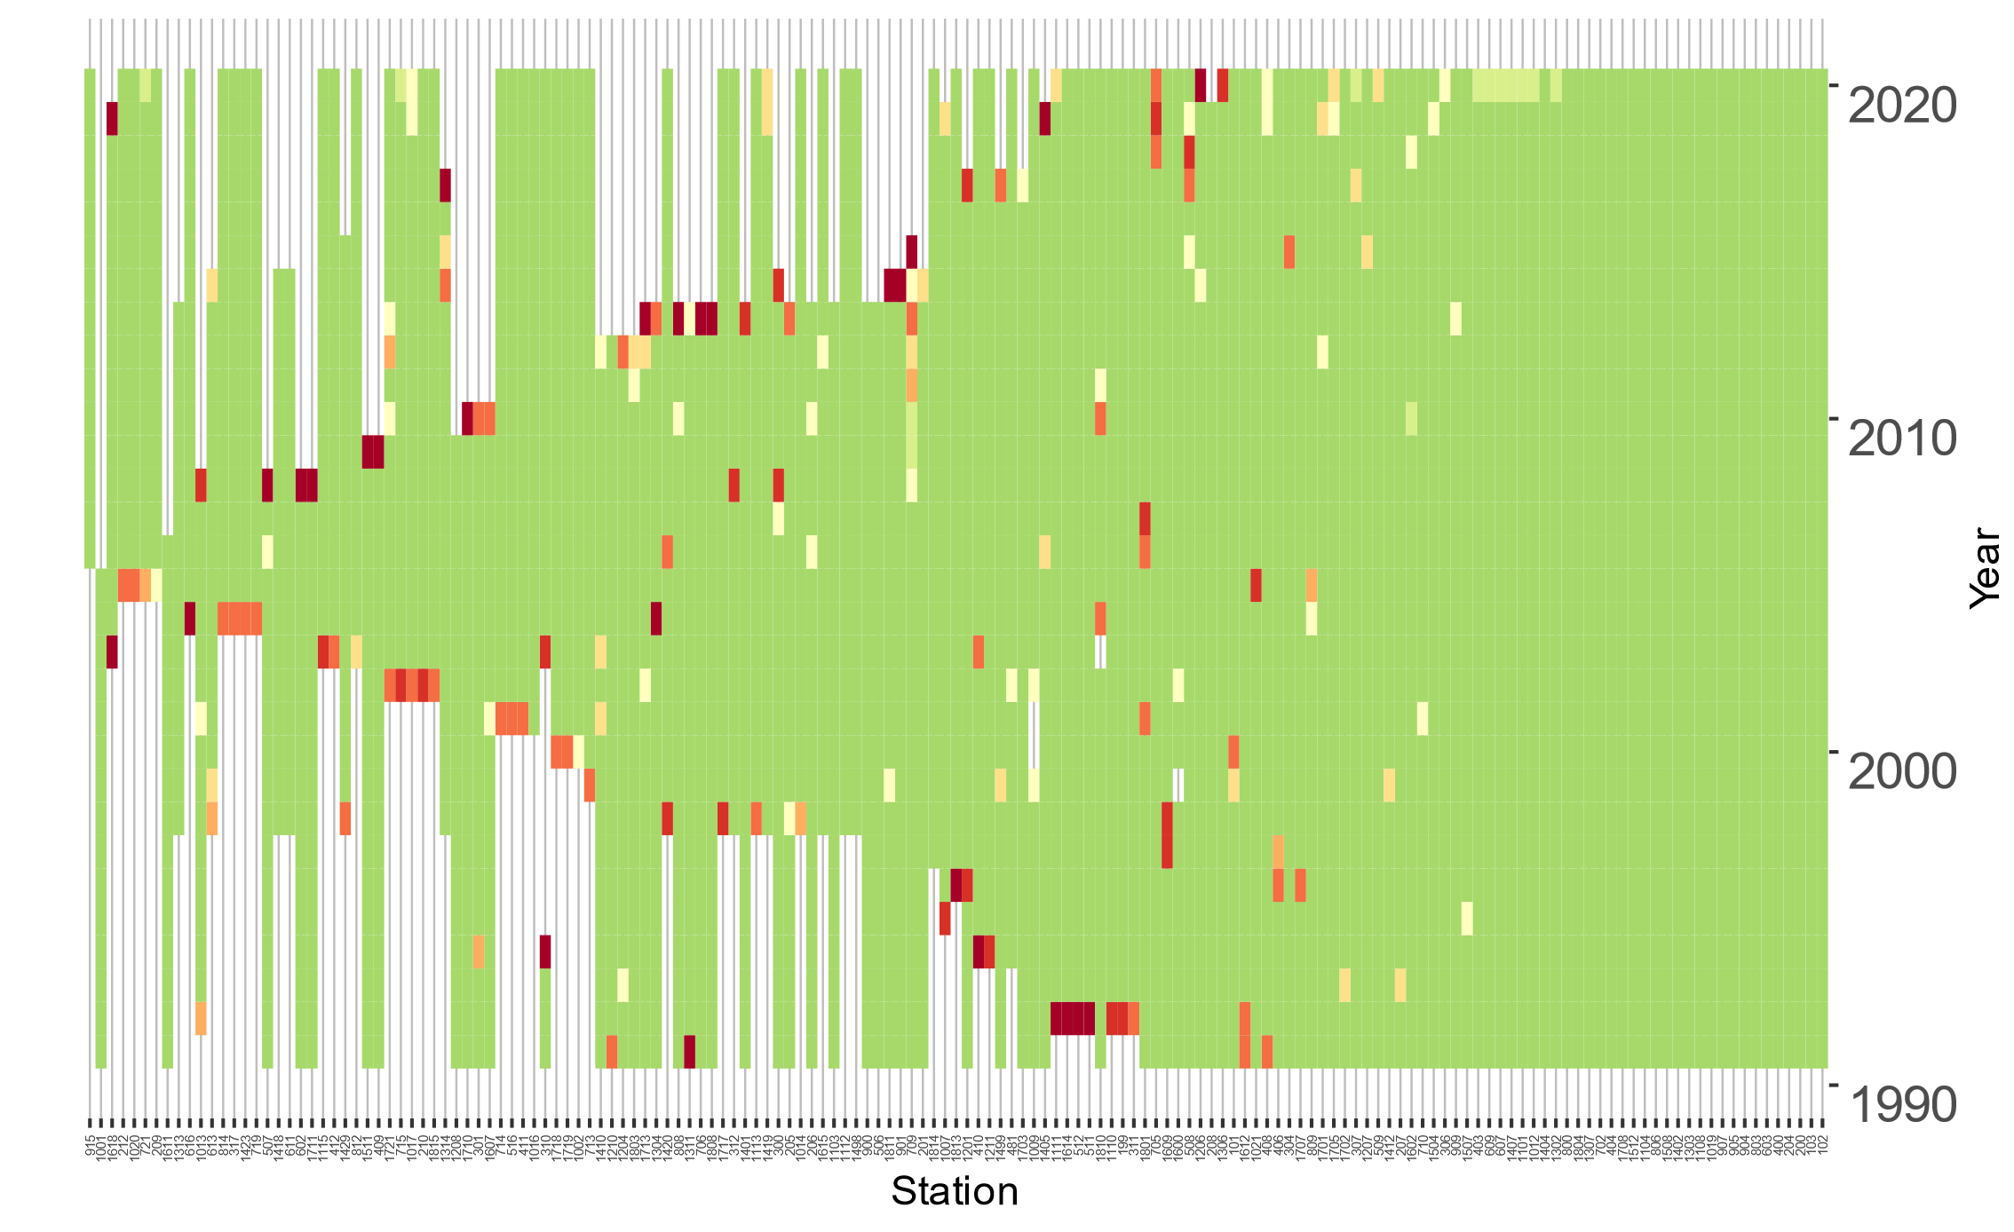
Data availability : Reality
~10 years
Goal
Complete the missing values using matrix completion methods
~2 years

Slide 5
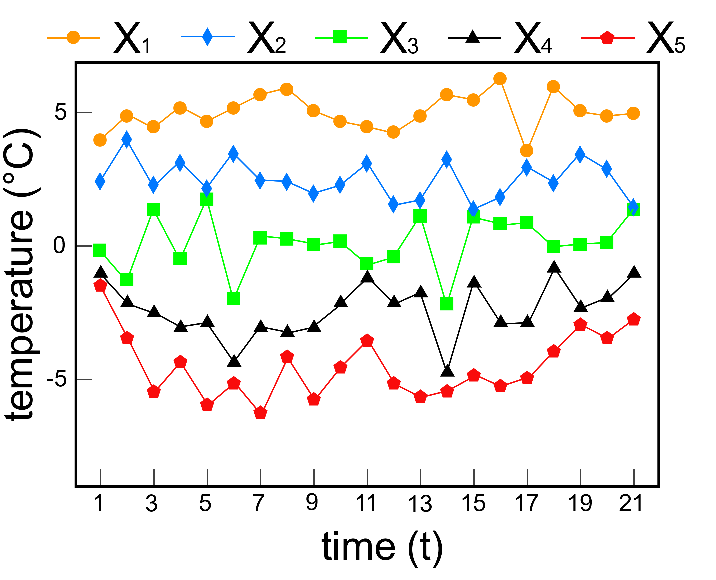
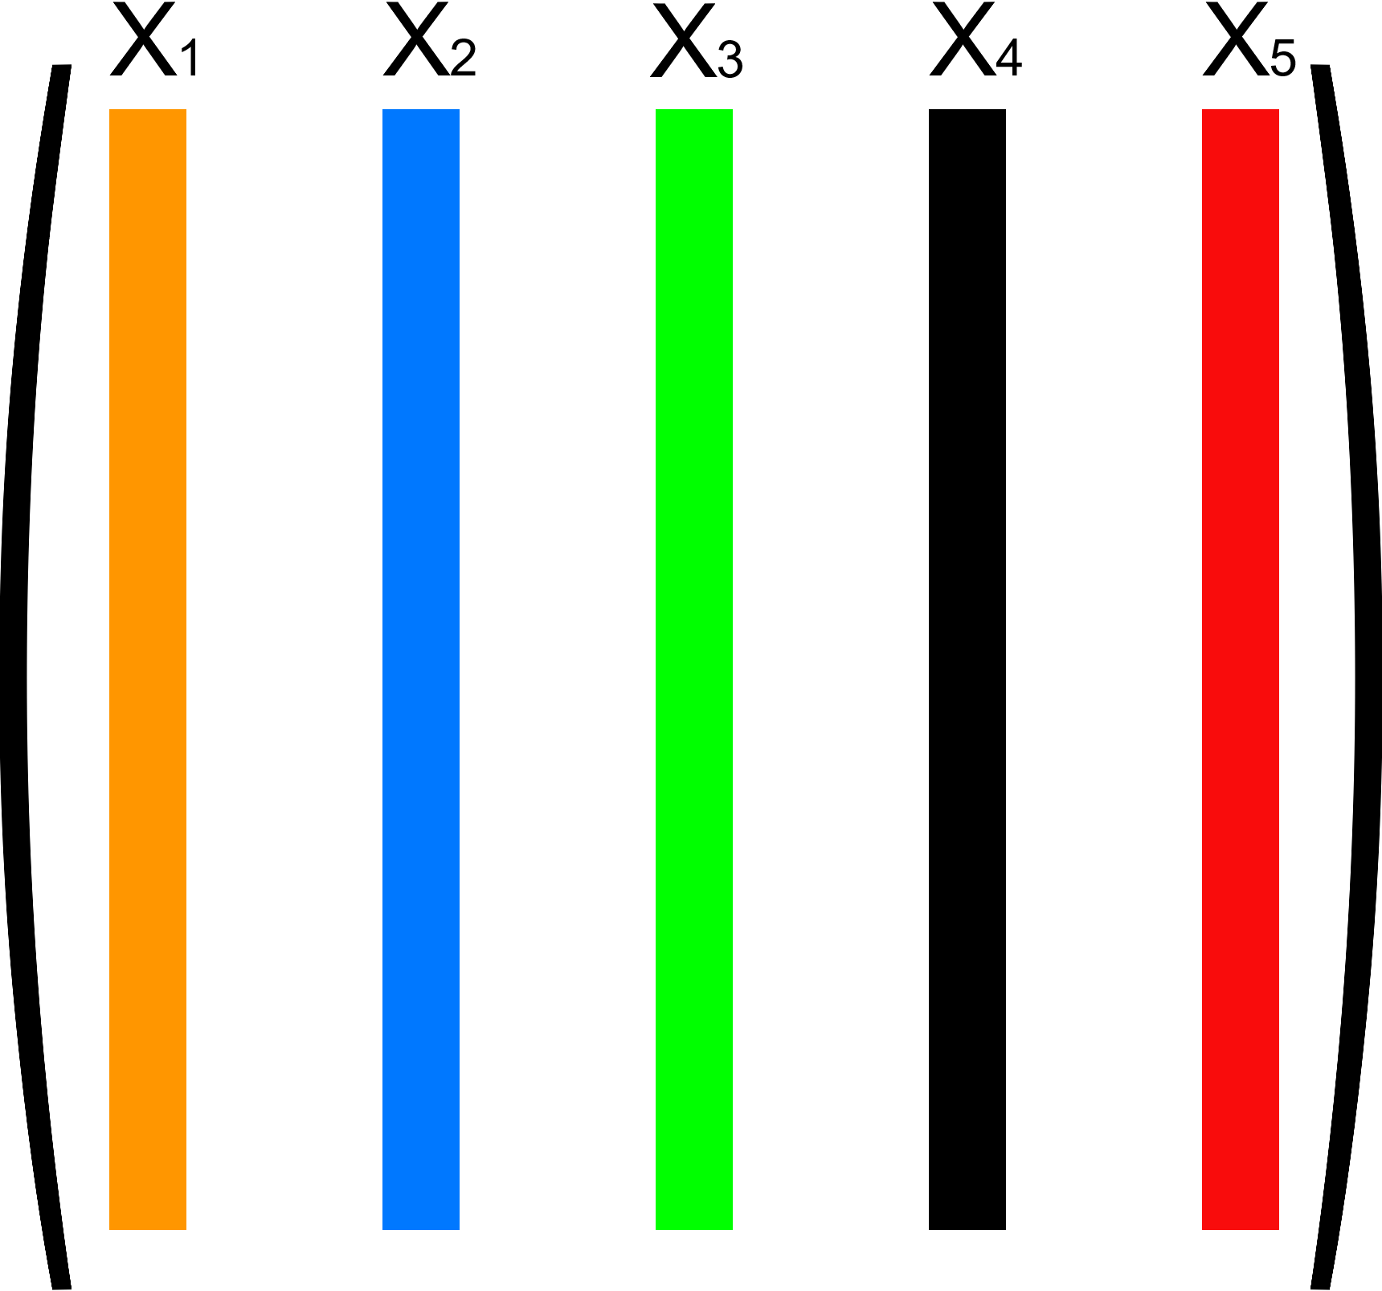
Graph-Matrix Representation
Graph Representation
Matrix Representation

Slide 6
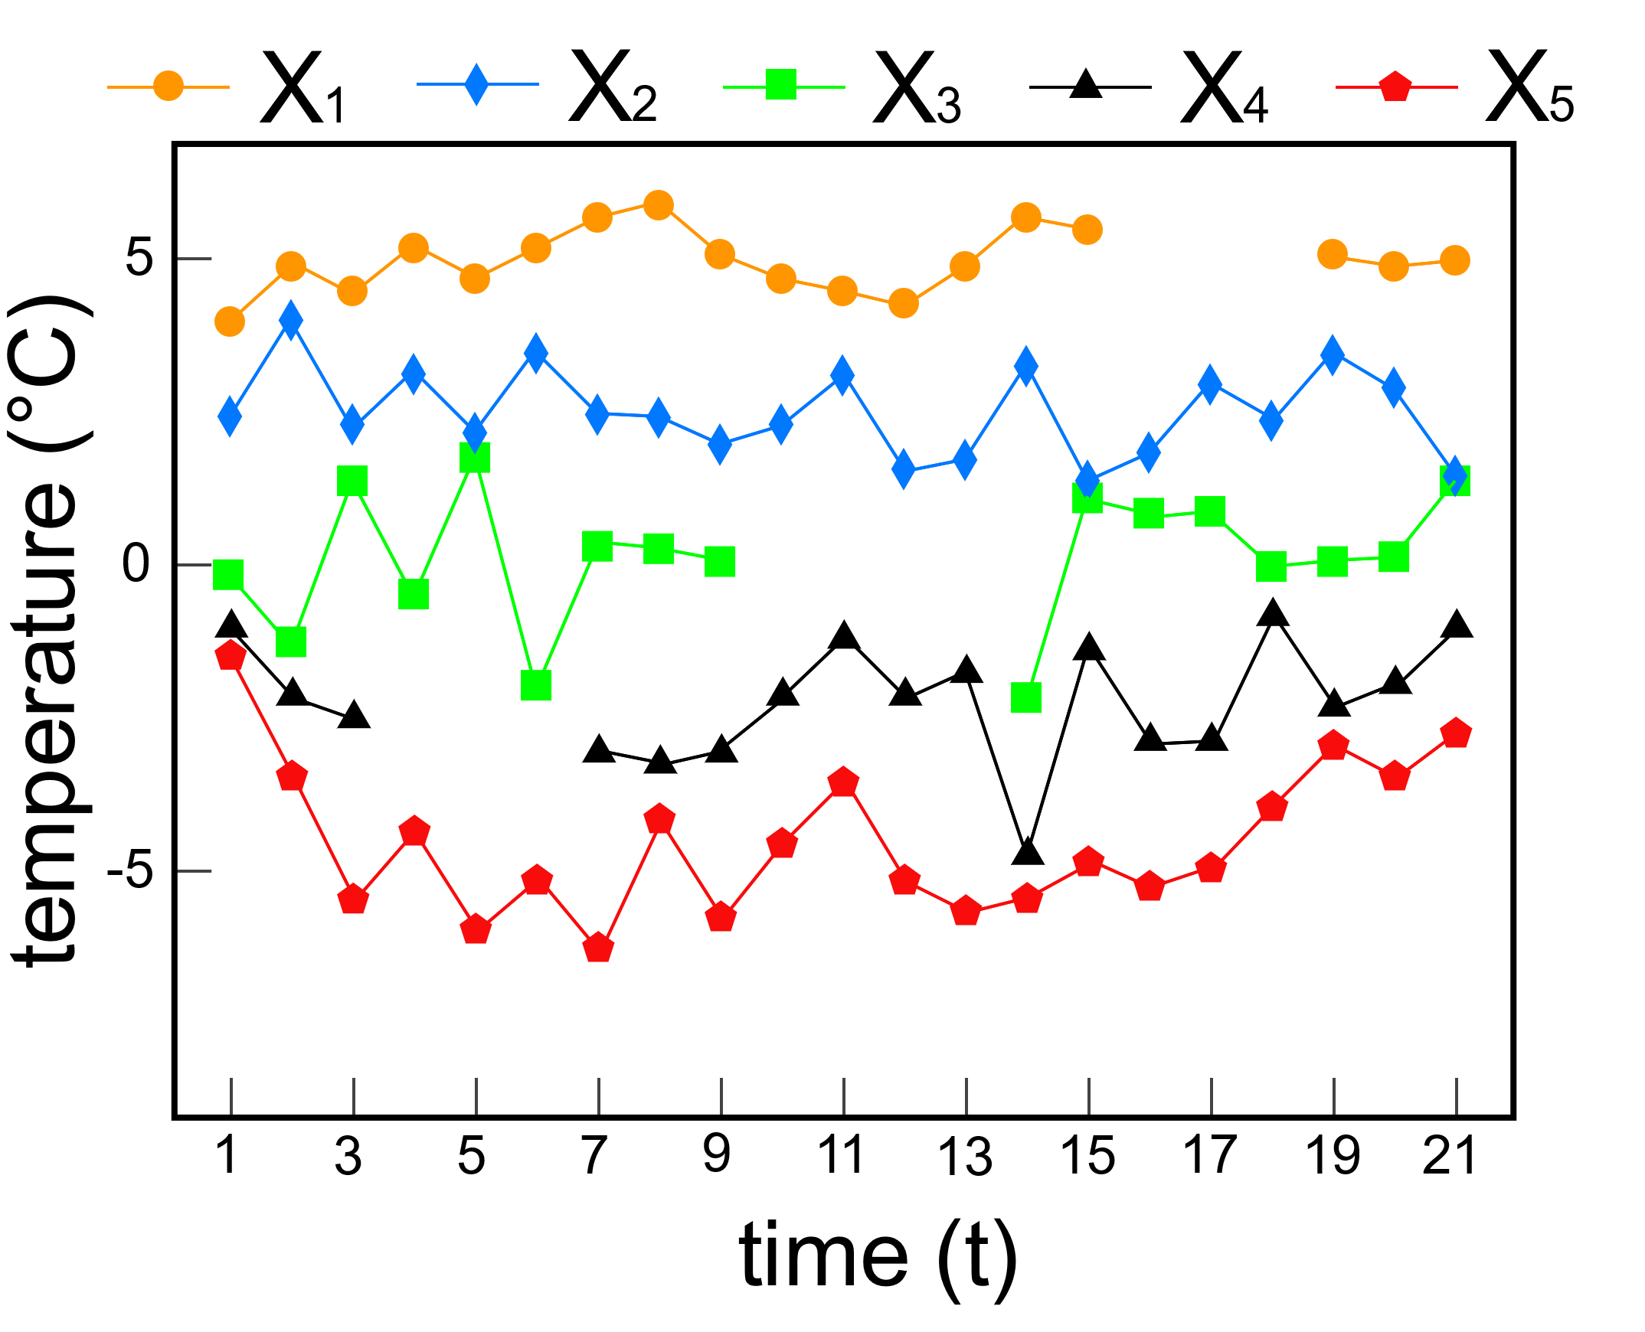
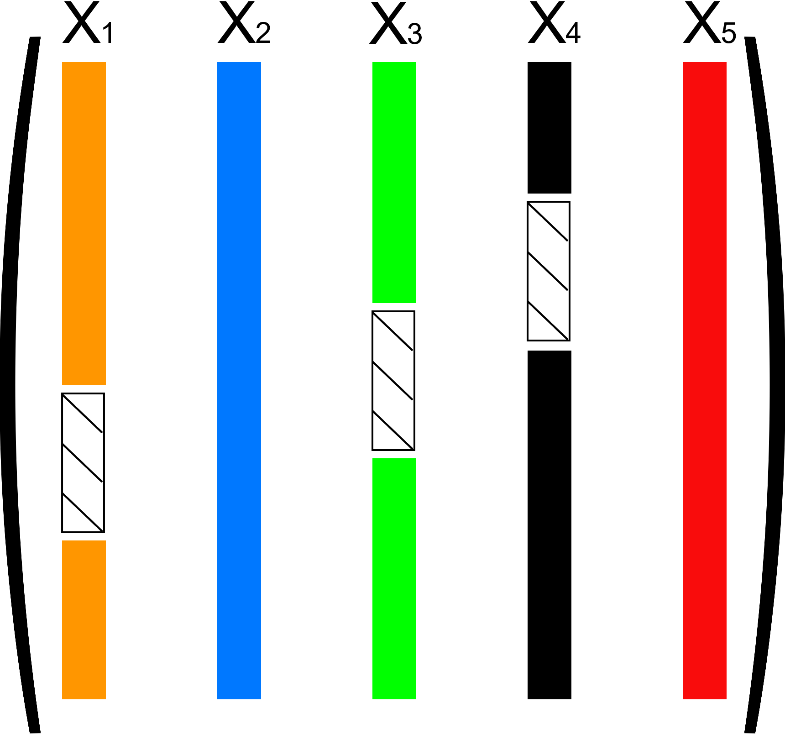
Graph-Matrix Representation
Graph Representation
Matrix Representation

Slide 7
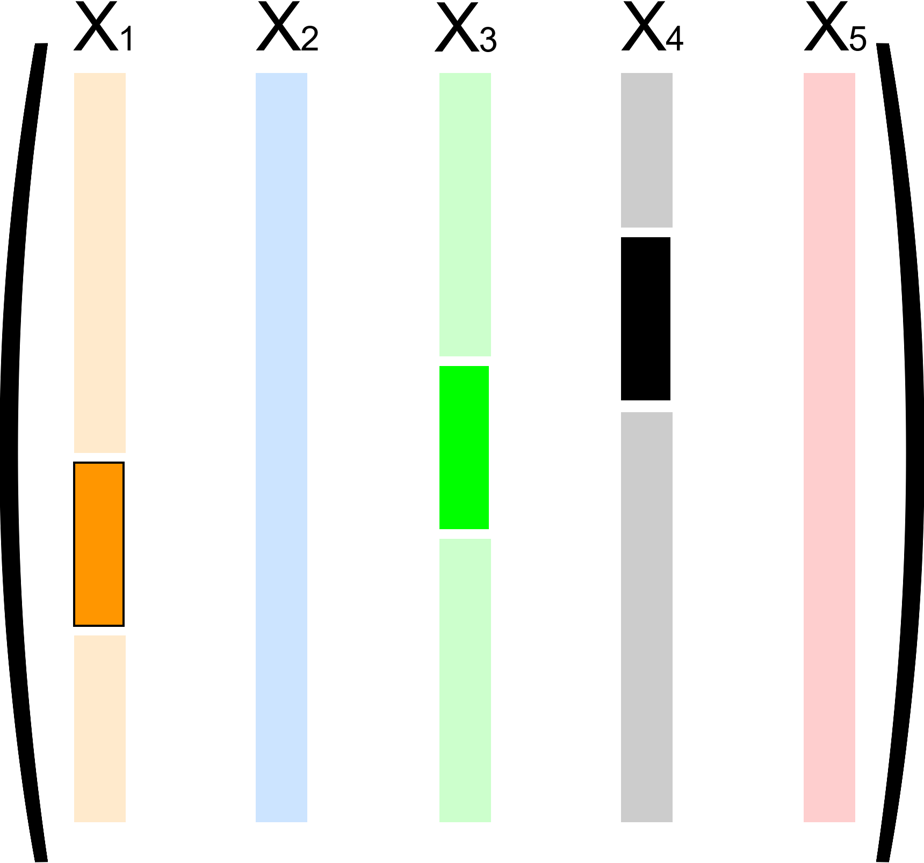
Matrix Completion
Input
Output
Matrix Completion method

Slide 8
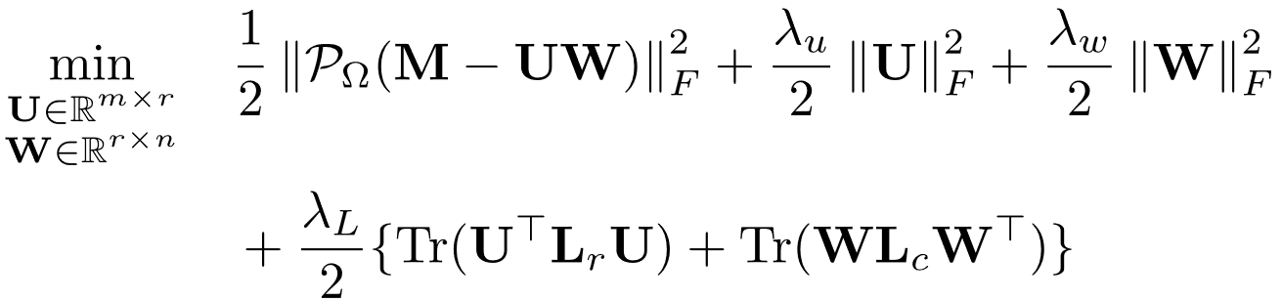
Matrix Completion methods
Matrix Completion method
Optimization Problem

Slide 9
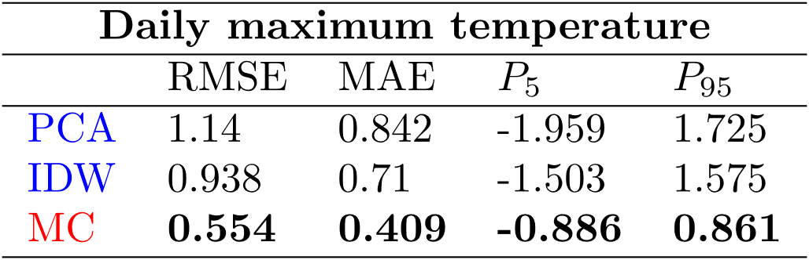
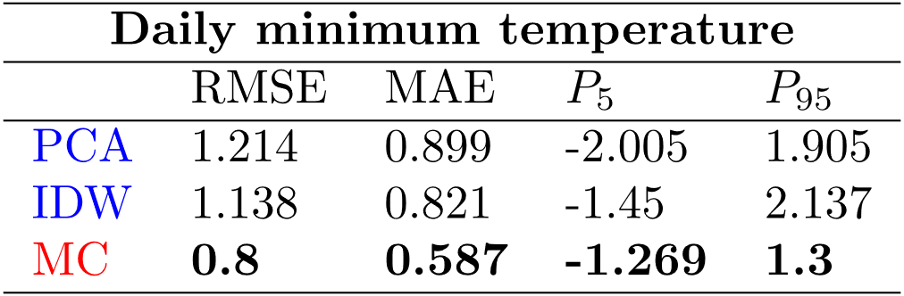
Results
Conclusion
Matrix Completion methods can be up to 40% more efficient than the state of the art!

Slide 10



Thank you for you attention!
benoit.loucheur@uclouvain.be

