Slide 1
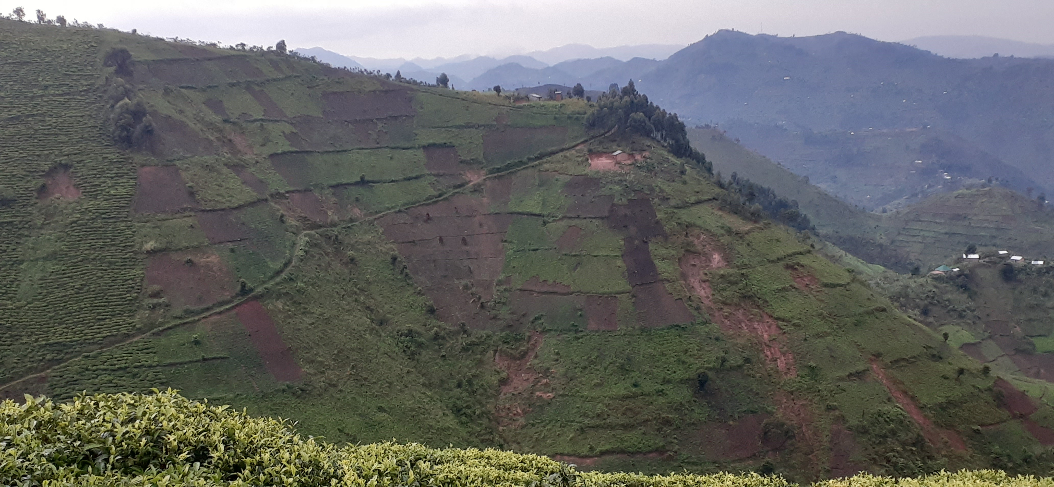






Understanding natural hazards in a changing landscape: A citizen science approach in Kigezi highlands, southwestern Uganda
Violet Kanyiginya, PhD student- RMCA, VUB, MUST
Dr. Olivier Dewitte, promoter, RMCA
Prof. Matthieu Kervyn, promoter, VUB
Dr. Ronald Twongyirwe, promoter, MUST

Slide 2
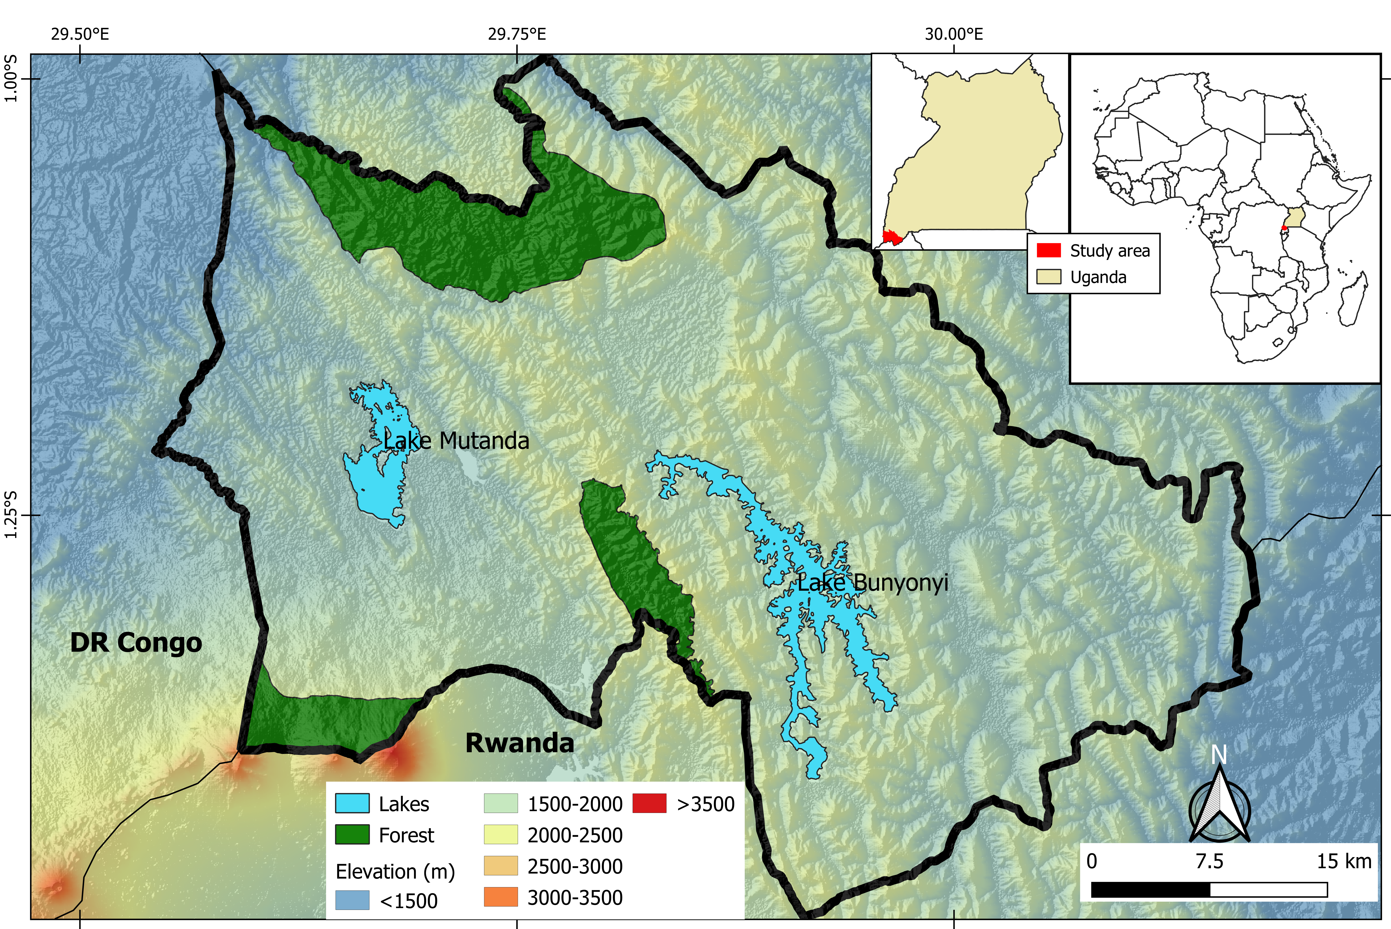
Region characteristics
Tropical mountainous region
Steep topography
High rainfall 990-1540 mm
Alternating dry & wet seasons
Deep weathering
High population density
High human-induced land use changes

Slide 3
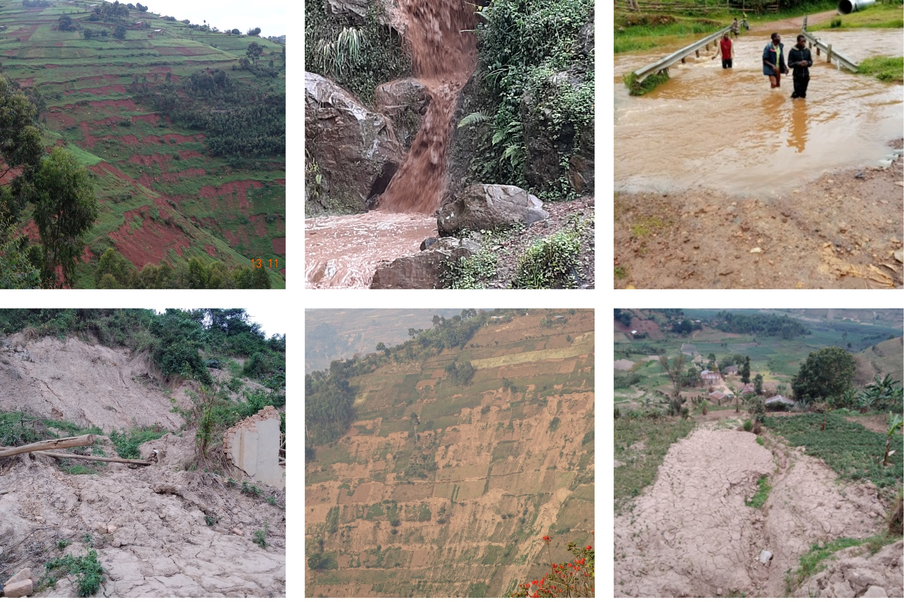
Among the most exposed regions to natural hazards in the country
Limited studies in the region
Detailed inventories is key for understanding hazard interactions

Slide 4

Objectives
Building a comprehensive inventory of natural hazards, evaluate their spatial-temporal distribution and interactions
Investigate multi-decadal landscape dynamics in relation to landslides and flood hazards
Determine flash flood frequency and magnitude in selected watersheds

Slide 5
Comprehensive inventory
Monitoring daily stream water levels
Tracing multi-decadal landscape change
Participatory citizen scientists
15 Geo-observers
8 River watchers
104 senior citizens
Methodology
Reports, literature & archives, satellite images, field surveys
1954 aerial photographs,
catchment characterization
Discharge measurement, rain gauges

Slide 6
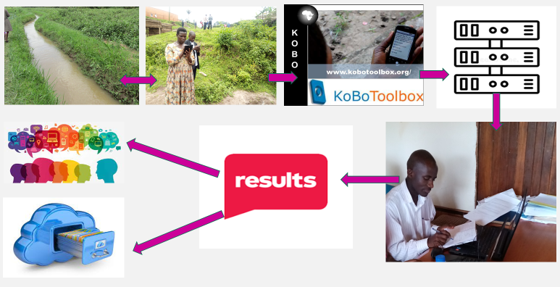
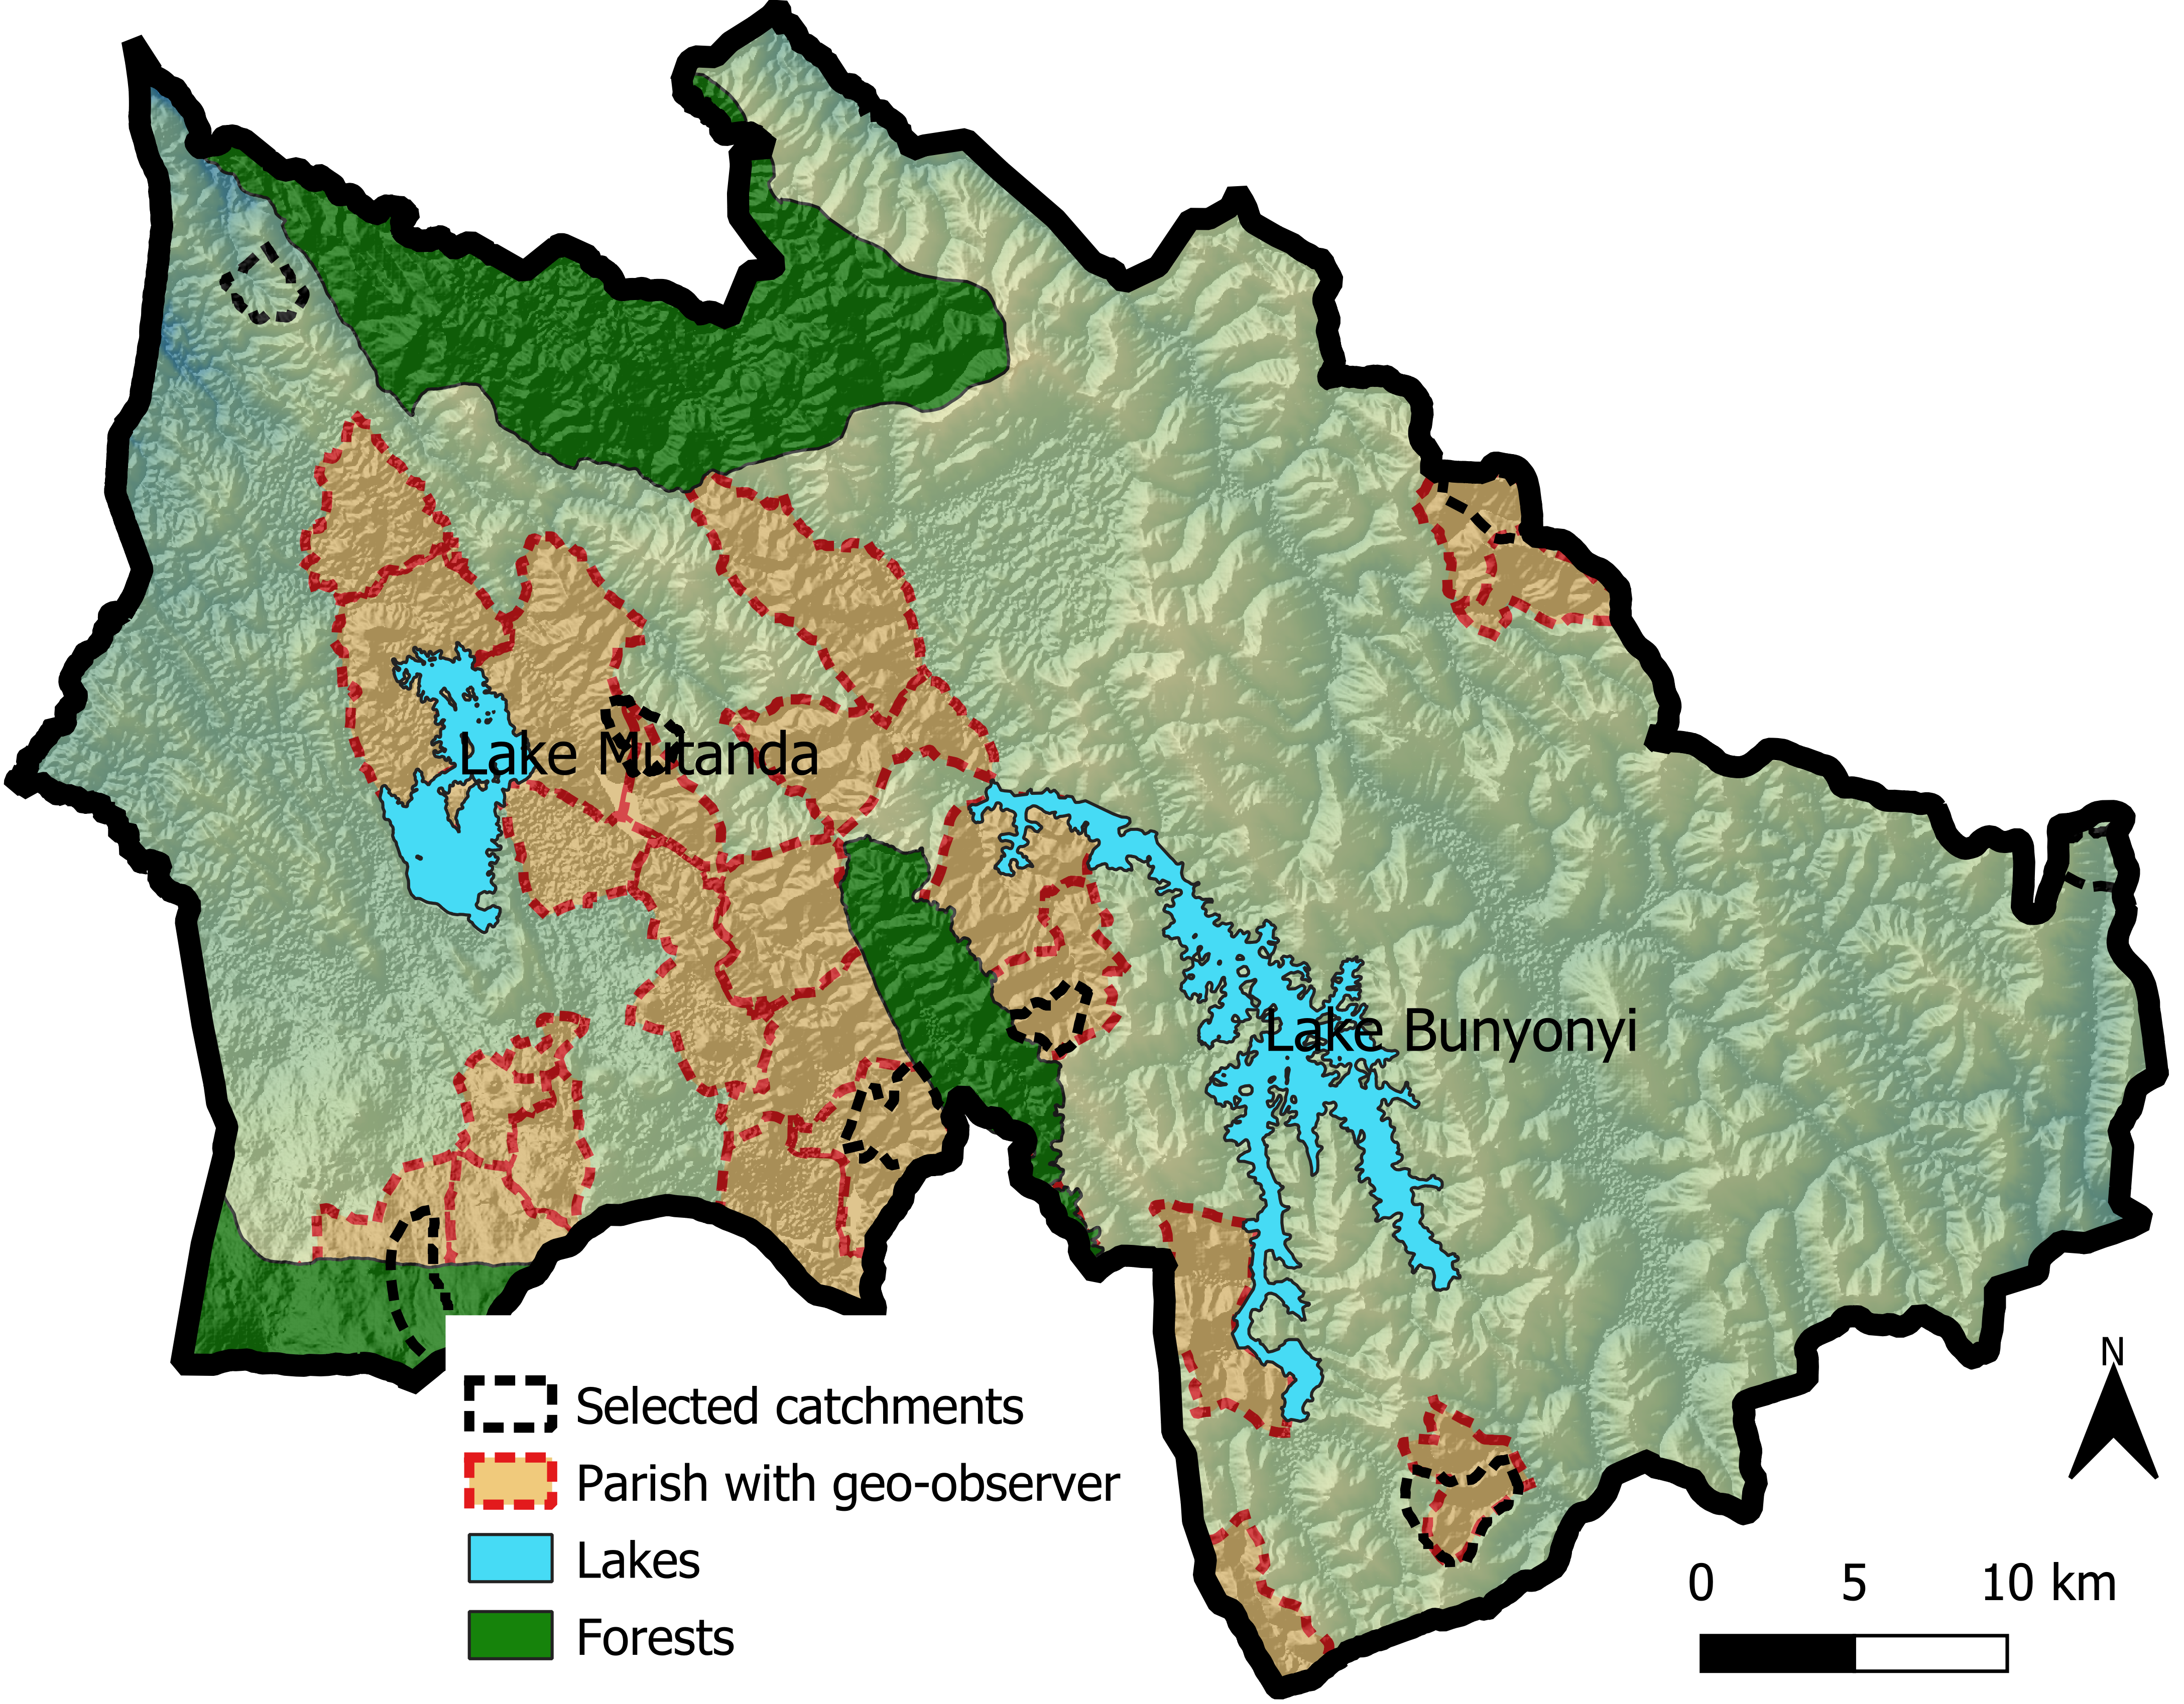
The data collection & validation processes
Data collected: Location, date and time of occurrence, description of hazard, impacts, pictures

Slide 7
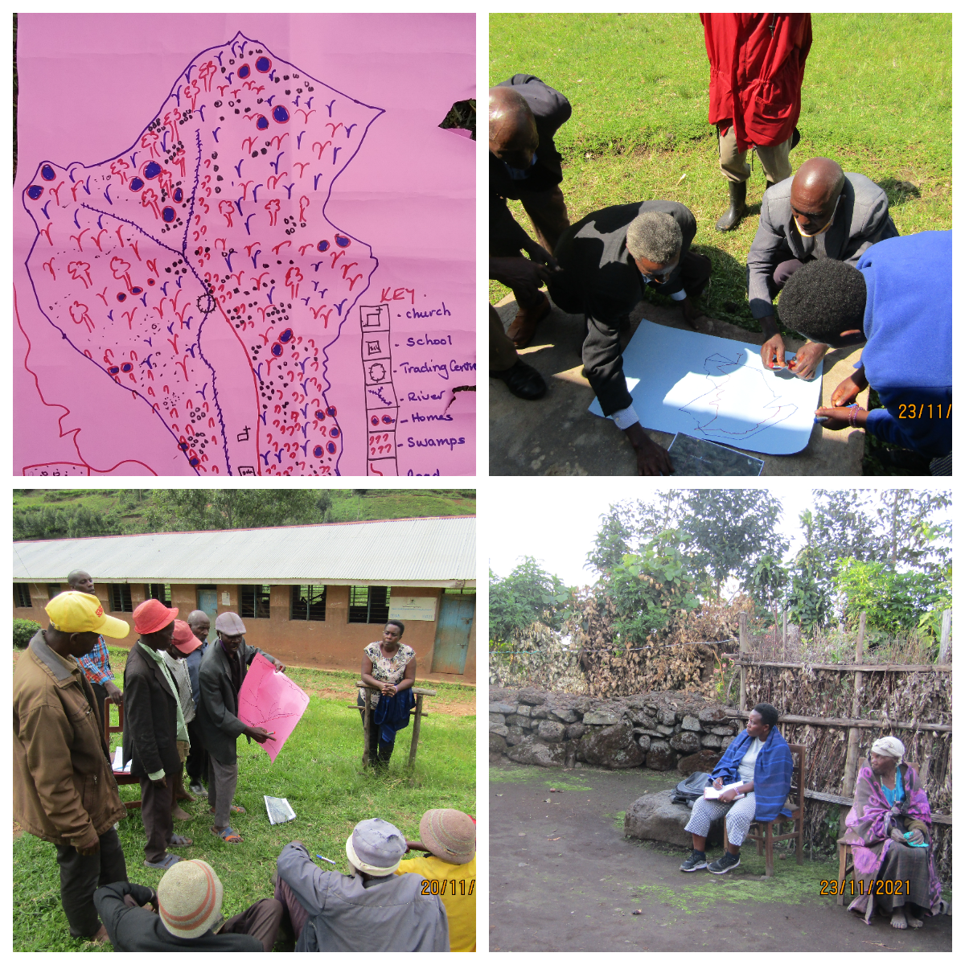
Tracing multi-decadal landscape change
Interviews & FGDs with the senior (70-98 years) in 8 study watersheds
Historical timelines constructed and used during the interviews
Participatory mapping was applied to highlight the LULC changes

Slide 8
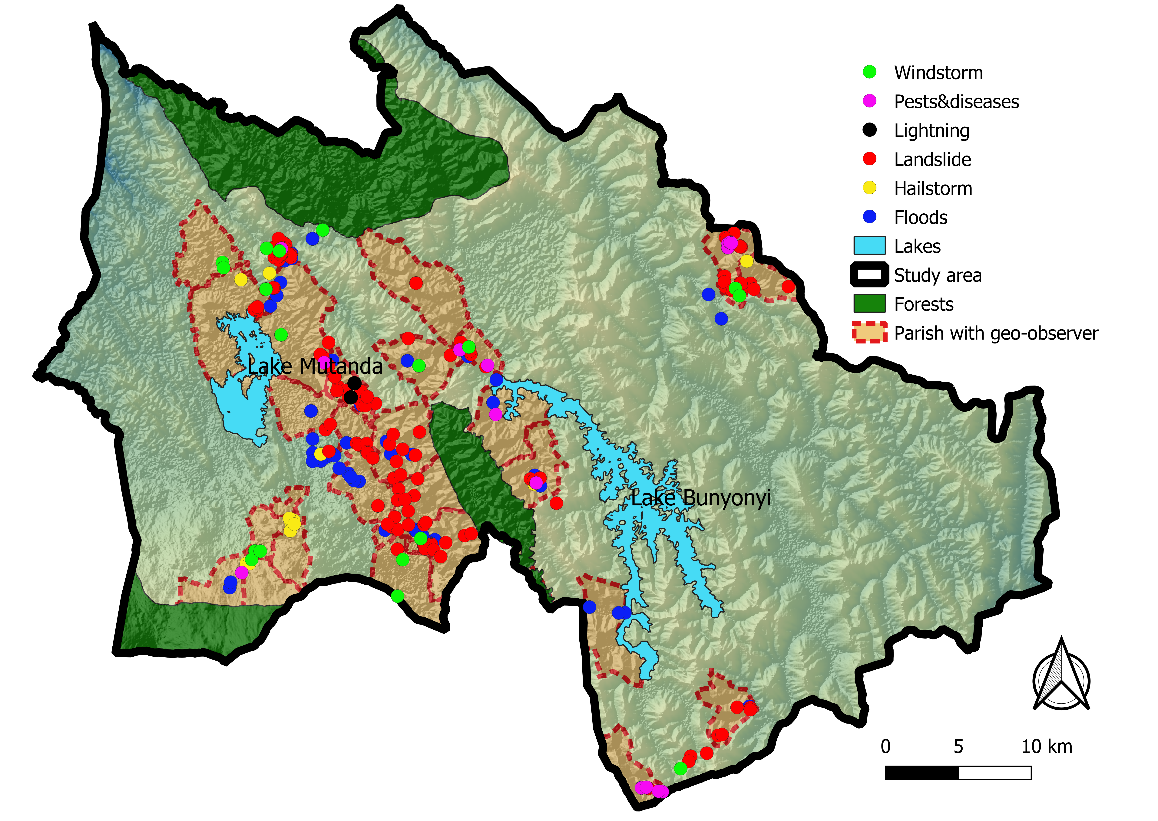
Natural hazards recorded and their distribution
266 hazard occurrences in in 2 years

Slide 9
Reliability and value added by geo-observers data
Natural hazards recorded in 2years from different sources
Proximity to the affected area & real-time reporting
Inclusive reporting (small and large events)
The data is georeferenced and detailed
Reliable in hazard vulnerability assessment

Slide 10
Natural hazard distribution and interactions
Number of events recorded in 2020 versus rainfall
35 hazard interactions characterized
40% primary directly triggered other hazards
60% hazards/processes increased the probability of secondary hazards occurring
Data collection affected by COVID-19
E.g.1
(Flash) floods
Triggers
Storm
Triggers
Landslides
Floods
Triggers
Rainfall is the main trigger; >90% occurrences in the peak rainy season
E.g.2
(Flash) floods
Road undercuts, vegetation removal
Increase probability
Landslides

Slide 11
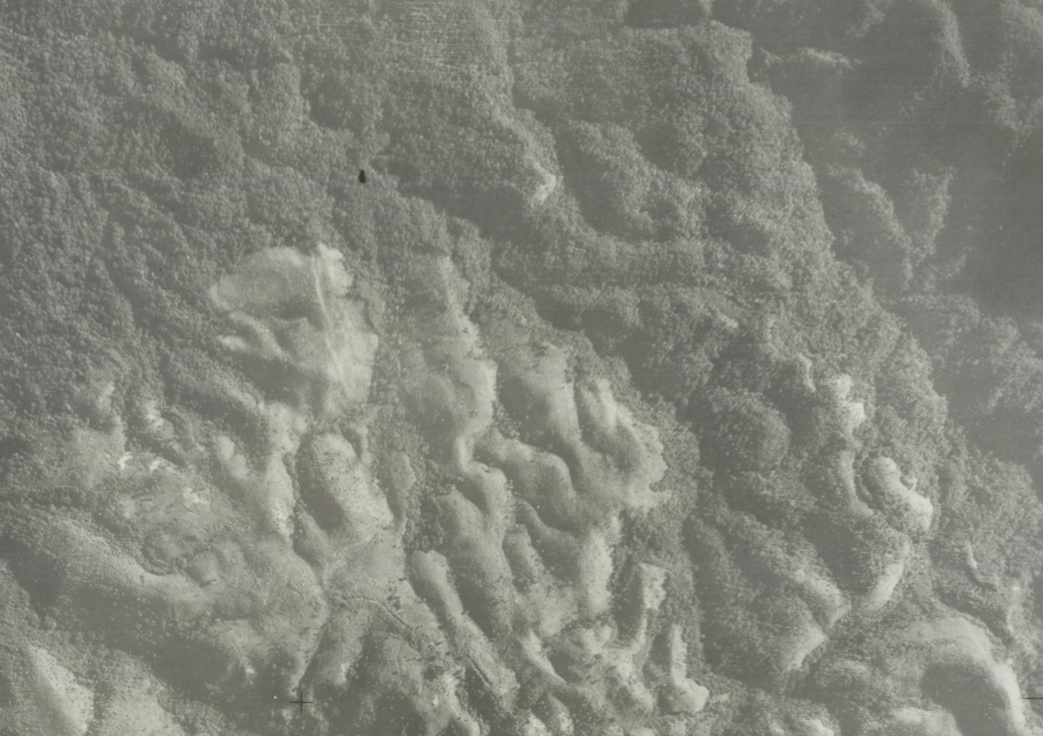
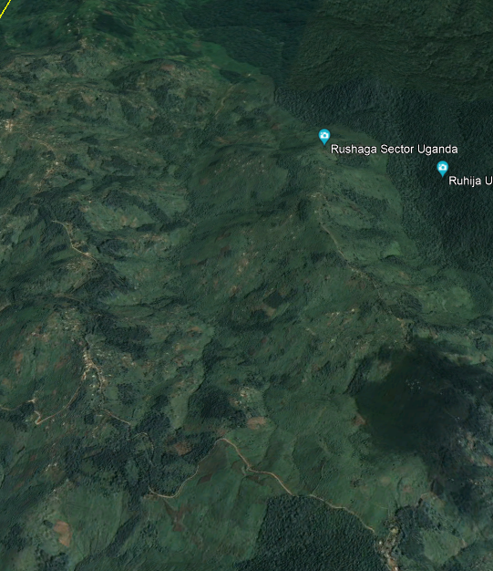

The landscape change
Deforestation (e.g. natural tree species to eucalyptus)
Increased cultivation of hillslopes
Drainage of wetlands
Road construction
Management practices abandoned (terraces & fallowing)
Population increase
October 1954
July 2019

Slide 12
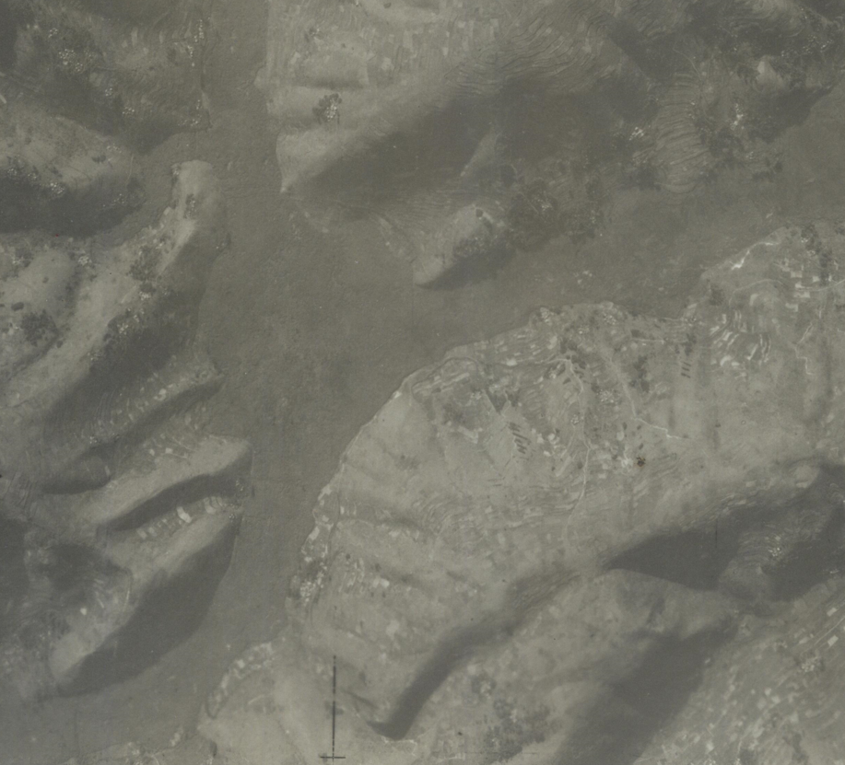
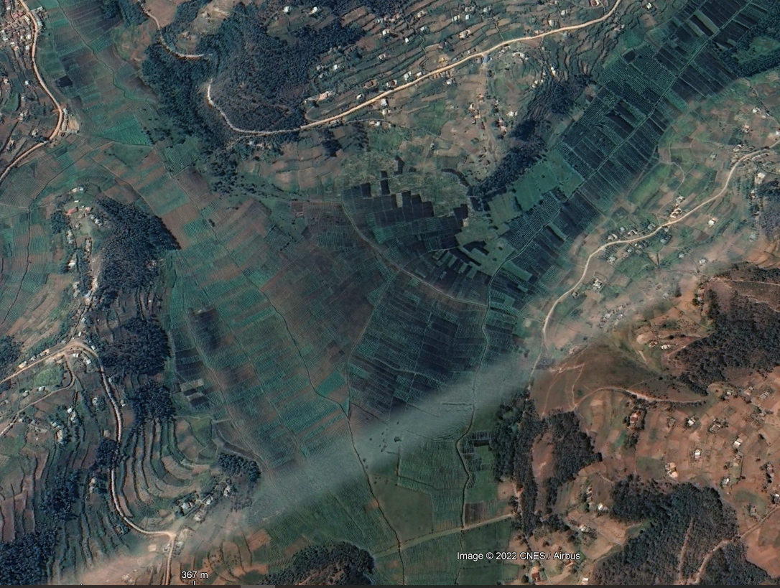

Reconstructing multi-decadal landscape change
October 1954
August 2021
Wetland conversion

Slide 13
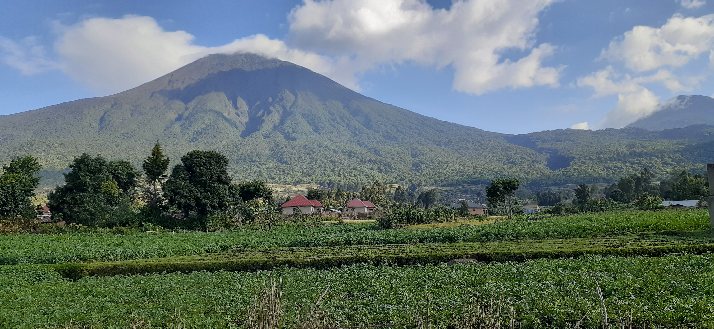

Conclusion
Violet.Kanyiginya@vub.be
Population growth has played a significant role in accelerating land use/cover changes & possibly influenced the patterns of natural hazards
Value added on data collected by citizen-led approaches in understanding natural hazards interactions
Raised community’s awareness on prevailing natural hazards in the region
Could be considered in developing early warning systems for Disaster Risk Reduction

