Slide 1


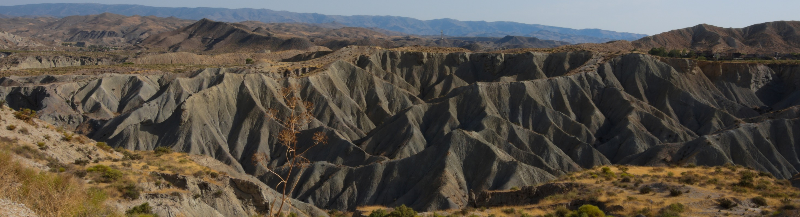







The Water Vapor Adsorption by Dry Soils Potentially Links the Water and Carbon Cycles: Insight from a Semiarid Crusted Ecosystem
Clément Lopez-Canfin¹, Roberto Lázaro², Enrique P. Sánchez-Cañete^{1,3}
¹University of Granada, Faculty of Science, Applied Physics, Granada, Spain (lopezcle@ugr.es)
²Experimental Station of Arid Zones (EEZA-CSIC), Desertification and Geo-Ecology, Almería, Spain
³Inter-University Institute for Earth System Research (IISTA-CEAMA), Granada, Spain

Slide 2
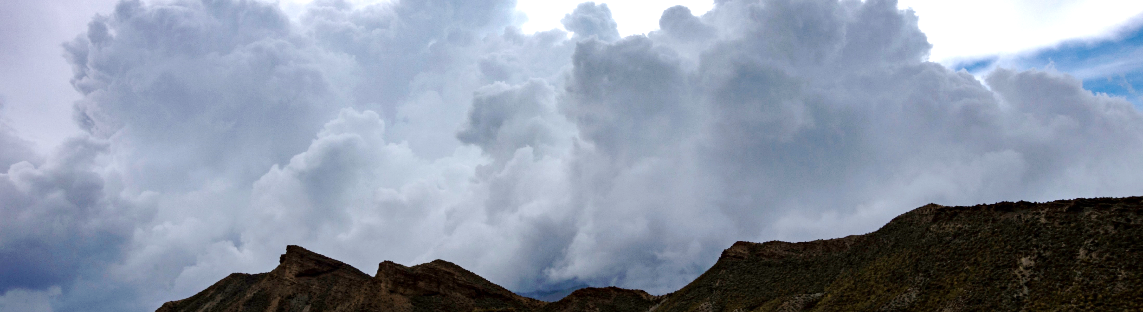
INTRODUCTION

Slide 3
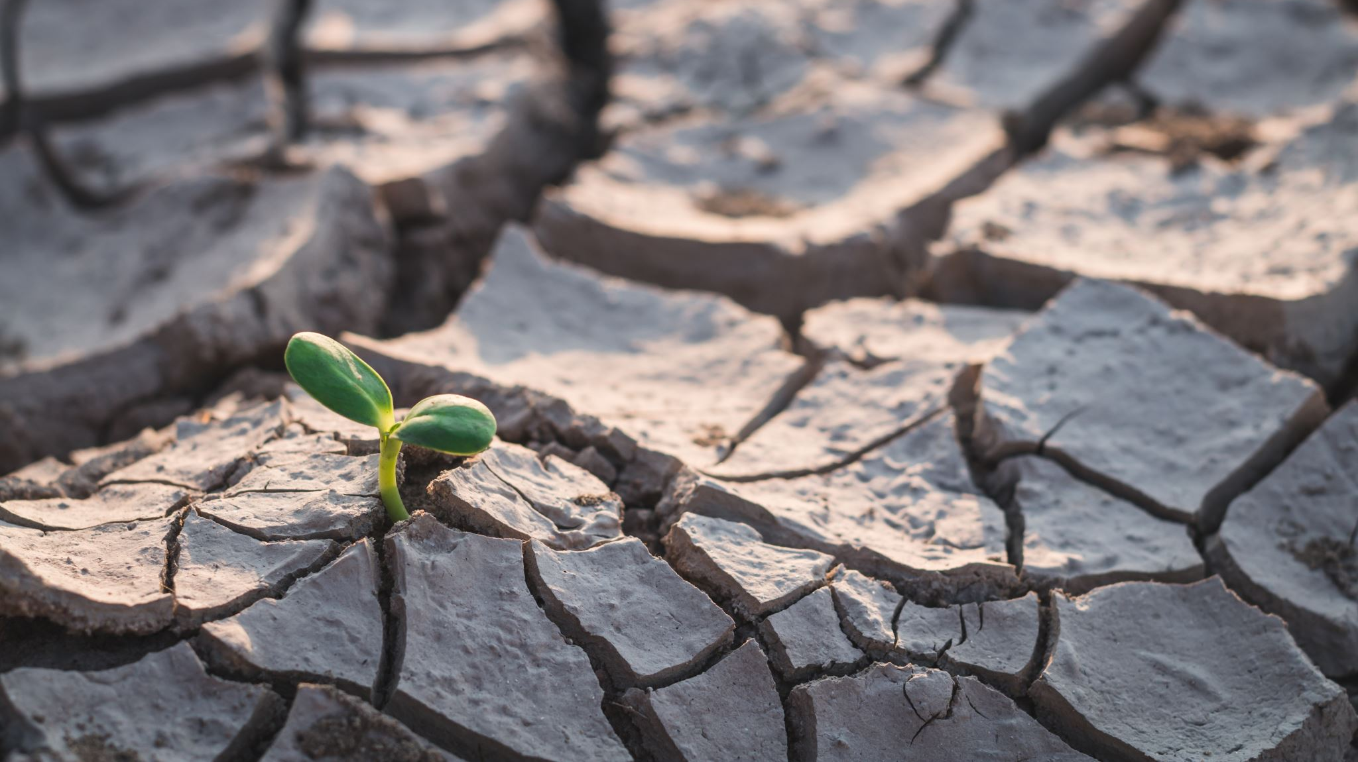

Introduction : Water Vapor Adsorption by Dry Soils, an Overlooked Water Input in Drylands
Adsorption Absorption
Water vapor adsorption (WVA) = water vapor movement from atmosphere to soil, forming liquid water on soil particles
Adsorption ≠ Absorption
Overlooked in drylands [Agam & Berliner, 2006; McHugh et al., 2015]
Few estimates
Underlying mechanisms?
Affects ecosystem processes and C cycle?
WVA commonly reported to occur at night when the soil-atmosphere water vapor pressure gradient inverts [Agam & Berliner, 2006; Kool et al., 2021; Kosmas et al., 1998]
Assumption: WVA drives the nocturnal CO₂ uptake increasingly reported in drylands worldwide [e.g. Cueva et al., 2019; Fa et al., 2016; Hamerlynck et al., 2013; Ma et al., 2013]
Notes:
WVA is the movement of water vapor from atmosphere to soil, forming liquid water on soil particles.
It is important to not confound it with ABsorption. ADsorption is a surface process whereas ABsorption is an uptake.
There is now evidence that WVA has been overlooked in drylands.
And many questions and uncertainties remain about it.
The process has commonly been reported to occur at night
So, we raised the assumption according to which WVA could drive the CO2 uptake that has been increasingly reported in drylands worldwide.

Slide 4
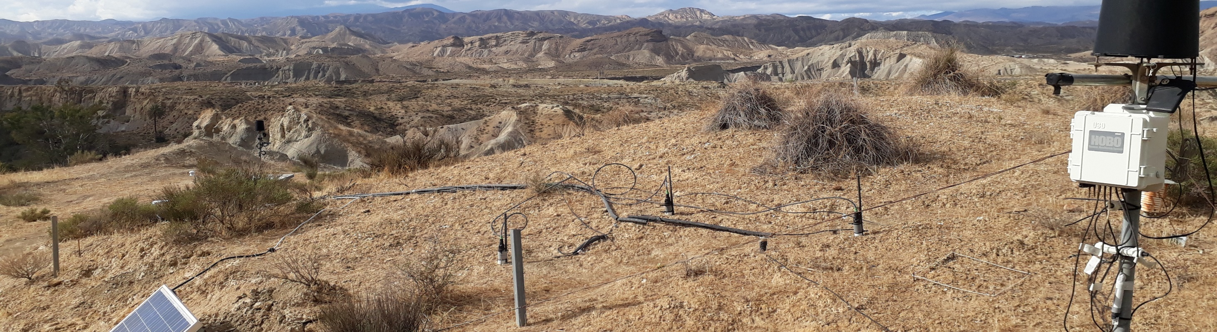
MATERIAL AND METHODS

Slide 5
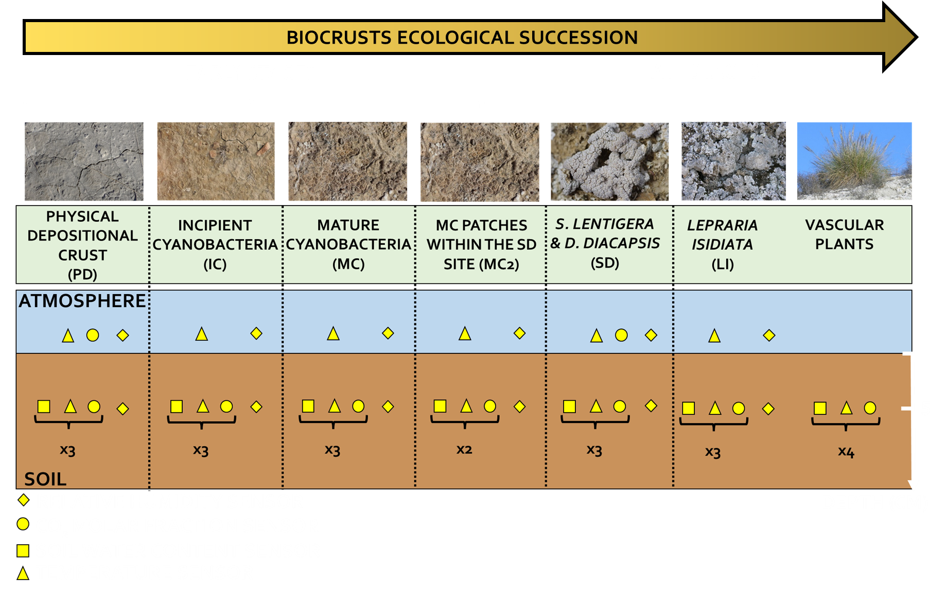
General Methodology: Environmental Measurements
In the Tabernas Desert (driest part of Europe):
+ Additional measurements:
Surface temperature (T_{surf})
Atmosphere temperature (T_{a})
Photosynthetically Active Radiation (PAR)
Precipitation
Data-logging:
During ~ 2 years
Every 30 s
20-min averages
Precipitation: on-off (event)
Notes:
In the Tabernas Desert in Spain,
We installed a network of sensors to measure continuously over 2 years some environmental variables in each step of the ecological succession of biological soil crusts (also called biocrusts).
The most important measured variables were:
The relative humidity and CO2 molar fraction in topsoil and atmosphere.
As well as the soil water content and soil temperature.

Slide 6
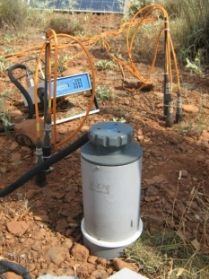
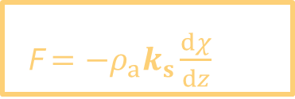
Material and Methods: Fluxes Estimation
By applying the gradient method based on Fick´s first law:
Soil-atmosphere water vapor
or CO₂ flux (mmol m⁻² s⁻¹ and
µmol m⁻² s⁻¹, respectively)
Gradient in water vapor or CO₂ molar fraction between atmosphere and soil (mmol mol⁻¹ and µmol mol⁻¹, respectively)
F $=−ρ_{a}k_{s}\frac{dχ}{dz}$
Average air molar density (µmol m⁻³)
Depth (m)
Diffusion coefficient
or empirical soil transfer coefficient (m² s⁻¹)
k_{s} for CO₂: modelled empirically according to Sánchez‐Cañete et al. [2017]
k_{s} for water vapor: estimated from general models [Bittelli et al., 2015; Xu et al. 1992]
Notes:
Then we estimated water vapor and CO2 fluxes between soil and atmosphere by applying the gradient method based on Fick´s first law.
A critical variable in this equation is the diffusion coefficient k_{s}
For CO2, it was modelled empirically according to a recommended protocol. For water vapor, it was estimated from two general models.

Slide 7
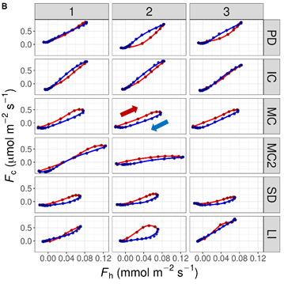
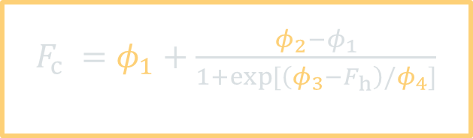
Material and Methods: Statistical Analysis
Data exploration:
Two sigmoid functions (↗ and ↘ in fluxes):
4-parameter logistic model
Horizontal asymptote as F_{h →} ∞
Horizontal asymptote as F_{h →} -∞
$F_{c} =φ_{1}+\frac{{φ_{2}−φ}_{1}}{1+exp⁡[\left(φ_{3}−F_{h}\right)/φ_{4}]}$
[Pinheiro & Bates, 2000]
Scale parameter on the x-axis
F_{h} value at the inflection point
+ pairwise relationships
Hysteresis loop
Notes:
Regarding the statistical analysis, a data exploration revealed the existence of a hysteresis loop between CO2 and water fluxes.
It was apparently possible to model it with 2 sigmoid functions.
So, we tried to fit this 4-parameter logistic model to predict the CO2 flux from the water vapor flux.
In addition, we analyzed relationships between pairs of variables.

Slide 8

RESULTS AND DISCUSSION

Slide 9
Results and Discussion
The gradient method (GM) as a novel approach to estimate WVA by soil
WVA periods identified for the 1st time with the GM
Inversion of χ_{h} gradient during hot and dry periods
→ summer
Negative F_{h} = water vapor movement from atmosphere to soil → this is WVA!
Estimates considerably impacted by diffusion model choice
Bittelli et al. [2015]:
0.2-0.9% of annual precipitation
Xu et al. [1992]:
0.8-2.8% of annual precipitation
Not neglectable + main water source in summer
Notes:
WVA periods were identified for the first time with the GM.
In this fig. you can see from top to bottom the time series of X_{h}, F_{h}, SWC and T_{s}.
As you can see in yellow in the 1st panel, we found an inversion of the soil-atmosphere gradient of X_{h} in summer.
That led to negative water vapor fluxes, meaning that water vapor was flowing from atmosphere to soil. That is actually WVA!
However, the estimates were considerably impacted by the choice of the diffusion model.

Slide 10
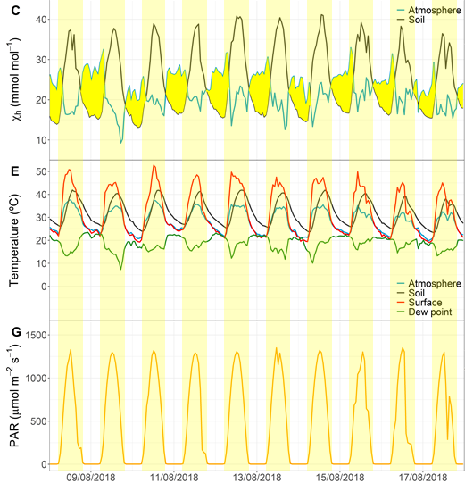
Results and Discussion
The gradient method (GM) as a novel approach to estimate WVA by soil
Provided information on mechanisms driving WVA
Inversion of χ_{h} gradient at night
Simultaneously with ↘ in temperature and PAR
→ reduced capacity of cold air to hold water vapor at night
No WVA during similar dry period in winter → 2 additional necessary conditions:
Substantial avg. atmosphere χ_{h}
Sharp atmosphere χ_{h} ↗ at night
More evaporation in summer
↗ capacity to store water vapor
Coastal effect?
Boundary layer stable stratification
Katabatic winds
Notes:
In spite of this uncertainty, the GM provided relevant information on the mechanisms driving the process.
By zooming on a summer period, you can see here in yellow that the gradient of X_{h} inverted at night
And it happened simultaneously with a ↘ in temp. and radiation. So, we attributed it to the reduced capacity of cold air to hold water vapor.
However, no WVA was observed during a similar dry period in winter. By comparing the 2 periods, we found that 2 other conditions were necessary:
A substantial avg. atmosphere X_{h} that could only be reached in summer
A substantial increase in this variable at night
In the published paper, we propose mechanisms that can explain those conditions.

Slide 11
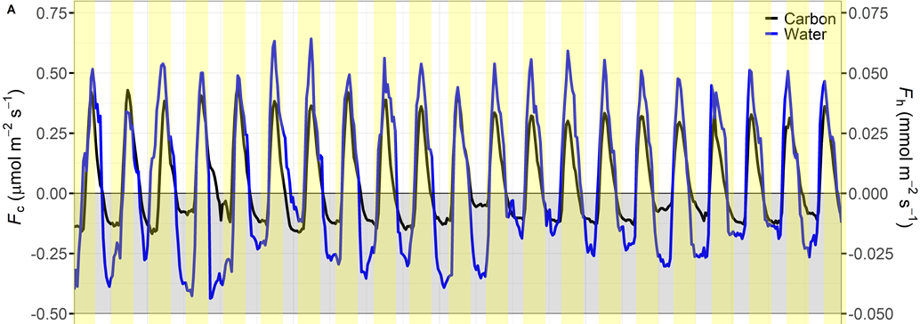
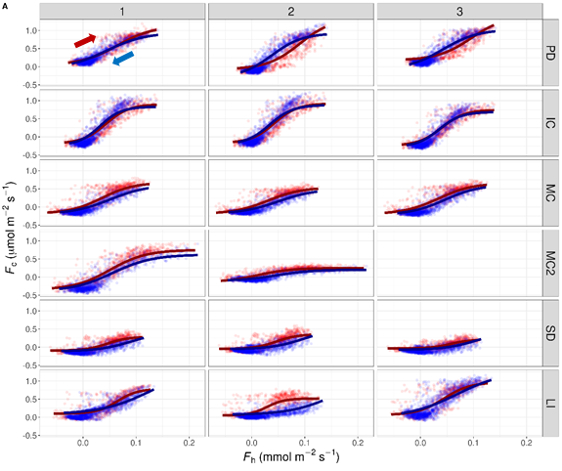
Results and Discussion
Coupling between water vapor and CO₂ fluxes on a diel scale
F_{c} and F_{h} both negative at night → Uptake
Hysteresis well modelled
Good predictions
In agreement with the assumption of WVA potentially driving the CO₂ uptake
Notes:
Probably the most striking finding of this study was the existence of a coupling between water vapor and CO2 fluxes on a diel scale
During this summer period, both CO2 and water vapor fluxes became <0 at night, revealing an uptake of both gases by soil.
In addition, the hysteresis could be well modelled
And the model provided good predictions of the CO2 flux.
So, this is in agreement with the assumption of WVA potentially driving the CO2 uptake.

Slide 12
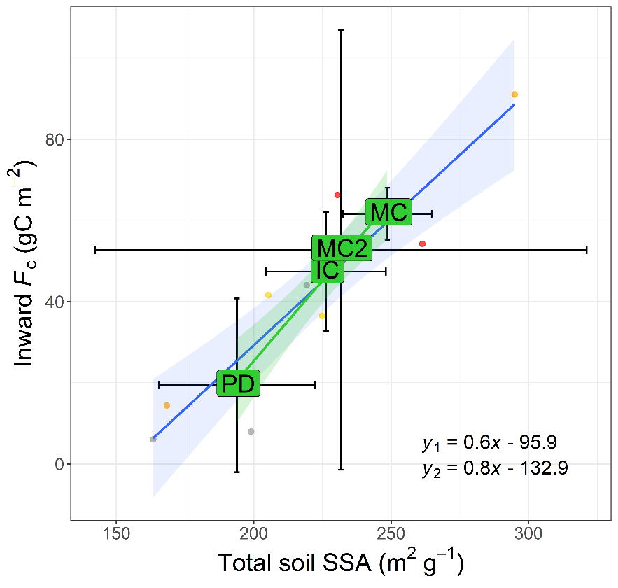
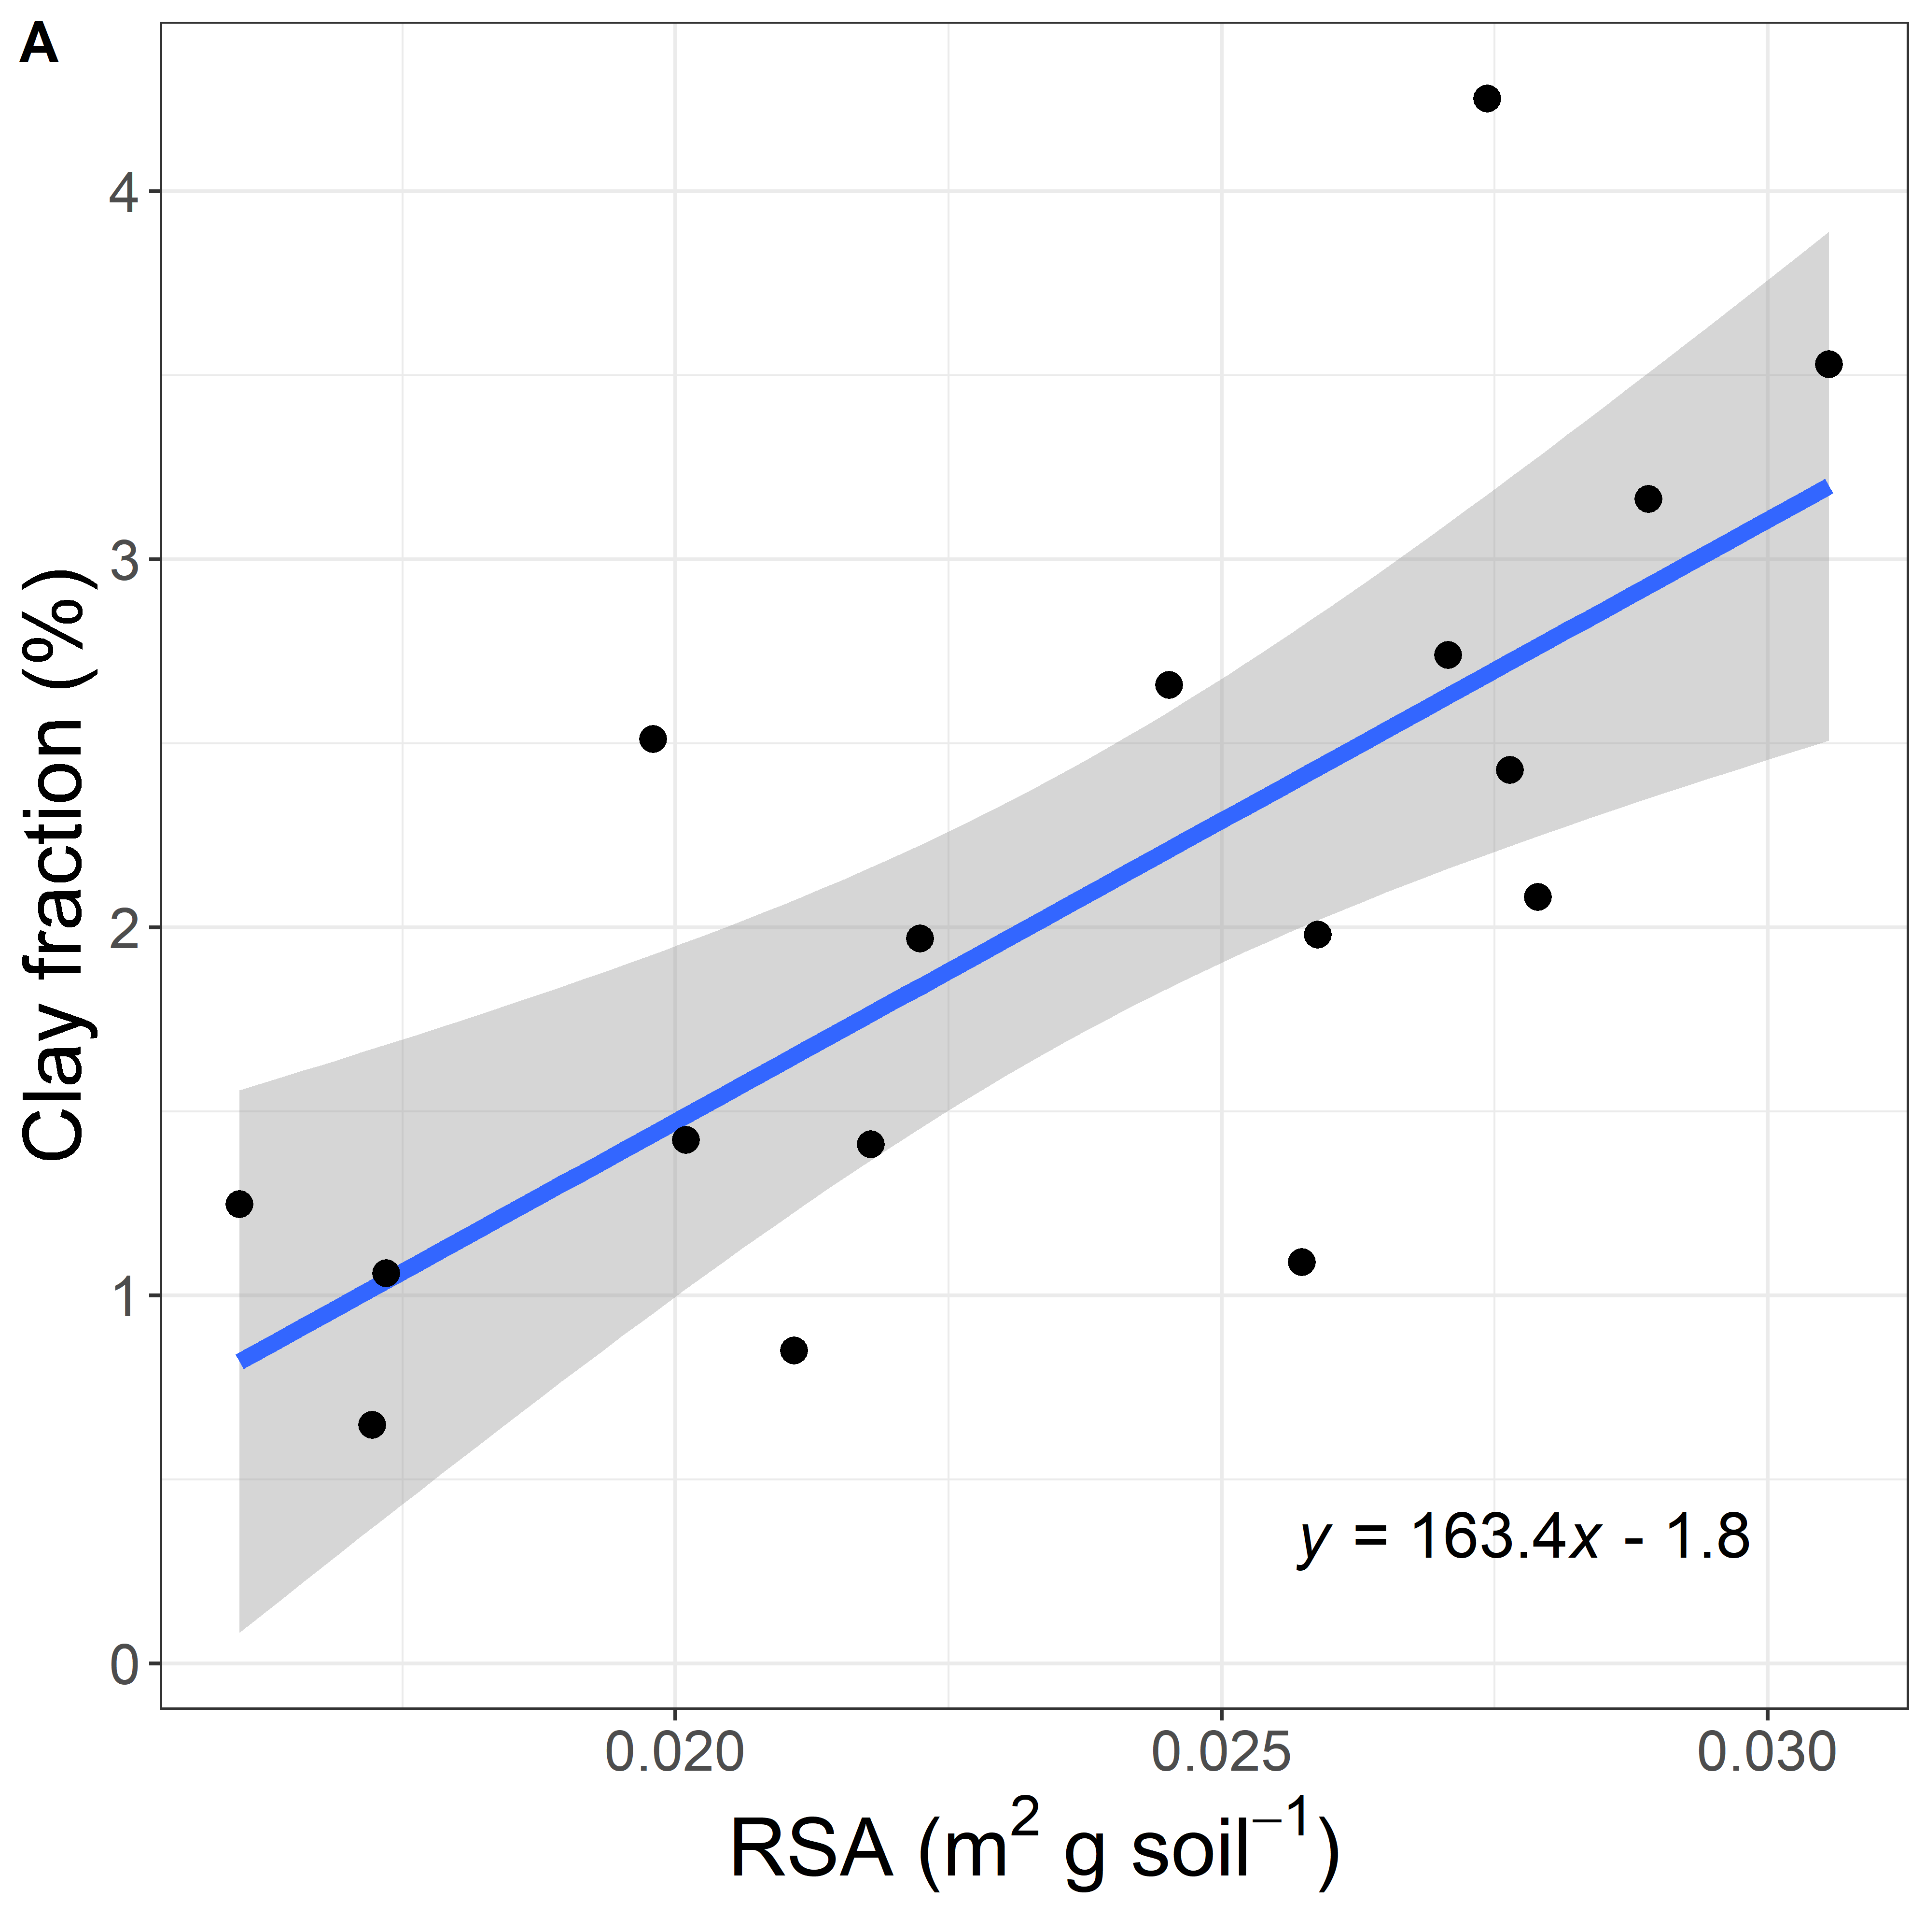
Results and Discussion
Effect of soil properties and biocrusts succession on WVA
Soil CO₂ uptake ↗ with SSA_{s}
Clay fraction (main contributor to SSA_{s}) correlated with RSA of CaCO₃
CO₂ adsorption?
Adsorbed CO₂ and/or water vapor interacts with highly reactive clay-size CaCO₃ [Loeppert & Suarez, 1996]?
Evidenced for the 1st time in-situ
In early stages, SSA_{s} ↗ following succession: accumulation by biocrusts? E.g. interception of fine particles or biomineralization
Notes:
We also found that the soil CO2 uptake ↗ with the soil specific surface area in early succession stages,
Suggesting that a process of CO2 adsorption could be involved.
To our knowledge, it is the first time that it is evidenced in-situ.
In addition, the clay fraction, which is the main contributor to spec. surf. area., was correlated with the reactive surface area of calcite.
That suggests that CO2 and/or water vapor could interact with clay-size calcite particles which are highly reactive.
We also found that in early succession stages, the soil spec. surf. area ↗ following the order of the succession, suggesting that biocrusts could favor the CO2 uptake through different mechanisms.

Slide 13
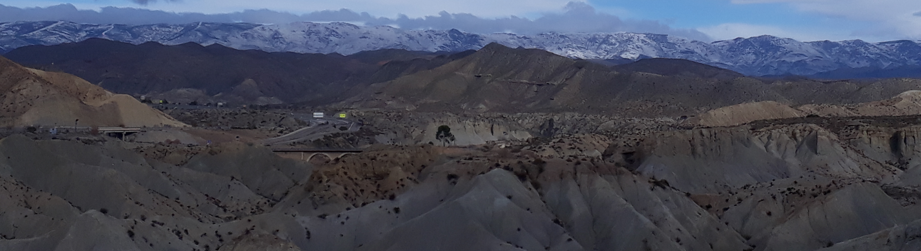
CONCLUSIONS

Slide 14
Conclusions
The gradient method has several advantages to estimate WVA
Easy
Low perturbation
Long-term continuous
Understanding
Low-cost
Spatio-temporal
Direct estimates
A standardized procedure to calibrate k_{s} would improve the accuracy of estimates → Lysimeters?
WVA is likely to drive the nocturnal CO₂ uptake by enhancing geochemical processes…
and/or dark microbial CO₂ fixation?
CO₂ dissolution
Mineral reactions
CO₂ co-adsorption
Leaves the door open for novel multidisciplinary research
More investigation is needed since water vapor and CO₂ sinks could grow with climate change
Notes:
In conclusion:
The GM has several advantages to estimate WVA. Among others, it has a low-cost and provides more direct estimates of WVA compared to the traditional method that uses lysimeters.
A standardized procedure to calibrate the diffusion coefficient of water vapor is still lacking and would improve the accuracy of the estimates. We suggest that could be done by combining the GM with lysimeter measurements.
It seems likely that WVA drives the nocturnal CO2 uptake by enhancing different geochemical processes.
But a biotic origin should not be discounted yet.
We think these results leave the door open for novel multidisciplinary research.
More investigation is needed on this topic since water vapor and CO2 sinks could grow with climate exchange.

Slide 15
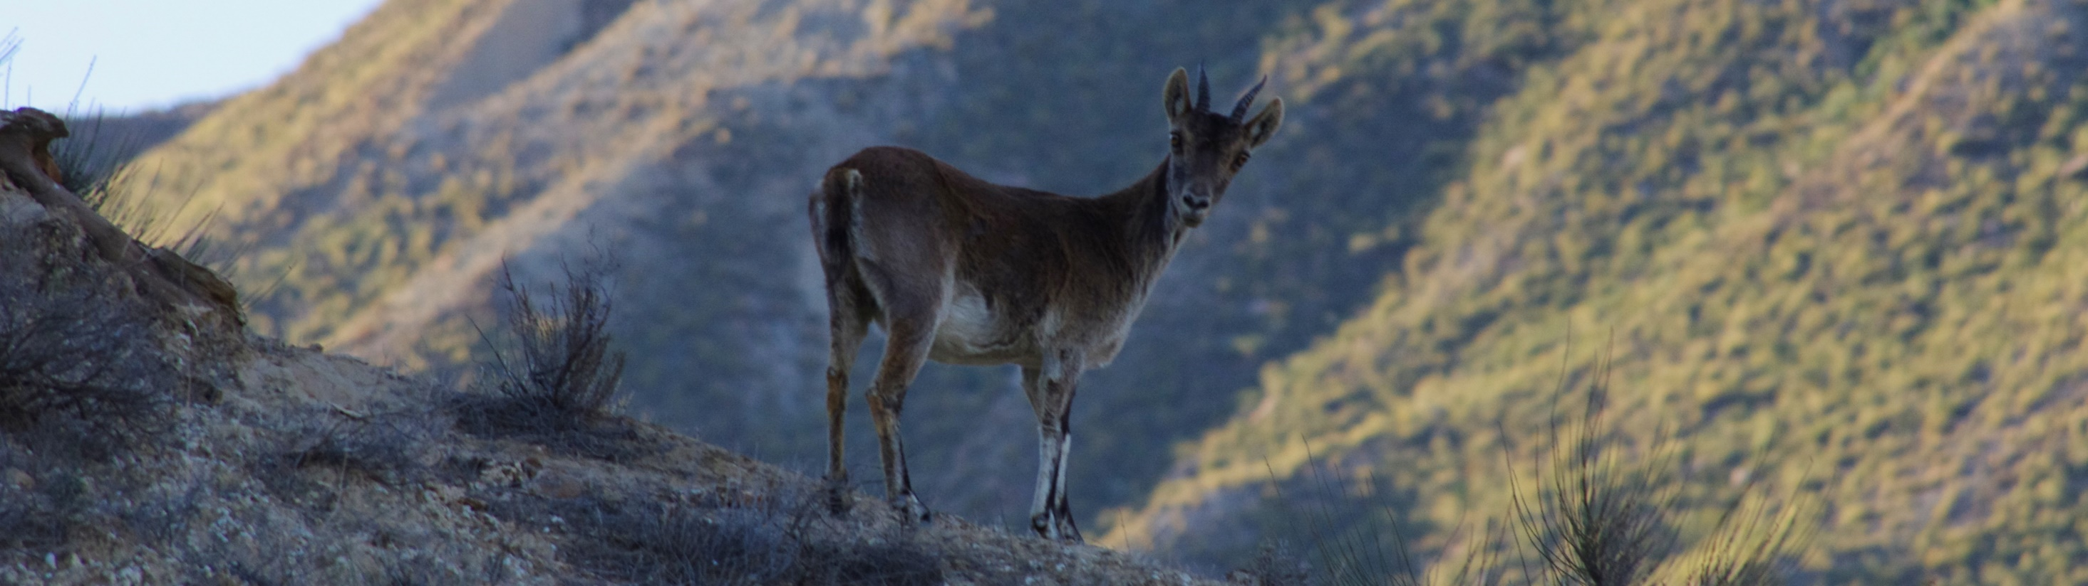
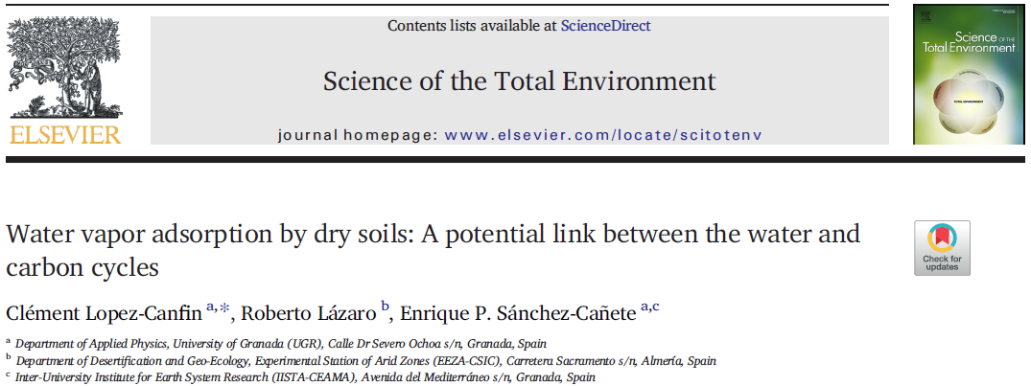
THANK YOU!
???
THAT´S ALL FOLKS!
lopezcle@ugr.es
This work was funded by the research project CGL2016-78075-P, Biocrust Dinamics (DINCOS), of the Spanish National Program of Scientific and Technical Research, and by the ICAERSA research project (P18-RT-3629) of the Andalusian Regional Government including European Union ERDF funds.
Notes:
Questions?

Slide 16
References
Agam, N., & Berliner, P. R. (2006). Dew formation and water vapor adsorption in semi-arid environments—a review. Journal of Arid Environments, 65(4), 572–590.
Bittelli, M., Campbell, G.S., Tomei, F., 2015. Soil physics with Python: transport in the soil-plant-atmosphere system. OUP Oxford. Buttersack, C., 2019. Modeling of type IV and V sigmoidal adsorption isotherms. Phys. Chem. Chem. Phys. 21, 5614–5626.
Cueva, A., Volkmann, T.H.M., van Haren, J., Troch, P.A., Meredith, L.K., 2019. Reconciling Negative Soil CO2 Fluxes: Insights from a Large-Scale Experimental Hillslope. Soil Syst. 2019, Vol. 3, Page 10 3, 10.
Davidson, G. R., Phillips-Housley, A., & Stevens, M. T. (2013). Soil-zone adsorption of atmospheric CO2 as a terrestrial carbon sink. Geochimica et Cosmochimica Acta, 106, 44–50.
Fa, K.-Y., Zhang, Y.-Q., Wu, B., Qin, S.-G., Liu, Z., & She, W.-W. (2016). Patterns and possible mechanisms of soil CO2 uptake in sandy soil. Science of the Total Environment, 544, 587–594.
Hamerlynck, E. P., Scott, R. L., Sánchez-Cañete, E. P., & Barron-Gafford, G. A. (2013). Nocturnal soil CO2 uptake and its relationship to subsurface soil and ecosystem carbon fluxes in a Chihuahuan Desert shrubland. Journal of Geophysical Research: Biogeosciences, 118(4), 1593–1603.
Kool, D., Agra, E., Drabkin, A., Duncan, A., Fendinat, P. P., Leduc, S., Lupovitch, G., Nambwandja, A. N., Ndilenga, N. S., & Thị, T. N. (2021). The overlooked non-rainfall water input sibling of fog and dew: Daily water vapor adsorption on a! Nara hummock in the Namib Sand Sea. Journal of Hydrology, 598, 126420.
Kosmas, C., Danalatos, N. G., Poesen, J., & Van Wesemael, B. (1998). The effect of water vapour adsorption on soil moisture content under Mediterranean climatic conditions. Agricultural Water Management, 36(2), 157–168.
Loeppert, R. H., & Suarez, D. L. (1996). Carbonate and gypsum. Methods of Soil Analysis: Part 3 Chemical Methods, 5, 437–474.
Ma, J., Wang, Z.-Y., Stevenson, B. A., Zheng, X.-J., & Li, Y. (2013). An inorganic CO2 diffusion and dissolution process explains negative CO2 fluxes in saline/alkaline soils. Scientific Reports, 3, 2025.
McHugh, T. A., Morrissey, E. M., Reed, S. C., Hungate, B. A., & Schwartz, E. (2015). Water from air: an overlooked source of moisture in arid and semiarid regions. Scientific Reports, 5(1), 1–6.
Pinheiro, J. C., & Bates, D. M. (2000). Mixed-Effects Models in S and S-Plus. Springer-Verlag New York.
Sánchez‐Cañete, E. P., Scott, R. L., van Haren, J., & Barron‐Gafford, G. A. (2017). Improving the accuracy of the gradient method for determining soil carbon dioxide efflux. Journal of Geophysical Research: Biogeosciences, 122(1), 50–64.
Xu, X., Nieber, J.L., Gupta, S.C., 1992. Compaction effect on the gas diffusion coefficient in soils. Soil Sci. Soc. Am. J. 56, 1743–1750.

