Slide 1





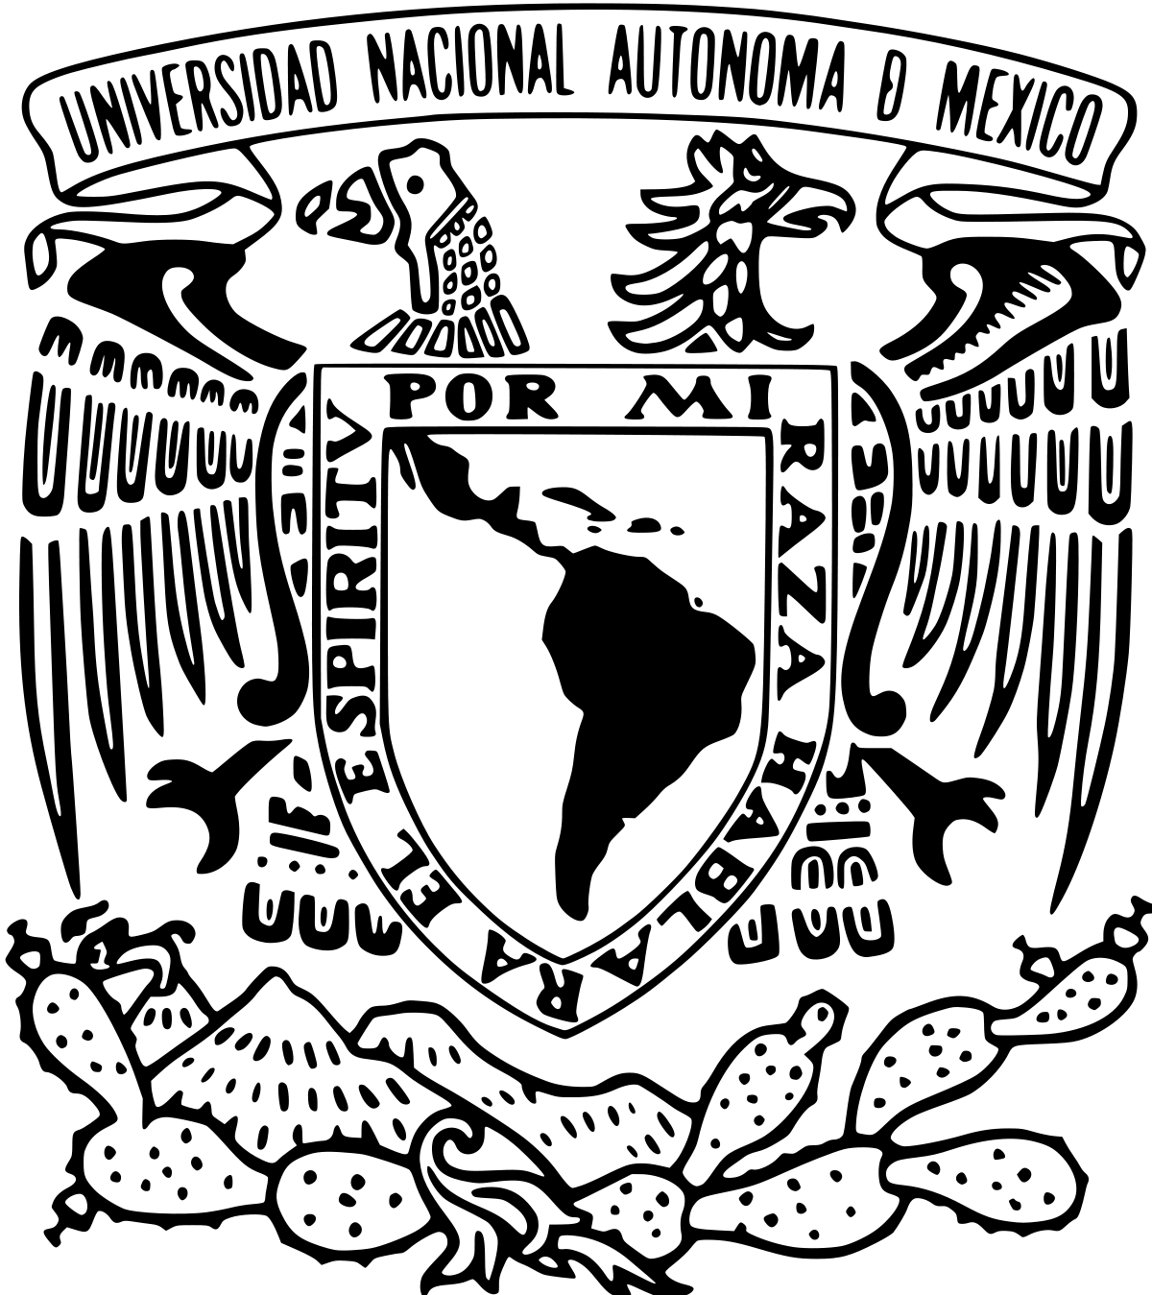

Mediterranean heat injection to the North Atlantic delayed the intensification of Northern Hemisphere glaciations
André Bahr¹, Stefanie Kaboth-Bahr², Christian Stepanek³, Maria Carolina Amorim Catunda¹, Cyrus Karas⁴, Martin Ziegler⁵, Ángela García-Gallardo⁶, and Patrick Grunert⁷
1 - Heidelberg University, Germany
2 - University of Potsdam, Germany
^{3 - AWI Bremerhaven, Germany}
4 - Universidad de Santiago de Chile, Chile
5 - Utrecht University, The Netherlands
6 - Universidad Nacional Autónoma de México, Mexico City, Mexico
7 – University of Cologne, Germany

Slide 2
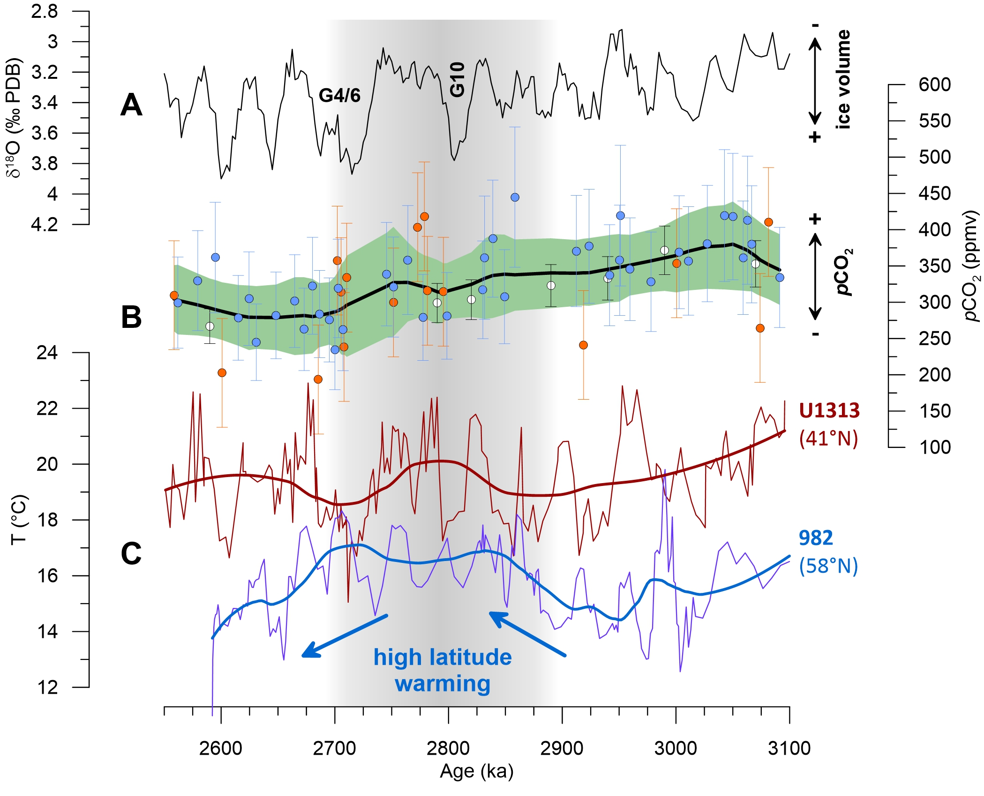
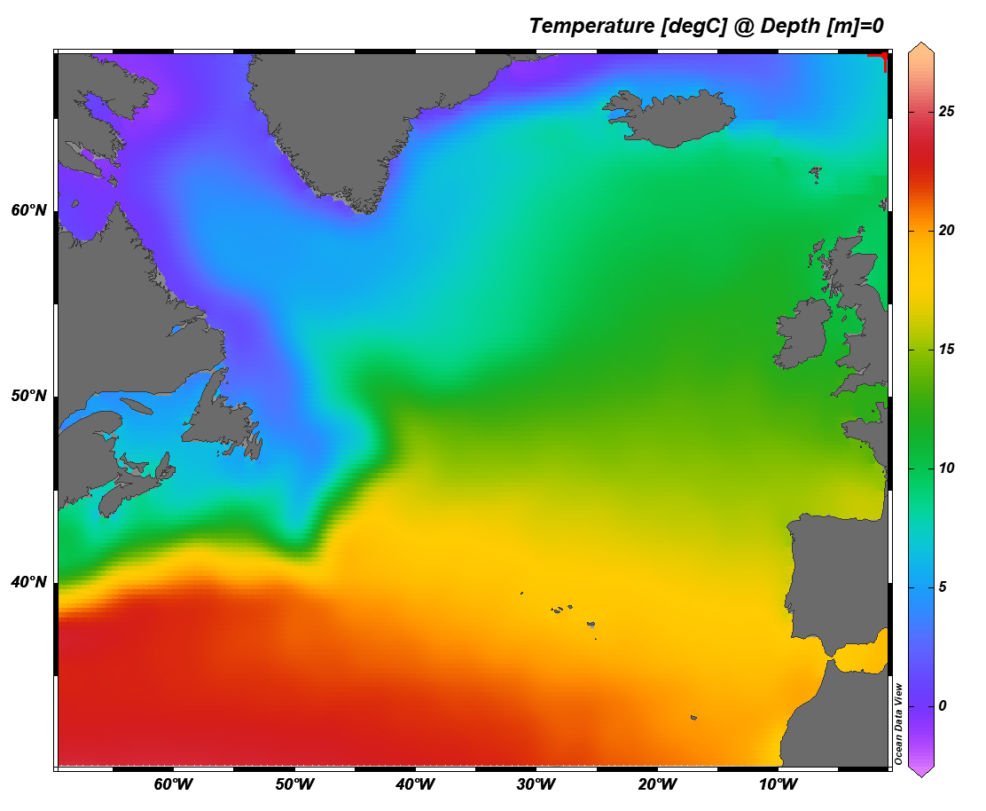
The conundrum:
High latitude warming despite lower pCO₂ levels
982
U1313
Kaboth-Bahr et al., 2021
Source: WOA18

Slide 3
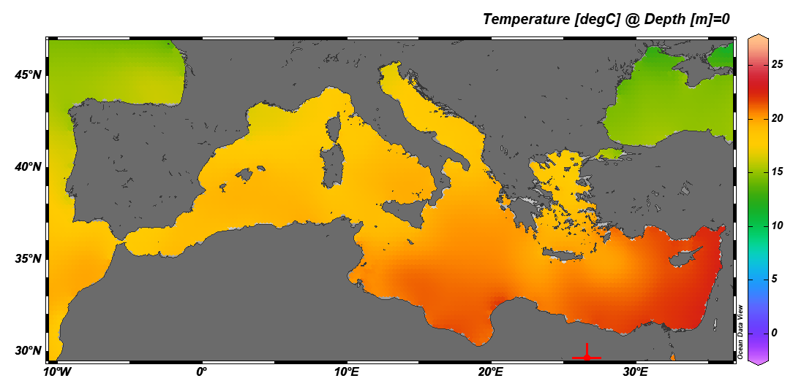
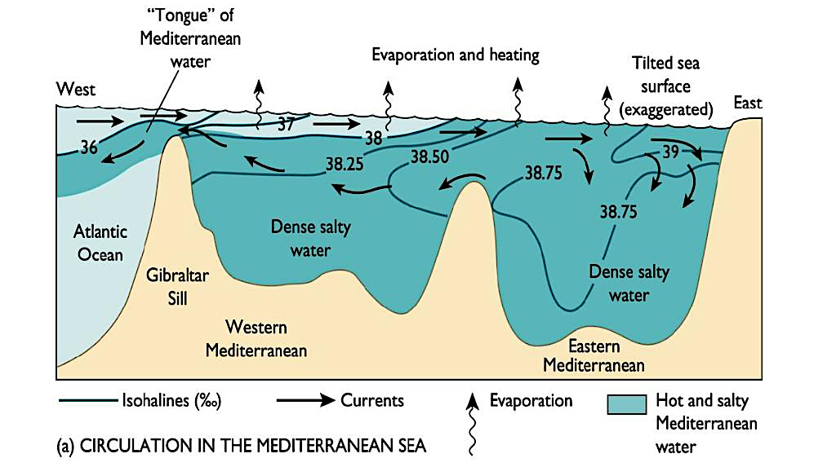
The heat source:
Mediterranean Outflow Water (MOW)
MOW
Marino, 2008

Slide 4
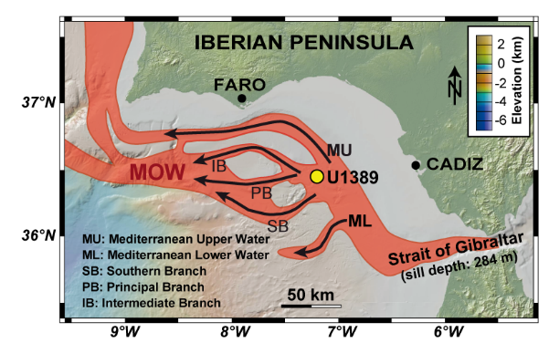
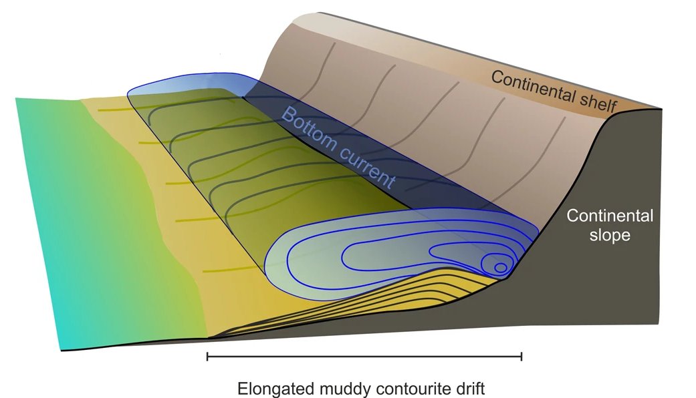
MOW flow path in the Gulf of Cadiz
Kaboth-Bahr et al., 2016, Marine Geology

Slide 5
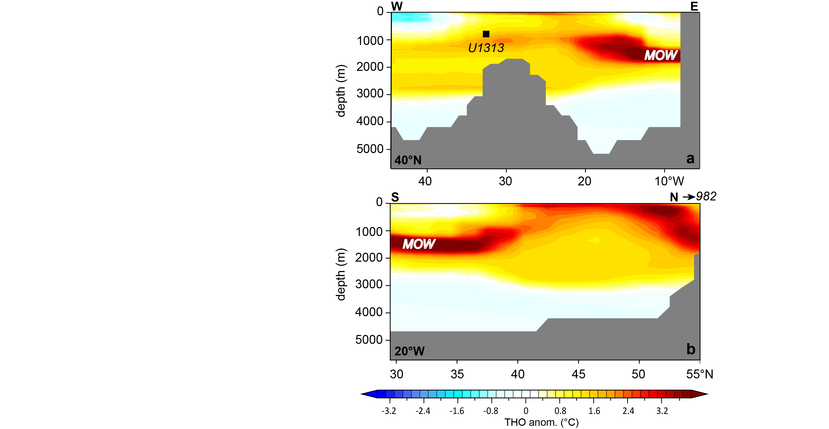
Modelled effect of a salinified MOW (45 PSU)
Model: COSMOS PlioMIP2
Gibraltar
Vigorous MOW
Kaboth-Bahr et al., 2021

Slide 6
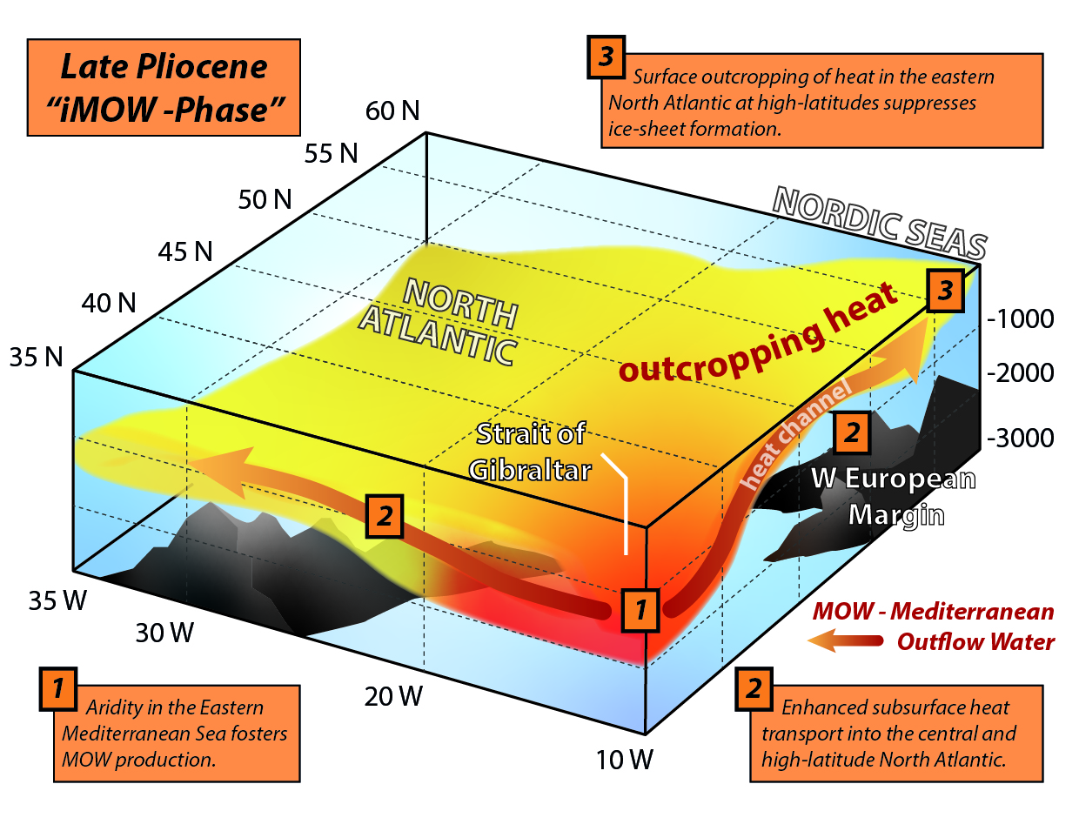
A subsurface heat channel warming up the
North Atlantic
982
modified after Kaboth-Bahr et al., 2021

