Slide 1

The kids aren’t alright
Wim Thiery, Stefan Lange, Joeri Rogelj, Carl-Friedrich Schleussner, Lukas Gudmundsson, Sonia Seneviratne,
Katja Frieler, Kerry Emanuel, Tobias Geiger, David Bresch, Fang Zhao, Sven Willner and many more.
(Alexander Radtke)

Slide 2

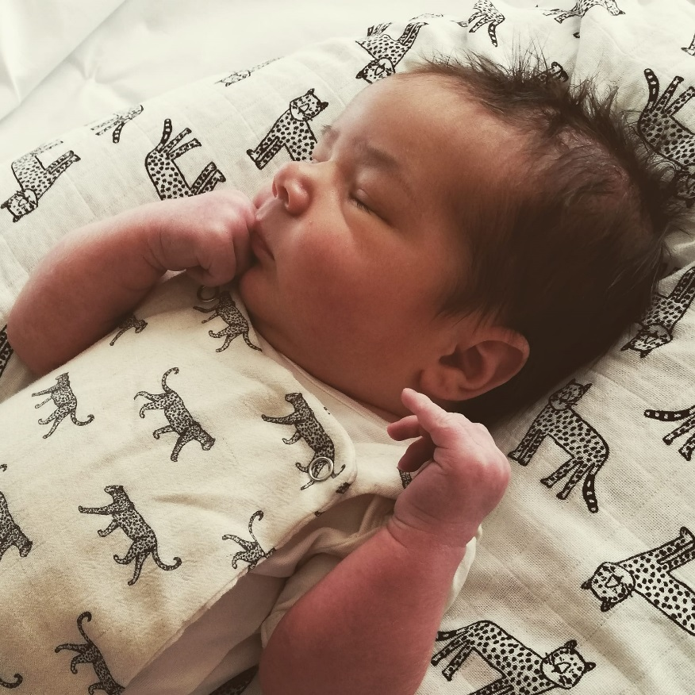
Notes:
When I announced the title of this presentation to my fellow climate scientists, some of my colleagues came up to me and asked: are your children ok?
I can tell you that my three children are doing just fine. But this presentation is not about my kids, it is about children everywhere in the world.
But let me nonetheless start by showing you a picture of my youngest son. This is Gaspard, and he was a newborn in 2020. On the left you see my mother, who was 60 years old in 2020.
Now before we start this presentation, I would like to ask you to think of your age, as well as the age of someone that is really close to your heart.
Then, let me ask you a question. Will a newborn experience more climate extremes than a 60-year old? I guess that you will all agree that the answer to this question is
Yes, of course that newborn will face more climate extremes.
But then comes the next question: Sure, but how many more?
Now This is something that we climate scientists hadn’t quantified, until recently
There are three reasons why this is an important question.

Slide 3
Will a newborn experience more extreme events than a 60-year old?
Yes, of course.
But how many more?
This we haven’t quantified (yet).
Notes:
Ask the audience to raise hands. It’s not a trick question.
We have experts on the call

Slide 4
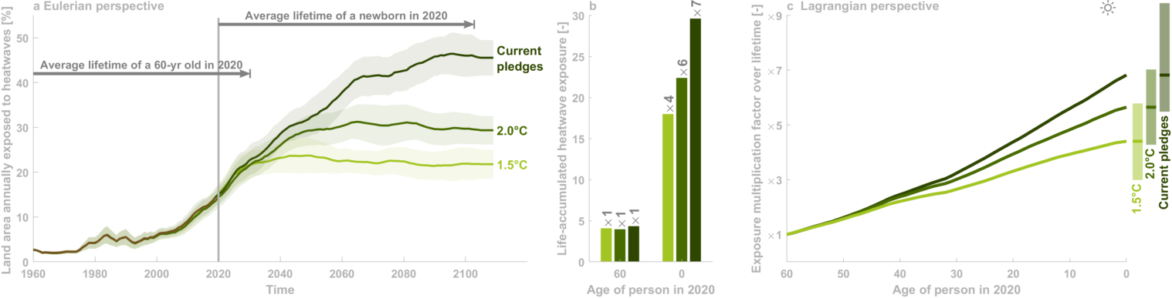
The idea Integrate exposure of an ‘average person’ to extreme events across lifetime
(Thiery et al., 2021 Science)
Notes:
This is because of the way we typically study the effects of climate change: you have a diagram, with time on the x-axis, and land area annually exposed to an extreme heatwave on the y-axis.
We then study how this variable evolves under different temperature pathways: under a 1.5°C scenario, around 20% of the land area will be annually exposed by 2100. Under 2,0°C, this increases to around 30%, and under current pledges, we end up above 40%.
This is what I call the Eulerian perspective to climate impacts.
If we now look at the lifetime of someone who is 60-years old in 2020, we see that this person will on average live until about 2030. In contrast, someone born in 2020 will live almost until the end of the century.
In this study, we integrate the exposure of an ‘average’ person in a birth cohort to extreme events across their lifetime. This gives us this second panel
You can of course compare the absolute values, showing that a 60-year-old wil experience around 4 extreme heatwaves across his/her lifetime, and that this exposure is independent of the future scenario we will follow. For a newborn, the exposure varies between 17 and almost 30 extreme heatwaves, with a strong dependency on the scenario. However, the absolute values are subjective to the extreme event definition.
Therefore, it is preferable to analyze the relative change, by computing the exposure multiplication factors: How much more extreme events will a newborn experience compared to a 60-year-old? For a 60-year-old, the exposure multiplication factor is 1 per definition. For a newborn, we find that life-accumulated heatwave exposure increases by factor 4 compared to a 60-year-old under 1.5°C warming and by factor 7 under current pledges.
We then repeat this analysis for all age cohorts and plot the exposure multiplication factor as a function of age. On this panel you can now look up your own age of that of your beloved ones, to find out how much more heatwaves this person will experience.
These results emerge from combining 5 sources of data.

Slide 5
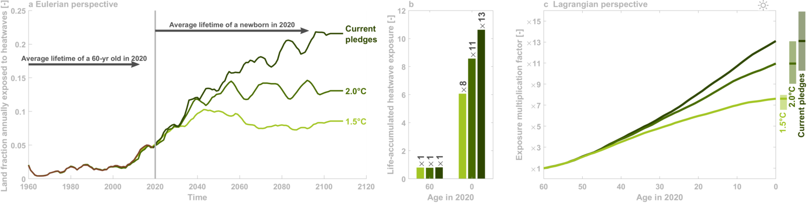
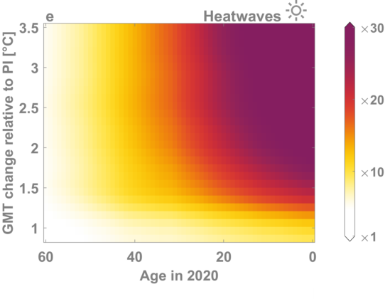
Burning embers for the kids
Notes:
So, then we get a plot with age on the x-axis, and the global warming level on the y-axis
Colored variable shown is exposure multiplication factor
Reference for the exposure multiplication factor is now person with year-1960 life expectancy living under picontrol climate.
Under 3.5°C of global warming, Newborns will face 44 times more heatwaves than the reference person living under picontrol climate.
(Not a real Burning Embers since we do not include vulnerability (or at least only indirectly by considering different income categories as a proxy for vulnerability).)
(Same colours as real burning ember but had to make choices regarding the transitions: a linear colour scale, in this case between x1 (white) and x30 (purple).)

Slide 6
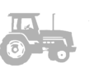
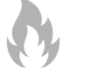
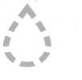
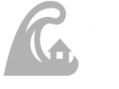
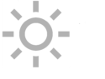
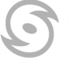
six impact categories 15 ISIMIP2b models, 273 global-scale projections
(Lange et al., 2020 EF)
Notes:
Thanks to the ISIMIP impact model data base, we can now do this analysis for 6 extreme event categories
So far we focused only on heatwaves, but in our study, we in fact performed these calculations for wildfires, crop failures, droughts, river floods, heatwaves, and tropical cyclones.
Our consistent approach across these different climate extremes allows us to develop the same type of figure for each of these six categories
In total 273 global-scale impact projections considered.
Those projections were derived with 15 models which you might have heard from: WaterGap, CLM, Orchidee, JULES, PCRGLOB, LPJmL, LPJ-GUESS,… All these simulations are publicly available through the Earth System Grid Federation
Categories have been defined by Stefan Lange, output from ISIMIP2b models have been harmonised, to form one gridded variable: land Fraction Affected by extreme event. This variable is available on annual time scales
This allows us to develop the burning ember figure for each of these categories

Slide 7
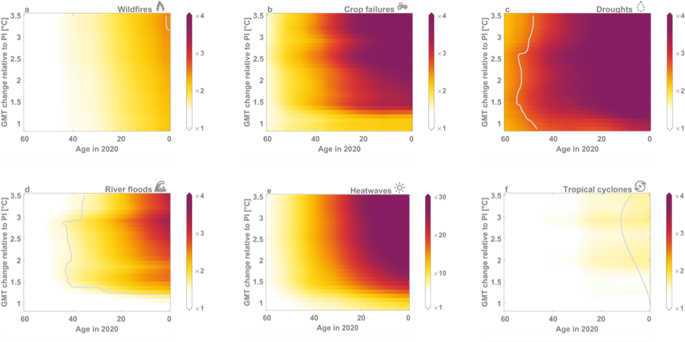
six burning embers
(Thiery et al., 2021 Science)
Notes:
So here’s the figure that we had already, and now we can add the panels for the five other extreme event categories.

Slide 8
six burning embers
e.g. 6-yr old under 3°C: wildfires/TCs x2; river floods 3x; crop failures x4; droughts x5, heatwaves x36
(Thiery et al., 2021 Science)
Notes:
All color scales ranging from 1 to 4, except for heatwaves which ranges from 1 to 30
General result: life-accumulated exposure to each of the considered extreme events consistently increases for higher warming levels and younger cohorts
Historical changes in climate impacts have had little to no effect on lifetime exposure for cohorts above age 55 in 2020, but this rapidly changes for younger cohorts as they start experiencing impacts in the coming years and decades.
For instance, at 3°C of global warming, a 6-year-old will experience twice as many wildfires and tropical cyclones, 3 times more floods, 4 times more crop failures, 5 times more droughts, and 36 times more heatwaves relative to the reference person.
While qualitatively consistent, quantitative exposure changes differ among categories: for wildfires and tropical cyclones, increases in exposure remain limited relative to the other categories, whereas heatwave exposure increases much more strongly
Using a bootstrapping approach, we then calculate the probability of each person's life-accumulated exposure occurring under pre-industrial control climate conditions. The grey isolines represent the 0.01% probability thresholds: so, if you’re above or to the right of the second line, you have less than 1-in-10’000 chance of living such life in a world without climate change.
Lives with an accumulated exposure that would occur with less than a 1-in-10'000 chance are then classified as unprecedented.
No line for heatwaves and cop failures: this means unprecedented exposure in all cases
cohorts above age 55 in 2020 will on average live an unprecedented life only for heatwaves and crop failures
cohorts aged 0-40 in 2020 will additionally face unprecedented exposure to droughts and flooding above 1.5°C warming

Slide 9
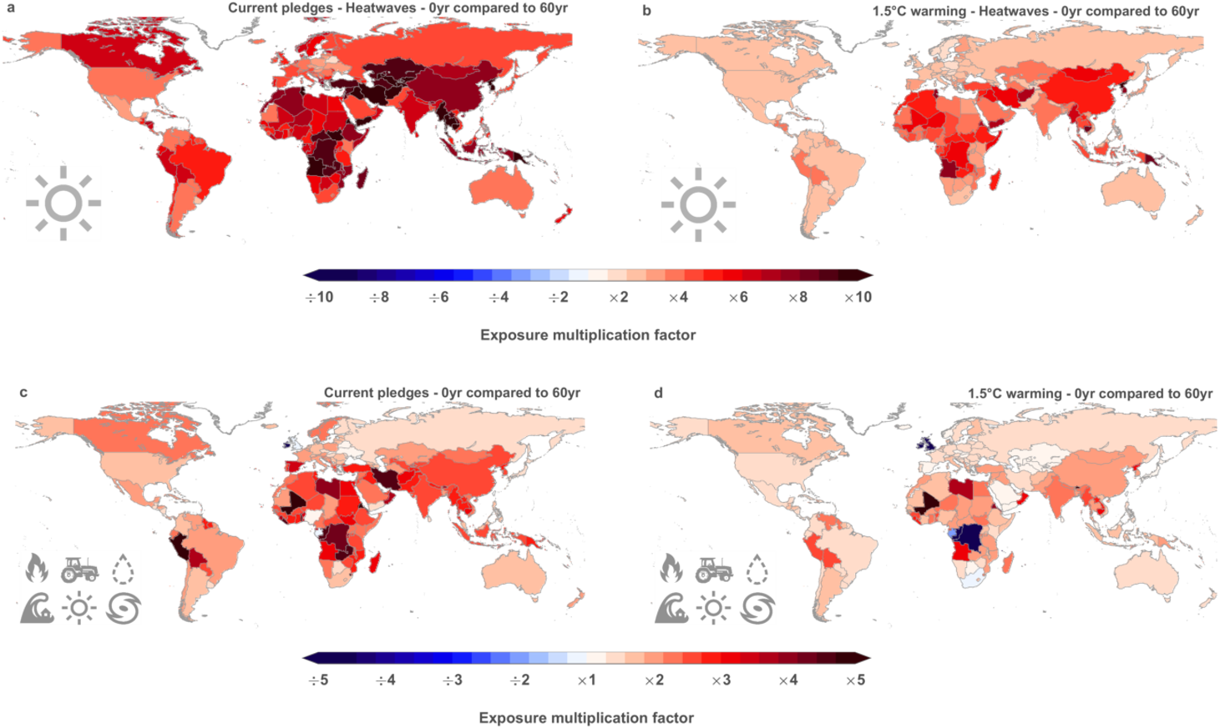
Increased climate ambition lowers burden on young generations
(Thiery et al., 2021 Science)
Notes:
I’m guessing that by now you might be thinking that we’re all doomed. Well, I can assure you that this is not the case.
Indeed, young people have most to lose if we go to high warming levels. But we can also turn this message around: young people have most to gain if we increase climate ambition:
If we look at this global map comparing the lifetime heatwave exposure between a newborn and a 60-year old, you see dark red colors everywhere. This means that under current climate pledges, children will face far more heatwaves than their grandparents in every country of the world.
However, if global warming stays below 1.5°C, we see that the colors become much lighter.
So, if we limit global warming to 1,5°C instead of the current pledges, we strongly reduce the burden on young generations in every part of the world. For heatwaves, such increased ambition would lower the intergenerational burden by 40%
So, in the end, a message of hope and a clear call to action arises from this research: We must limit global warming to 1.5°C for safeguarding the future of young generations.

Slide 10


Thanks! Questions?
@WimThiery
(Jersey warming stripes vandalised, bailiwickexpress.com)
(2017 Italy drought, imaggeo.egu.eu)
Notes:
And on that note, I will end my presentation and happily take questions from you! Thanks a lot for your attention!
https://www.bailiwickexpress.com/jsy/news/artist-teases-new-look-vandalised-climate-change-mural/

Slide 11

#myclimatefuture
https://myclimatefuture.info/
Notes:
Carbon brief: nr 13

Slide 12
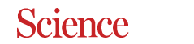
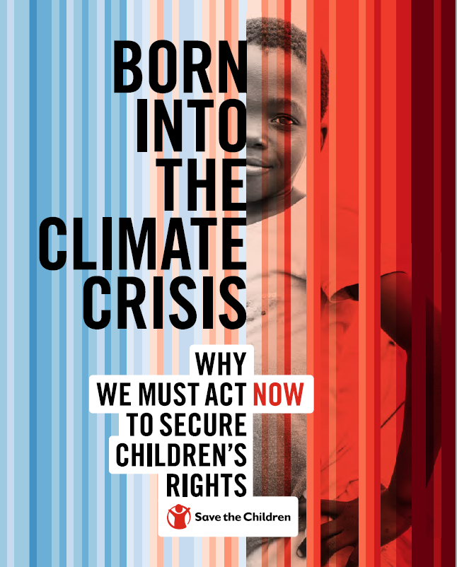
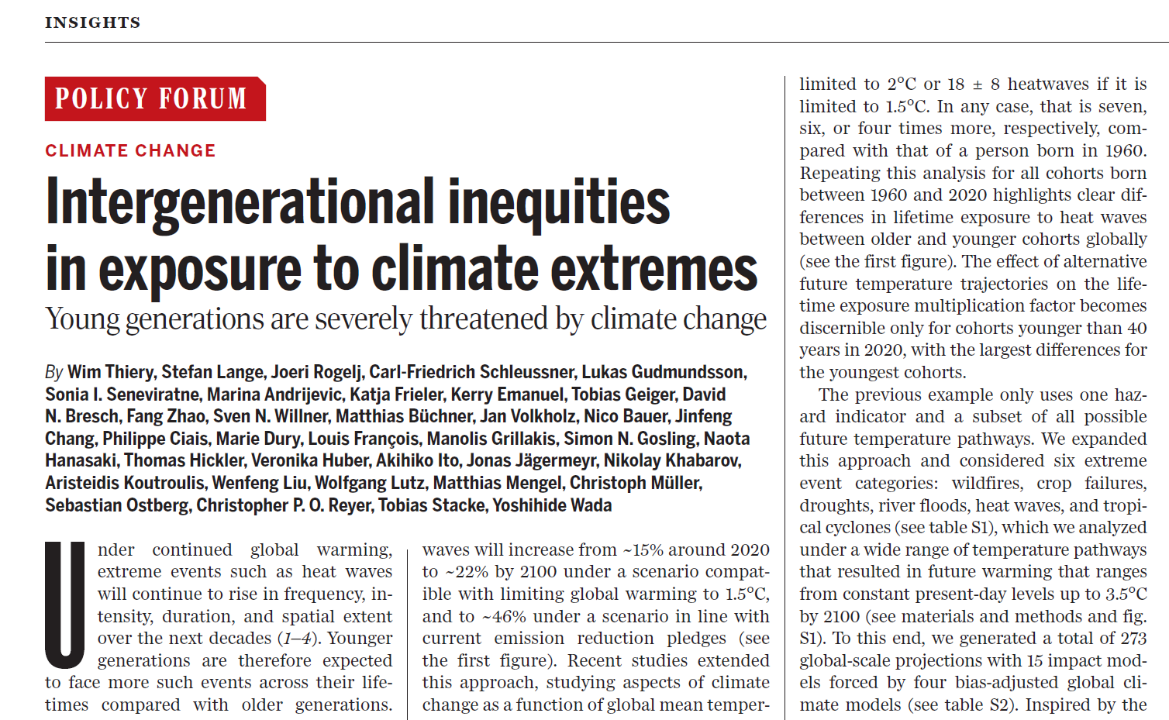
outcomes
Notes:
De studie heft heel wat internationale weerklank gekregen, met in totaal meer dan 270 media-artikels over deze studie, waaronder stukken in The Washington Post, The Guardian, BBC World, The Independent, The Times, Der Spiegel.
Op de website myclimatefuture.info kan je zelf uitzoeken wat klimaatverandering voor jou betekent.

Slide 13
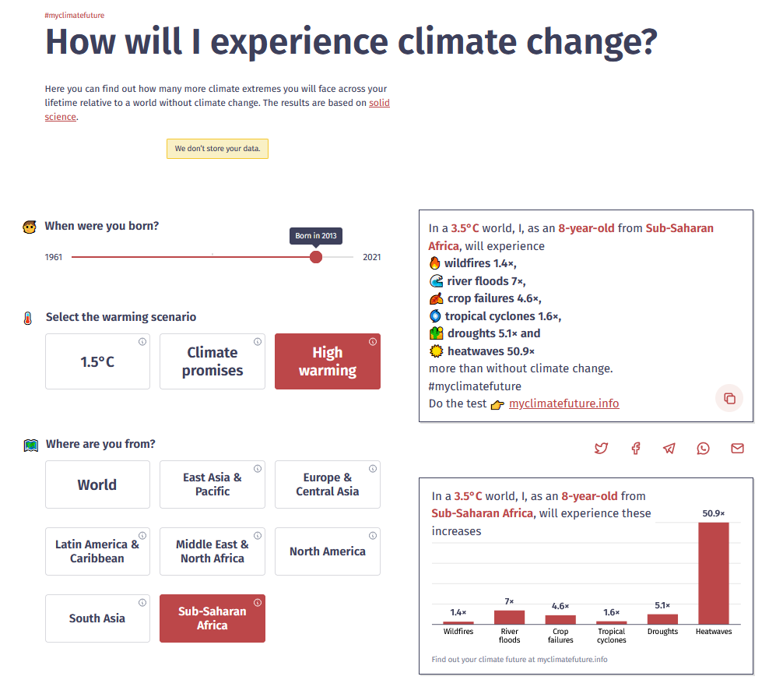
#myclimatefuture
https://myclimatefuture.info/
Notes:
Carbon brief: nr 13

Slide 14

Notes:
The first reason is that it is a question of enormous societal relevance.
Since late 2018, Young people from around the world have been leading climate demonstrations. These young people are organizing school strikes, worldwide protest marches and recently even hunger strikes to demand more ambitious climate action.
Meanwhile, governments fail to reduce CO2 emissions. In fact, the climate pledges made by countries around the world currently put us on a path to 2,4°C warming by the end of the century, which is way more than what these same countries stipulate in the Paris Climate Agreement.
The absence of sufficiently ambitious climate policies holds the risk of turning into a generation conflict. Young people face the consequences of decision-making by older people who may themselves not experience the long-term effects of climate change.
Or, to put in simpler terms: ‘OK, Boomer’

Slide 15

(© UNICEF/UNI207443/Chalasani)
Notes:
A second reason why this question matters is climate litigation
People from around the world are today suing fossil fuel companies for their contribution to the climate crisis as well as governments for their lack of climate action.
Every week new cases appear in the media. National governments of The Netherlands, Germany, France and Belgium were already convicted in court cases.
Now in several cases, such lawsuits are started by young people, who claim that countries’ failure to tackle the climate crisis constitutes a violation of child rights.
So, asking how many more climate extremes a young person will experience, is not only a question of societal relevance, it is also an important legal question. Because if a 15-year old will experience more impacts from climate change than a 60-year old, that young person is also better positioned to start a law suit.
(https://weshare.unicef.org/Folder/2AM408TVA60S)

Slide 16
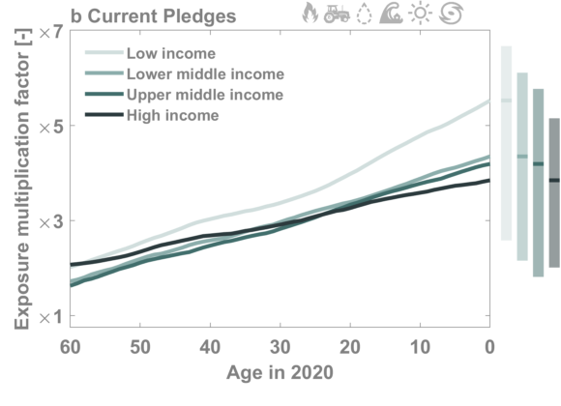
Current pledges – income categories
(Thiery et al., 2021 Science)
Notes:
It gets even more interesting when we group the countries according to their income.
In this case we see that there’s a substantial increase in life-accumulated exposure for low income countries.
Importantly, this analysis is just looking at ‘one average person’, i.e. one average member of that cohort in that particular region

Slide 17
Key points
Now quantified: younger generations will live an unprecedented life
Implications for intergenerational justice and climate litigation
Heatwaves dominate increasing aboslute exposure to hazards
Hence geometric mean
Regionally, up to 9-fold increase in exposure for newborns under current pledges
Clear added value of mitigation
Strongest effects for low income countries
where almost half of today’s newborns live

Slide 18
The nitty-gritty details
ISIMIP2b Data:
5 sectors: global water, biomes, agriculture, tropical cyclones
15 impact models
forced by 4 bias-adjusted CMIP5 GCMs
under picontrol, historical, RCP2.6, 6.0 and 8.5
273 global impact projections
101 picontrol simulations (average length: 542 years)
use this data as damage functions (i.e. look-up tables) to get impacts per GMT anomaly in SR1.5 scenarios
1.5°C, 2°C, NDCs (=current pledges)
life-accumulated exposure across age cohorts (1960-2020)
main analysis at country scale
Aggregation to regional and global scale
spatial averaging accounts for
within-country population density variability
between-country cohort size differences
the approach encapsulates spatiotemporal changes in climate hazards, life expectancy and population dynamics
no account of vulnerability

Slide 19
Why we are conservative
We treat consecutive events affecting a location within a calendar year as one
cfr. Consecutive disasters (De Ruijter et al., 2020)
We consider changes in the frequency of events, neglecting changes in intensity and duration
Especially relevant for tropical cyclones and heatwaves (Russo et al., 2017)
We ignore compound events
e.g. droughts – heatwaves – crop failures (Zscheischler et al., 2017; 2020)
We only consider exposure to local hazards
cfr. Breadbasket failure (Kornhuber et al., 2020)
We employ stringent extreme event definitions
e.g. four heatwaves across lifetime of 60-y old (fig. 1; Lange et al., 2020)
We ignore possible lagged response
e.g. tropical cyclones and sea level rise (Nauels et al., 2019)
Notes:
This lagged response further augments inter-generational inequity, and this to the extent that even the already committed sea level rise will enhance life-accumulated exposure of generations well beyond the ones we consider in this study
On shorter time scales, this reasoning also applies to wildfires, as fuel aridity may build up over several years in response to a long-term warming trend
Overall, these six reasons highlight that our current results may underestimate changes in actual extreme event exposure and thereby underscore the benefits of climate action for current and future young generations.

Slide 20

Why this matters (1) Fridays for future: surge in societal debate
Notes:
There are three reasons why this is a relevant question.
The first reason is that it is a question of high societal relevance.
Since late 2018, Young people around the world have been leading climate demonstrations.
climate strikers are a group of young, diverse people. But their actions continue to receive fierce criticism, in many cases coming from older people.
Meanwhile, government actions are falling short of achieving the emission reductions required to halt global warming at the safe levels agreed upon under the Paris Agreement
The absence of sufficiently ambitious climate policies is turning into a generation conflict (cfr ok, boomer). Young people facing the consequence of decision-making by older people who may not experience the long-term effects of climate change.

Slide 21
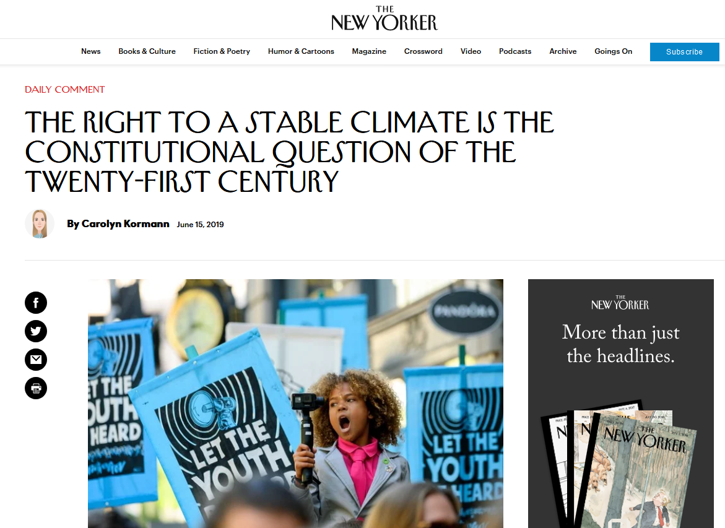
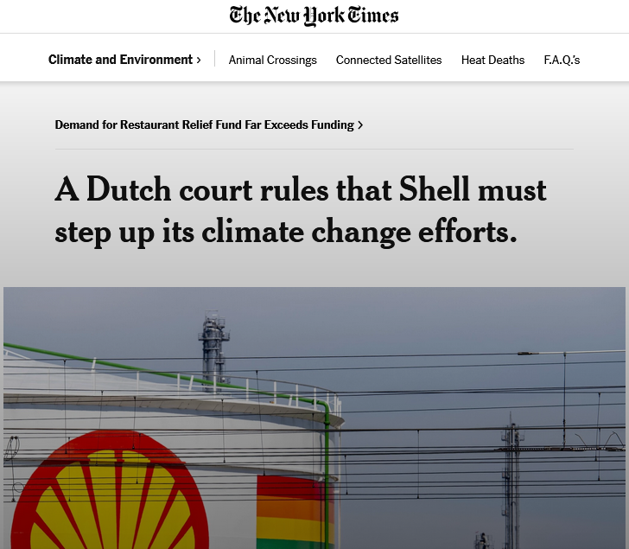
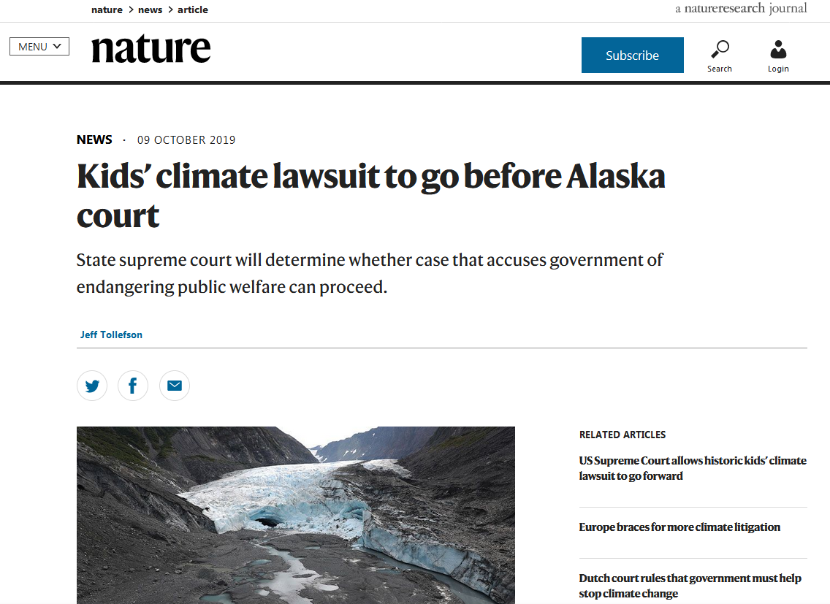
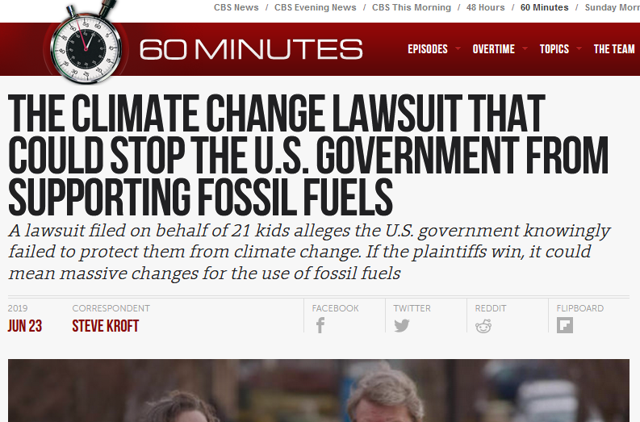
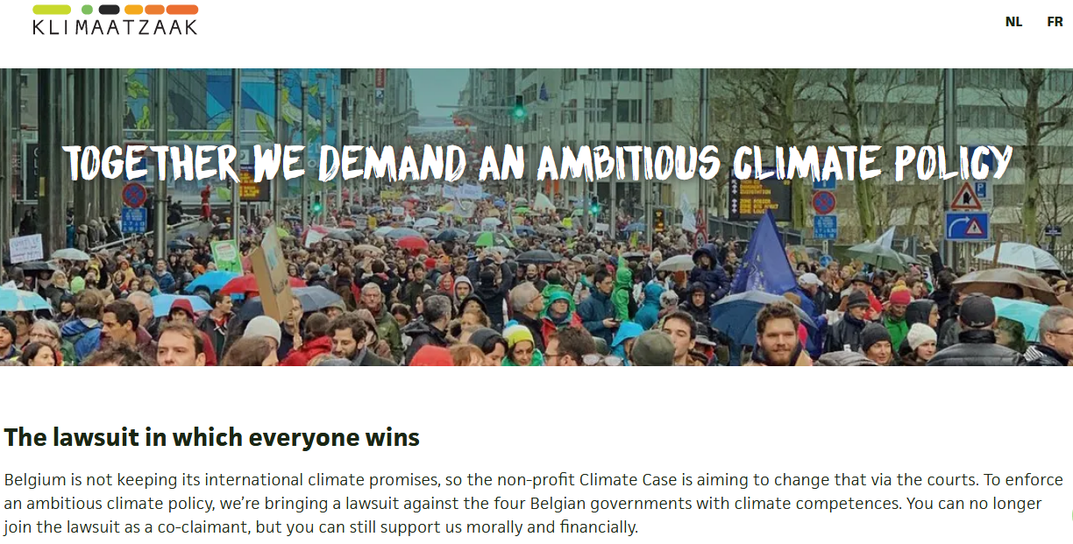
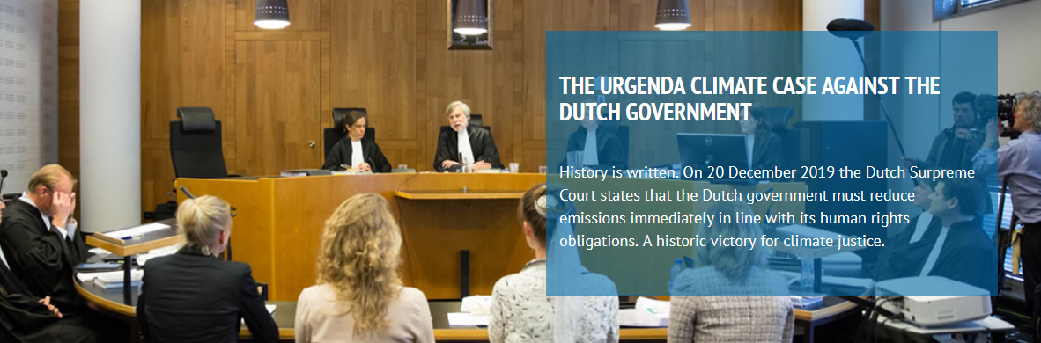
Why this matters (2) Climate litigation: Is a 15-year old more entitled to start a lawsuit than a 60-year old?
Notes:
A second reason why this question matters is climate litigation
Litigation, not mitigation: e.g. Dutch government has been condemned for not meeting up with it’s pledges (the famous Urganda case). A similar case is ongoing in Belgium (klimaatzaak).
Greta Thunberg is suing several G20 countries for violating the UN children rights treaty which they signed themselves.
Every week new cases in the media. Last week a Dutch court ruled that Shell should increase its climate ambitions
So a relevant question to ask in this context is: is a 15-year old more entitled to start law suits than a 60-year old? For me this was the question that sparked this research.
Our children’s trust: Juliana vs. United States. 21 youth plaintifs challinging Obama administration: Claim that the governments affirmatve policies regarding greenhouse gas emissions amounted to a violating the youth’s consitutional rights under theunited States constitution.
Plaintifs are especially vulnerable to climate change impacts.
(every kid has an impact, e.g. Oregon, more asthma attacks because of forest fires, loss of income for family working in ski resort).
See also Oregon case: climate kids vs. The United States
https://www.newyorker.com/news/daily-comment/the-right-to-a-stable-climate-is-the-constitutional-question-of-the-twenty-first-century
A Peruvian farmer is suing the German electricity production company RWE because of it’s contribution to global climate change. The farmer lives below a melting glacier, and the lake formed because of that is about burst out and destroy his entire town (Lliwuya v. RwE).
See talk Michael Burger
Notre Affaires a Tous v. Total
v. Shell
A question from the audience during one of my public lecture sparked the idea for this research (by a famous biochemistry professor)
This is based on the assumption that 15-year old will face more impacts than a 60-year old. While we can reasonably assume this is the case, it has in fact never been comprehensively quantified!

Slide 22
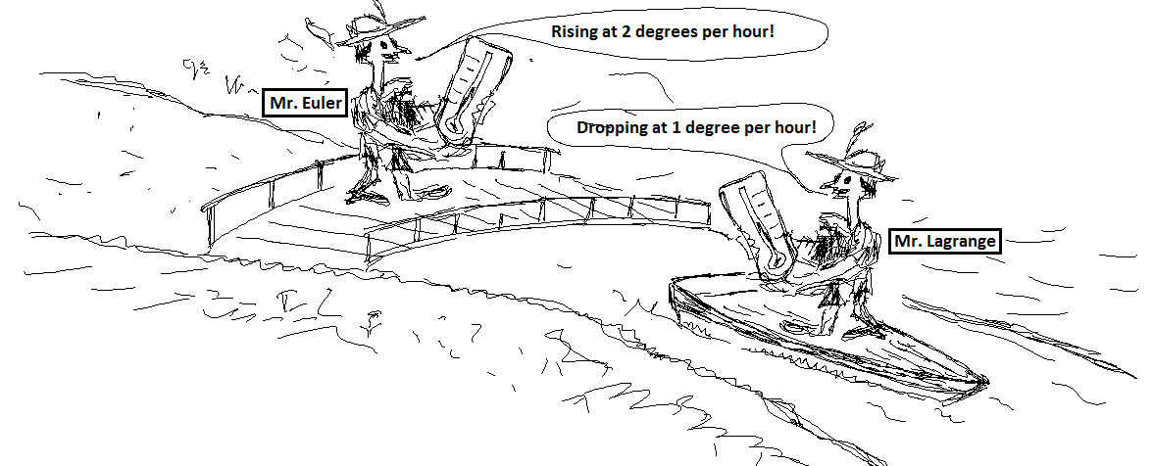
Why this matters (3) Eulerian vs. Lagrangian: A common distinction in atmospheric science, not in impact research
Notes:
But also scientifically, this is a very interesting question, because it links to a common distinction in atmospheric science which received (to my knowledge) very little attention in impact modelling.
Who has never heard of the difference between Eulerian and Lagrangian?
Eulerian: measure quantity at a fixed location in space as it evolves over time. Lagrangian: move along the flow while measuring a quantity. Can yield very different results, which can be both correct.
(Source: http://www.flowillustrator.com/fluid-dynamics/basics/lagrangian-eulerian-viewpoints.php)

Slide 23
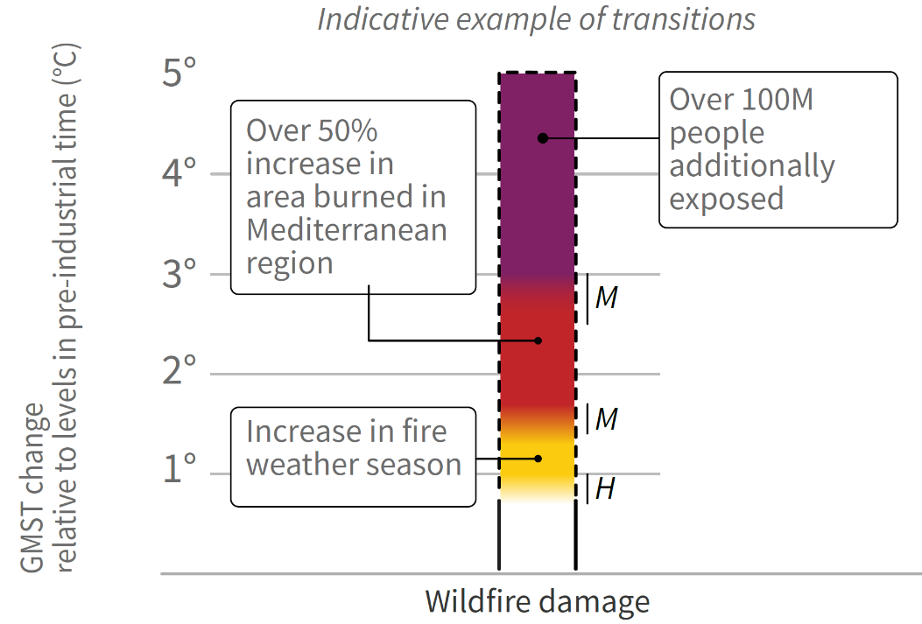
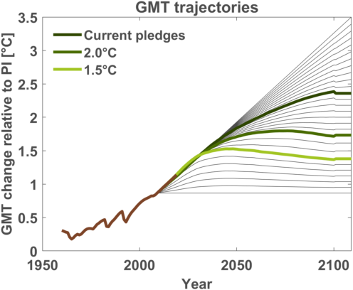
Towards a burning ember plot for the kids
(IPCC, 2019;
Zommers et al., 2020 Nat. Rev. Earth Env.)
Notes:
So far, the results were only for three scenarios: 1.5°C, 2°C and current pledges, the latter implying a GMT increase by about 2.6°C by 2100.
Next question: can we develop a burning ember figure based on this analysis that maps these multiplication factors under a continuous scale?
What are burning embers: Colour bars denoting the relationship between increasing global mean temperature and risks to humans or ecosystems as identified through expert judgement. They are an effective tool for communicating risks related to anthropogenic climate change in a way that can support both public discussions and policy decisions,
I was fortunate to be part of the team developing the Burning embers in the IPCC Special report on climate change and land.
In this process we introduced expert elicitation methodologies from medical sciences as a steps towards standardized, transparent process of expert elicitation in the production of burning embers diagrams to enhance their quality, comparability, and credibility. last year we published a review paper on this iconic IPCC figure in Nature Reviews Earth and Environment.
To develop our burning embers, we first constructed several stylised pathways: interpolation between 5 scenarios: constant present-day temperature, 1.5, 2.0, NDC and linear increase to 3.5°C by 2100.
Once I have these pathways, I can repeat my analysis for each of these scenarios, for any region and any impact category.
(note that this is the 50% or 66% percent probability, so lower than the current pledges you find in e.g. the climate action tracker).
(Note that 1.5°C is actually below 1.5, as it is scenario with 50% chance of staying below 1.5°C. idem for 2°C and NDCs (2.6°C))

Slide 24
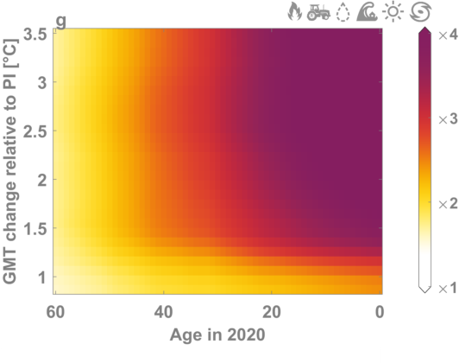
The youth will face strong increases, older generations won’t
under 10: x4 under 1.5°C warming
under 8 : x5 under 3°C
Notes:
Geometric mean of EMF across all the events. Why? 5% change in every category has the same weight.
These results allow us to compare the exposure across the 6 categories: exposure to ‘extreme events’
people younger than 10 in 2020 will experience about a fourfold increase in extreme events under 1.5°C of global warming, an increase that older cohorts will never experience, even if a scenario towards 3.5°C warming is followed
exposure multiplication factors scale robustly with the warming pathway and cohort across a range of aggregation methods, despite some variation in the factor values

Slide 25
local value of global mitigation
Notes:
Coming to the last part of my analysis: Go into even more detail: to the country scale:
We now compare country-scale two different scenarios: in this case NDCs against 1.5
The smaller the country, the more uncertain the results. Hence we should perhaps not zoom into individual country, but look at the overall pattern: in nearly any case, there is an increase in exposure multiplication factor going from 1.5°C to the current pledges scenario, meaning that younger generations are generally worse off under the higher warming scenario.
Our results overall highlight the strong benefit of aligning policies with the Paris Agreement for safeguarding the future of current young generations.

Slide 26
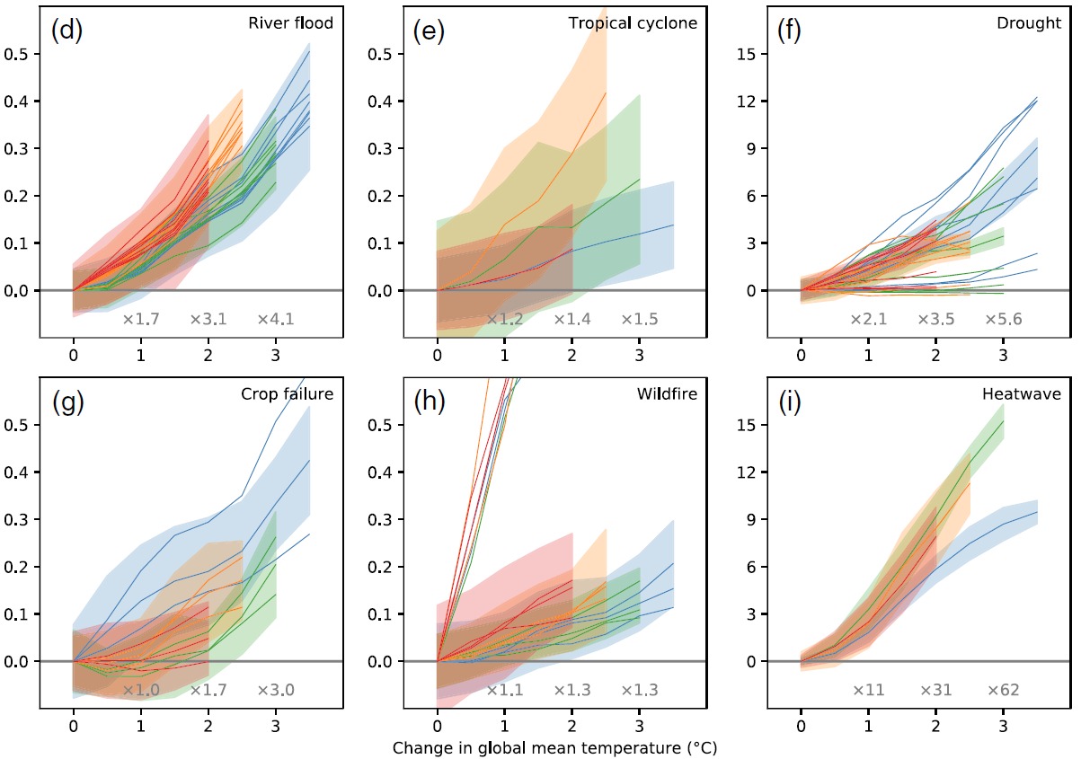
Most (all?) climate impact studies are Eulerian
(Lange et al., 2020 EF)
Notes:
Meteorological extremes, hazards, or climate change impacts are thus mostly studied as they evolve over time under varying emission scenarios and socio-economic pathways
Recent studies extended this approach by studying aspects of climate change as a function of global mean temperature (GMT) anomalies, highlighting the scenario-independence of several extreme event indicators but remaining, in essence, a comparison of two time windows.
This is usually how we do our research: we scale extremes/hazards/impacts with time or, more recently, with GMT.
But all these studies are eulerian, i.e. they compare two time windows at a given location.

Slide 27
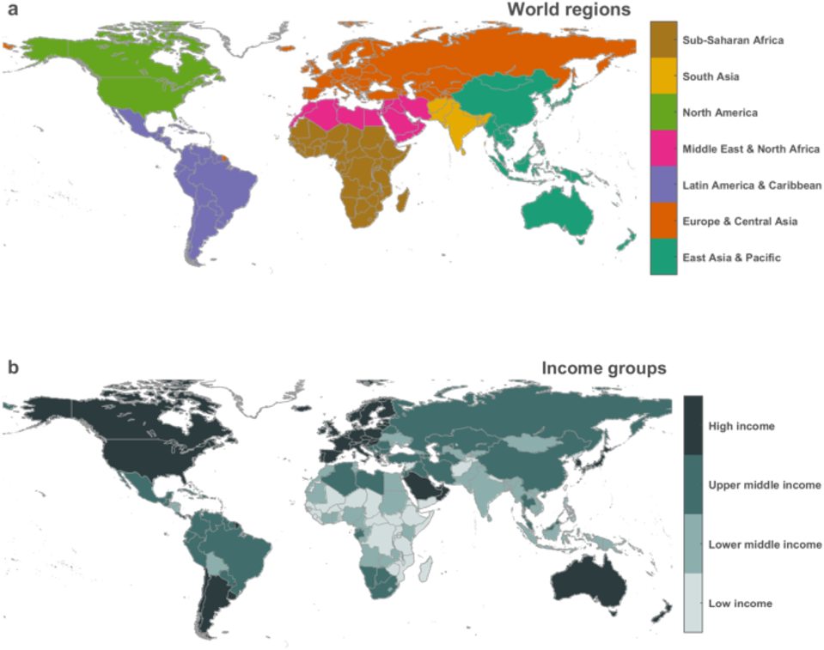

Slide 28
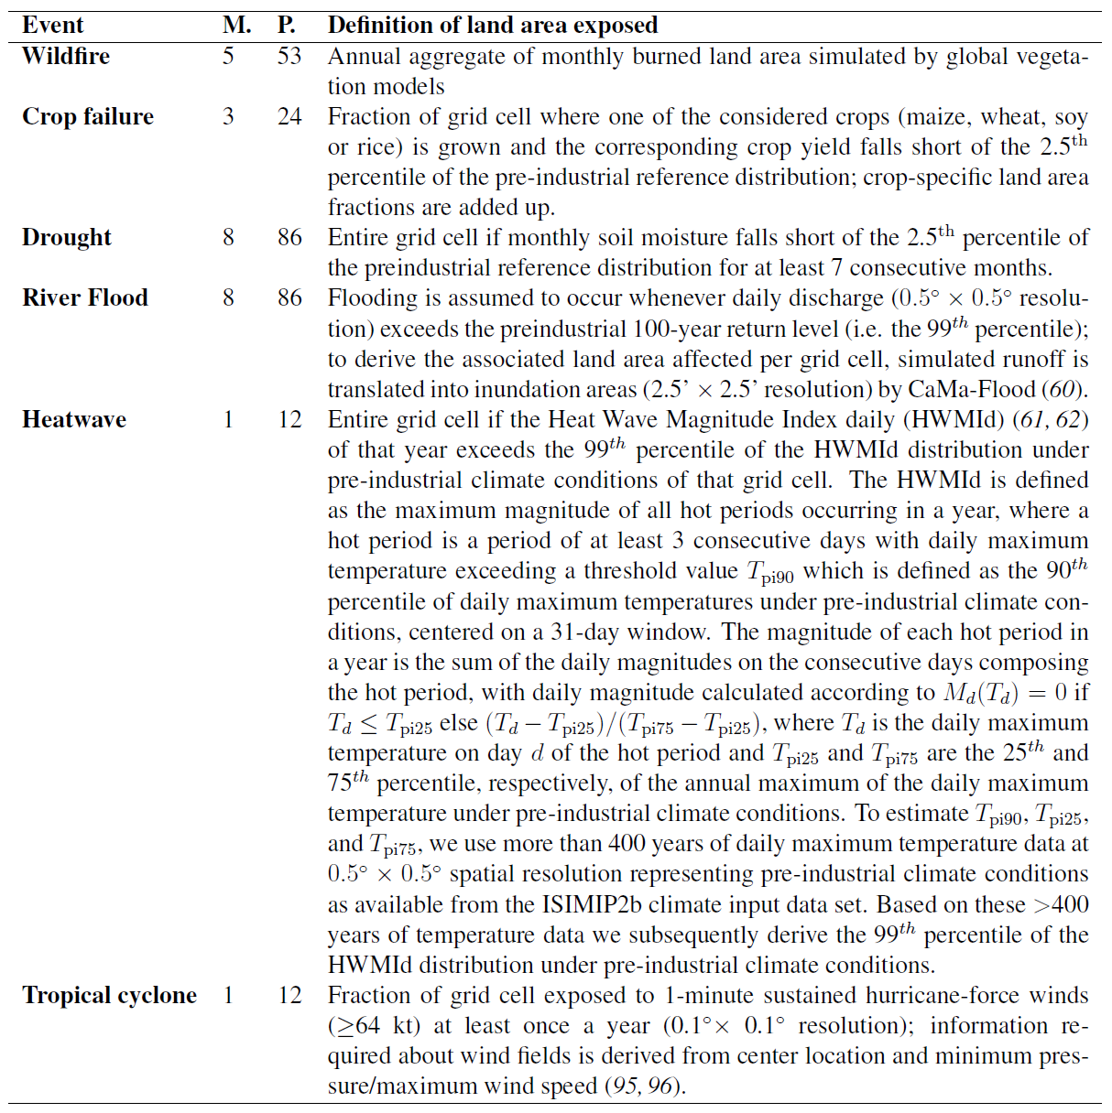

Slide 29
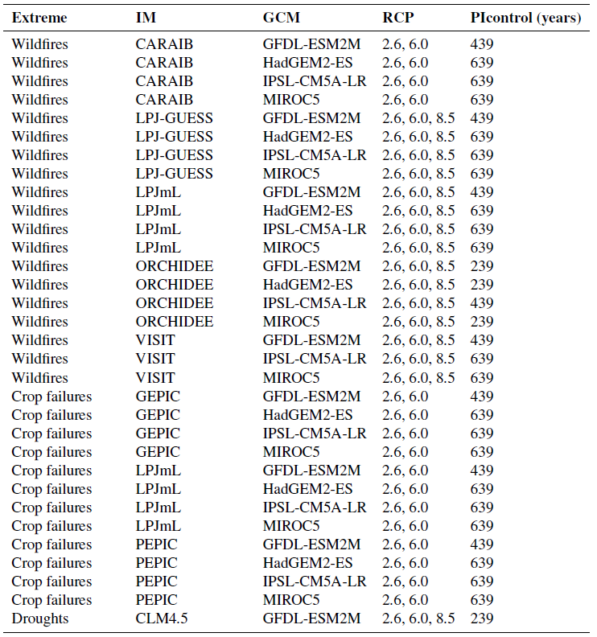
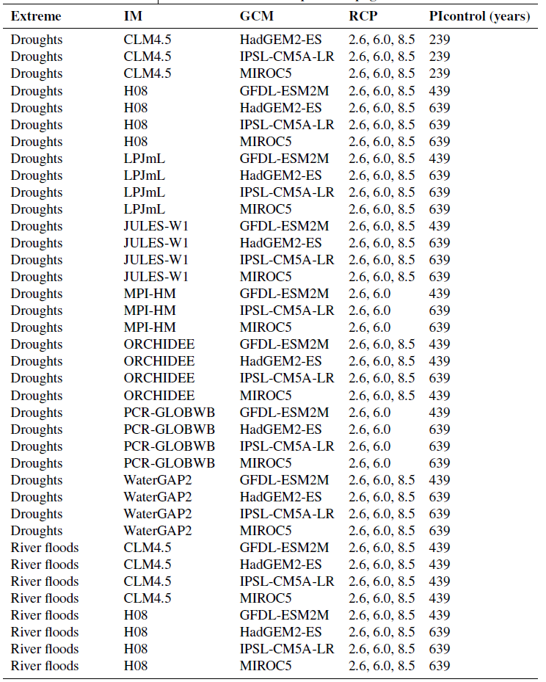
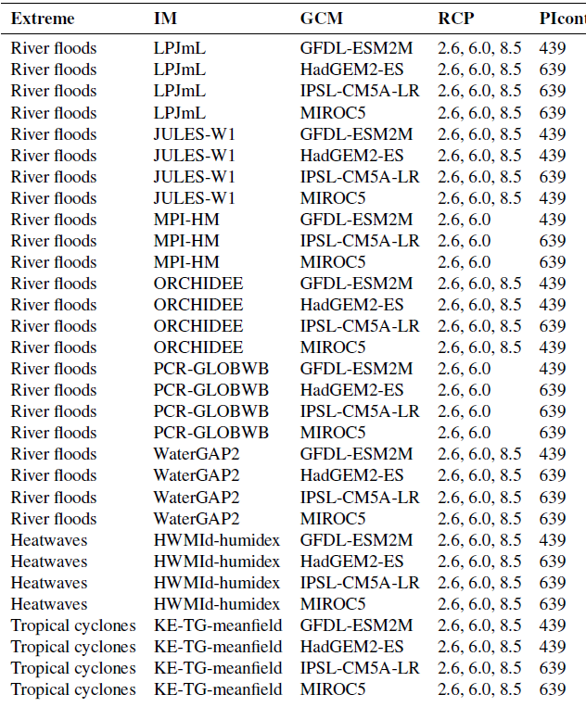

Slide 30
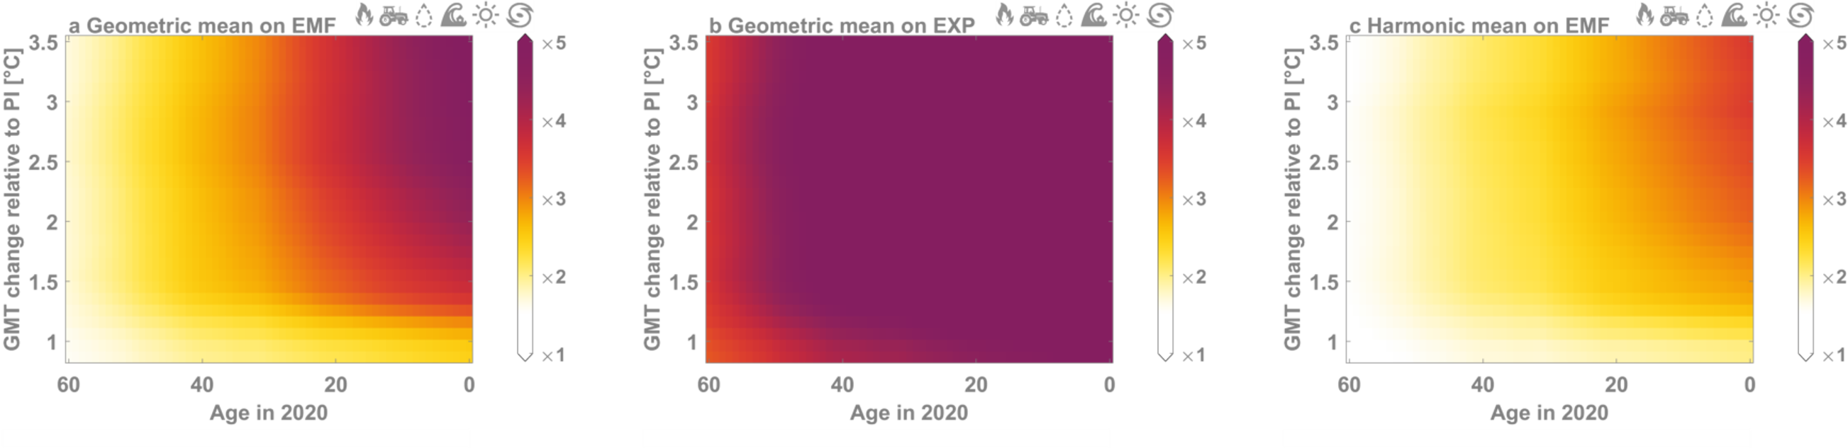
Sensitivity to aggregation method

Slide 31
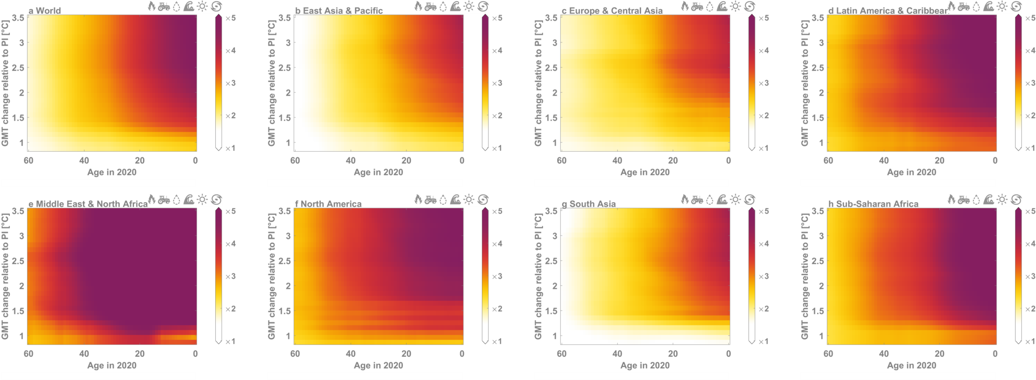

Slide 32
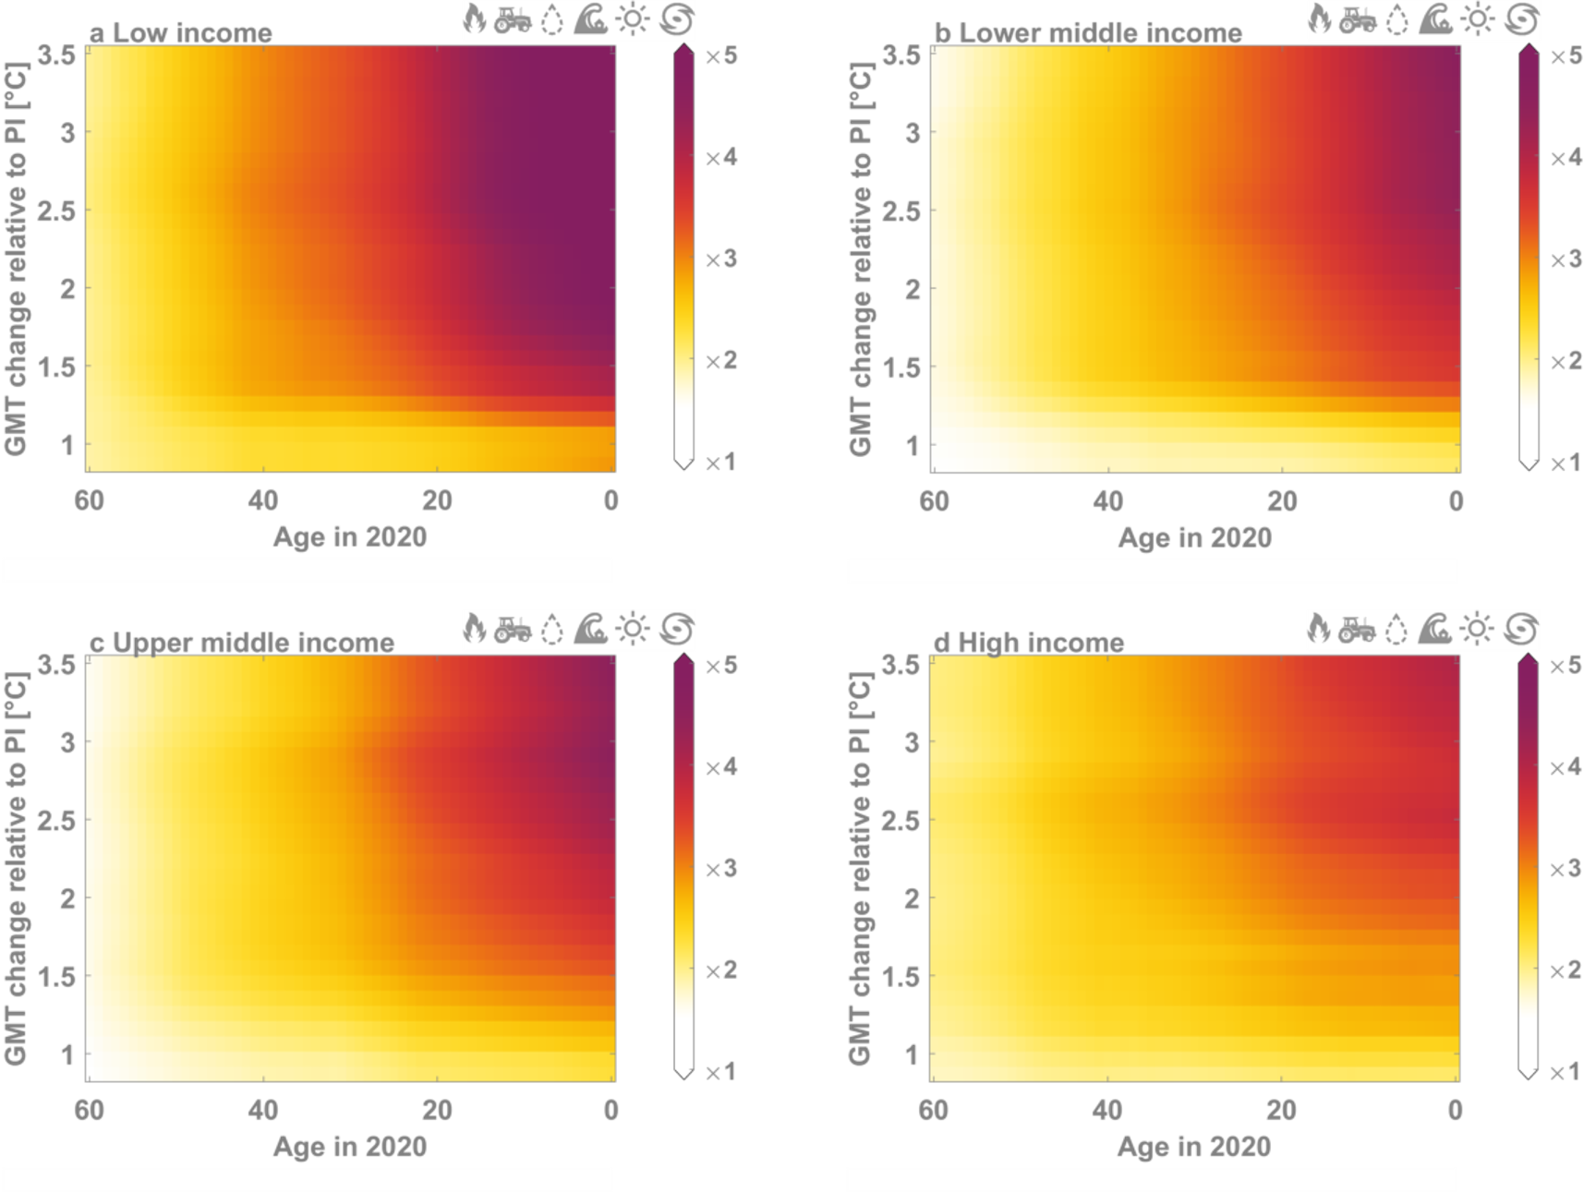

Slide 33
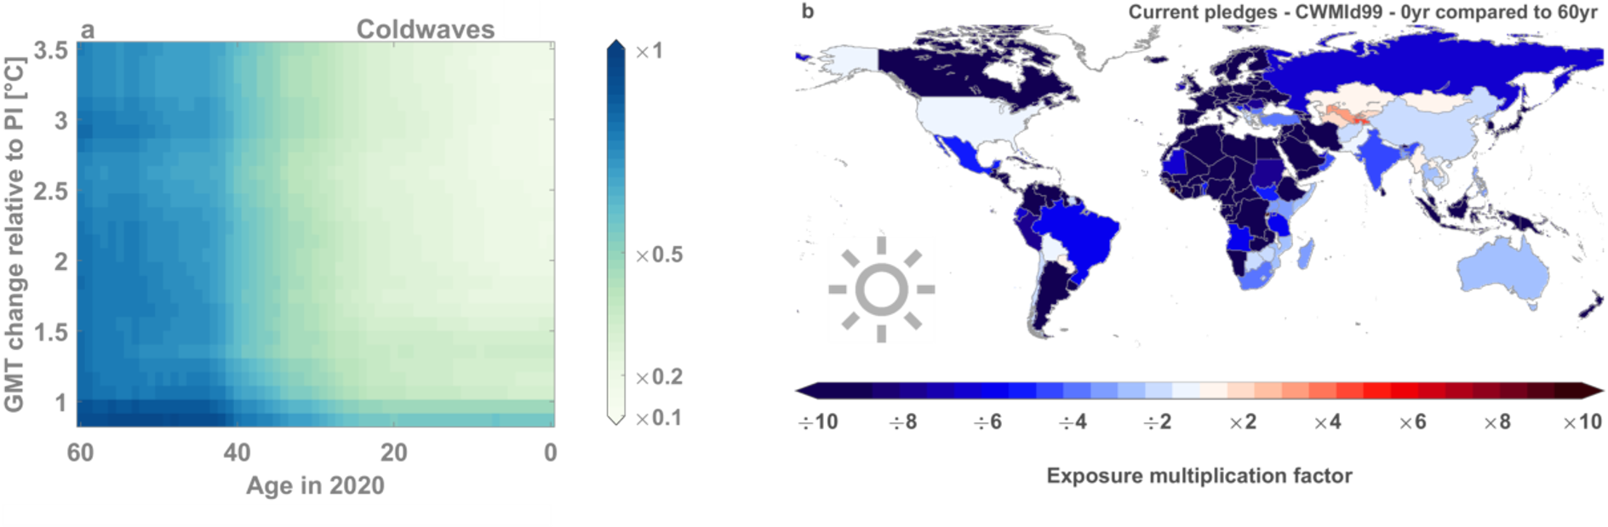
Cold spell exposure change

Slide 34
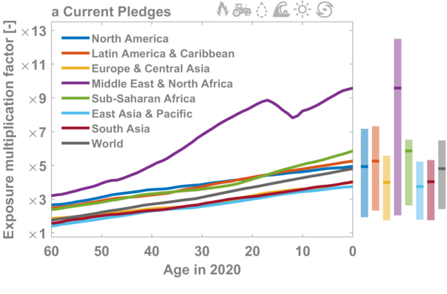
Current pledges – world regions
Notes:
So far the analysis was global, taking a cohort size-weighted global average of the ISIMIP impact data and assuming one global life expectancy time series.
From now on, go into more spatial detail. Here we are showing the exposure multiplication factors for different geographic regions. We can do this because the World Bank also provides life expectancy data for each of these regions.
The results show marked differences between regions, with the strongest increase in life-accumulated extreme event exposure over the Middle East and North Africa: at least 7 times higher exposure for all cohorts younger than 25 years in 2020 under current pledges

Slide 35
Current pledges – income categories
Notes:
It gets even more interesting when we group the countries according to their income.
In this case we see that there’s a substantial increase in life-accumulated exposure for low income countries.
Importantly, this analysis is just looking at ‘one average person’, i.e. one average member of that cohort in that particular region

Slide 36
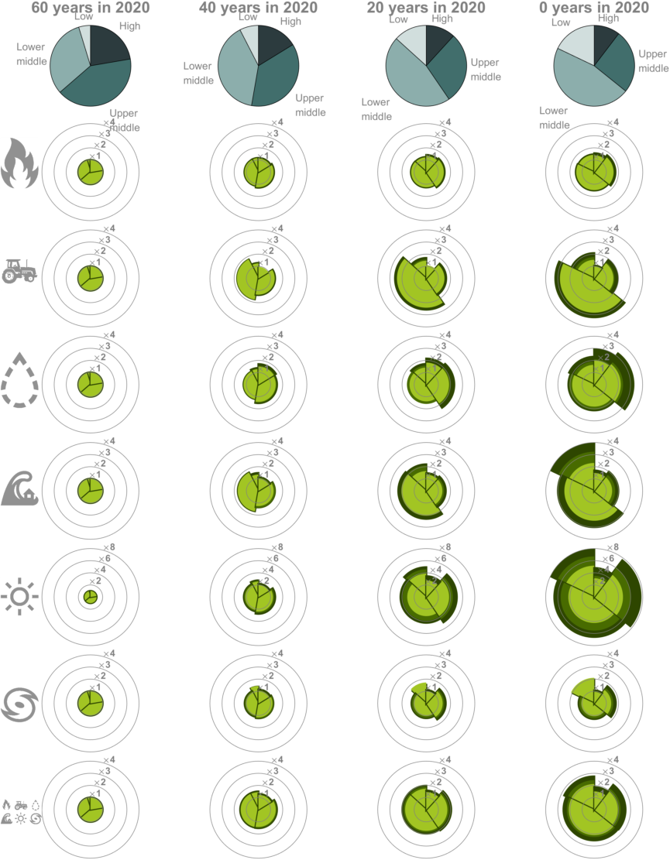
Many young people live in hard-hit regions
Notes:
Differences are even more striking if you account for differences in income categories
60-year old people in high-income countries represent 22% of their cohort globally, this fraction has reduced to 10% for newborns
Low and lower-middle income countries: two third of

Slide 37
Many young people live in hard-hit regions

Slide 38
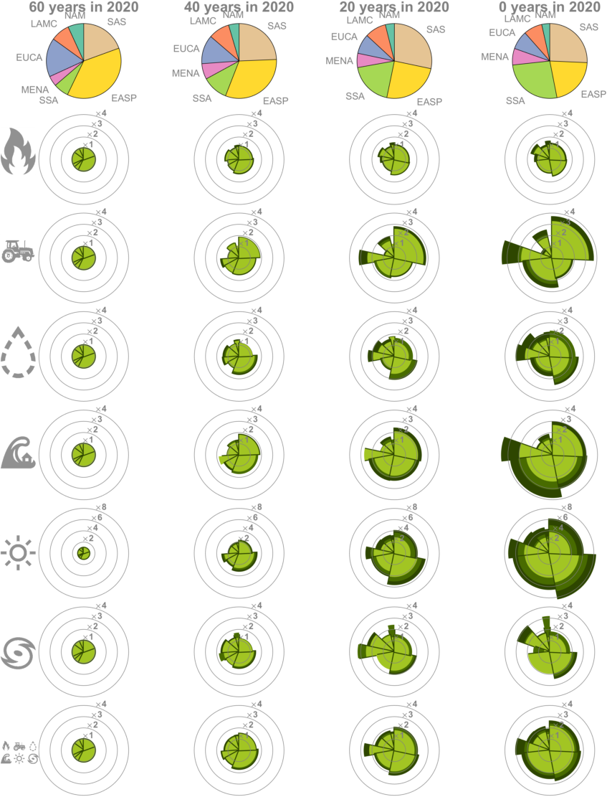
Many young people live in hard-hit regions
Notes:
Differences are even more striking if you account for differences in income categories

Slide 39
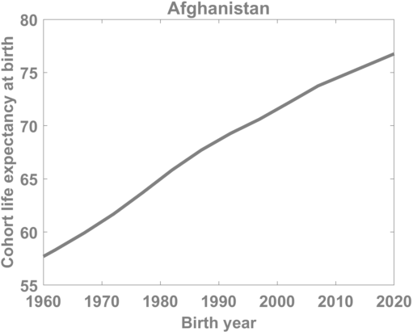
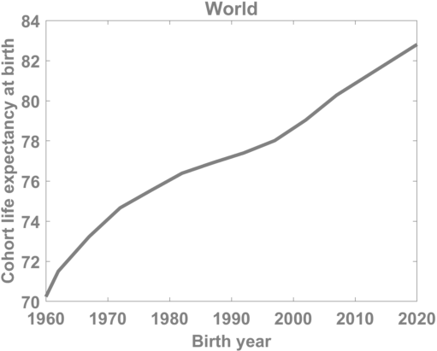
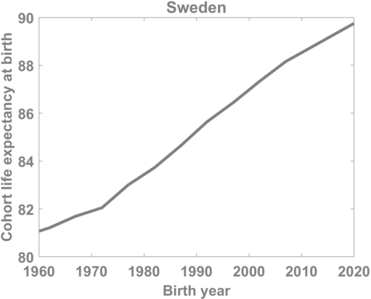
Life expectancy change
(source: World Bank)
Notes:
One can now ask: how much of this increase is due to climate change, and how much due to an increase in life expectancy?
This is a relevant question, because, the world's population has seen an average increase in life expectancy from 70 year in 1960 to 83 years in 2017.
This global average masks important spatial variations.
For instance, in Afghanistan, life expectancy strongly increases from 58 years to 77 years,
whereas in Sweden, it increased by only nine years from 81 to 90 over this period.
So is the increased extreme event exposure we find across different regions caused by climate change or simply an increased life expectancy?
(https://data.worldbank.org/indicator/SP.DYN.LE00.IN)

Slide 40
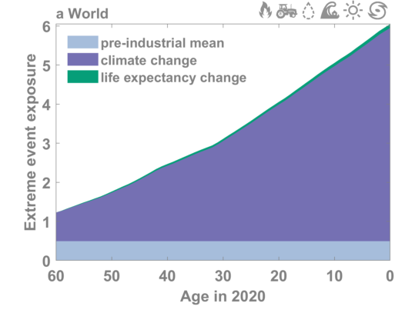
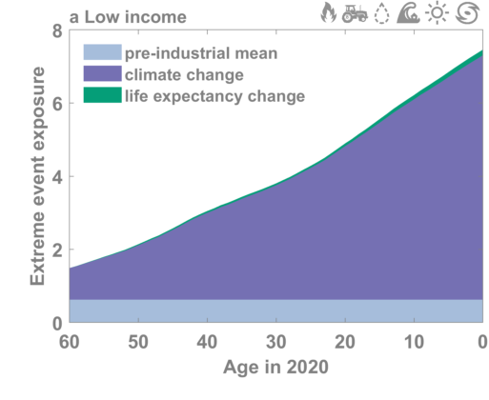
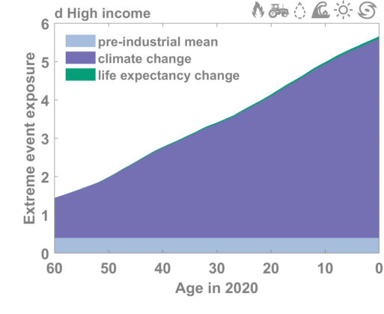
Contribution of climate vs. life expectancy chance
Notes:
To answer this question, we quantify the exposure of all age cohorts in the pre-industrial control simulations, thereby effectively isolating the pure life expectancy change effect in absence of climate change from the total exposure signal.
Light blue: extreme event exposure in a world without climate change.
Purple: increased exposure due to climate change.
Green: increased exposure due to life expectancy change.
Now looking at the absolute extreme event exposure instead of the relative change
Take home message: it’s nearly all climate change
globally, climate change explains 98\% of a newborn's exposure change under the current pledges scenario
In high-income countries, the enhanced exposure of a newborn is almost entirely attributable to climate change (99%).
In low, lower-middle and upper-middle income countries, climate change contributes 98% of the total exposure change.

Slide 41
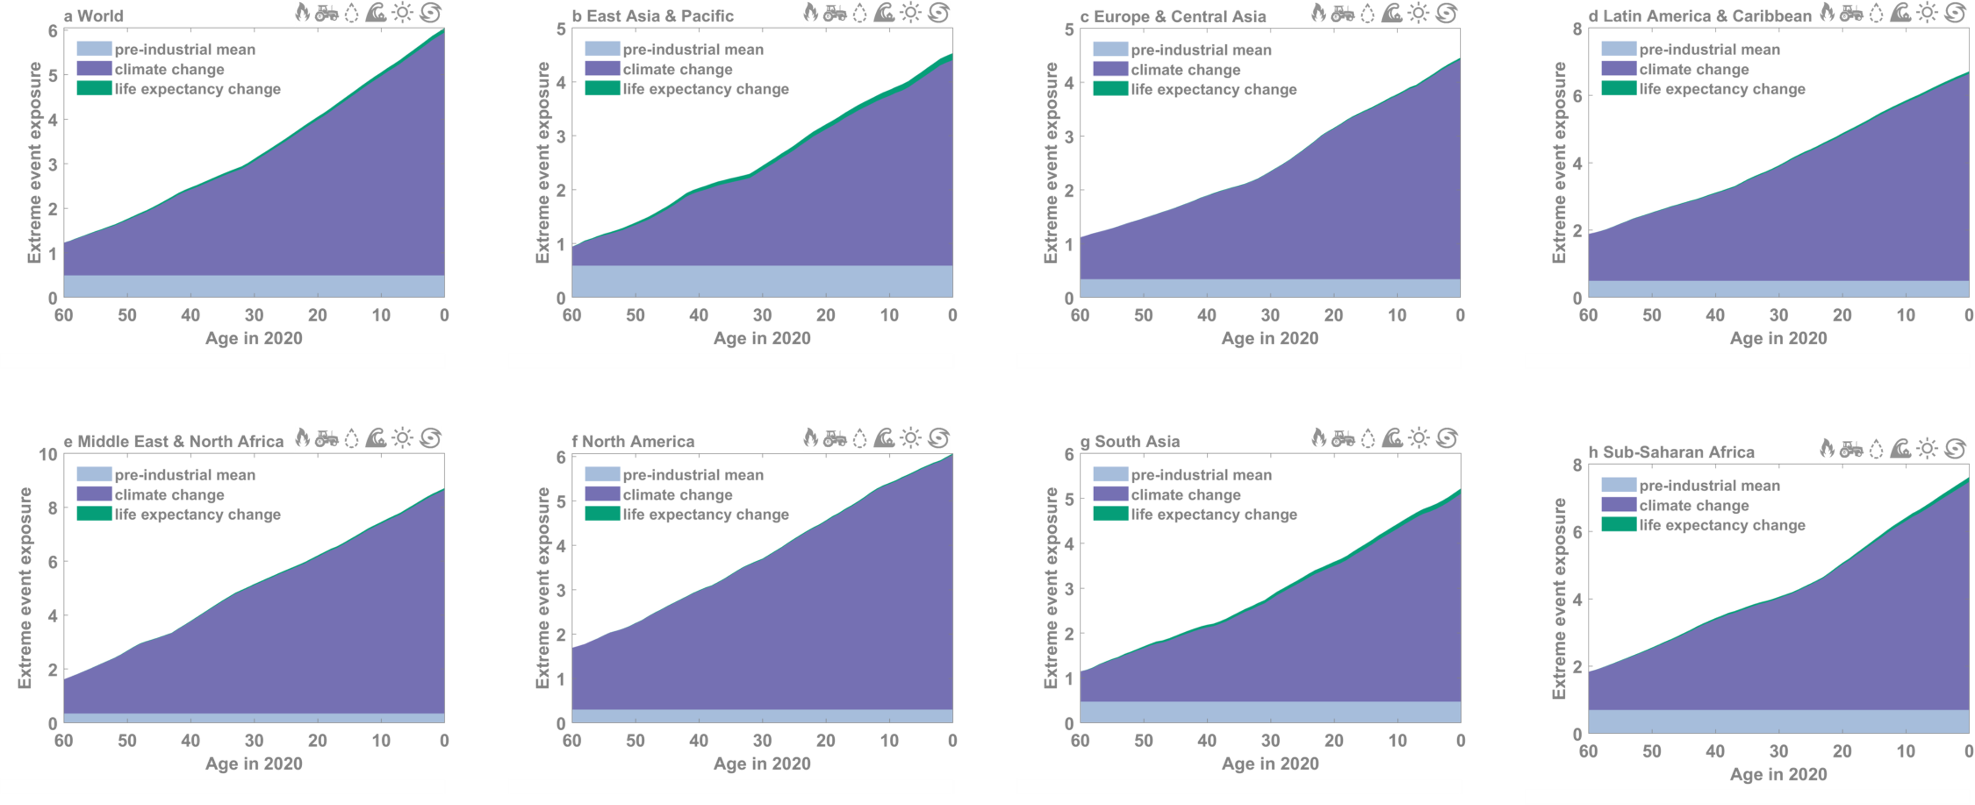

Slide 42
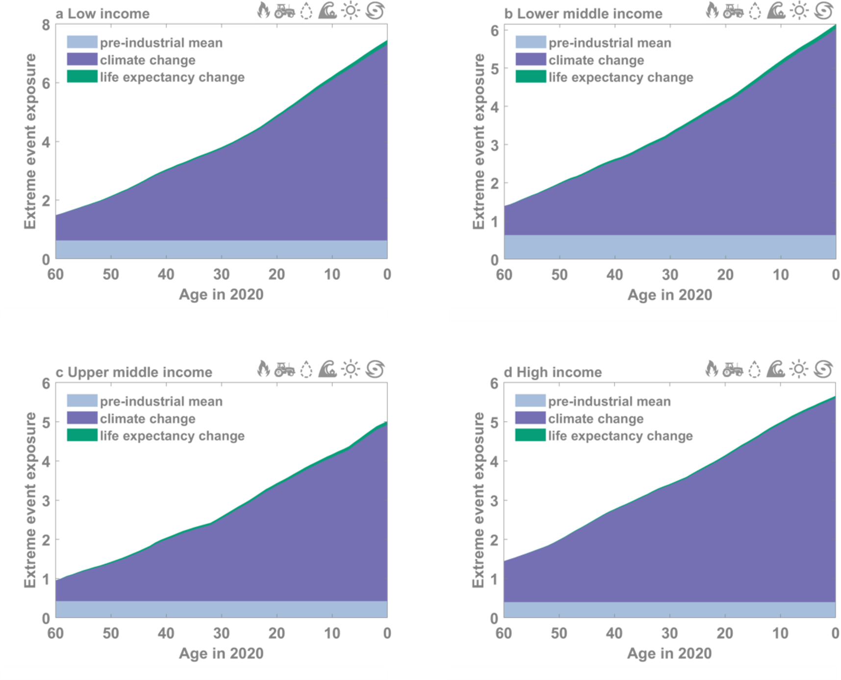

Slide 43
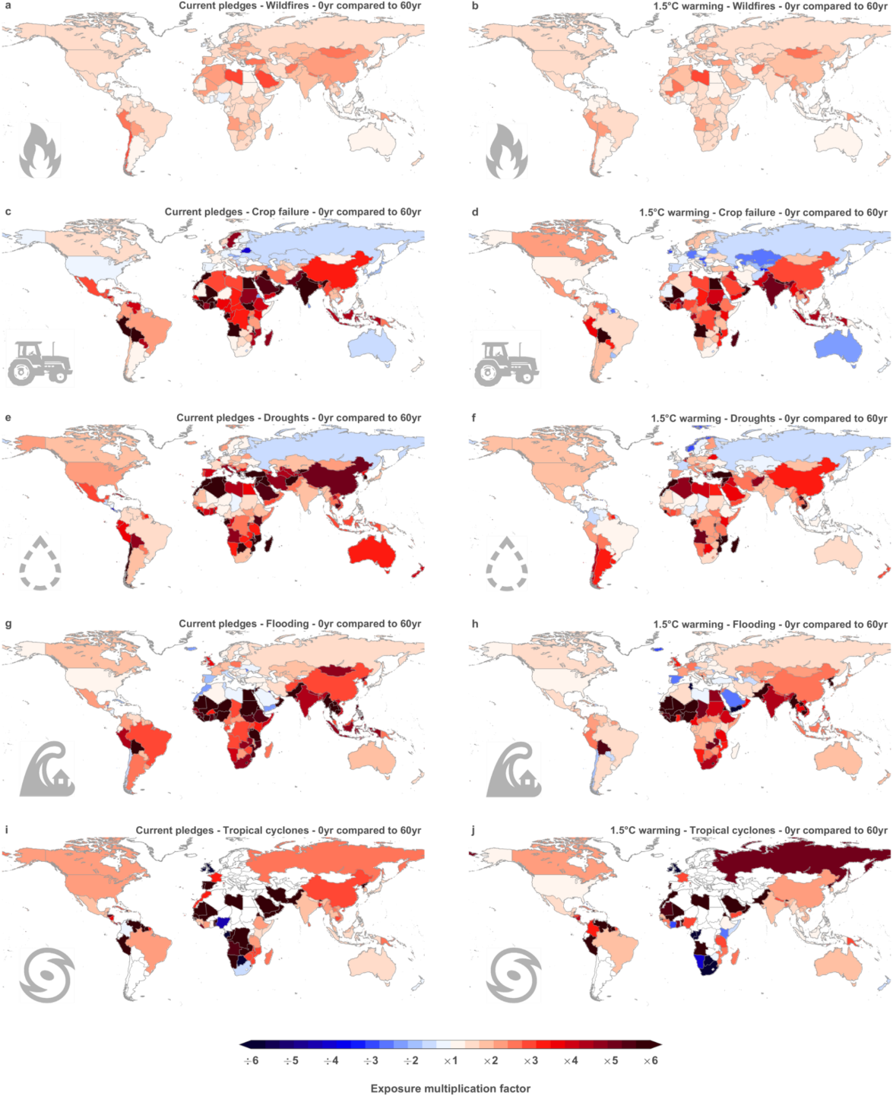
Notes:
Now the metric I’m showing here is exposure multiplication factor, which follows a similar to the PR metric used earlier, but with the difference that the exposure is not a probability but the number of extreme events that a person is facing across his/her lifetime (and can thus be larger than one).
Looking at the map of wildfire risk, we see a mixed image, with increased exposure in some countries and reduceed exposure in other regions.
Burned area is notoriously difficult to model, so lets look at the other extreme impacts. It is clear that in this case the increased exposure is more pronounced spatially.
Very strong increase in heatwaves, which dominates the picture here.
Relative increase, not absolute increase. E.g. from no TC to one is increase by factor infinite, but from 5 to 10 heatwaves only by factor 2/

Slide 44
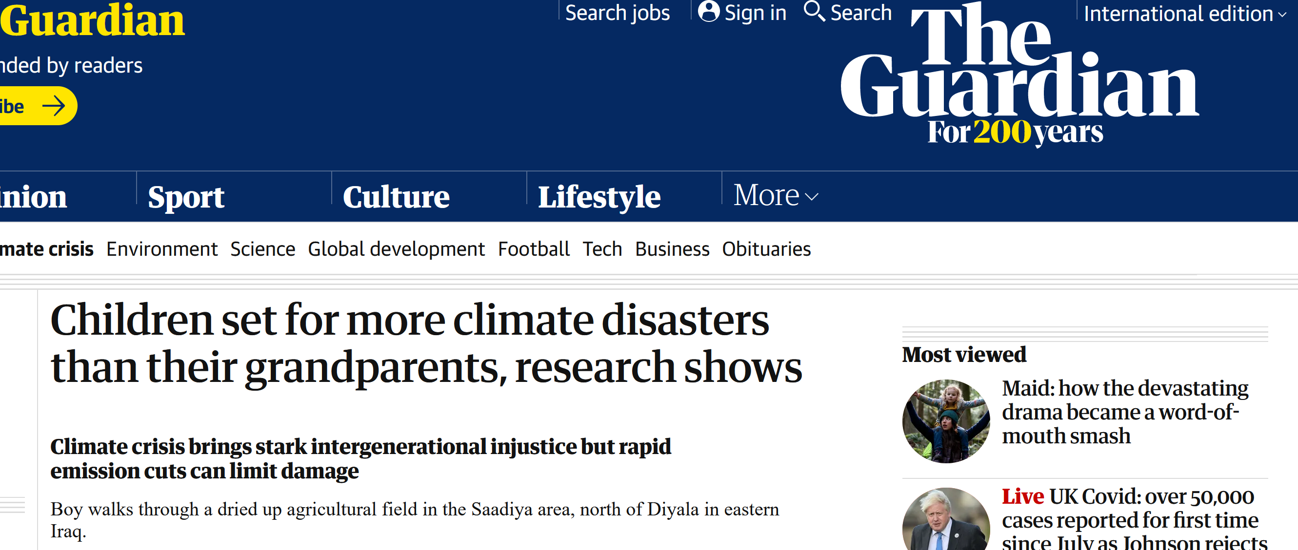




Media attention
Notes:
Carbon brief: nr 13

