Slide 1





Nine years of warming and N addition promote SOC loss in the Tibetan grassland but did not alter SOC chemical structure
Fudan
University
Huimin Sun^{1, 2}, Michael W.I. Schmidt², Ming Nie¹
1. School of Life Sciences, Fudan University, Shanghai, China.
2. Department of Geography, University of Zurich, Zurich, Switzerland
huimin.sun@uzh.ch
Notes:
Hi everyone. Today I am going to introduce part of my research about effects of nitrogen enrichment and warming on soil carbon pool and carbon stabilization in a grassland in Tibetan plateau

Slide 2
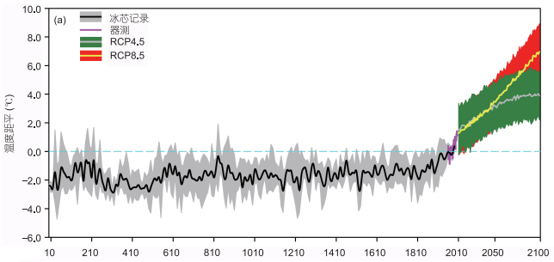
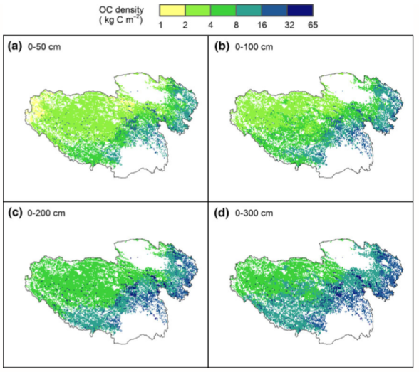

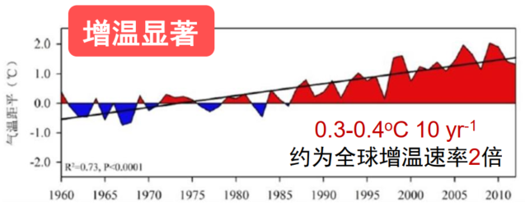

Tibetan plateau: an ideal district to study SOM decomposition
Getting warmer
Large C pool
Temperature departure (°C)
Chen et al. 2015
About twice the global warming rate
Temperature departure (°C)
A large C pool with 15.31 Pg C (Ding et al. GCB, 2016a)
Yao et al. 2015
Notes:
Our study site is located in the Gansu province on the Tibetan plateau, which is a special region with high carbon storage and is experiencing nitrogen deposition, which is also highly sensitive to temperature changes. The unique climate and vegetation types make the plateau an ideal region for investigating effects of environmental controls on soil carbon pool in high-altitude ecosystems.

Slide 3
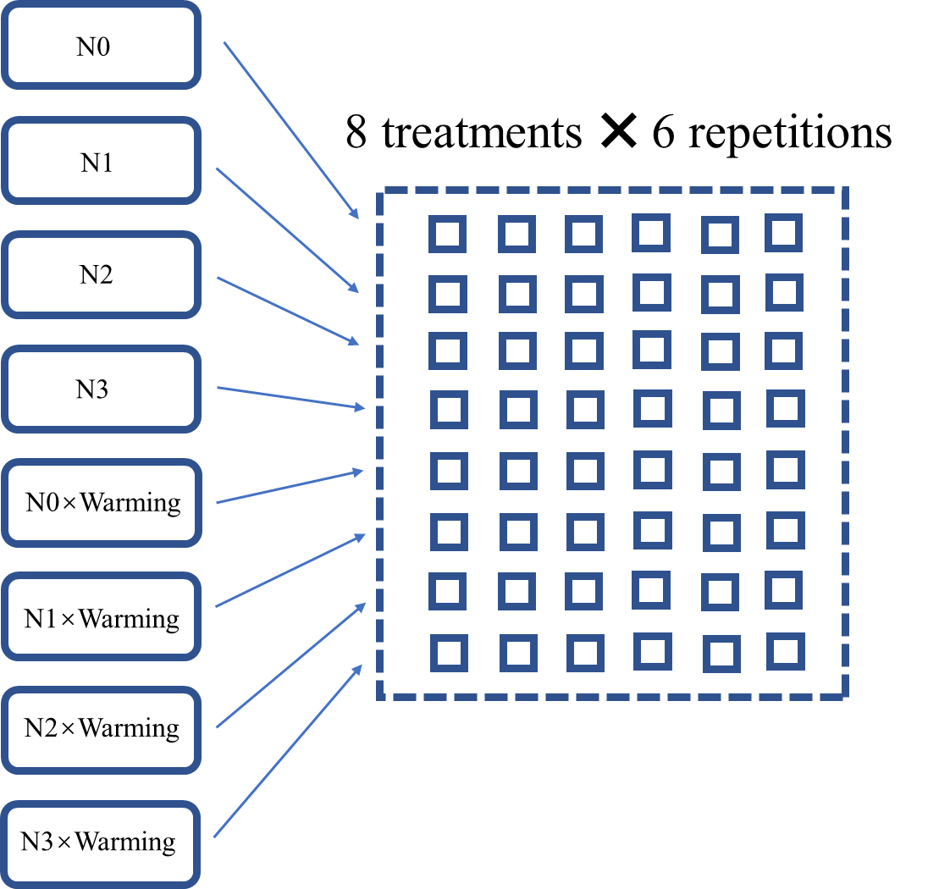
Site description
Site
Tibetan plateau, Gansu, China (101°53′ E, 35°58′ N);
MAT: 1.2 ℃ (-10.7~11.7 ℃ ); MAP: 620 mm;
48 plots, 0-10 cm topsoil
Warming
Open top chamber (2011-2019);
+0.77°C (2013), +1.03 °C (2019)
Simulated chronic N deposition
NH₄NO₃ form;
0, 5, 10, 15 g/m²
Notes:
Our study site is located in the Gansu province on the Tibetan plateau, which is a special region with high carbon storage and is experiencing nitrogen deposition, which is also highly sensitive to temperature changes. The unique climate and vegetation types make the plateau an ideal region for investigating effects of environmental controls on soil carbon pool in high-altitude ecosystems.
The field manipulation experiment was established in June 2011 in a southeast-facing meadow. 48 Plots were randomly assigned to the control or warming treatment and one of four N enrichment concentrations.

Slide 4
SOC content and stock decreased up to 25% after 9-year warming
N effect: P = 0.000
W effect: P = 0.000
N enrichment × Warming: P = 0.000
N effect: P = 0.000
W effect: P = 0.000
N enrichment × Warming: P = 0.000

Slide 5
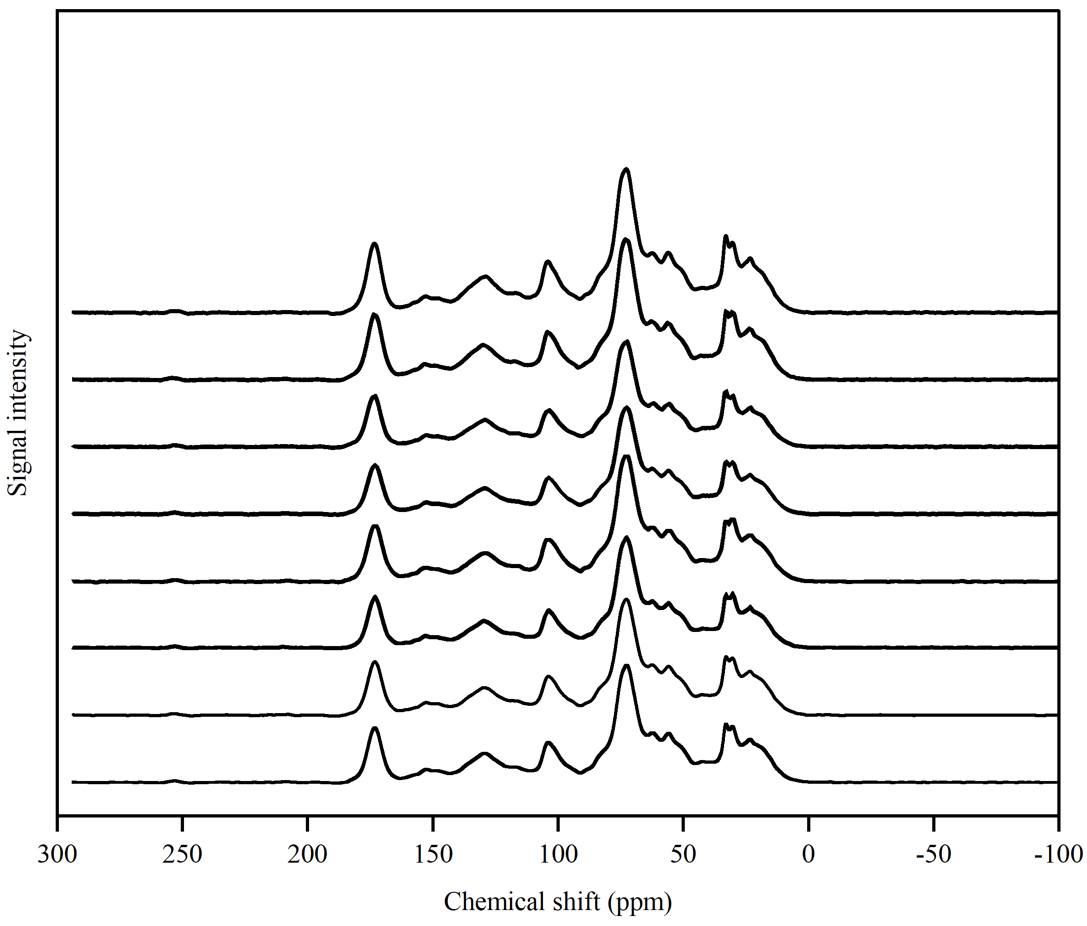
SOC species (¹³C NMR) does not change with warming or N addition
Solid-state ¹³C NMR spectra
O-alkyl C
4 ratios did not change significantly
A/O-A(C₀₋₄₅/C₆₀₋₉₀): decomposition level;
aromaticity (C₁₁₀₋₁₆₅/C₀₋₁₆₅): complexity of molecular structure;
aliphatic/aromatic C (C₀₋₁₁₀/C₁₁₀₋₁₆₅): molecular structure of soil C;
hydrophobic/hydrophilic C (C_{0–45} + C_{110–165})/ (C_{45–110} + C_{165–210}): stability of soil aggregation
Carbonyl C
di-O-alkyl C
N-alkyl C
Aromatic C
Alkyl C
Phenolic C
WN3
WN2
WN1
WN0
N3
N2
N1
N0

Slide 6
SOC bulk chemical structure (IR spectra) does not change with warming or N addition
1
2
3
4
5
6
7
8
9
1: 3000–2800 cm⁻¹ aliphatic C–H, 2: 1735–1720 cm⁻¹ aromatic esters, carbonyl/carboxyl C=O, 3: 1660–1600 cm⁻¹ aromatic C=C, 4: 1515–1500 cm⁻¹ lignin like residues, 5: 1430–1380 cm⁻¹ aromatic C=C, 6: 1260–1210 cm⁻¹ phenolic/cellulose, 7: 1170–1148 cm⁻¹, C–O bonds of poly-alcoholic and ether groups, 8:1060–1020 cm⁻¹ aliphatic C–O – and alcohol C–O, 9: 880, 805, 745 cm⁻¹ C–H aromatic.
Notes:
The same result was also found in the DRIFT experiment. Based on these results, we can come out a conclusion that labile C and less labile C may lose simultaneously under long-term warming and nitrogen enrichment from C molecular structure level.

Slide 7
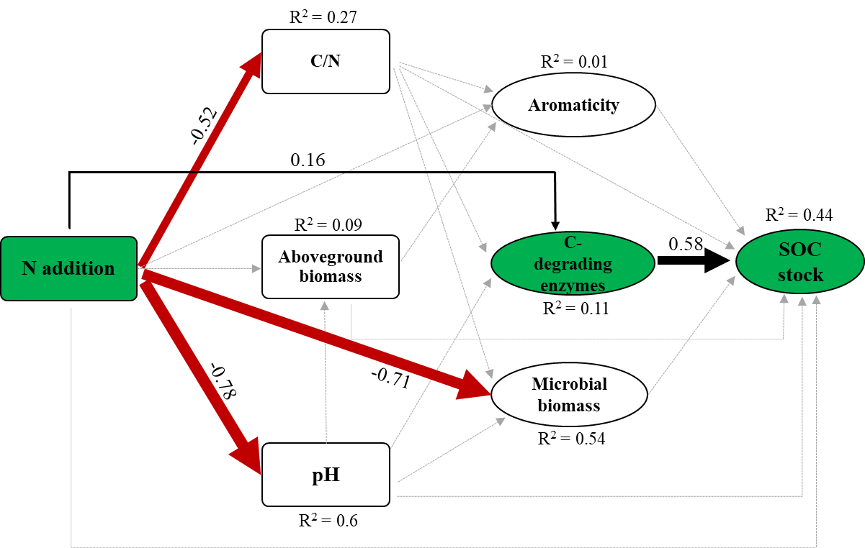
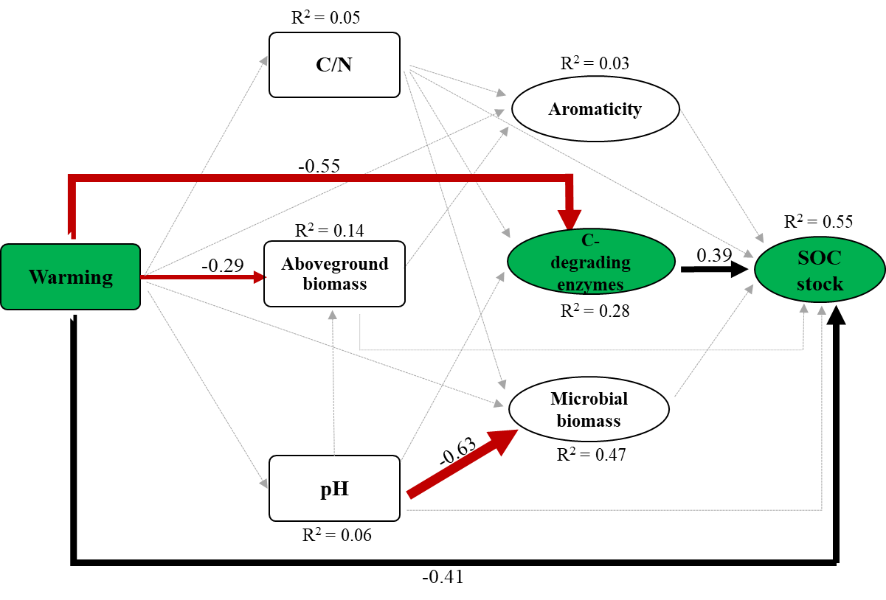
Structural equation model:
Enzymes are most important (in)direct factors regulating SOC stock
Notes:
Then we conducted a structural equation model to see the regulating factors of soil carbon pool. We found that the carbon degrading enzymes may play a very important role in regulating the SOC no matter in an indirect way or in a direct way. We must not neglect the role of enzymes in the future exploration of carbon climate feedback.

Slide 8
Take-home messages
SOC content & SOC stock decreased 25% with warming;
SOC chemical structure did not change after 9-year warming and N addition;
C-degrading enzymes play a key important role in regulating SOC stock.

Slide 9


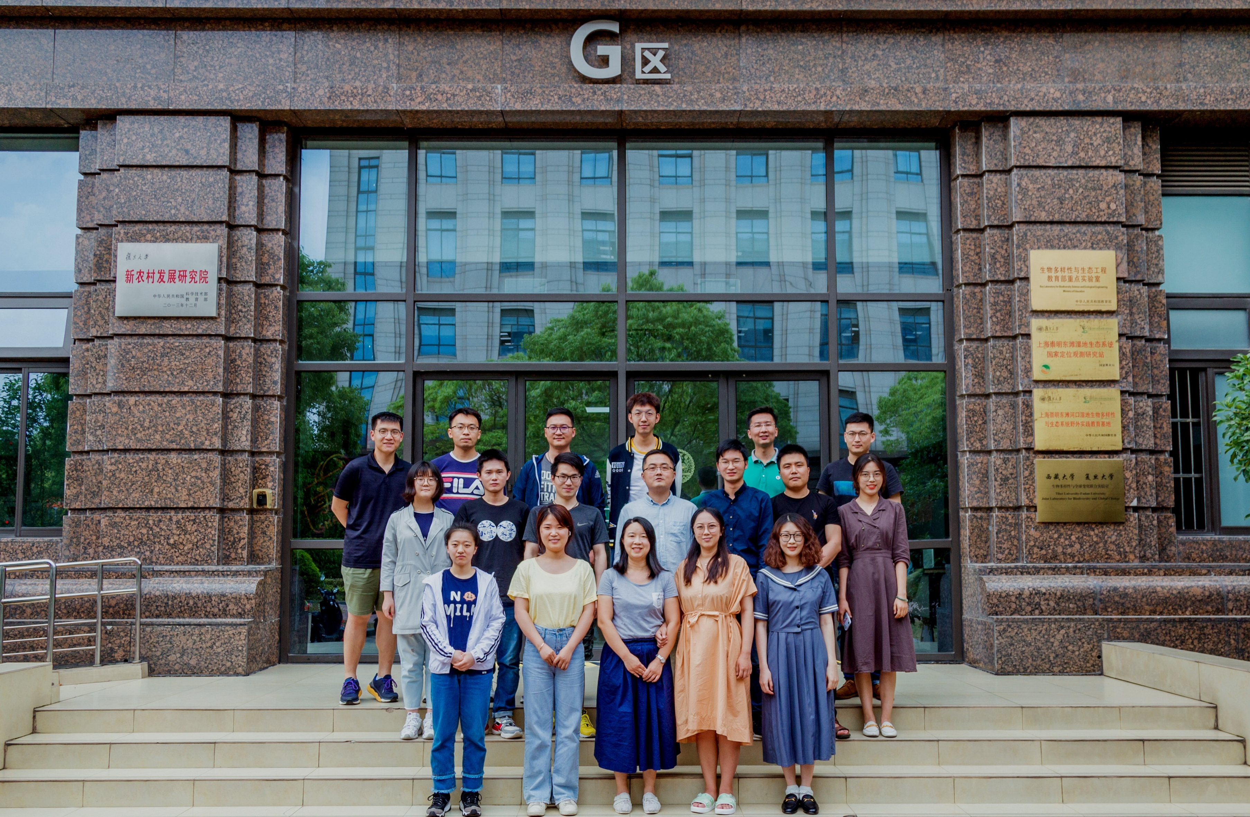

Thanks for FDU GCE & UZH 2B groups and great Tibetan!!
Notes:
Thanks for all my collogues and the great beautiful Tibetan!

