Slide 1
Geochemistry of emerald from the Colombian Emerald belts: Genetical implications
Valeria Ramirez Juya¹, Camilo Andres Betancur¹, Javier Garcia Toloza^{1,2}, and Luis Angarita¹
¹Technological development Centre for the Colombian Emeralds, Bogota, Colombia (valeriajuya@gmail.com)
²National University of Colombia
geologist@gemlabcdtec.com

Slide 2
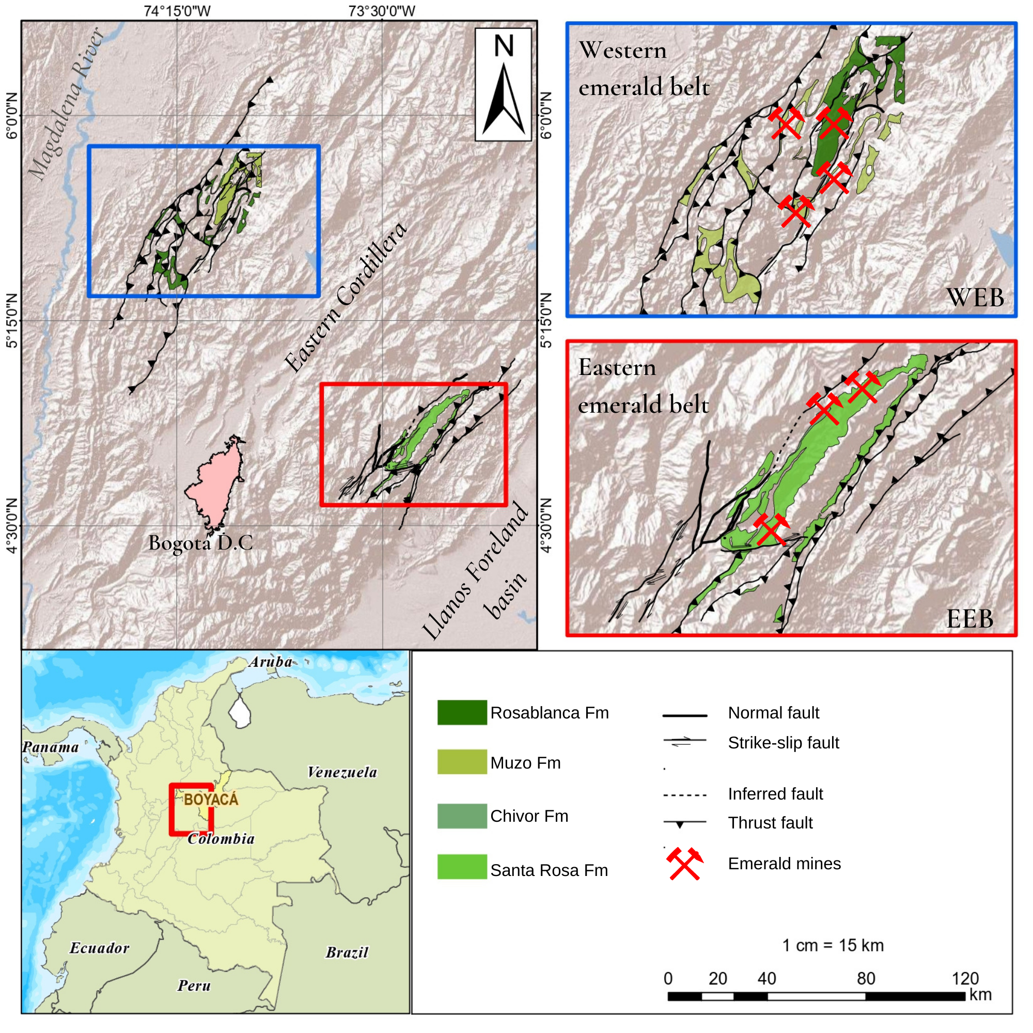
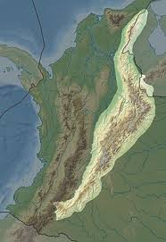
Introduction
geologist@gemlabcdtec.com

Slide 3
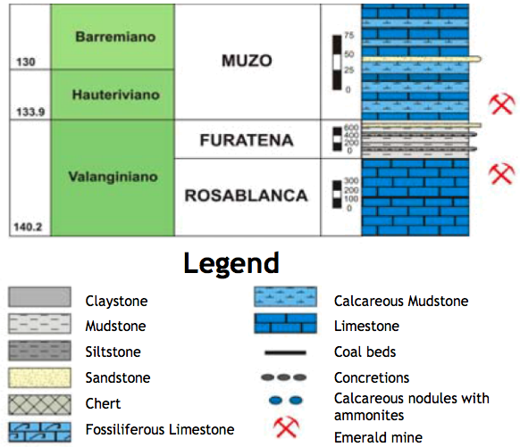
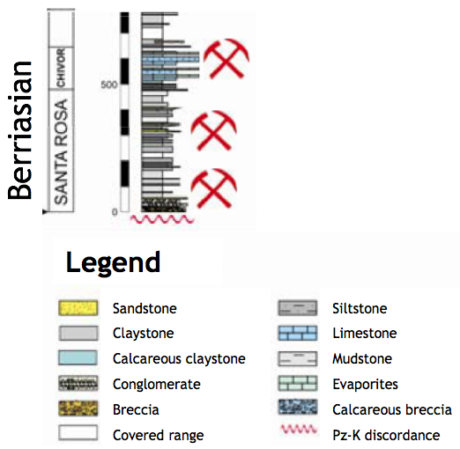
Modified from (Colombian Geological Survey, 2011)
Modified from (Terraza et al., 2008)
geologist@gemlabcdtec.com

Slide 4
Structural style
Extensive CEOR
Compressive CEOC
Mineralogical
Radiometric Ages
CEOR= Paleocene(65+/-3)
CEOC= Eocene (38-23 Ma) (Cheilletz et al., 1994)
12 Ma (Mantilla et al., 2007)
67 Ma (Romero et al., 2000)
Trapiche emerald
Evaporites+
Shale ratio
(Cheilletz et al., 1994).
Structural trapping.
(Branquet et al., 1995).
Sedimentary sequence (carbonaceous to calcareous shales).
COMMON FEATURES
DIFFERENCES
geologist@gemlabcdtec.com

Slide 5
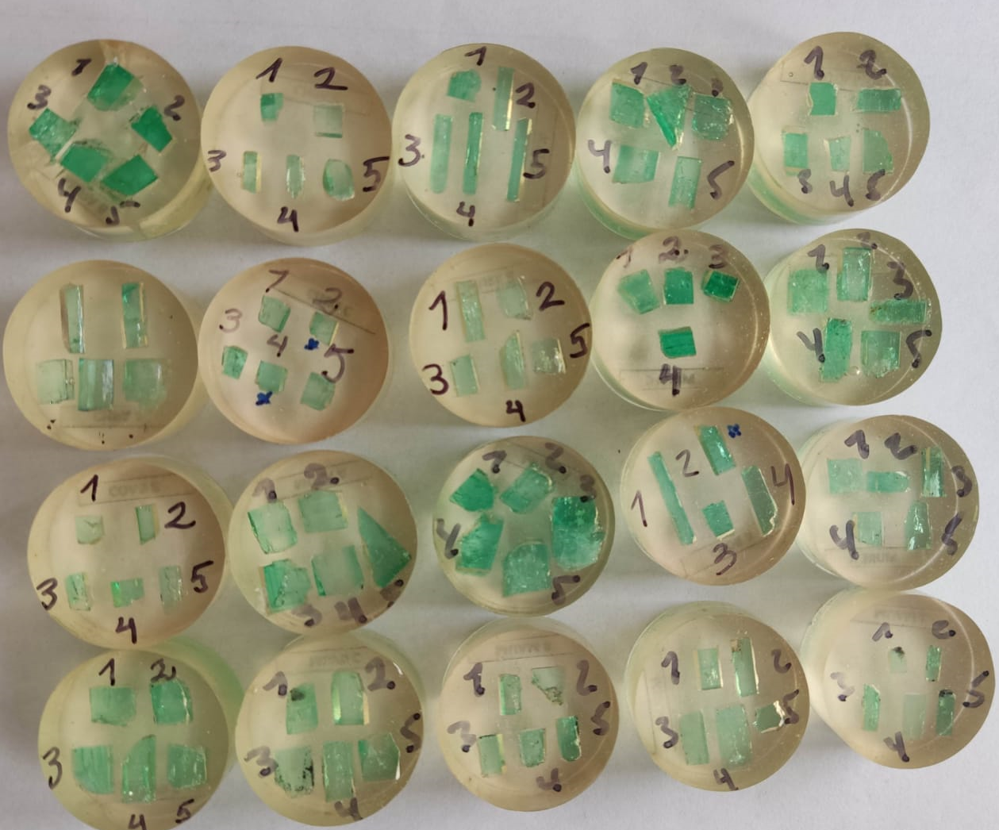
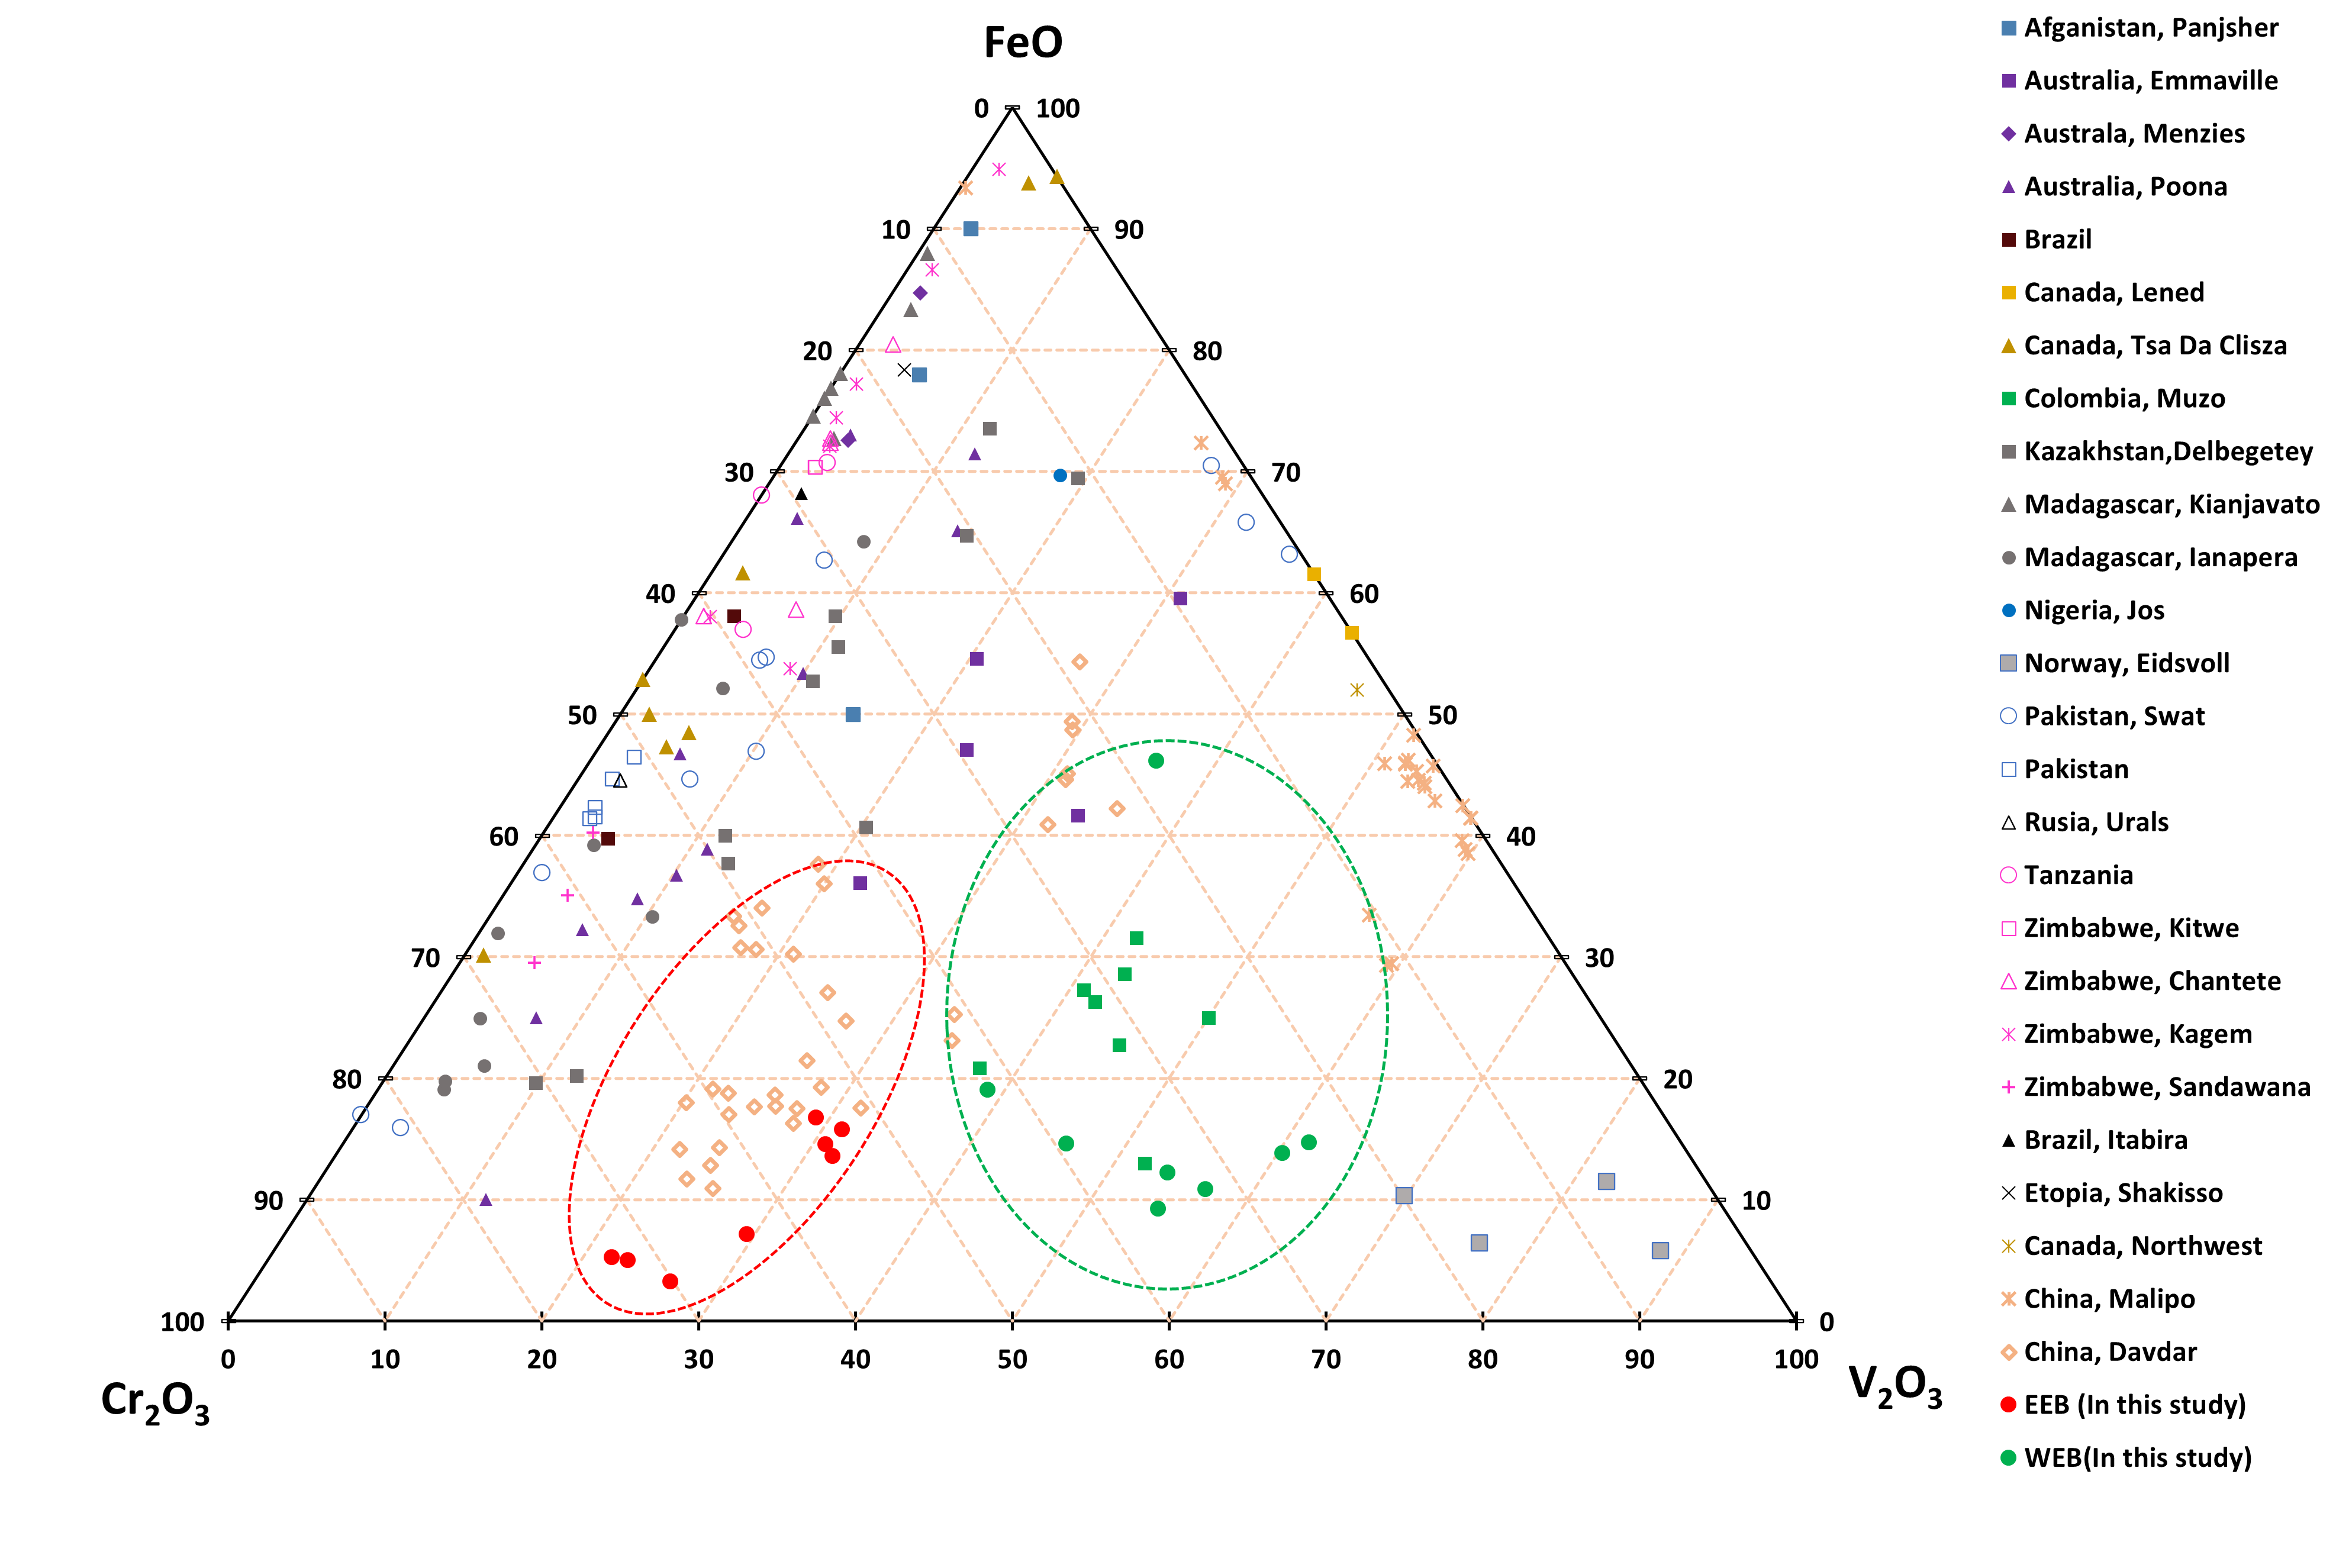
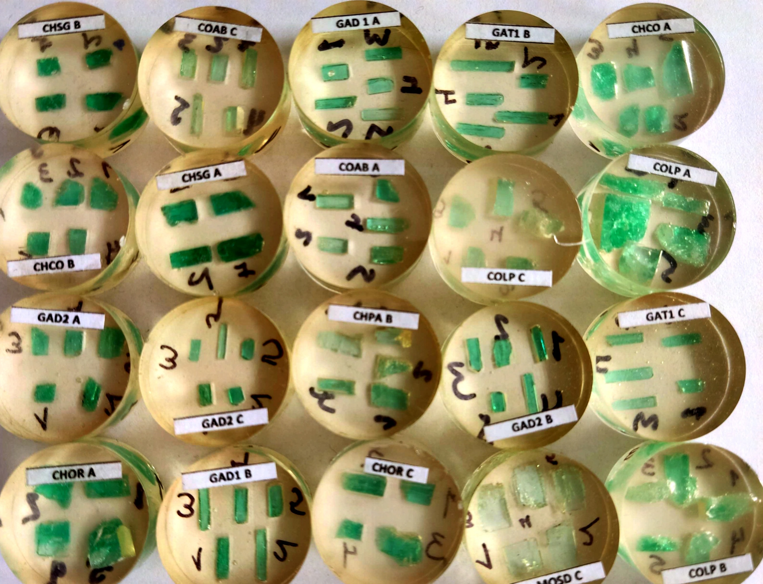
Emeralds: Colombia VS other WW deposits
geologist@gemlabcdtec.com

Slide 6
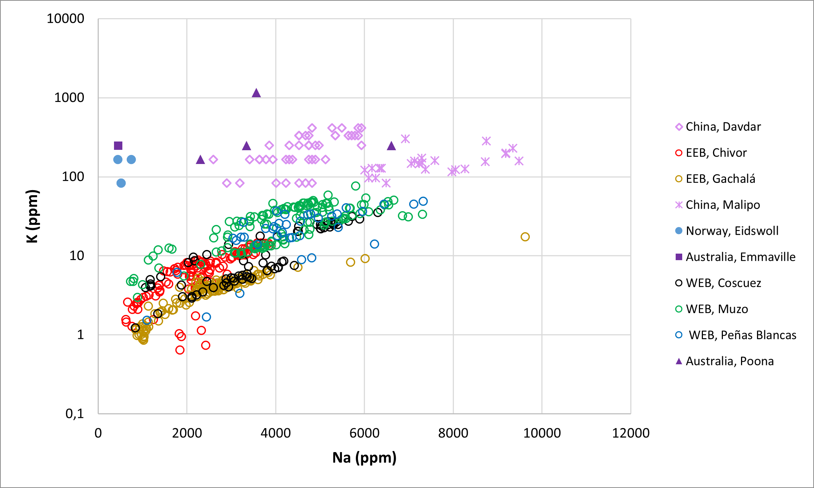
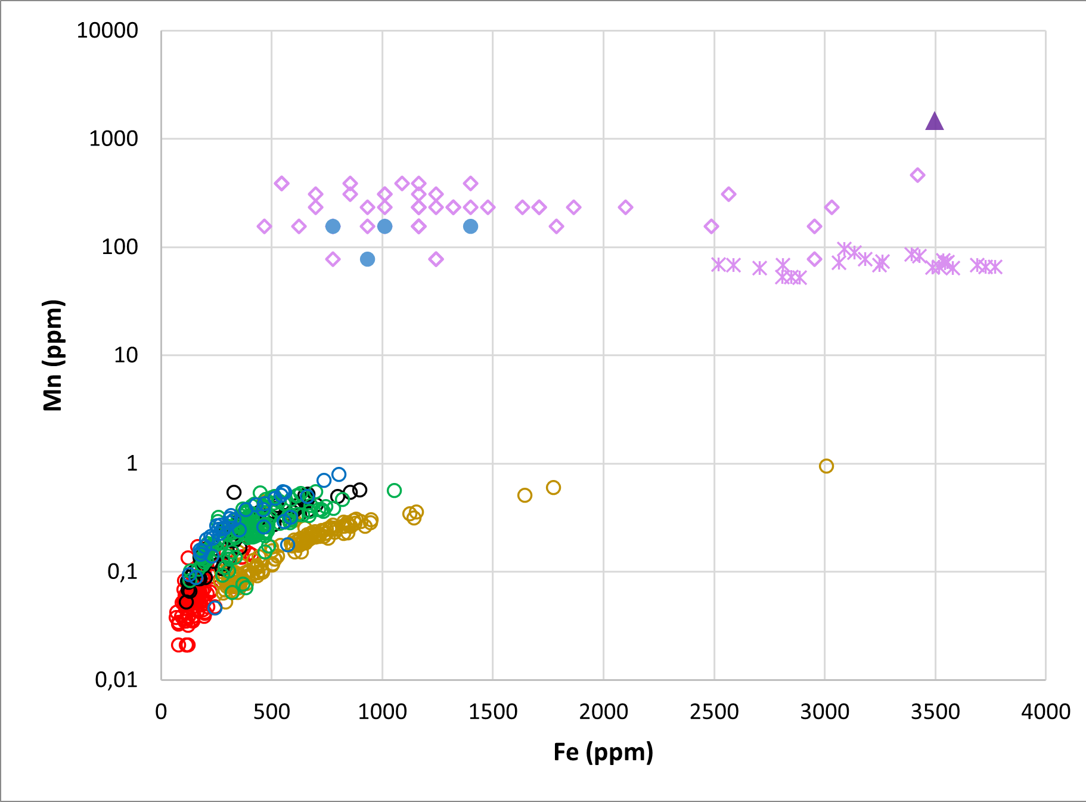
Emeralds: Colombia VS other WW deposits
geologist@gemlabcdtec.com

Slide 7
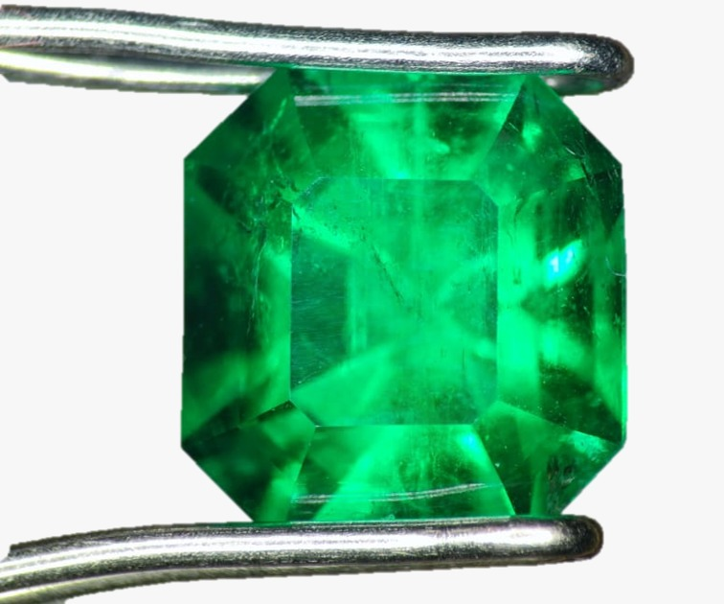
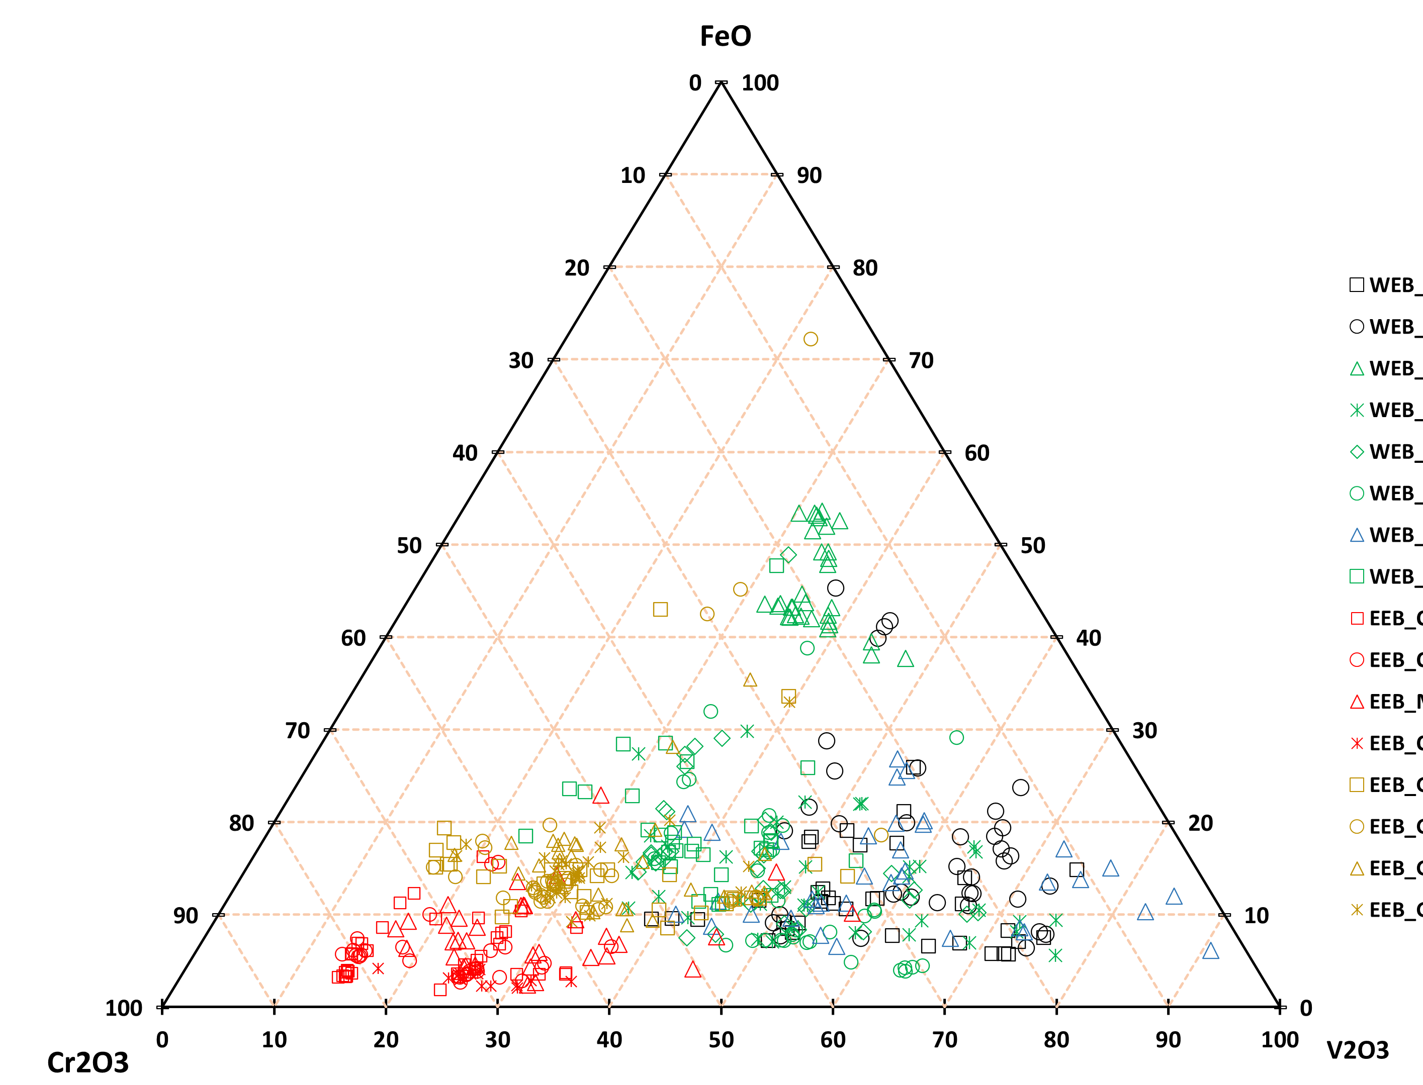
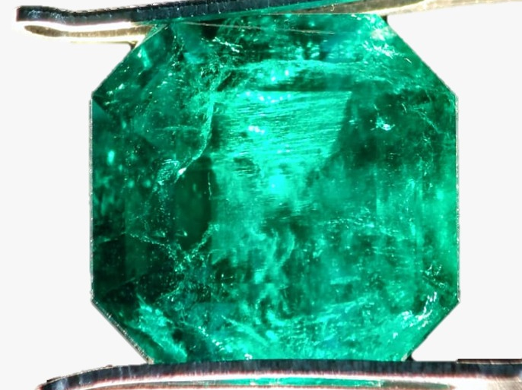
Colombian emeralds: a comparison between WEB and EEB
WEB
EEB
WEB
EEB
geologist@gemlabcdtec.com

Slide 8
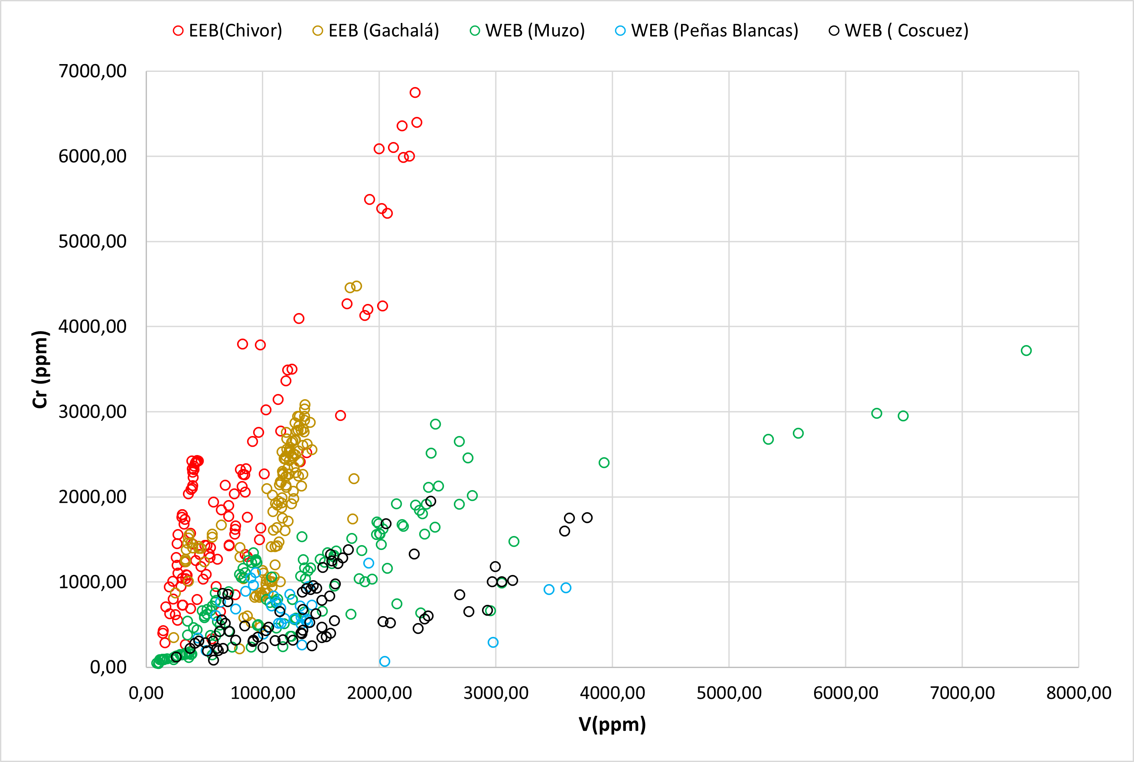
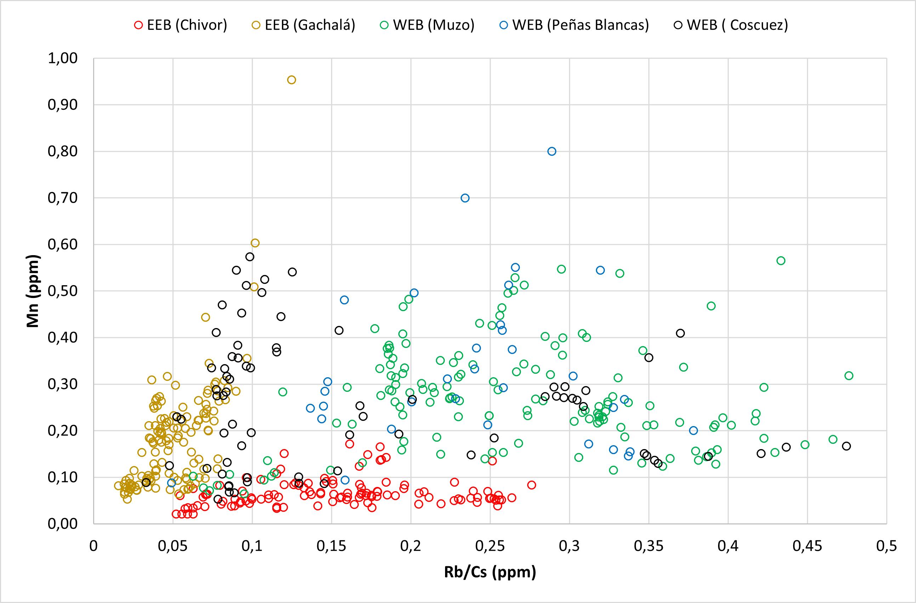
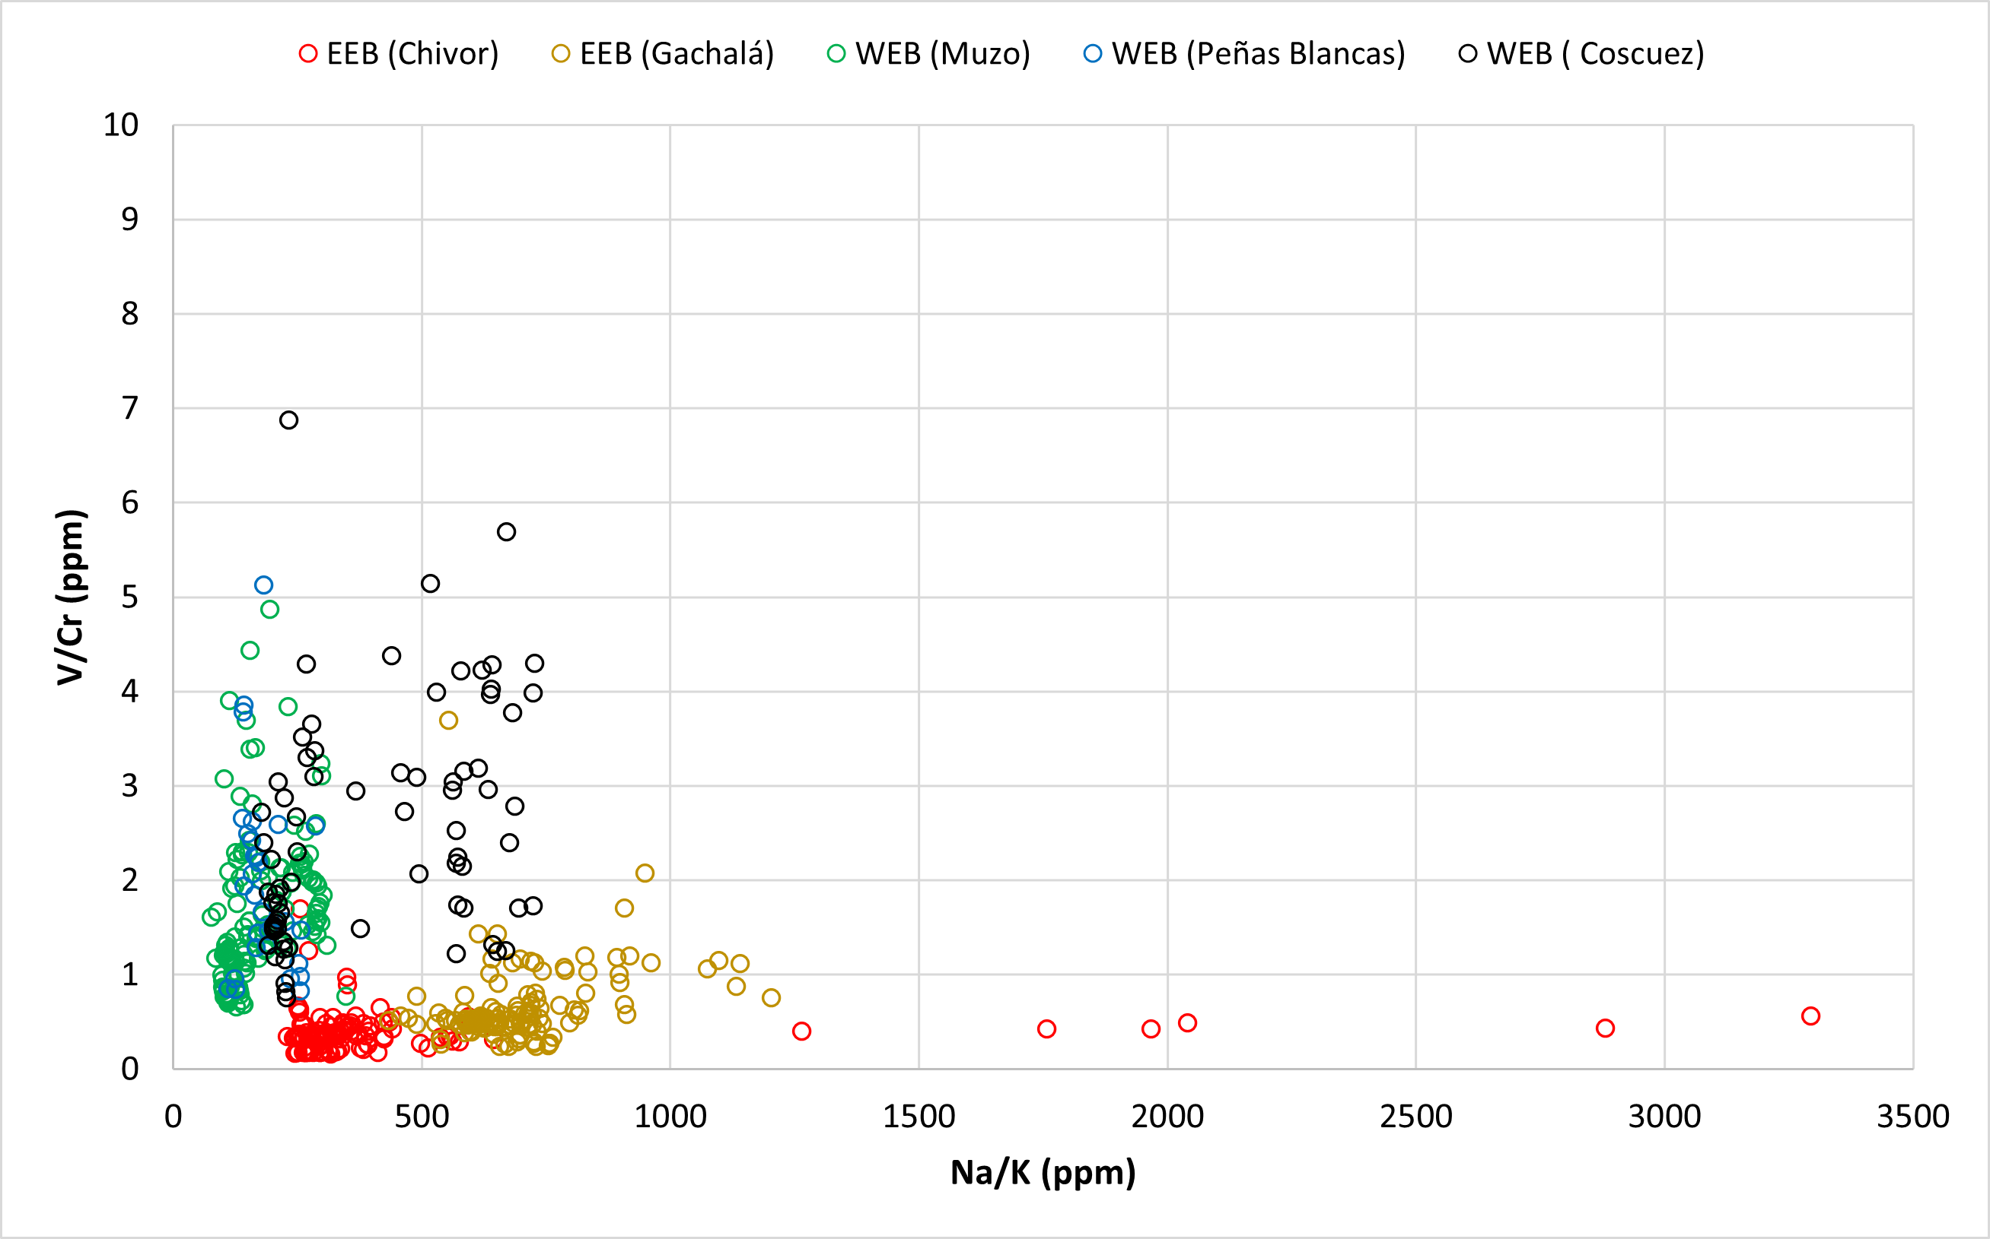
Colombian emeralds: A comparison between WEB and EEB
WEB
EEB
geologist@gemlabcdtec.com

Slide 9
Conclusions
Na/K relation shows differences between both belts due to the albite crystallization, and the structural regime. In the EEB extensive tectonic, the fluid migrates along normal faults allowing a crystallization of large layers of albites. In the WEB, crystallization of those minerals is restricted to the hinge of the fold.
The host-rock (sedimentary rock) imprints chemical features on the emeralds such as the low content in Mn, K, and Na, among others.
The proportion of chromophore elements (Cr, V, Fe) differentiates Colombian emeralds from most of the rest of the world. however, the K and Mn content must also be taken into account differentiating Chinese and Australian emeralds against Colombian.
geologist@gemlabcdtec.com

