Slide 1


Laboratory simulation of gas hydrate formation at ice surfaces in Earth atmosphere Brian Durham, Christian Pfrang, Ali Hassanpouryouzband Session AS3.16 - Atmospheric surface science and ice nucleating particles EGU2022

Slide 2
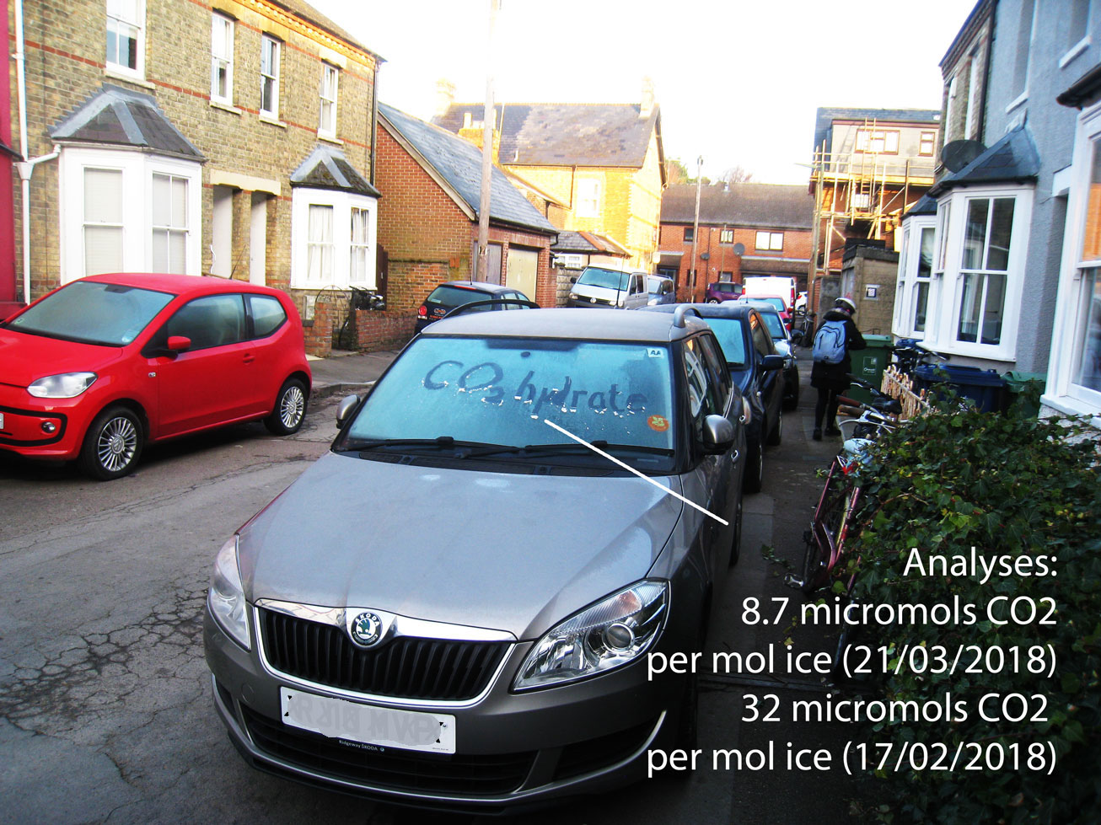
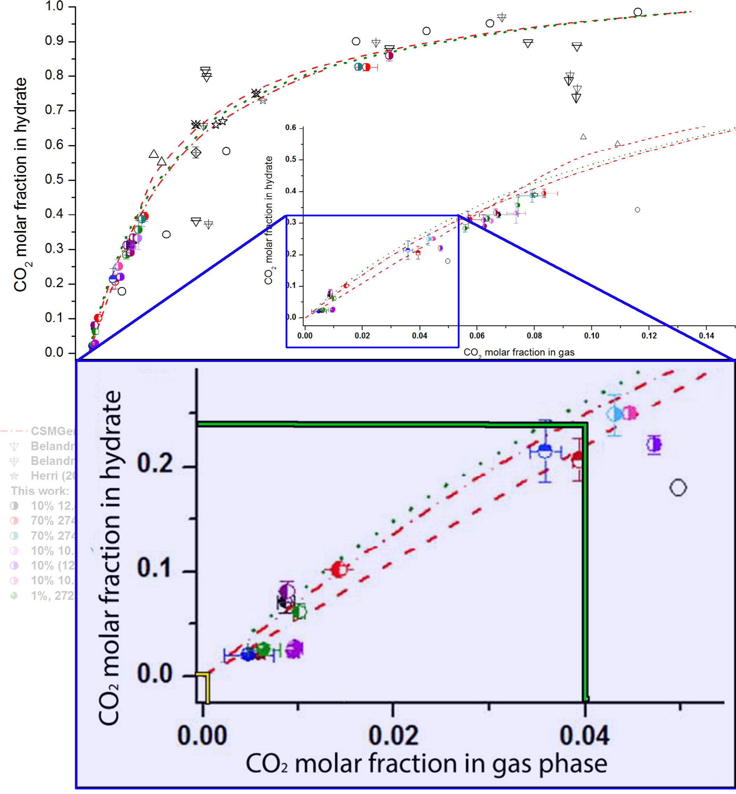
Gas capture at a growing ice surface
The property of ice to `cage’ otherwise mobile gas molecules has significance in the evolving hydrogen economy.
In the carbon economy, CO₂ is a hydrate-former, and its property as a radiation absorber means it can be quantified continuously and non-destructively in the gas phase.
The relevance of CO₂ is that rainwater and snow are 40 x supersaturated relative to the Henry equilibrium, and the frost that forms on your windscreen can release between16 and 64 times the Henry equilibrium content (EGU 2020). This also means that the pH of fresh rainwater typically rises when shaken with successive changes of ambient air.
Pure CO₂ hydrate will hold 1mol CO₂ per 6mol H2O. This proportion declines with lower partial pressure of the molecule according to a curve generated by University of Lille. This appears to confirm that cage occupancy is a scalable non-stoichiometric relationship, (Chazallon and Pirim (2018) `Selectivity and CO₂ capture efficiency in CO₂ -N₂ clathrate hydrates investigated by in-situ Raman spectroscopy', Figs 4A and 4B).
Windscreen frost
analysed by degassing
Chazallon and
Pirim (2018)
Figs 4A and 4B

Slide 3
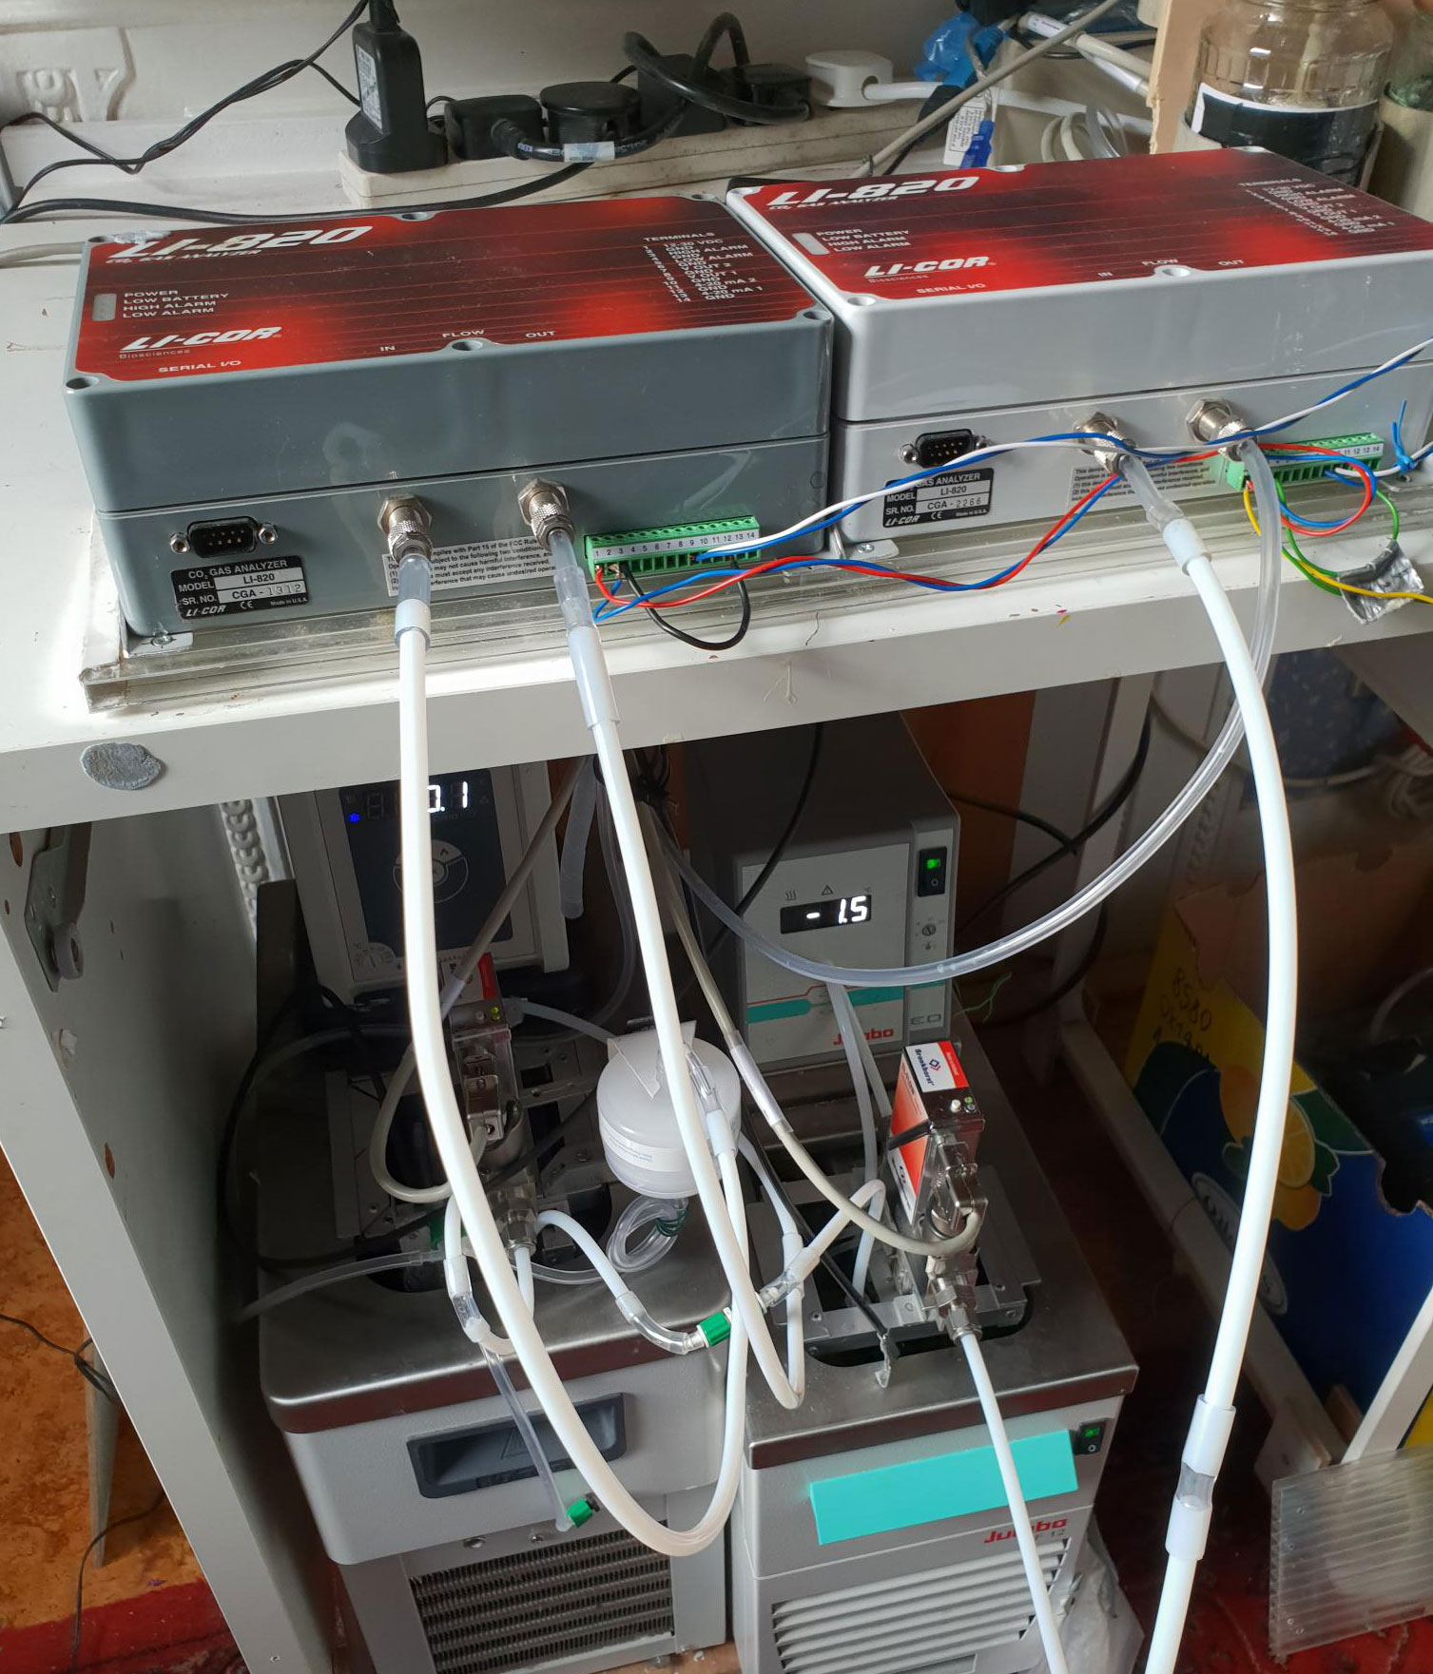
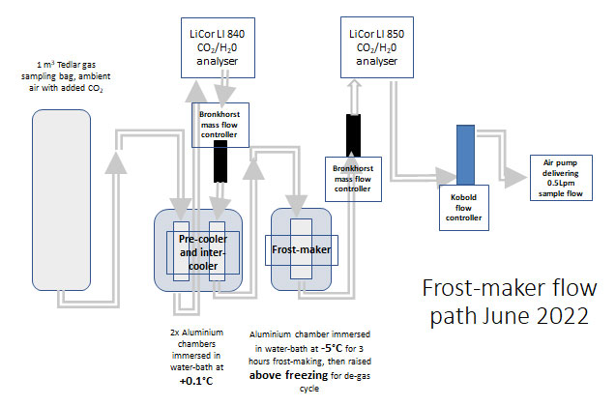
Gas capture at a growing ice surface
Frost-making May 2022
Our principle is to measure depletion of CO₂ from an airstream by formation of `frost’, and to match that value to the release of the molecule in melting the condensate
The current apparatus uses:
1 m³ Tedlar gas sample bag, ambient air filtered 1µ;
Pre-cooler and inter-cooler heat-exchangers (bath at 0.1°C), delivering a known mol fraction of CO₂ /air, of which CO₂ and water vapour content are monitored by NDIR, flow monitored by MFC),
Frost-chamber (bath at 0.1°C for instrument calibration, cooled to -5°C for frost-making), outflow CO₂ monitored by NDIR, flow monitored by MFC).
Procedure:
Calibrate instruments for 1 hour with both chillers at 0.1°C;
Reduce downstream chiller to -5°C , grow frost for 3 hours;
Melt condensate by lifting the frost chamber out of its chiller bath, allowing the same air-stream to sublimate/melt the frost and any caged gas;
Calibrate for final hour;
Schematic of frost-making flow path,
June 2022

Slide 4
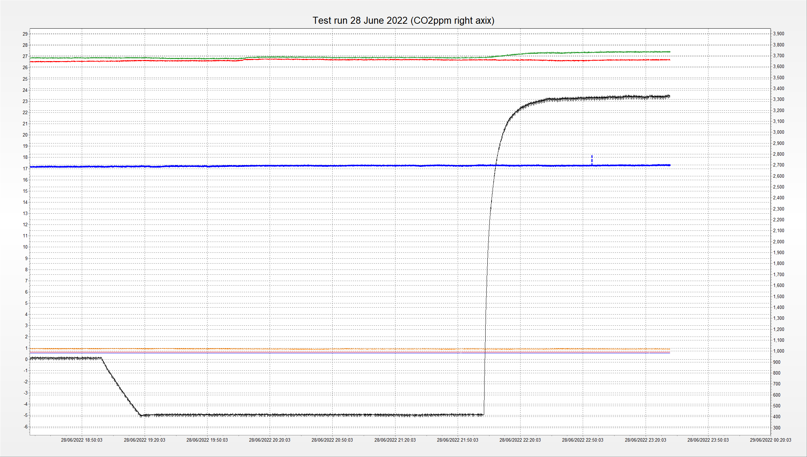
Release of CO₂ captured at a growing ice surface
Campbell Science LoggerNet 4.1 on-screen monitoring
Test run 28 June 2022 for illustration;
Gas mixture 0.5 L per minute flow for 3 hours, frost chamber at -5°C over :
Following lifting of frost chamber from waterbath at 22:00, the downstream CO₂ rises with release from condensate. Downstream H₂O proved unstable in all runs, trace omitted.
Thanks to Daniel Wilson and Ian Smillie of Licor UK for loan of demonstrator analysers LI840A and LI850.
Green = CO₂ D/S;
Red = CO₂ U/S;
Black = temperature (°C);
Blue = water vapour U/S

Slide 5
Gas capture at a growing ice surface Interim conclusion and next steps
CO₂ release at beginning of melt cycle provisionally supports:
Lille results;
Degassing of windscreen frost;
CO₂ supersaturation in atmospheric water.
Next steps:
Repeat frost-making from lower and higher µmol fractions of CO₂ to extend Lille curve;
Frost-making at a range of freezing temperatures (Hassanpouryouzband et al 2019 `Geological CO₂ capture and storage ..,’);
Direct degassing of the melt phase, by bubbling 1 mol of CO₂ -free dry air through frost chamber for 20 minutes to achieve quantitative analysis of the melt;
As above, with/without SDS (sodium dodecyl sulphate) as hydrate `promoter.’
Hardware upgrades include CO₂/water vapour analysers, and gas chromatograph at the outlet to quantify N₂ and O₂ hydrates at atmospheric pressures.

