Slide 1



Mechanism of Faster CH₄ Bubble Growth under Surface Waves in Muddy Aquatic Sediments: Effects of Wave Amplitude, Period and Water Depth
Abhishek Painuly* (ab.hishek901234@gmail.com), Regina Katsman (rkatsman@univ.haifa.ac.il)
Dr. Moses Strauss Department of Marine Geosciences, Leon H. Charney School of Marine Science, University of Haifa, Mount Carmel, Haifa 3498838, Israel
Notes:
Hello,
This presentation talks about the Impact of Surface Waves Over Growth Mechanism of Methane Bubble in Fine-Grained Muddy Aquatic Sediments and the effects of Effects of Wave Amplitude, Period and Water Depth over bubble growth. This work was performed at Dr Moses Strauss department of marine geosciences, University of Haifa, Israel, in supervision of Dr Regina Katsman.

Slide 2
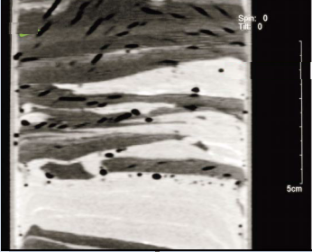
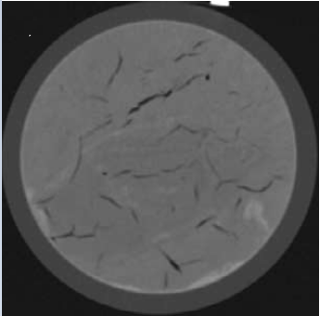
Introduction and background
Aquatic sediments are important source of natural CH₄, where it is produced by microbial remineralization of organic matter
This yields discrete gas bodies in surrounding sediment
Boudreau et al. (2005)
Bubbles growth is driven by solute diffusion from sediment
Elastically deform the sediment matrix and grow by fracturing
Footprints of released bubbles
Rise towards water column, once they mature
Best et al. (2004)
Notes:
Aquatic sediments are an important source of natural methane, it is produced in aquatic environments by microbial remineralization of organic matter in sediments.
It has been observed in many field studies, that this methane eventually form discrete bodies of immiscible gas in a surrounding sediment, as seen in the picture.
These bubbles grow by the process of solute diffusion; which is driven by the concentration gradient of dissolved CH₄ at the bubble surface. They elastically deform the sediment matrix and grow by sediment fracturing.
Once these bubbles attain mature size, they rise towards the water column and can eventually liberate to atmosphere.

Slide 3
Introduction and background
The lifespan of these bubbles within the sediment comprises two successive stages
Growth from nucleation up to a mature size and configuration
Buoyant ascent towards the sediment - water interface
Sediments experience fluctuating loads due to:
Passage of surface waves induced by winds or storms, Swells or tides and seasonal water level changes
Notes:
The lifespan of these bubbles within the sediment comprises two successive stages:
Their growth from nucleation up to a mature size, and then their buoyant ascent towards the sediment - water interface.
Bubbles often experience an oscillating overburden load due to the passage of winds or storm or tides, which can potentially affect both stages of the bubble’s lifespan.

Slide 4
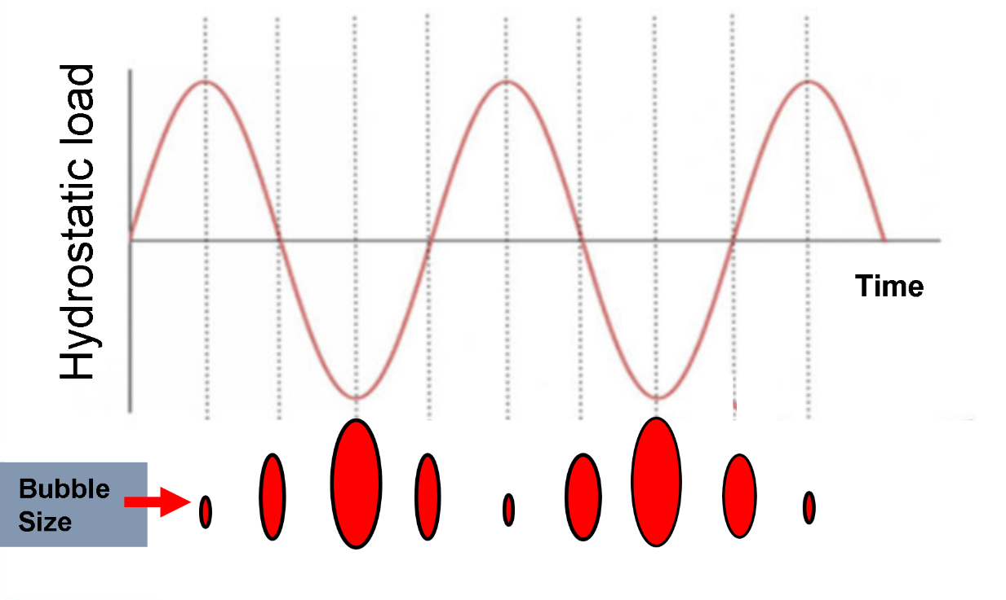
Introduction and background
Bubbles react to mechanical energy of varying hydrostatic load by rectifying their sizes and adjusting inner pressure.
This affects the process of CH₄ diffusion to a growing bubble from within ambient sediments, and hence affects bubble growth
Notes:
Bubbles react to the mechanical energy of the varying hydrostatic load by rectifying their sizes and adjusting inner pressure, in accordance with the fluctuating overburden load.
This is coupled with the process of CH₄ diffusion to a growing bubble from within the ambient sediments, which is responsible for the bubble growth.

Slide 5
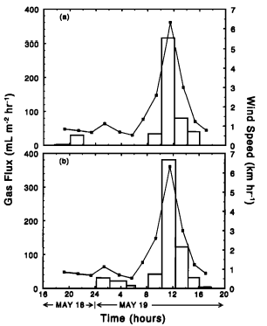

Introduction and background
Depth~0.5m
As wind speeds approaches 6 Km hr⁻¹, gas flux rises > 350 mL m⁻² hr⁻¹
At wind speeds between 0 to 2 Km hr⁻¹, gas flux remains <70 mL m⁻² hr⁻¹
Depth~3.7m
Keller and Stallard (1994)
Methane emission by bubbling from Gatun Lake, Panama
Notes:
Various Field studies have reported a strong correlation between high ebullition flux from aquatic sediments with variations in hydrostatic pressure.
For e.g., here is a data reported by Keller and Stallard 1994, where it is seen that at low wind speeds less than 2 Km/hr the gas flux was nearly 70 units, however when wind speed rises near 7 km/h gas flux suddenly rises early five times up to 350 mL/m²/hr

Slide 6

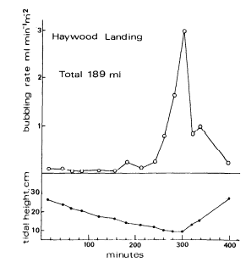
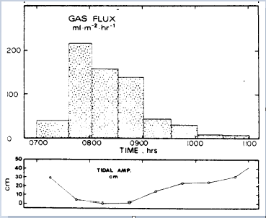
Introduction and background
High ebullition is due to fast bubble growth or only due to rise of already mature bubble?
As tide decreases water level by ~20cm, gas flux rises from ~30 mL m⁻² hr⁻¹ to ~220 mL m⁻² hr⁻¹
As tide decreases water level by ~20cm, gas flux rises from ~0.1 mL min⁻¹ m⁻² to ~2 mL min⁻¹ m⁻²
Martens and Klump (1979)
Methane emission from Cape Lookout Bright, North Carolina, USA
Chanton et al. (1989)
Gas emission from White Oak River estuary, North Carolina, USA
Notes:
Similar observation during passage of tides is reported by Martens and Klump (1979), who observed gas flux rise from 30 Units to 220 units with decrease in water depth by nearly 20cm. Also, at white oak river estuary Chanton et al (1989) reported Similar observations.
However, it is not clear from these observation that whether this enhanced gas flux is due to fast bubble growth or due to rise of only already mature bubble present in sediments.

Slide 7
Research Questions?
By what mechanism, does the fluctuating overburden load caused by surface waves, affects bubble growth?
How do the different wave loading parameters (amplitude and period) and water depth affect the bubble growth in sediments?
Which factor play dominant role in expediting bubble growth?
Notes:
This incites several questions:
By what mechanism, does the fluctuating overburden load caused by surface waves, affects bubble growth?
How do the different wave loading parameters (amplitude and period) and water depth affect the bubble growth in sediments?
Which factor play dominant role in expediting bubble growth?

Slide 8
Objectives
Explore bubble growth pattern and its specific characteristics under surface waves
Quantify the effects of different wave amplitude and period over bubble growth
Study effect of water column depth over the bubble growth pattern
Notes:
Keeping these questions in mind, the present work:
Explore bubble growth pattern and its specific characteristics under surface waves
Quantify the effects of different wave amplitude and period over bubble growth
Study effect of water column depth over the bubble growth pattern

Slide 9



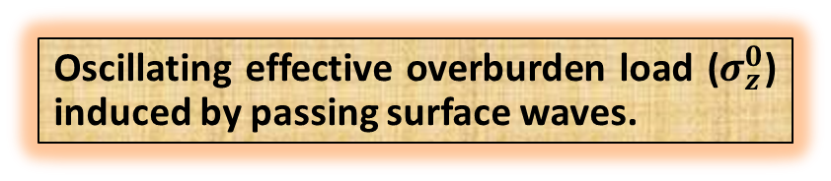












Methods
Effective overburden load ($σ_{z}^{0}$)
2D View of the crack (in XZ plane)
Employed a mechanical reaction-transport model, developed in Katsman et al. (2013)
Symmetry plane (XZ)
Bubble head
$$B$$
$$F$$
Bubble free surface
$$P$$
$$Z=0$$
$$d$$
Couples the processes of CH₄ bubble expansion diffusion-fed from the surrounding sediment and elastic-fracture mechanical response (LEFM) of sediment
$$h$$
$$O$$
$$X=0$$
$$A$$
Crack front
$$z$$
$$e$$
Bubble tail
$$Y$$
$$l$$
Sediment cell
$$X$$
Oscillating effective overburden load ($σ_{z}^{0}$) induced by passing surface waves.
Notes:
In present work, we employed a mechanical reaction- transport, single bubble model to simulate bubble growth from penny shaped initial bubble seed to mature configuration, which was previously developed in Katsman et al. (2013).
Computational domain consists of a 3D sediment box cut by a symmetry plane (XZ), with an embedded penny-shaped bubble seed.
The model simulates the coupled process of diffusion-driven bubble expansion due to a concentration gradient of dissolved CH₄ at the bubble surface, and the sediment’s elastic-fracture mechanical response to bubble growth.
The effect of passing surface wave of the bubble is inculcated in the model by applying an Oscillating effective overburden load (σ_z^0) over the top boundary of sediment box.

Slide 10
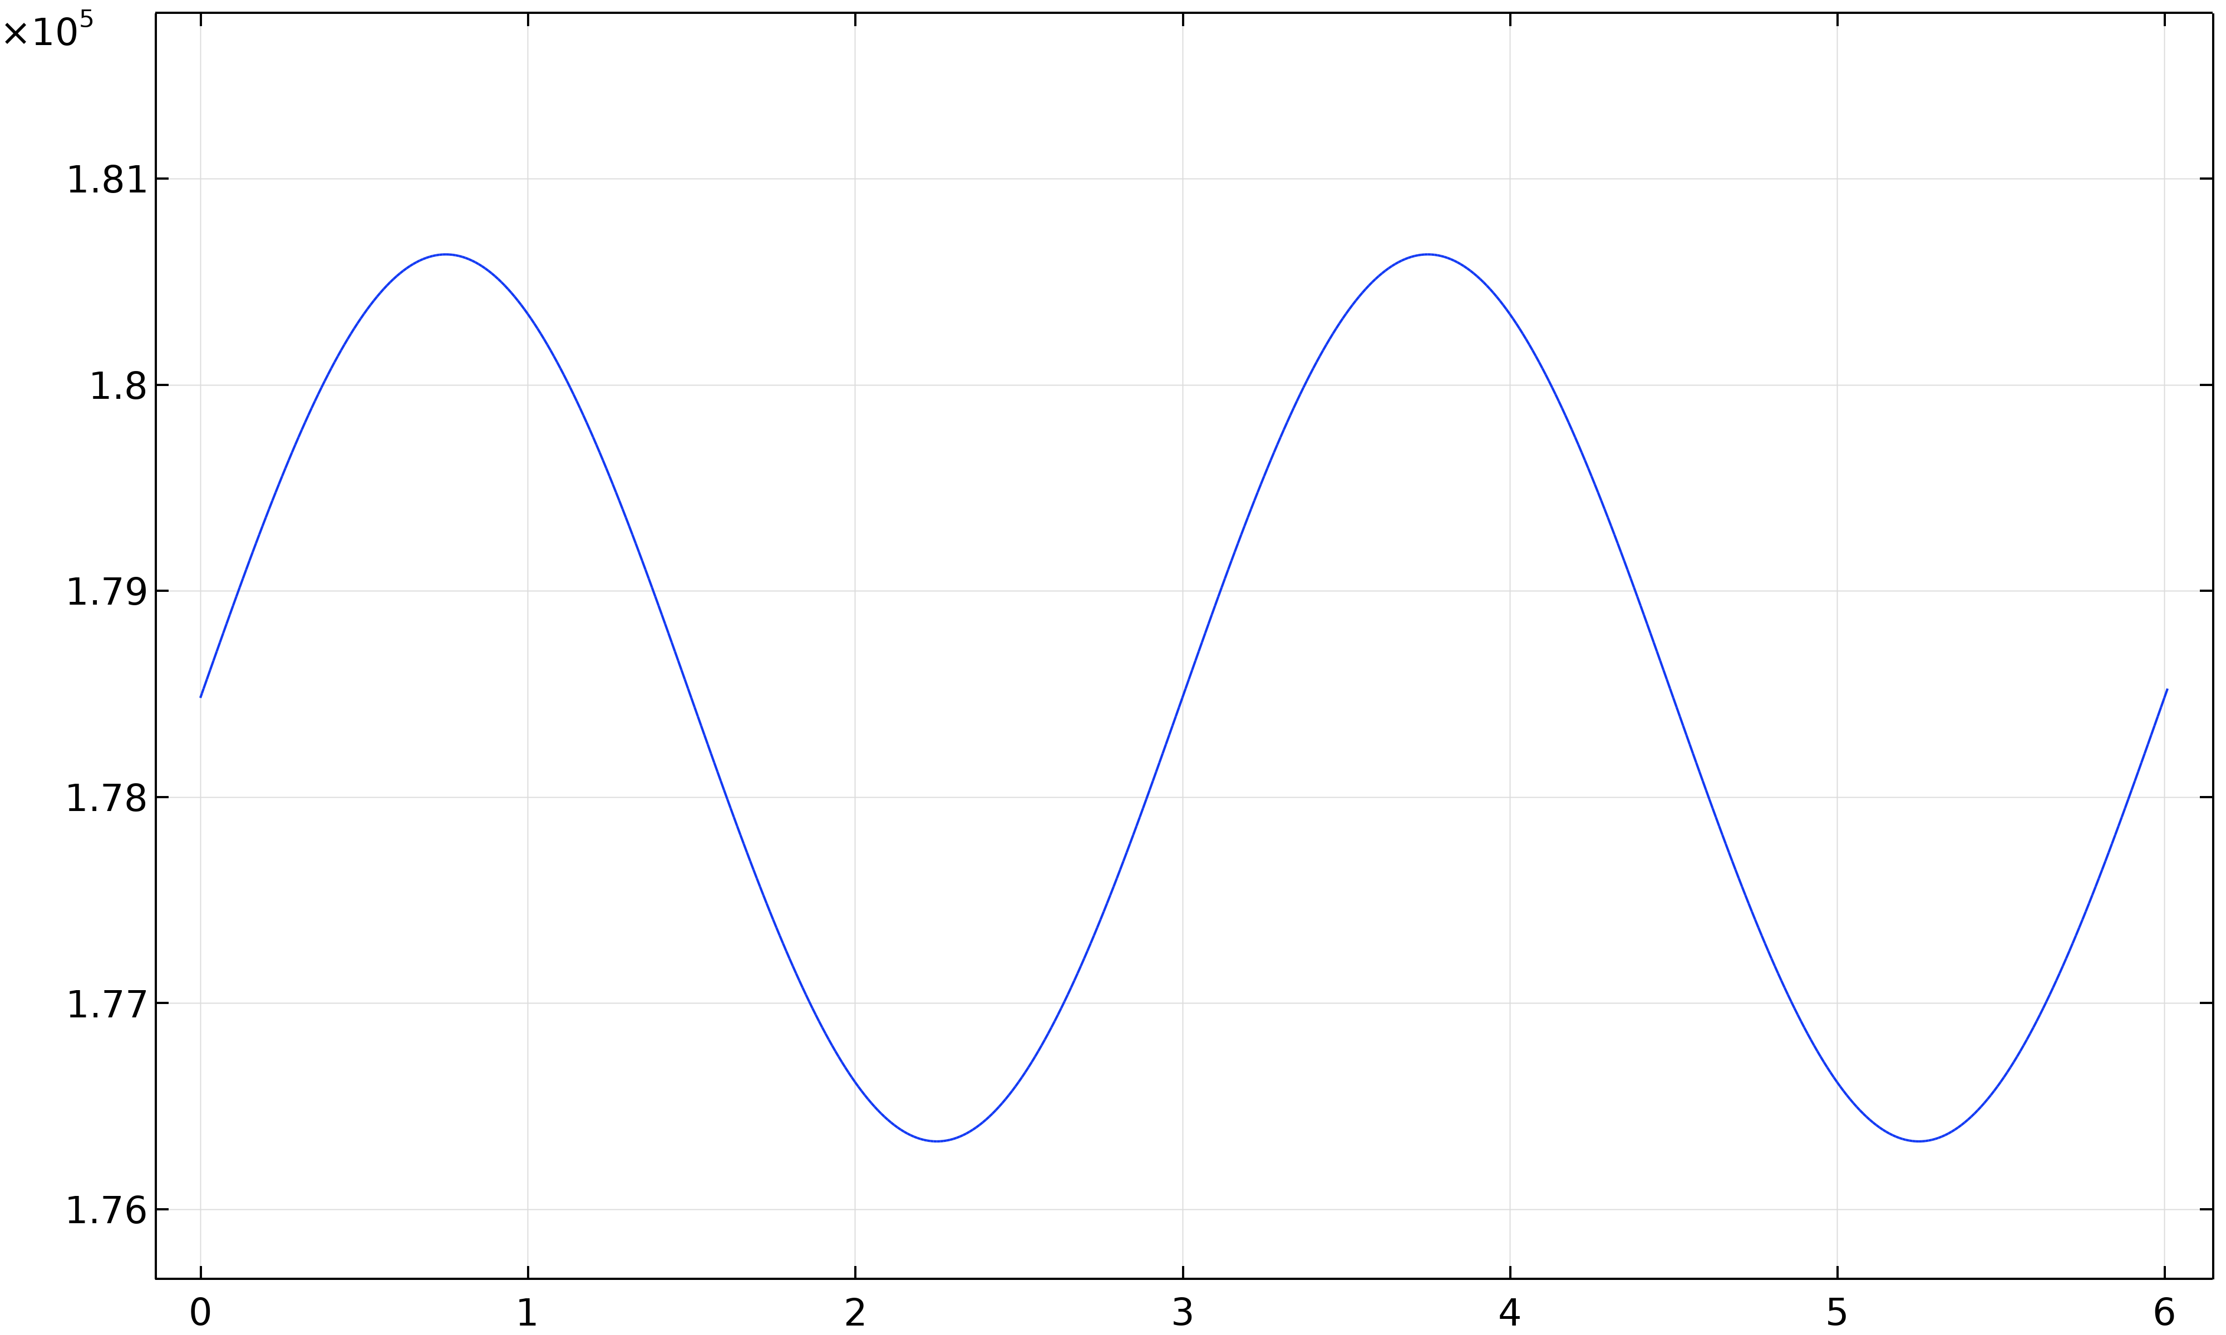


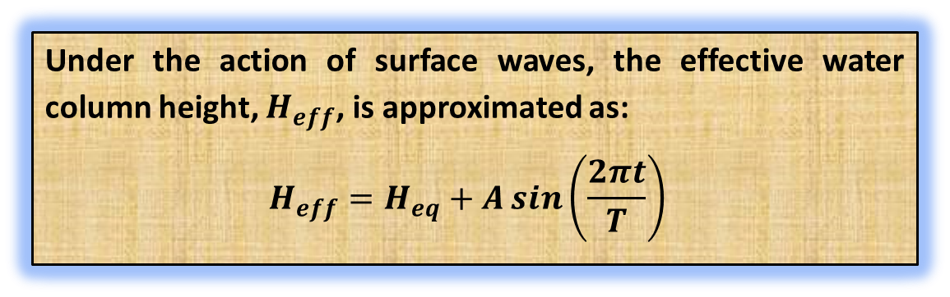
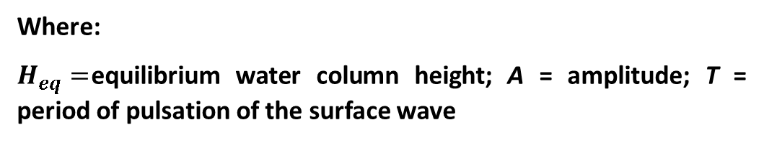

Methods (contd.)
Under the action of surface waves, the effective water column height, $H_{eff}$, is approximated as:
$$H_{eff}=H_{eq}+A\sin\left(\frac{2πt}{T}\right)$$
Unloading phase 1
Time t = 0.75 - 2.25 s
$$σ_{z}^{max}$$
Where:
$H_{eq}=$equilibrium water column height; A = amplitude; T = period of pulsation of the surface wave
$$σ_{z}^{min}$$
Effective overburden Load, $σ_{z}^{0}$(Pa)
Loading phase 2
Time t = 2.25 - 3.75 s
Time (s)
Notes:
Under the action of surface waves, the effective height of water column continuously osculate from its equilibrium height, we modelled it here by the equation: $H_{eff}=H_{eq}+A\sin\left(\frac{2πt}{T}\right)$
Figure, illustrate the oscillations in effective overburden load in presence of waves of Amplitude 0.22 m, period 3s, in ambient water depth of 18m.
This effective overburden load, can be differentiated in two subsequent loading phases: (1) “unloading” phase, describing the continuous fall of the load from its max value to min value; (2) “loading” phase, describing a continuous rise in load from min to max value.

Slide 11
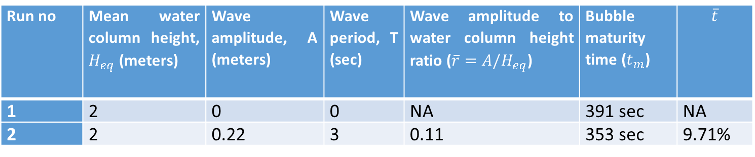
Results
General pattern of bubble growth under the wave loading
Bubble growth is simulated in presence of waves and in no wave conditions, and their growth pattern are comparatively studied
Run no | Mean water column height, $H_{eq}$ (meters) | Wave amplitude, A (meters) | Wave period, T (sec) | Wave amplitude to water column height ratio ($\overline{r}=A/H_{eq}$) | Bubble maturity time ($t_{m}$) | $$\overline{t}$$
1 | 2 | 0 | 0 | NA | 391 sec | NA
2 | 2 | 0.22 | 3 | 0.11 | 353 sec | 9.71%
No wave case
With waves
Measure of contrast in maturity time in wave and without waves:
$$\overline{t}=100∙|t_{m}\left(\text{no} \text{wave}\right)−t_{m}\left(\text{with} \text{wave}\right)|/t_{m}(\text{no} \text{wave})$$
Notes:
Firstly, we intend to understanding the general pattern of bubble growth under wave loadings, for that we simulated bubble growth in two case: bubble growth in presence of surface waves and bubble growth in absence of waves.

Slide 12
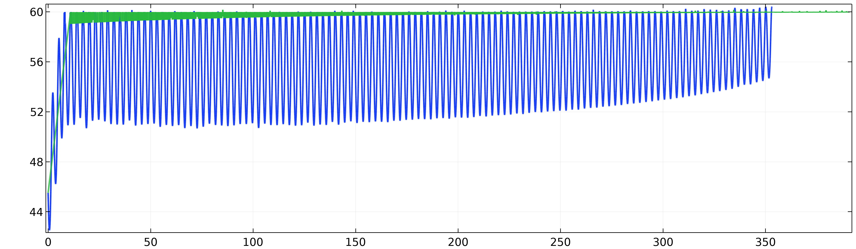

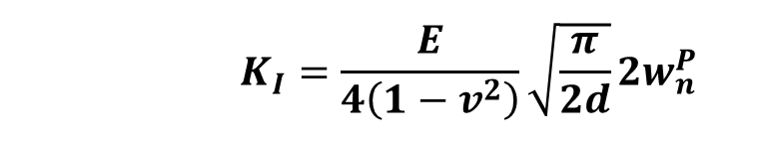
Results (contd.)
$K_{head}$ ($Pa m0.5$)
With waves
No waves
Time (s)
$K_{head}$ is Stress Intensity Factor at bubble head
Stress intensity factor (SIF) measures the stress state at crack front
Evaluated using onae-point methodology
$$K_{I}=\frac{E}{4\left(1−v^{2}\right)}\sqrt{\frac{π}{2d}}2w_{n}^{P}$$
Young's modulus
Normal displacement at crack surface
Poisson’s ratio
Notes:
To understand the fracturing pattern, we track here the parameter K_{head}. It quantitate the stress intensity factor at bubble head.
Stress Intensity Factor is a measure of the stress state at the crack front, evaluated here using one-point methodology.
This quantity implicitly depends upon normal displacements at crack surfaces.

Slide 13
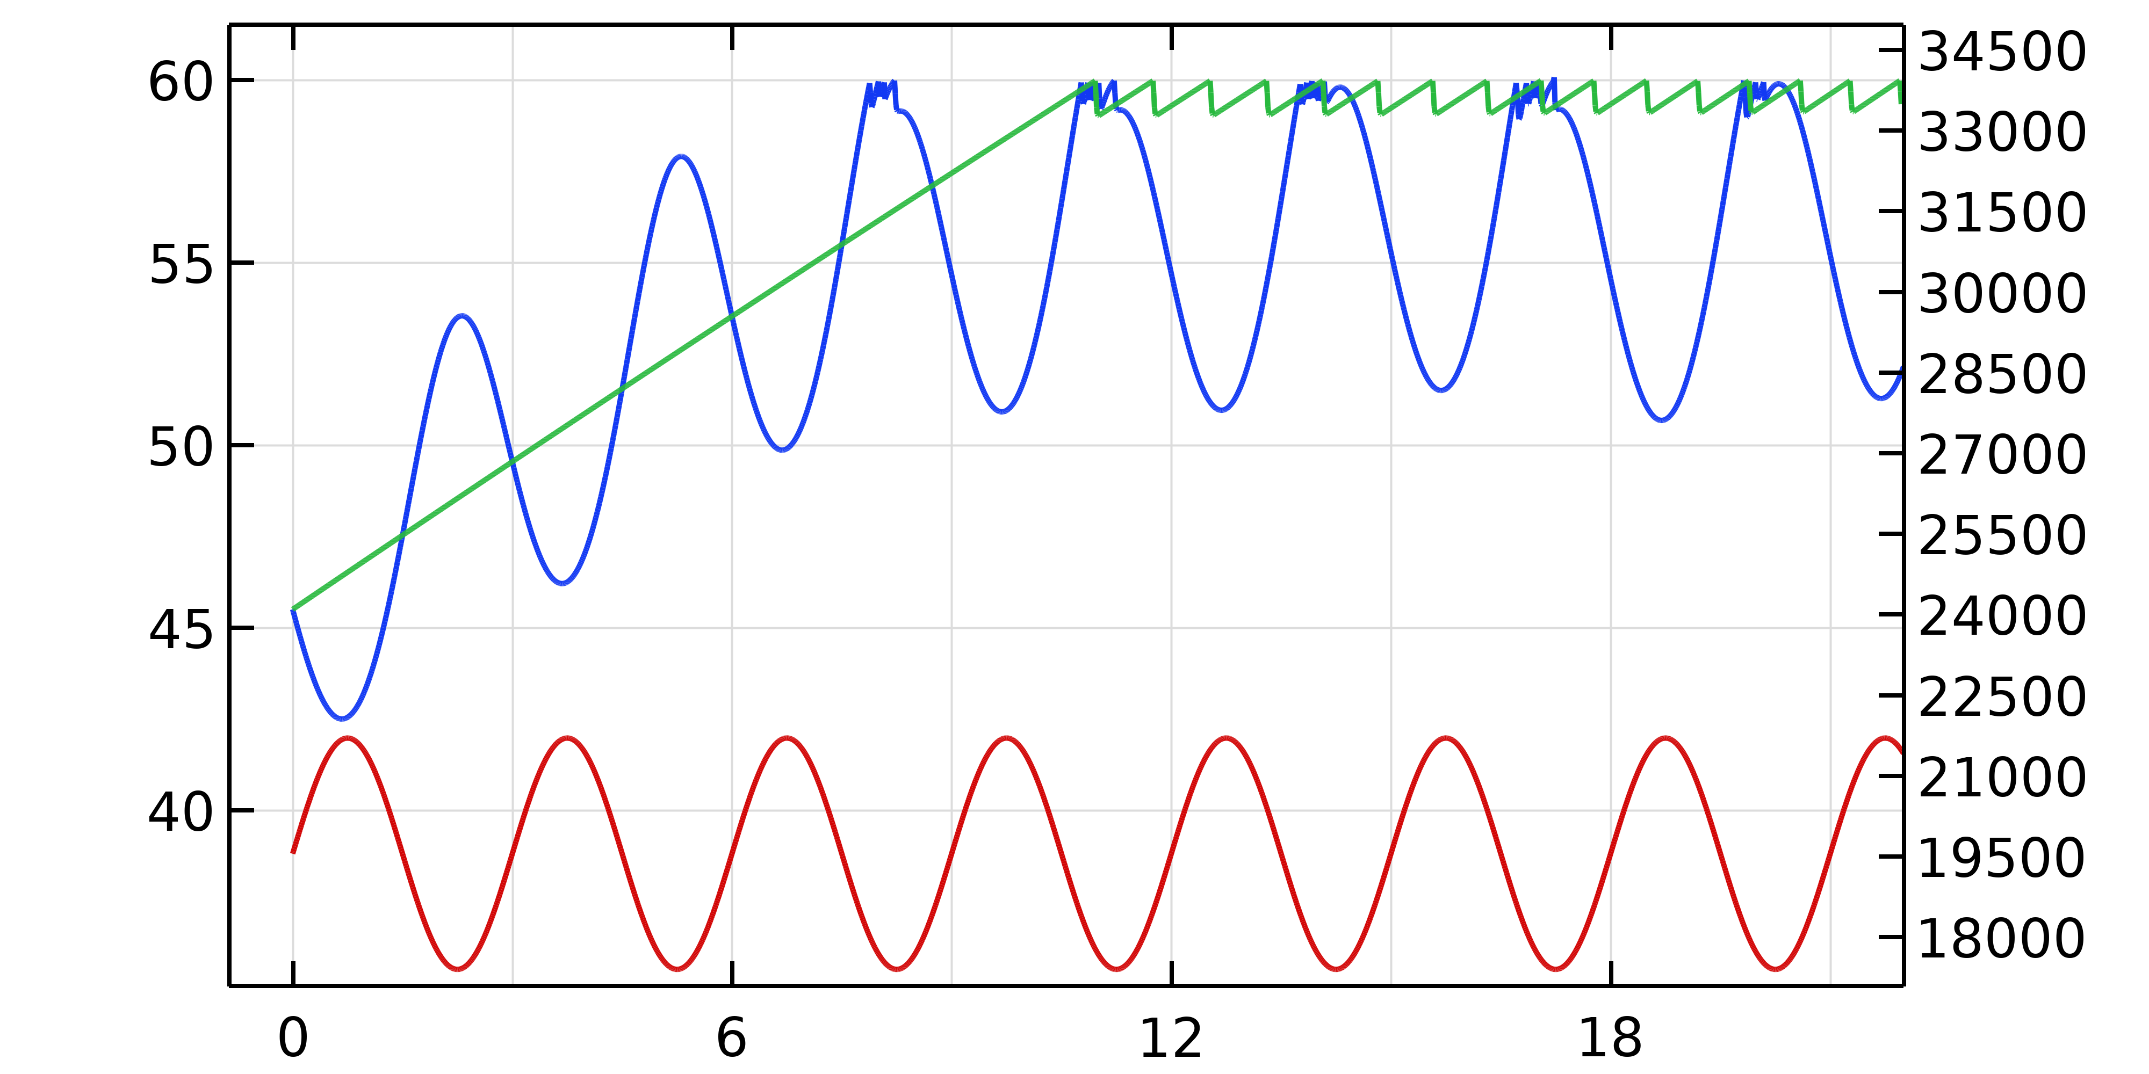

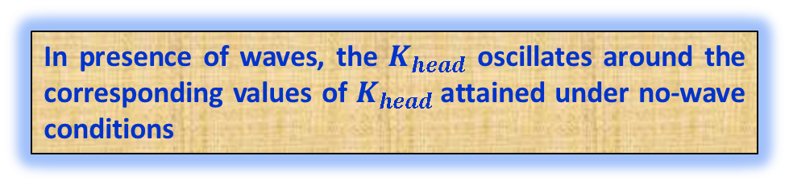
Results (contd.)
$K_{head}$ ($Pa m0.5$)
With waves
No waves
Time (s)
In presence of waves, the $K_{head}$ oscillates around the corresponding values of $K_{head}$attained under no-wave conditions
$$K_{head} (Pa m0.5)$$
Overburden load (Pa)
Overburden Load
Notes:
What we see here are two profiles of K_{head} for bubbles growing in presence of waves and absence of wave.
Here we see a zoomed section of these profiles, In presence of waves, the $K_{head}$ oscillates around the corresponding values of $K_{head}$ attained by the bubble at the elastic expansion stage under no-wave conditions.

Slide 14

Results (contd.)
$K_{head}$ ($Pa m0.5$)
With waves
No waves
Early fracturing
Time (s)
Early fracture initiate due to decline in overburden load
$$K_{head} (Pa m0.5)$$
Overburden load (Pa)
Overburden Load
Notes:
Secondly, $K_{head}$ is reversely synchronized to the oscillating effective overburden load, $σ_{z}^{0}$, in case of waves. This, aids bubble to achieve the fracturing condition a bit earlier, in comparison no wave case, because of the declining overburden load in unloading stage.

Slide 15
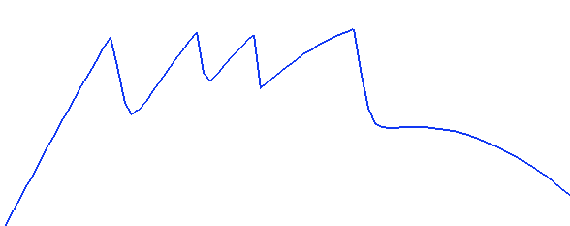
Results (contd.)
$K_{head}$ ($Pa m0.5$)
With waves
No waves
Multiple fracturing events
Early fracturing
Time (s)
Multiple fracturing events occurs when wave approach its troughs and fracturing halts when wave loading phase initiates
$$K_{head} (Pa m0.5)$$
Overburden load (Pa)
Phase 1 Initiation (t=6.75 s)
Termination of Phase 1 (t=8.25 s)
Fracture initiation (t=7.85 s)
Overburden Load
Notes:
Also, under waves, the $K_{head}$ profile exhibits sequences of temporarily ceased fracturing events, in contrast to the no wave case where fracturing continuously persists.
Whenever, the wave approaches its trough, the bubble rapidly increases in size by acquiring multiple fracturing events in a stable fracturing regime.

Slide 16
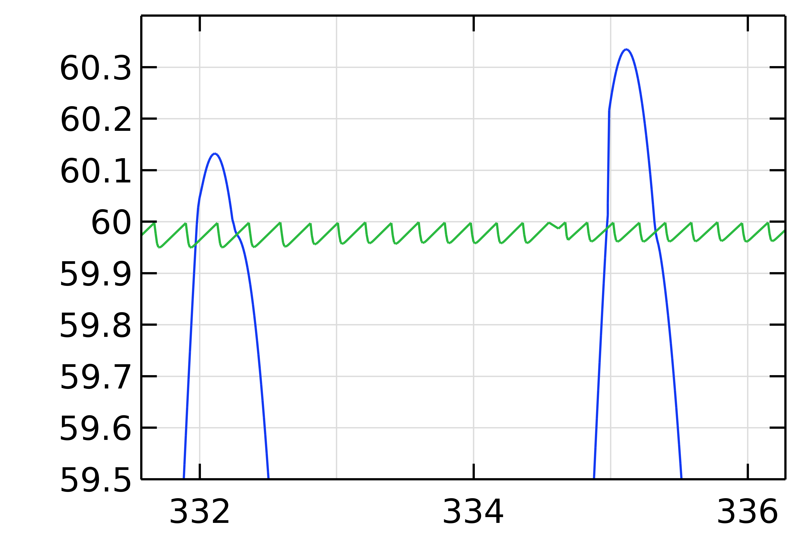

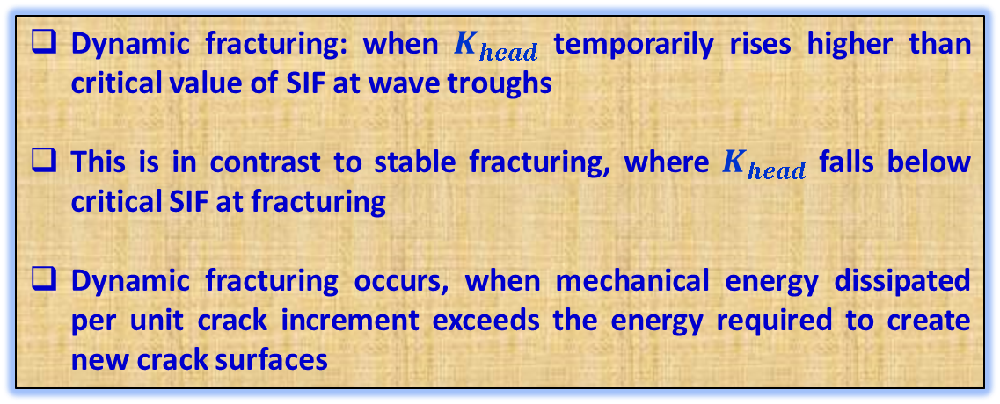

Results (contd.)
$K_{head}$ ($Pa m0.5$)
Dynamic crack propagation
$$K_{IC}=60 Pa m0.5$$
Time (s)
Dynamic fracturing: when $K_{head}$ temporarily rises higher than critical value of SIF at wave troughs
This is in contrast to stable fracturing, where $K_{head}$ falls below critical SIF at fracturing
Dynamic fracturing occurs, when mechanical energy dissipated per unit crack increment exceeds the energy required to create new crack surfaces
${ K}_{head}$ ($Pa m0.5$)
Notes:
At later stage, this bubble grow by dynamic fracture propagation, when despite the fracturing events, $K_{head}$ temporarily rises higher than $K_{IC}$.
This contrasts with stable fracturing, where 𝑲_𝒉𝒆𝒂𝒅 falls below critical SIF at fracturing, as seen in no wave case.
Such growth appears, when mechanical energy dissipated per unit crack increment exceeds the energy required to create new crack surfaces .

Slide 17
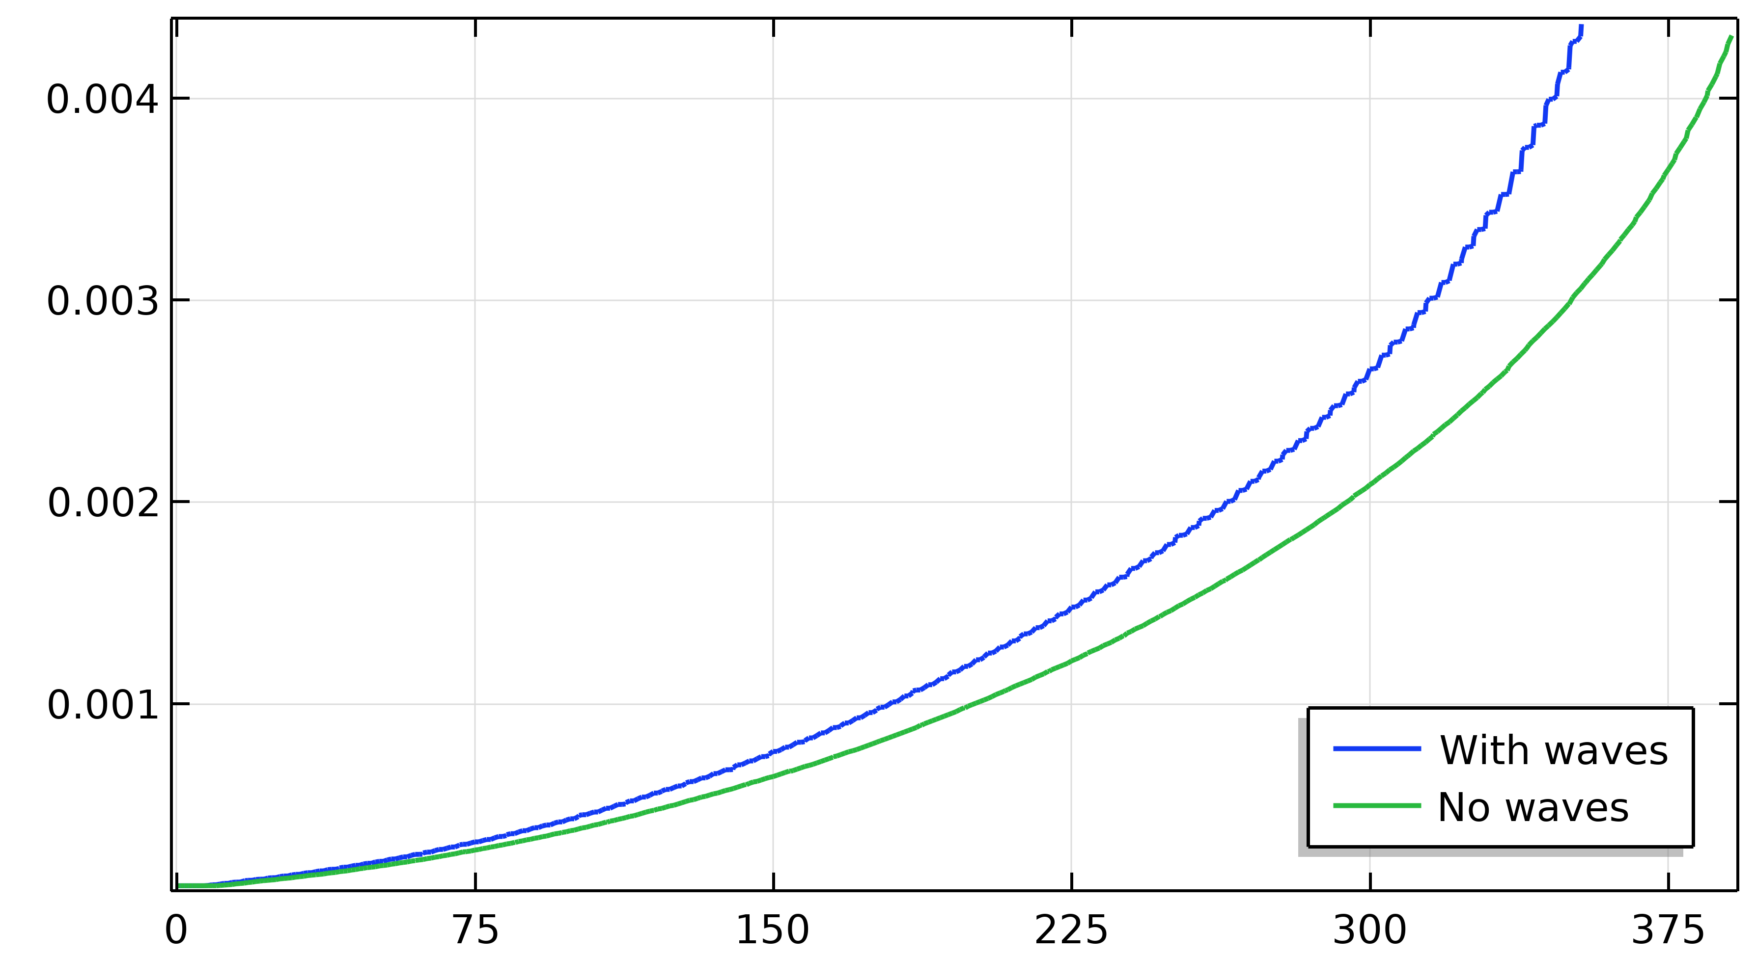
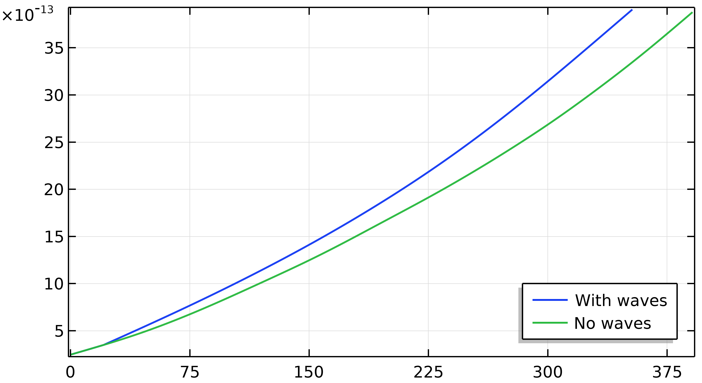
Results (contd.)
Due to “early” and “multiple” fracturing features, bubble attains larger surface area and thus grows with higher total diffusive flux, compared to the bubble growing under no waves.
Surface Area (m²)
Time (s)
Bubble mature in:
nearly in 391 s under no wave conditions
nearly 353 s in presence of waves
Thus, waves aid bubble to mature in approximately 9.71% faster.
Total Diffusive Flux (Kg/s)
Time (s)
Notes:
As a result of appearance of these early and multiple fracturing features, the bubble in presence of waves attains a larger surface area and thus grows with a higher total diffusive flux over its surface as compared to the bubble growing under no waves.
It is observed that bubble in presence of waves grew nearly 9.71% faster compared to bubble in no wave conditions.

Slide 18
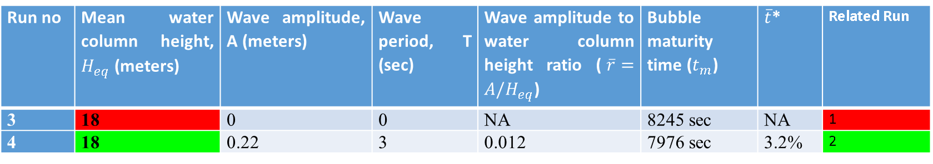
Results (contd.)
Effects of water depth on bubble growth
Bubble growth is simulated at 18 m water depth and result is compared with runs in shallow water depths (at 2 m depth, runs 1 and 2)
Run no | Mean water column height, $H_{eq}$ (meters) | Wave amplitude, A (meters) | Wave period, T (sec) | Wave amplitude to water column height ratio ($\overline{r}=A/H_{eq}$) | Bubble maturity time ($t_{m}$) | $\overline{t}$* | Related Run
3 | 18 | 0 | 0 | NA | 8245 sec | NA | 1
4 | 18 | 0.22 | 3 | 0.012 | 7976 sec | 3.2% | 2
Notes:
Next, to demonstrate the effect of water depth on bubble maturity time and fracturing pattern, bubble growth is simulated in sediment under a water depth of 18 m, without and with waves and results are compare those from run 1, 2; having similar wave amplitude and period.

Slide 19
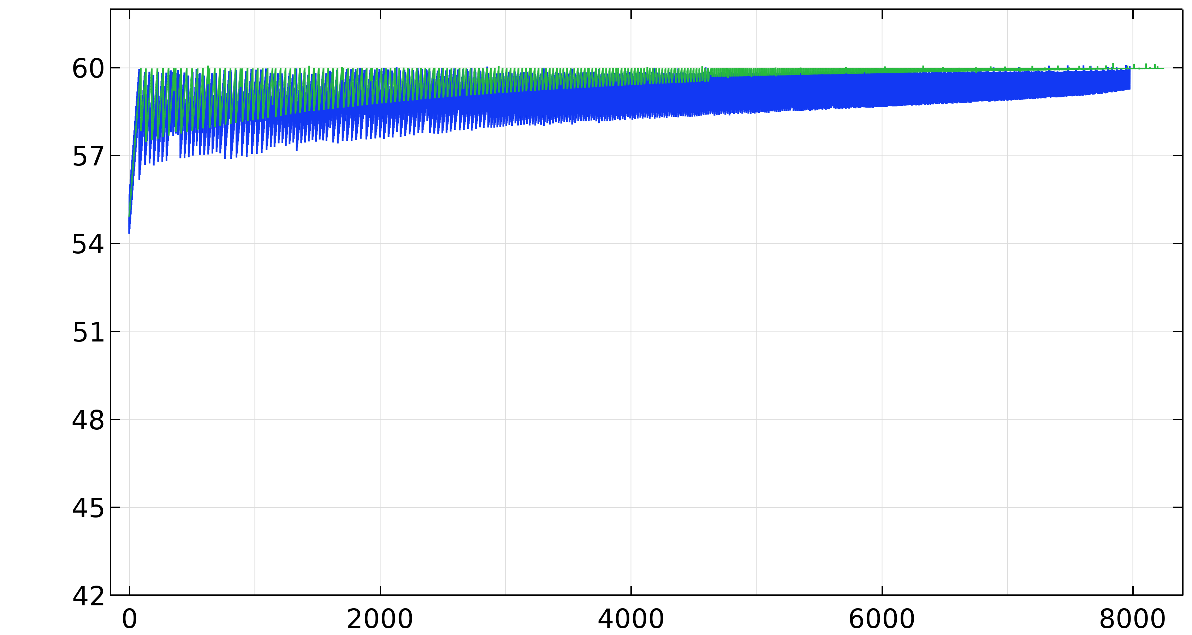
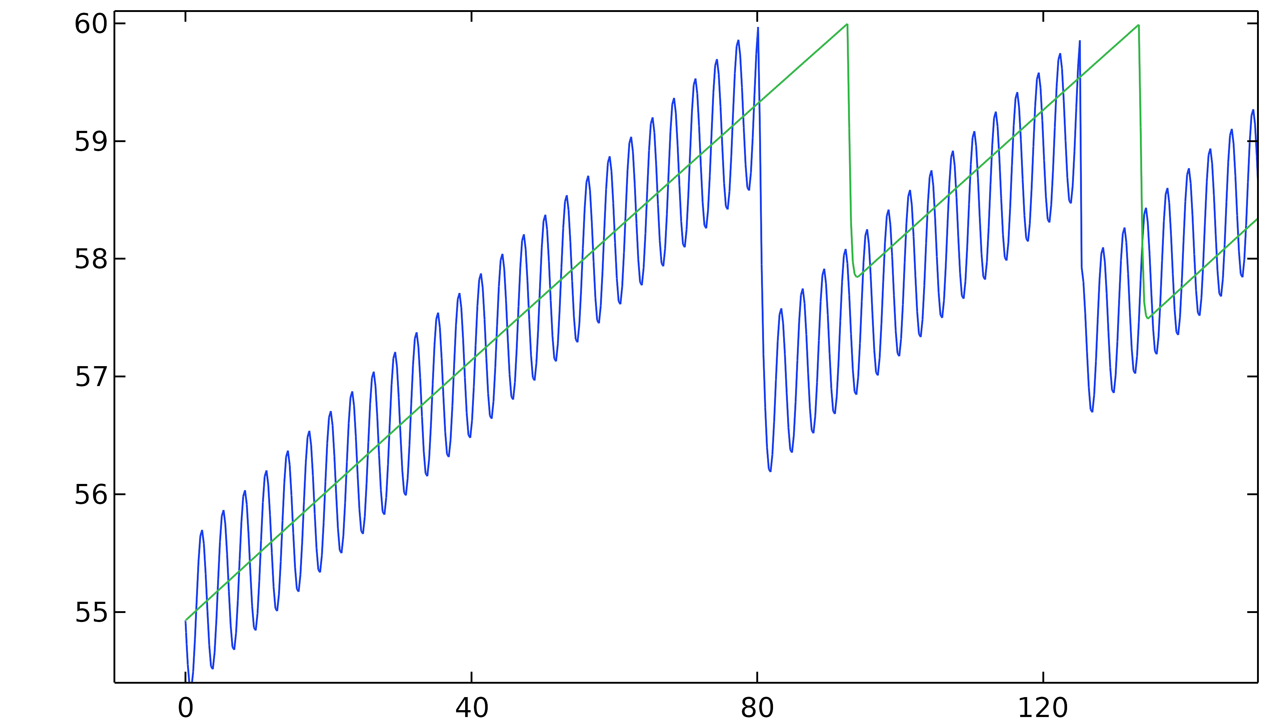


Results (contd.)
Early fracturing events
Bubbles induce early fracturing, but no multiple fracturing
Why?
$$K_{head} (Pa m0.5)$$
Bubbles in deeper water have higher inner pressure
This increases solute concentration at bubble surface, thus reduces the total diffusive flux
So, required solute to induce next fracturing accumulates in large number of wave periods
Time (s)
The bubble grow nearly ~3.2% faster, compared to bubble in absence of waves
In contrast, bubble in 2 m water depth grew 9.71% faster.
Notes:
It is seen that bubbles do induce early fracturing , but no multiple fracturing is observed.
Why? Because: Bubbles in deeper water grow with higher inner pressure. which increases the solute concentration at the bubble surface and thus reduces the temporal total diffusive flux to the growing bubble. Therefore, the gaseous CH₄ accumulated in the bubble per wave period decreases with an increase in the water column depth. Consequently, the amount of solute required to induce the next fracturing event accumulate over a substantially large number of wave periods
Therefore, bubble grow nearly ~3.2% faster, compared to bubble in absence of waves, however, in contrast, bubble in 2 m water depth grew 9.71% faster.

Slide 20

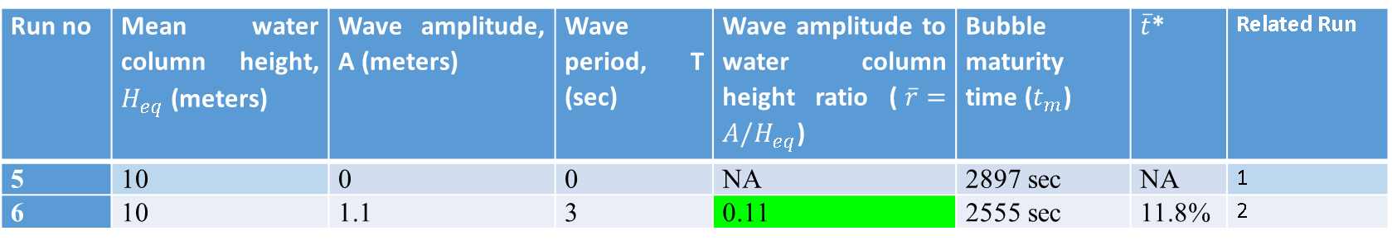
Results (contd.)
Role of ratio of wave amplitude to water depth over bubble growth $(\overline{r}=A/H_{eq}$)
Run no | Mean water column height, $H_{eq}$ (meters) | Wave amplitude, A (meters) | Wave period, T (sec) | Wave amplitude to water column height ratio ($\overline{r}=A/H_{eq}$) | Bubble maturity time ($t_{m}$) | $\overline{t}$* | Related Run
5 | 10 | 0 | 0 | NA | 2897 sec | NA | 1
6 | 10 | 1.1 | 3 | 0.11 | 2555 sec | 11.8% | 2
Same value of ratio $\overline{r}$ is preserved, as in run 2
Notes:
Another parameter of interest here is the ratio of wave amplitude to water depth (A/H_{eq}). to explore its role, over the bubble growth, we analyse results of bubble growth at water depth 10mand compare them with those from run 2, at depth 2m but with same value of ratio r.

Slide 21
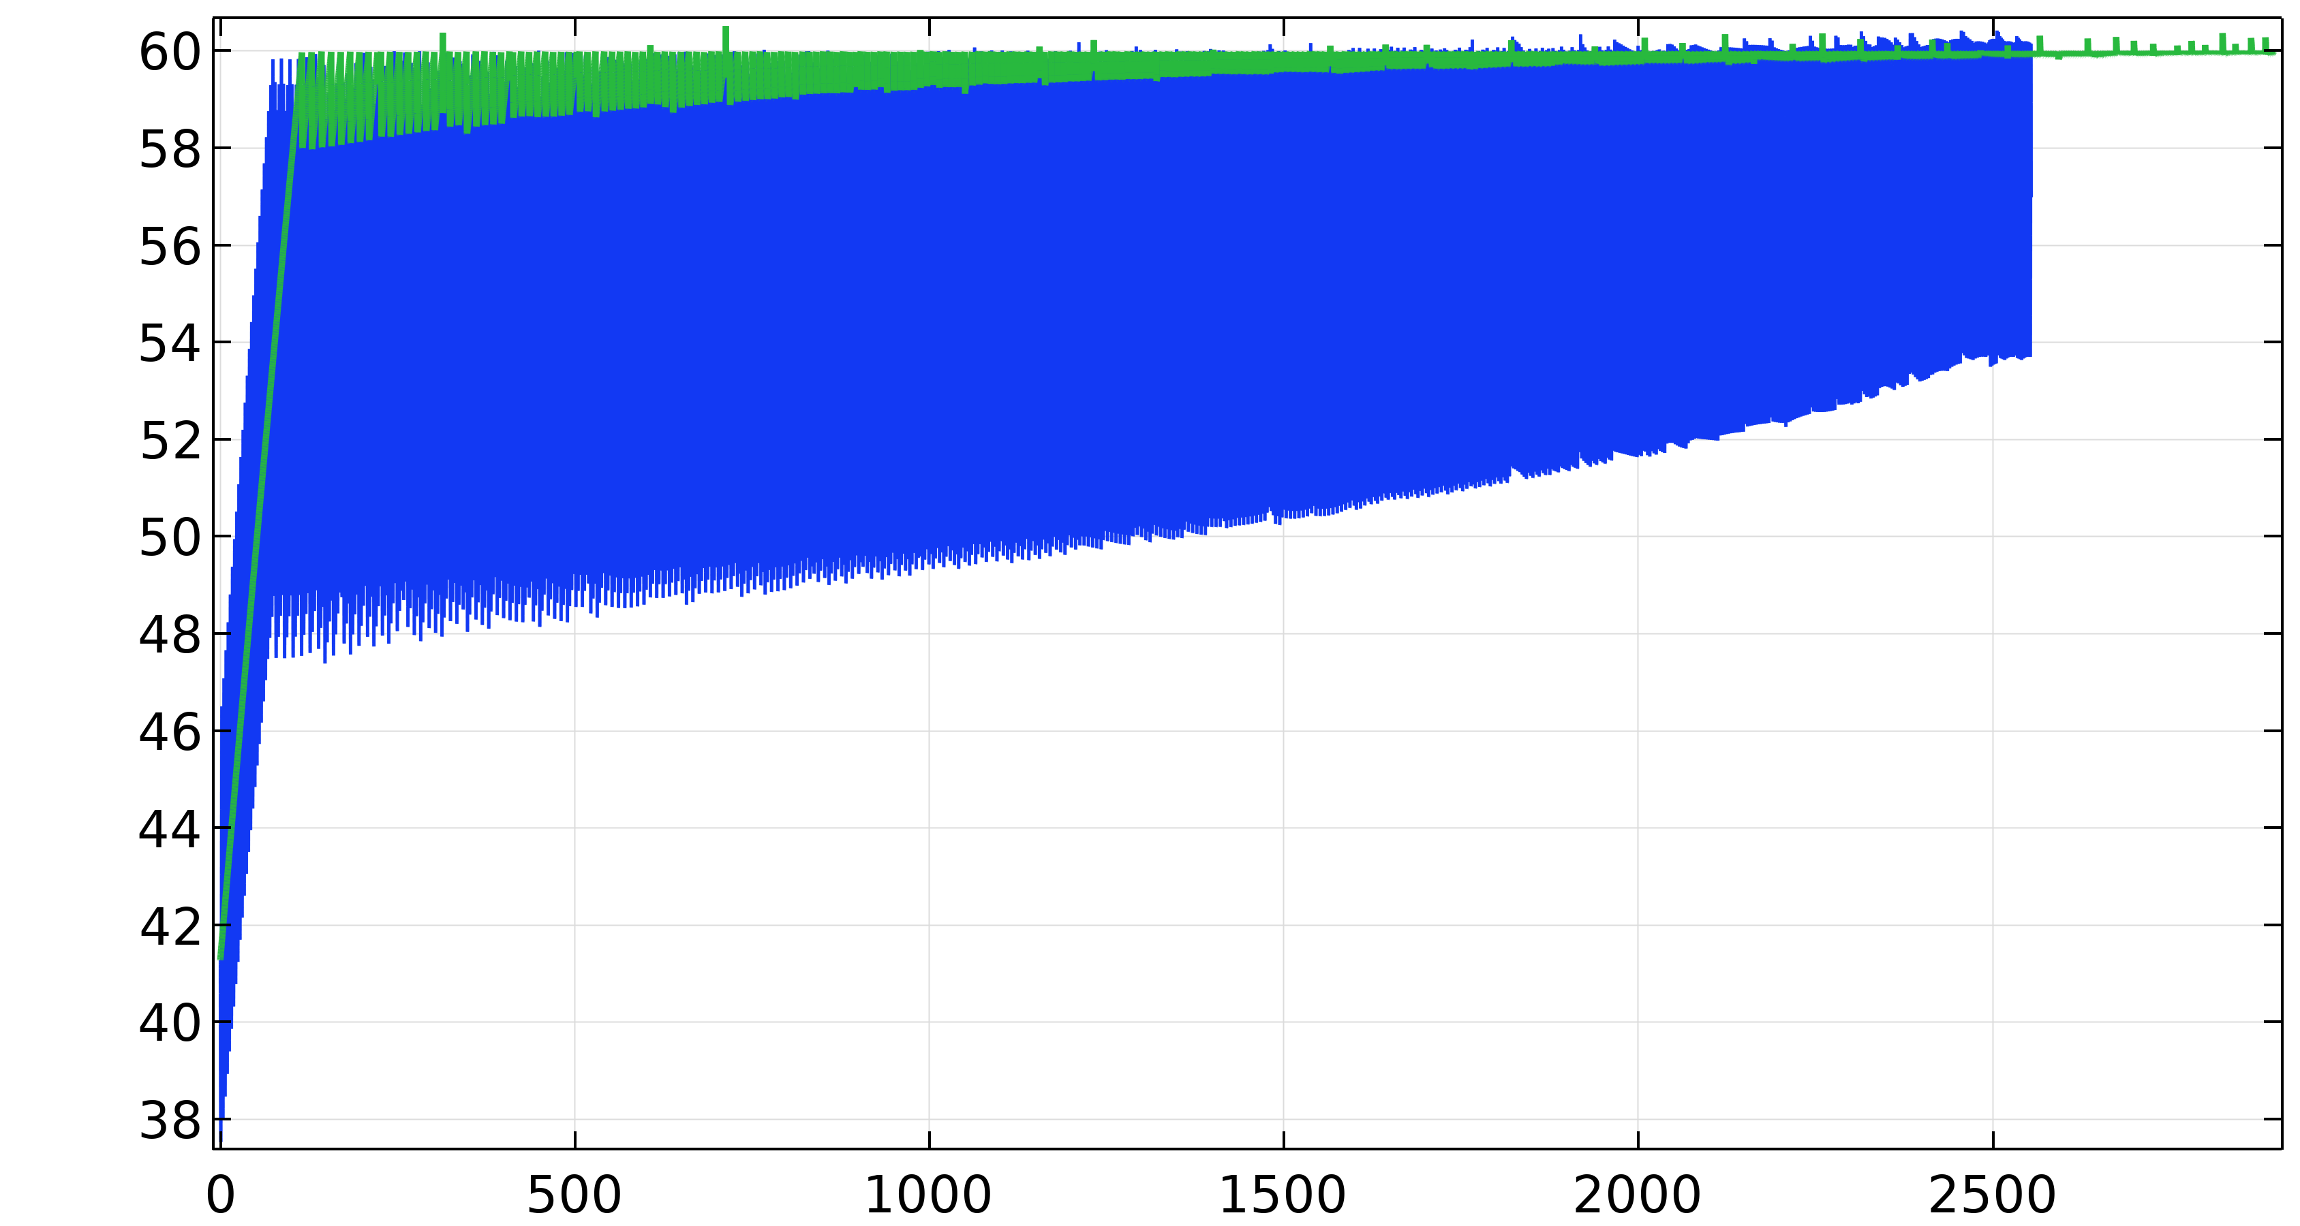
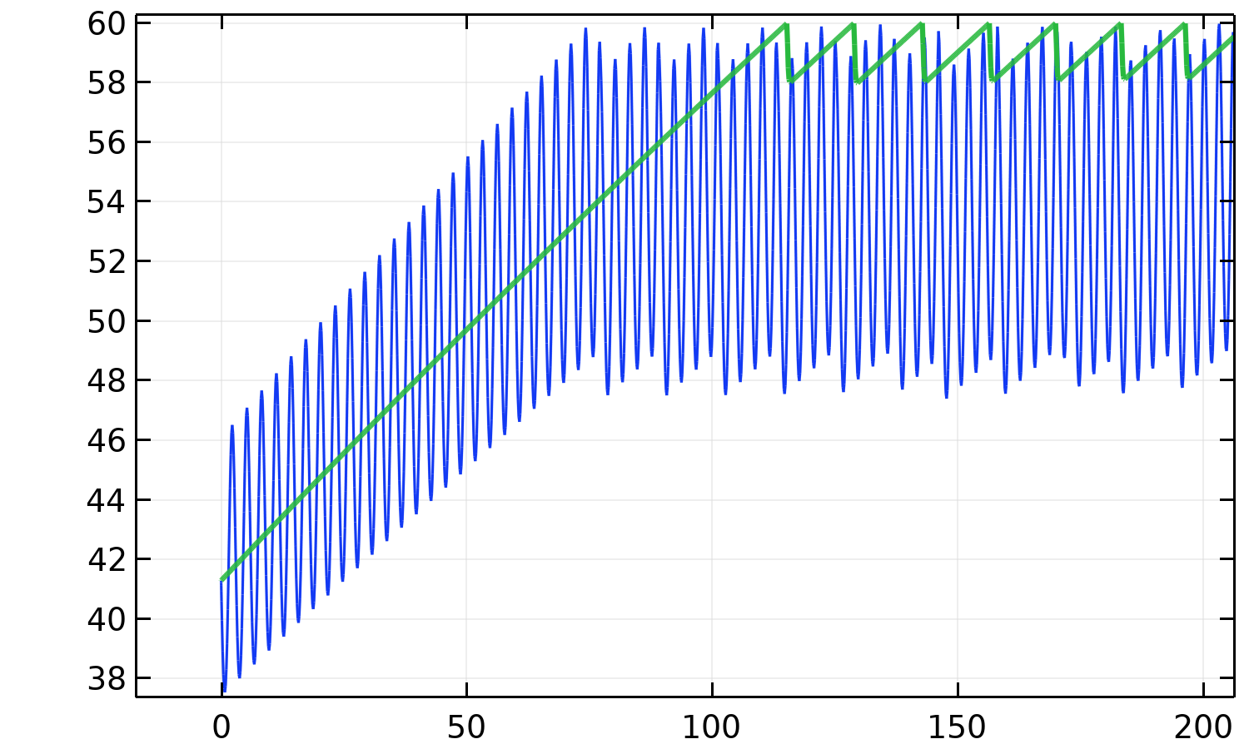


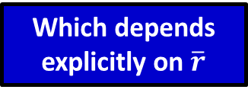
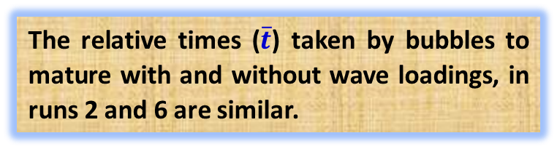
Results (contd.)
Bubble in grew nearly 11.8% faster
First fracturing
The relative times ($\overline{t}$) taken by bubbles to mature with and without wave loadings, in runs 2 and 6 are similar.
$K_{head}$ ($Pa m0.5$)
Time (s)
Why?
Which depends explicitly on $\overline{r}$
The rate of change in scaled hydrostatic overburden load:$\frac{∂(σ_{H}^{s})}{∂t}=\overline{r}∙cos\left(\frac{2πt}{T}\right)∙\frac{2π}{T}$
This generates oscillations of equivalent magnitude in $K_{head}$, for bubbles growing in environments with similar ratios, $\overline{r}$.
Notes:
What we observed that, by incurring early fracturing events, the bubble in presence of waves grew nearly 11.8% faster.
Despite distinct overburden loads, the contrast in bubble maturity time in run 2, and 6 is quite similar, 9.71% and 11.8 % ($\overline{t}$), respectively.
Why? Because the rate of change in scaled hydrostatic overburden load induced by waves is given as, which depends on parameter r. Therefore, this generates oscillations of equivalent magnitude in bubble openings and K_{head}, for bubbles growing in environments with similar ratios, r ̅.

Slide 22
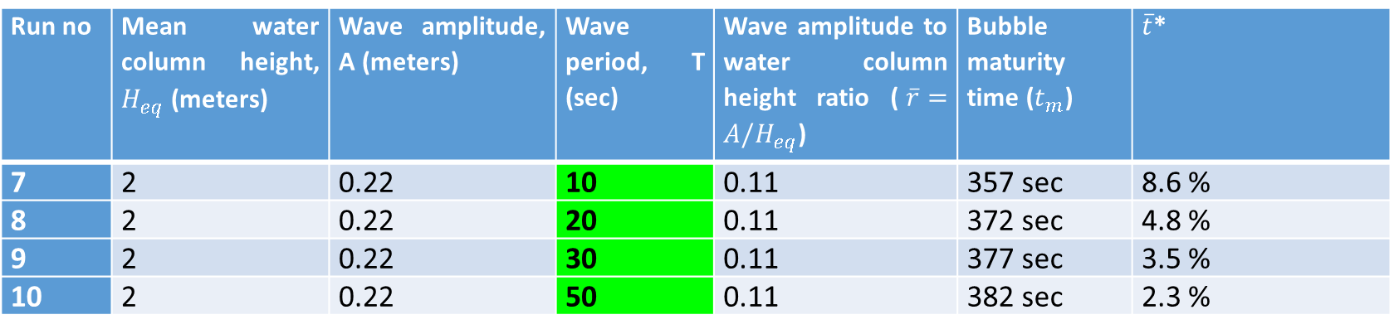
Results (contd.)
Role of wave periods over bubble growth
Run no | Mean water column height, $H_{eq}$ (meters) | Wave amplitude, A (meters) | Wave period, T (sec) | Wave amplitude to water column height ratio ($\overline{r}=A/H_{eq}$) | Bubble maturity time ($t_{m}$) | $\overline{t}$*
7 | 2 | 0.22 | 10 | 0.11 | 357 sec | 8.6 %
8 | 2 | 0.22 | 20 | 0.11 | 372 sec | 4.8 %
9 | 2 | 0.22 | 30 | 0.11 | 377 sec | 3.5 %
10 | 2 | 0.22 | 50 | 0.11 | 382 sec | 2.3 %
Bubble growth is simulated at distinct time periods
Notes:
Further, we simulate bubble growth with different wave periods having same ambient conditions in order to understand the effect of wave periods (T) over bubble growth.

Slide 23


Results (contd.)
Mean water depth ($H_{eq}$) = 2 m
Wave amplitude (A) = 0.22 m
Smaller period waves expedite bubble growth more
Bubble maturity time, $t_{m}$ (s)
Why?
Because, for short wave periods, bubble is exposed to wave trough loadings more frequently, where early and multiple fracturing occurs
Wave periods, T (s)
Notes:
Simulations reveal that smaller period waves expedite bubble growth more compared to longer period waves.
The reason is that : For smaller wave periods, the bubble is exposed to wave trough loadings more frequently, over the entire period of its growth. Thus, bubble growth via early or multiple fracturing events occurs more frequently in the presence of short period waves. This facilitates bubbles in attaining mature size in less time.

Slide 24
Discussion
Surface waves can reduce the duration of the growth phase of bubbles and allow early upward buoyant bubble rise. In the modelled conditions, simulated bubbles grew ~2.3 - 11.8 % faster in the presence of surface waves.
In shallow water depths, bubbles may grow by inducing a dynamic fracturing and can unrestrictedly dynamically ascent toward the sediment-water interface, if the wave action halts at wave troughs.
At higher water depths, the wave’s contribution to expedite bubble growth is relatively small. However, it is significant in shallow depths, and can significantly decrease bubble’s total lifespan in water body.
Large period waves (for e.g., tides) have a marginal effect over the bubble maturity time. However, they can affect migration of already mature stationary bubbles, and can cause release of bubbles from shallow gas horizons at low tides.
Notes:
Here are few important discussion based on our results:
Surface waves can reduce the duration of the growth phase of bubbles and allow early upward buoyant bubble rise. In the modelled conditions, simulated bubbles grew ~2.3 - 11.8 % faster in the presence of surface waves.
In shallow water depths, bubbles may grow by inducing a dynamic fracturing and can unrestrictedly dynamically ascent toward the sediment-water interface, if the wave action halts at wave troughs.
It is inferred that in higher water depths, the wave’s contribution to expedite bubble growth would be relatively small. However, in shallow depths, it would be significant and can significantly decrease bubble’s total lifespan in water body.
The Large period waves like tides and swells have a marginal effect over the growth phase of bubbles. However, they can affect migration of already mature stationary bubbles, as suggested by Katsman, 2019, and can cause release of bubbles from shallow gas horizons at low tides.

Slide 25
Discussion
Sediments maintain partially annealed rise paths, wherein, subsequent bubbles of smaller mean volumes can rise. In presence of waves, subsequent bubbles of smaller volumes should grow faster and liberate by vertical conduits; which explains the rise of multiple bubbles observed in field studies in presence of wind or storm-induced surface waves.
In water bodies where organic matter is distributed mainly in littoral zones, waves contribute substantially to bubble growth, and enhance ebullition fluxes from those regions. Conversely, in sites where organic matter is concentrated in deeper zones, the slow bubble growth at CH₄ generating sites, ultimately lead to occurrence of stationary bubbles (or very slow growth), forming sub-surface gas horizons despite wave actions.
Notes:
Sediments maintain partially annealed rise paths, wherein, subsequent bubbles of smaller mean volumes can rise. In presence of waves, subsequent bubbles of smaller volumes should grow faster and liberate by vertical conduits; which explains the rise of multiple bubbles observed in field studies in presence of wind or storm-induced surface waves.
In water bodies where organic matter is distributed mainly in littoral zones, waves contribute substantially to bubble growth, and enhance ebullition fluxes from those regions. Conversely, in sites where organic matter is concentrated in deeper zones, the slow bubble growth at CH4 generating sites, ultimately lead to occurrence of stationary bubbles (or very slow growth), forming sub-surface gas horizons despite wave actions.

Slide 26
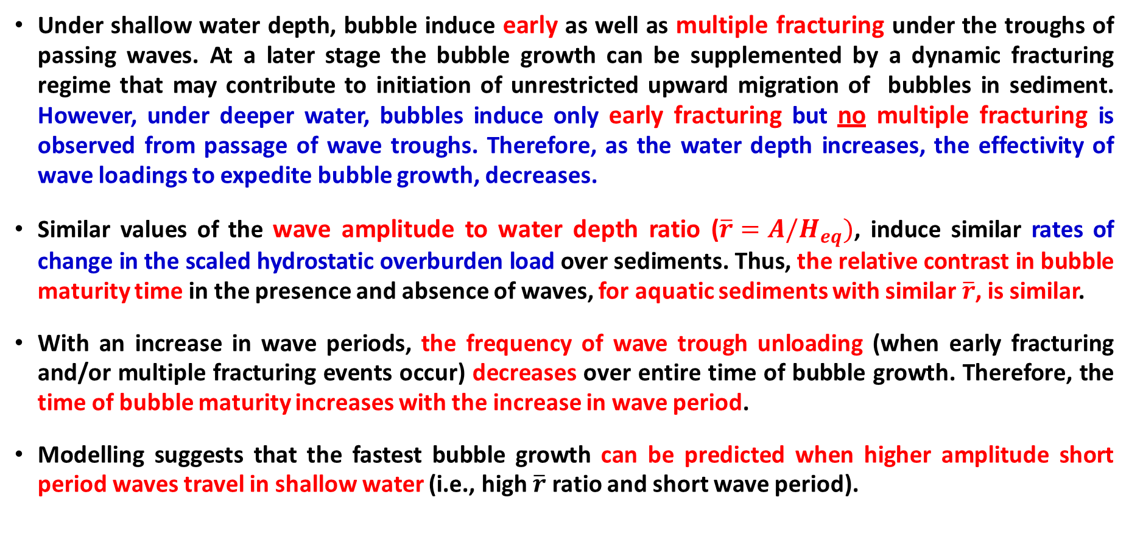
Conclusions
Under shallow water depth, bubble induce early as well as multiple fracturing under the troughs of passing waves. At a later stage the bubble growth can be supplemented by a dynamic fracturing regime that may contribute to initiation of unrestricted upward migration of bubbles in sediment. However, under deeper water, bubbles induce only early fracturing but no multiple fracturing is observed from passage of wave troughs. Therefore, as the water depth increases, the effectivity of wave loadings to expedite bubble growth, decreases.
Similar values of the wave amplitude to water depth ratio ($\overline{r}=A/H_{eq})$, induce similar rates of change in the scaled hydrostatic overburden load over sediments. Thus, the relative contrast in bubble maturity time in the presence and absence of waves, for aquatic sediments with similar $\overline{r}$, is similar.
With an increase in wave periods, the frequency of wave trough unloading (when early fracturing and/or multiple fracturing events occur) decreases over entire time of bubble growth. Therefore, the time of bubble maturity increases with the increase in wave period.
Modelling suggests that the fastest bubble growth can be predicted when higher amplitude short period waves travel in shallow water (i.e., high $\overline{r}$ ratio and short wave period).
Notes:
Under shallow water depth, bubble induce early as well as multiple fracturing under the troughs of passing waves. At a later stage the bubble growth can be supplemented by a dynamic fracturing regime that may contribute to initiation of unrestricted upward migration of bubbles in sediment. However, under deeper water, bubbles induce only early fracturing, but no multiple fracturing is observed from passage of wave troughs. Therefore, as the water depth increases, the effectivity of wave loadings to expedite bubble growth, decreases.
Similar values of the wave amplitude to water depth ratio (𝒓 ̅=𝑨/𝑯_𝒆𝒒), induce similar rates of change in the scaled hydrostatic overburden load over sediments. Thus, the relative contrast in bubble maturity time in the presence and absence of waves, for aquatic sediments with similar 𝒓 ̅, is similar.
With an increase in wave periods, the frequency of wave trough unloading (when early fracturing and/or multiple fracturing events occur) decreases over entire time of bubble growth. Therefore, the time of bubble maturity increases with the increase in wave period.
Modelling suggests that the fastest bubble growth can be predicted when higher amplitude short period waves travel in shallow water (i.e., high 𝒓 ̅ ratio and short-wave period).

Slide 27
Thank you for your kind
attention
Notes:
For more information, kindly refer to https://doi.org/10.3389/feart.2022.833918
Many thanks for your Kind attentions.

