Slide 1





QUANTIFYING THE MORPHOLOGICAL DEGRADATION OF TERRESTRIAL IMPACT CRATERS THROUGH A DENUDATION INDEX DERIVED USING DRAINAGE NETWORK SIGNATURES
S. James¹, Saranya R. Chandran¹ and K.S. Sajinkumar^{1,2}
¹ Department of Geology, University of Kerala, India
² Department of Geological and Mining Engineering and Sciences, Michigan Technological University, USA
Session: GM11.1/PS11.5
Thursday, 26 May 2022

Slide 2
OVERVIEW
INTRODUCTION
CONCEPT OF DENUDATION INDEX
METHODOLOGY
RESULTS AND DISCUSSION

Slide 3
INTRODUCTION
Liquid water
– an essential component of the Earth
– oversee landscape evolution globally
Terrestrial impact craters
– posses characteristic drainage patterns
– dominantly denuded by fluvial processes

Slide 4
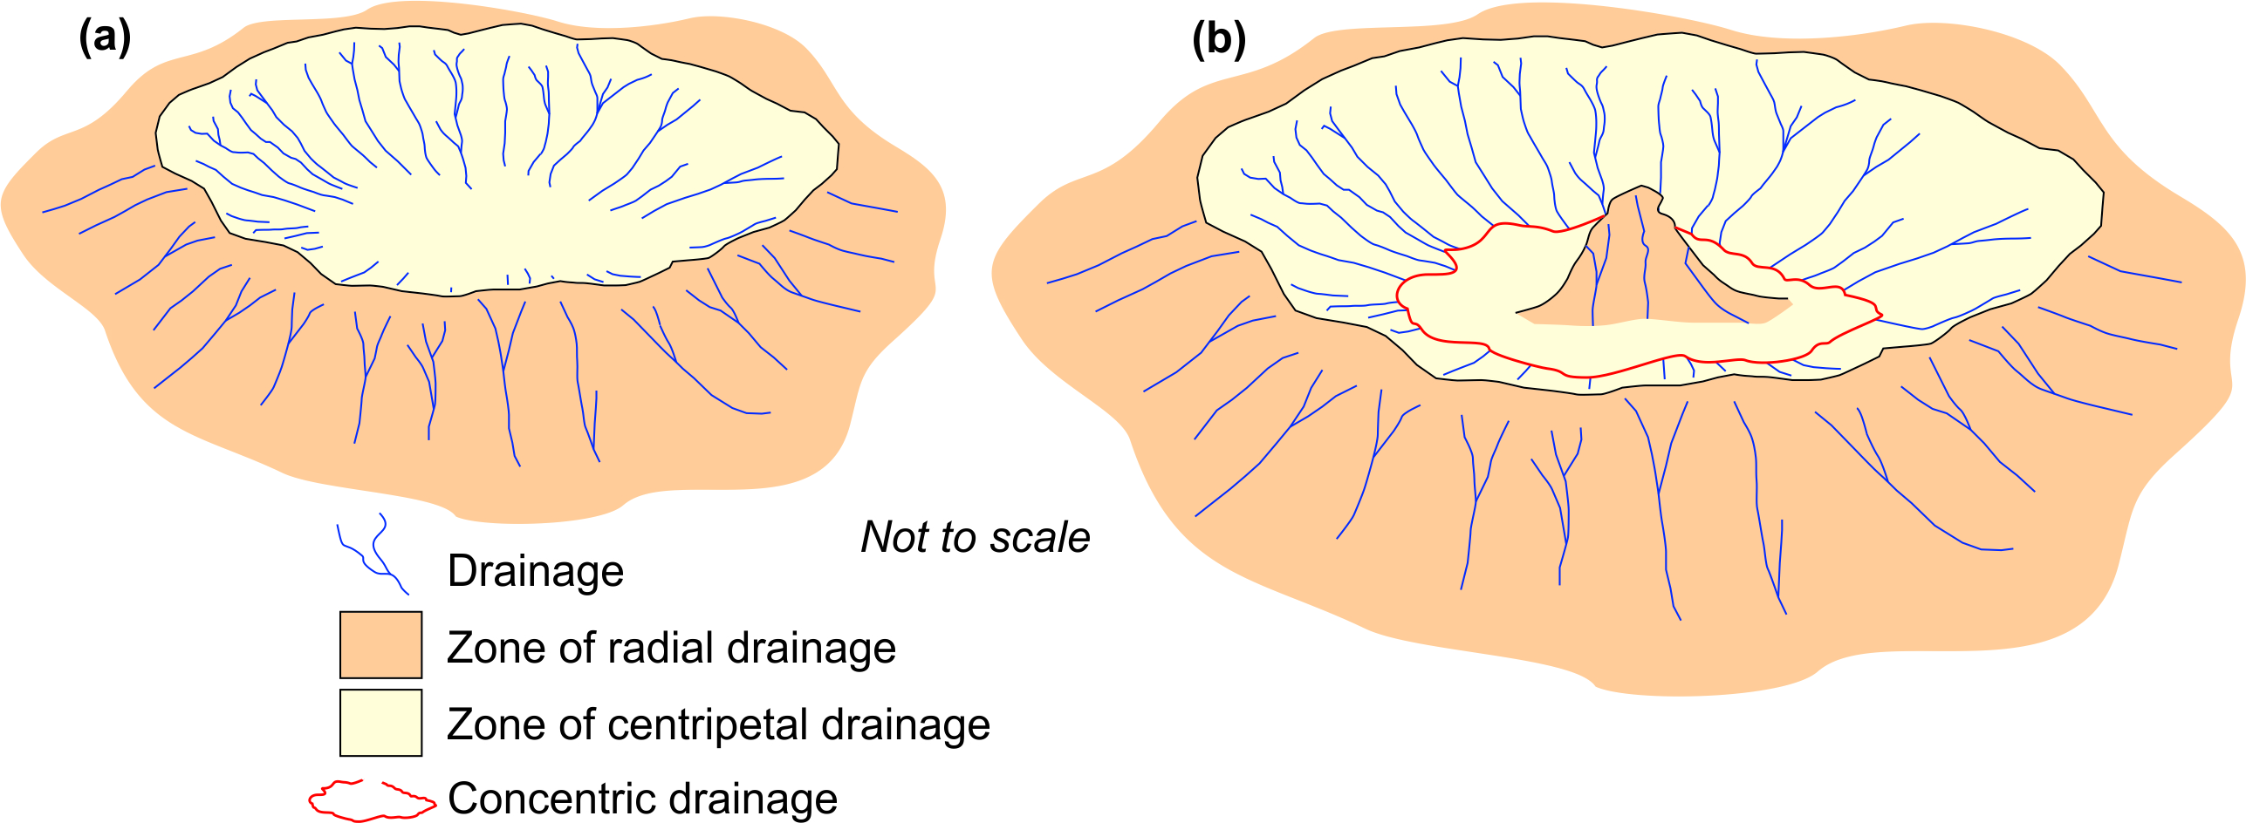
Fig 1: Drainage patterns associated with terrestrial impact craters
(a) simple crater – 1 radial, 1 centripetal pattern
(b) complex crater – 2 radial, 1 centripetal pattern

Slide 5
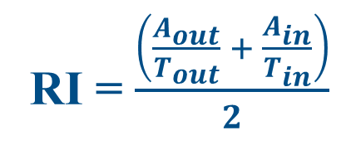
CONCEPT OF DENUDATION INDEX
RI = $\frac{\left(\frac{A_{out}}{T_{out}} + \frac{A_{in}}{T_{in}}\right)}{2}$
DI = 1–RI

Slide 6
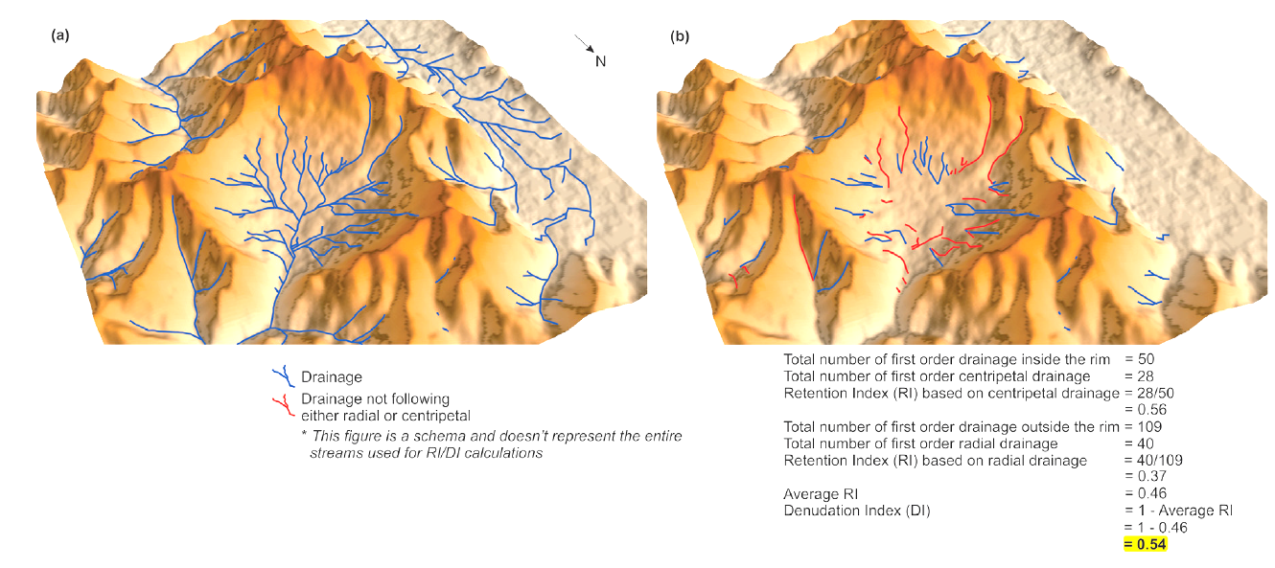
Fig 2: a) Drainage evolved from elevated rim at Xiuyan, China (b)1st order streams in red neither follow radial or centripetal pattern (ALOS PALSAR elevation map over hill shade).

Slide 7
METHODOLOGY
Crater selection
Drainage extraction & verification (Google Earth)
DI derivation
DI correlation – a) age
– b) target lithology
– c) reconstructed paleoclimate

Slide 8
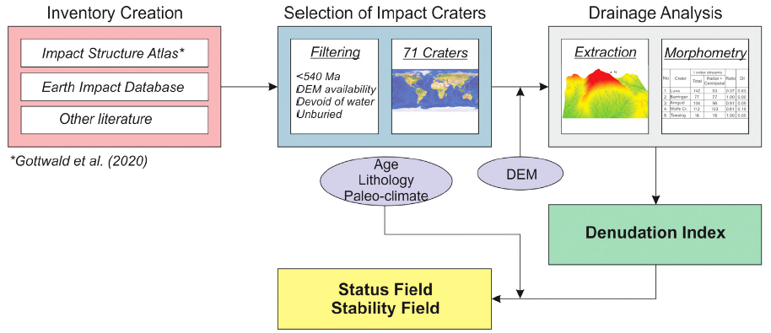
Fig 3: Schema of the methodology adopted for the present study

Slide 9
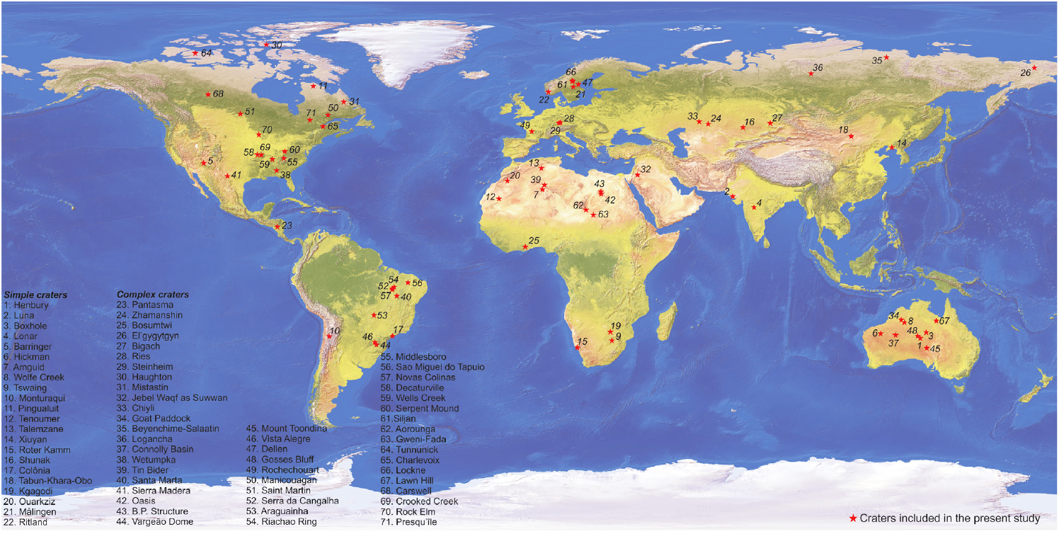
Fig 4: Location of 71 terrestrial impact craters considered in the study

Slide 10
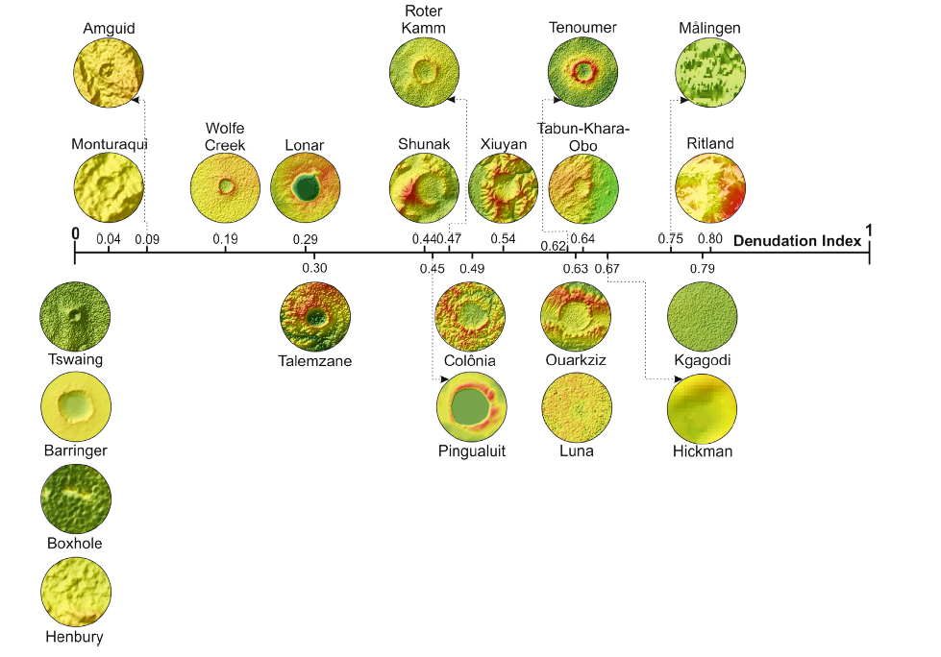
RESULTS AND DISCUSSION
Fig 5: DI scale for simple impact craters

Slide 11
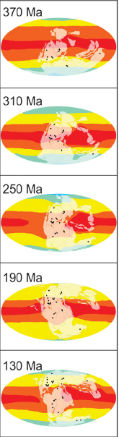
DI α duration of crater exposure to the denudation agents
Denudation increases in order:
LOW DENUDATIONAL CLIMATES HIGH DENUDATIONAL CLIMATES
Longer durations in LDC can equate to shorter durations in HDC, irrespective of target rock types.

Slide 12
Notable Deviations
DI of Hickman (0.67) > DI of Tabun-Khara-Obo (0.64) (150±20Ma).
DI of craters on crystalline target (Decaturville, 0.55) > DI at sedimentary target (El'gygytgyn, 0.87).

Slide 13
THANK YOU ☺

