Slide 1
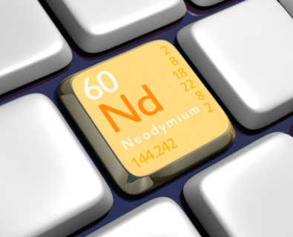
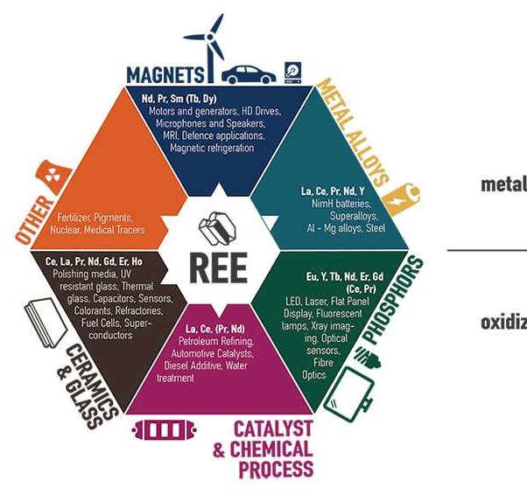

REE fluoro-carbonates within rocks and emerald-bearing veins in eastern emerald belt, Colombia
Emerald “fingerprint”
Javier Garcia-Toloza ¹, Andrés F. González ¹, James Day ², Gabriel Angarita ¹, Holman Alvarado ¹, Valeria Ramírez-Juya ¹, Valentina González ¹, Camilo A. Betancur A. ¹
1. Technological development Centre for the Colombian Emeralds, Bogotá, Colombia, 2. Scripps Institution of Oceanography UC San Diego, San Diego, CA, USA
geologist@gemlabcdtec.com
Notes:
Why study rare earth element? We wish understand their genesis and their rol in the emerald formation. Futher, this mineral can dated. So, this mineral can be useful exploraty purpose.

Slide 2

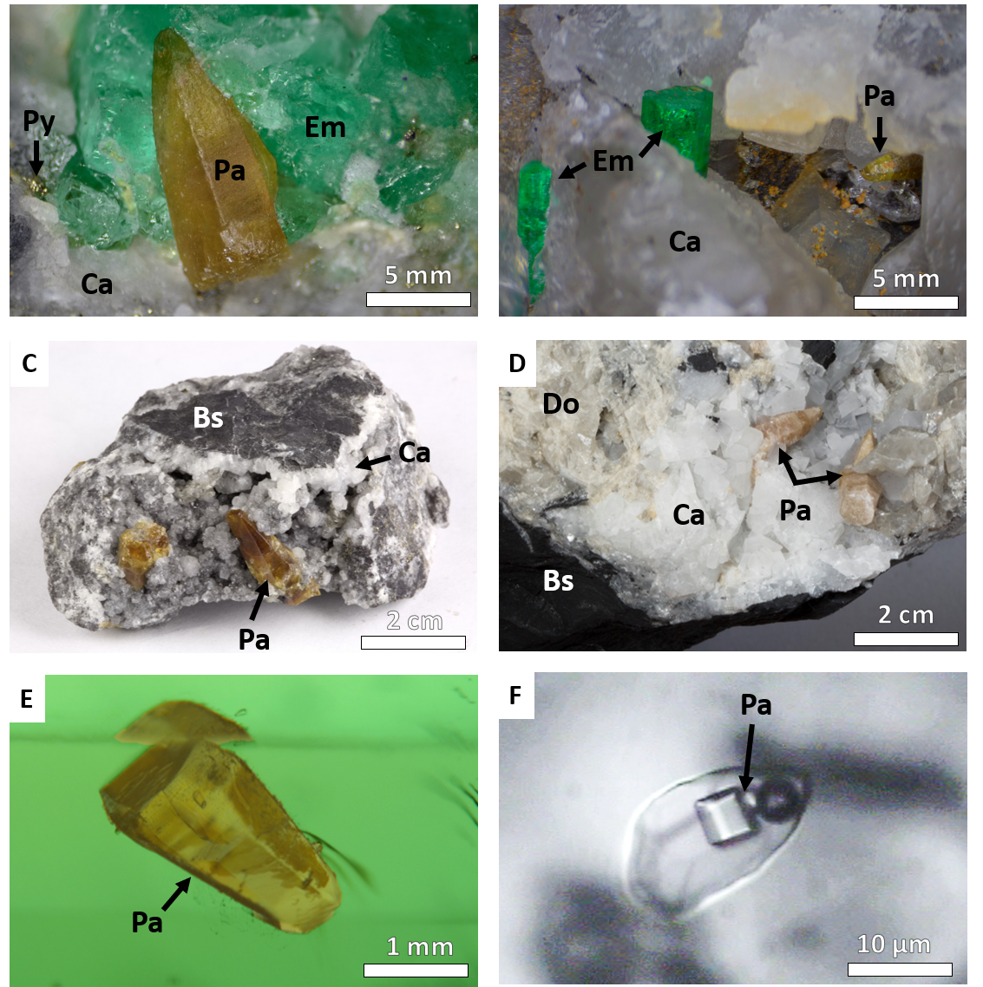
Parisite: Ca(Ce,La)2(CO3)3F2
Emerald
Types Rock
Igneas
Metamophic
Sedimentary
Parisite and emerald ocurrences of the world
Emerald: Be₃Al(Cr,V,Fe)₂Si₆O₁₈
ORIGIN:
COLOMBIA
geologist@gemlabcdtec.com
Notes:
its map show the location parasite in the world, also, the location of emeradl. In the worls until now, the unique place where La parisita-(Ce) Ca(Ce,La)2(CO3)3F2: fluorocarbonato de cerio, lantano y cerio, cristaliza en el sistema hexagonal, asociado a otros minerales del grupo de las tierras raras. Fue llamada así en honor de J.J.Paris, propietario de una mina de esmeralda en Muzo en Colombia donde fue descubierta.

Slide 3
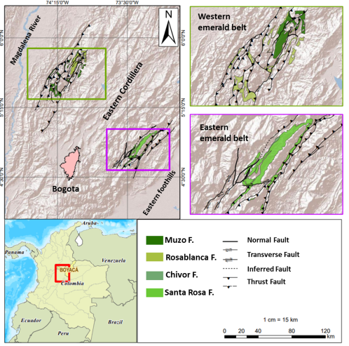
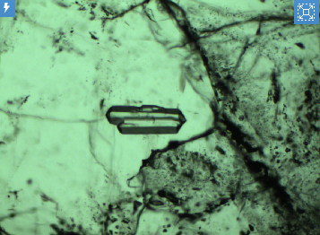
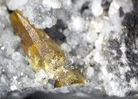

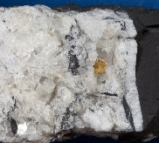
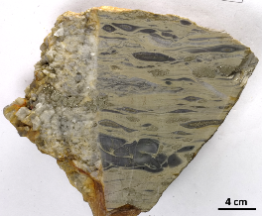
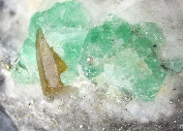

F-Apatite
Albite
Xenotime
Rare earth elements minerals
In emerald formation
Stage | 1 | 2 | 3 | 4
 | Rock | Albitization | Carbonatization | Late stage
Pre-mineral Monacite
Fibrous calcite
Quartz 1
Albite 1
Albite 2
Xenotime
F-apatite
Emerald 1
Calcite
Mica
Dolomite
Quartz 2
Emerald 2
F-Apatite
Parisite-Synshisite
Geological Setting
WEB Western emerald belt
EEB Eastern emerald Belt
Mineralizing Setting
geologist@gemlabcdtec.com
Notes:
Colombian emerald deposits are sediment-hosted unlike to Zambia and Brasil deposits, and occur within two parallel, elongated belts called the Eastern and Western Emerald Belts.
The host-rocks displaying strong alteration (albitized and carbonatized) leached and released elements like beryllium, chromium, vanadium, essential for emerald formation. Emeralds are formed in hydrothermal breccias and veins composed of calcite- dolomite, albite, and pyrite.
Colombian emeralds by their relation of Cr /V from the both zones display differences in color, WEB have a yellow-green hue, whereas EEB’s have a blue-green hue

Slide 4
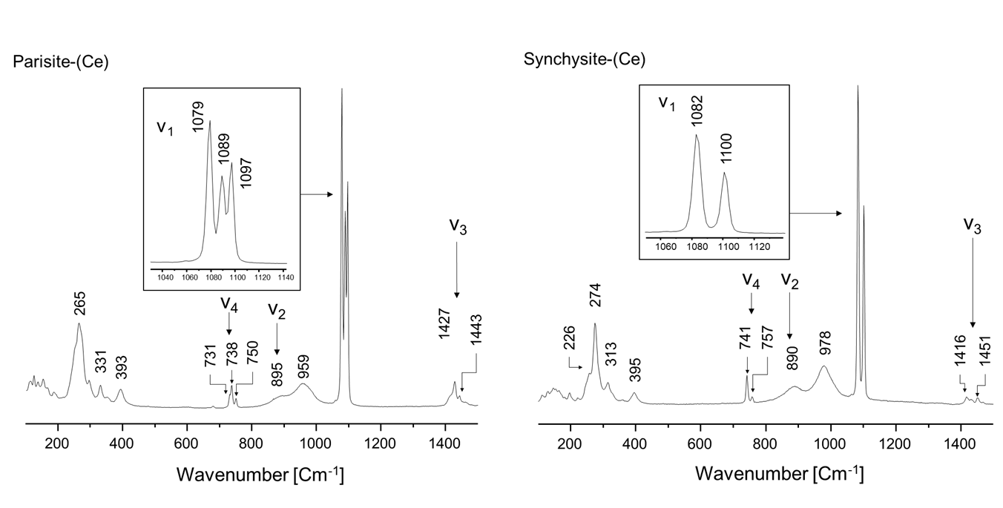
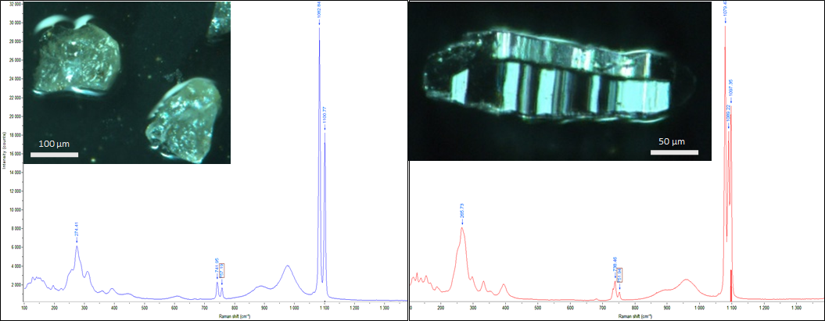
geologist@gemlabcdtec.com

Slide 5
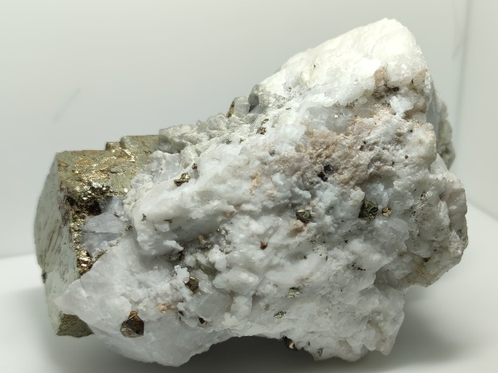
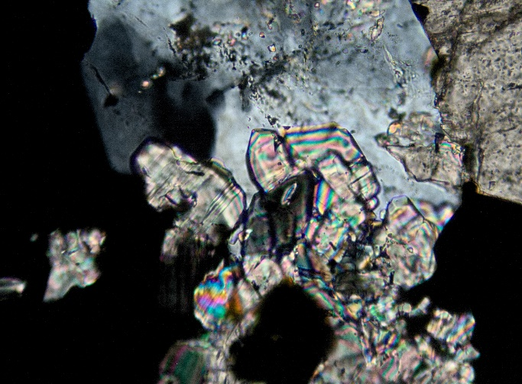
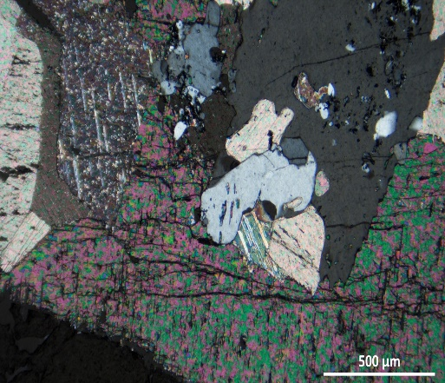
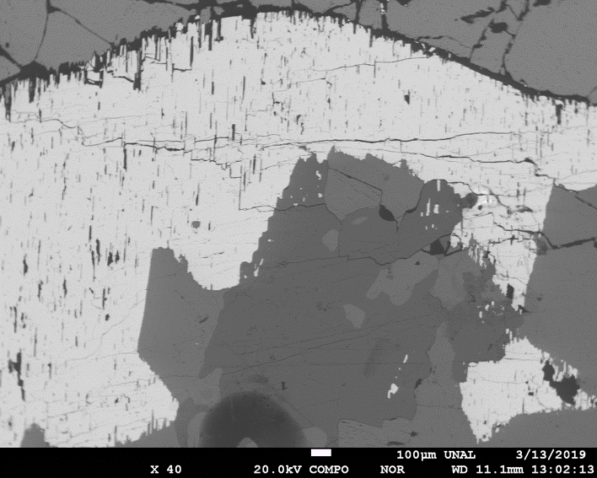
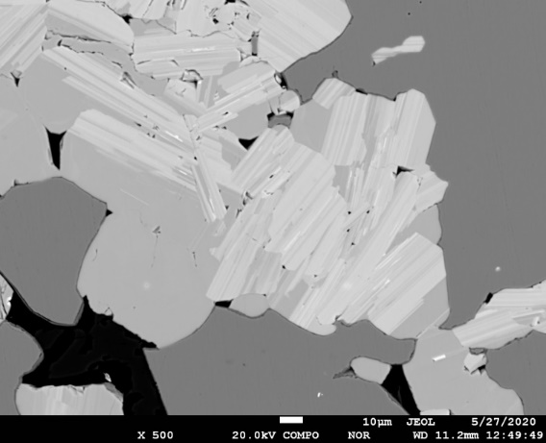
geologist@gemlabcdtec.com
WEB
EEB
Parisite and synchysite
Pyrite
Emerald
Pyrite
Parisite
Calcite
Calcite
Quartz
Calcite
Py
Al
Parisite
Parisite
Cal.
Dol.
Parisite
Parisite
Synchysite
geologist@gemlabcdtec.com

Slide 6
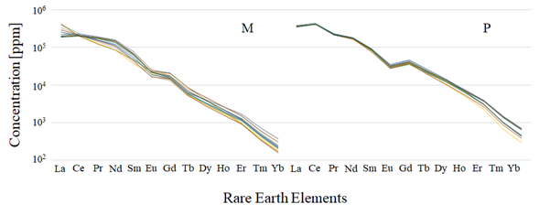
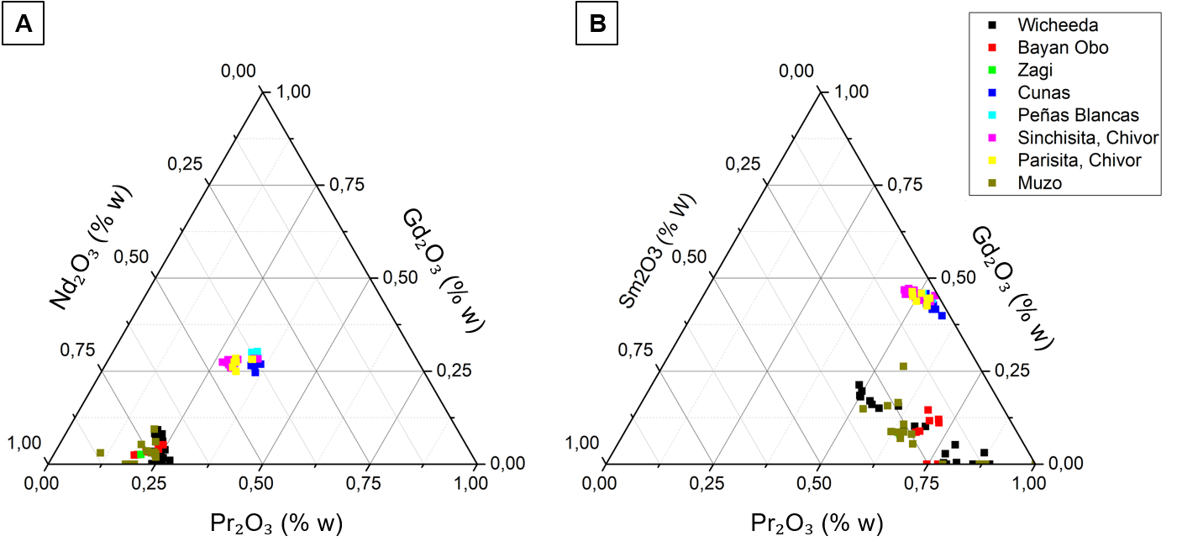
M: Host rock. Eastern emerald belt. Authigenic Monacite
P: Vein. Eastern emerald belt
Hydrotermal Parisite and synchysite
geologist@gemlabcdtec.com

Slide 7
Takeaway points
Motivate more research on the economic potential of rare earth elements in Colombia hosted in sedimentary rock
The parisite as a pathfinder for geochemical exploration (Greenfields)
The relationship between Authigenic Monazite - Hydrothermal Parisite → the genetic model that describes that black shales are the source of all the elements necessary to form emeralds.
Gemological implication: Parisite and synshite as a fingerprint of Colombian emeralds
Acknowledgements
This study was supported by the National Emerald Federation (FEDESMERALDAS), the association of Colombian Emerald Producers (APRECOL), the Colombian association of trade in emeralds (ASOCOESMERAL), Colombian Association of Emerald Exporters (ACODES) and the Ministry of Mines and Energy.
geologist@gemlabcdtec.com
Notes:
The geochemical study of micas shows that could be an indicator mineral in exploration to identify the emerald-bearing veins, thus the micas from the second stage have a particular fingerprint owe to the chromophores relation near to 1:1 in the WEB and 1:2 (Cr: V) in the EEB.
Negative Cr, and V anomalies in the host-rock evidence a relation with the presence of mineralized zones.
The famous and exotic colors of Colombian emeralds; the yellowish-green from the WEB, and the blueish-green from the EEB are linked to the relation of the chromophores Cr:V.

Slide 8

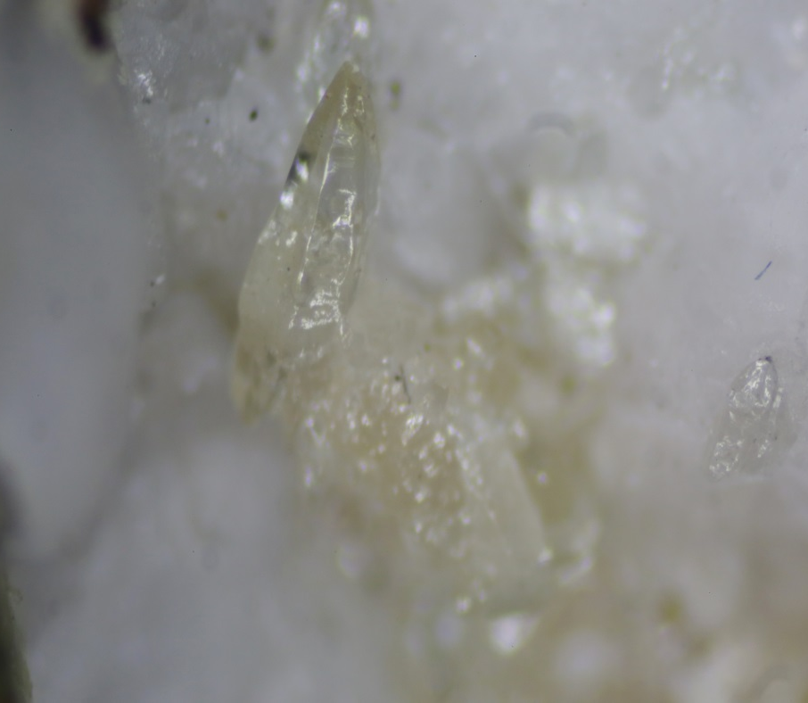
Javier Garcia Toloza
Geologist. CDTEC
geologist@gemlabcdtec.com
jagarciato@unal.edu.co
REE-Fluorocarbonates from Eastern Emerald Belt, Chivor, Boyaca. Colombia

