Slide 1





Variability of the Upper Ocean Energy Field in the Amundsen Basin, Arctic Ocean
Wen-Chuan Wu, Ying-Chih Fang, Benjamin Rabe,
and Team Ocean
26.05.2022

Slide 2
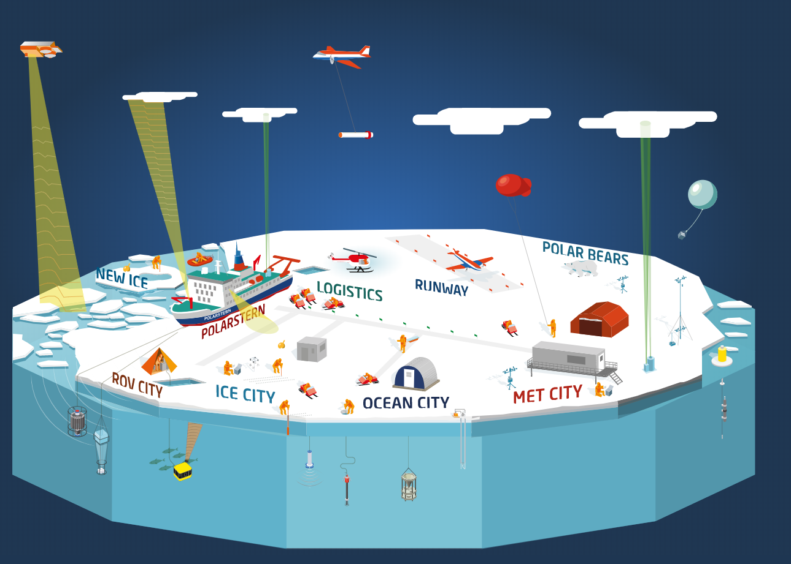
1

Slide 3
1
Buoy

Slide 4
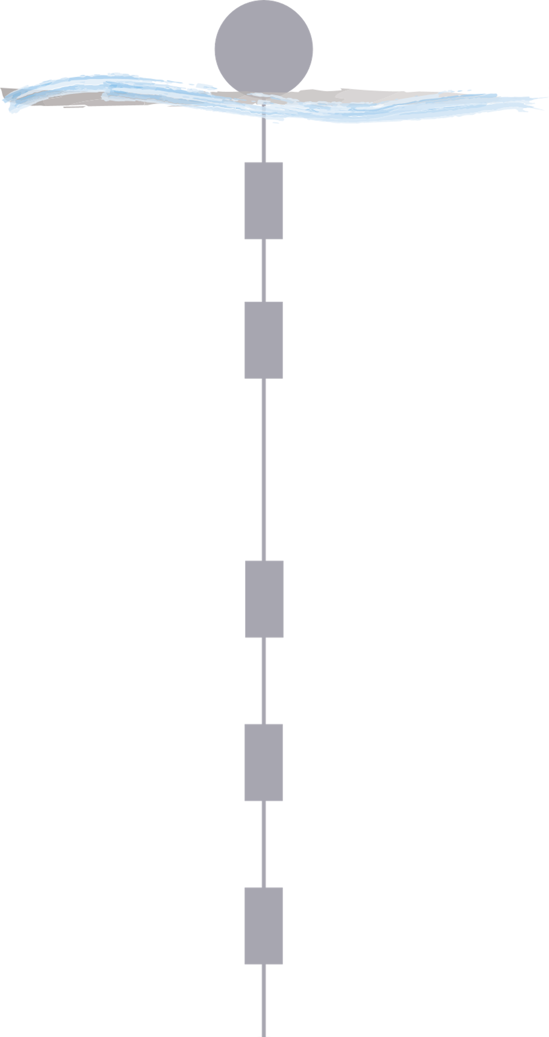
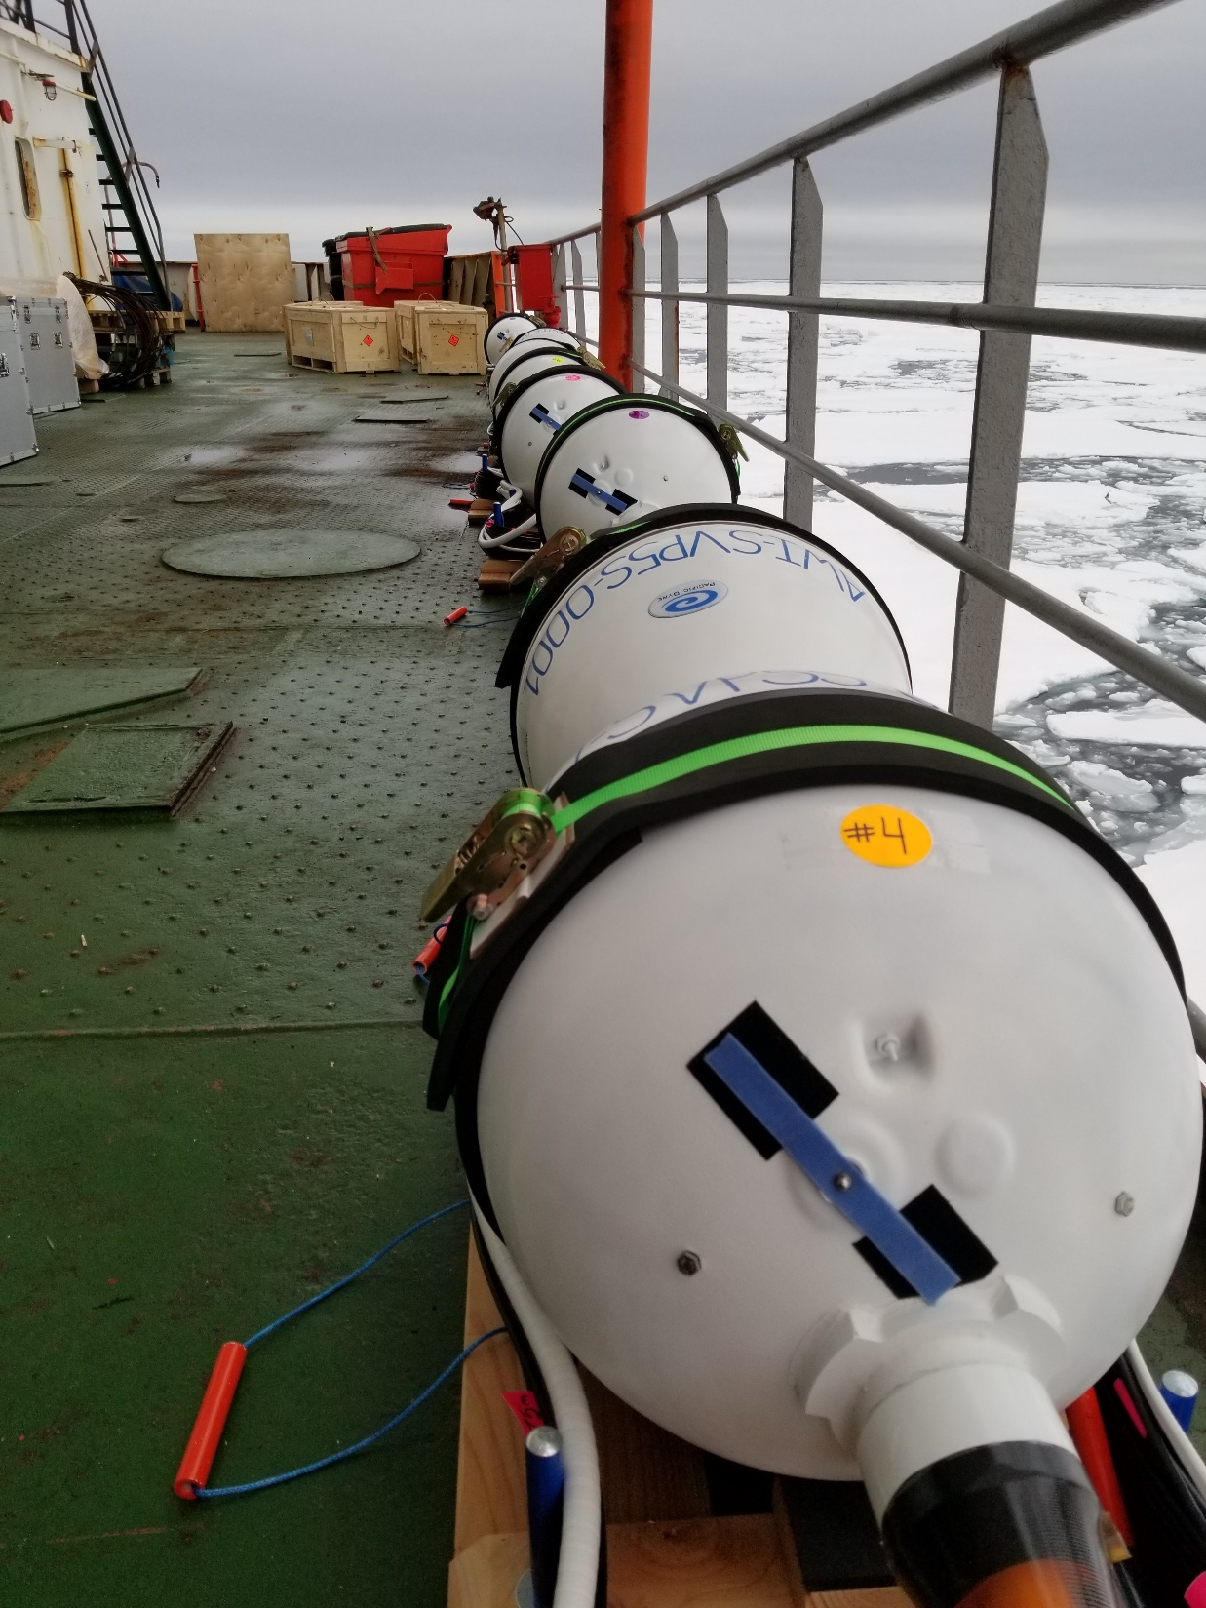
2
Sampling interval: 10 minutes
Surface unit
10 m
Depth
20 m
50 m
75 m
100 m
(Photo provided by Ying-Chih Fang)

Slide 5
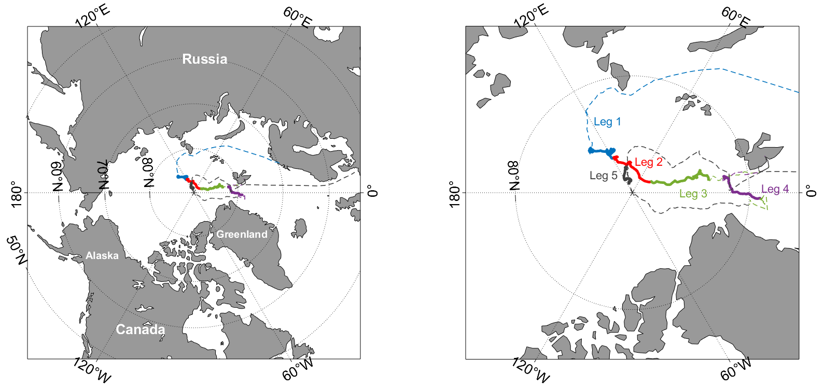
Drift of MOSAiC Expedition
3

Slide 6
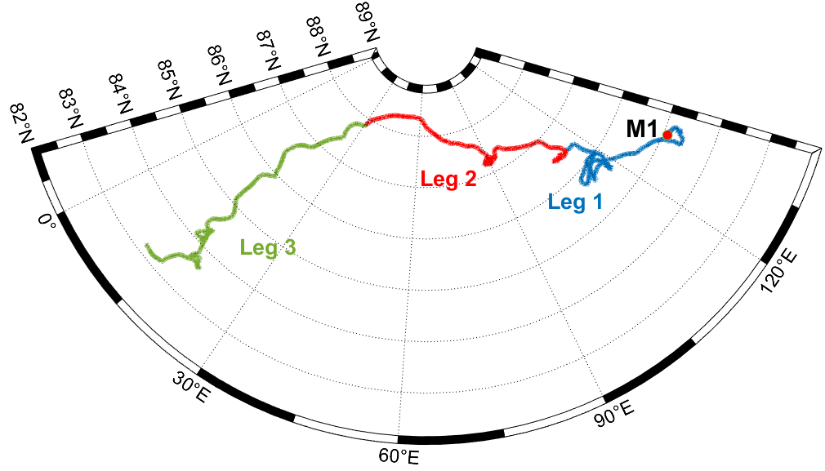
Drift of MOSAiC Expedition
4
Start: 2019.10.17
End: 2020.05.15
We defined 13 sections with nearly 100 km long in Leg 1 to Leg 3

Slide 7
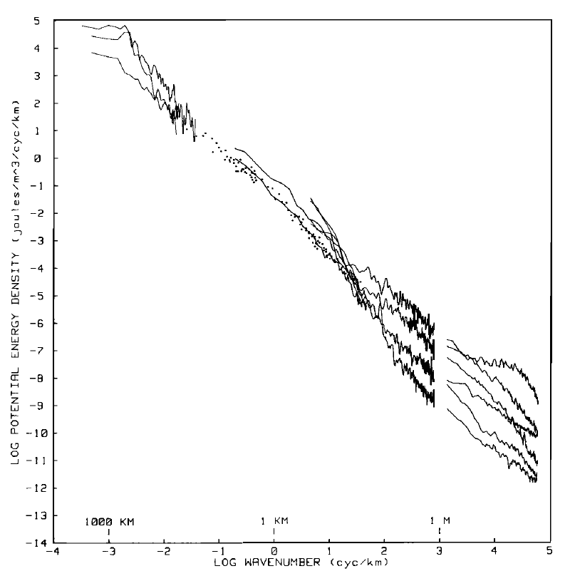
5
Our Goal
Horizontal wavenumber spectra of density
Examine the spectra from the defined 13 sections
Examine the spectra slopes
Investigate energy cascade from large scale motion to small scale
An example of horizontal wavenumber spectra from a towed CTD section
(Dugan et al., 1986. JGR.)

Slide 8
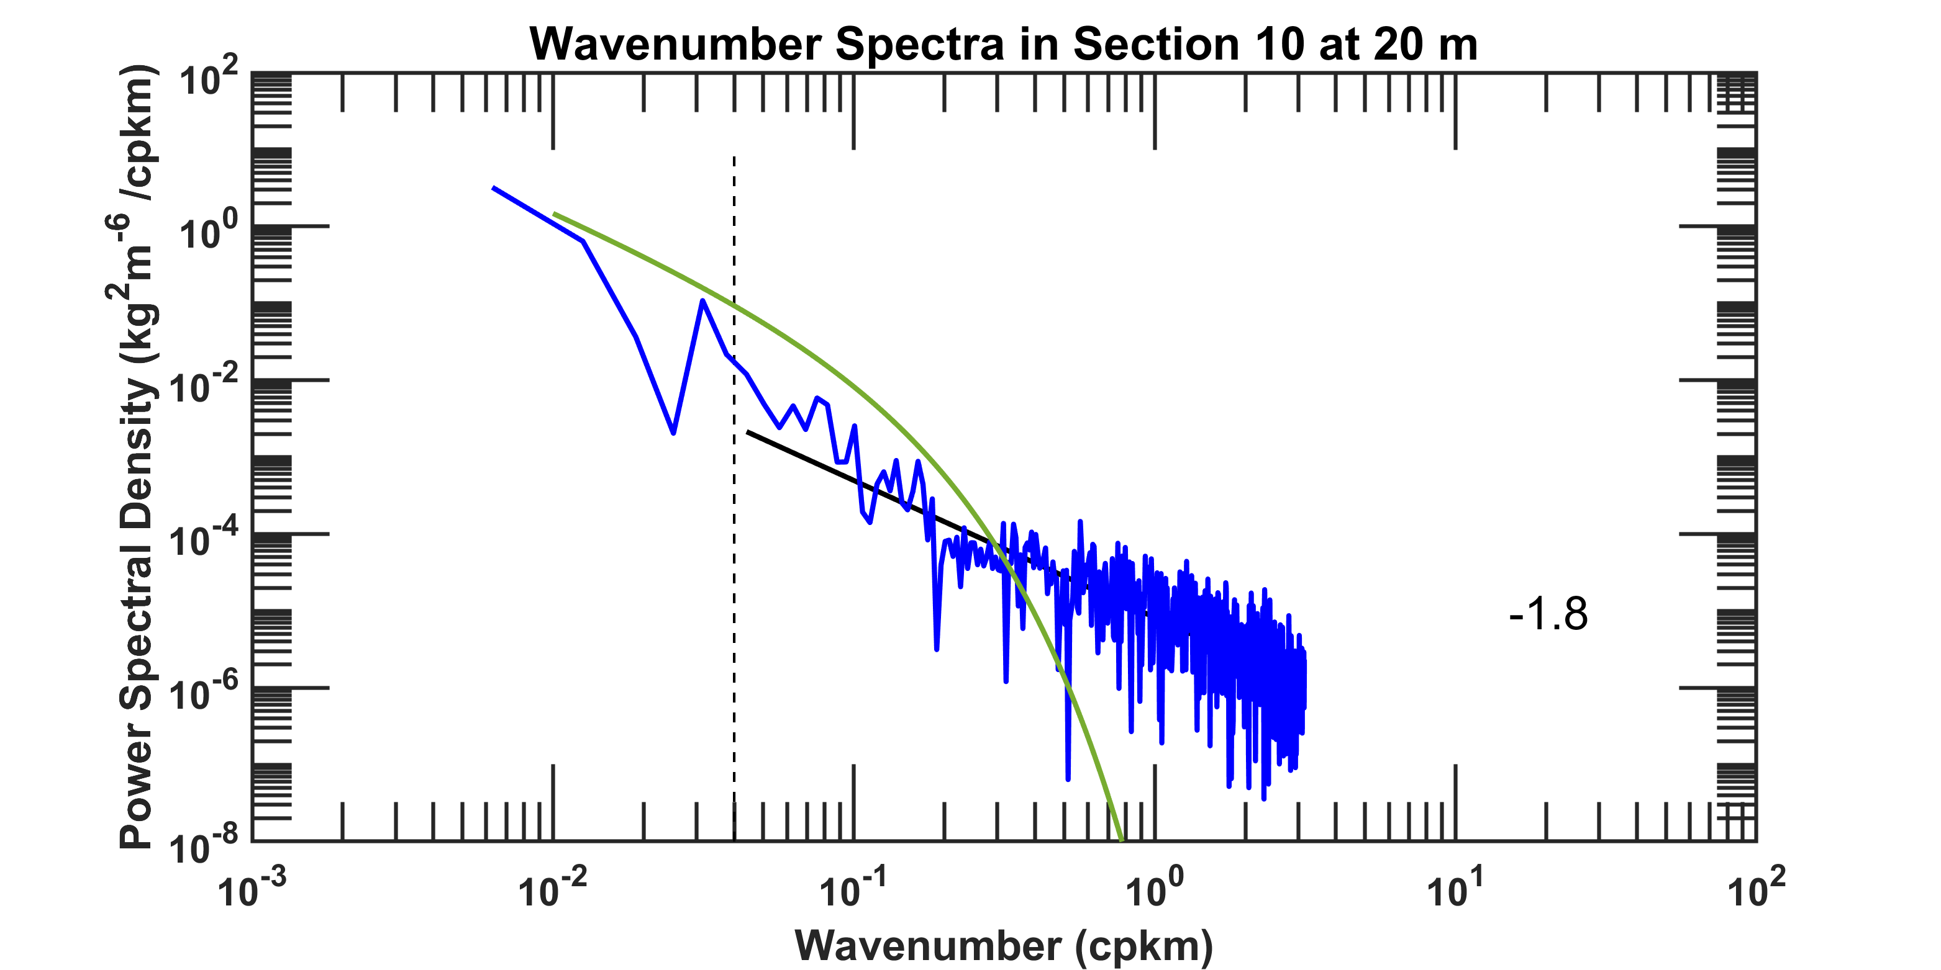
6
Preliminary Results of Spectra Analysis
Modeled spectra (green line) based on Callies & Ferrari 2013

Slide 9
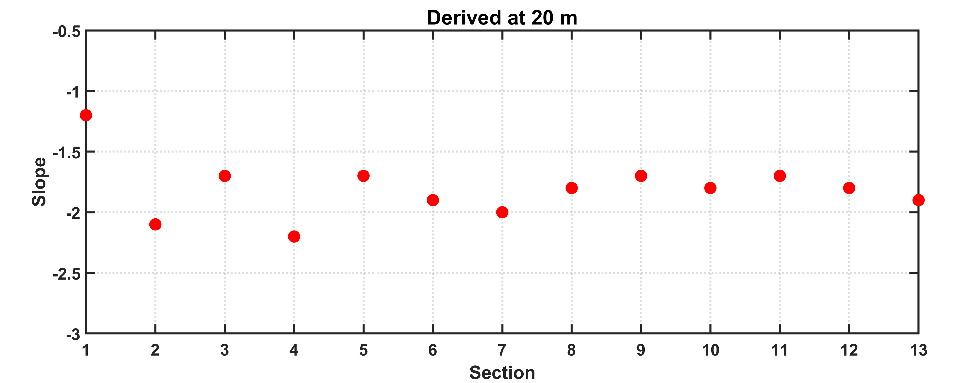
7
Preliminary Results of Spectra Analysis
(In Mixed Layer)

Slide 10
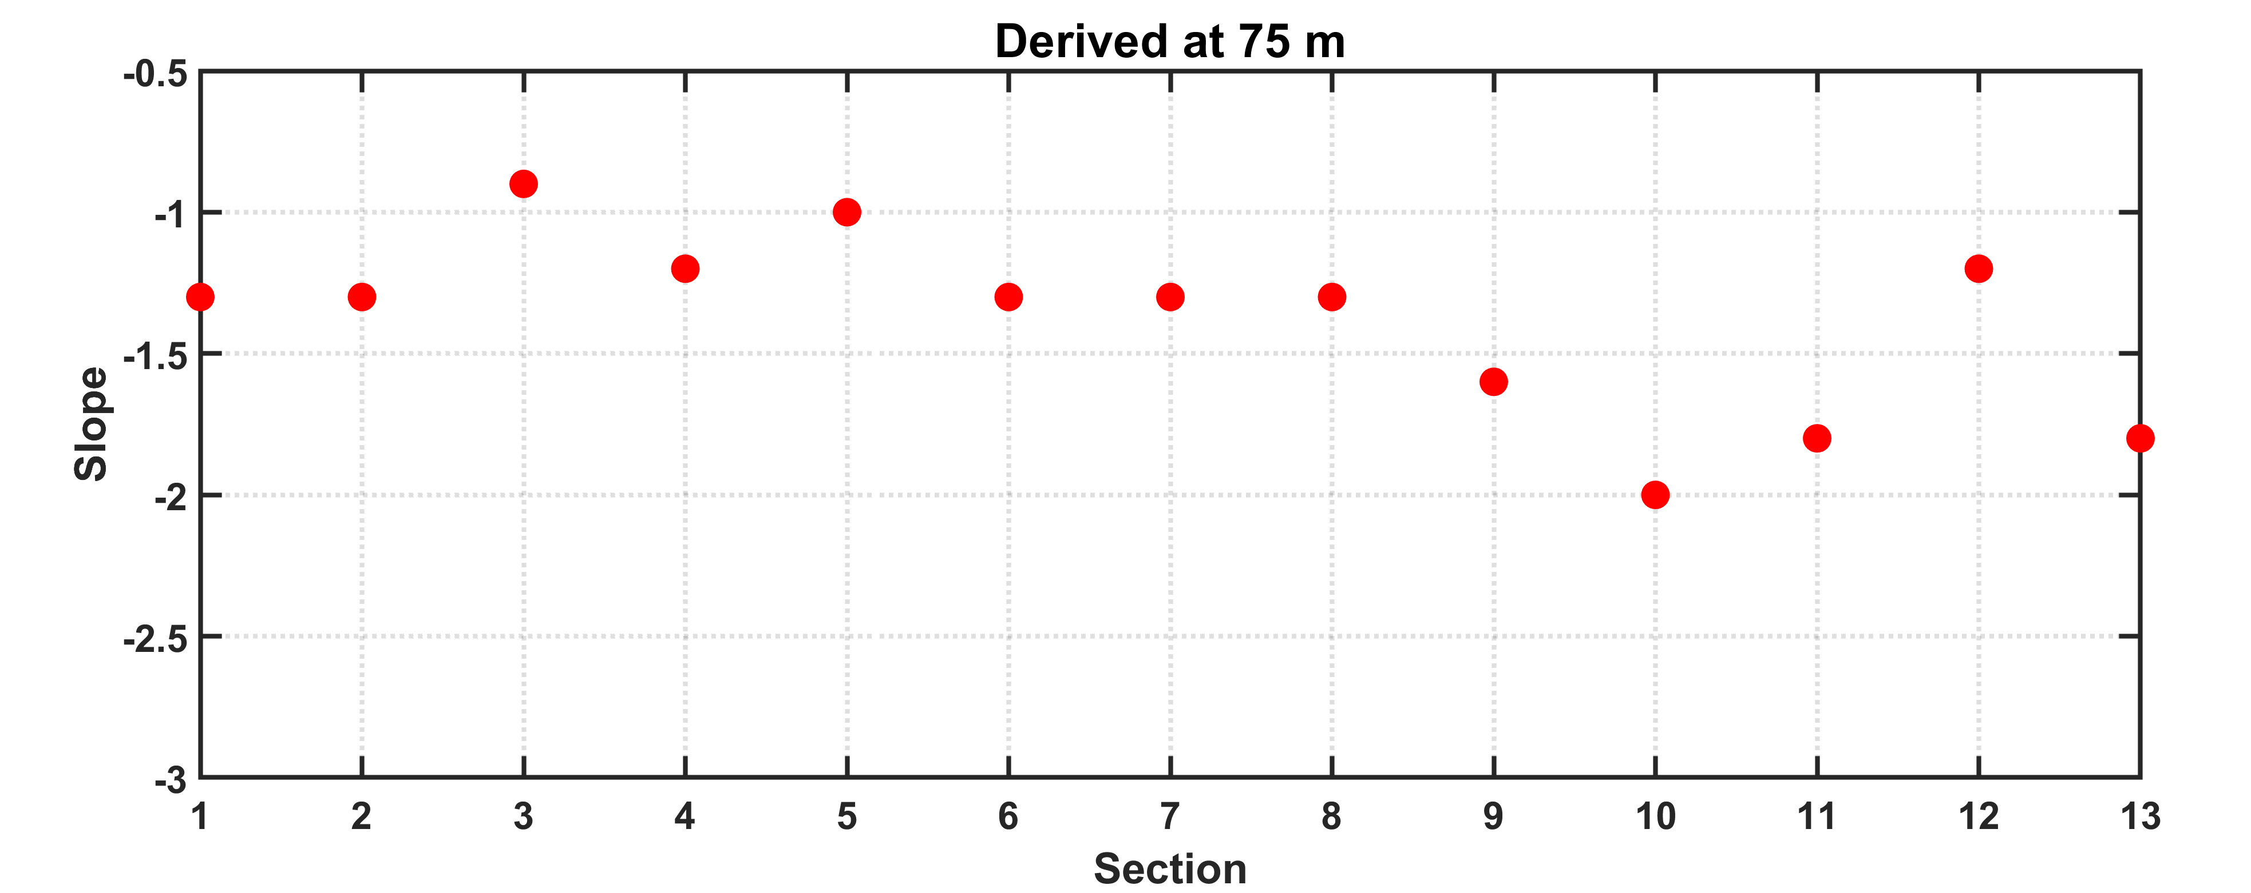
8
Preliminary Results of Spectra Analysis
(In Halocline)

Slide 11
9
Take-home Message
Observations show slopes of horizontal wavenumber spectra at 20 m in a range of ~-2 – ~-1.5, and that for ~-1.5 – ~-1 at 75 m.
Impacts from variable surface forcing and stratification with respect to time and space are currently examined
We hope to gain insights of energy cascade from this unique data set

