Slide 1


Assessing the groundwater sustainability of Bengaluru megacity, India, through the lens of socio-hydrogeology
Tejas Kulkarni^{1,2}, M. Gassmann¹, C. M. Kulkarni², V. Khed³, A. Buerkert⁴
¹Hydrology and Substance Balance, University of Kassel, Germany
²Kiran Consultants, Bengaluru, Karnataka, India
³Department of Agricultural Economics, University of Agricultural Sciences, Bengaluru, India
⁴Organic Plant Production and Agroecosystem Research in the Tropics and Subtropics OPATS, University of Kassel, Germany
Notes:
Hello, and good evening to all. I am Tejas Kulkarni
And I'll be speaking about the long-term viability of groundwater systems in Bengaluru, South India, using the lens of socio-hydrogeology.
The results of this study are documented in our recently published paper.

Slide 2
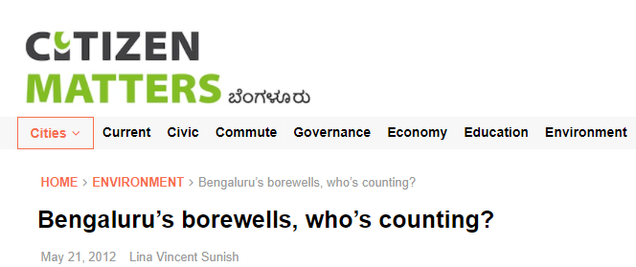
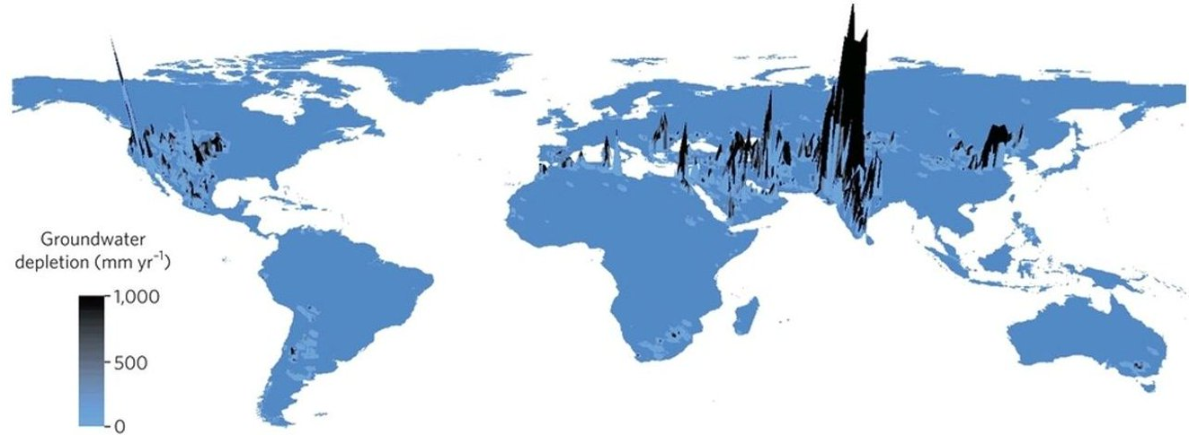
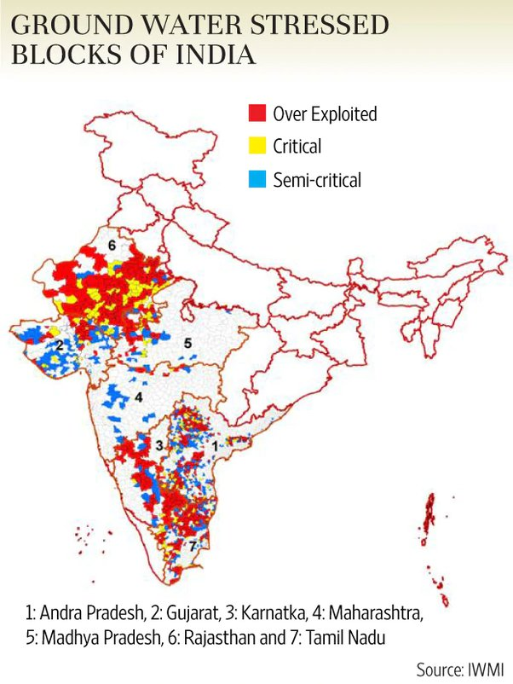
Groundwater situation in India
Alluvial aquifers
Lander and Swenson, 2012
India – the world’s largest GW user (~250km3/year)
Bengaluru – India’s fastest growing metropolis (~11 million)
Located at an altitude of 940m AMSL
Receives annual rainfall of 860mm
No perennial river source
Crystalline aquifers
~500,000 borewells are supposed to have been dug (many abandoned)
Notes:
To begin, India is the world's largest GW user, with GW providing 80 percent of the country's irrigation and domestic needs.
While numerous portions of India's aquifers have been labeled as over-exploited or severely threatened, it is crucial to remember that the aquifer systems in the country's topography vary greatly.
The northern plains for India are primarily Alluvial aquifers, while the Southern Peninsular has crystalline or hard rock aquifers.
Our research area (Bengaluru city) is Asia's fastest growing city, and its consumption is heavily reliant on GW.
Because GW is not a regulated resource, the city has an estimated half-million wells, many of which have been abandoned.
Moreover, there is a significant mismatch between government datasets, such as the number of wells or GW levels, and end-user observations.

Slide 3
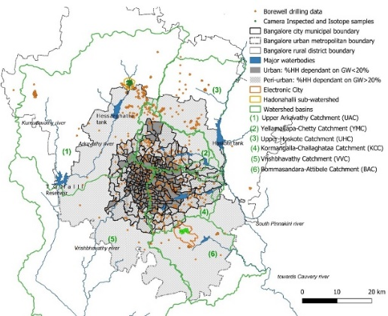
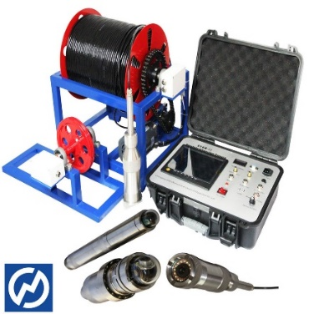
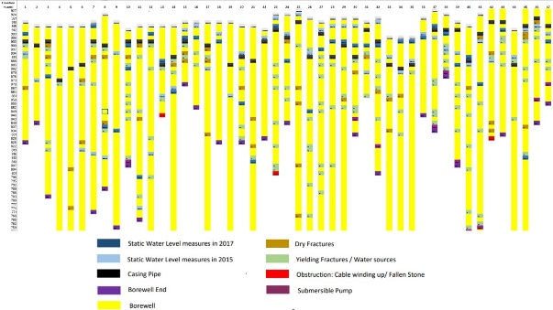
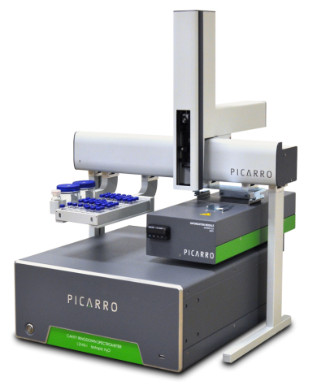
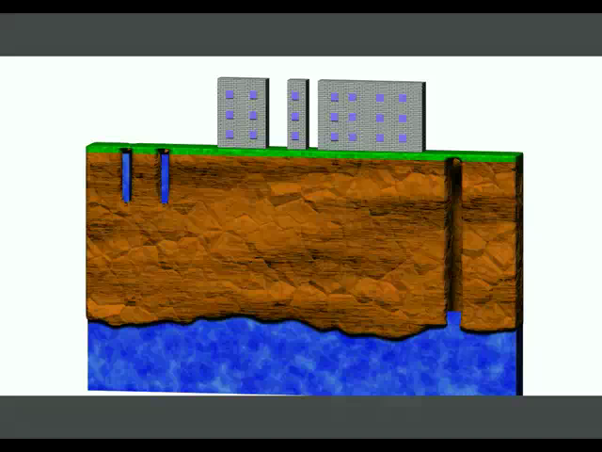
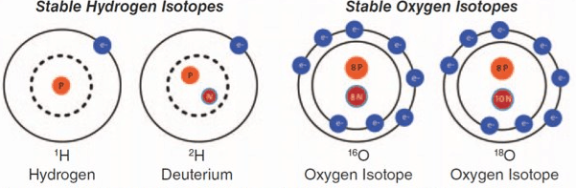
Socio-hydrogeological Appoach
Reproducing the spatio-temporal evolution of borewells in city
Aquifer Conceptualization through Camera inspections and borehole logs
Local Hydrogeological knowledge
Stable Isotope analysis to assess groundwater recharge processes
Outlook to Groundwater Sustainability for the city
Notes:
So, we first replicated the spatio-temporal evolution of wells in the city using the socio-hydrogeological strategy of front-lining local hydrogeological knowledge.
Then we chose a small research area and used cameras to investigate 54 wells in order to generate well logs and learn about the aquifer strata. Additionally, create a conceptual aquifer system.
Then, to better understand the recharge mechanisms, we gathered samples from these
wells, rainfall, and surface water and analyzed them for stable isotopes.
Finally, we analyzed our findings to develop an estimate for GW sustainability in the city.

Slide 4
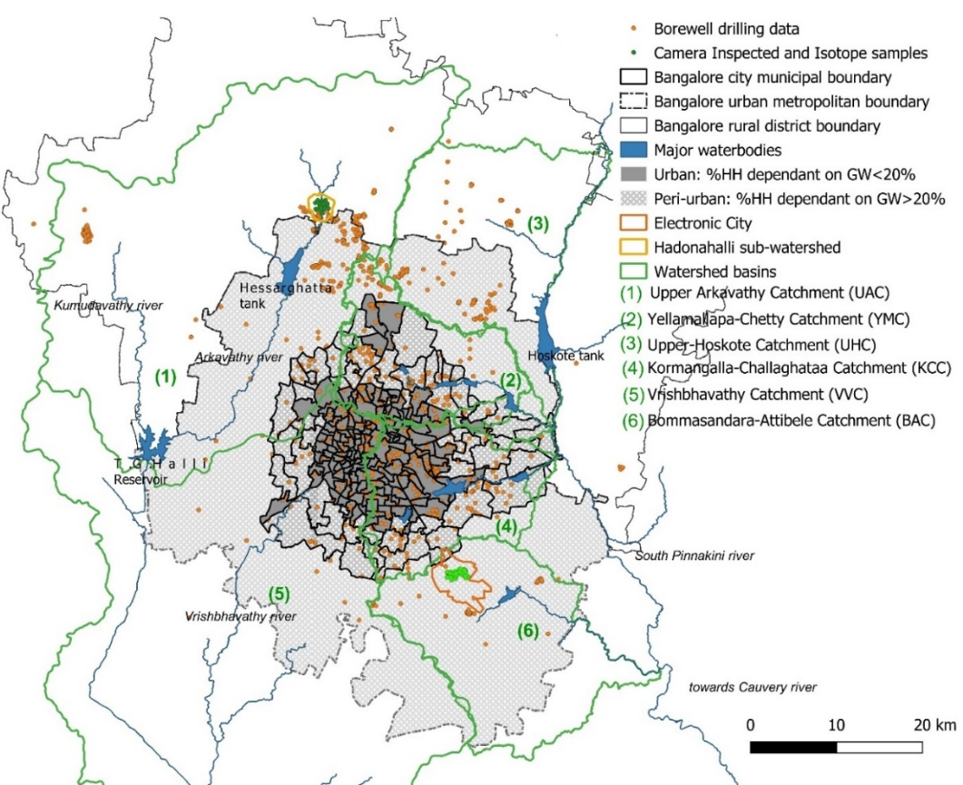
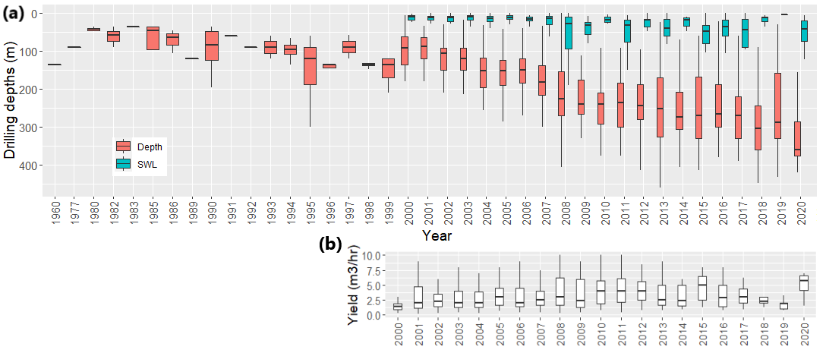
Spatio-temporal development of wells in Bengaluru
Reports of local well drillers, hydrogeological consultants, farmers
  1303 borewell depth, date of drilling, place of drilling
  640 water level
  630 borewell yields
GIS-Data
  Bengalurus‘ districts
  GW usage and piped water fraction
  Catchments
Statistics
  Mann-Kendall trend analysis
    Significance level p < 0.05
 | Period | Urban | Peri-urban | Rural
Drilling depth of borewells (m) | Pre-2000 | NA | 120 | 105
 | 2000–2010 | 125 | 152 | 180
 | 2011–2020 | 211 | 265 | 302
Static water levels (m) | 2000–2010 | 12 | 15 | 24
 | 2011–2020 | 18 | 29 | 46
Reported yield (m³/hour) | 2000–2010 | 2.5 | 2.0 | 4.0
 | 2011–2020 | 3.5 | 4 | 3.9
Notes:
We gathered 1303 well data from local hydrogeologists and well drillers, which included static water levels and borewell yields, then overlaid critical boundaries including districts, catchments, and water consumption to spatially partition the data.
• After that, we ran a temporal trend analysis on the dataset
Wells are currently being dug at a median depth of 430 meters below ground level. Over the last two decades, the median depths have steadily increased.
In comparison to metropolitan areas that receive piped water via inter-basin transfers, this is more pronounced in rural and peri-urban areas.
However, reported yields have not increased significantly, implying that drilling deeper does not actually find more water-bearing zones, but rather aids in maintaining yields.

Slide 5
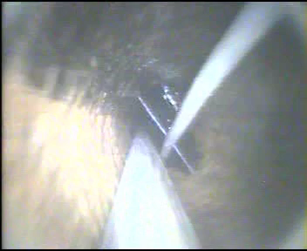
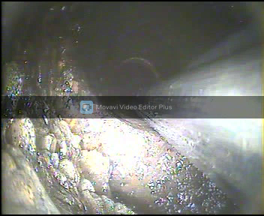
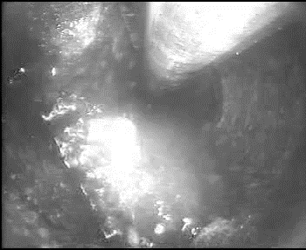
Camera inspections of wells in Bengaluru
Water jet in velankani @ 70m
Typical flow hole @ 80m
Mineralization along the joint
Observed Cascading flows from upper fractured zones
Yielding fracture @ 90m depth
Notes:
I'm just displaying some of the yielding fracture videos from the camera examinations.
These come in a variety of shapes and sizes, such as a jet stream in the first well or a flow hole in the next two.

Slide 6
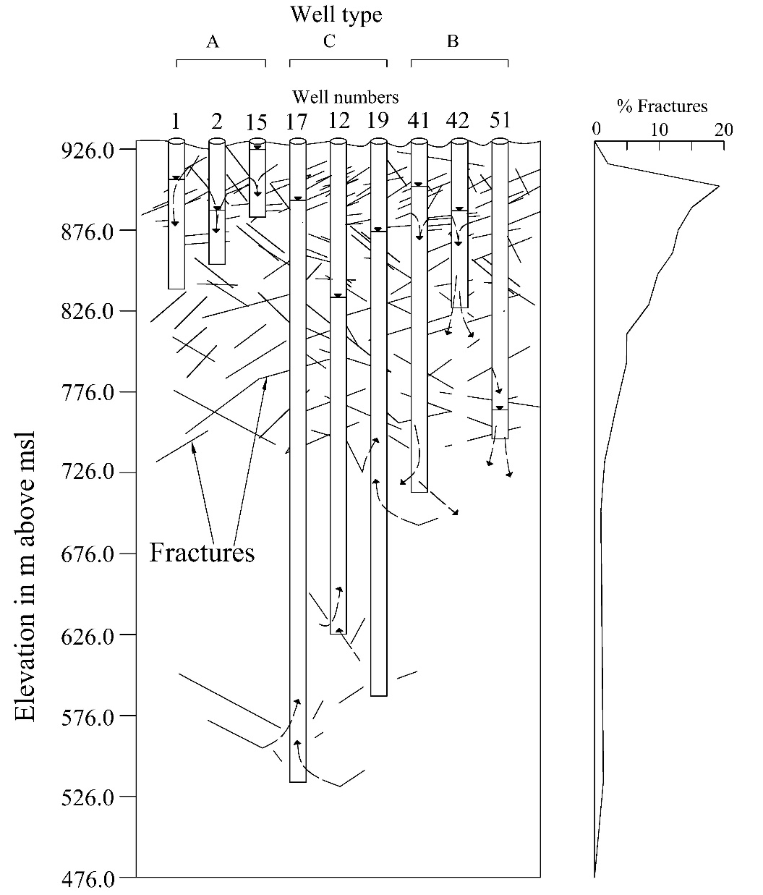
Conceptualization of the over-exploited hard-rock aquifer
Type A well: 56m – 112m
  Shallow wells with shallow GW table
Type B well: 120m – 246m
  Medium depth,
  Cascading flow from upper zones
  Yielding fractures above GW table
Type C well: 300m – 435m
  Deep wells with deep GW tables
  Often yielding fractures below 250m and the GW table
  → show the real GW table
Recharge zone
Recharge zone
Dewatered zone
Saturated zone
6
Notes:
So, depending on their depths and recharge processes, we plotted these well logs and categorized them into three sorts of wells.
The shallower type A wells have water levels that have stabilized in upper zones due to higher fracture density in the upper recharge zones.
Type B wells are medium-depth wells with cascading flows from the top zones and, on occasion, outflows into deeper zones, resulting in a dewatered zone.
Type C wells, which are those that are deeper than 300 meters, have higher water levels, and only those having giving fractures in these deeper zones, below 250 meters, can reflect the real GW table.

Slide 7
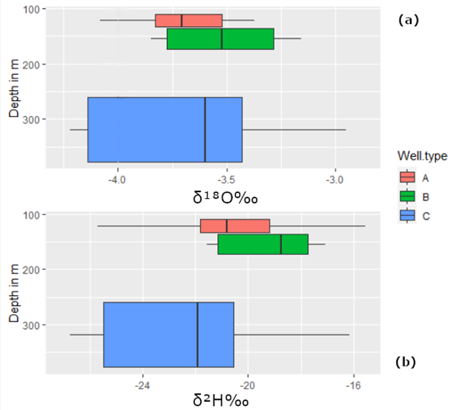
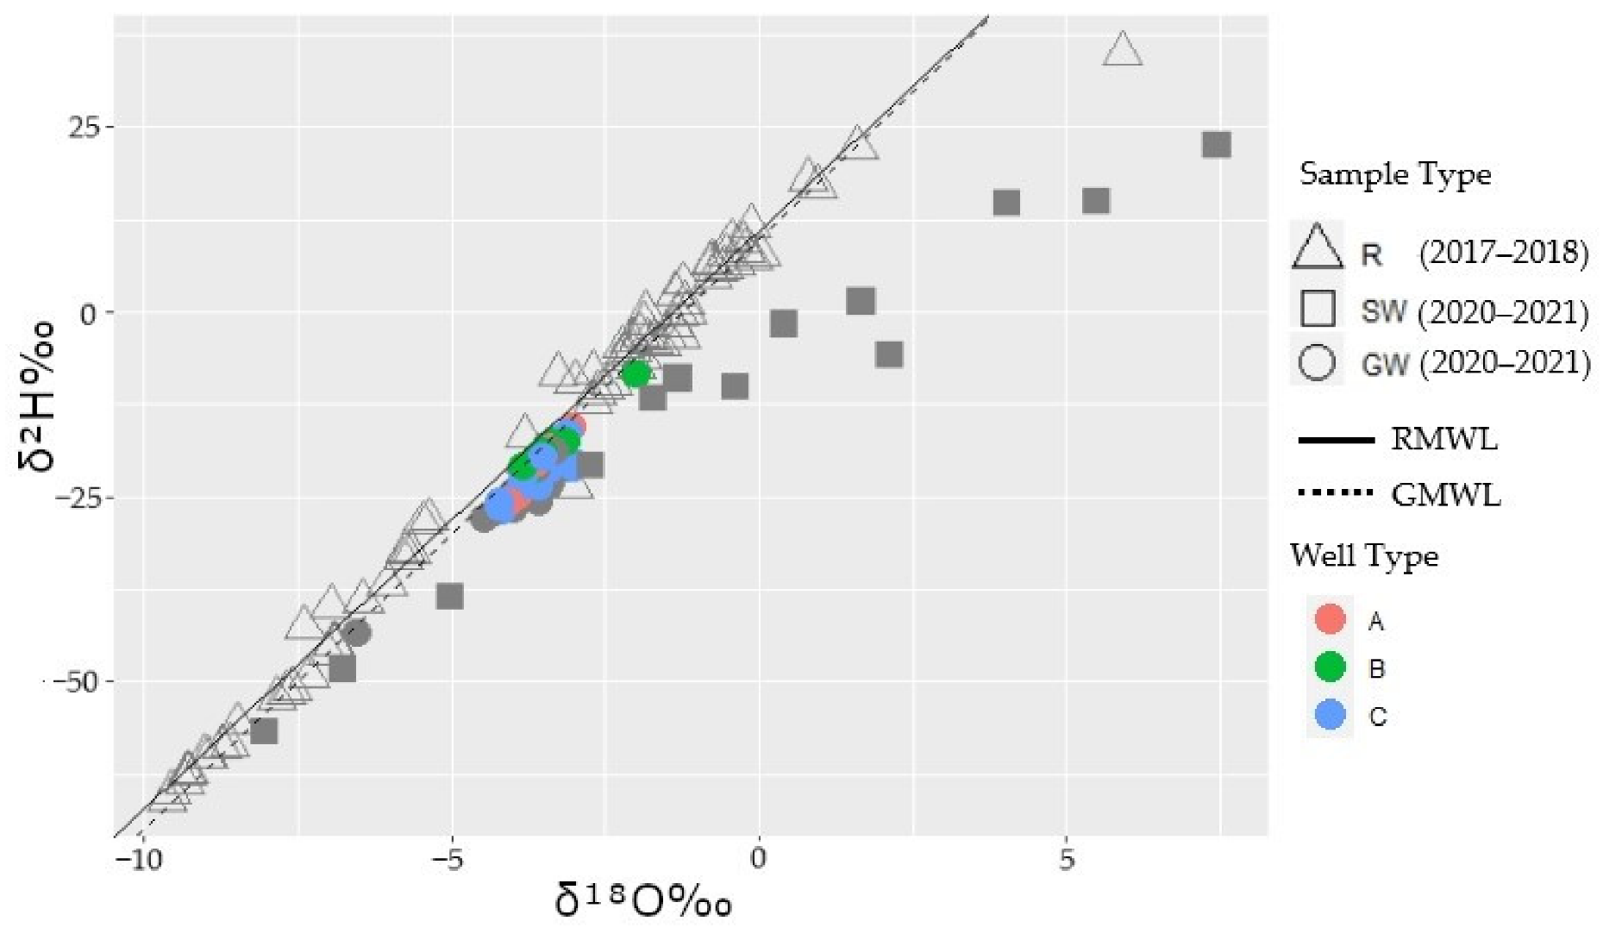
Isotope distribution across depth and recharge processes
evaporation signal
→ no significant variation with depth
→ GW samples within rainfall span
Notes:
The question now is whether the water in these deeper wells is fossil water or water that has recently been recharged.
As you can see, the isotope enrichment does not vary significantly between depths.
Furthermore, all of the wells in the dual isotope map were within recent rainfall signals.

Slide 8
Conclusions
So what do the boreholes tell us?
The strongest increase in well depth was in the period 2000-2010
Depth increased more in areas without tap water infrastructure or waste-water infiltration
Selection of wells which can show the real GW table, necessary before installing water-level sensors
The pumped water was recently infiltrated (not paleo-water)
→Interconnectedness between upper and deeper aquifers indicate GW management is possible, but the management of the last decades was unsustainable.
8
Notes:
To summarize our findings, well depths increased significantly between 2000 and 2010, which we ascribe to the city's piped water infrastructure and wastewater return flow.
Camera examinations showed that only a few deeper wells can display the true GW table, therefore we must select the appropriate well before installing sensors.
And the isotopes indicate that water at all depths is recently recharged water. So there is not much sense in drilling deeper, rather than to increase the borehole volume.
To summarize, while there is potential for sustainable management because to the considerable interconnectedness between the upper and deeper aquifer zones, previous management practices have been severely unsustainable.

Slide 9
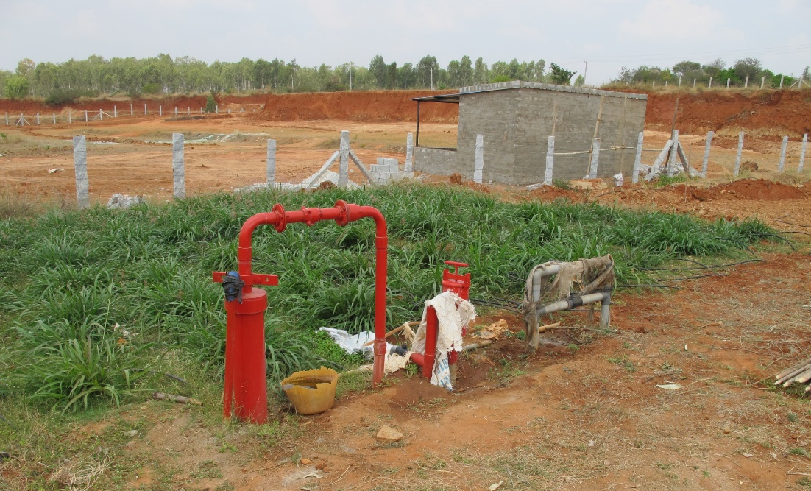
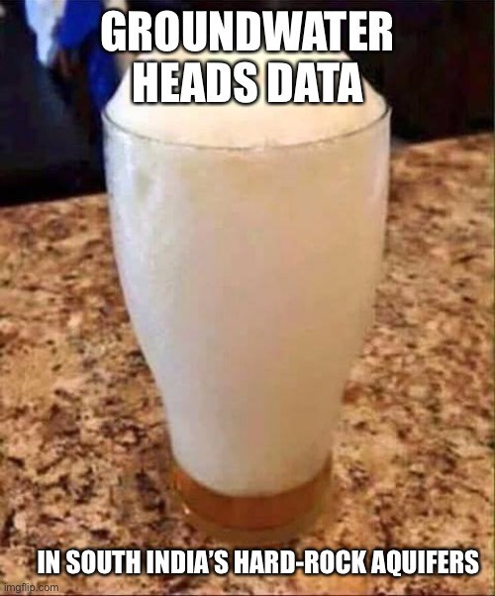
Thank you for your attention
…and thanks to…
V. Srinivasan (ATREE, Bengaluru), K.N. Ganeshaiah (UASB), M. Zars (UASB) for constructive discussions and access to secondary data.
Rama N.S. and R. Singh (ELCITA) for providing access to the wells in EC
Deeksha and Moksha (KC) for compiling the primary data
Santosh L.G. (KC) for discussions
Narayana and Manjunath (KC) for assistance in ﬁeld work
9

