Slide 1





Bounce Resonance Scattering of Radiation Belt Energetic Electrons by Extremely Low-Frequency Chorus Waves
Deyu Guo, Zheng Xiang, and Binbin Ni
Wuhan University
2022.05.24

Slide 2

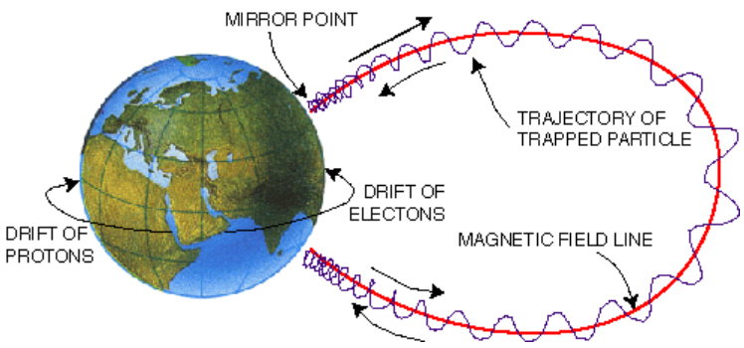
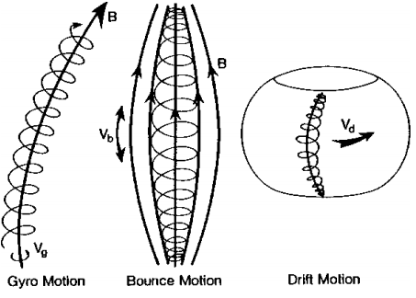
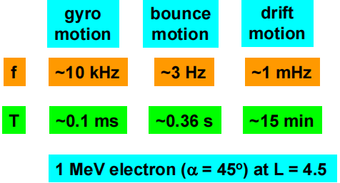
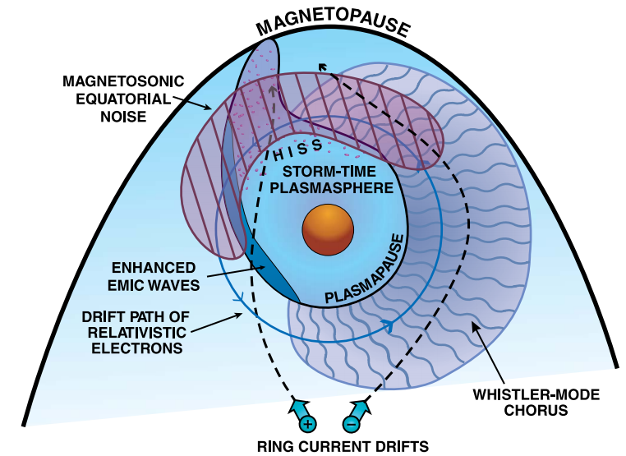
Introduction——periodic motions of trapped electrons
Walt, 1994
Thorne et al. (2010)

Slide 3
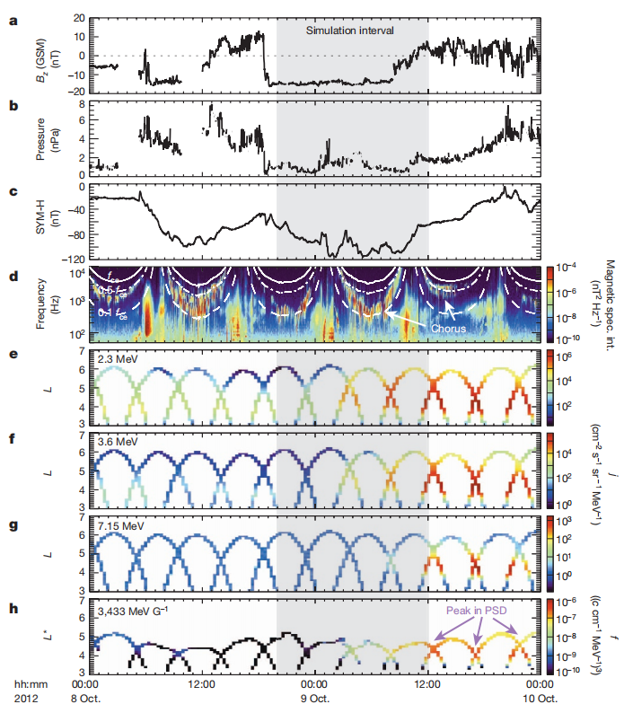
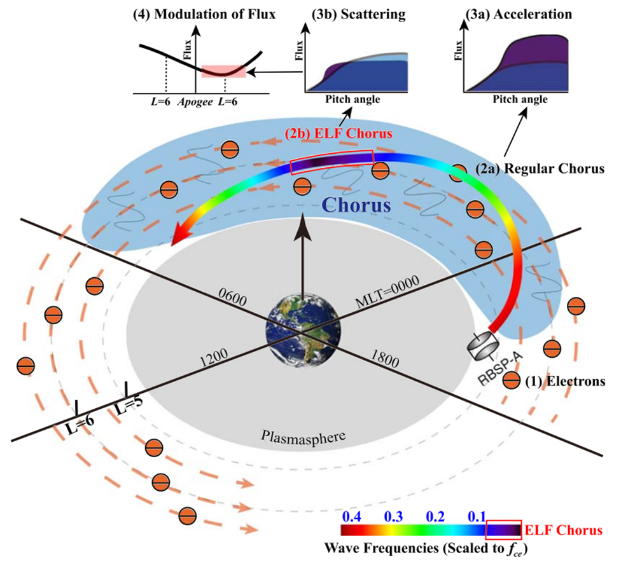
Introduction——Chorus wave
Thorne et al. (2013)
Liu et al. (2020), GRL

Slide 4
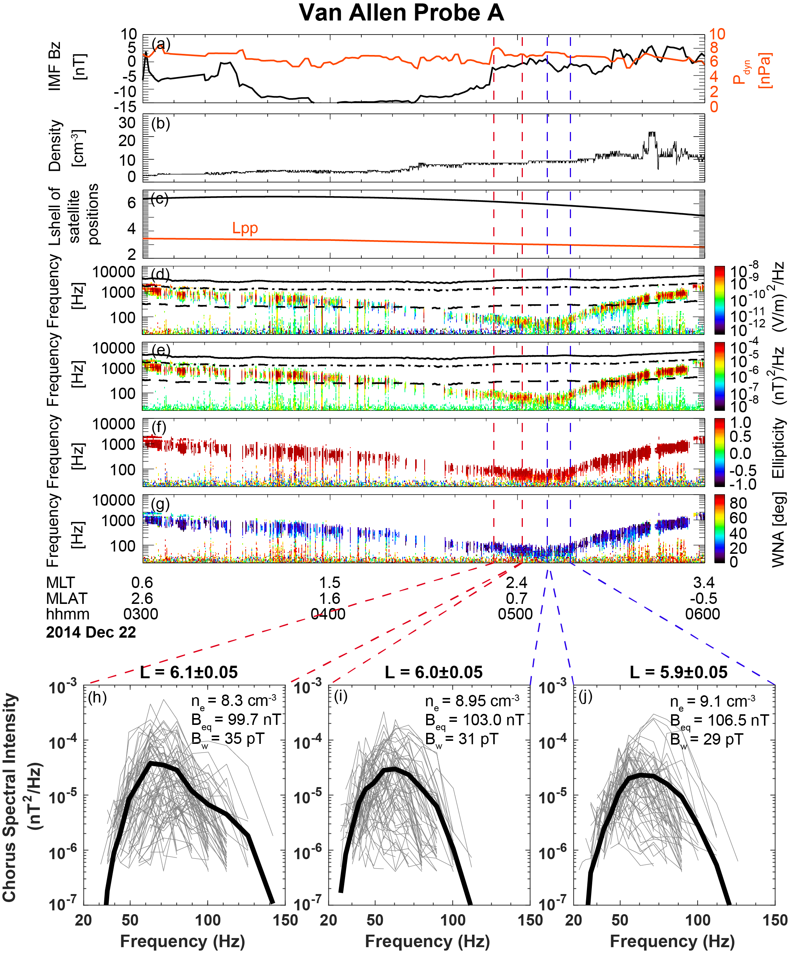
Overview of ELF chorus wave event on Dec 22, 2014
VAP-A was outside the plasmasphere during this period.
0.1 f_{ce}
Right-handed rotation with low wave normal angles
Wave spectrum further used to calculate bounce resonance coefficients

Slide 5
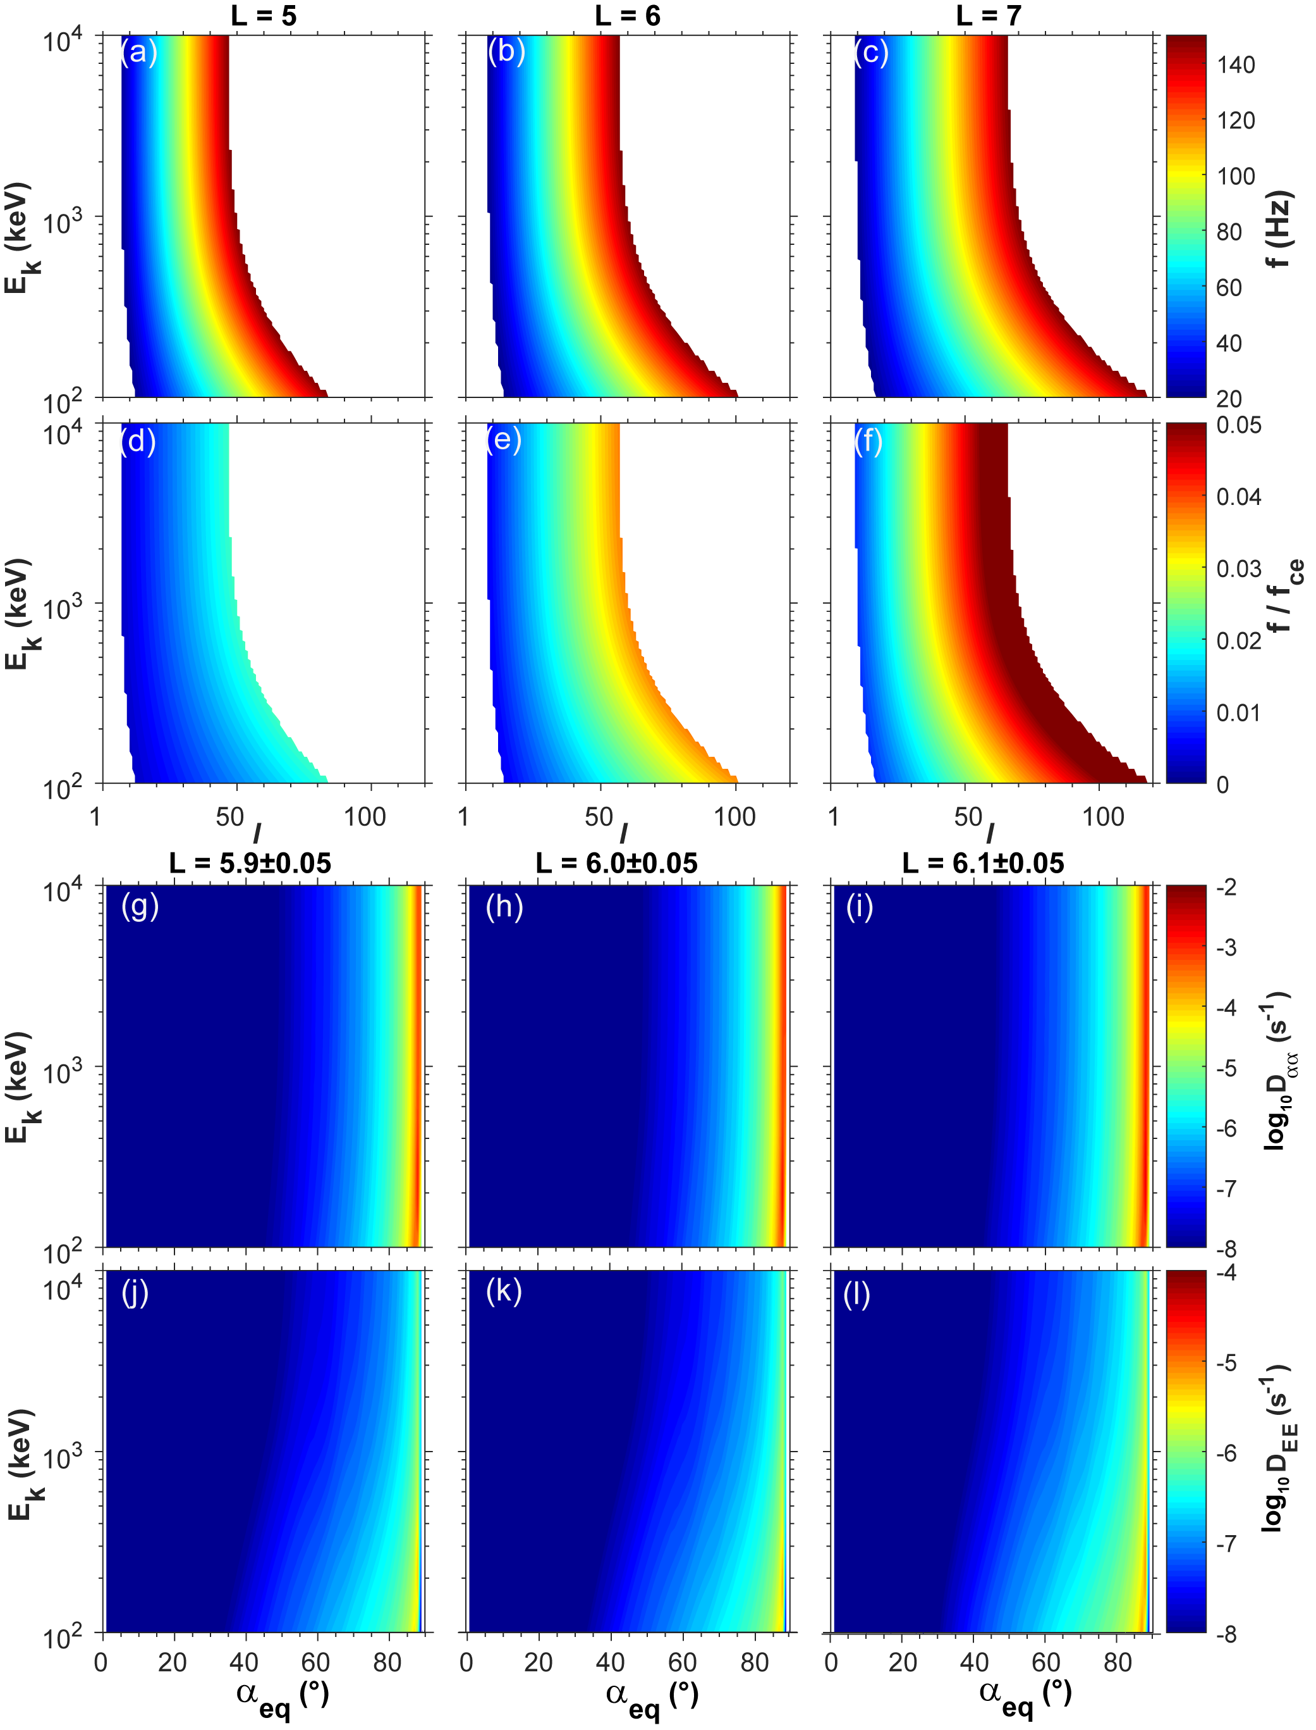

Bounce resonance region and coefficients
Method: Tao and Li (2016), GRL
Results:
As L increases, higher order bounce resonance is more likely to occur.
The bounce resonance has high scattering rates for electrons with pitch angles above 80°
As L increases, the diffusion rates increase
$f$ = l *${ f}_{b}$
l is the bounce resonance order
f_{b} is the particle bounce frequency
1-100 order bounce resonance is considered in this study

Slide 6
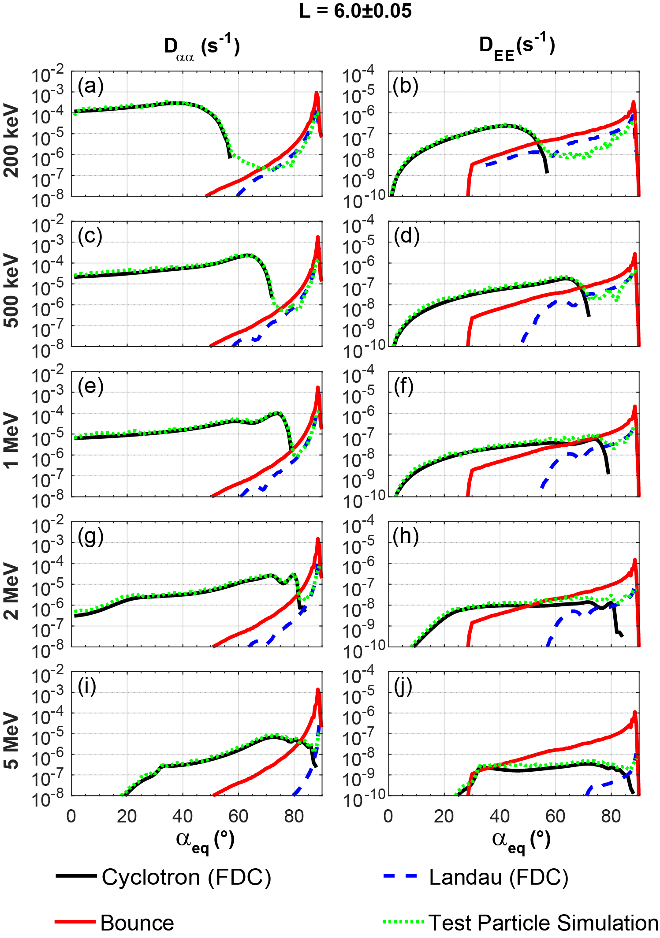
Compare with cyclotron and Landau resonance
Individual effect:
Combined effect
Low pitch angle – cyclotron resonance
For 100s keV electrons:
The bounce resonance and the Landau resonance compete with each other, affecting electron energy diffusion at high pitch angles corporately.
For 100s keV electrons at high pitch angles, the bounce effect is approximate to the Landau effect
For MeV electrons at high pitch angle,
bounce effect is stronger than Landau effect
The bounce resonance coefficients are insensitive to energies

Slide 7
Summary
The ELF chorus waves can bounce-resonate with electrons at high equatorial pitch angles over a wide energy range with considerable diffusion rates.
The bounce resonance by ELF chorus waves has slight energy dependence.
For <1 MeV near-equatorially mirroring electrons, the TPS results suggest that the combined effects of bounce and Landau resonances are not linear superposition but mutual inhibition, leading to the energy diffusion coefficients lower than theoretical analysis values.
Bounce resonance between ELF chorus and electrons should be considered in the future radiation belt models.
This article can be found in GRL https://doi.org/10.1029/2021GL095714

Slide 8



Thanks for listening!
guodeyu@whu.edu.cn

