Slide 1


Geopotential measurement with a robust, transportable Ca⁺ optical clock
Yao Huang, Hua Guan, Kelin Gao
Innovation Academy for Precision Measurement Science and Technology, Chinese Academy of Sciences, Wuhan China
Notes:
Hello everyone! My name is Yao Huang from the Innovation Academy for Precision Measurement Science and Technology, Chinese Academy of Sciences, from Wuhan China. Today it is my pleasure to share with you our Recent Progress on the Geopotential measurement with a transportable Ca⁺ optical clock

Slide 2
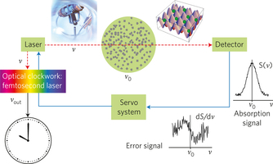
Optical clocks – Better time and frequency standards
High Q-factor: better stability
Two types of optical clocks: lattice clock (atoms)/ion clock(single ion)
Insensitive to the electric/magnetic fields
Riehle, Nat. Photon. 11, 25 (2017)
Notes:
Compared to the microwave clocks, Optical clocks have frequencies a few orders of magnititude higher, the high q-factors mean they would pontentially have better stabilities. Optical clocks are also Insensitive to the electric/magnetic fields fluctuations, Scientists have made great progress on optical clocks In the last twenty years, and optical clocks shows their advantages on the uncertainties and stabilities compraered to the microwave clocks, some of the optical clocks have reached uncertainties or stabilities at the E-18, or even E-19 level.

Slide 3
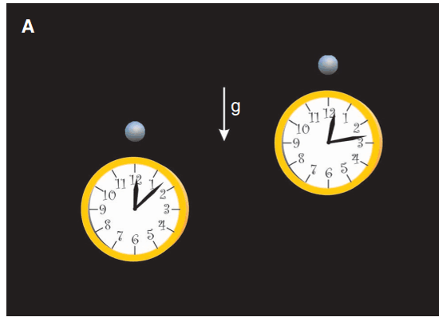
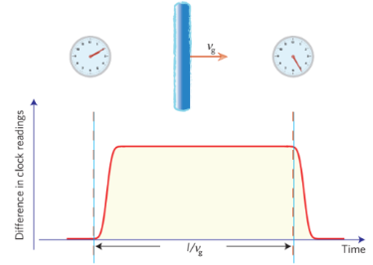
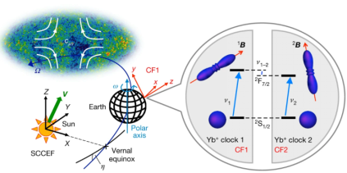
Optical clocks——Application on fundamental physics
Whether the fine structure constant α varies through time?
Test for the general relativity
Rosenband et al, Science 319, 1808 (2008)
Chou et al, Science 329, 1630 (2010)
Test for the Lorentz invariance
Detecting the Topological Dark Matter
Sanner et al, Nature 567, 204 (2019)
Derevianko et al, Nat. Phys. 10, 933 (2014)
Notes:
Due to their ultra low uncertainties or ultrahigh precision, optical clocks may have many other Application on fundamental physics, including answering the question about Whether the fine structure constant α varies through time? Test for the general relativity, Test for the Lorentz invariance, Detecting the possible Topological Dark Matter,
3

Slide 4
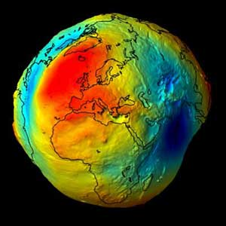
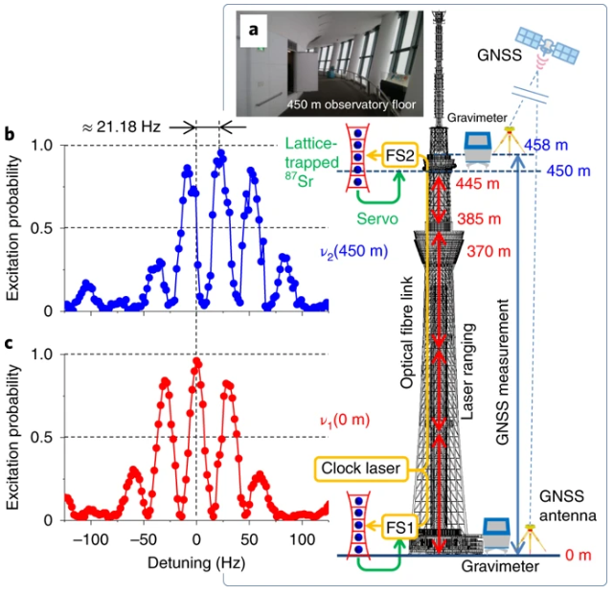
Optical clocks——Application on Geodesy
Science 329, 1630 (2010)
Nat. Photonics. 10, 1038 (2020)
Notes:
Application on Geodesy, etc. For clocks, To make a geopotential measurement, a E-18 level uncertainty coresponds to a measurement uncertainty of about 1 cm， so with high accuracy clocks, it is possible to do a cm level measurement, or haveing even better results

Slide 5
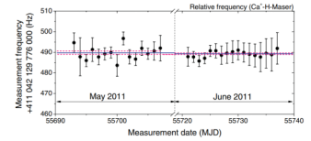
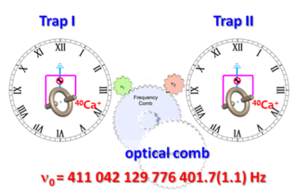
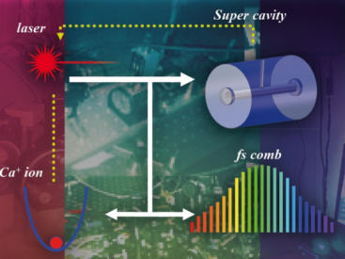
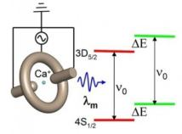
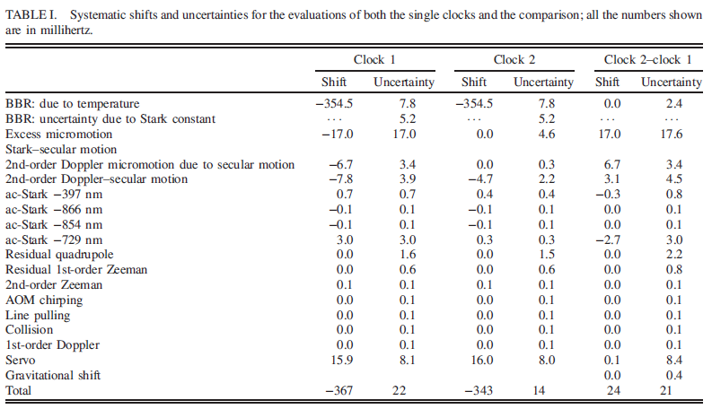
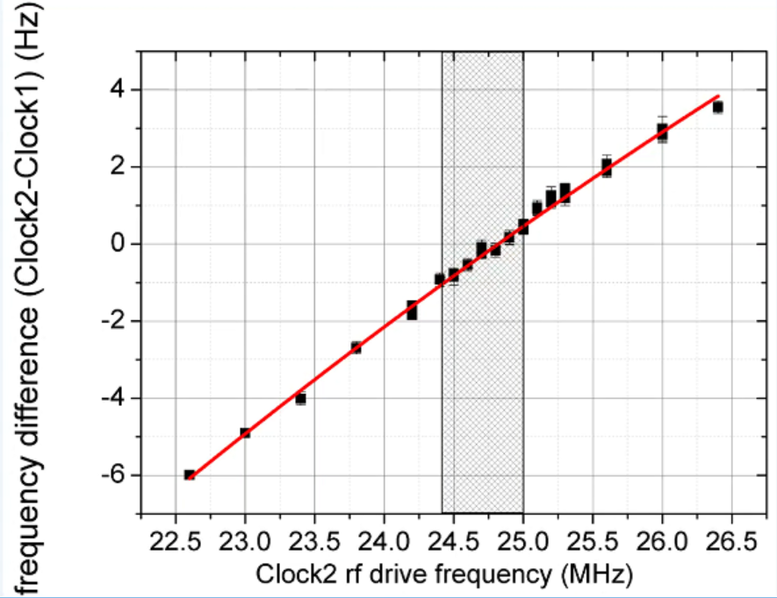
Our previous results (~2019)
Clock based Precision measurement
10⁻¹⁷ level uncertainty clock
10⁻¹⁶ level uncertainty clock
Absolute frequency measurement
Phys. Rev. A 85, 030503(R) (2012)
Magic wavelength measurement
Phys Rev. Lett. 114, 223001 (2015)
Measurement on the polarizability
Phys. Rev. A 84, 053841 (2011)
Phys. Rev. Lett. 116, 013001(2016)
Phys. Rev. A 99, 011401(R) (2019)
……
Notes:
We have our first single ion trapped in 2004, published our first clock evaluation results in 2011, The clocks’ systematic uncertainty and stability are improved to the E-17 level in 2016, and a few Clock based Precision measurements are made, including the Absolute frequency measurement, the Magic wavelength measurement, and the Measurement on the differential static polarizability, etc.

Slide 6
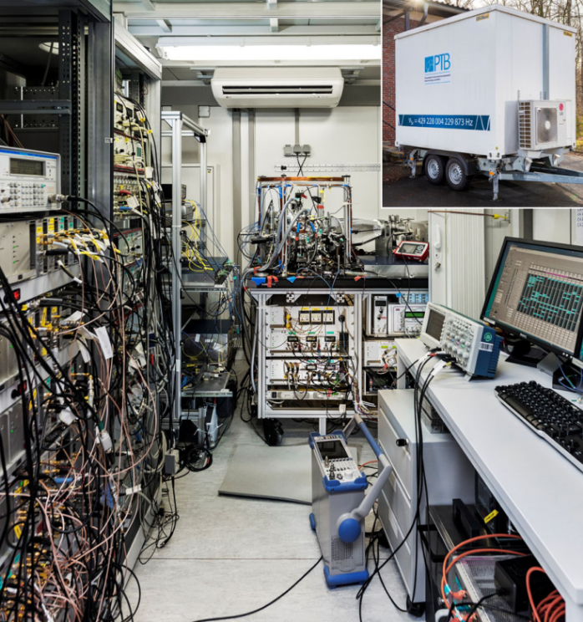
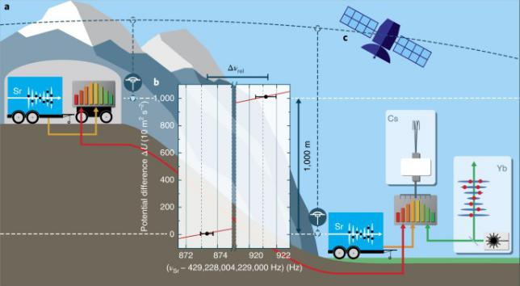
Transportable clock - Application on Geodesy, or even more…
PTB transportable Sr clock, Germany
Koller et al, Phys. Rev. Lett. 118, 073601 (2017)
Grotti et al, Nat. Phys. 14, 437 (2018)
Notes:
It was proposed long time ago that Transportable optical clocks would have Application on Geodesy or even more. PTB has built a transportable Sr clock in a car trailer. This clock is then transported and made Geodesy measurements by the clock comparison.

Slide 7
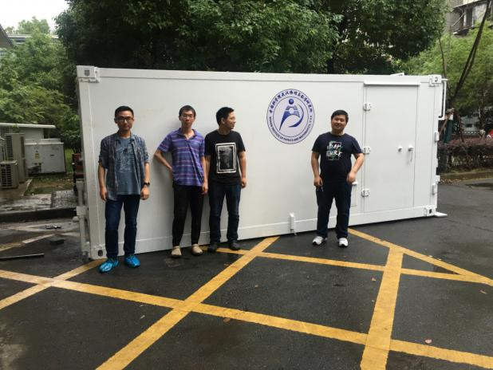
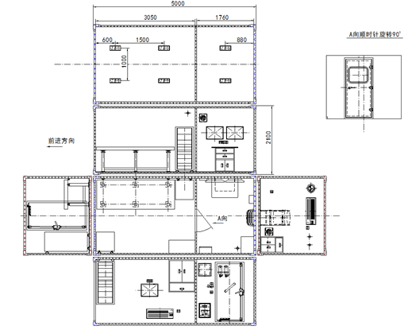
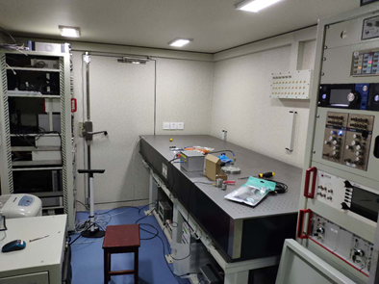
Transportable clock built in Wuhan, China
Total size of the car trailer
（5000 mm×2438 mm×2100 mm ）
Notes:
We Followed PTB to build a transportable Ca+ clock. The setup is started in 2018. The car trailer has 2 parts, one for the experiment, the other for clothes changing and closets where one can put tools and else in it. The experiment part has a similar size compared to the PTB clock.

Slide 8
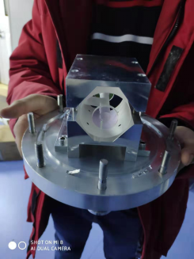
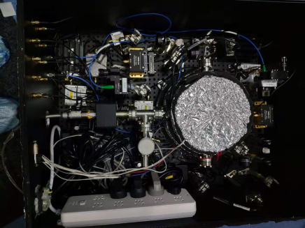
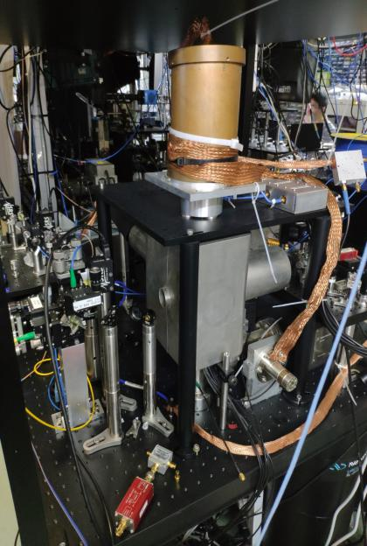
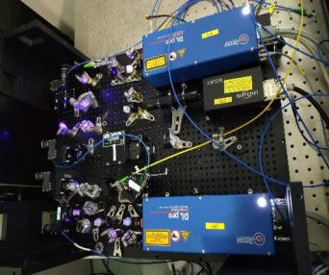
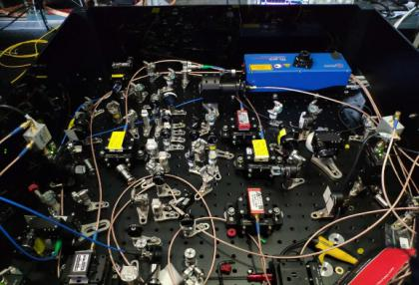
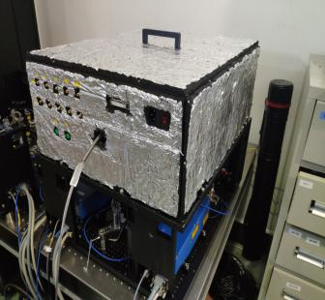
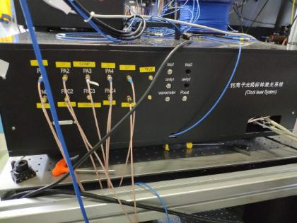
Transportable clock built in Wuhan, China
Towards a more compact and reliable clock
Notes:
We make every parts of the laboratory clock more compact, and also more reliable. Good enough for the long distance transportations.

Slide 9
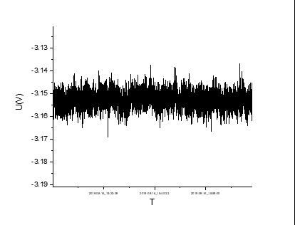
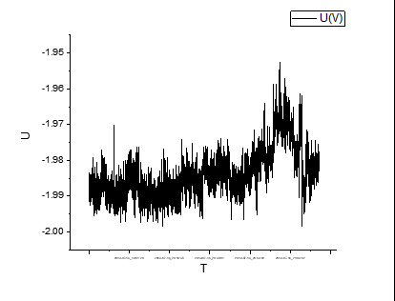
Transportable clock built in Wuhan, China
Test for the car trailer environment
Background magnetic field measurements
振动环境测量
Car trailer
Laboratory
70 nT peak to peak
250 nT peak to peak
Notes:
After the car trailer is ready, we have investigated the Background magnetic field, the vibration, and the temperature fluctuation. Since these are the most important parameters a clock setup concerns. First of all, we found the Background magnetic field in the car trailer is actually a few times better than the Laboratory environment. We guess more instruments in the lab would be a possible reason.

Slide 10
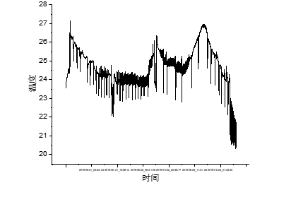
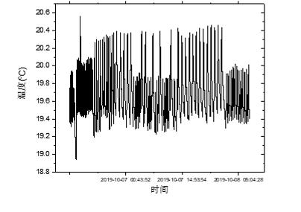
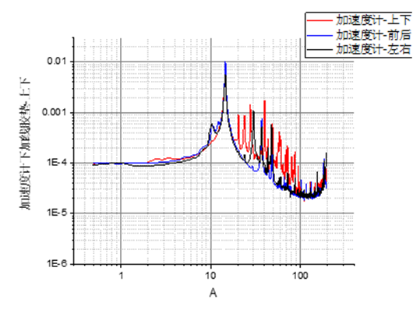
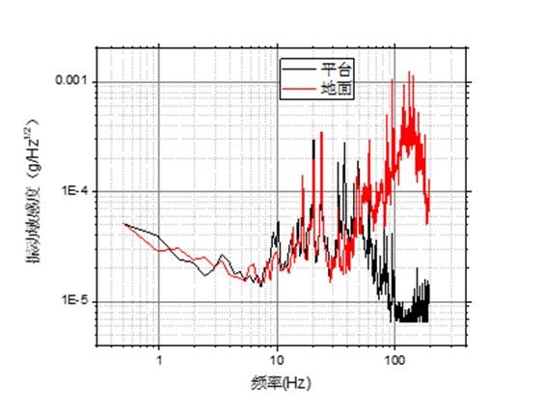


Transportable clock built in Wuhan, China
Test for the car trailer environment
Temperature measurements
Temperature (degree C)
Temperature (degree C)
Optimizing the
Air conditioning
time
time
Vibration measurements
Vibration (g/Hz^{1/2})
Vibration (g/Hz^{1/2})
Optimizing
Frequency (Hz)
Frequency (Hz)
Notes:
The temperature and the vibration environment was not so good, both worse than the lab, it takes us some time to deal with these issues, we optimized the Air conditioning, searched for the vibration source, and after all, we think the environment is good enough for the clock enoronment.
,

Slide 11
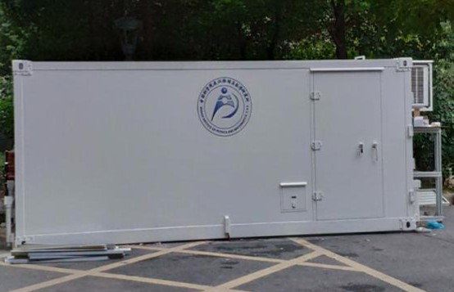
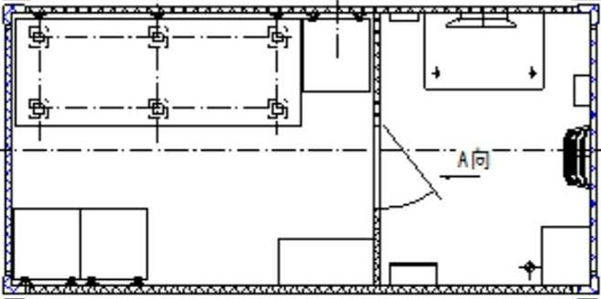
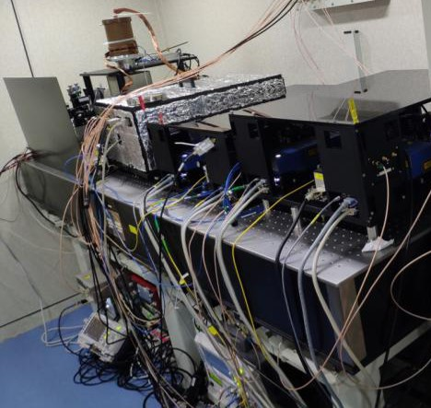
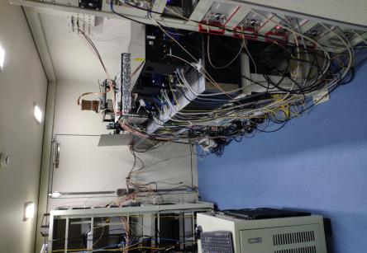
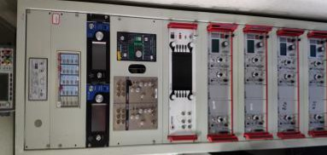
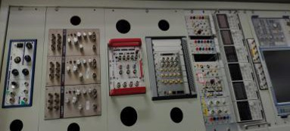
Transportable clock built in Wuhan, China
5 m
2.44 m
Experimental room
3.05 m
Rack 1
Rack 2
Phys. Rev. A 102, 050802(R)(2020)
Notes:
Then the clock parts can be put into the car trailer for expriments.

Slide 12
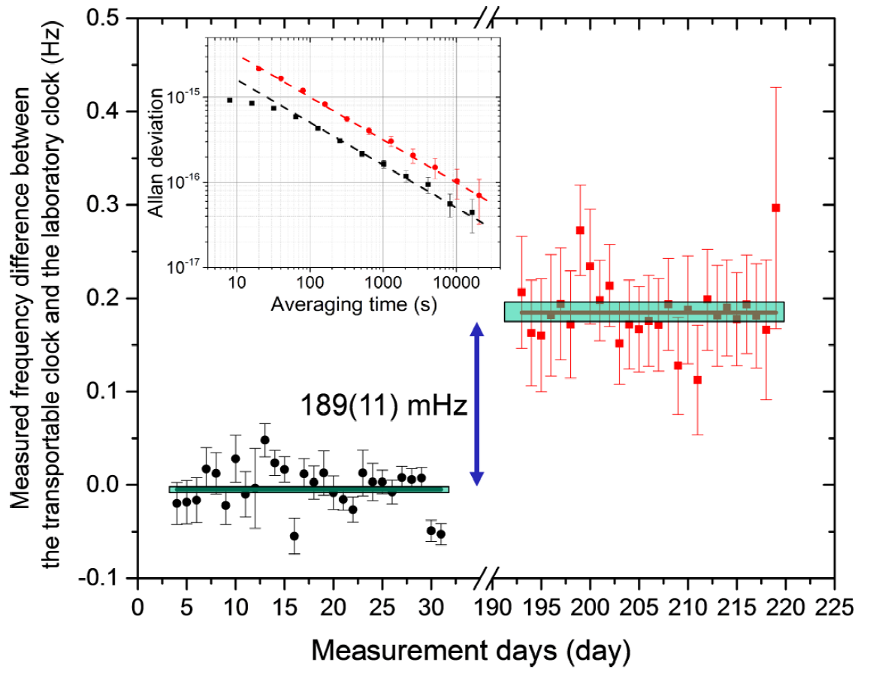
Local comparison——first transportation
Phys. Rev. A 102, 050802(R)(2020)
Notes:
Local clock comparison is made first for tests. Before moving the transportable clock to the car trailer, the transportable clock is frequency compared to a laboratory clock. The two clocks have a height difference of about 1 cm. the frequency difference of the two clocks are shown in black data points. Then the transportable clock is moved to the car trailer, which is more than 4 meters higher than the lab. The two clocks are compared again with a 100 m long fiber, the frequency difference of the two clocks are shown in red data points. The two comparison experiments shown different scatters because we are running the clocks with different parameters, for the black data points, we use the Ramsey interrogations, and for the red ones, the Rabi interrogations are used. The two rounds of clock comparisons gives a frequency difference change of 189 plus minus 11 mHz, in agreement to the calculated change according to the height difference measured by a spirit level.

Slide 13
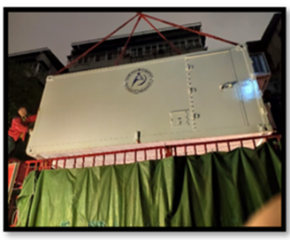

Transported for >1200 km, from Wuhan to Beijing
Overall uptime in 20 days: >75%
 | Key specifications
Car trailer volume | 3.1×2.3×2 m³
Max transfer distance | > 1200 km
stability | 1×10⁻¹⁴ τ^{-1/2}
uncertainty （laboratory environment） | 2×10⁻¹⁷
uncertainty （car trailer environment） | 1.3×10⁻¹⁷
> 1200 km
Phys. Rev. A 102, 050802(R)(2020)
Notes:
After the local test, the clock is Transported for >1200 km, from Wuhan to NIM in Beijing. The systematic uncertainty for the transportable clock is evaluated as 1.3×10⁻¹⁷

Slide 14
Conclusion & Next step
Transportable clock:
uncertainty：1.3×10⁻¹⁷
transported for >1200 km
Further improvement needed：
better temperature/vibration control to the ion trapping chamber
better transportable clock laser with higher reliability and uncertainty
at the E-18 level,
corresponding to a geopotential measurement uncertianty at the cm level
Notes:
Well, now I would like to give the conclusion and what we would like to do for the next step. For the laboratory clock, the uncertainty is 3E-18, the stability is 2.5E-15/√τ, reaching E-18 level at > 200000 s of averaging time, for the Transportable clock, the uncertainty is 1.3E-17, it has been transported for >1200 km, can be used for Geodesy applications and more.
Here are the Further improvements we needed： for the Laboratory clock: we need even better magnetic shielding, 1E-16 or better clock laser, we also need cryogenic system with longer continuous running time. For the Transportable clock: we need even better temperature and vibration control to the ion trapping chamber, and also a better transportable clock laser is needed.

Slide 15
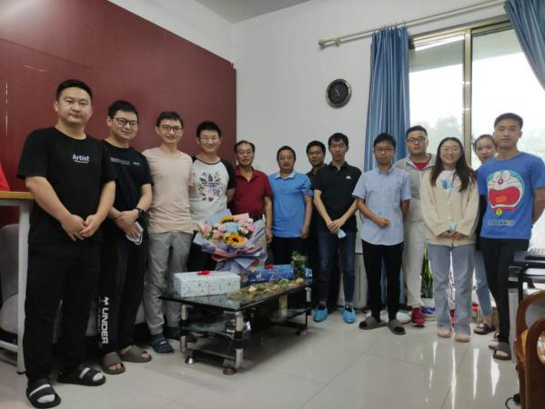
Acknowledgement
Wuhan Ca⁺ Group:
H. Zhang, B. Zhang, M. Zeng, Y. Qian, Z.
Ma, M. Wang, Z. Chen…
We thank the NIM (Beijing) group for the absolute frequency measurement efforts
We thank L-S. Ma from ECNU (Shanghai) for help with improvement works on the clock laser
We thank Y. Li from NICT (Japan), P. Dubé from NRC (Canada), J. Ye from JILA, D. Leibrandt and C-W. Chou from NIST… for helps discussions
Very useful helps also come from coworkers in APM: L. Chen, L. Li, J. Li, C. Wan…
This work is sponsored by National Key R&D Program of China, National Natural Science Foundation of China, and CAS
Notes:
Here goes the Acknowledgement
First we would thank the Wuhan Ca⁺ Group for their hard work.
We thank the NIM (Beijing) group for the absolute frequency measurement efforts
We thank L-S. Ma from ECNU (Shanghai) for help with improvement works on the clock laser
We thank Y. Li from NICT (Japan), P. Dubé from NRC (Canada), J. Ye from JILA, D. Leibrandt and C-W. Chou from NIST… for helps discussions
Very useful helps also come from coworkers in APM.
This work is sponsored by National Key R&D Program of China, National Natural Science Foundation of China, and CAS
Here I’ll thank the conference committee to give us the chance to give a talk about our work. Thank for the audience who is still listening, Thank you for your attention. This is a pre-recorded video recoded at early June, however our video will have its own text-based “conversation” feature where you are welcomed to leave comments or ask questions. We will answer your questions there, and hopefully we can make few more progress by then. Thank you!

