Slide 1



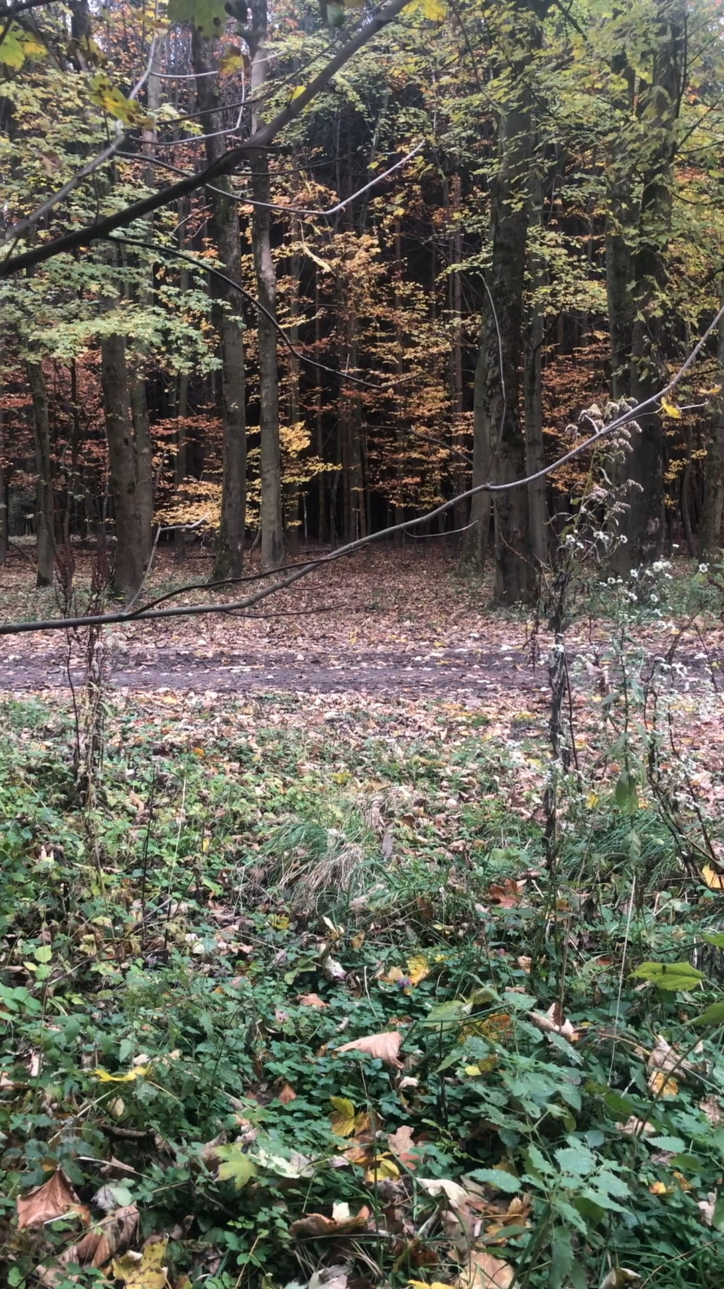
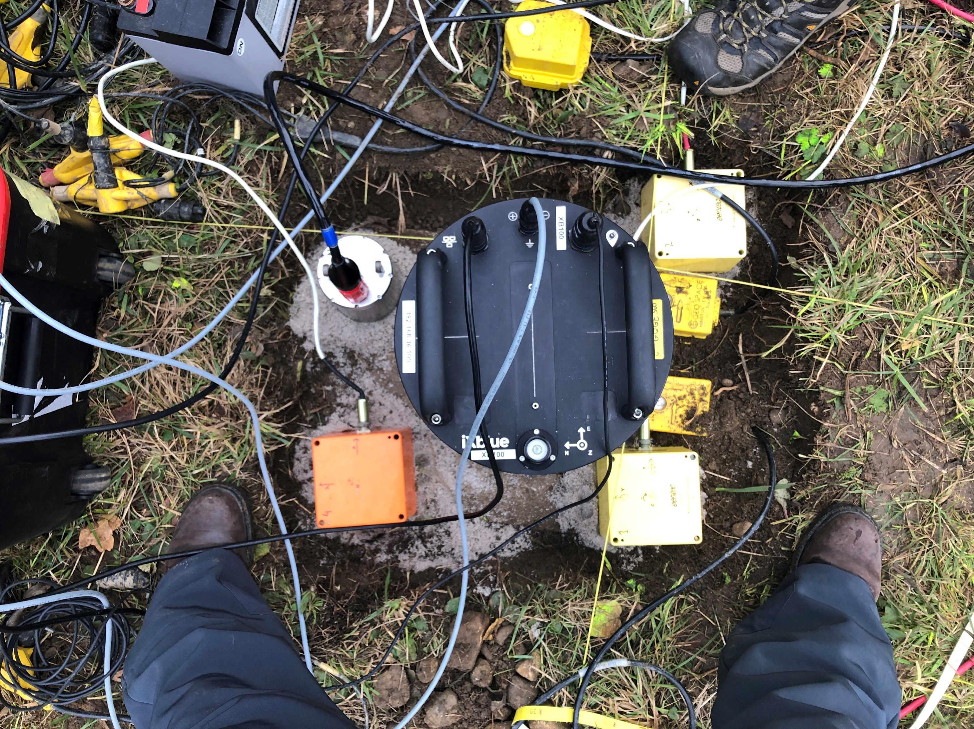
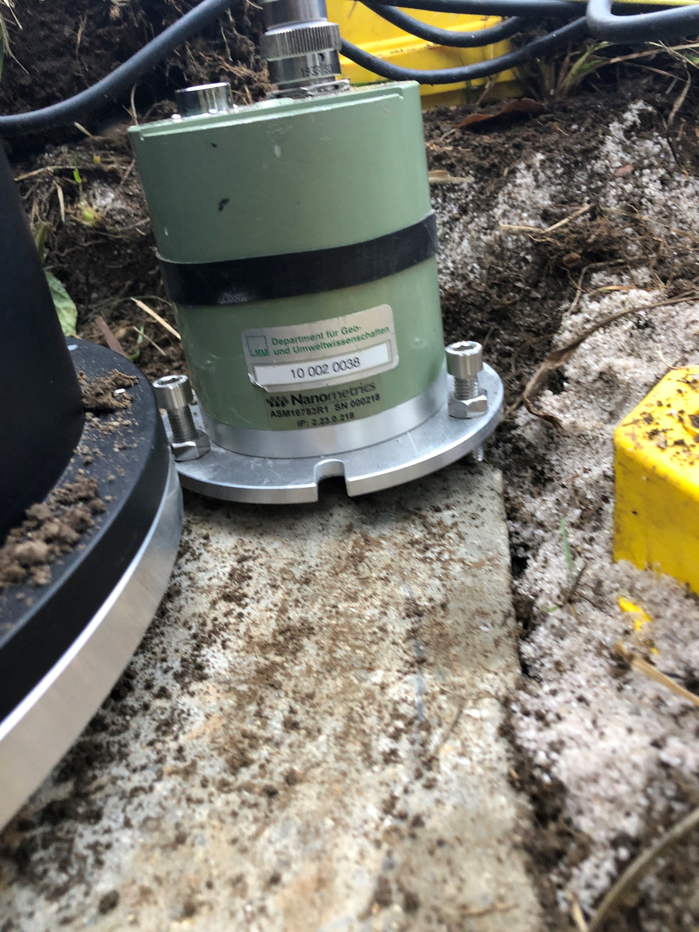
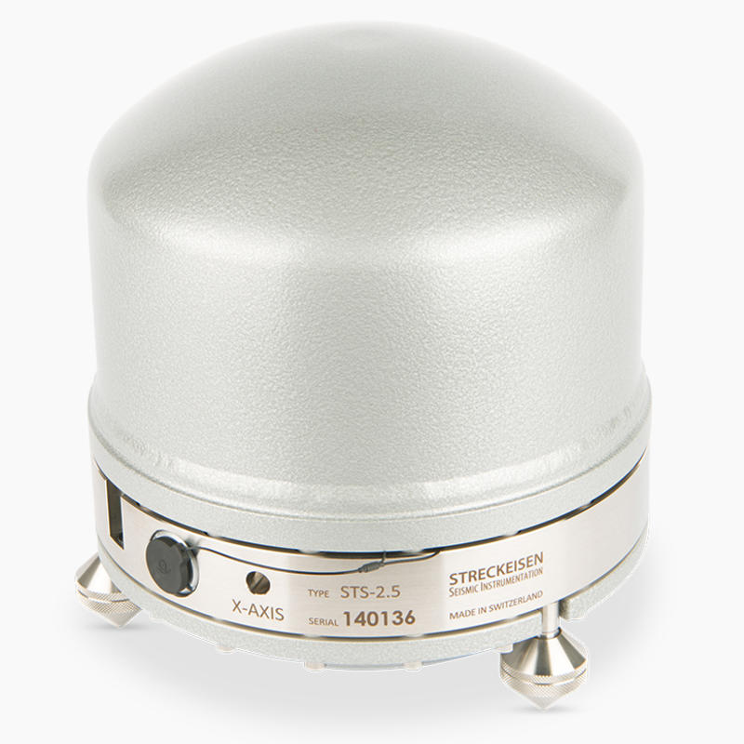

Locating Nearby Explosions in Fürstenfeldbruck, Germany, Combining 8 Rotational Sensors
Gizem Izgi ⁽¹⁾, Eva P.S. Eibl ⁽¹⁾, Frank Krüger ⁽¹⁾, Felix Bernauer ⁽²⁾
1 Institute of Geosciences, University of Potsdam, Karl-Liebknecht-Str. 24, 14476 Potsdam, Germany
2 Department für Geo- und Umweltwissenschaften, Ludwig-Maximilians Universität München, 80333 München, Germany
We compare 8 rotational sensors and test the recording with respect to active sources.
Testing the performance of the blueSeis-3A rotational sensor in the field.
Notes:
sources i.e. we know where the source is.
Nanometrics Trillium Compact
Streckeisen STS2.5

Slide 2
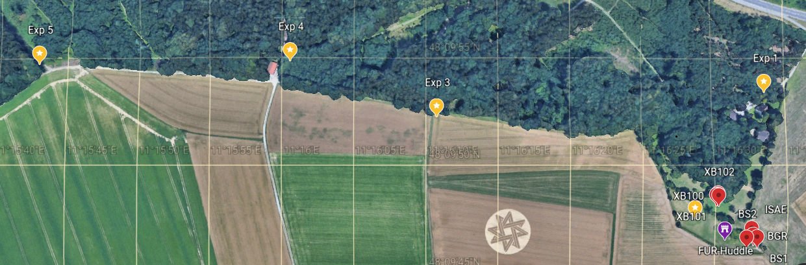
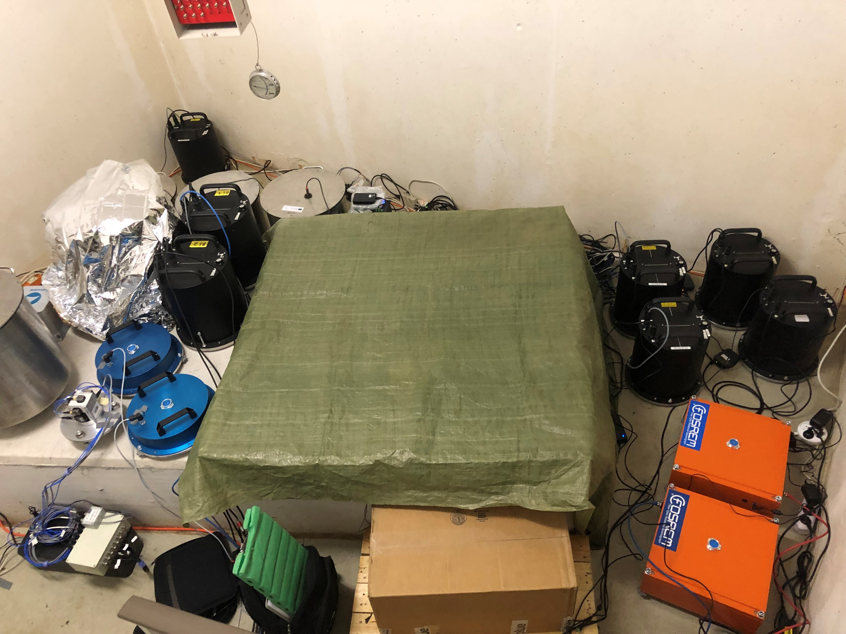
EXPERIMENT & LOCATIONS
650 m
450 m
1.1 km
XB100
BS1
XB101
XB102
BS2
FUR
XBLUE
ISAE

Slide 3
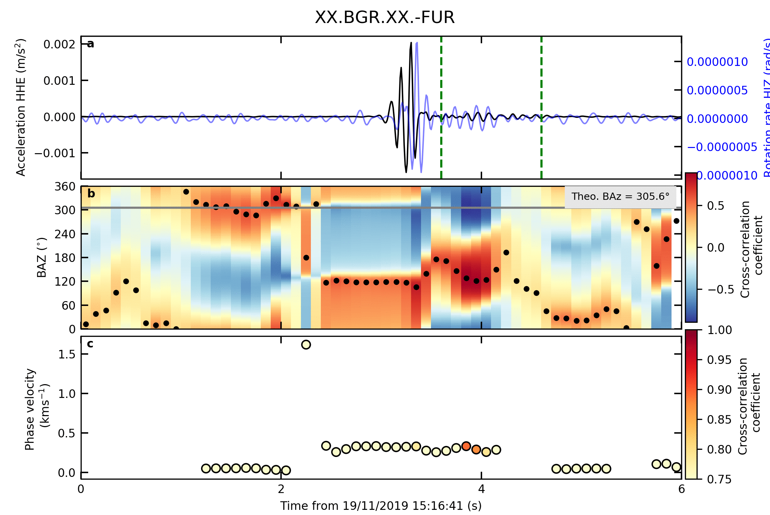
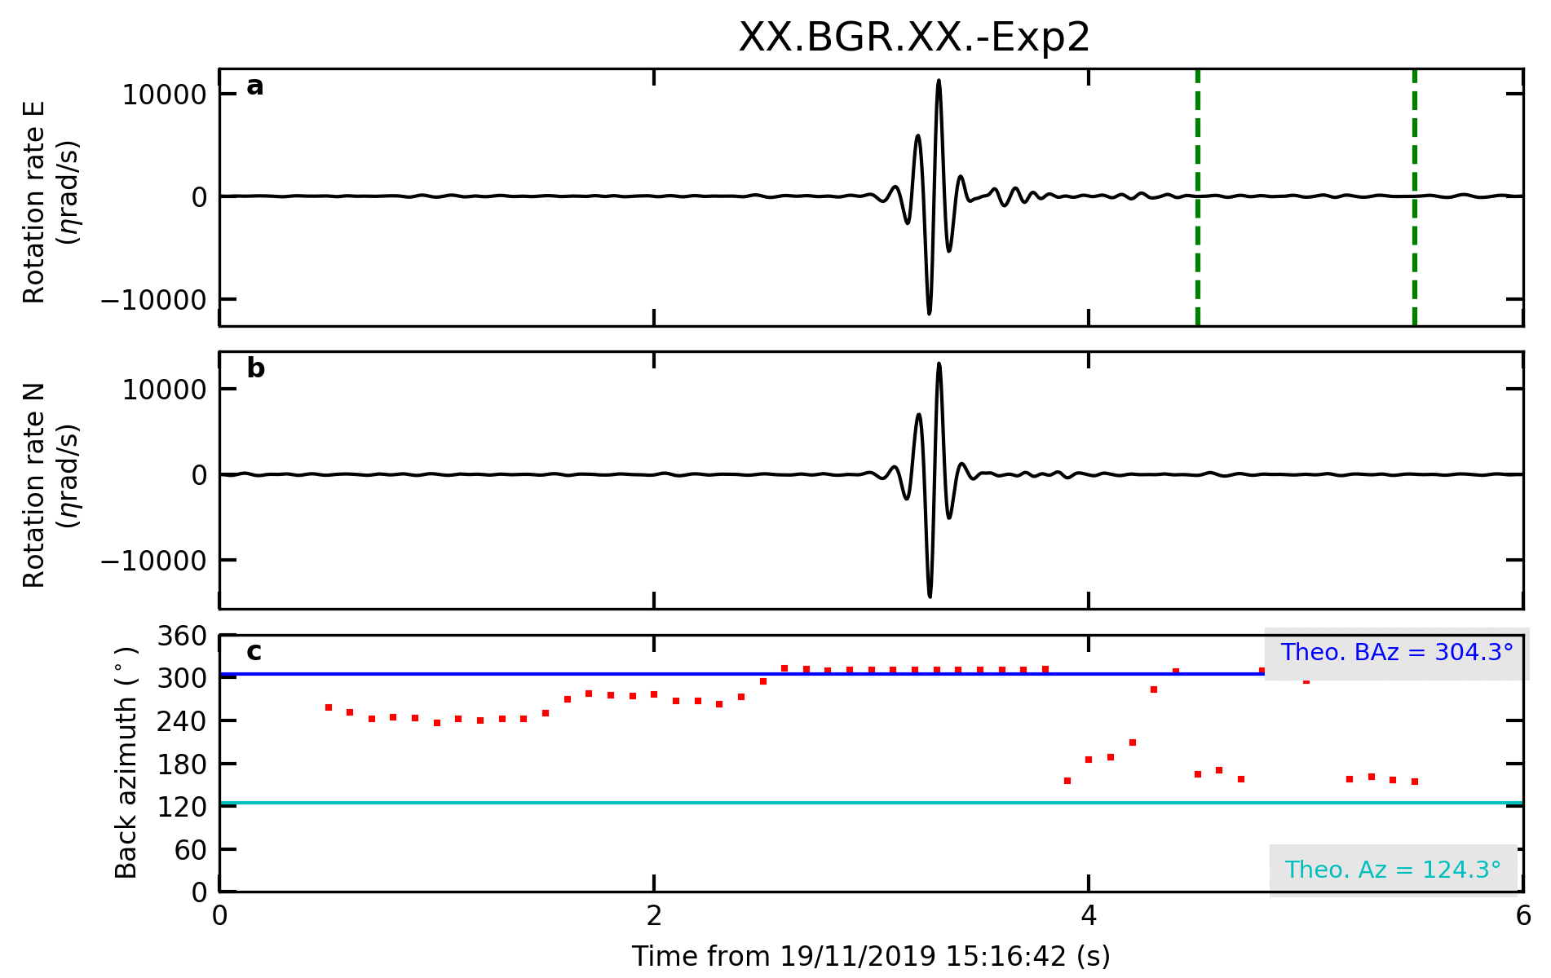
METHODS
BAz calculation using vertical rotation and transvers acceleration
SH-type Waves
Calculates CC coefficient
Grid search over all possible back azimuths
Hadziioannou et al. 2012
BAz calculation using horizontal rotational components
SV-type Waves
Eigenvector associated with the smallest eigenvalue points in the direction of the BAz
The ratio between HJ1/HJ2 is related with the BAz.
Yuan et al. 2020

Slide 4
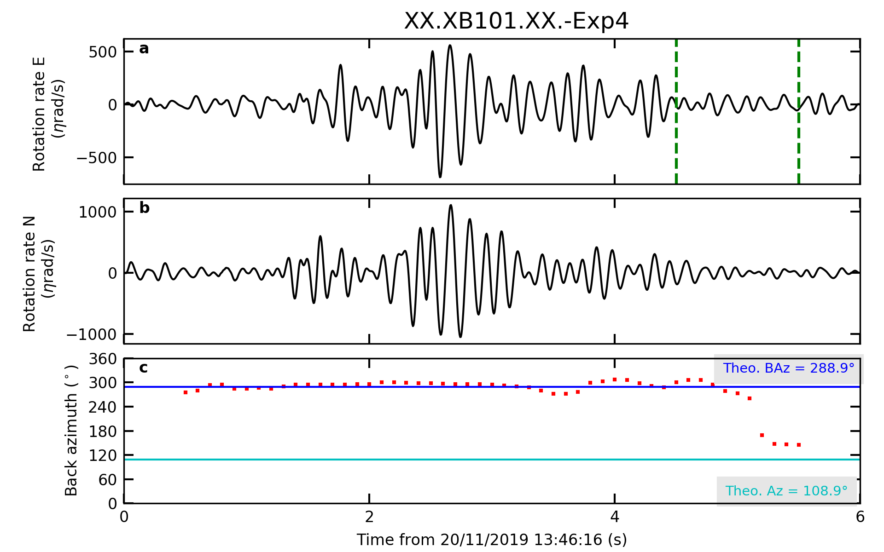
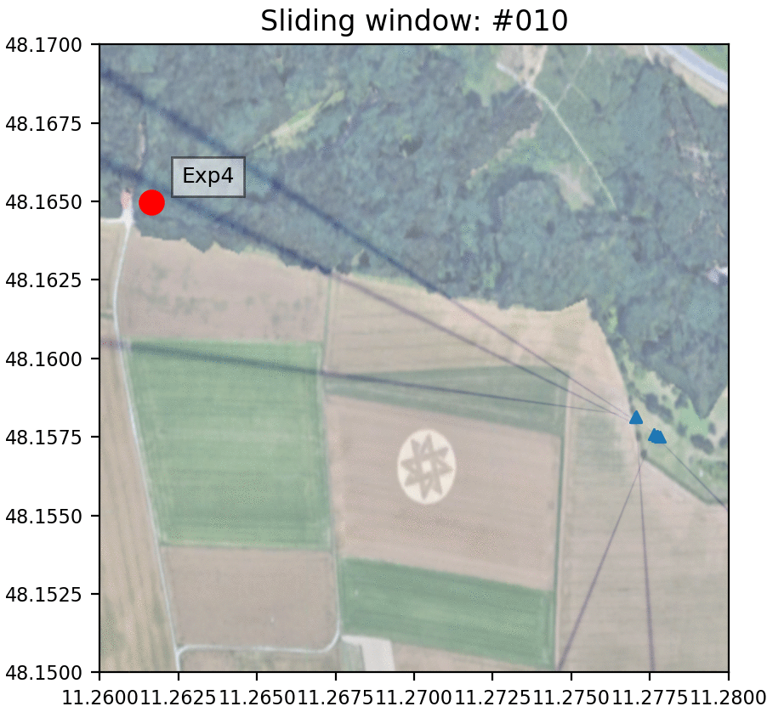
BAz Calculation Using Only Rotational Sensor
4-10 Hz Bandpass Filter
1 sec Moving Time Window
90% Overlap
Distance to group 1: 650m
Distance to group 2: 720m
Explosive: 1500g

Slide 5
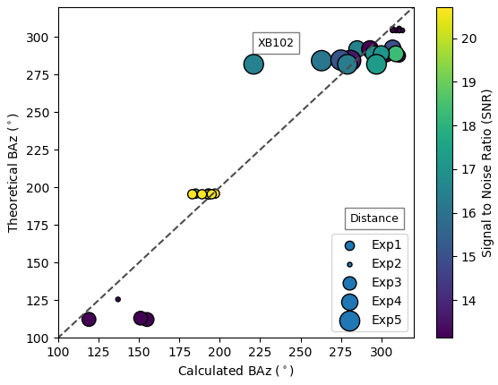
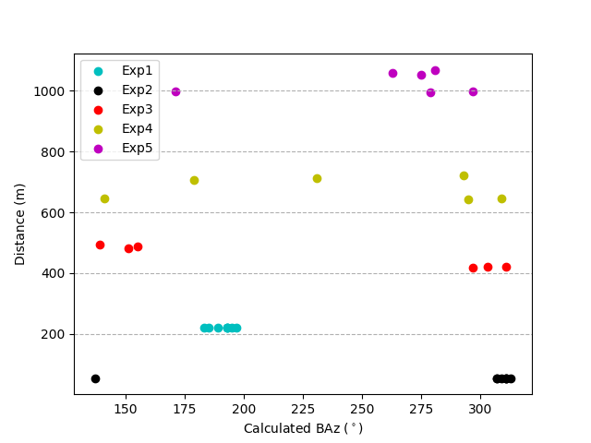
SIGNAL TO NOISE RATIO
SNR least for closest because of lower explosive amount.
The optimum SNR is 500g explosive and 150m distance.
 | 1st (150g) | 2nd (500g) | 3rd (1500g) | 4th (1500g) | 5th (1500g)
XB100 | 220m | 52m | 421m | 646m | 997m
XB101 | 219m | 54m | 419m | 644m | 995m
XB102 | 219m | 54m | 422m | 647m | 998m
XBLUE | 219m | 54m | 422m | 645m | 996m
BS1 | 220m | 53m | 495m | 721m | 1067m
BS2 | 220m | 53m | 482m | 707m | 1052m
BGR | 220m | 54m | 489m | 714m | 1060m
ISAE | 219m | 54m | 487m | 715m | 1058m
GROUP 1:
GROUP 2:

