Slide 1





CO₂ INJECTION FOR GEOTHERMAL POWER GENERATION AND STORAGE IN HYDROTHERMAL RESERVOIRS IN AL WAJH BASIN, SAUDI ARABIA
Bora Yalcin, Justin Ezekiel, P. Martin Mai

Slide 2

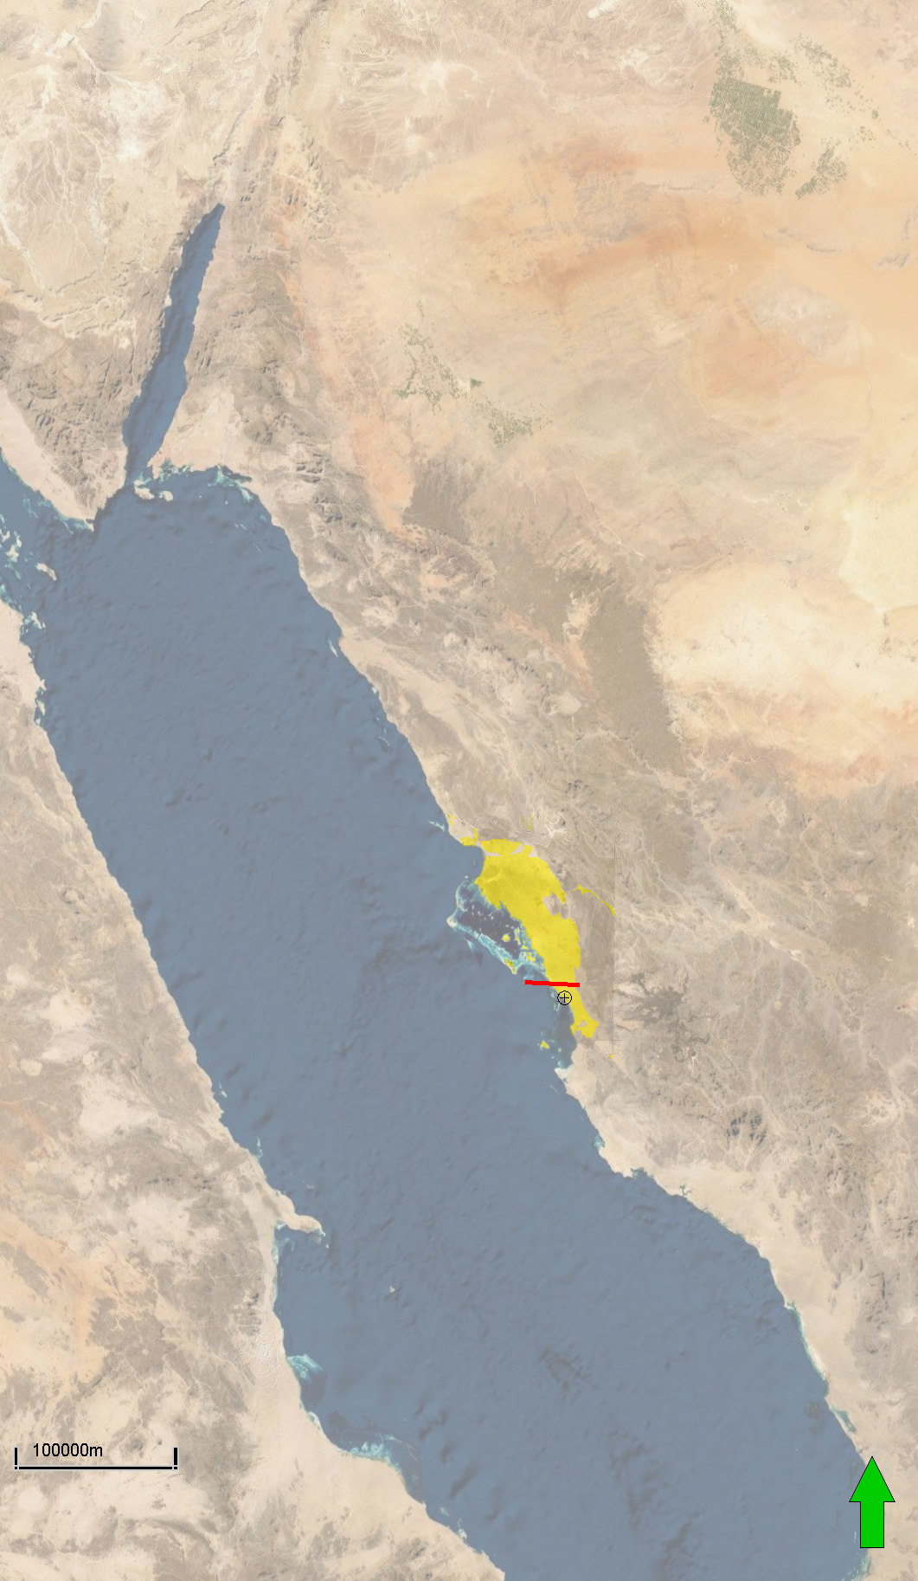
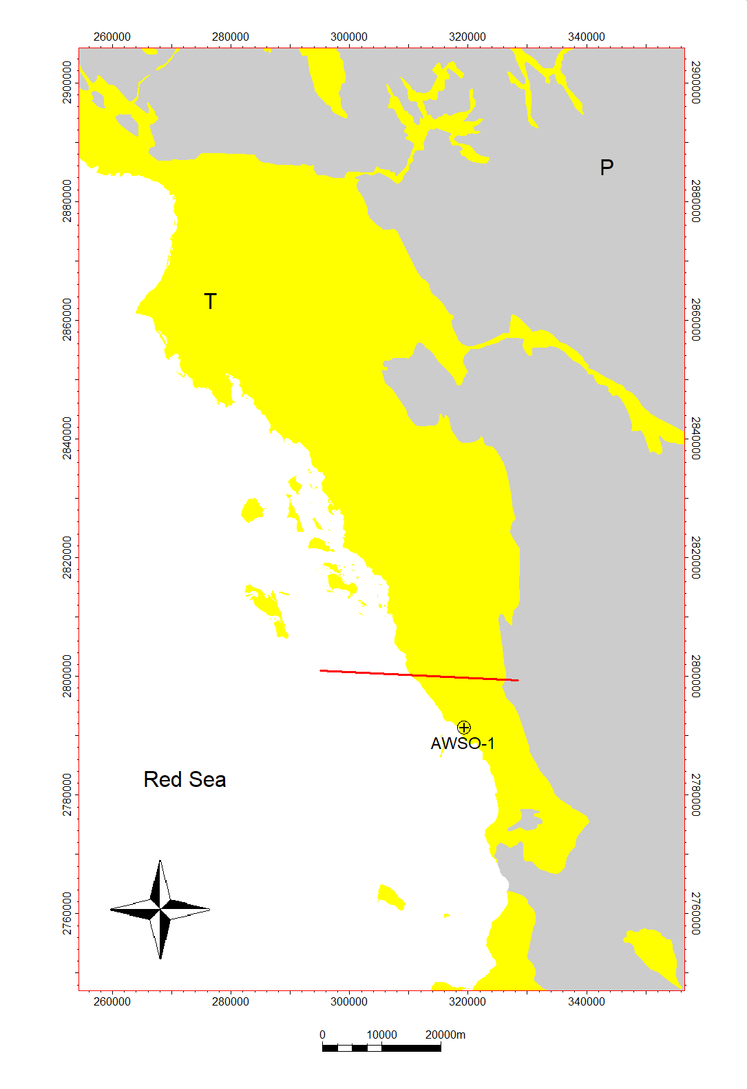
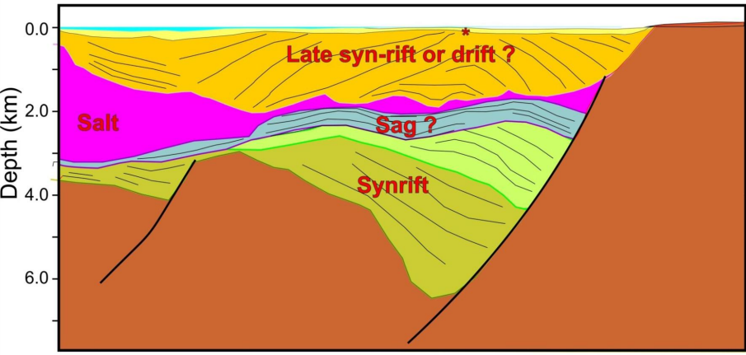

AREA OF INTEREST & MOTIVATION
Location of Al Wajh Basin
Model Area
Motivation
CO₂-based geothermal energy mining
Red Sea region has high heat flux (60-100 mW/m²) and favorable hydrothermal system.
Al Wajh is a rift basin with thick syn-rift turbidites capped by anhydrite seal.
AWSO-1 well ,seismic section and satellite gravity map available for geo-model input
A
A’
A
A’
(Mohriak, 2014)

Slide 3
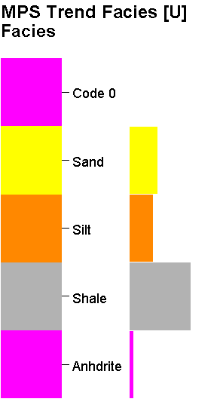
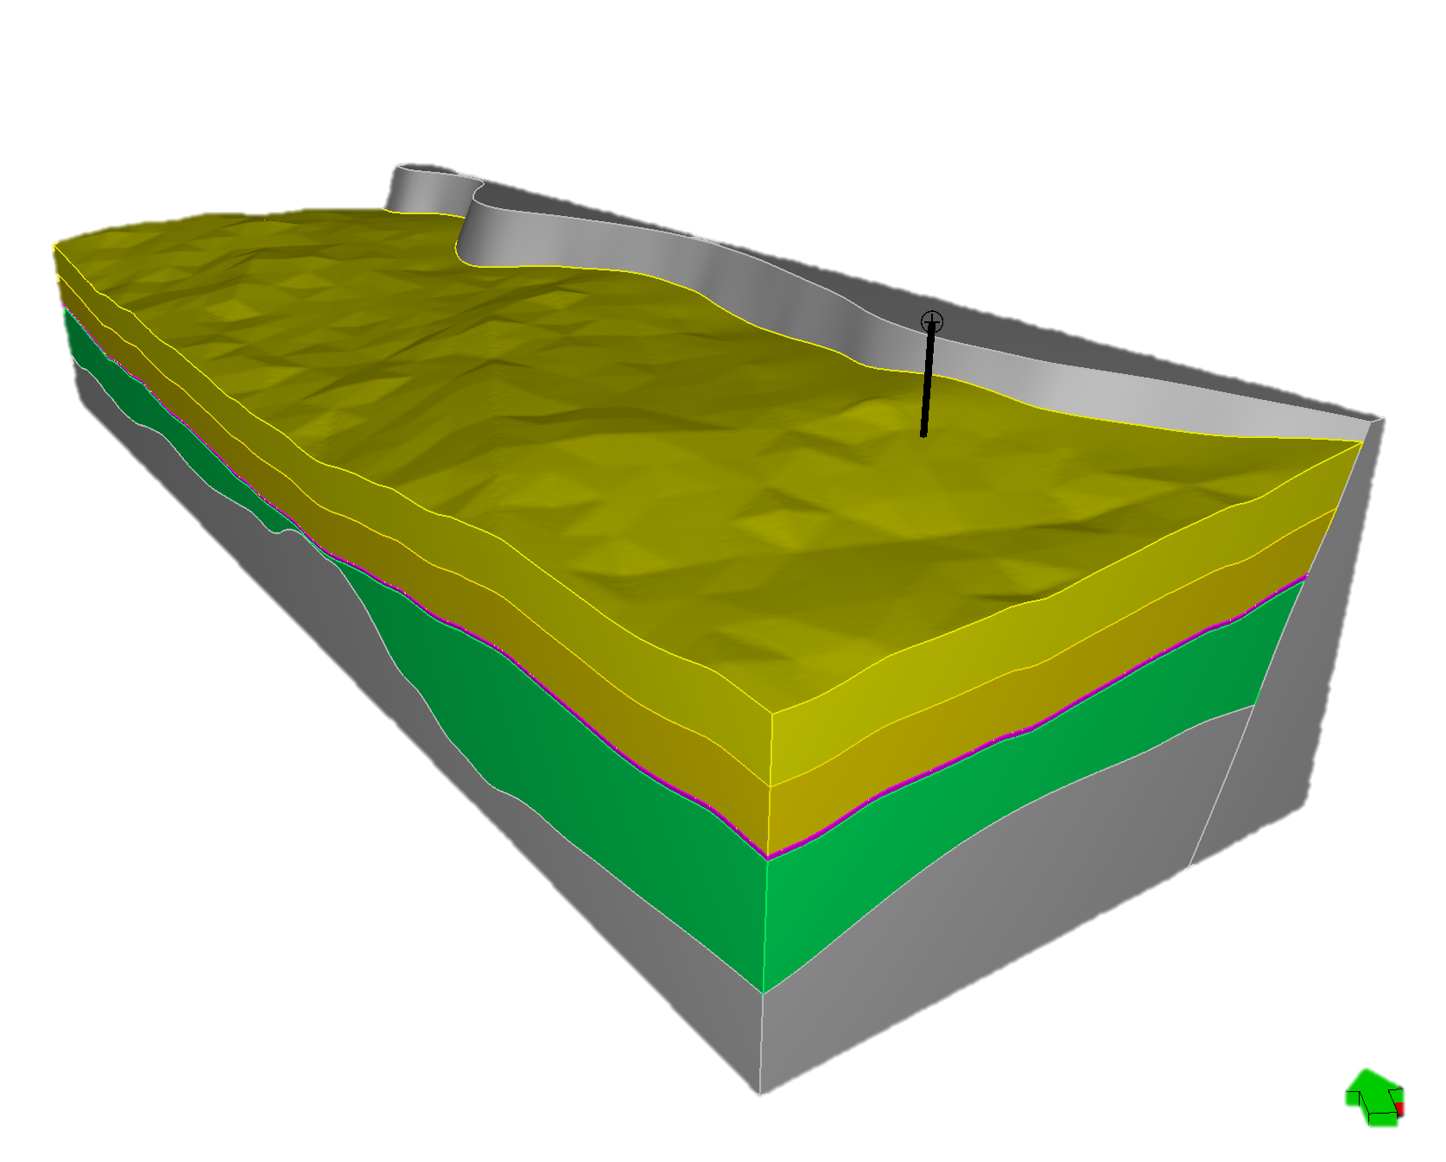
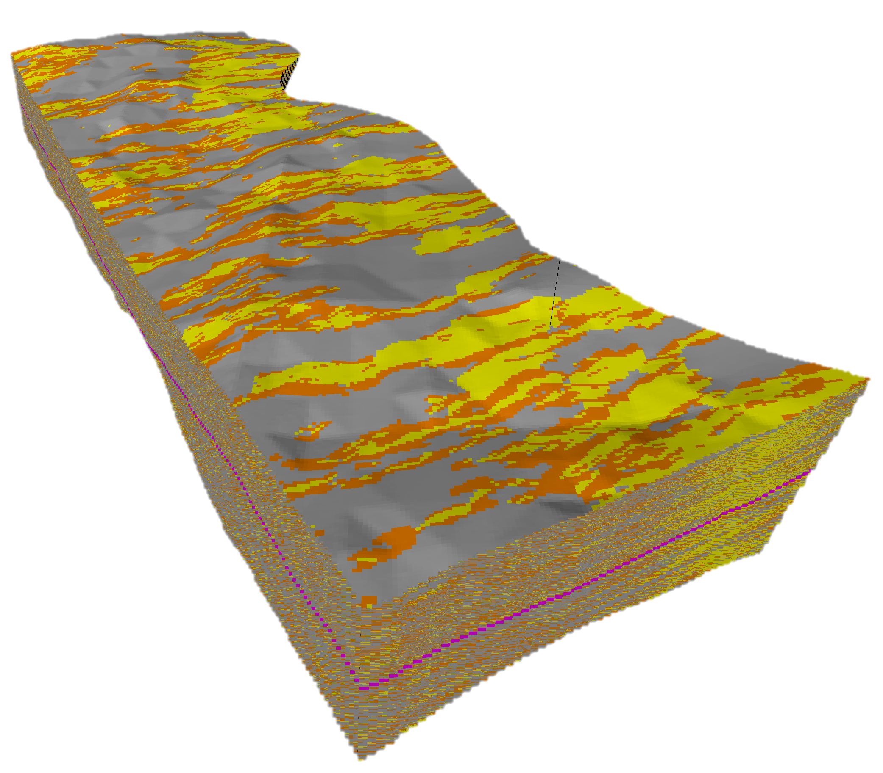
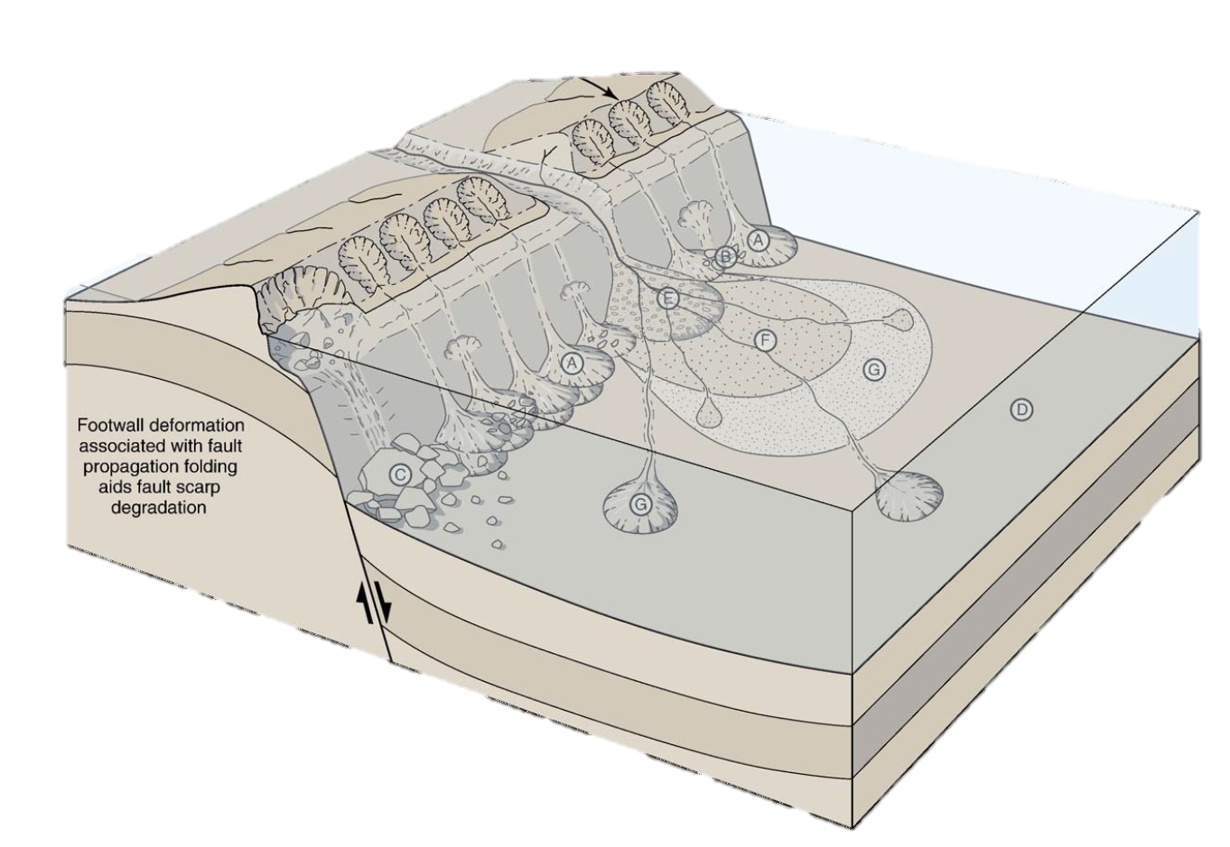
GEOMODEL
Structural model/grid
Syn-rift submarine paleo analog
MPS facies model
AWSO-1
Umluj
Burqan
Yanbu
AlWajh
115 km
Basement
Leppard, 2006
30 km
We used VBM technique for structural model.
We used the channel dimensions from present bathymetry data as main input for multipoint simulation
We derived sand/silt/shale probability cubes based on published statistics. Then, in addition to the well data, we conditioned the distribution density of the channels to those probability cubes
Yalcin et al., in preparation

Slide 4
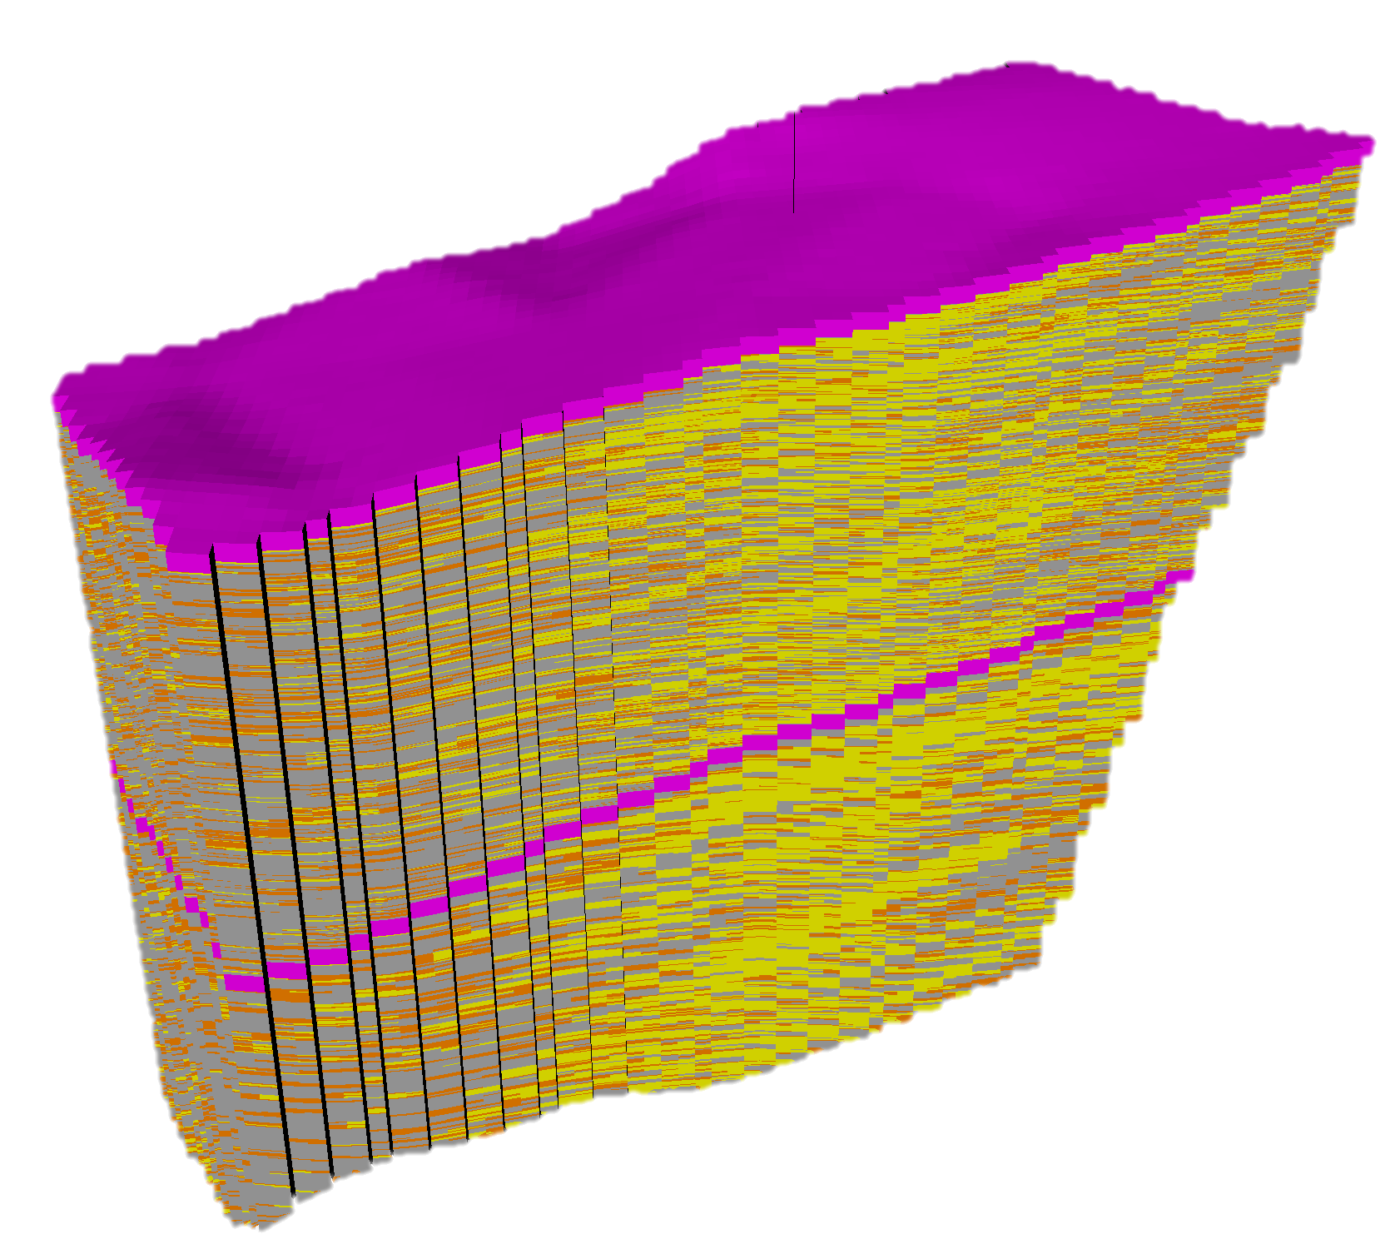
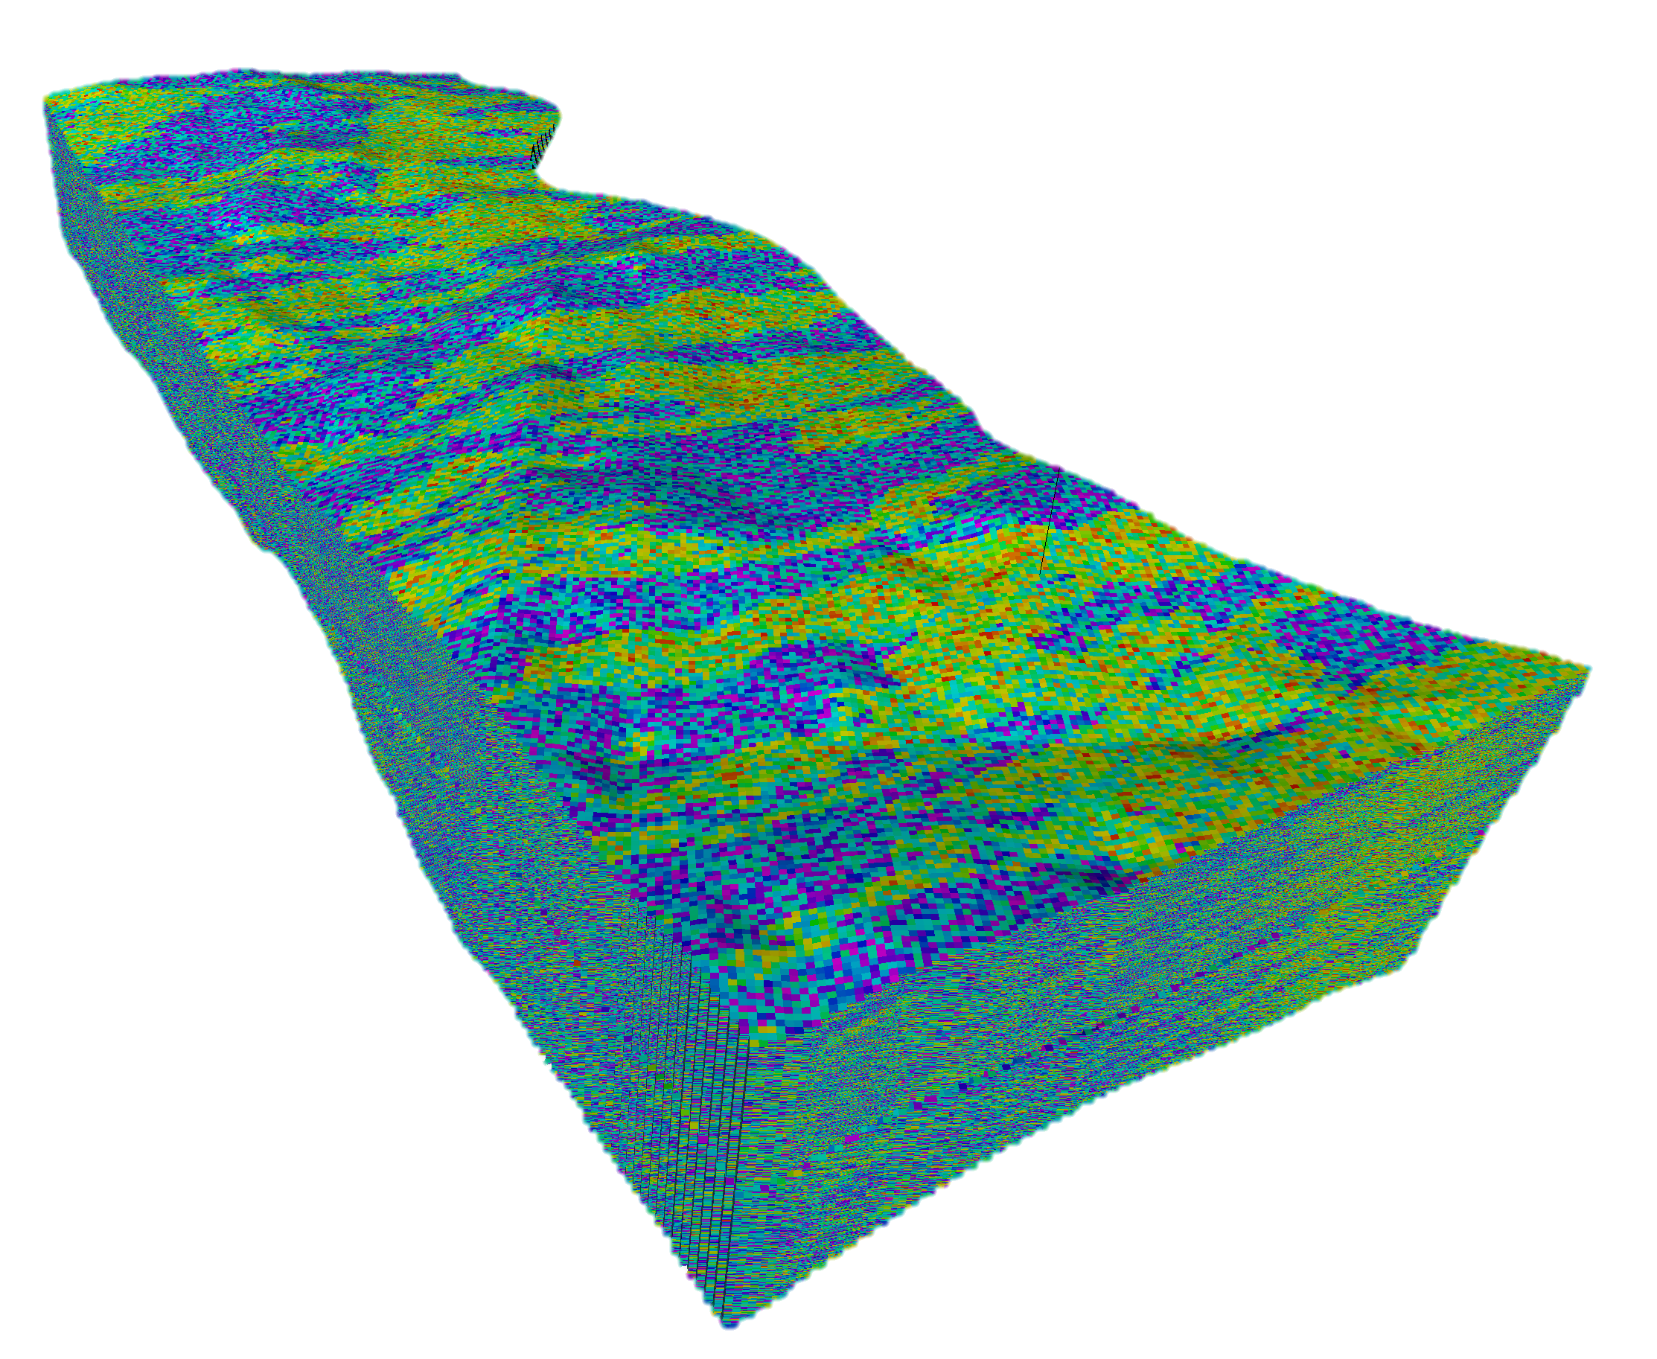
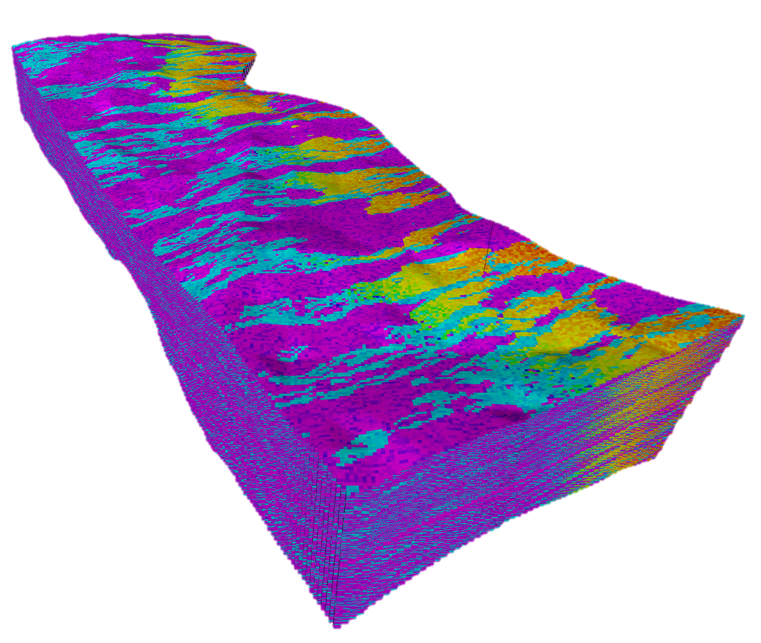
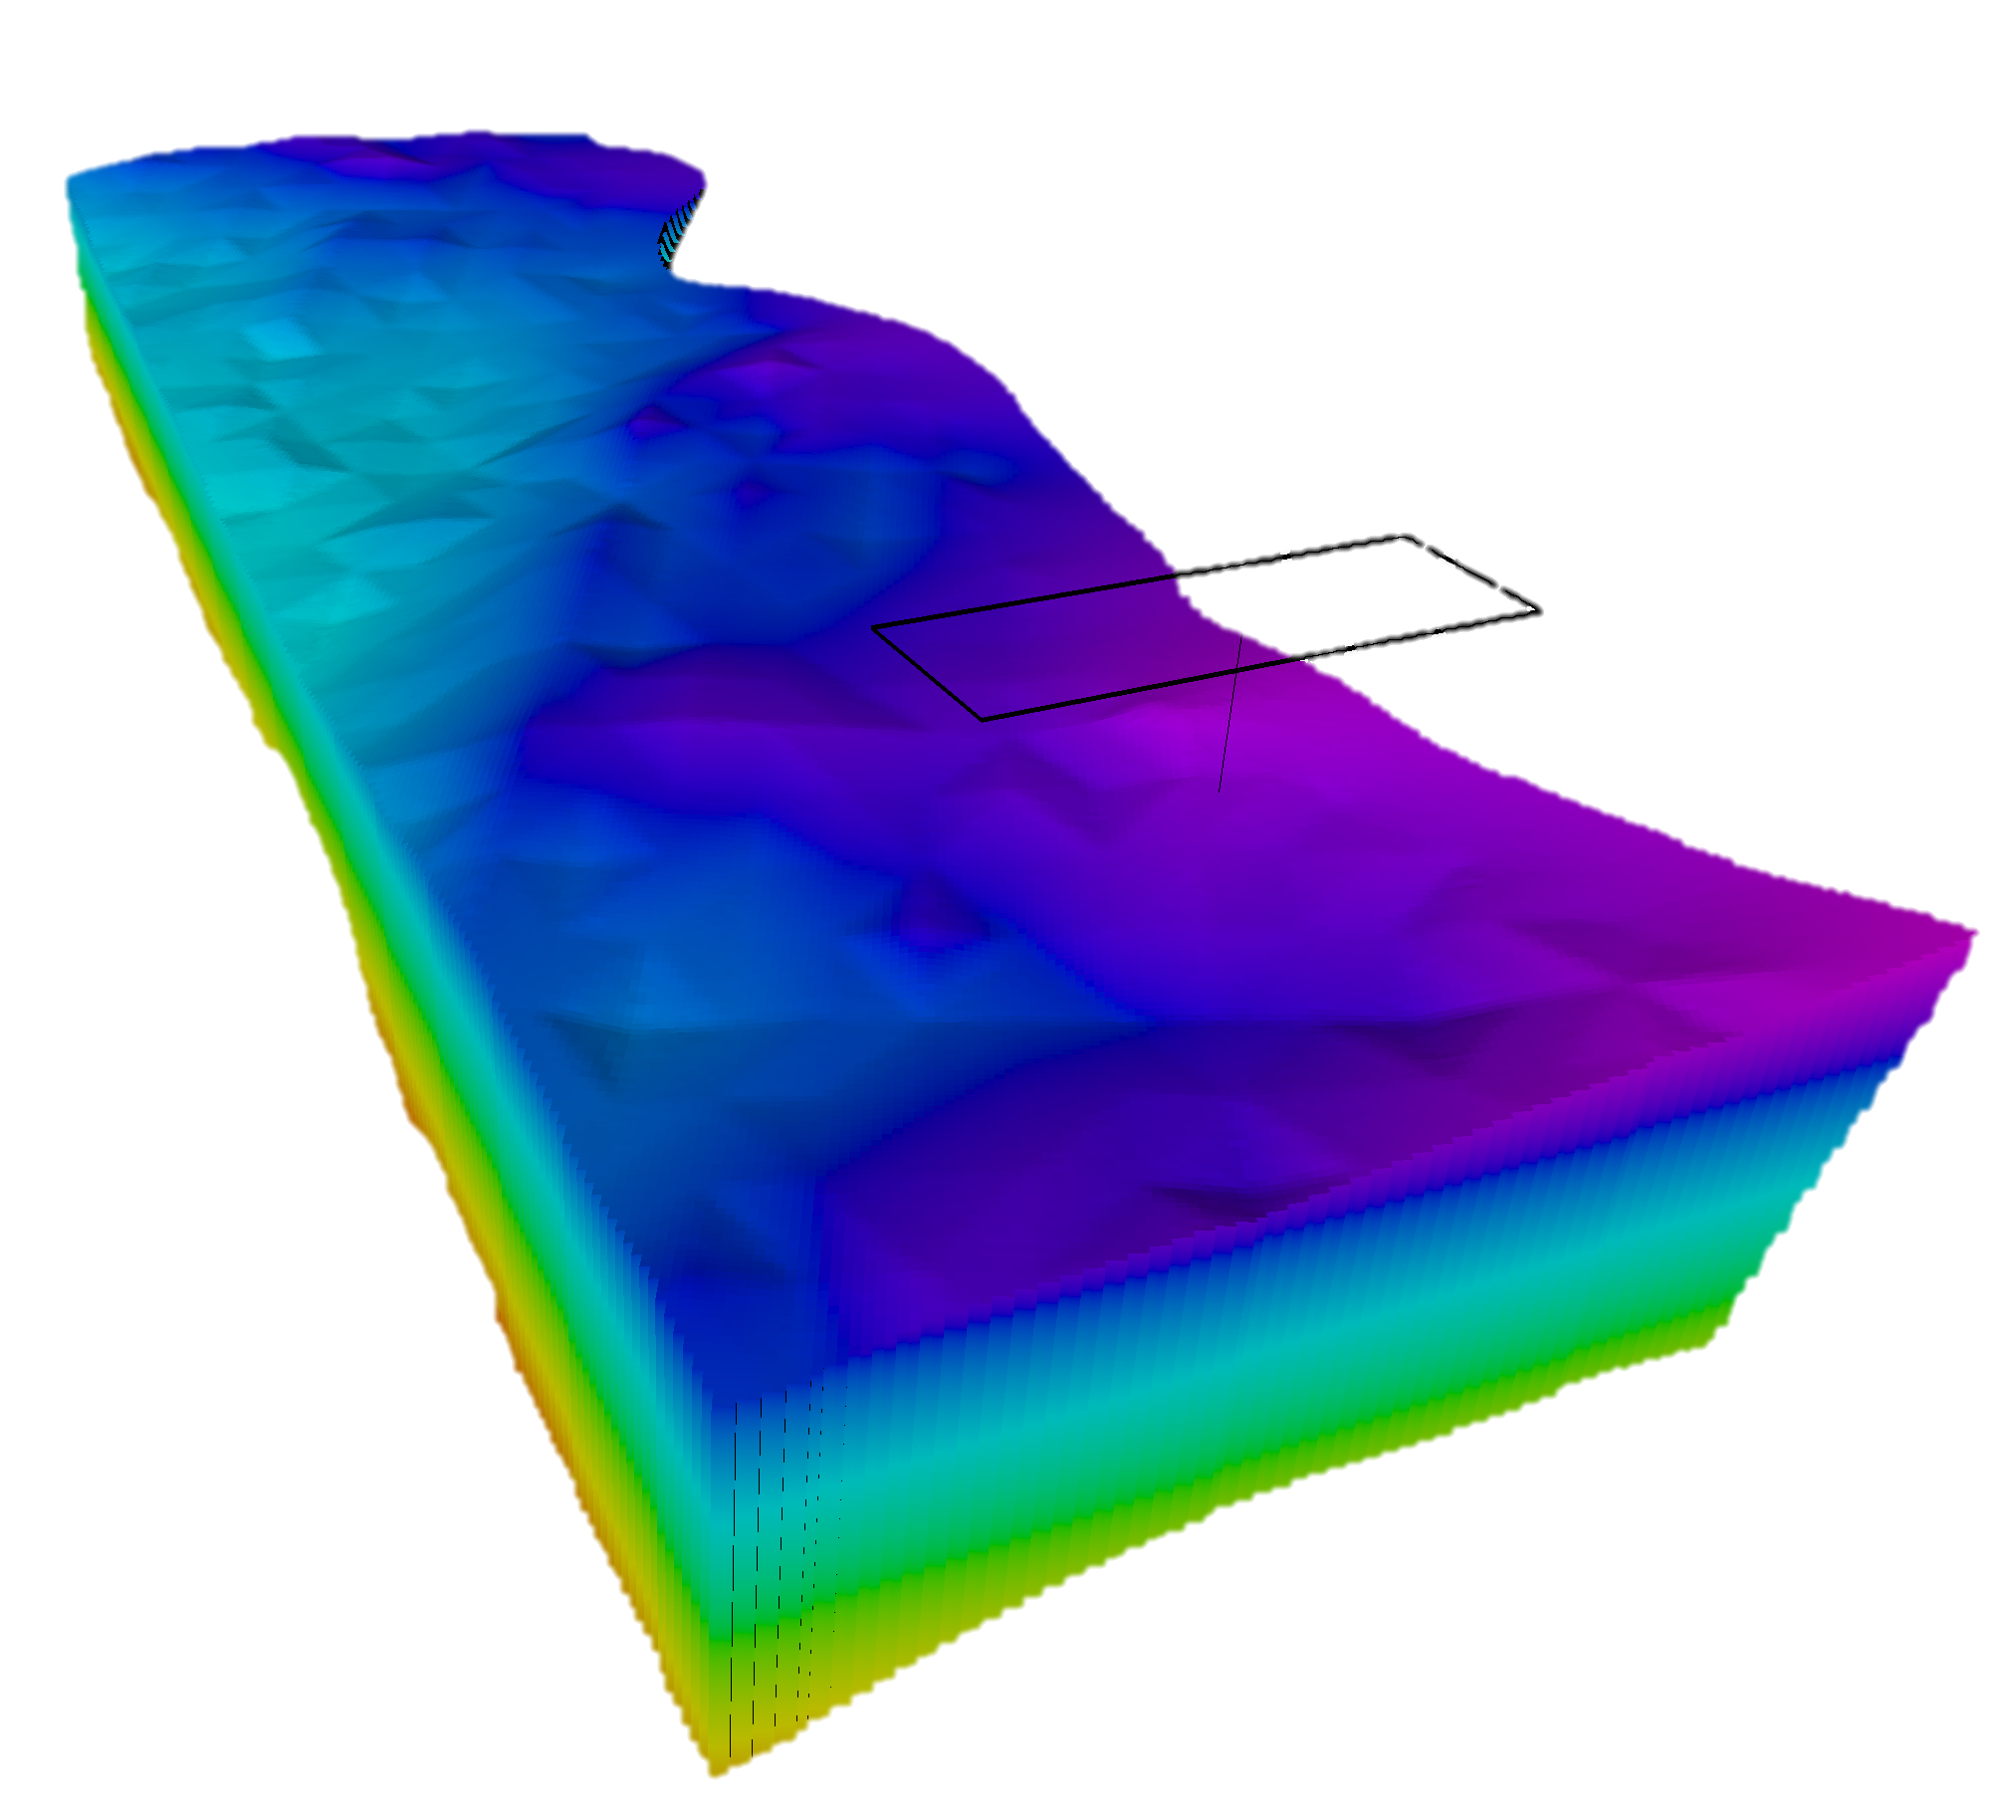
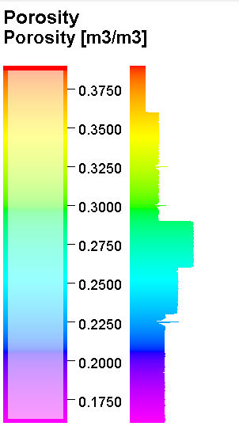
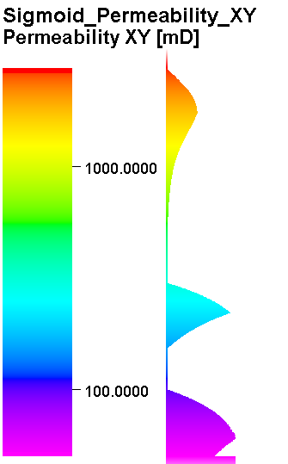
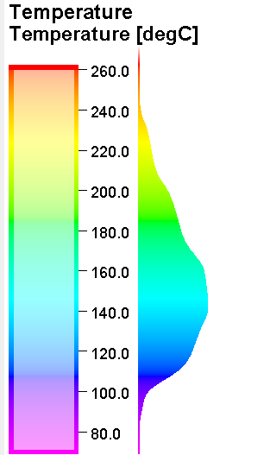
PETROPHYSICAL PROPERTY MODEL
Sector Model
We assigned representative porosity and permeability distributions for turbidite facies associated rock types.
For the channel sand: We applied pore-size (and hence the permeability) re-distribution to honor grain size changes based on proximity to the sediment source.
We selected a representative –smaller- area as sector model for simulation purposes
AWSO-1
Porosity distribution
Permeability distribution
Temperature model
6 km
12 km
Yalcin et al., in preparation

Slide 5
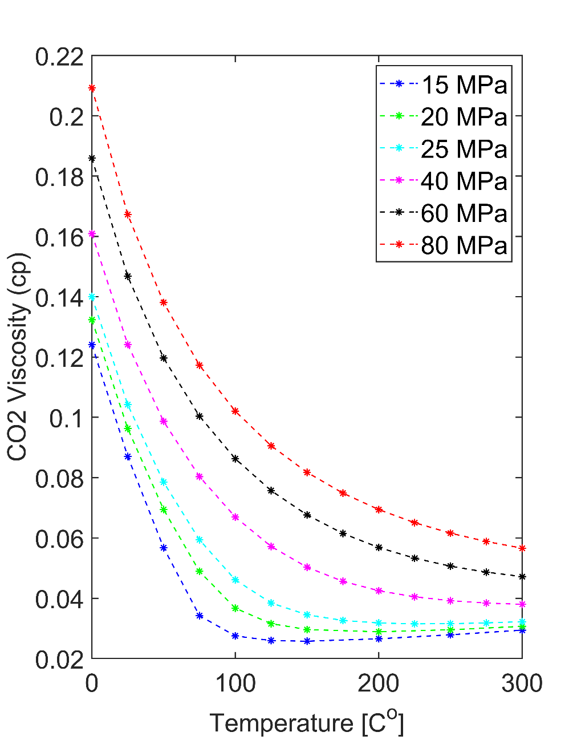
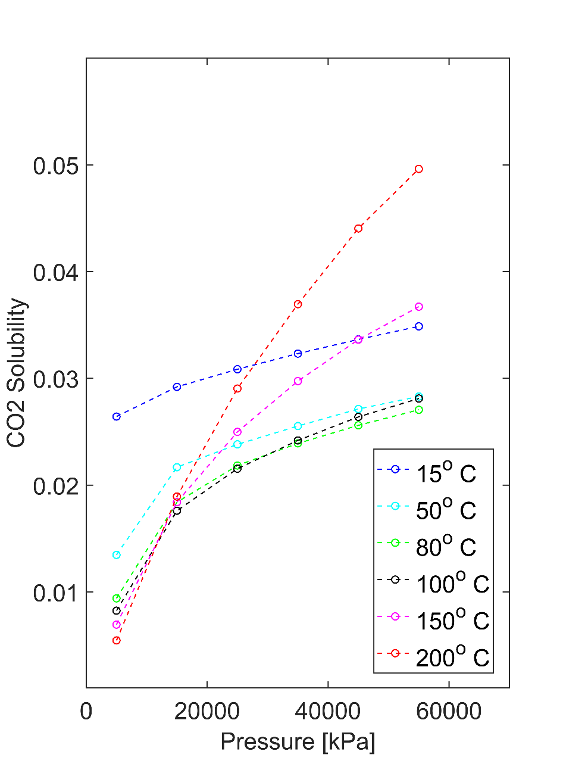
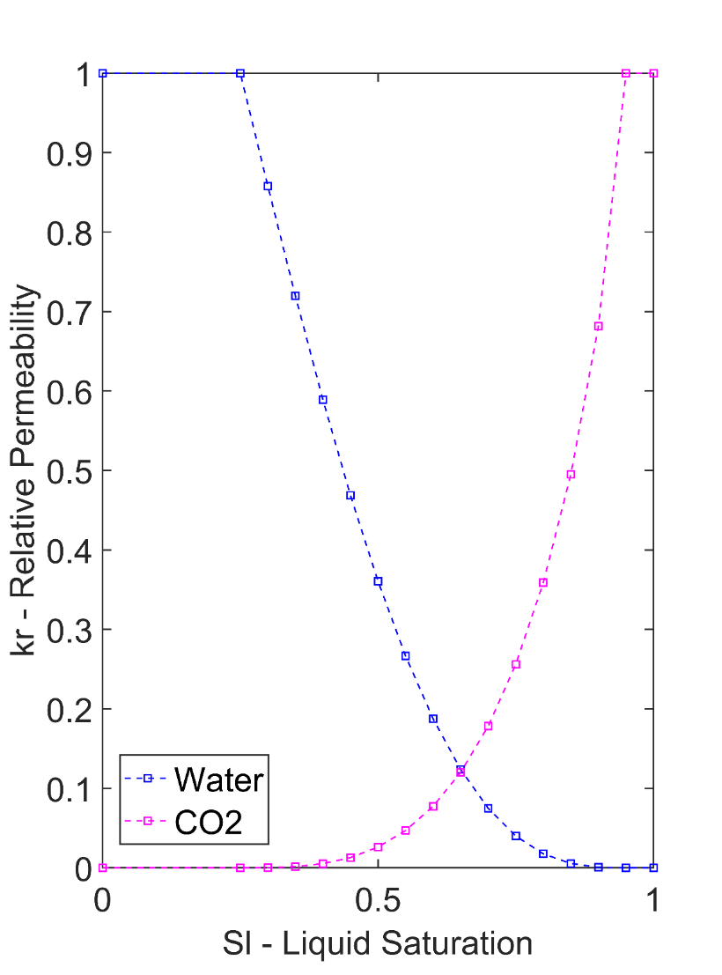
FLUID PROPERTY MODEL
CO₂ Viscosity
CO₂ Solubility
CO₂ Relative Permeability
(after NIST)
(after Spycher et.al., 2003)
(Van Genuchten parameter: m = 0.77)
We explicitly modeled both H₂O and CO₂ viscosity, solubility for a desired range of temperature and pressure
We then also assign relative permeability curves with Van Genuchten parameter of 0.77
Yalcin et al., in preparation

Slide 6
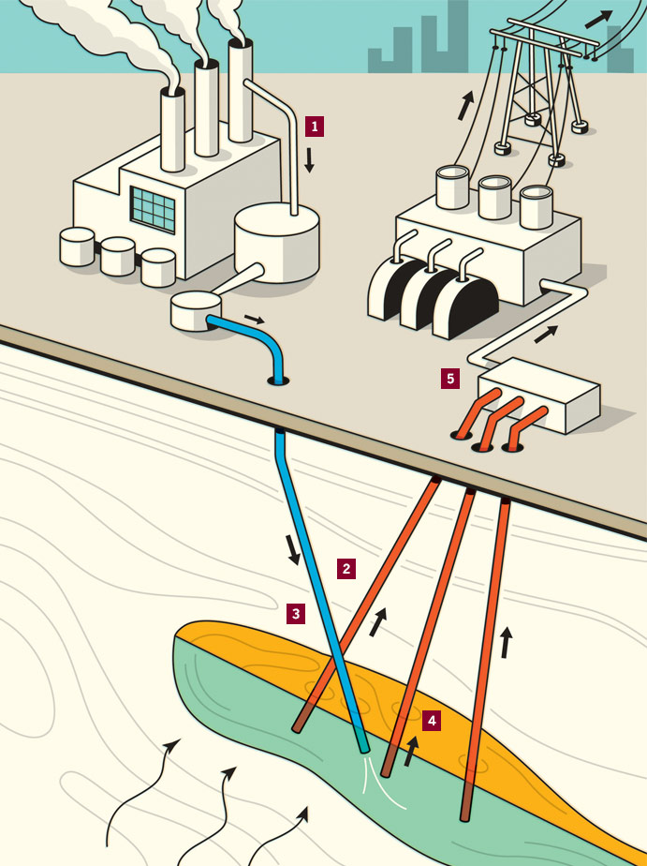
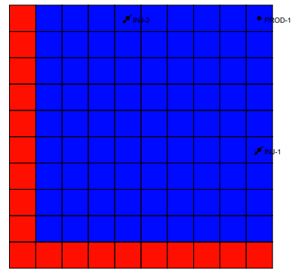
SIMULATION SCHEME
Specs of simulation
CO₂ Injection - Production scheme
Well pattern with open boundary condition
Open boundary (heat and pressure) condition for the simulation model
We focused on the upper 400 meters of syn-rift sedimentary rocks for the simulation
We designed the well pattern such that we can achieve 95% of CO2 saturation on the production well.
7 years of injection and 33 years of production in total 40 years of simulation.
INJ
PROD
INJ
INJ
INJ
(Harry Campell)
1600 m
Yalcin et al., in preparation

Slide 7
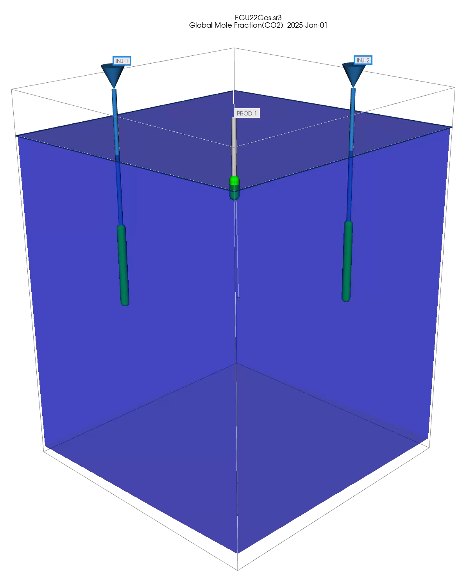
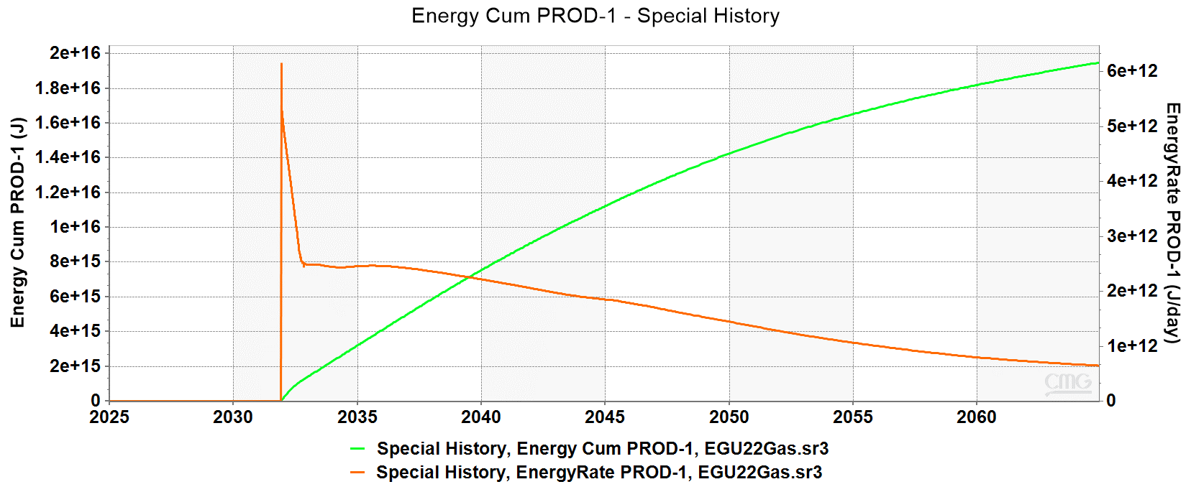
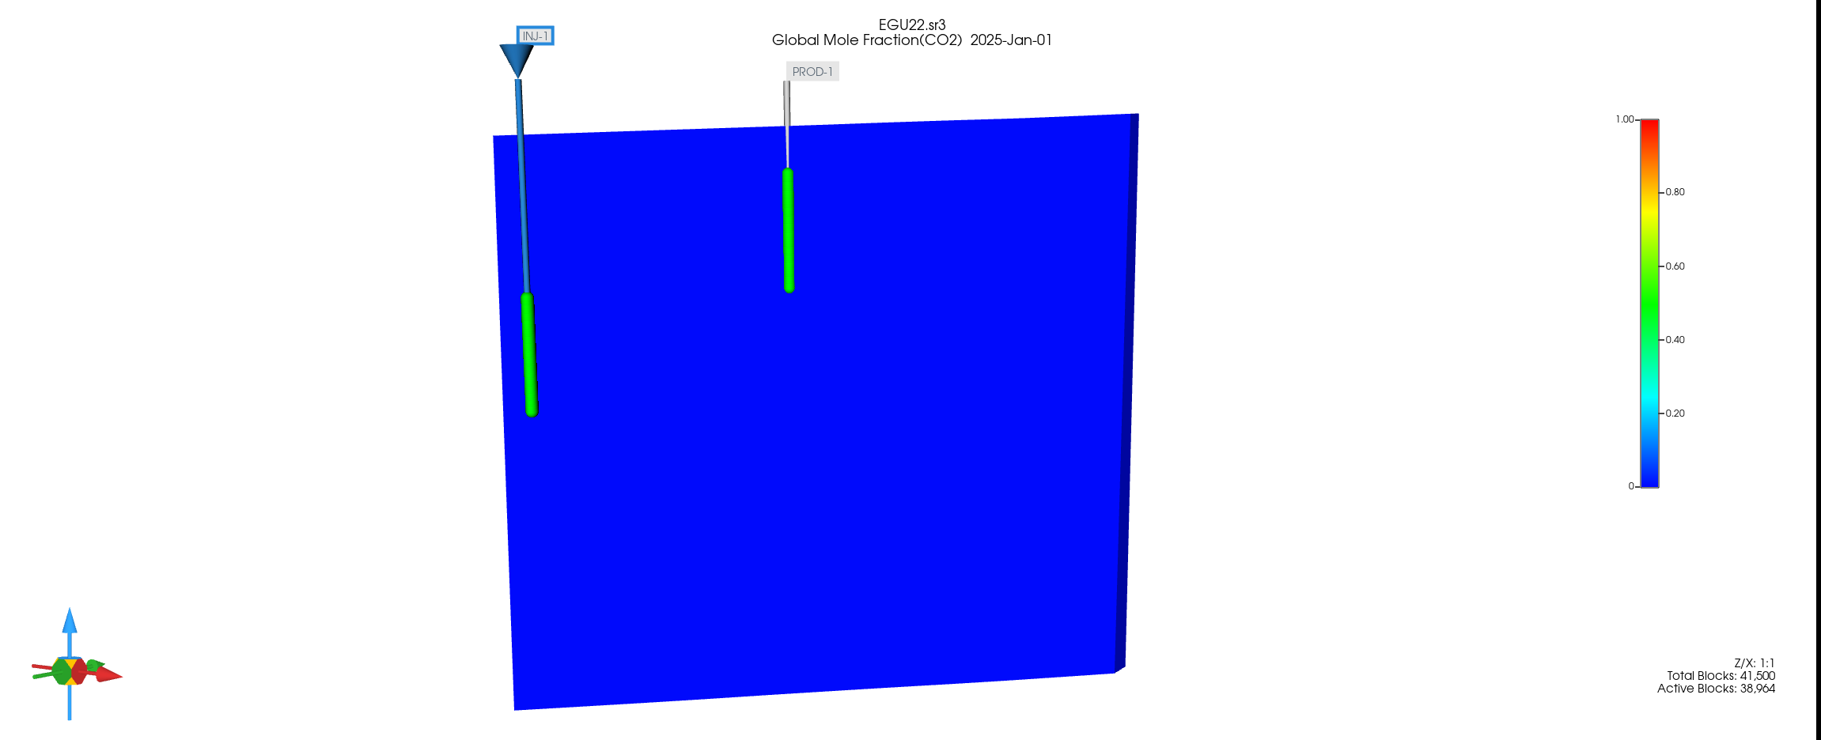
FLUID FLOW SIMULATION
Total energy in pre-salt sediments in Al-Wajh basin
CO₂ Plume in time & space
Seal
**Yearly electricity production of USA was 15 ExaJ as of 2021
Ref: (https://www.eia.gov/)
Top 400 m
13.6 % of the energy in place is recovered
Yalcin et al., in preparation

Slide 8

PRELIMINARY RESULTS AND OUTLOOK
With this work we established the GRV (gross rock volume), rock type distribution and total energy potential for syn-rift sedimentary rocks in Al Wajh
For a 40 years of Injection production scenario from upper 400 meters of syn-rift sedimentary rocks:
  With the current well pattern design we recover 13.6% of the thermal energy in place with CO₂ plume
  Energy production starts on the order of Peta Joules (E+15) per year
Currently we work on the uncertainty quantification of the reservoir simulation
With this study we will assess the heat mining potential of the Al Wajh basin via CCUS method

