Slide 1



Assessing the suitability of multi-spectral satellite data for the development of data-driven models of phytoplankton dynamics in lakes and reservoirs
Kyriakos Kandris, Evangelos Romas, Apostolos Tzimas, Ilias Pechlivanidis, Philipp Bauer, Klaus Joehnk, Mariano Bresciani, Claudia Giardino, Janet Anstee, Blake A. Schaeffer, and Maria-Antonietta Dessena

Slide 2
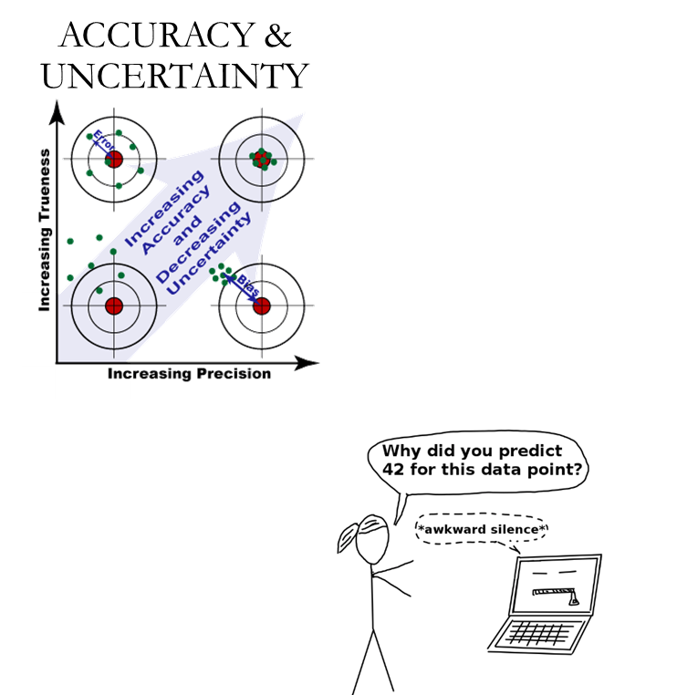
Main objective
Can we leverage medium-resolution, multi-spectral satellite data (Landsat-8, Sentinel-2) to develop credible, explainable models for the prediction of phytoplankton dynamics?

Slide 3
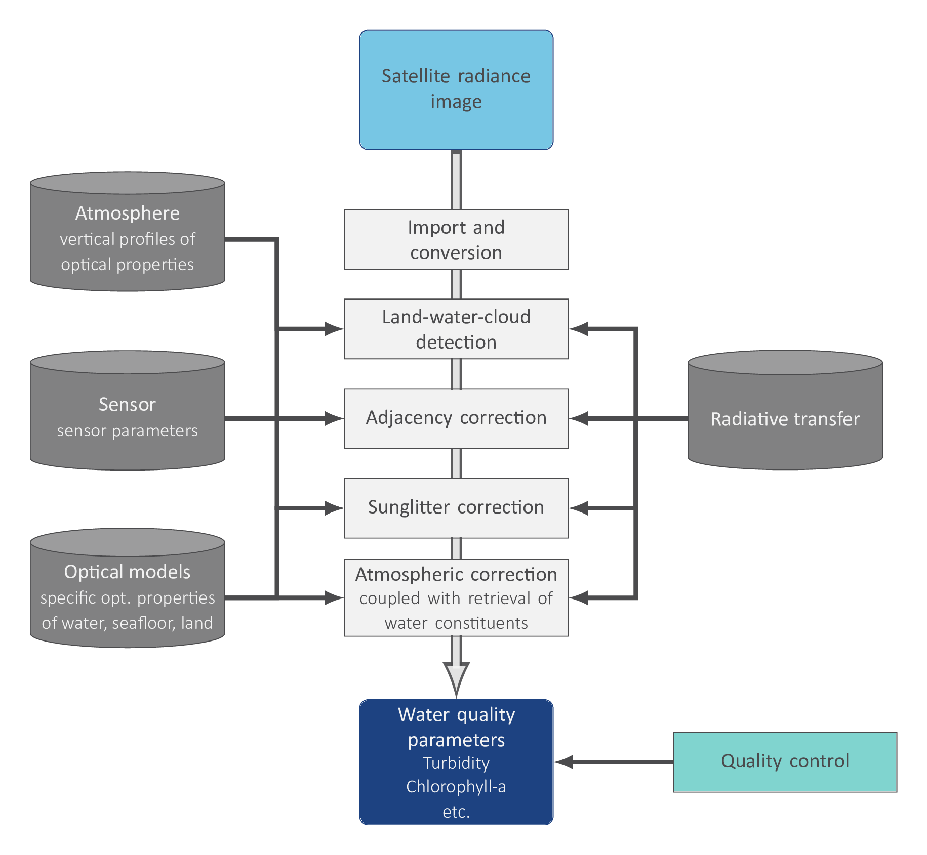
A theory-guided model architecture
Predictors
Target value
Total nitrogen
Total phosphorus
Total inflows
Hydrology
Random forests
WW-HYPE, E-HYPE reanalysis data
Chlorophyll-a
Time series derived from Landsat-8
Sentinel-2
Air temperature
Wind speed
Total precipitation
Radiation
Meteorology
Gaussian Process regression
ERA5 Land
Sensor-independent, physics-based MIP (EOMAP)

Slide 4
Predictive abilities of the models
Models developed and tested in seven areas of interest (AOIs) in three surface water bodies
  Mulargia reservoir (Italy)
  Lake Harsha (USA)
  Lake Hume (Australia)
Both data-driven models, i.e., RFs and GPRs, generalize well for most cases.
RFs are slightly more accurate compared to their GPR-based counterparts.
With scarce and imbalanced data (i.e., data having few extremes), the models underpredicted chl-a values.

Slide 5
Model interpretation
Utilized model-specific and model-agnostic methods (individual conditional expectation plots and Shapley values).
RFs were a better option compared to GPR models in terms of interpretability.
RFs indicated towards specific relationships between variables, which could explain the temporal variation of chlorophyll-a values at each AOI.
The GPR models utilized few of initially considered predictors, but the models were harder to interpret. These few variables impacted chlorophyll-a predictions in an obscure way, which in many cases contradicted cause-effect relationships that have been well documented.

Slide 6
Benchmarking in forecast mode
Benchmarking against a naïve alternative, i.e., using the persistency of the last available observation.
RFs were more accurate compared to GPR algorithms for all AOIs in all case studies.
When compared to the naïve alternative, the RF algorithm was more accurate for lead times up to ten days ahead.
Only in data scarce AOIs the RFs were outperformed by naïve alternatives for lead times greater than five days.
Forecasting skill deteriorated slightly with increasing lead times, mostly due to meteorological uncertainty.

Slide 7



Conclusions and take-home-considerations
Medium-resolution, multi-spectral data were a valuable source of observations for the development of credible and accountable machine learning models.
Even if, no algorithm should be expected to be (or presented as) the best-performing solution with respect to every single criterion, RFs provided accurate and generalizable models, while they offered more transparent and, thereby, trustworthy predictions.
Data-driven models are not a panacea.
For areas with scarce and imbalanced data, machine learning models may be inadequate.
In such cases, fusing different data sources (e.g., Sentinel-2 and Sentinel-3 data) could be a promising solution.

Slide 8


Thank you for attending!

