Slide 1



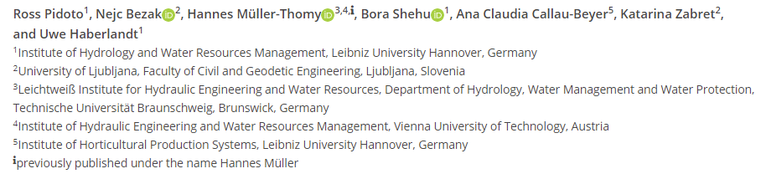
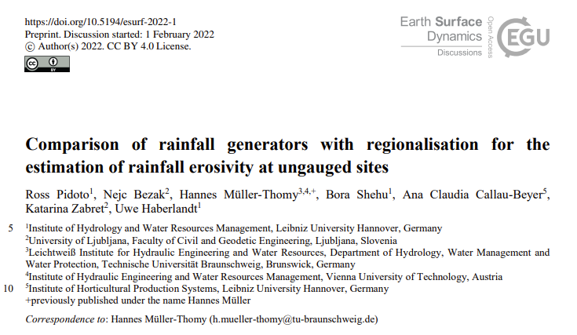

Investigation of the applicability of rainfall generators for the estimation of the rainfall erosivity for ungauged locations
EGU General Assembly 2022
SSS2.3 - Soil Erosion, Land Degradation, and Conservation
May 24, 2022

Slide 2
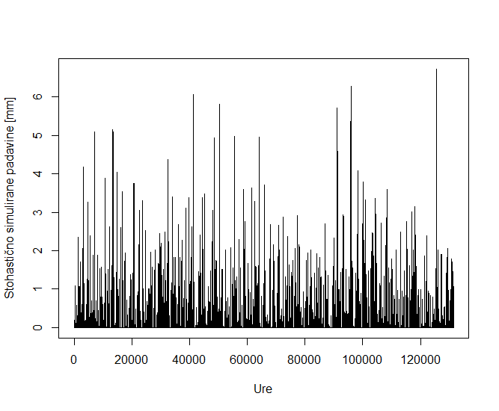
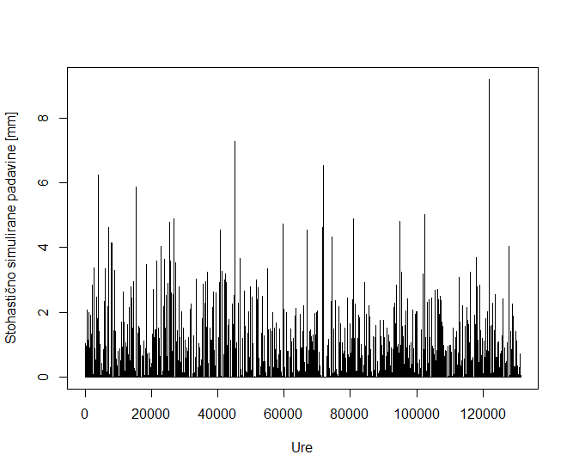
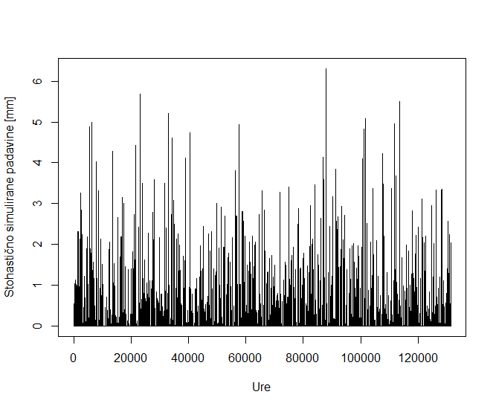
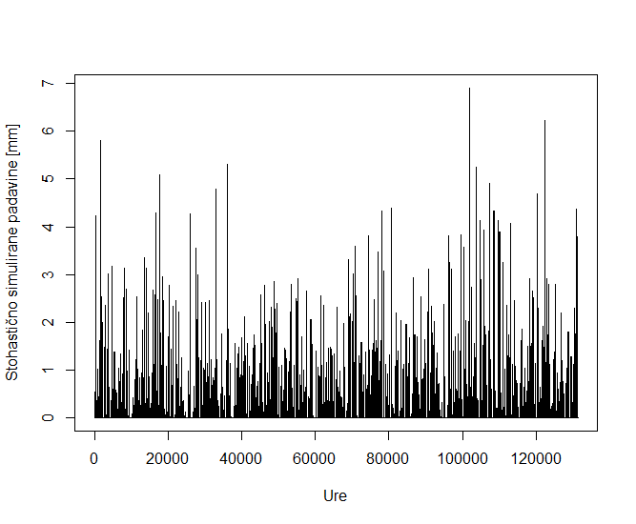
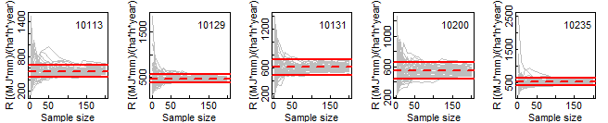
Motivation, research questions?
Given a lack of high-resolution rainfall time series, the research question is whether these stochastic rainfall models can adequately reproduce observed rainfall erosivity statistics?
Given the existence of a high-resolution rainfall time series, how long should this time series be in order to obtain stable site rainfall erosivity statistics?

Slide 3
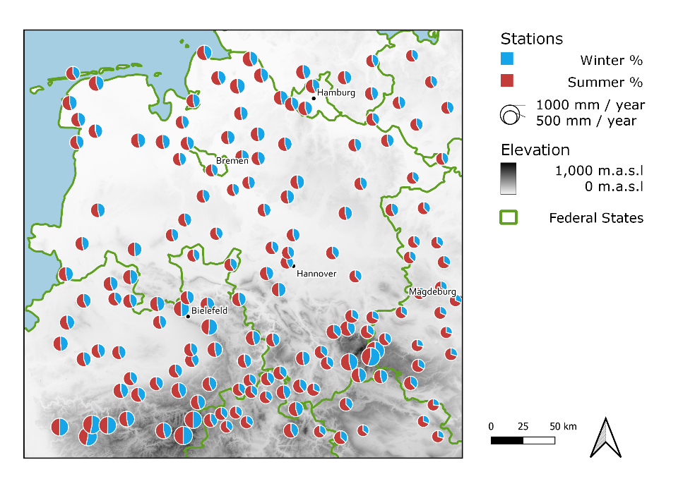
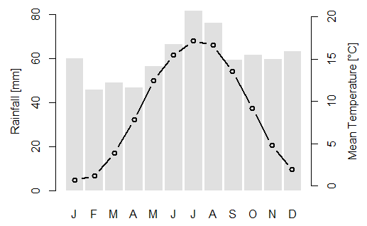
Data
High-resolution observed rainfall data for 159 stations in and around the northern German federal state of Lower Saxony was acquired from the German Weather Service (DWD). The one minute source time series, from a combination of tipping bucket and later drop counter measurements, were aggregated to 5 minutes for use within this project. All data used for the project is restricted to the ten year period 2007-2016, as all 159 stations have at least 98% data availability for this period.

Slide 4

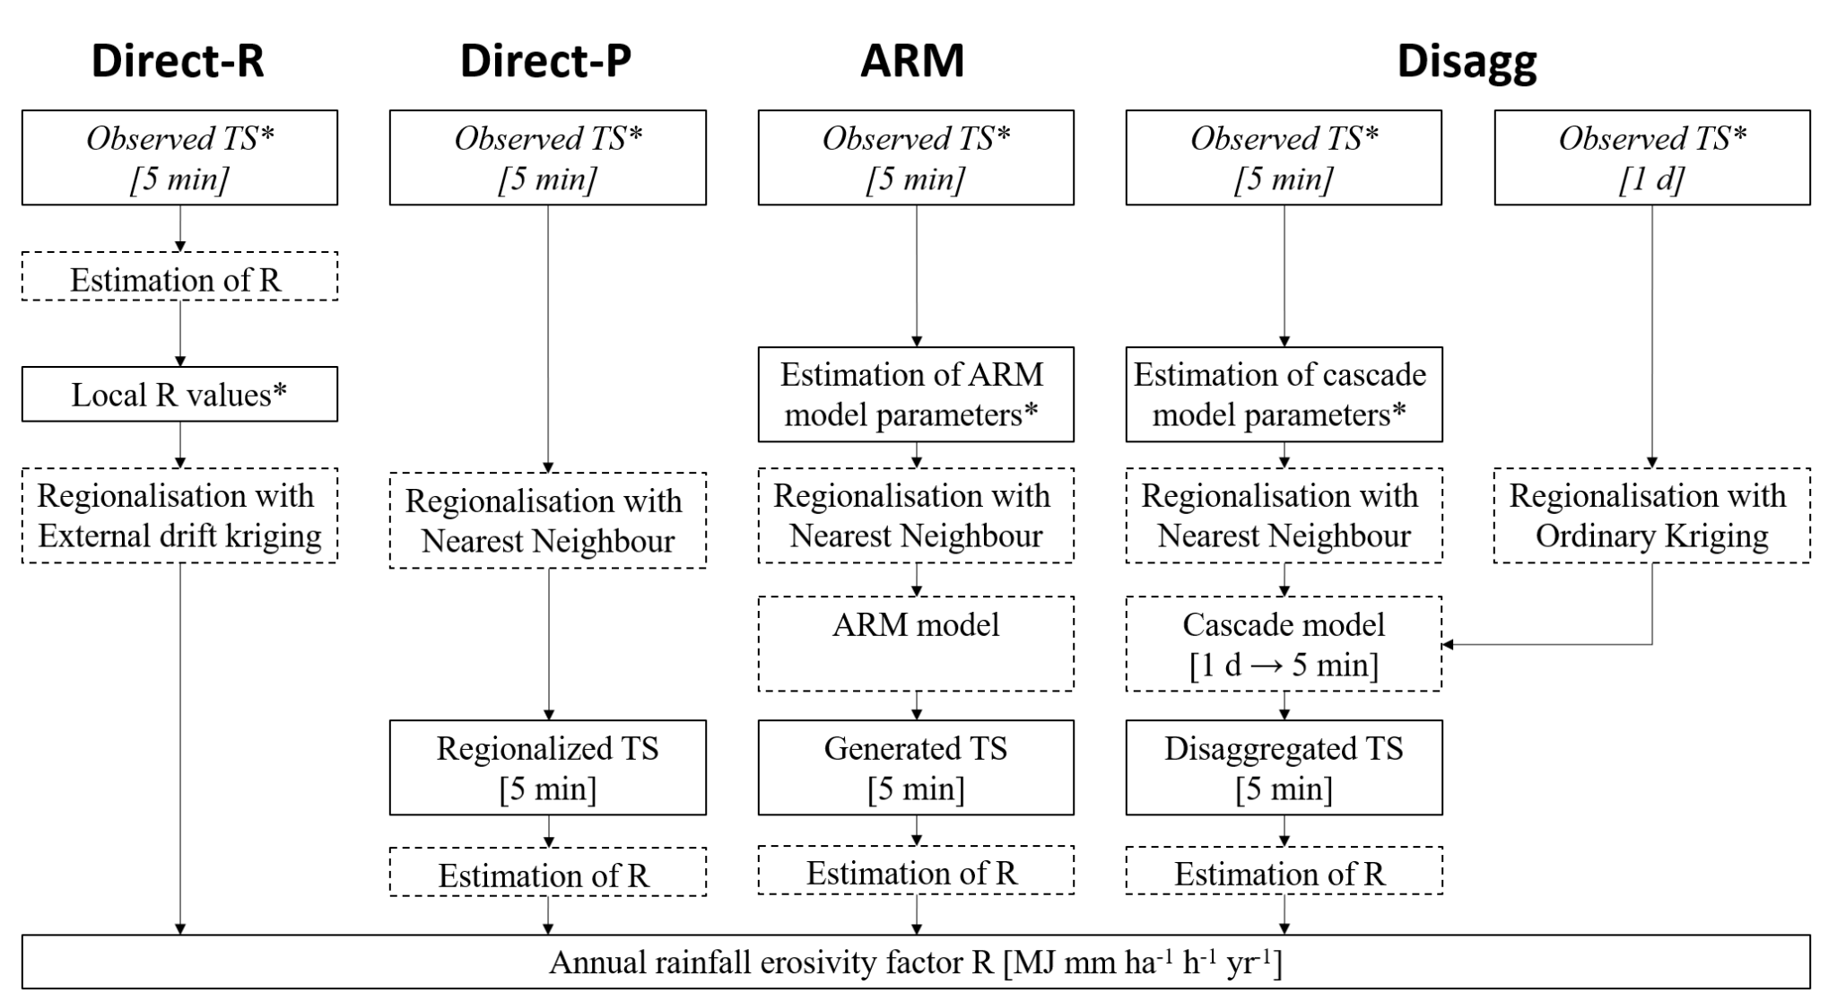
Methods
Rainfall erosivity was estimated using RUSLE methodology (Renard et al., 1997), specific kinetic energy was estimated using Brown and Foster (1987) equation:
Four methods to calculate annual rainfall erosivity for ungauged sites were tested:

Slide 5
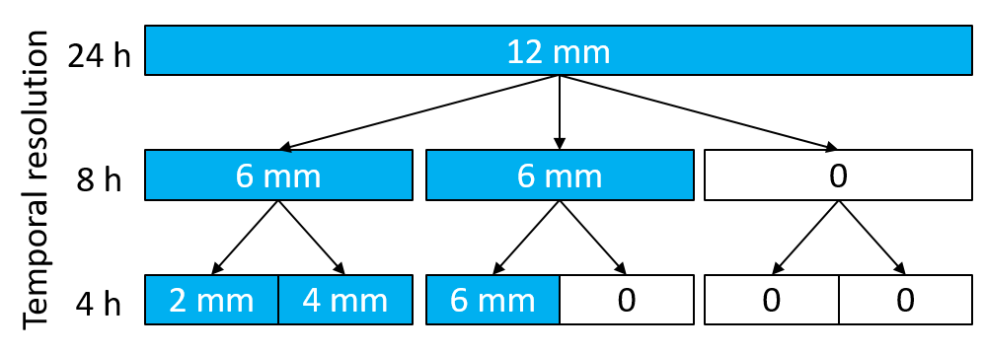
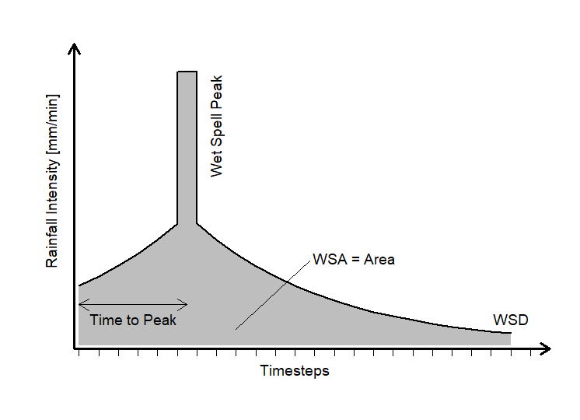
Methods
Detailed description of the methodology can be found here: https://esurf.copernicus.org/preprints/esurf-2022-1/.

Slide 6
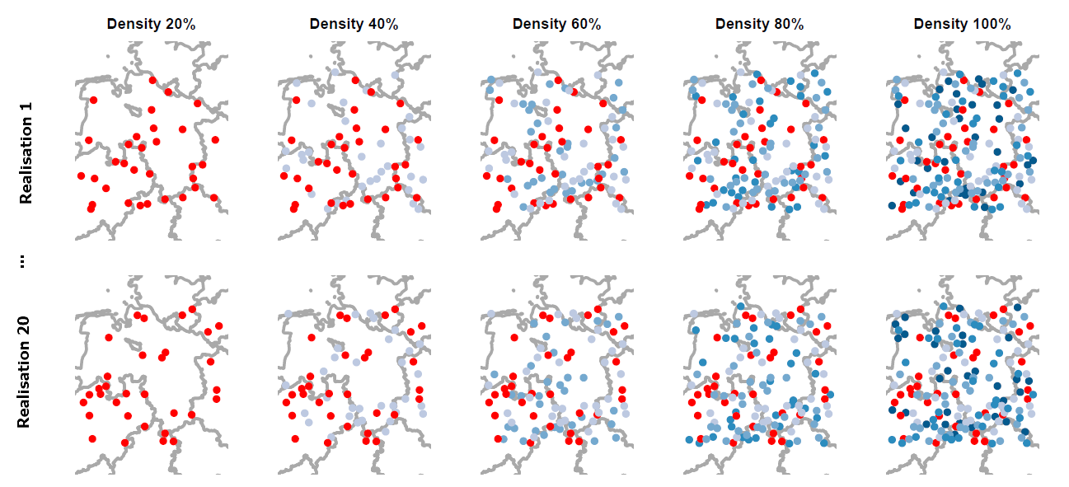
Methods
In order to adequately test the performance of the different methods, all regionalisations have been performed in a cross validation mode at varying station densities. Five station densities were chosen – 20% (N=32), 40% (N=64), 60% (N=96), 80% (N=128) and 100% (N=159) of the total available station count.
Three different evaulation criteria metrics were tested: RMSE, median relative error, Pearson correlation.

Slide 7
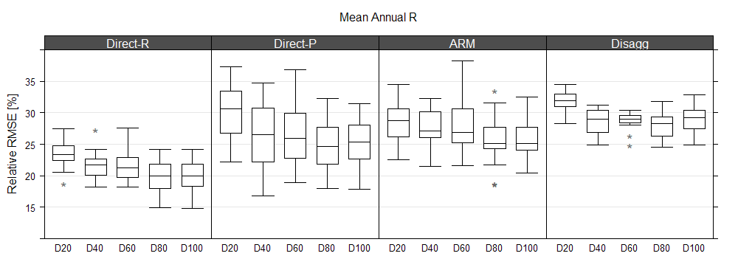
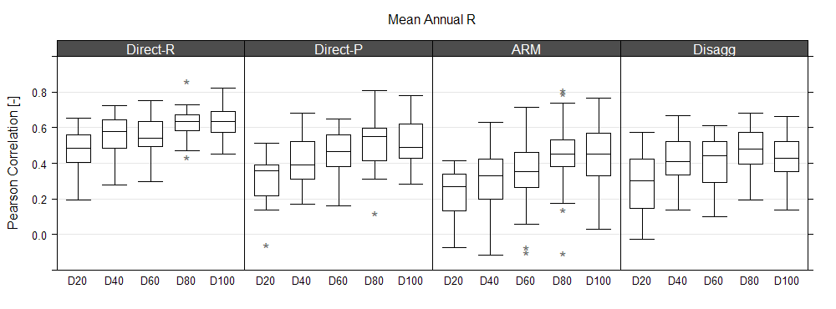
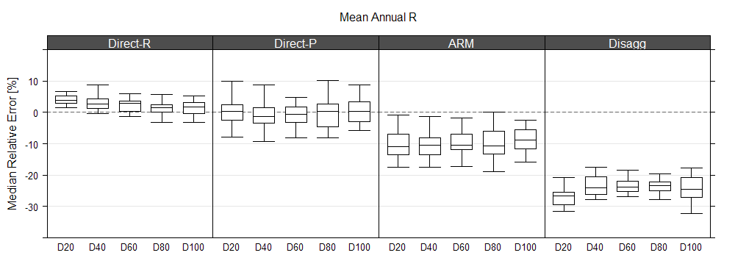
Mean annual rainfall erosivity
The main focus of this study is to evaluate the performance of the four different tested methods in reproducing observed mean annual erosivity

Slide 8
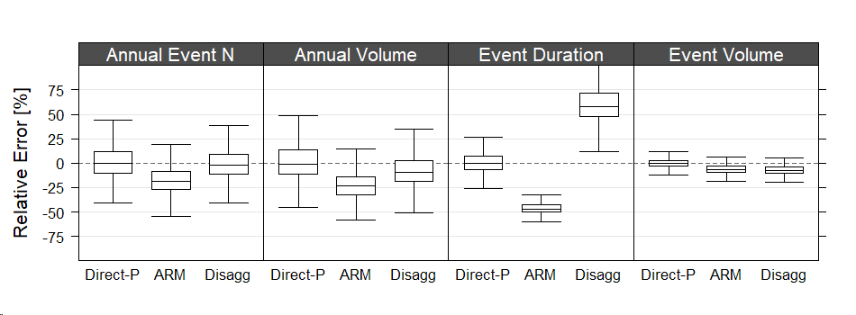
Erosive event characteristics
We also tested the more detailed performance of these methods (the ones that are able to produce specific characteristics), more details in the preprint:

Slide 9
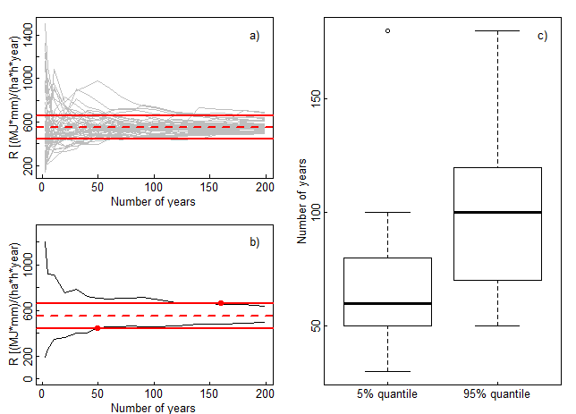
Data length sensitivity
Relationship between mean annual rainfall erosivity and number of years used in the rainfall erosivity calculation. a) shows 50 different realizations (grey lines) together with mean annual value that is calculated using all 50 realisations with 200 years of data (solid red line) and +-20% of this mean value (dotted red line). b) shows 5% and 95% quantile values (black line) calculated based on 50 realizations shown in a) and intersections between these quantile values and +-20% interval. c) shows boxplots of intersection points for 17 stations for the 5% and 95% quantile. a) and b) are shown for station ID = 10113.

Slide 10
Conclusions
Both tested direct regionalisation methods (Direct-R and Direct-P) outperform the tested stochastic rainfall models (ARM and Disagg), with slightly better results for Direct-R. Furthermore, in terms of method complexity, this can be regarded as the simplest since it does not require the fitting of any model parameters.
In terms of the characteristics of the erosive events, the Direct-P method yields better performance than both tested stochastic rainfall models.
Both rainfall generators have proven their applicability in the field of soil erosion modelling since they are able to produce long synthetic series of the high-resolution data.
The results of the study are part of the bilateral research project between Slovenia and Germany “Stochastic rainfall models for rainfall erosivity evaluation” and research Programme P2–0180: “Water Science and Technology, and Geotechnical Engineering: Tools and Methods for Process Analyses and Simulations, and Development of Technologies” (P2-0180) that is financed by the Slovenian Research Agency (ARRS). Hannes Müller-Thomy has been financially supported by the DFG e.V., Bonn, Germany, as a Research Fellowship (MU 4257/1-1). Additionally, part of the results were also obtained in the scope of the bilateral project between Slovenia and Germany “Validation of precipitation reanalysis products for rainfall-runoff modelling in Slovenia (PRE-PROMISE)”.

Slide 11
Conclusions
Cross validation methodology using multiple density scenarios has indicated that performance of all methods slightly increases with increasing station density.
More than 60 years of data is required in the case that one would like to obtain rainfall erosivity estimates within 20% of the actual long-term mean annual rainfall erosivity.
In cases where only 5-10 years of observed rainfall data is available, the estimated mean annual rainfall erosivity can be up to ±100% in comparison to the actual long-term mean annual rainfall erosivity
The results of the study are part of the bilateral research project between Slovenia and Germany “Stochastic rainfall models for rainfall erosivity evaluation” and research Programme P2–0180: “Water Science and Technology, and Geotechnical Engineering: Tools and Methods for Process Analyses and Simulations, and Development of Technologies” (P2-0180) that is financed by the Slovenian Research Agency (ARRS). Hannes Müller-Thomy has been financially supported by the DFG e.V., Bonn, Germany, as a Research Fellowship (MU 4257/1-1). Additionally, part of the results were also obtained in the scope of the bilateral project between Slovenia and Germany “Validation of precipitation reanalysis products for rainfall-runoff modelling in Slovenia (PRE-PROMISE)”.

