Slide 1
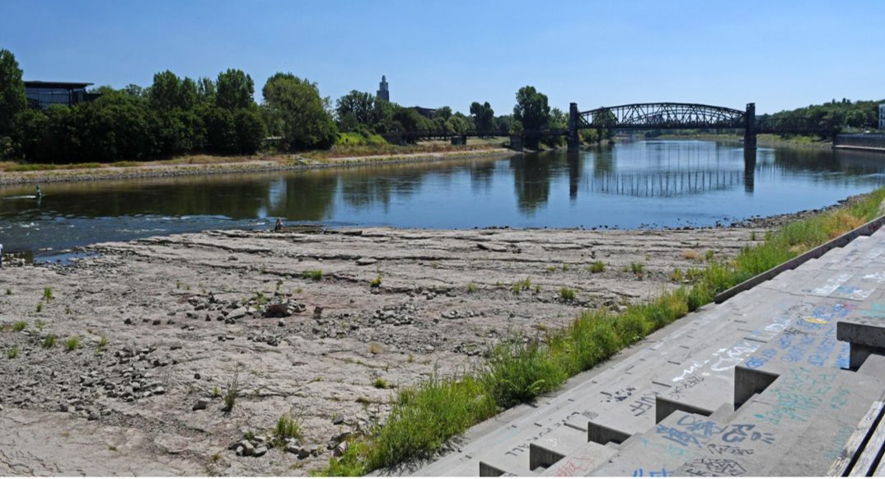

Revealing unexpected sources and quantities of groundwater discharge into major river systems during drought conditions
Julia Zill, Christian Siebert, Tino Rödiger, Markus Weitere, Ulf Mallast
M.Sc. Julia Zill (PhD student)
Helmholtz Centre for Environmental Research
Dep. Catchment Hydrology & Dep. River Ecology

Slide 2
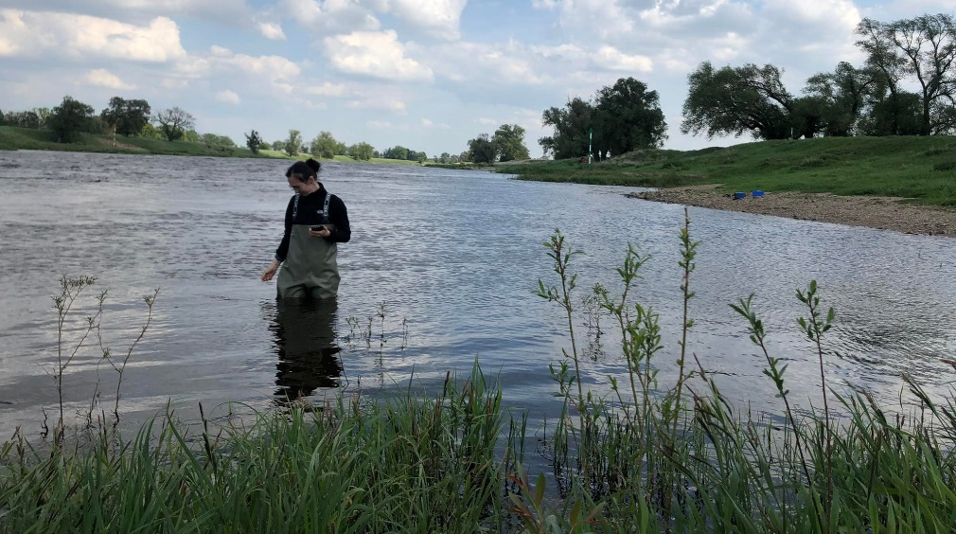
Revealing unexpected sources and quantities of groundwater discharge into major river systems during drought conditions
Julia Zill, Christian Siebert, Tino Rödiger, Markus Weitere, Ulf Mallast
M.Sc. Julia Zill (PhD student)
Helmholtz Centre for Environmental Research
Dep. Catchment Hydrology & Dep. River Ecology

Slide 3
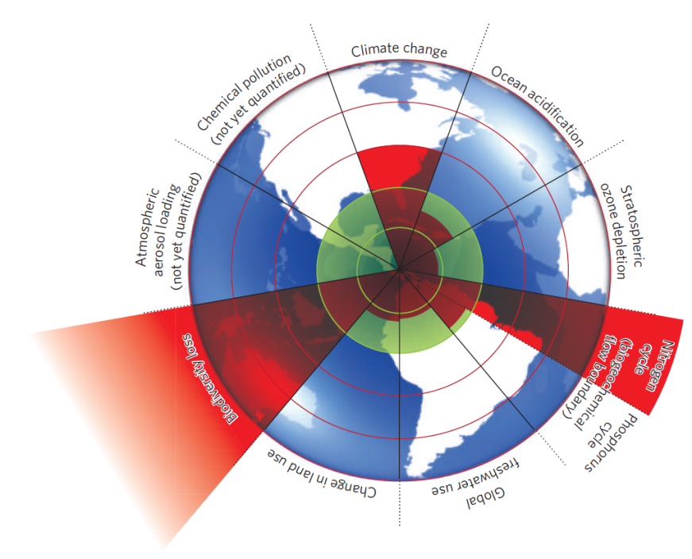
Challenges of diffuse nutrient loads
Groundwater discharge is the major diffuse source of nutrients (N, P) ^{1, 2, 3}
Oversaturation of nutrients leads to eutrophication ^{4, 5}
Eutrophication jeopardizes ecosystem stability and biodiversity ^{6, 7, 8}
Rockström et al., 2009
Efficient eutrophication management needs knowledge of river-aquifer systems

Slide 4
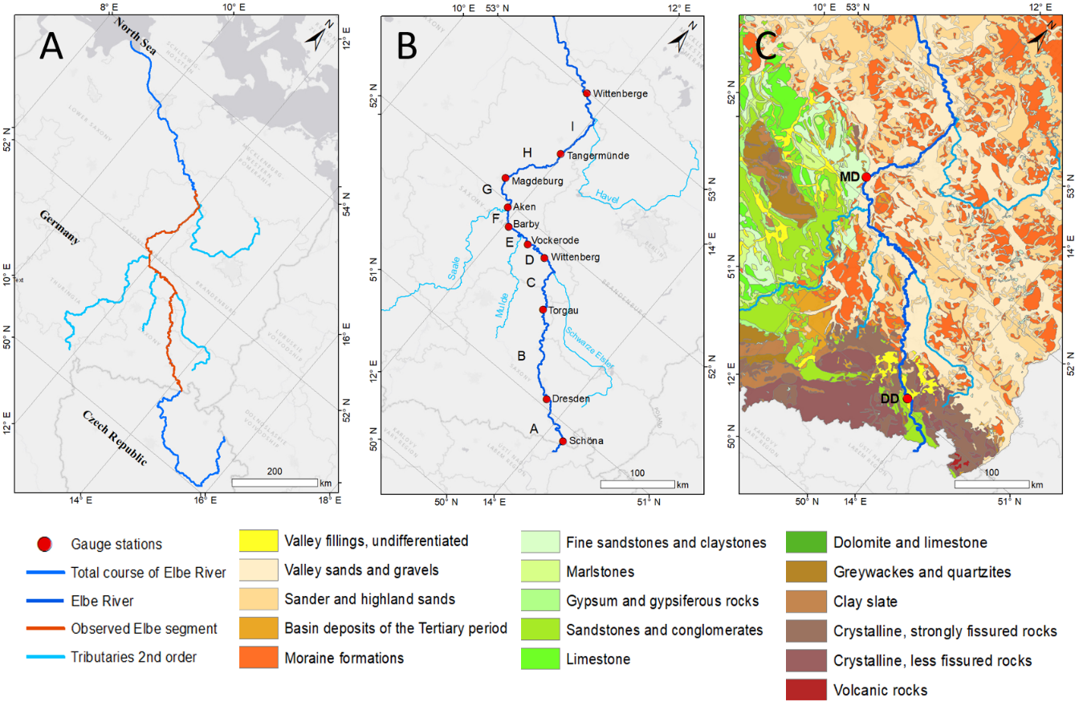
Elbe River as research area
Cretaceous marl- and sandstone as bedrock
Unconsolidated glacio-fluvial quarternary sediments
Highly eutrophic river, particular under drought conditions ¹⁰

Slide 5
Multi-methodological approach
Groundwater discharge
Localisation & Steadiness
Quantification & Probability
Hydraulic gradients
Flux balance
Geochemical modeling (PhreeqC)
Darcy approach

Slide 6
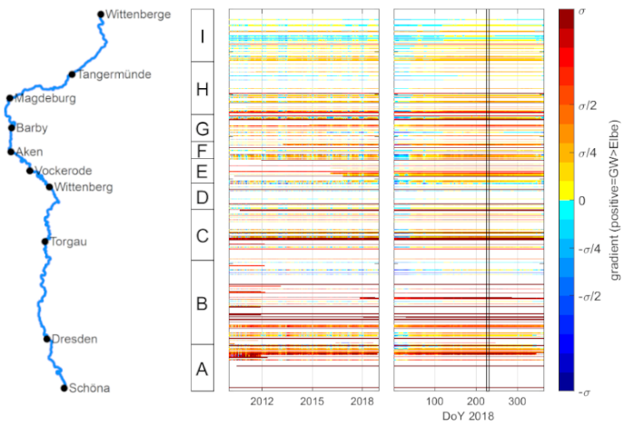
A: hydraulic gradient
effluent conditions
→ river gain groundwater
influent conditions
→ river lose groudwater
highly dynamic conditions
→ seasonal fluctuations

Slide 7
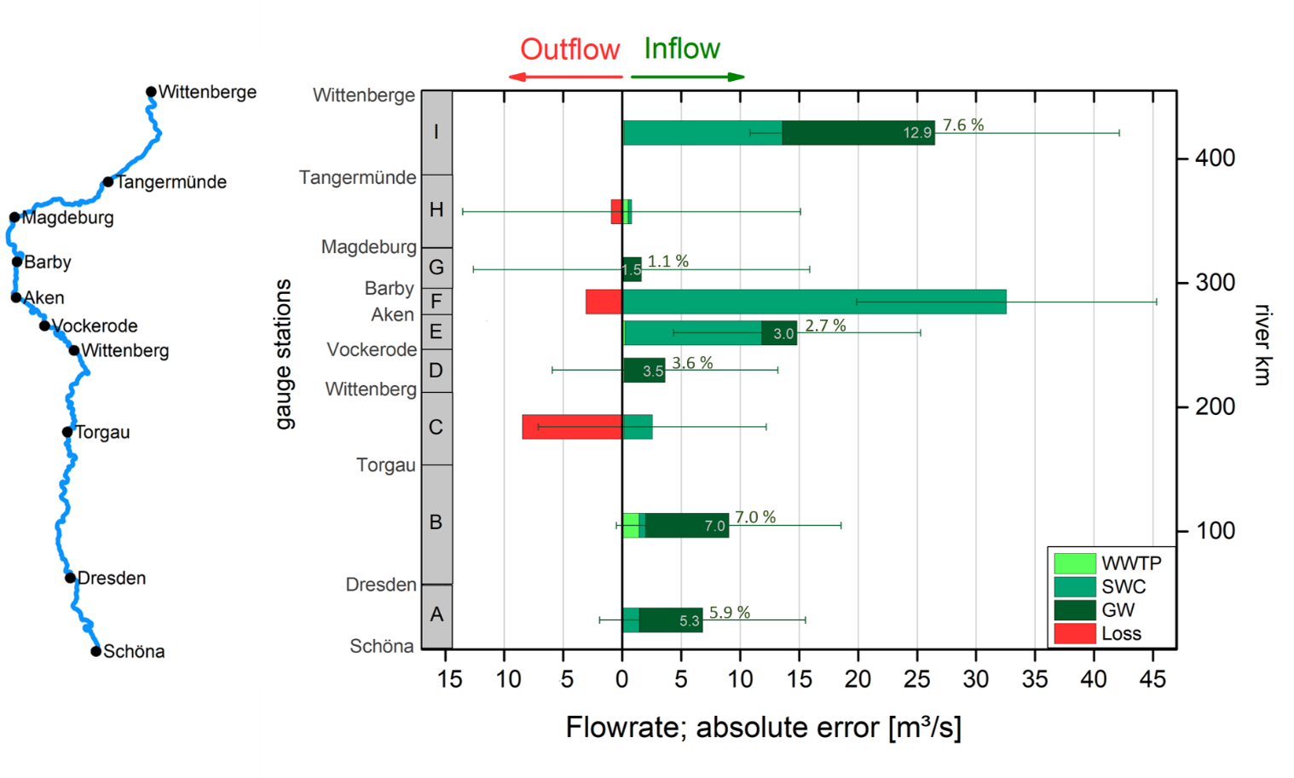
B: flux balance
Volumetric flow for each segment was calculated by subtraction
Segment A,B,I show major gw discharge
→ Total gw volume: 33 m³/s = 28 %

Slide 8
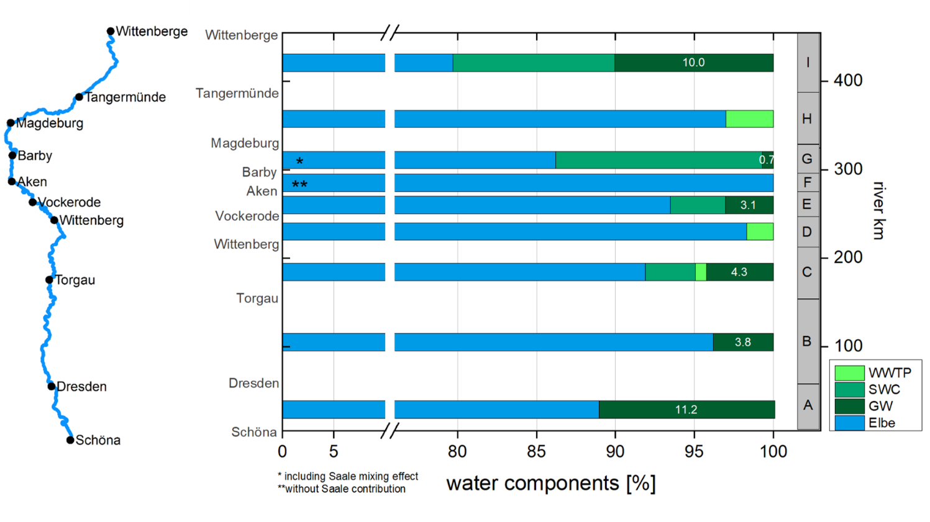
C: Inverse geochemical modeling
chemical composition of the river segments end as an integral of all inflows
Segments A, B, C, I show major gw discharge
→ Total gw volume: 39 m³/s = 30 %

Slide 9
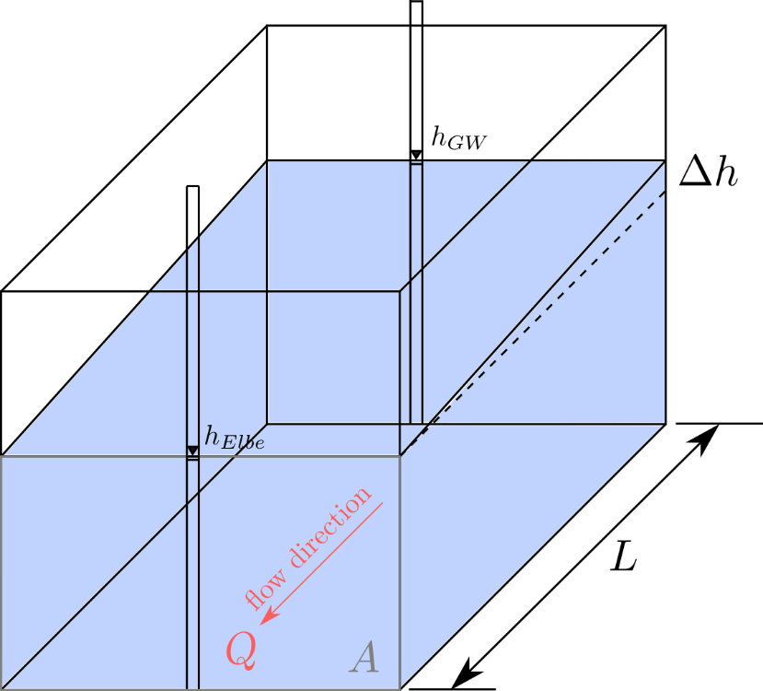

D: Darcy approach
river bank area
$$Q=k_{f}⋅A⋅ \frac{h_{GW}−h_{Elbe}}{L}$$
hydraulic conductivity
hydraulic gradient
→ Total gw volume: 8 m³/s = 7%

Slide 10
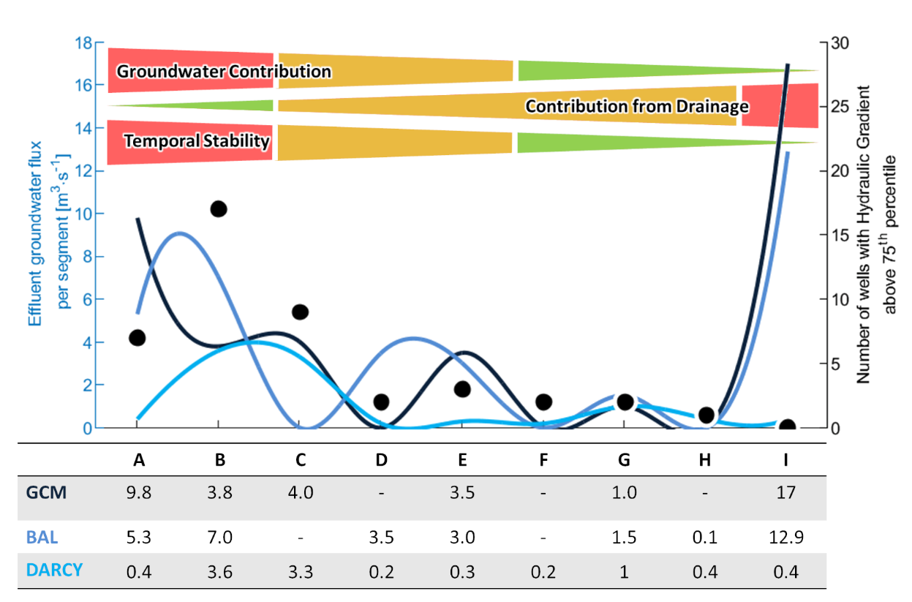
Combined results
A-C: major gw flow
D-H: moderate to low flow
I: drainage ditches overlay the gw signal
→ Total gw volume: 7 – 30 %

Slide 11
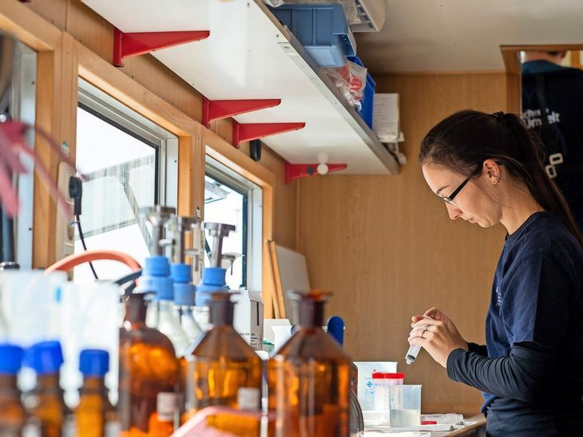
Combined results
Location and quantification of groundwater discharge
Impact may increase under drought conditions
Providing essential information for a sustainable river management
Multi-methodological approach is necessary for understanding large scale systems
Blueprint for other river basins

Slide 12
1: Sharpley, A.N., Chapra, S.C., Wedepohl, R., Sims, J.T., Daniel, T.C., Reddy, K.R.: Managing Agricultural Phosphorus for Protection of Surface Waters: Issues and Options, J Environ Qual, 23, 437-451, https://doi.org/10.2134/jeq1994.00472425002300030006x, 1994.
2: Donohue, I., Styles, D., Coxon, C., Irvine, K.: Importance of spatial and temporal patterns for assessment of risk of diffuse nutrient emissions to surface waters, J Hydrol, 304, 183-192, https://doi.org/10.1016/j.jhydrol.2004.10.003, 2005.
3: UBA: Federal Environmental Agency, Nitrogen and phosphorus loads from point and diffuse sources to surface waters in Germany, https://www.umweltbundesamt.de/sites/default/files/medien/384/bilder/dateien/2_abb_n-p-eintraege_2020-09- 17.pdf, last access: 02. November .2021, 2020.
4: Bachmann, R.: The Role of Agricultural Sediments and Chemicals in Eutrophication. J Water Pollut Con F, 52, 2425-2600,1980.
5: Dodds, W.K.: Eutrophication and trophic state in rivers and streams, Limnol Oceanogr, 51, 671-680, https://doi.org/10.4319/lo.2006.51.1_part_2.0671, 2006.
6: Mallin, M.A., Johnson, V.L., Ensign, S.H., MacPherson, T.A.: Factors contributing to hypoxia in rivers, lakes, and streams, Limnol Oceanogr, 51, 690-701, https://doi.org/10.4319/lo.2006.51.1_part_2.0690, 2006.
7: Dodds, W.K., Bouska, W.W., Eitzmann, J.L., Pilger, T.J., Pitts, K.L., Riley, A.J., Schloesser, J.T., Thornbrugh, D.J.: Eutrophication of U.S. Freshwaters: Analysis of Potential Economic Damages, Kansas State University, Manhattan, Kansas, Environ. Sci. Technol., 43, 12–19, https://doi.org/10.1021/es801217q, 2009.
8: Donald, D.B., Bogard, M.J., Finlay, K., Bunting, L., Leavitt, P.R.: Phytoplankton- Specific Response to Enrichment of Phosphorus-Rich Surface Waters with Ammonium, Nitrate, and Urea, PLOS ONE, 81, e53277. https://doi.org/10.1371/journal.pone.0053277, 2013.
9: Rockström, J., Steffen, W., Noone, K. … Foley, J.A. (2009): Planetary boundaries: Exploring the safe operating space for humanity, Nature 461, 472-475.
10: Hardenbicker, P., Weitere, M., Ritz, S., Schöll, F., Fischer, H.: Longitudinal Plankton Dynamics in the Rivers Rhine and Elbe, River Res Applic, 32, 1264– 1278, https://doi.org/10.1002/rra.2977, 2016.

