Slide 1
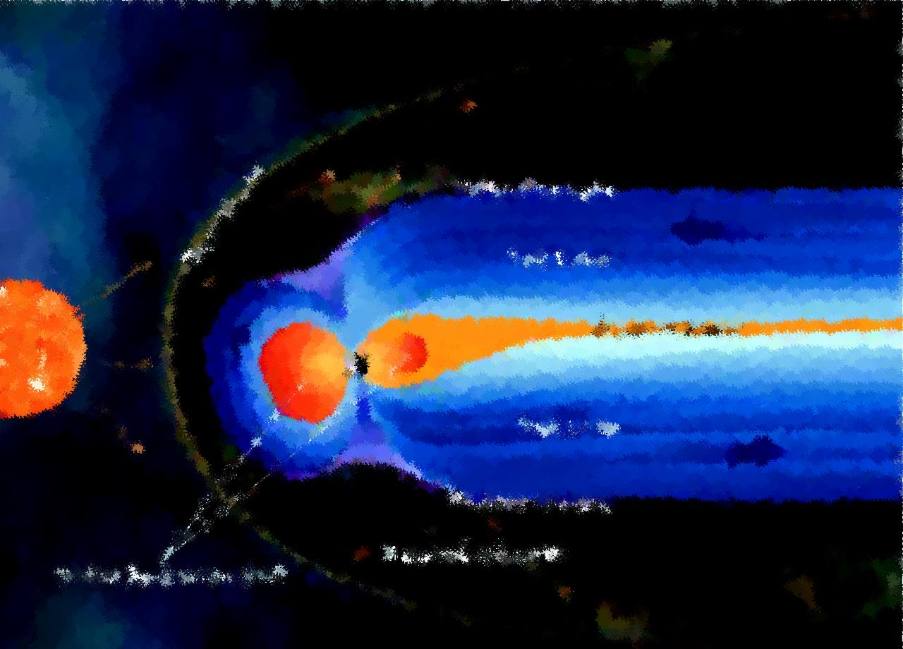







Piersanti M.¹, D. Del Moro², A. Parmentier³, M. Martucci^{2,4}, F. Palma^{2,4}, A.Sotgiu^{2,4}, C. Plainaki⁵, G. D’Angelo³, F. Berrilli², D. Recchiuti^{6,3}, E. Papini³,L. Giovannelli², G. Napoletano², R. Iuppa^{6,7}, P. Diego³, A. Cicone¹, M.Mergè⁴, C. De Donato⁴, C. De Santis⁴, R. Sparvoli^{2,4}, P. Ubertini³, R.Battiston^{6,7}, P. Picozza^{6,7}
1) University of L’Aquila, L’Aquila, Italy.
2) University of Rome ”Tor Vergata”, Rome, Italy
3) National Institute of Astrophysics - IAPS, Rome, Italy
4) INFN - Sezione di Roma ”Tor Vergata”, Rome, Italy
5) Italian Space Agency, Rome, Italy
6) University of Trento, Trento, Italy.
7) TIFPA - University of Trento, Trento, Italy.
On the magnetosphere-ionosphere coupling during the May 2021 Geomagnetic storm.

Slide 2
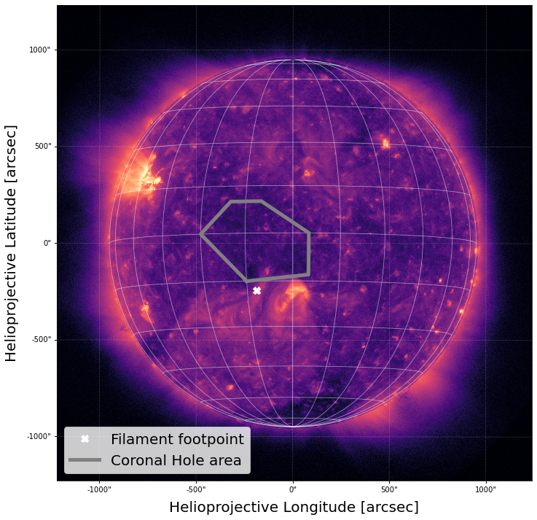
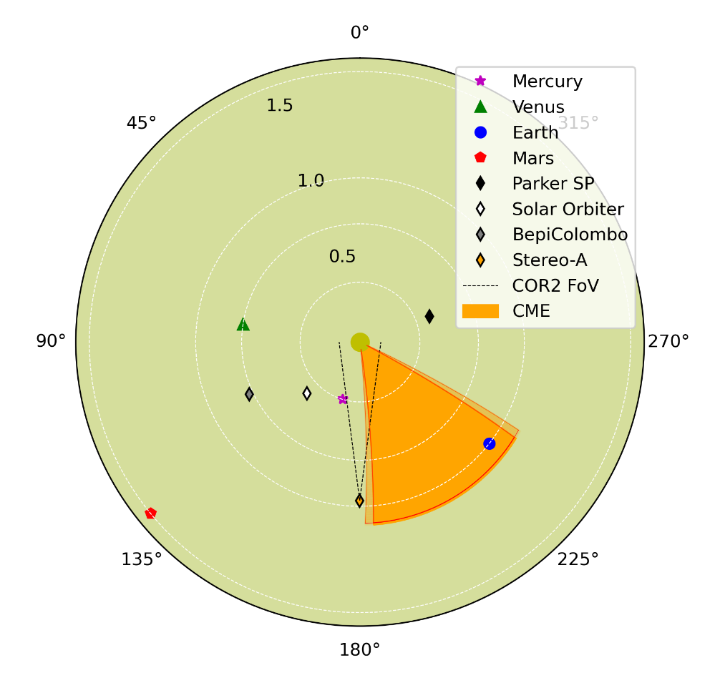
CME identification and its interplanetary propagation: the P-DBM model
The most probable source for the CME was a filament eruption observed on May 9, 2021 at t₀= 11:30 UT in the southern solar hemisphere (white cross).
Considering the source on the Sun and the hypothesis of radial propagation, we can de-project the CME PoS velocities and estimate its radial velocity as V_{R}=720 ± 100 km/s.
To describe the ICME propagation in the heliosphere we have used the Probabilistic Drag Based Model of Napoletano et al. (2018).
We propagate the CME in the heliosphere, with the characteristics computed above and considering its interaction with fast solar wind originated by the CH (grey area in upper panel) for the whole duration of its travel and estimate its time to travel to 1AU and its velocity at arrival.
We obtained the propagation scheme reported in right panel.
We estimated both the arrival time and speed at 1 AU: 2021/05/12 04:00 ± 06:00 UT; V_{1AU}=640 ± 70 km/s.

Slide 3
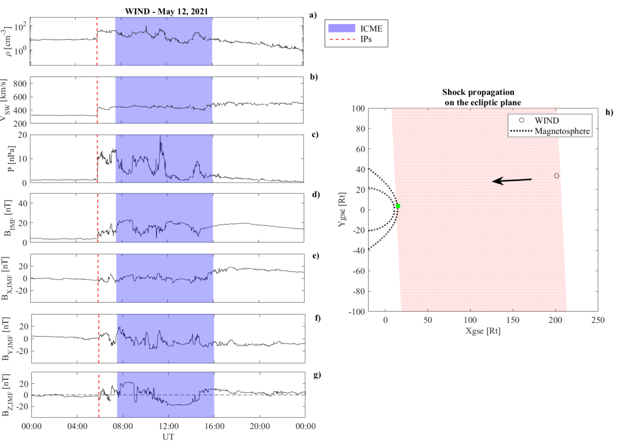
Solar Wind reconstruction at L1
One Interplanetary Shocks (IP) preceded the ICME:
IP: 12/05 at 05:45 UT – Increase of all SW parameters;
ICME: 12/05 at 07:40 UT – Rotation of Bz(IMF) and increase in the SW density and IMF amplitude;
Using the Rankine-Hugoniot conditions under the assumption that both energy and momentum are conserved across the shock we have estimated the shock normal: Θ_{SE}=177° ± 5° and Φ_{SE}= 111° ± 5°.
We have estimated the shock speed: v_{IP}= (538 ± 10) km/s.
Under the assumption of planar propagation (black arrow) we have predicted both the time and location of the IPs impact onto the magnetosphere (green rectangle): 06:34 UT and 12:49 ± 00:15 LT (i.e., in the noon sector of the magnetosphere), respectively.
Notes:
Θ_{SE} and Φ_{SE} being the angles formed by the shock normal with the Sun-Earth line and with the y axis in the yz plane, respectively

Slide 4
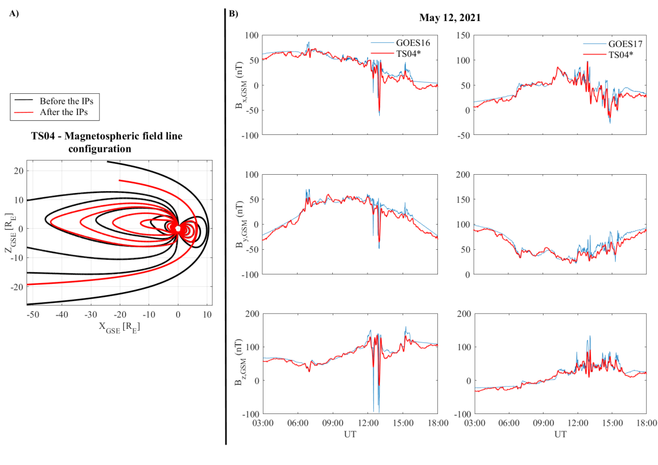
Magnetospheric response
Magnetosphere strongly compressed (red) with respect to SQ configuration (black) due to the SI [from 10 R_{E} to 6.8 R_{E}];
GOES response
Huge variation of the magnetospheric field at both GOES 16 and GOES 17 spacecraft;
The variations along X confirm the stretching of the magnetotail field lines;
The variations along Y confirm the twisting of the magnetotail field lines;
The variations along the Z component confirm the concurring compression of the magnetopause and action of the enhanced ring and tail currents;
This scenario is confirmed by the simulation of a modified TS04* model (red dashed lines) in which:
we considered the contribution of the ring current and tail current (hereafter, TC) alone during the geomagnetic storm;
the magnetotail hinging point R_{H} shifted from 8.75 R_{E} to 6.85 R_{E}
the current sheet thickness D_{H} changed from 5 R_{E} to 5.9 R_{E}
TS04* gives a good representation of the behavior of the GOES observations, confirming the key role of the ring current in the morning sector and of the tail current in the nightside sector.

Slide 5
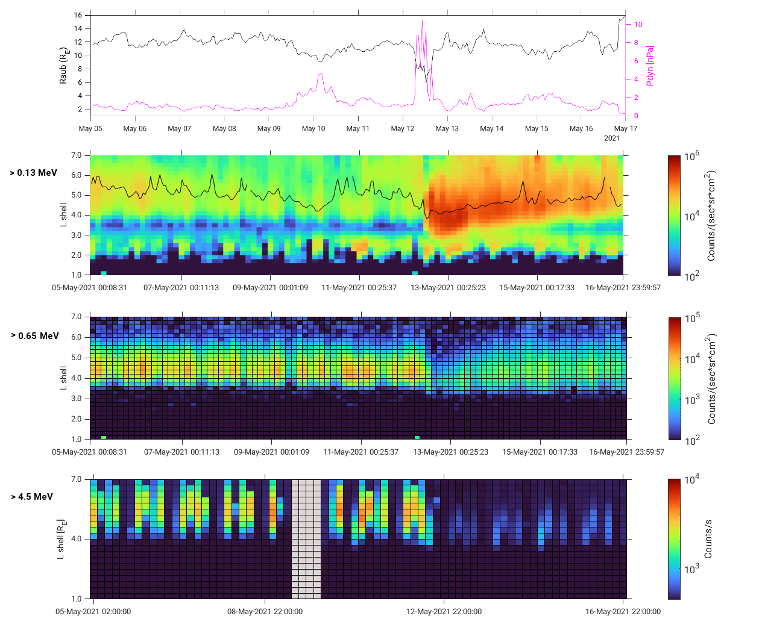
Ionospheric particle response at LEO orbit
The rearrangement of electron populations in the Earth's magnetosphere was analyzed by using particle data from the MEPED-90° (lower panel) electron telescope on board the NOAA19-POES satellite.
The flux values, which are dominated by the contribution of low-energy electrons, point out a prolonged slot-filling event immediately downstream of maximum geomagnetic disturbance.
Correspondingly, the plasmapause (full black line) - estimated from the Liu et al. (2014) model - steps back to L ~ 3.8.
At the onset of May 12, 2021 storm, the concurrent substorm activity may represent a suitable candidate for the injection of such source/seed populations to be resonantly accelerated by ULF waves at the boundary of the plasmasphere, where the plasma density gradient affects wave growth (Liu&Cao 2014) and interactions.

Slide 6
Conclusions
The May 12, 2021 geomagnetic storm was caused by a CME occurred on May 9, 2021 at 11:30 UT, as a consequence of a filament eruption observed in the southern solar hemisphere.
Under the hypothesis that the part of the ICME hitting the Earth interacts with the fast SW generated by the CH over the whole duration of its travel, we have estimated its time travel to 1AU and its velocity at arrival, obtaining May 12, 2021 at (04:00 ± 6)h and (640 ± 70) km/s, respectively.
Such estimations are confirmed by the observations at the first Lagrangian point (WIND satellite).
The consequence of the ICME passage through the Earth's magnetosphere was the reconfiguration of the magnetospheric principal current systems:
IPs: the magnetopause nose moved back to ~ 6.8 R_{E}, as a consequence of the concurrent contributions of a strong increase in the SW dynamic pressure and the southward switching of the IMF orientation;
During the passage of the magnetic cloud, the magnetospheric observations confirmed the direct interplay of the partial ring current, which increased in amplitude due to the reconnection at the magnetopause, with the magnetotail current, which dipolarizes and experiences an increasing of plasma density in its neutral sheet.
From the particle point of view one primary impact of the storm development is the sudden and persistent loss of relativistic electrons from the entire ORB, whose very rapid, non-recovering dropout can only be the result of non-adiabatic processes (magnetopause shadowing + outward radial transport) permanently removing particles from the system.
More details on Piersanti et al., (2022), https://doi.org/10.1029/2021SW003016.

Slide 7
The End
The authors want to acknowledge Prof. E. Comparisòn for his useful comments and suggestions in the proof-reading.

Slide 8
BACK-UP SLIDES

Slide 9
Ionospheric particle response at LEO orbit
The rearrangement of electron populations in the Earth's magnetosphere was analyzed by using particle data from the MEPED-90° (panels b and c) electron telescope on board the NOAA19-POES satellite and the High-Energy Particle Detector (HEPD-01, panel d) on board the CSES satellite.
Panels c) and d) show MEPED fluxes over the >0.65 MeV range and the rate of >4.5 MeV particles detected by HEPD-01, respectively.
At L shells typical of the ORB, a persistent depletion starts right after the onset of the main phase, with no short-term flux recovery to pre-storm levels.
These ORB losses in the relativistic range may be consistent with magnetopause shadowing (MS - Herrera et al., 2016) and outward radial transport, as suggested by a deep incursion of the estimated magnetopause on L shells no higher than ~6.2 R_{E} in correspondence with the peak of the storm (panel a).

Slide 10
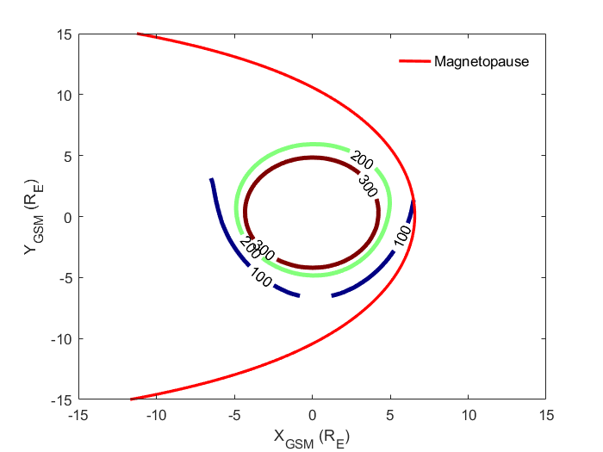
Ionospheric particle response at LEO orbit
Using the TS04* simulation at the peak of the main phase, extracting X-Y GSM cuts we found that ORB electrons are depleted on open drift paths that were previously closed.
Magnetic field iso-contours basically correspond to drift paths of equatorially mirroring (i.e., 90° pitch-angle) electrons that, at large L shell, are more likely to intercept the magnetopause and get lost.
Our results shows that the magnetopause intercepts the 100 nT line near the geosynchronous orbit at the time of maximum compression, which is strongly suggestive of MS having a role in removing relativistic electrons from the ORB.
The dropouts observed by both MEPED-90° and HEPD-01 at relativistic energies penetrate down to L~ 4, which is a value significantly lower than minimum magnetopause standoff distance. A recent model (Ukhorskiy et al. 2015) suggests that MS and outward radial transport should be sufficient to trigger such deep losses, even though this not rarely happens in concurrence with wave-induced precipitation to the atmosphere.
Notes:
Figure include the magnetopause location and the iso-contours of the local magnetic field strength over the 100-300 nT range

