Slide 1


Mapping areas suitable for artificial recharge structures in the Ropar district of Punjab, India
Thallam Prashanth ¹, Dolon Banerjee², Sayantan Ganguly ³
¹PhD Research Scholar, Department of Civil Engineering, Indian Institute of Technology Ropar, Rupnagar, Punjab – 140001; Email : thallam.prashanth@iitrpr.ac.in
²PhD Research Scholar, Department of Civil Engineering, Indian Institute of Technology Ropar, Rupnagar, Punjab – 140001; Email : dolon.20cez0004@iitrpr.ac.in
³Assistant Professor, Department of Civil Engineering, Indian Institute of Technology Ropar, Rupnagar, Punjab – 140001; Email : sayantan.ganguly@iitrpr.ac.in

Slide 2
Introduction
In present scenario, groundwater is an indispensable part of industrial, agricultural, and even domestic sectors.
Ropar is also highly agriculture-dependent and the rapid growth in urbanization of this district has caused variation in rainfall and temperature patterns affecting the groundwater level to a large extent.
The long-term trend of water level observed for ten years showed a gradual decline in the entire Ropar district of Punjab. The maximum fall of groundwater level is observed to be 1.05 m/year.
With the ever-increasing population, the exploitation of groundwater will always be on the rise making it insufficient for future sustenance. To create a balance between the water supply and demand, artificial recharge structures are proven to be beneficial in various studies.
Objectives:
Mapping areas suitable for artificial recharge structures using Analytical Hierarchical Process and Artificial Neural Networks.
Propose the suitable type of artificial recharge structure based on lithology and drainage density.

Slide 3
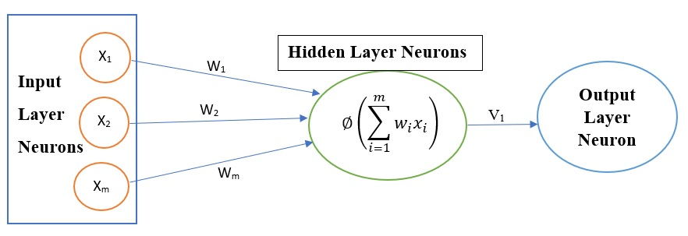
Analytical Hierarchy Process (AHP):
Analytical Hierarchy Process (AHP) is a best method for decision making and to resolve conflicts when there are a number of alternatives and criteria which are conflicting each other.
AHP is a process of developing an hierarchical framework keeping its goal or objective at primary level, criteria's in the secondary level, possible alternatives at tertiary level.
AHP relies on experts judgement and their assumptions. Based on their assumptions and suggestions with respect to a goal, a pair-wise comparison matrix is developed. Pair-wise comparison matrix provides relative importance of one attribute with respect to other attributes.
Based on the literature, Pair-wise comparison matrix is said to be consistent when consistency ratio<0.1.
Artificial Neural Network (ANN):
Artificial Neural Network (ANN) is a computational model that consists of several processing inputs that receives inputs and delivers outputs based on their predefined activation functions.
Activation function is the function that is assigned to the hidden layer neuron and it is applied to the weighted sum and then neuron understands whether it is to be activated or not.
Fig-1: An example of neuron showing the inputs, associated weights, and the activation function applied to weighted sum of the inputs

Slide 4
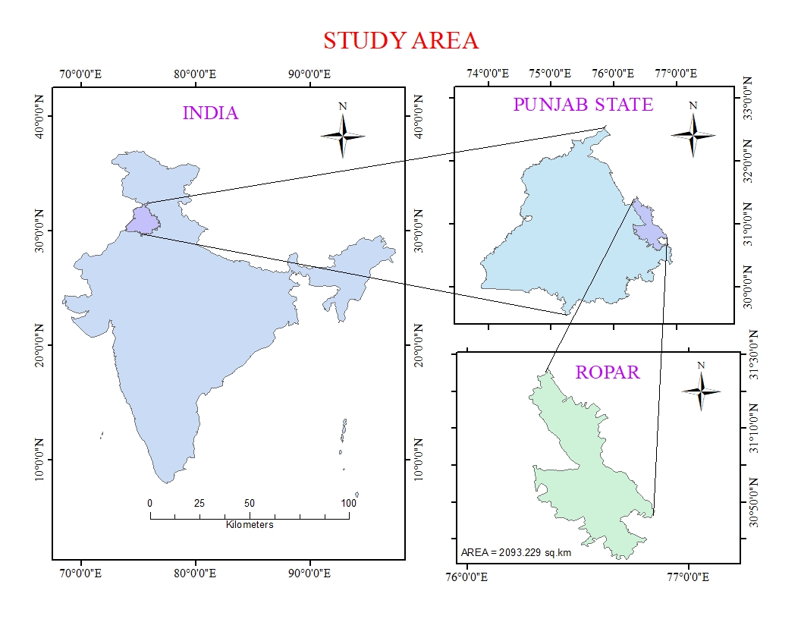
Figure-2: Study Area

Slide 5
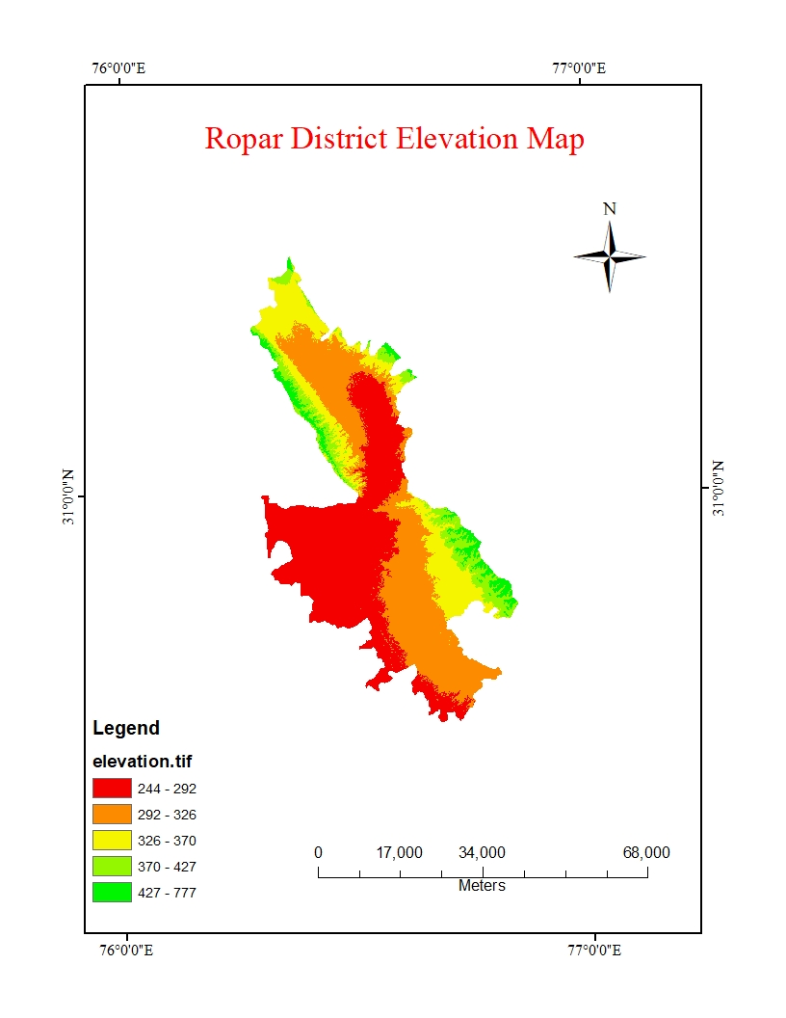
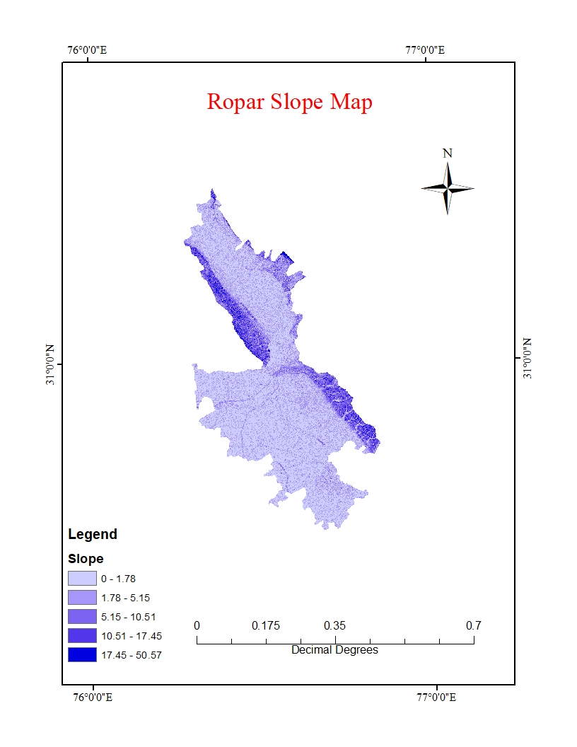
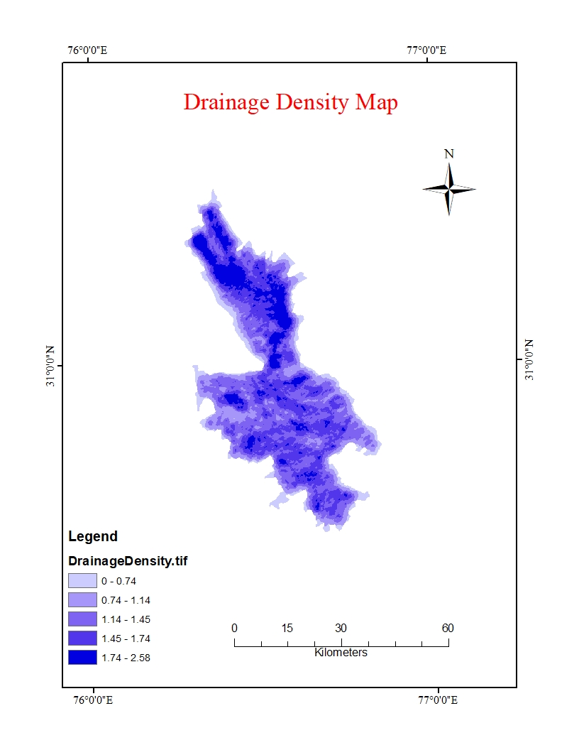
Input Data Required
Figure-3: Elevation Map
Figure-4: Slope Map
Figure-5: Drainage Density Map

Slide 6
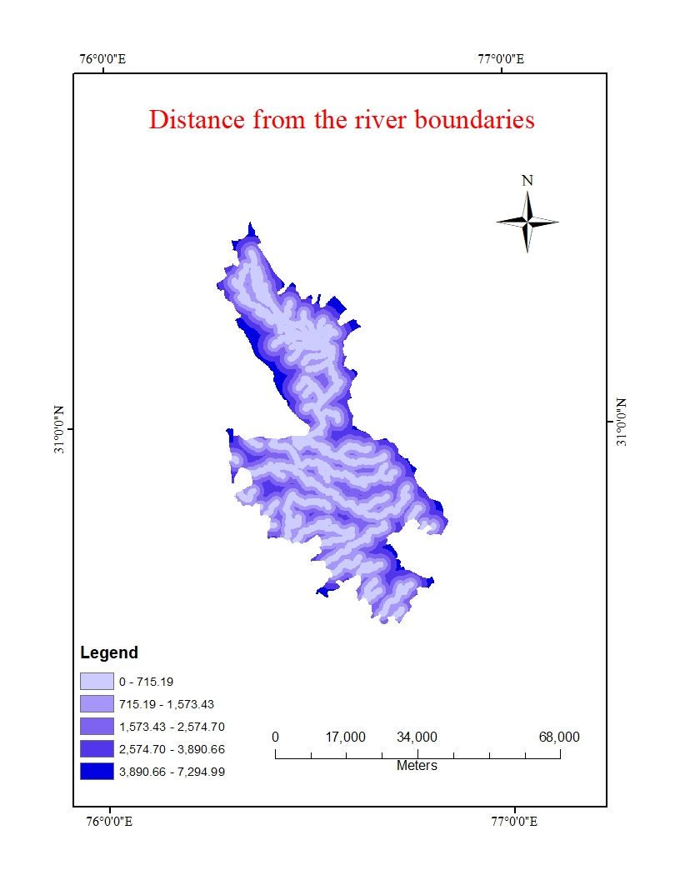
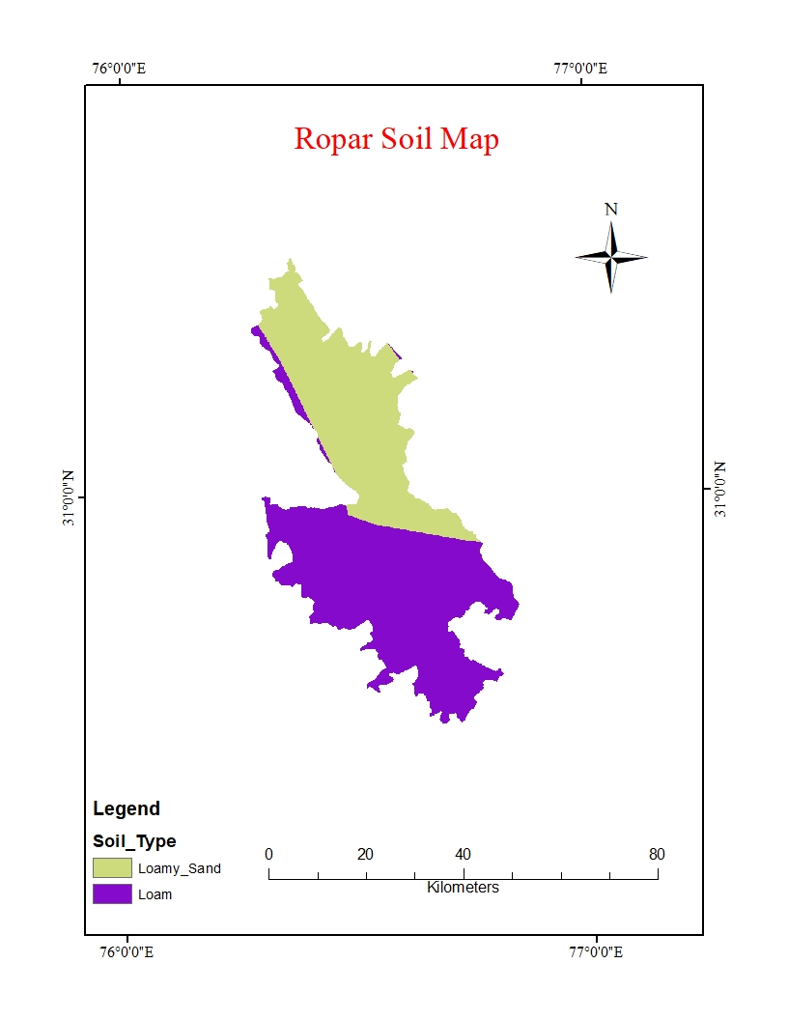
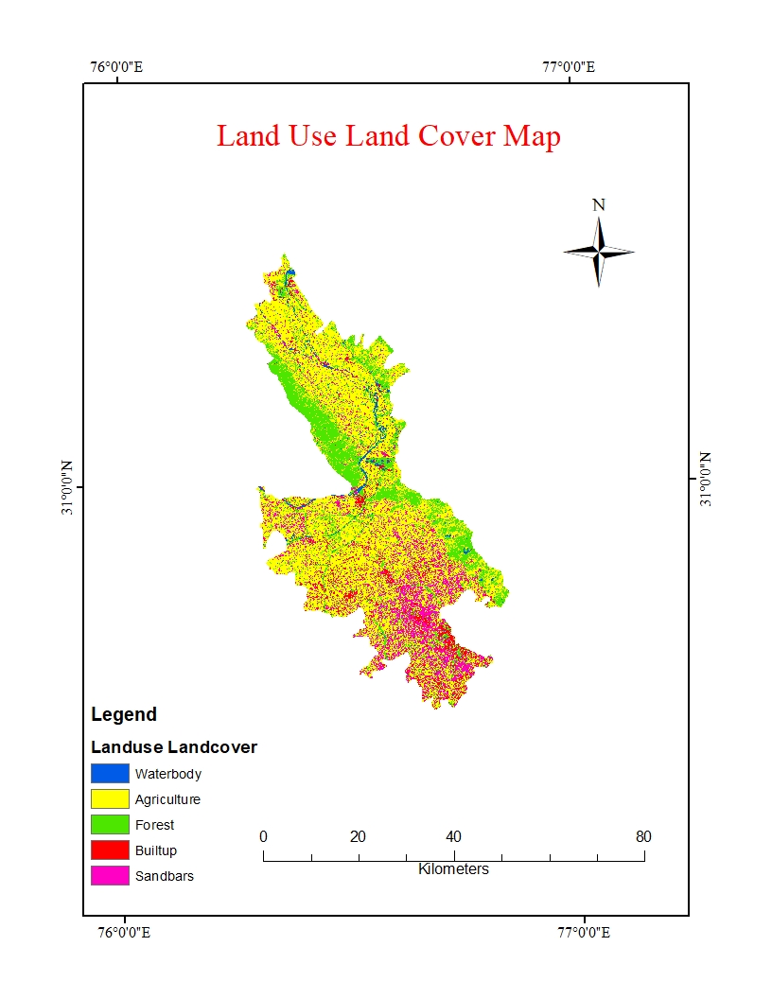
Figure-5: Distance from river
Figure-6: Soil Map
Figure-7: Land Use Land Cover (LULC) Map

Slide 7
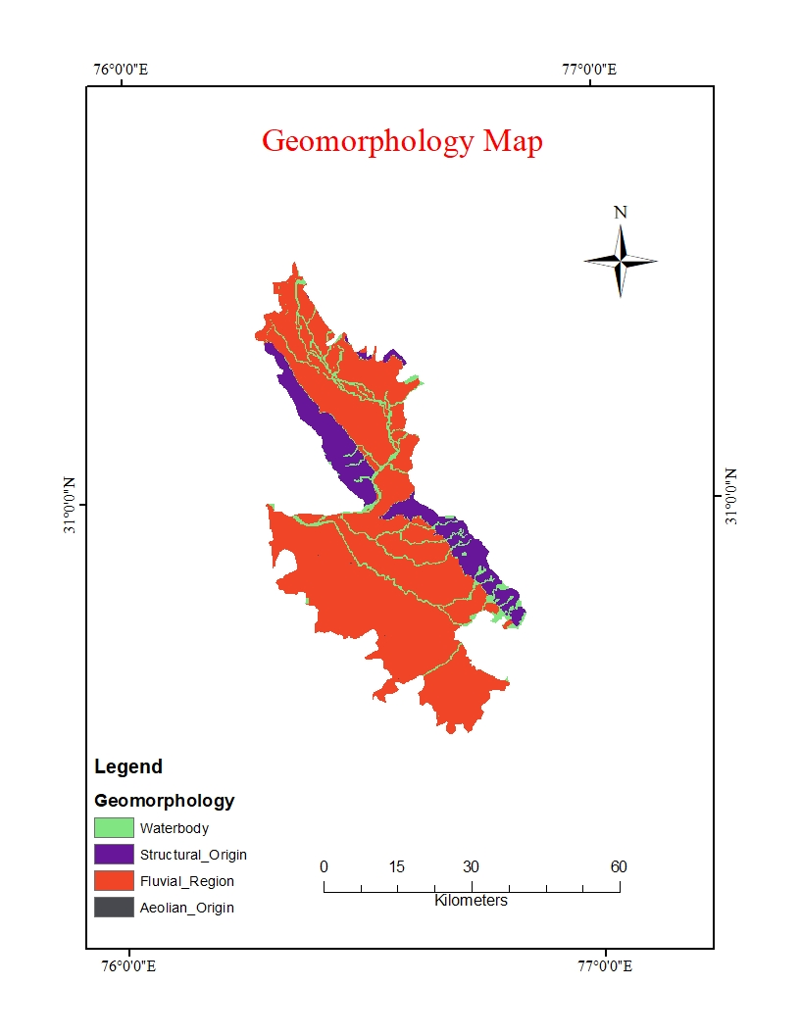
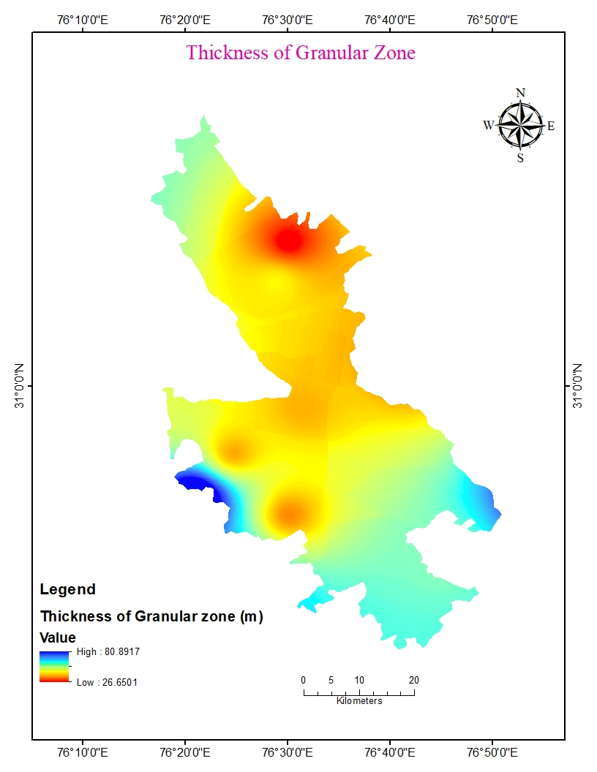
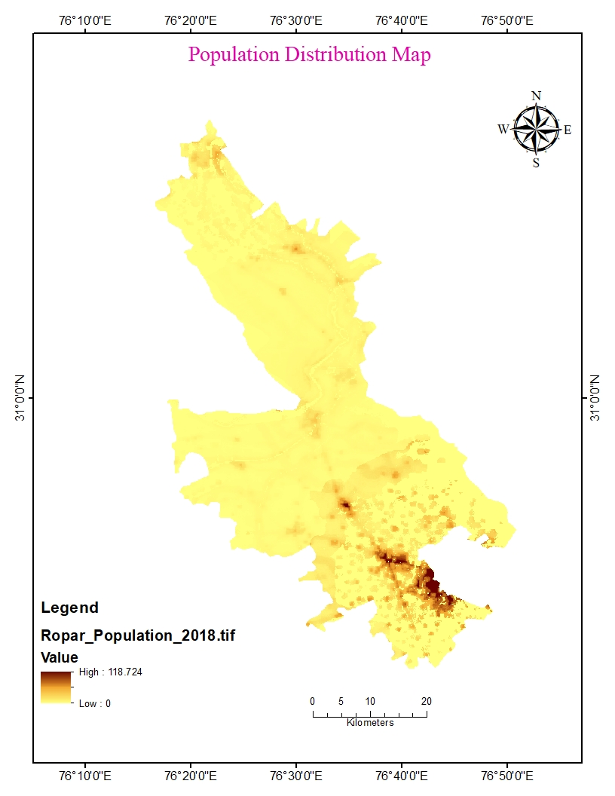
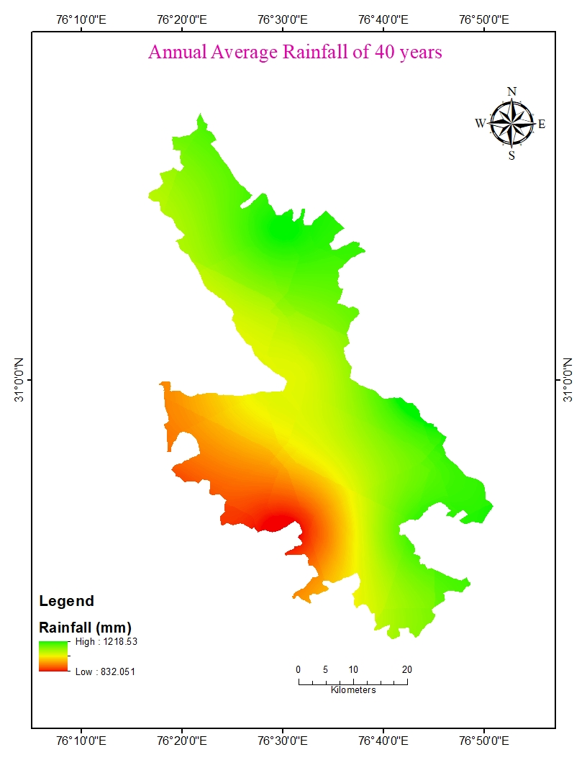
Figure-8: Geomorphology Map
Figure-9: Thickness of Granular zone Map
Figure-10: Population Map
Figure-11: Rainfall Map

Slide 8
Work-Flow
ASTER DEM from USGS Website
Sentinel-2 data (2020)
Flow Direction
Flow Accumulation
IMD Pune Website
Landscan Website (30” X 30” resolution)
Performed supervised classification using google earth engine
Food and Agricultural Organization (FAO)
Bhuvan Website
Stream Raster to Vector
Euclidian Distance
CGWB Reports
Rainfall data (1981-2020)
Population Distribution Map (2018)
Drainage Density
Distance from River
Slope
Thickness of Granular Zones
Land Use Land Cover
Geomorphology Map
Soil Map
Rainfall Map
Reclassify all Maps
Performing Weighted Overlay in Arc-GIS
Areas Suitable for Artificial Recharge Structures
Figure-12: Workflow for AHP

Slide 9
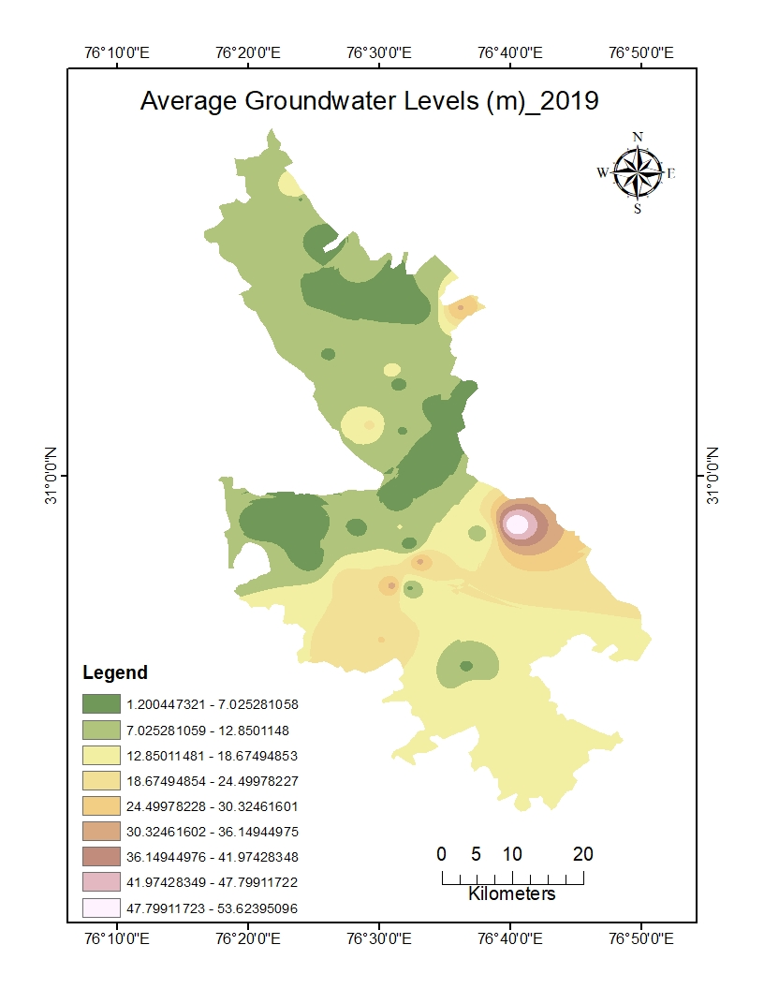
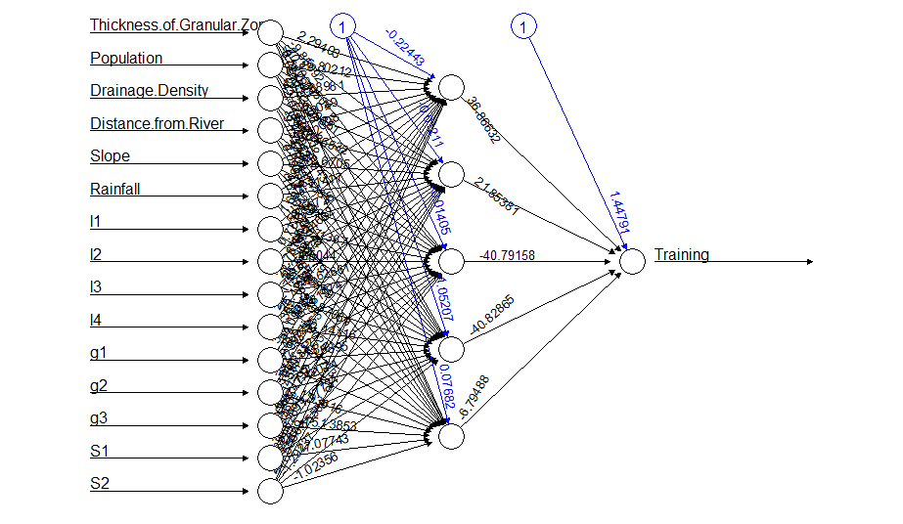
Figure-13: Average Groundwater levels (mbgl)
Figure-14: ANN model with inputs, associated weights for their inputs during training

Slide 10
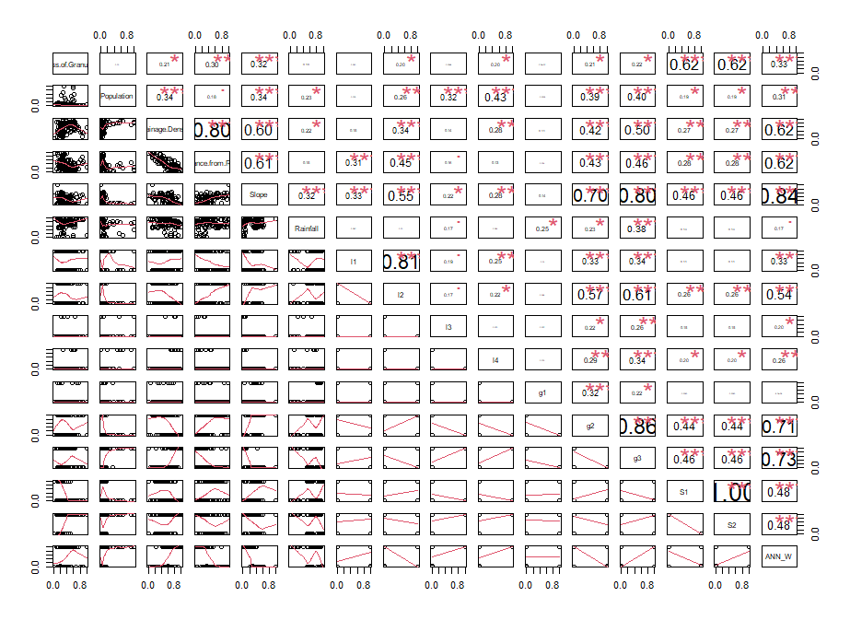
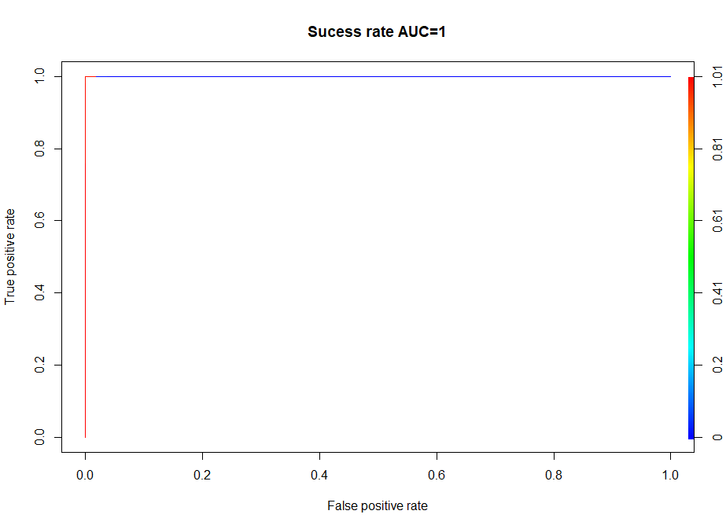
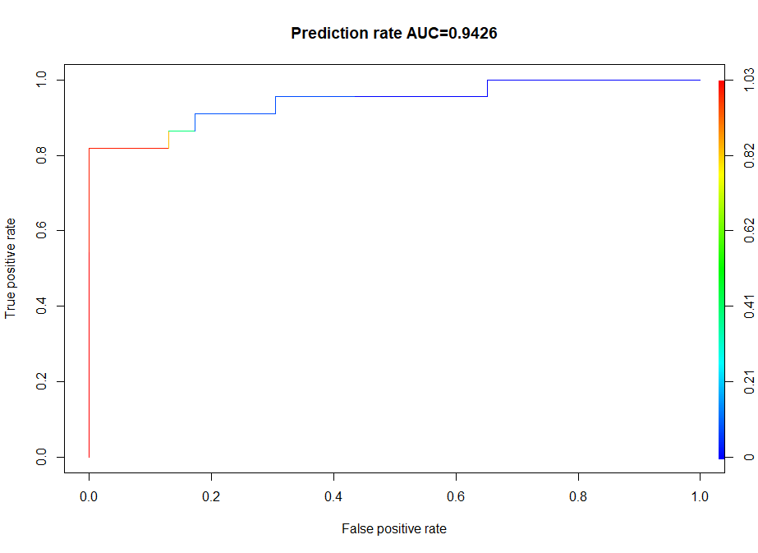
Results
Figure-16: ROC Curve while training
Figure-15: Pair-Wise plots for different attributes while training
Figure-17: ROC Curve while testing

Slide 11
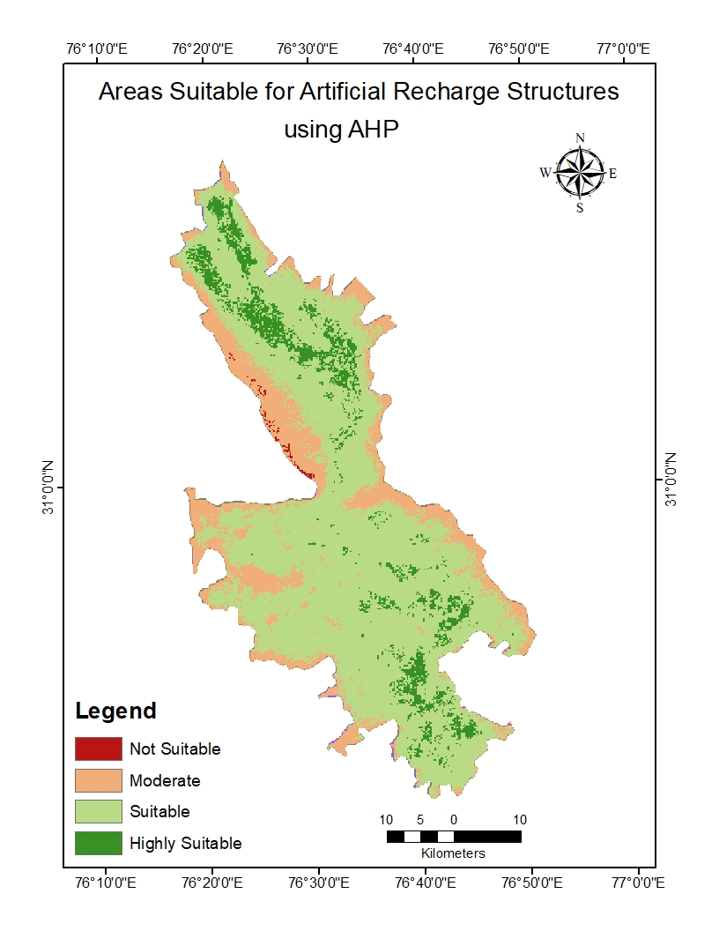
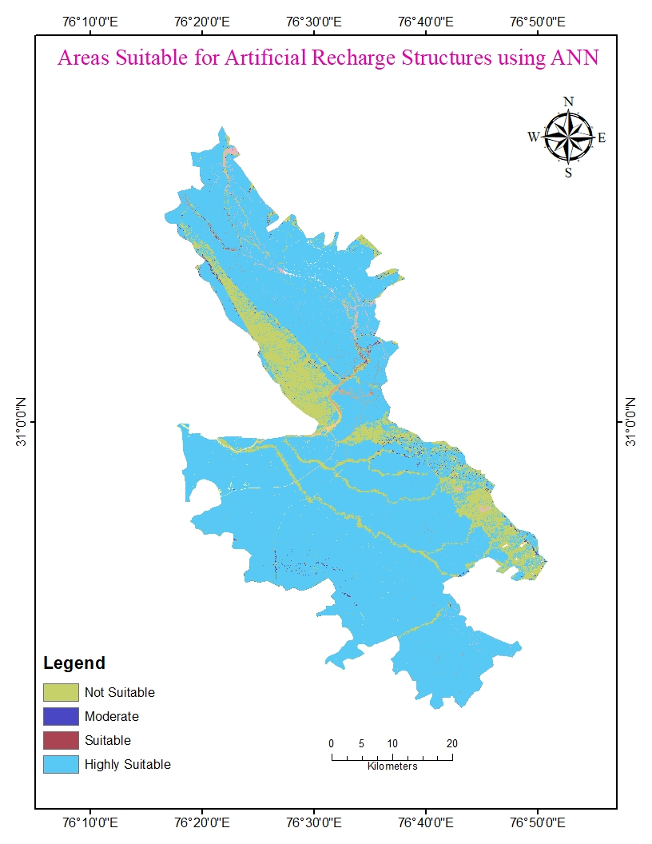
Figure-18: Areas Suitable Artificial Recharge Structures using AHP
Figure-18: Areas Suitable Artificial Recharge Structures using ANN

Slide 12
Conclusions
Based on the results obtained, we can conclude that:
Based on lithology and drainage density:
  the areas which are classified as strongly suitable and suitable, we can prefer Induced Recharge or Injection well method to replenish the aquifer.
  the areas which are classified as moderately suitable, we can prefer injection well technique to replenish the aquifer.
As ANN is based on data-driven, it is giving high precision results comparing with AHP (based on Subjective knowledge) because in some areas where groundwater level is high, it modeled as suitable but not strongly suitable.
The best positive Receiver Operating Characteristic (ROC) curve is fitted while training at all classification thresholds.
The Area under Curve (AUC) is achieved ‘1’ in training, 0.9426 while testing.

