Slide 1
The European Geosciences Union General Assembly 2022
23 - 27 May 2022
Sample Association by using Anomalous Concentration Episodes and Decay-Consistent Isotopic Ratios at IMS Radionuclide Stations
Yuichi Kijima, Robin Schoemaker, Boxue Liu, Jolanta Kuśmierczyk-Michulec, Martin Ertl, Anne Tipka, Martin Kalinowski
CTBTO/IDC

Slide 2
Introduction
For enhancing the International Data Centre (IDC) products such as the Standard Screened Radionuclide Event Bulletin (SSREB), there is a need to associate the detections of CTBT-relevant nuclides in samples from the International Monitoring System (IMS) radionuclide stations with the same release to characterize its source for the purpose of nuclear explosion monitoring.
Episodes of anomalous activity concentrations at the stations are the first best guess for being related to the same release episode.
For multiple isotope observations, the consistency of their ratios in subsequent samples with radioactive decay is another plausible hint at the same release.
Atmospheric transport modelling (ATM) might contribute to a conclusive estimation of event-related associations by identifying the air currents that link the release to multiple samples.
We focused on a basic approach as well as the criteria for automatic sample association for the
SSREB. This is of relevance for expert technical analysis applied to observations of special interest.

Slide 3
Introduction
Association of noble gas samples
- Case 1 : Episode on no consecutive Level C samples
・
・
・
Level A
Level B
Level C
Level A
Level B
Level A
・
・
・
Time
It might be possible that these samples are associated, i.e. originated from a same release.
- Case 2 : Episode on two consecutive Level C samples
・
・
・
Level A/B
Level C
Level C
Level B
Level A/B
Level A/B
・
・
・
Time
It might be possible that these samples are associated.
- Case 3 : Episode on three consecutive Level C samples
・
・
・
Level A/B
Level C
Level C
Level C
Level A/B
Level A/B
・
・
・
Time
It might be possible that these samples are associated.

Slide 4
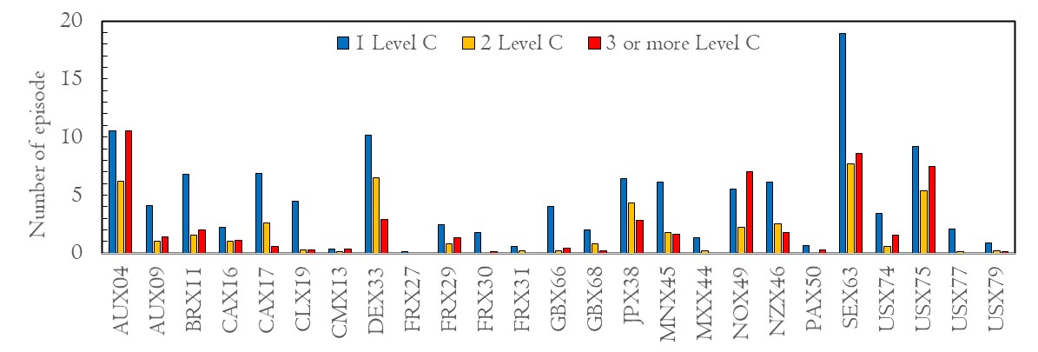
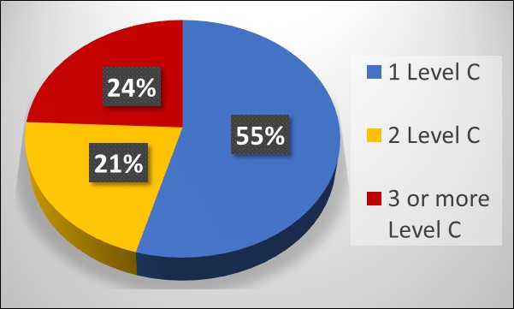
Anomalous Concentration Episodes
Consecutive Level C Samples
Annual average number of occurrences until 2021 with no (that is, 1) , 2, 3 or more consecutive Level C samples at all
certified IMS stations irrespective of which radioxenon isotope caused the Level C categorization
・ The longest episode ever recorded has 19 consecutive Level C samples (station AUX04).
・ Almost half (45%) of all episodes have consecutive Level C samples.
・ About one quarter (24%) has at least three consecutive Level C samples, i.e. PSR can be determined.

Slide 5
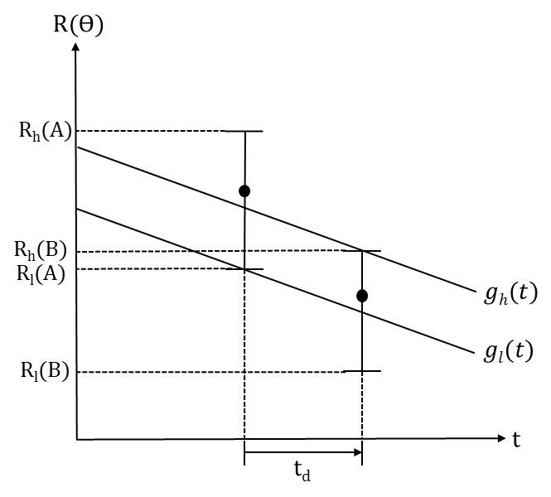
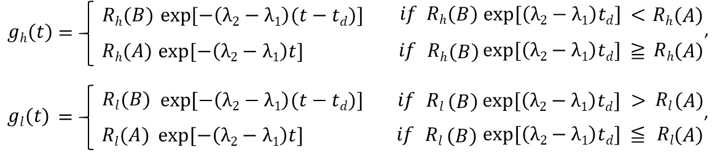
Sample Association
using Decay-Consistent Isotopic Ratios
: Isotopic ratio of isotope 2 to isotope 1 in sample $θ$
Log
Sample A
Sample B
where λ_{i} : Decay constant of isotope i, R_{h,l} : Upper and lower limit of isotopic ratio.
: Upper limit of decay curve
Range for which the decay curve can be drawn
: Lower limit of decay curve
Sample association method by using the decay-consistent isotopic ratios
1. In case of two samples:
(“Sample association check formula”)
2. In case of three or more samples:
“_{n}C₂ combinatorics” with the sample association check formula above,
or visual check of plots if samples are on the same decay curve.

Slide 6
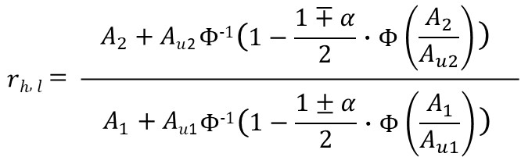
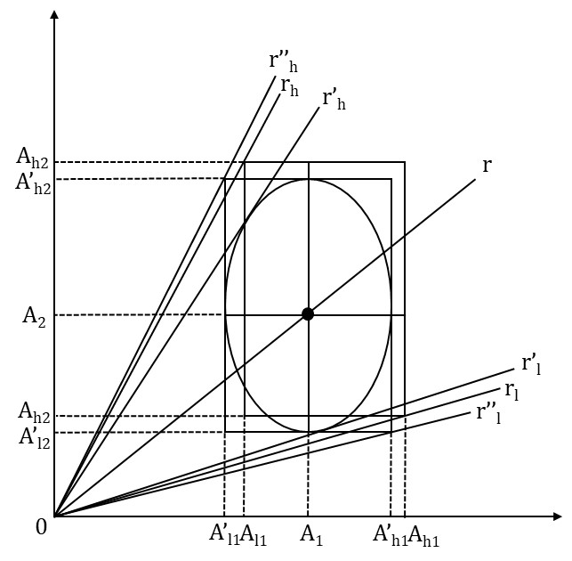
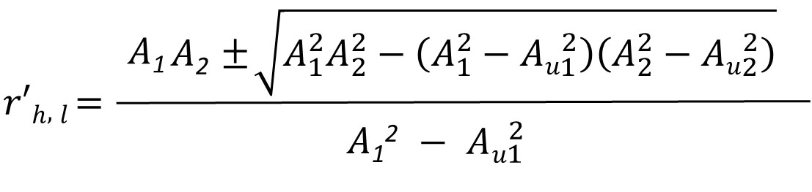
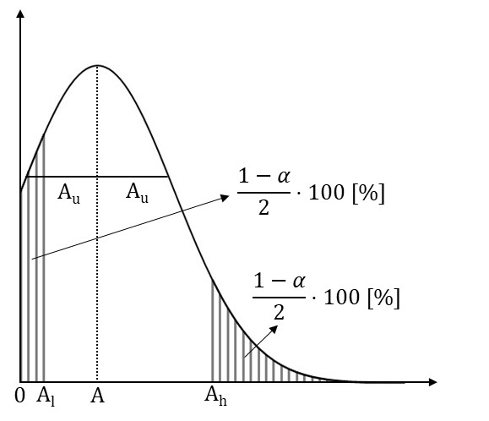
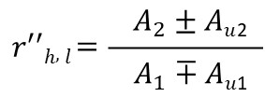
Calculation of Upper and Lower Limit of Isotopic Ratios
1. Bayesian approach
Geometric interpretation of Bayesian,
Fieller’s and Min-Max approaches
Comparison of approaches
If A₁= A₂= 1±0.5 Bq and α = 0.68, we get;
Method used | Upper limit of ratio | Lower limit of ratio
Bayes | 2.78 | 0.36
Fieller | 2.22 | 0.45
Min-Max | 3.00 | 0.33
2. Fieller’s approach
Bayesian probability density function
3. Min-Max approach
r_{h,l} : Bayes, r’_{h,l} : Fieller, r’’_{h,l} : Min-Max
For example, we can use Bayesian approach*¹, Fieller’s approach*²
and simple approach named Min-Max approach to calculate
the upper and lower limit of the isotopic ratio.
*¹ See M. Zähringer, et.al., “On the calculation of activity concentrations and nuclide ratios from measurements of atmospheric
radioactivity”, Applied Radiation and Isotopes 92, 12–17 (2014).
α : confidential level
*² See A. Axelsson, et.al., “Radioxenon detections in the CTBT international monitoring system likely related to the announced
nuclear test in North Korea on February 12, 2013”, Journal of Environmental Radioactivity, 128, p47-63 (2008).

Slide 7
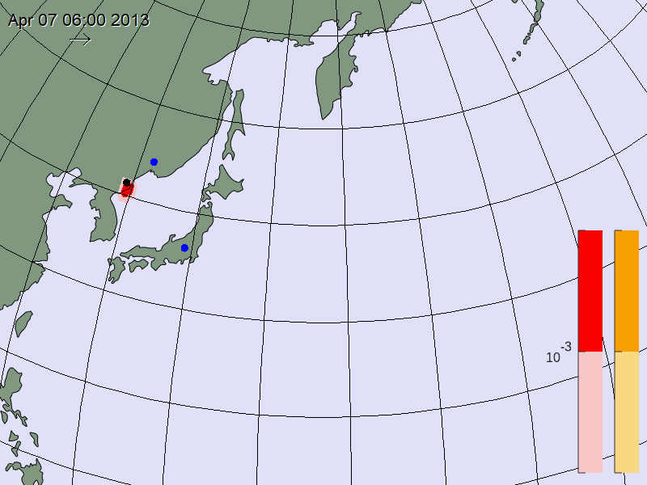
Decay-consistent isotopic ratios - case study: DPRK-2013 Context
This case study investigates Level C samples at JPX38 and RUX58 considered to have originated from the 2013 DPRK’s nuclear test event*^{1,} *²
*¹ See A. Ringbom, et.al., “Radioxenon detections in the CTBT international monitoring system likely related to the announced nuclear test in North Korea on February
12, 2013”, Journal of Environmental Radioactivity, 128, p47-63 (2014).
*² See P. Eslinger, et.al., “Investigation of associations among atmospheric radionuclide measurements”, Journal of Environmental Radioactivity, 241, 106777 (2022).
An example of the Xe releases scenario
_{For this case study we}
_{expect that:}
t_{A,air} < t_{B,air}
RUX58
DPRK
_{Release A happened earlier}
_{than release B and was}
_{observed earlier than}
_{Release B.}
(but A observation could be later if the winds dictate so)
Release A
JPX38
t_{A,air}
Release B
Atmospheric transport modelling assuming a release on 7 April 2013 from the DPRK site; at 6 a.m. (orange) and at 3 a.m. (red).
(IMS stations indicated in blue.)
t_{B,air}
nuclear
explosion

Slide 8
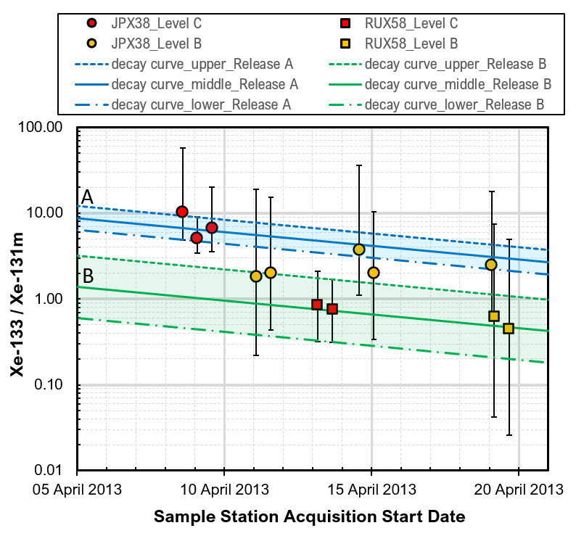
Decay-consistent isotopic ratios - case study: DPRK-2013 Approach
This case study investigates Level C samples at JPX38 and RUX58 considered to have originated from the 2013 DPRK’s nuclear test event*^{1,} *²
*¹ See A. Ringbom, et.al., “Radioxenon detections in the CTBT international monitoring system likely related to the announced nuclear test in North Korea on February
12, 2013”, Journal of Environmental Radioactivity, 128, p47-63 (2014).
*² See P. Eslinger, et.al., “Investigation of associations among atmospheric radionuclide measurements”, Journal of Environmental Radioactivity, 241, 106777 (2022).
We follow a three-step approach:
1. With observational data, our sample association method, using the calculated decay-consistent isotopic ratios, confirms that:
Three Level C samples at JPX38 are associated. (“_{n}C₂ combinatorics”)
Two Level C samples at RUX58 are associated. (“Sample association check formula”)
2. We assume the following:
All Level C samples originate from the same event (a single detonation on Feb. 12).
For this one event, two air-borne release episodes follow (A and B), favouring the Level C sample measurement locations (JPX38, RUX58) respectively, marked by two non-overlapping decay bandwidths of isotopic ratios (Xe-133 / Xe-131m) vs. time.
Level B samples show much larger uncertainties and might not all originate from the one event. But if Level B samples do link to it, they seem difficult to associate to either release.
3. Support from atmospheric transport modelling (ATM) can provide insight in:
Associating Level B samples with Level C samples and one or more release episodes (for this one 12 February event).
Estimating the time for one or more release episodes.

Slide 9
Decay-consistent isotopic ratios - case study: DPRK-2013 Support by atmospheric transport modelling (ATM)
ATM backward Field of Regard (FOR) simulations give a first approximation in space and time for the areas of origin of released radionuclides measured at IMS stations.
Possible Source Region (PSR) simulations (ATM) + radionuclide measurements aim to get the best correlation of samples (C and B) and their linkage to location and to time; and (if possible) also to other releases. For this case study, the PSR simulations show that:
JPX38 samples marked by blue and the RUX58 samples (green) correlate to the event (test) location.
JPX38 samples marked by black do not correlate to the event location.
FOR check: the air masses either passed the DPRK location in a different time period or not passed at all.
Next to release A, of which the time is confidently determined, was there a release B as well?
FOR check: the green observations (RUX58) do not link up at first approximation with the blue (JPX38).
A
!
B
?

Slide 10
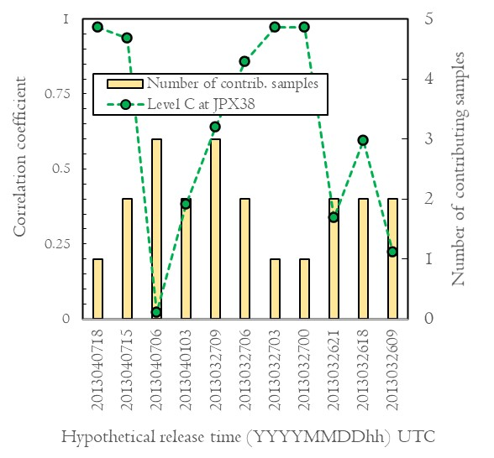
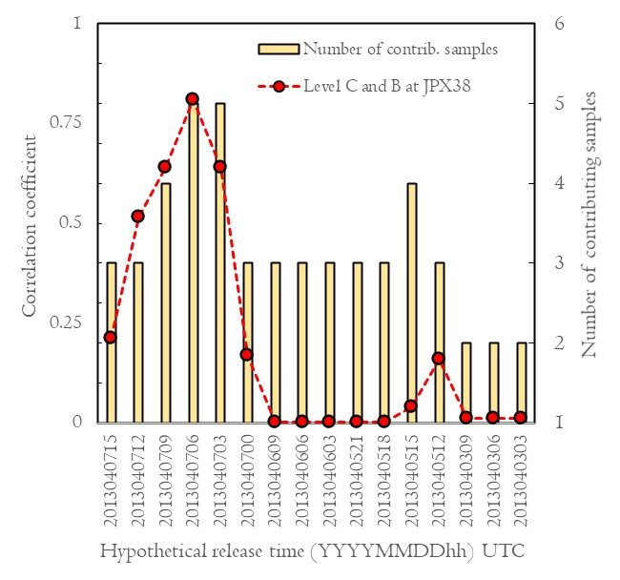
Decay-consistent isotopic ratios - case study: DPRK-2013 Possible Source Region and correlation coefficients – Release A (1D)
PSR calculated for JPX38 Level C samples
PSR calculated for the JPX38 Level C
and the two blue Level B samples
PSR calculated for three Level C samples at JPX38 does not indisputably provide the hypothetical release time.
When including the relevant Level B samples, the hypothetical time of
(at least) one release is confined to
7 April between 3 a.m. and 6 a.m.
A
!
B
?

Slide 11
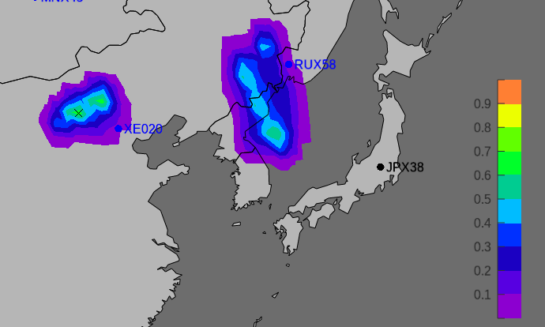
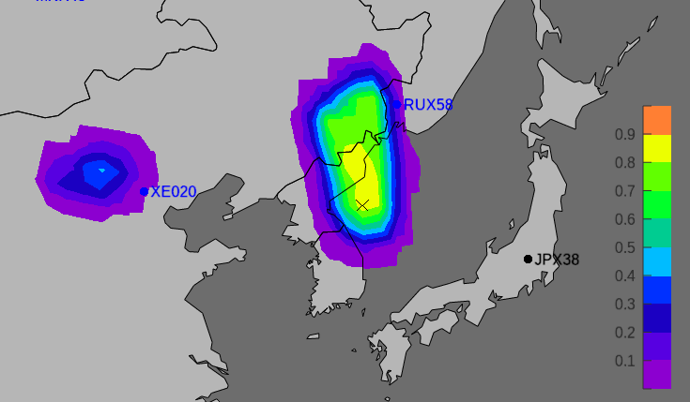
Decay-consistent isotopic ratios - case study: DPRK-2013 Possible Source Region - Release A: 7 April 2013
Correlation for DPRK release
No PSR correlation for DPRK release A when any of the two black Level B measurements at JPX38 is added as well to the JPX38 Level C and B collection for the PSR computation – as expected (cf. FOR check).
PSR: 7 April 2013 at 06:00 hrs. for the Level C sample collection only.
Better correlation for DPRK release
A
!
PSR: 7 April 2013 at 06:00 hrs. for the Level C sample collection + associated Level B collection.

Slide 12
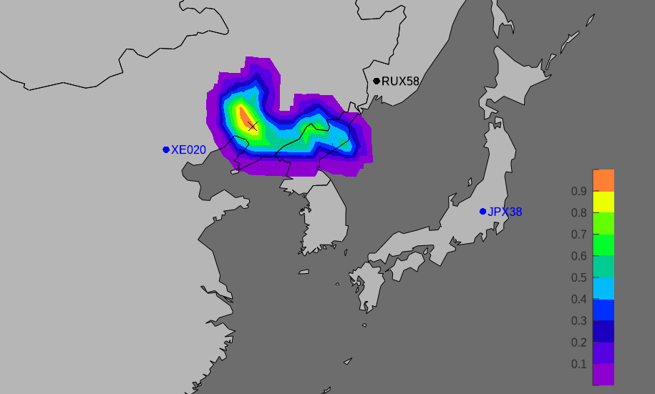
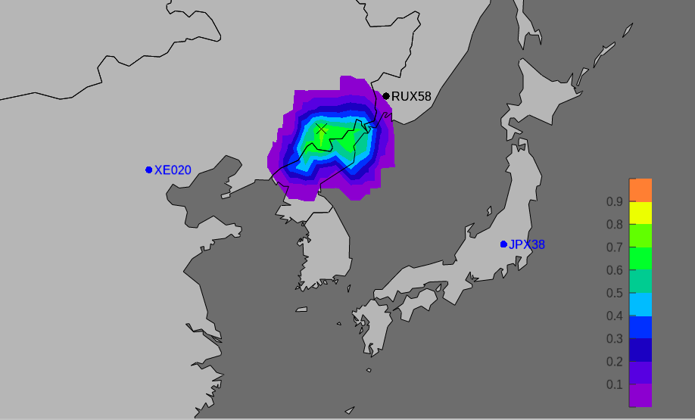
Decay-consistent isotopic ratios - case study: DPRK-2013 Possible Source Region - Release B: 12 April 2013
Unreliable* correlation for DPRK release
No PSR estimation for DPRK release B when any of the two black Level B measurements at JPX38 is added as well to the RUX58 Level C and B collection for the PSR computation – as expected (cf. FOR check).
PSR: 12 April 2013 at 09:00 hrs. for the Level C sample collection only.
Better correlation for DPRK release
B
!
PSR: 12 April 2013 at 09:00 hrs. for the Level C sample collection + associated Level B collection.

Slide 13
Summary
Combining anomalous concentration episodes with decay-consistent isotopic ratio analyses proofs to be promising for future automatic sample association products needed for the Standard Screened Radionuclide Event Bulletin (SSREB) and Expert Technical Analyses (ETA).
Sample association results that lack definitive information, or cope with too many uncertainties, can be combined with ATM simulations for better estimations or even confirmations.
For a case study involving the DPRK nuclear test event in February 2013, we showed:
That our decay-consistent isotopic ratio analysis confirms that there were two distinct releases episodes in April 2013.
That by using ATM it was possible to backtrack and further correlate in space and time the radio-isotopes to their Level C and Level B detections.
It is shown that the two Level B samples at JPX38 can indeed be associated with the three Level C samples at JPX38, and that the two Level B samples at RUX58 can indeed be associated with the two Level C samples at RUX58. The dates of the two releases at DPRK’s nuclear test site are confidently estimated to be 7 and 12 April 2013.

Slide 14
Thank you !
You might also be interested in presentations that follow soon hereafter:
EGU22-8689, “Quality Assessment of the different Possible Source Region (PSR) algorithms”
EGU22-8514, “A demonstration of CTBTO’s capability to identify the possible source region of the specific case of DPRK announced tests by conducting a sensitivity study using high-resolution ATM”

