Slide 1

Modeling groundwater flow and solute transport in the active layer of hillslope system in permafrost environments
Alexandra Hamm & Andrew Frampton
Stockholm University
Correspondence: alexandra.hamm@natgeo.su.se

Slide 2
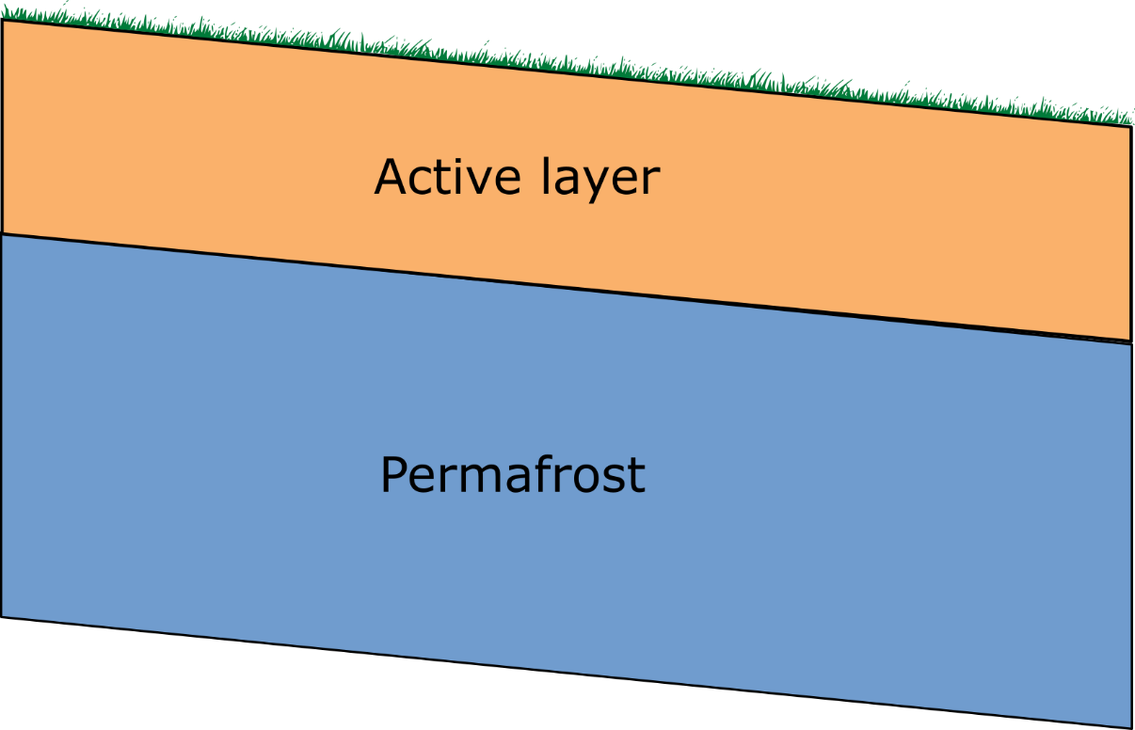

Background
Water flow mostly confined to the active layer
How does lateral water flow impact the hydrothermal regime of the active layer?
Notes:
2

Slide 3
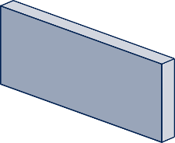
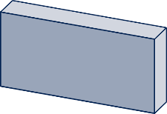

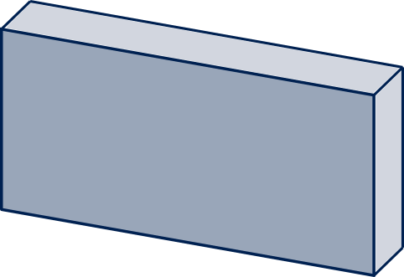
Method
ATS (Advanced Terrestrial Simulator v088, physically based numerical model)
2 slope inclinations
SEB: air temp, SWin, humidity,
windspeed, LWin, precipitation
Constant temperature from
borehole measurements
Notes:
Also have surface processes going on
Heat advection from up- to downhill did not make a significant contribution
3

Slide 4

Main results (subsurface characteristics)
Liquid saturation
Heat capacity
Thermal conductivity
warmer
summer
temperatures
colder
summer
temperatures

Slide 5
Main results (surface/subsurface fluxes)
Small evaporative cooling
Large warming through infiltration
Small warming through infiltration
Large evaporative cooling
warmer
summer
temperatures
colder
summer
temperatures
Liquid saturation
Heat capacity
Thermal conductivity
Notes:
Also have surface processes going on
Heat advection from up- to downhill did not make a significant contribution
(why is infiltration higher uphill: We don’t look at the individual components but at the energy balance at the surface and so evaporation is lower uphill and causes heat advection to contribute to the overall positive energy flux into the subsurface)
5

Slide 6
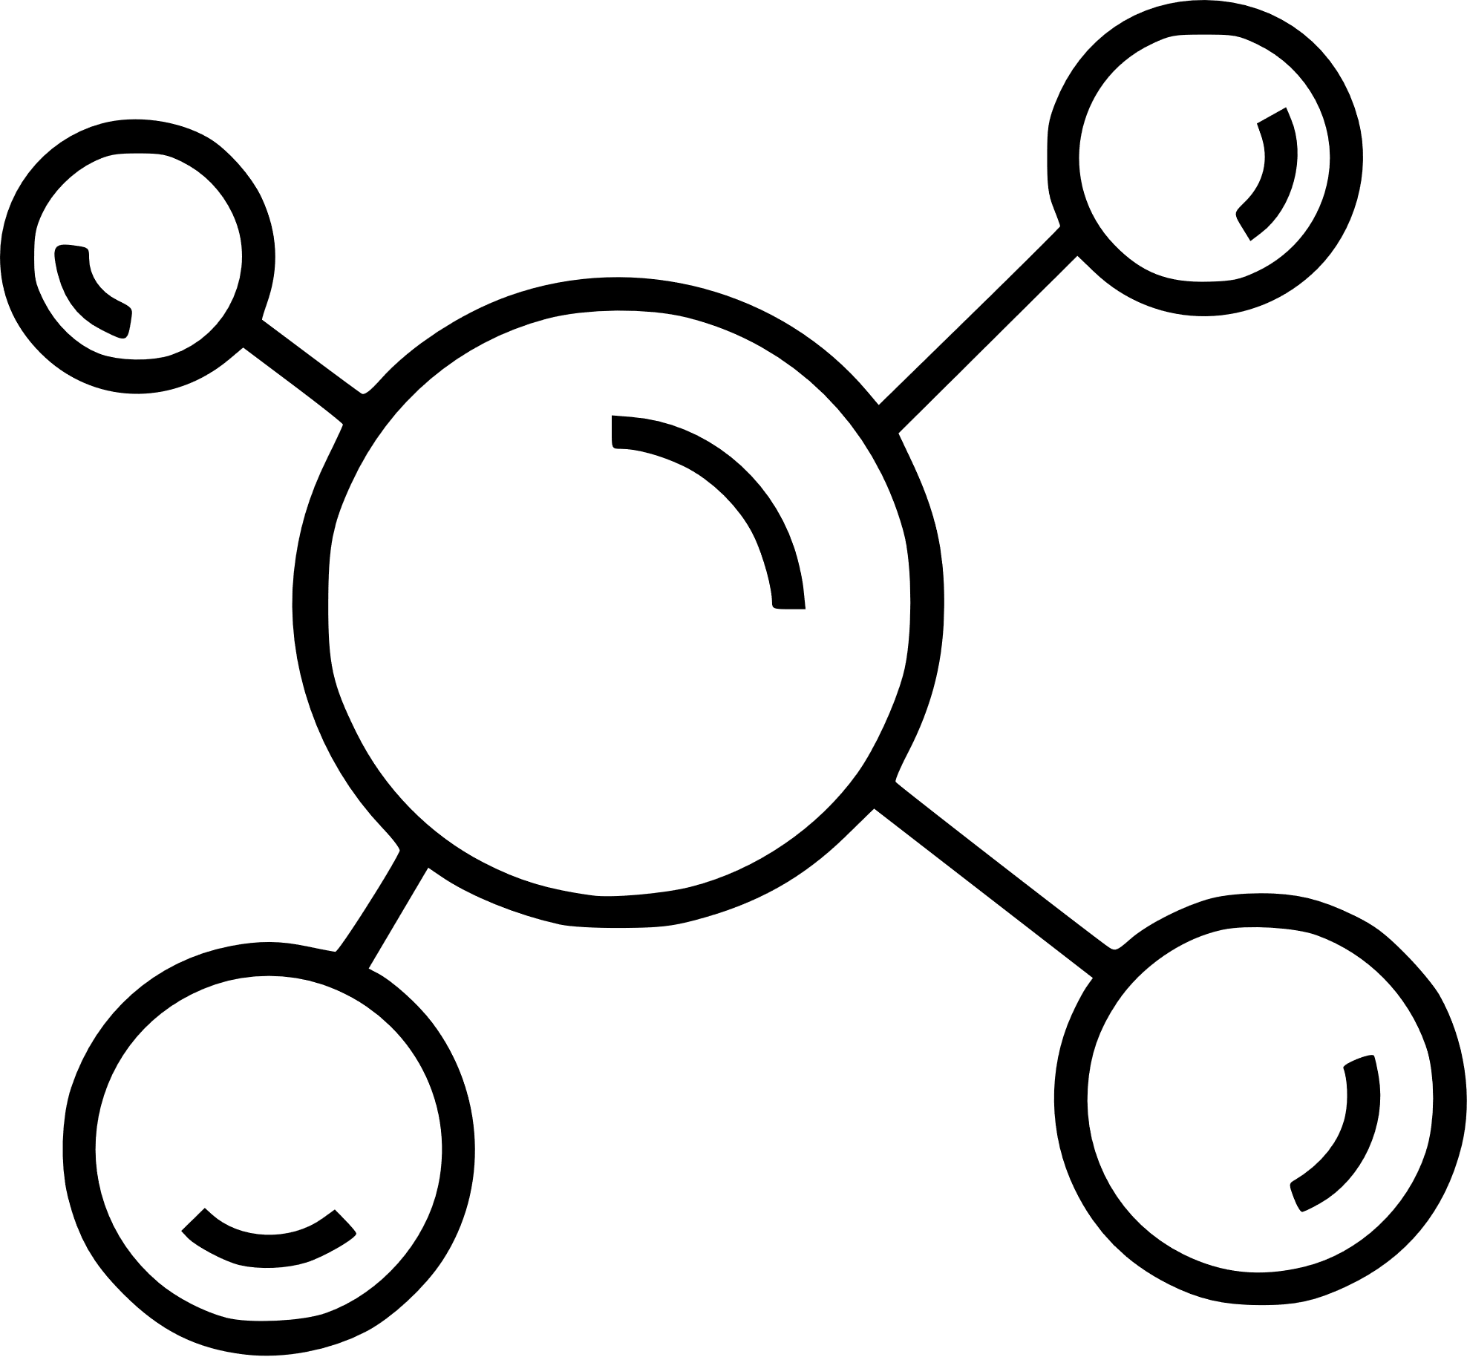
Next up: solute transport
Transport times affected by:
Freeze-thaw cycle
Unsaturated soil thickness
Sorption, degradation, reaction…
Notes:
Also have surface processes going on
Heat advection from up- to downhill did not make a significant contribution
6

Slide 7
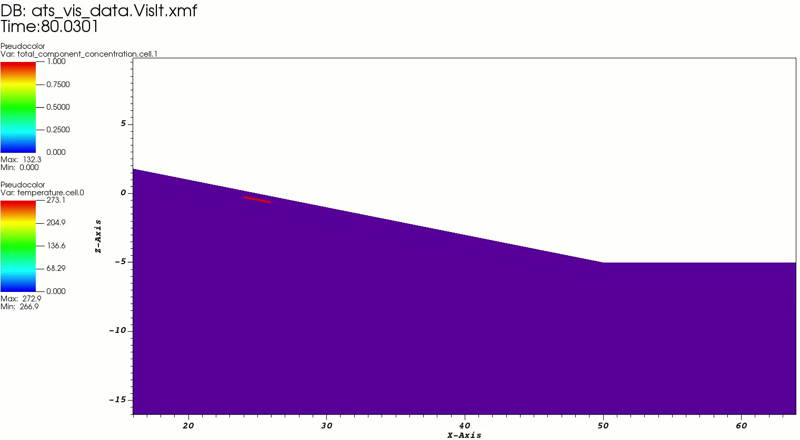
Very first simulation results (video)
Tracer injection after 80 years of spinup
Advection-dispersion equation for transport (no reaction)
Dispersion moves tracer also uphill

