Slide 1


Two-dimensional analysis of the irrigation needs in Danubian Lowland in Slovakia (case study)
M. Čistý, B. Považanová

Slide 2
Introduction
Indicators
parameters (variables) used to describe drought (e.g., precipitation, temperature, streamflow, groundwater and reservoir levels, soil moisture ...)
Indices
computed numerical representations of drought severity, using hydrological and meteorological inputs
Quantitative assessment
Like other hazards, droughts can be characterized in terms of their
Statistical evaluation
Frequency analysis – univariate, multivariate
1) severity, 2) location, 3) duration and 4) timing.

Slide 3
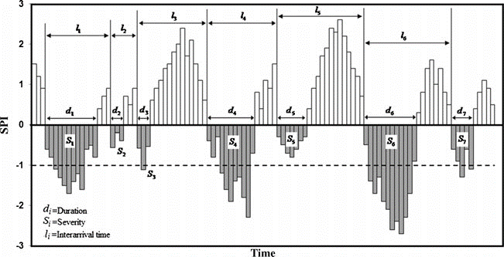
Introduction
SPI value | drought category
2.00 or more | Extremely wet
1.50 to 1.99 | Severely wet
1.00 to 1.49 | Moderately wet
−0.99 to 0.99 | Near normal
−1.49 to −1.00 | Moderately dry
−1.99 to −1.50 | Severely dry
−2.00 or less | Extremely dry
Source: Mirabbasi, R., Fakheri-Fard, A., & Dinpashoh, Y. (2012). Bivariate drought frequency analysis using the copula method. Theoretical and applied climatology, 108(1), 191-206.

Slide 4
Objective
We evaluated the return periods of droughts regarding the need for irrigation
with two constructed indices which depends on precipitation and temperature
we accomplish this multidimensionally using copulas
Case study – lowland in southwestern Slovakia (“Rye Island”)
Notes:
Copula is a mathematical function that expresses the joint cumulative probability distribution of multiple variables

Slide 5
Case study and data

Slide 6
Variables
An analysis of the maximum annual potential irrigation period was performed in this work, which is defined using two indices, defined with help of two indicators: precipitation and temperature.
Length of the maximum potential irrigation period within a year. It is derived from the number of consecutive days with a temperature above 25° C. The detected warm period was eventually extended by precipitation-free days before and after it.
Precipitation deficit with respect to the normal period according to World Meteorological Organization (1960-1990).
The following analysis evaluates these two statistical variables univariately and multivariately.

Slide 7
Methodology
Preparation of basic data (temperature, precipitation) and determination of variables that describe drought,

Slide 8
Methodology
Preparation of basic data (temperature, precipitation) and determination of variables that describe drought,
verification of the relationship between variables,

Slide 9
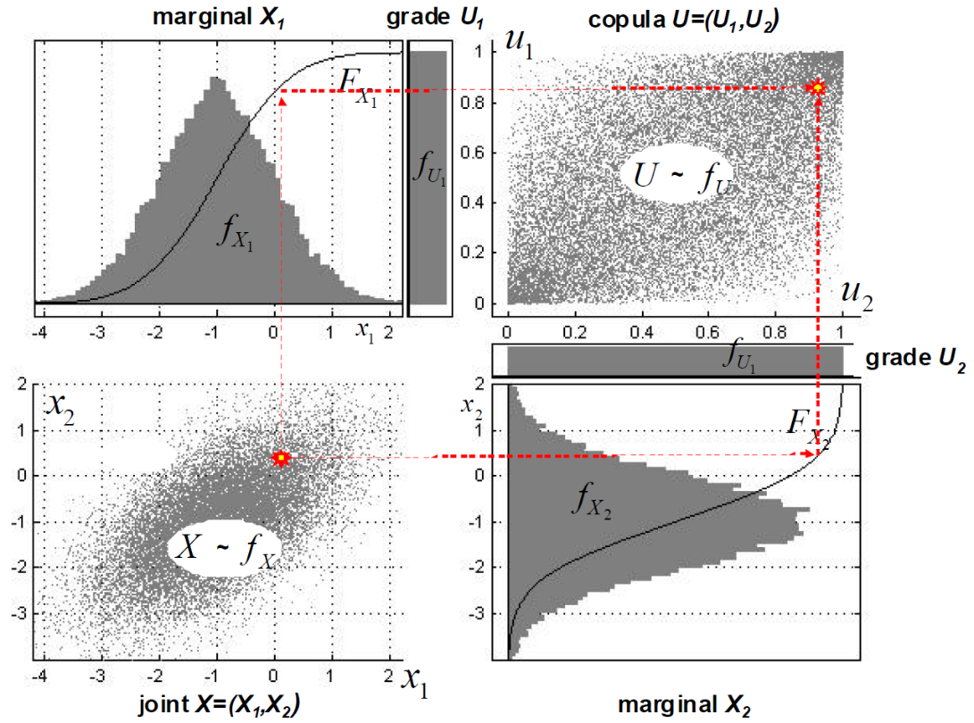
Methodology
Preparation of basic data (temperature, precipitation) and determination of variables that describe drought,
verification of the relationship between variables,
identification of the one-dimensional distribution of selected variables,
determination of the expected copula class forming a two-dimensional probabilistic dependence,
determining copula parameters (copula fitting), and
evaluation of the return time of droughts with various lengths and severities.

Slide 10
Marginal distributions – length of irr. period

Slide 11
Marginal distributions – rainfall deficit

Slide 12
Evaluation of the copula operator fitting
Length of the potential irrigation period (days)
Rainfall deficit (mm)

Slide 13
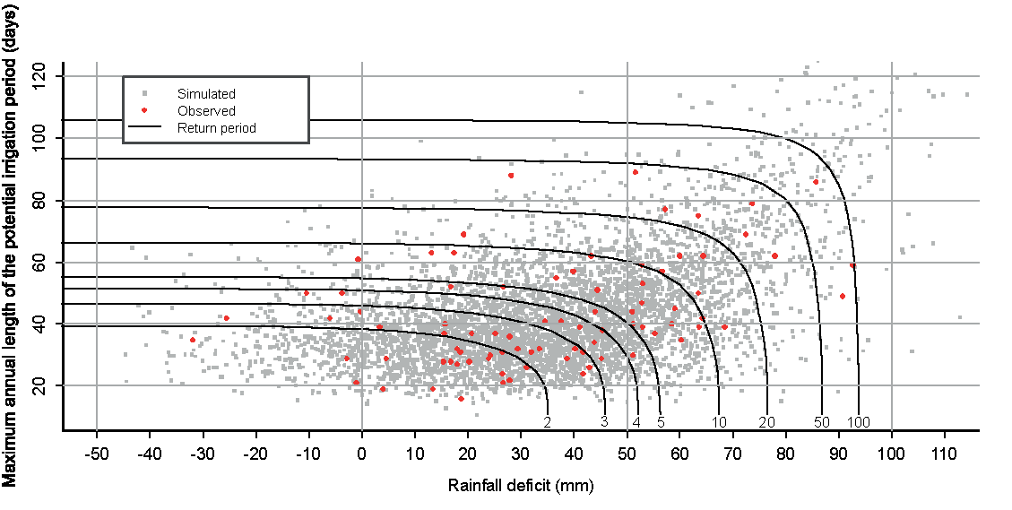

Return periods
$T_{x,y}=\frac{1}{1−F_{\left(x\right)}−F_{\left(y\right)}+C\left(F_{\left(x\right)}, F_{\left(y\right)}\right)} \text{(}\text{Michele} \text{and} \text{Salvadori}\text{ 2003)}$
where F_{(x)} and F_{(y)} are one-dimensional probability distribution functions and C(F_{(x)},F_{(y)}) represents an associated distribution function based on the Joe copula.
Notes:
contours

Slide 14
Return periods
Probability | One-dimensional return period | Length of the potential irrigation period | Rainfall deficit | Joint return period
 | years | days | mm | years
0.5 | 2 | 39 | 35 | 4
0.8 | 5 | 55 | 56 | 9
0.9 | 10 | 66 | 67 | 20
0.95 | 20 | 78 | 76 | 39

Slide 15
Conclusion
The results indicate that in the context of Slovakia, the need for irrigation occurs in warm regions very often. Every second year, for example, a period can be expected in which dry period is lasting about one month with a moisture deficit of about 30 mm.
The authors are aware that irrigation requirements depends on additional conditions, such as the pedological conditions, developmental stage and type of crops, price of water in relation to expected benefits from irrigation, etc.
Drougts cause significant damage to agriculture yields, which, as is declared by the domestic irrigation practitioners, are greater than the investment needed for appropriate maintenance or reconstruction of irrigation systems.

Slide 16
Thank you for your attention

