Slide 1


Adsorption of Chromium (VI) by soil sediments in heterogeneous porous media: a case
study in Rupnagar district of Punjab, India
Shreya Ganguly¹, Sayantan Ganguly²
¹PhD Research Scholar, Department of Civil Engineering, Indian Institute of Technology Ropar, Rupnagar, Punjab – 140001;
²Assistant Professor, Department of Civil Engineering, Indian Institute of Technology Ropar, Rupnagar, Punjab – 140001;

Slide 2
INTRODUCTION
Chromium is released into the environment through various industrial sources like: steel and alloy production, electroplating, leather tanning, refractory synthesis etc.(Ye et al.,2019).
Chromium exists as Cr(III) and Cr(VI) in nature and have different physical and chemical characteristics including toxicity, reactivity and mobility(Liu et al.,2019).
The trivalent chromium is an important element for living beings while the hexavalent chromium is carcinogenic, toxic (more than 500 times of Cr(III) in aqueous solution) , non-biodegradable and is responsible for liver and kidney damage when consumed (Kan et al., 2017).
Due to several health adversities and high solubility, Cr(VI) poses a serious environmental threat and needs to be reduced to its stable form Cr(III) for its remediation. Therefore, it is essential to study the transport and fate of Cr(VI) through soil and water to assess the water quality changes and the extent of contamination that it might cause over time.
During the transport of Cr(VI) in a porous media adsorption by the soil sediment play an important role in its natural attenuation .Therefore, the soil lithology and its chemical composition needs to be assessed when Cr(VI) gets accidentally leaked from a stainless steel plant located in the area.
In this study, the natural adsorption capacity of the topsoil located in Rupnagar district, Punjab, India is calculated by batch adsorption studies where the initial concentration of Cr(VI) is assumed to be 2mg/l. Various effects of parameters like quantity of soil, pH , etc, are also predicted in this study.

Slide 3
OBJECTIVES
Determination of soil lithology by drilling test.
Determination of surface morphology and chemical composition of the topsoil to predict natural attenuation of Cr(VI) by the process of adsorption using SEM and EDS analysis.
Determination of the natural attenuation capacity of the topsoil to adsorb Cr(VI) by batch adsorption studies.
Determination of the influence of dosage of soil, pH of Cr(VI), time of contact between Cr(VI) and soil sediments and change in concentration of Cr(VI) on adsorption capacity of the soil.
The optimal affects of the parameters are calculated along with adsorption isotherms.

Slide 4
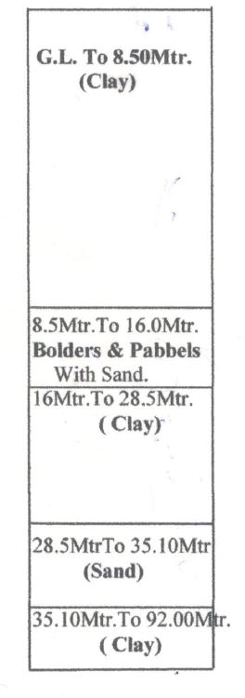
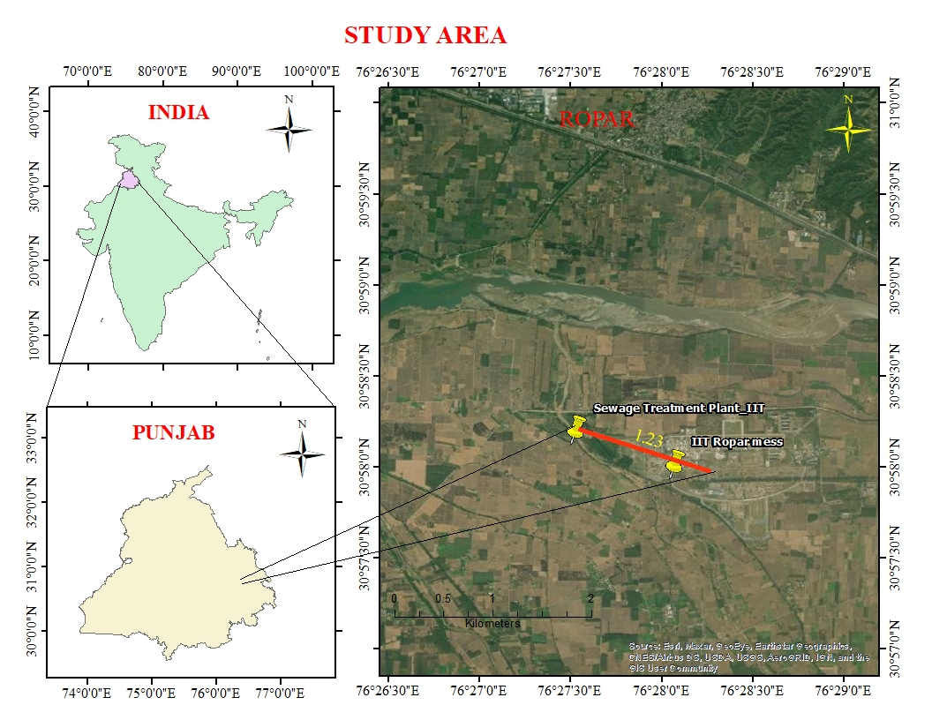
STUDY AREA
The study area originates from the IIT Ropar main campus (area = 113160 m²) with latitude 30^{ο}57’58.36” N and longitude 076^{ο}28’19.68” E, extending 1230 m towards a sewage treatment plant located at latitude 30ο58’12.18” N and longitude 076ο27’32.82” E. It is assumed that Cr(VI) is leaking from a stainless steel plant located at 300 m from the main campus. Cr(VI) being highly soluble is leaching through the ground and is contaminating the various soil layers and the groundwater located at a very shallow depth from the surface.
The soil profile ( figure 1b) was obtained from the piezometer drilling data at the IIT Ropar campus site ( figure 1a).
Figure 1a Index map of study area Figure 1b Vertical soil profile at selected site

Slide 5
METHODOLOGY

Slide 6
Batch Adsorption Study
150 mL Cr(VI) solution of initial concentration 2 mg/l was introduced into a 250mL Erlenmeyer flask which contained the desired quantity of adsorbent
The flask was then put in an rotatary shaker at 180 rpm for 3 hours at room temperature .
The mixture in each flask was filtered using vacuum filter and the final concentration of Cr(VI) in the filtrate was measured using UV spectrometer with the desired wavelength
The concentration of the filtrate determined using standard graph of the Cr(VI) based on beer-lambert law .

Slide 7
concentration | Absorbance
1 | 0.0832
2 | 0.1271
3 | 0.1656
4 | 0.2269
5 | 0.2965

Slide 8
The effect of changing pH on Cr(VI) was analyzed over a pH range from 2 to 11. The pH was adjusted using 0.1M HCl and 0.1M NaOH solutions. Using the optimum pH and optimum dose, the effect of contact time was analyzed.
Then by keeping all the obtained optimum parameters constant, the initial concentration of Cr(VI) was varied and the removal efficiencies were calculated in each case.
Each experiment was carried out twice for confirmation of the results.

Slide 9
ADSORPTION ISOTHERM
The equilibrium isotherm adsorption model is fundamental tool in depicting the interactive behaviour between the adsorbate and the adsorbent. Analysis of isotherm data is important for predicting the adsorption capacity of the adsorbent, which is one of the major parameters for the design of an adsorption system.
Two models were used to analyze the equilibrium adsorption data:
Langmuir and
Freundlitch

Slide 10
Results and discussion
SEM and EDS analysis of the topsoil
Batch adsorption study
Adsorption isotherms

Slide 11
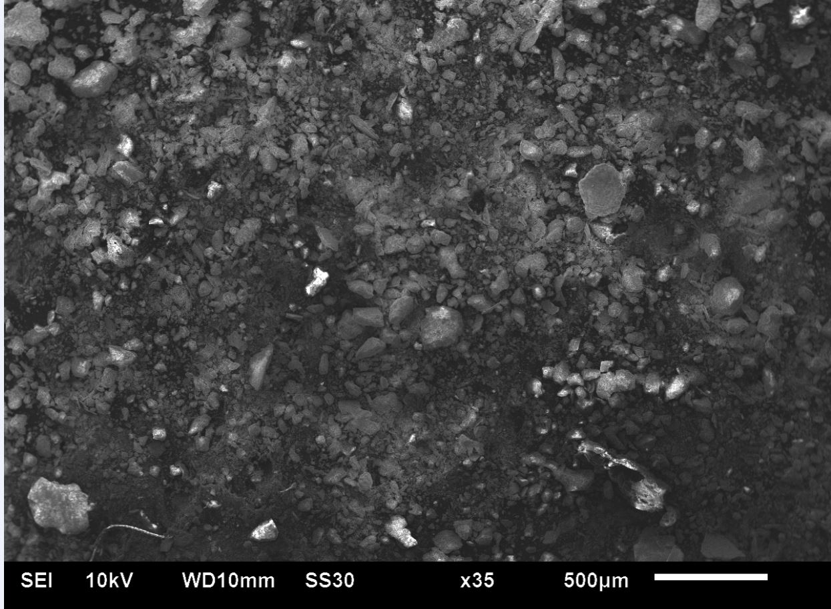
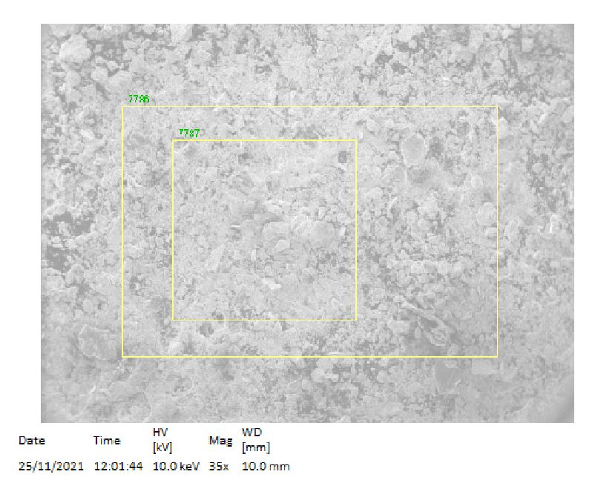
Sand
Clay
Figure 1a surface morphology of topsoil observed in Scanning electron microscopy
The SEM and EDS analysis(Figures 1a and 1b) was performed on the topsoil which shows the surface morphology of the soil particles and their chemical composition respectively. We observed that both clay and sand particles primarily constitute the soil. Figure above shows that the structures of the particles are irregular and flaky tending to form agglomerate.
Figure 1b selection of sites on the sample for performing chemical composition analysis

Slide 12
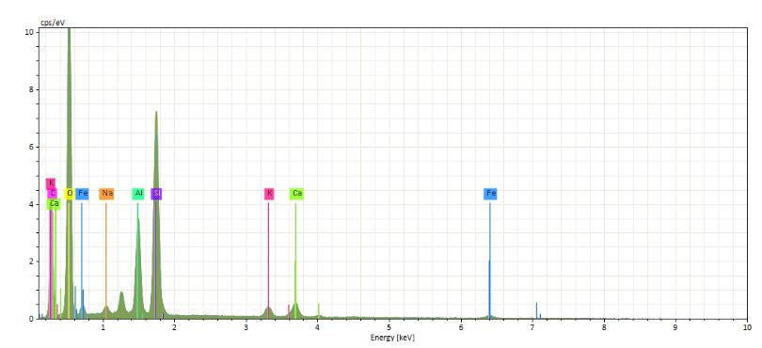
Table 1 Atomic concentration [%] of the topsoil
Spectrum | C | O | Na | Al | Si | K | Ca | Fe
7786 | 29.06 | 49.91 | 12.45 | 0.546 | 3.70 | 0.92 | 1.66 | 1.73
7787 | 23.39 | 52.45 | 15.19 | 0.58 | 3.82 | 0.94 | 1.69 | 1.94
The chemical composition showed the existence of Oxygen and Sodium to be 50% and 13% approximately. Iron was available in trace amounts (less than 2%) indicating low adsorption sites for efficient Cr(VI) attenuation. Trace amounts of Silicon and Calcium were also present in the soil. The carbon concentration came from the tape used in the study.
Hence, Cr(VI) may travel freely without much hindrance and further pollute the groundwater table located at shallow depth.
Figure 1c EDS spectrum of topsoil

Slide 13
Effect of change of soil dose on Cr(VI) adsorption efficiency
Initial concentration: 2mg/l
Initial pH : 7.23
Initial time of contact : 5 minutes
Variation of dose of soil: (1-25)gm
Increase of adsorption efficiency of soil and at dose of 5gm it shows maximum efficiency of 65.94% .
There is decrease of adsorption capacities with increase of dosage of soil (56.98-53.96)%.

Slide 14
Effect of change of pH on Cr(VI) adsorption efficiency
Initial concentration: 2mg/l
Initial time of contact : 5 minutes
Optimal dose of soil: 5gm
Variation of pH : 2.5-11
Highest adsorption efficiency is observed in acidic pH. At pH 2.5, the optimal adsorption efficiency is recorded (66.86%).
The efficiency continuously decreases with increase in pH. From pH 6-10, the adsorption efficiency ranges from 58% to 48% respectively.
At higher alkalinity, the efficiency drastically decreases to 10% approximately.

Slide 15
Effect of contact time on Cr(VI) adsorption efficiency
Initial concentration: 2mg/l
Optimal pH : 2.5
Optimal dose of soil: 5 gm
Variation of contact time : 5-35 minutes
Increase of adsorption efficiency from 68.54% in 5 mins to optimal removal efficiency of 69% is observed in 10 mins.
The adsorption efficiency starts to decrease after 10 mins. The efficiencies ranges from 50% to 17% with the passage of time and reaches the ultimate low of 14% after 35 mins.

Slide 16
Effect of change in concentration of Cr(VI) on its adsorption efficiency
Optimal pH : 2.5
Optimal dose of soil: 5 gm
Optimal contact time : 10 minutes
Variation of concentration- 1-7 mg/l
The adsorption efficiency of soil is maximum for concentration of 1mg/l of Chromium (71.2%)
With the increase in concentration, the adsorption efficiency ceases. For a concentration of 7mg/l, the adsorption efficiency is 52.8% .

Slide 17
Adsorption isotherms of Cr(VI) using natural soil as adsorbent
Langmuir monolayer adsorption capacity : 0.08 mg/gm
Langmuir constant : 2.49 l g/l
Freundlich adsorption isotherm :
Kf :0.05377
1/n : .724
The highest value of regression co-efficient is observed in Freundlich isotherm predominance of multilayer adsorption and the presence of heterogeneous adsorption surface. But the adsorption capacity is extremely low in this case.

Slide 18
CONCLUSIONS
The following conclusions can be derived from the study :
The topsoil has negligible Iron or Manganese content which resulted in low adsorption capacity .
For a concentration of 2mg/l concentration of Cr(VI) , maximum 69 % adsorption efficiency is achieved.
Both monolayer and multilayer adsorptions are predominant in this study.
The adsorption of Cr(VI) is pH dependent . The rate of formation of Chromate or dichromate is crucial to determine the contaminant plume.
For any accidental leakage of Cr(VI) from a stainless steel plant located nearby, the risk of contamination of the ambient groundwater is extremely high
Proper treatment mechanisms are required to delay the travel of the contaminant plume from polluting the shallow groundwater table.

Slide 19
References
Kan, C.C., Ibe, A.H., Rivera, K.K.P., and Arazo, R.O. (2017). Hexavalent chromium removal from aqueous solution by adsorbents synthesized from groundwater treatment residuals. Sustainable Environment Research, 163-171.
Liu, Y., Li, Y., Hu, Y., Mostofa, K.M.G., Li, S., and Liu, Z. (2019). Adsorption Characteristics and Transport Behaviour of Cr(VI) in Shallow Aquifers Surrounding a Chromium Ore Processing Residue (COPR) Dumpsite. Journal of Chemistry, 4932837.
Ye, T., Li, H., Wang , Z.H., Huang, R., Yu, Y., Yang, Z., Gao, C., and Xie , C.(2019). Transport and fate of hexavalent chromium in slag–soil system. Environmental Earth Sciences, 78:239.

Slide 20
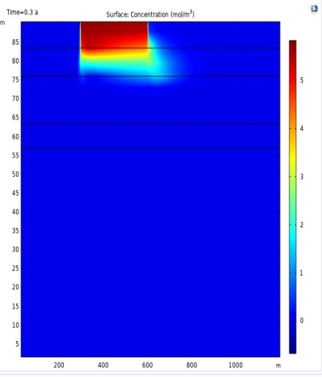
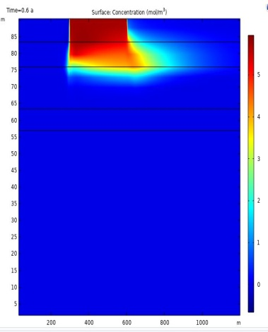
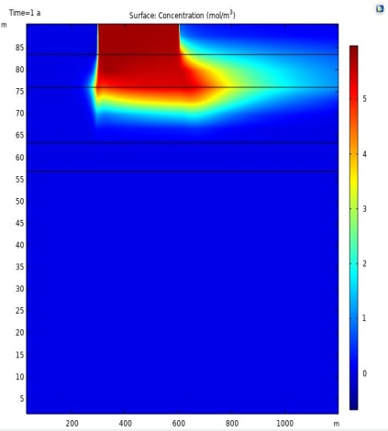
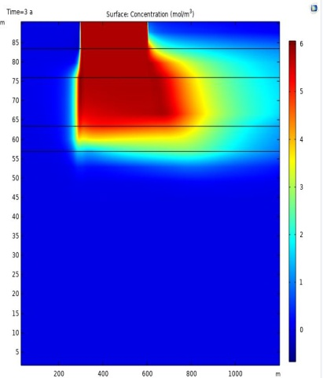
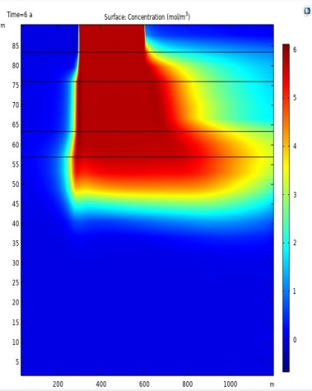
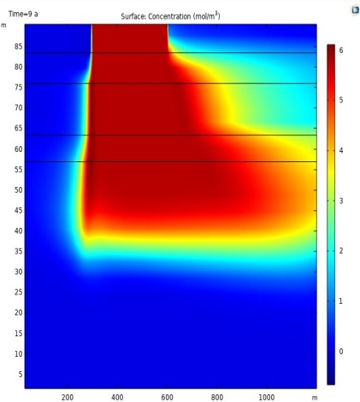
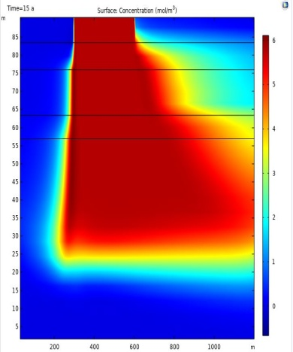
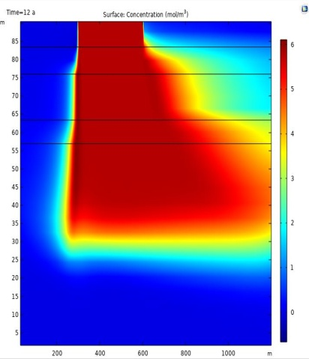
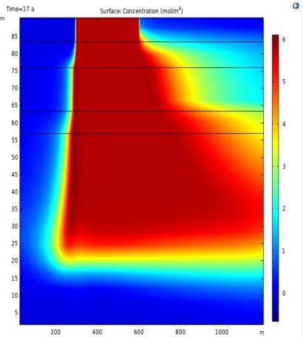
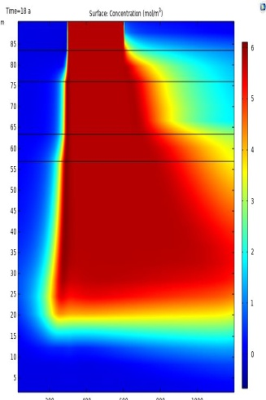

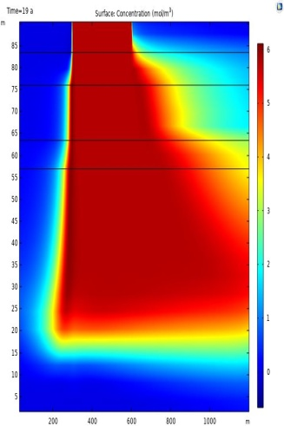
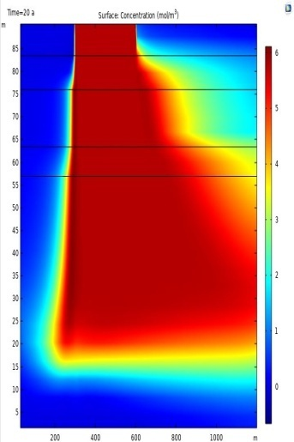
Transport of Cr(VI) in soil media when no adsorption occurs
Example
a
b
c
d
Transient spread of Cr(VI) plume observed for: a) 3 months b)6 months c) 1 year d)3 years e) 6 years f) 9 years g) 15 years
in 1 year, the plume travelled 22 m distance from the ground surface and reached around 77 m after 15 years
e
f
g

