Slide 1


Spatiotemporal patterns of crop diversity reveal potential for diversification in Swedish agriculture
Hanna Sjulgård¹, Tino Colombi¹, Thomas Keller^{1,2}
¹ Swedish University of Agricultural Sciences (SLU), Sweden
² Agroscope, Switzerland

Slide 2
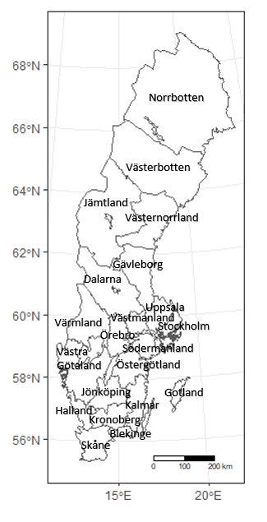
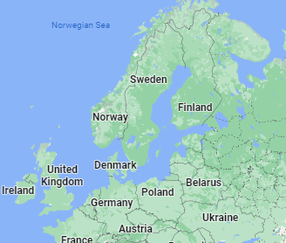
Aims
(i) to quantify spatiotemporal patterns of crop species diversity at the regional and national scale in Sweden
(ii) to examine relationships between crop diversity and climatic factors and soil texture
(Google maps)

Slide 3
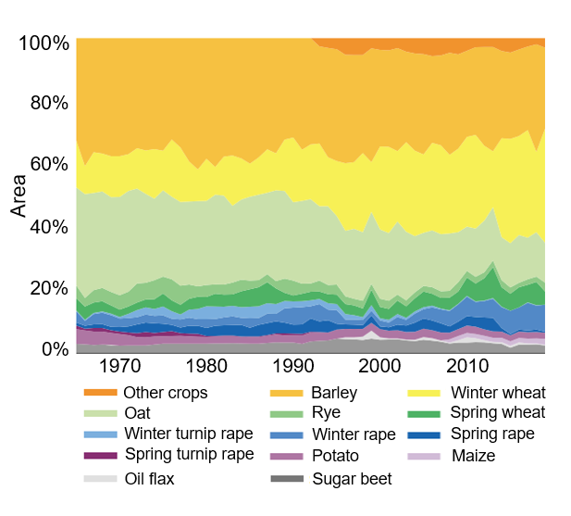
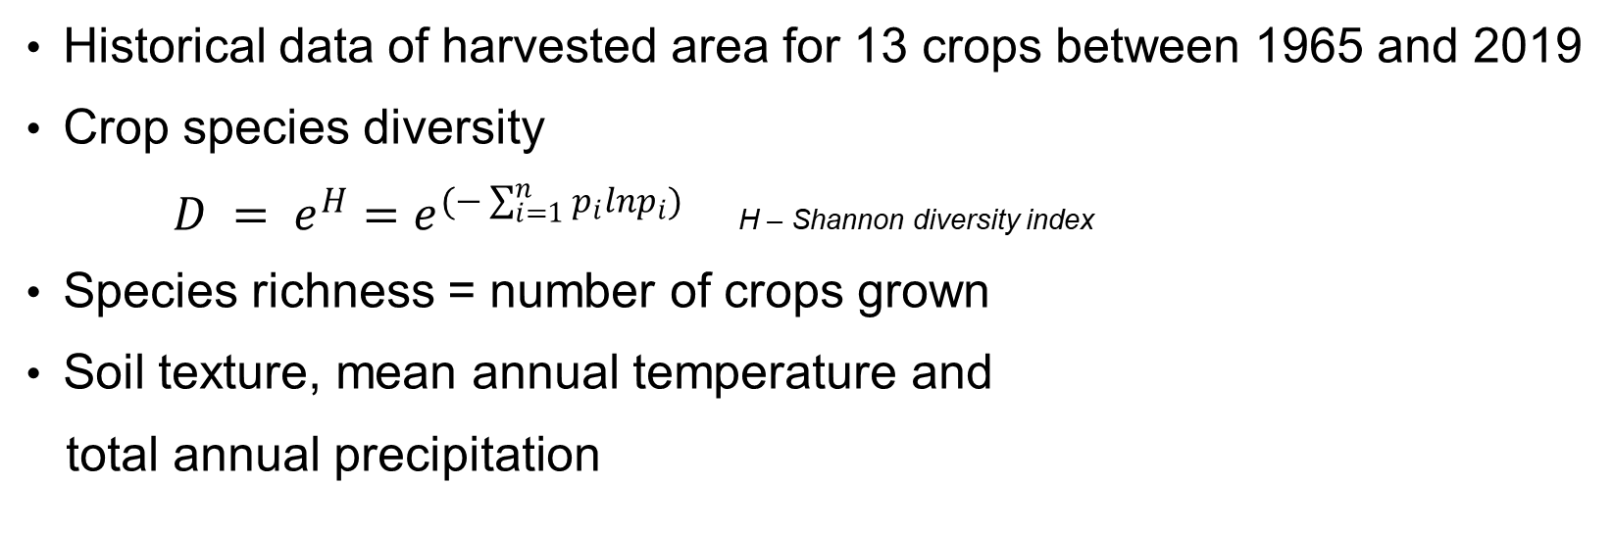
Materials and methods
Historical data of harvested area for 13 crops between 1965 and 2019
Crop species diversity
$D = e^{H}=e^{(−\sum_{i=1}^{n}{p_{i}ln}p_{i})}$ H – Shannon diversity index
Species richness = number of crops grown
Soil texture, mean annual temperature and
total annual precipitation

Slide 4
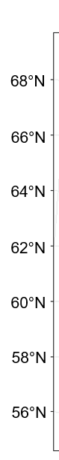
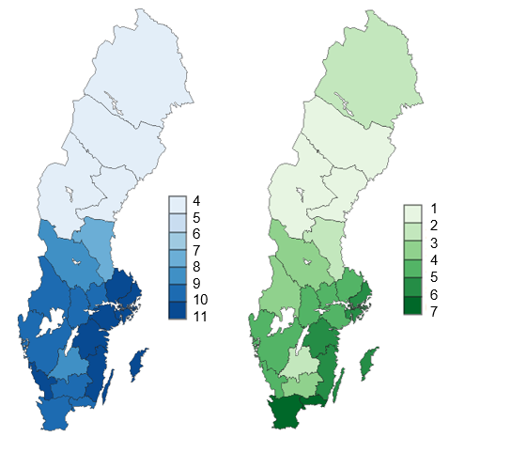
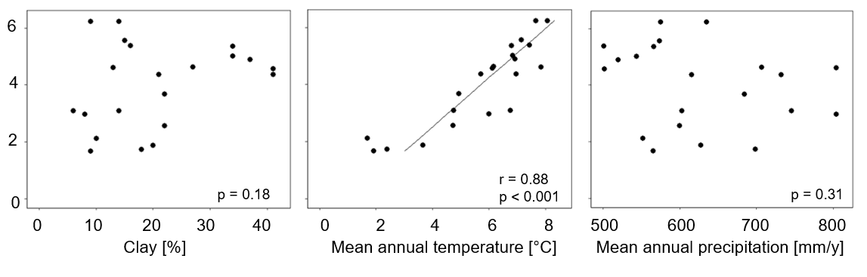
Richness (number of crops)
Crop diversity
Crop diversity

Slide 5
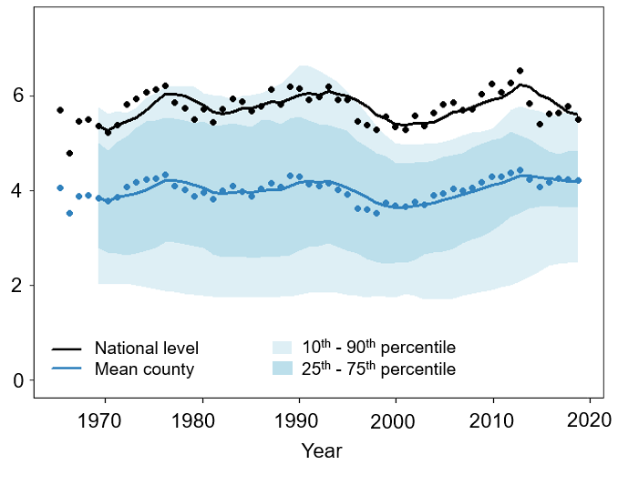
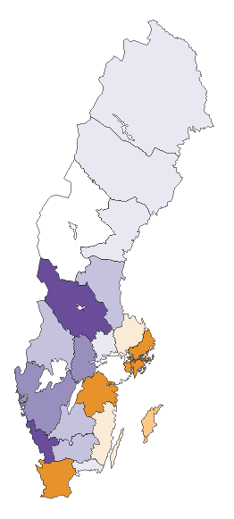

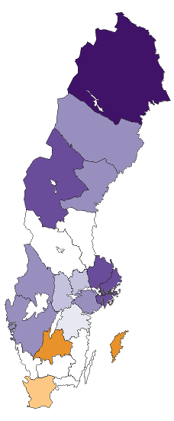
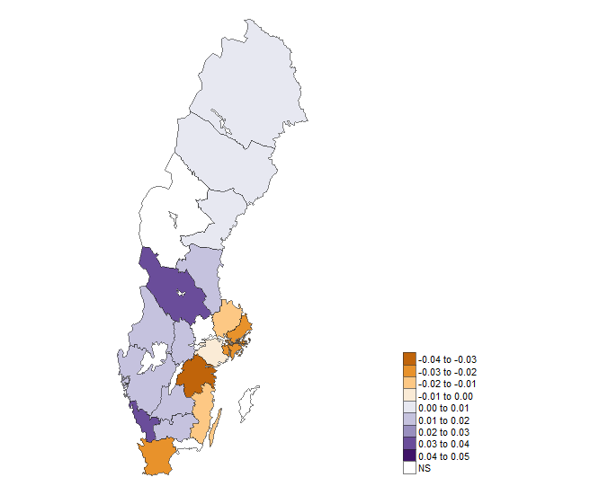
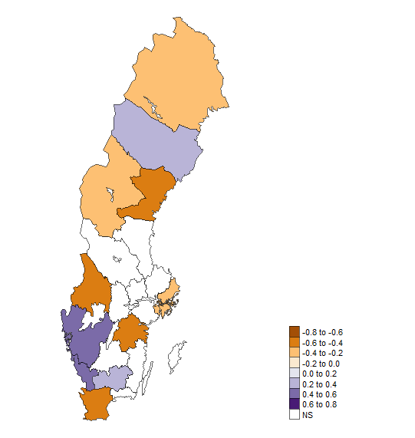
Temporal variation, 1956 - 2019
Slope of linear regression
richness vs time
crop diversity vs time
Crop diversity
Slope
-0.04
-0.03
-0.02
-0.01
0
0.01
0.02
0.03
0.04
0.05
NS

Slide 6
Conclusions
Natural factors (climate) strongly controls how many and which crops that can be grown
National scale - no change over time in crop diversity
Regional scale - different temporal trends between counties
The importance of scale analyzed
Temporal increase in several counties - possible to increase crop diversity

Slide 7
Thank you!
hanna.sjulgard@slu.se

