Slide 1



Competition for Carbon between Sinks Affect Seminal Root System Architecture in Maize
Israel Oren¹, Xavier Draye¹, Bertrand Muller²
EGU 2022
1
2

Slide 2
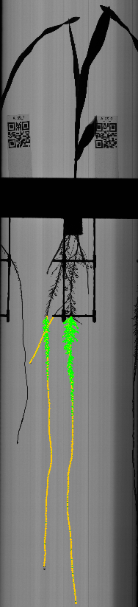
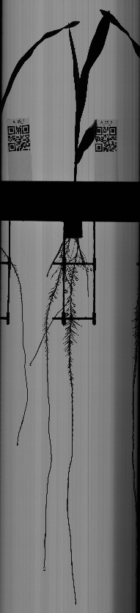
Introduction and methods
Maize root system architecture
Seminal: primary, seminals, laterals.
Laterals are not uniform -> reduced competition and increased carbon investment efficiency with regard to water and nutrient uptake.
Growing new roots demands carbon -> changes in carbon availability (e.g. due to stress or damage to roots) -> root architecture and physiology.
Research goal
Determine the effect of changes in carbon source and sink sizes on lateral root diversity in maize seminal root system.
Image acquiring and root tracing
Aeoroponics, images taken at high temporal and optical resolution.
Tracing using SmartRoot plugin in ImageJ -> dimensions and growth rates of individual lateral roots.
Lateral roots
Seminal roots
Primary root

Slide 3





Experimental design
High light
No excision
Low light
No excision
High light
Primary excised
High light
Seminals excised
Low light
Primary excised
Low light
Seminals excised
Seminal
Seminal
Seminal
Seminal
Seminal
Seminal
Seminal
Seminal
Seminal
Seminal
Seminal
Seminal
Primary
Primary
Primary
Primary
Primary
Primary
n = 5 plants treatment⁻¹

Slide 4
Results
Mean= 0.55 cm
Mean= 1.23 cm
Mean= 0.80 cm
Mean= 0.32 cm
n= 5 plants treatment⁻¹

Slide 5
Results
Mean= 1.04 cm
Mean= 1.09 cm
Seminal
Primary
Mean= 1.25 cm
Mean= 0.52 cm
Seminal
Primary
n= 5 plants treatment⁻¹

Slide 6
Discussion
  Competition for carbon between sinks shape root architecture and lateral root diversity.
  Shading and excision exposed the order of sink strengths:
  primary > shoot > seminals.
  Suggestion: breed for varieties a more uniform primary and seminals carbon sink sizes:
    To improve water and nutrient uptake in soil volume explored by the seminals through increased lateral root diversity.
    As a safety measure in case of catastrophic damage to the primary (to increase water and nutrient uptake and carbon allocation from the shoot to the remaining seminals).

