Slide 1
Peter Herzsprung, Wolf von Tümpling, Norbert Kamjunke, Oliver J. Lechtenfeld
Dissolved organic matter quality variations in drinking water reservoirs and their catchment waters – Scientific knowledge and research gaps
Schedule of cited references and abstracts

Slide 2
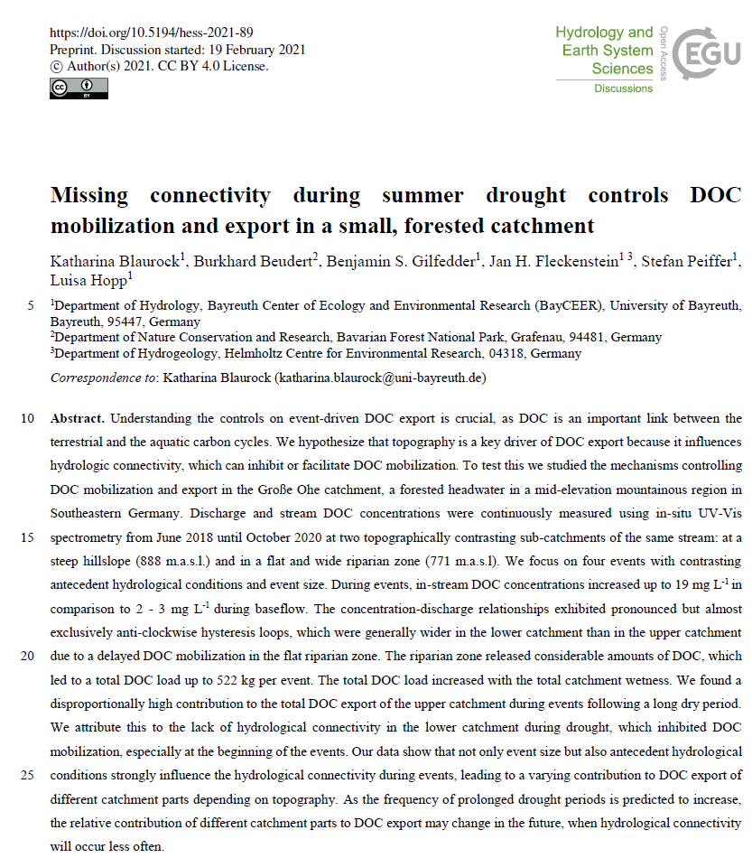
Reference 1

Slide 3
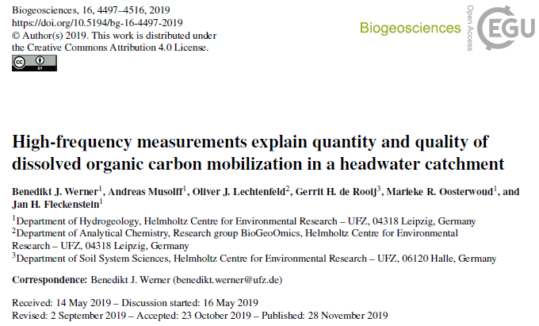
Reference 2
Abstract.
Increasing dissolved organic carbon (DOC) concentrations and exports from headwater catchments impact the quality of downstream waters and pose challenges to water supply. The importance of riparian zones for DOC export from catchments in humid, temperate climates has generally been acknowledged, but the hydrological controls and biogeochemical factors that govern mobilization of DOC from riparian zones remain elusive. A high-frequency dataset (15 min resolution for over 1 year) from a headwater catchment in the Harz Mountains (Germany) was analyzed for dominant patterns in DOC concentration (CDOC) and optical DOC quality parameters SUVA254 and S275􀀀295 (spectral slope between 275 and 295 nm) on event and seasonal scales. Quality parameters and CDOC systematically changed with increasing fractions of high-frequency quick flow (Qhf) and antecedent hydroclimatic conditions, defined by the following metrics: aridity index (AI60) of the preceding 60 d and the quotient of mean temperature (T30) and mean discharge (Q30) of the preceding 30 d, which we refer to as dischargenormalized temperature (DNT30). Selected statistical multiple linear regression models for the complete time series (R2 D 0:72, 0.64 and 0.65 for CDOC, SUVA254 and S275􀀀295, resp.) captured DOC dynamics based on event (Qhf and baseflow) and seasonal-scale predictors (AI60, DNT30). The relative importance of seasonal-scale predictors allowed for the separation of three hydroclimatic states (warm and dry, cold and wet, and intermediate). The specific DOC quality for each state indicates a shift in the activated source zones and highlights the importance of antecedent conditions and their impact on DOC accumulation and mobilization in the riparian zone. The warm and dry state results in high DOC concentrations during events and low concentrations between events and thus can be seen as mobilization limited, whereas the cold and wet state results in low concentration between and during events due to limited DOC accumulation in the riparian zone. The study demonstrates the considerable value of continuous high-frequency measurements of DOC quality and quantity and its (hydroclimatic) key controlling variables in quantitatively unraveling DOC mobilization in the riparian zone. These variables can be linked to DOC source activation by discharge events and the more seasonal control of DOC production in riparian soils.

Slide 4
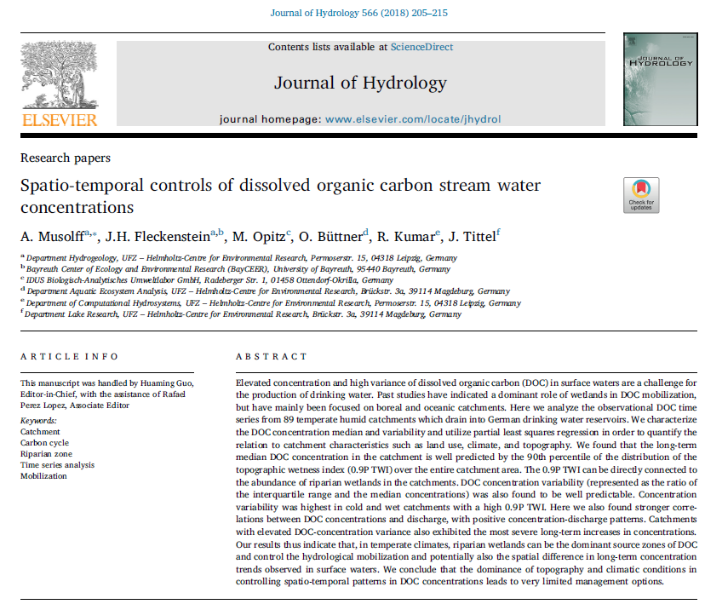
Reference 3

Slide 5
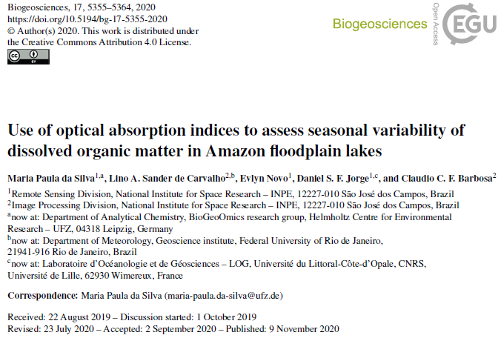
Reference 4
Abstract.
Given the importance of dissolved organic matter (DOM) in the carbon cycling of aquatic ecosystems, information on its seasonal variability is crucial. In this study we assess the use of optical absorption indices available in the literature based on in situ data to both characterize the seasonal variability of DOM in a highly complex environment and for application in large-scale studies using remote sensing data. The study area comprises four lakes located in the Mamirauá Sustainable Development Reserve (MSDR). Samples for the determination of colored dissolved organic matter (CDOM) and measurements of remote sensing reflectance (Rrs) were acquired in situ. The Rrs was used to simulate the response of the visible bands of the Sentinel-2 MultiSpectral Instrument (MSI), which was used in the proposed models. Differences between lakes were tested using the CDOM indices. The results highlight the role of the flood pulse in the DOM dynamics at the floodplain lakes. The validation results show that the use of the absorption coefficient of CDOM (aCDOM) as a proxy of the spectral slope between 275 and 295 nm (S275–295) during rising water is worthwhile, demonstrating its potential application to Sentinel-2 MSI imagery data for studying DOM dynamics on the large scale.

Slide 6
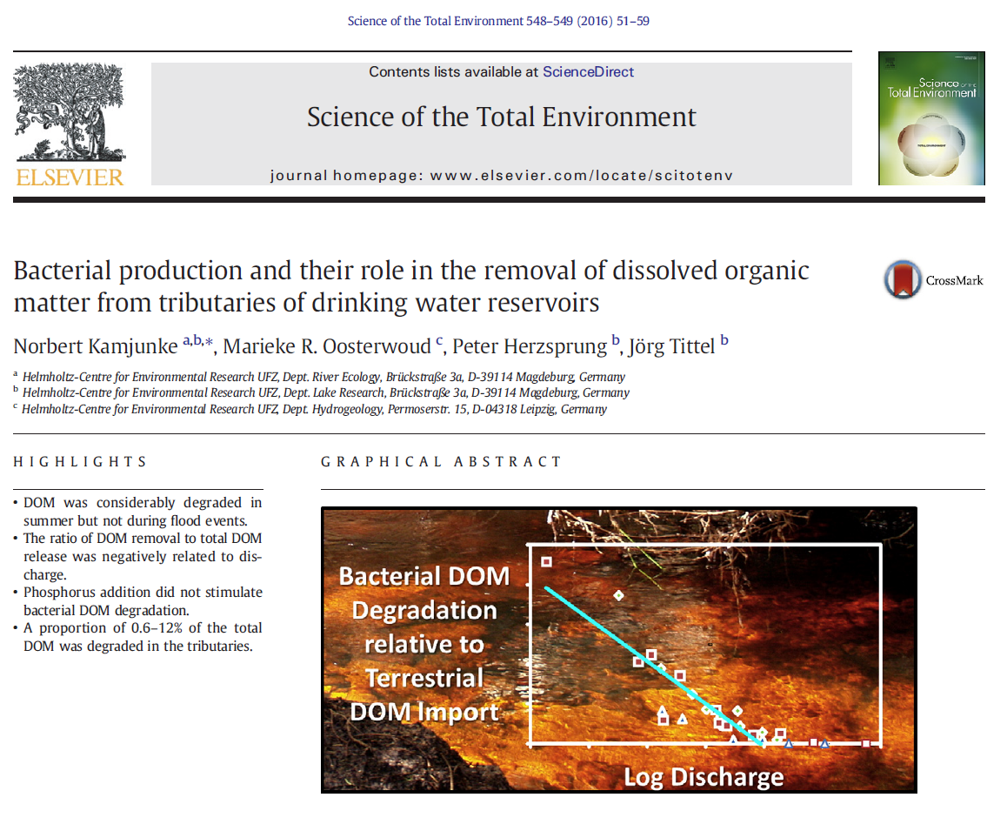
Reference 5

Slide 7
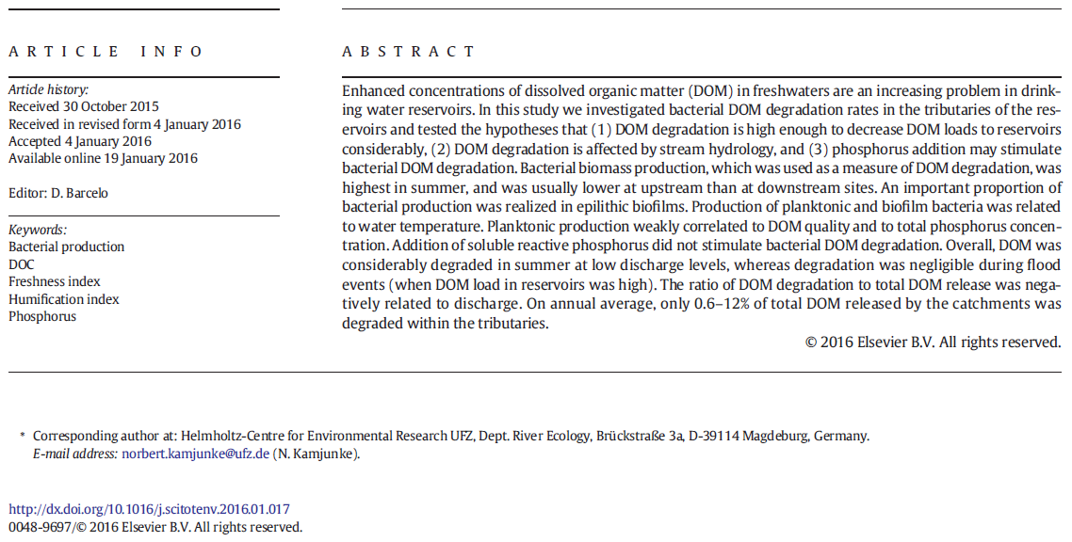
Reference 5

Slide 8
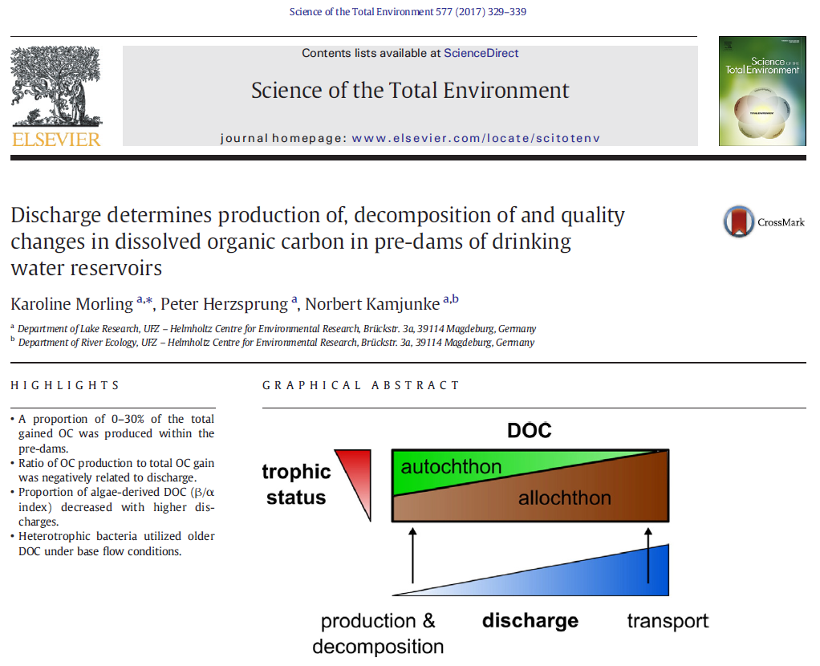
Reference 6

Slide 9
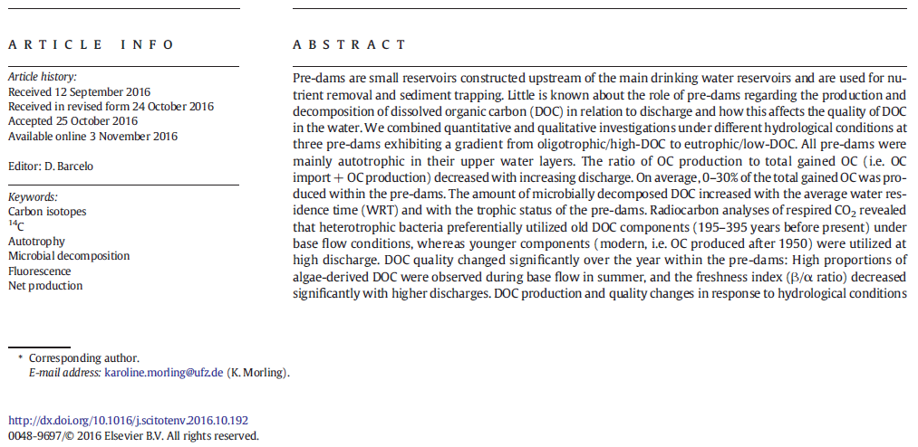
Reference 6

Slide 10
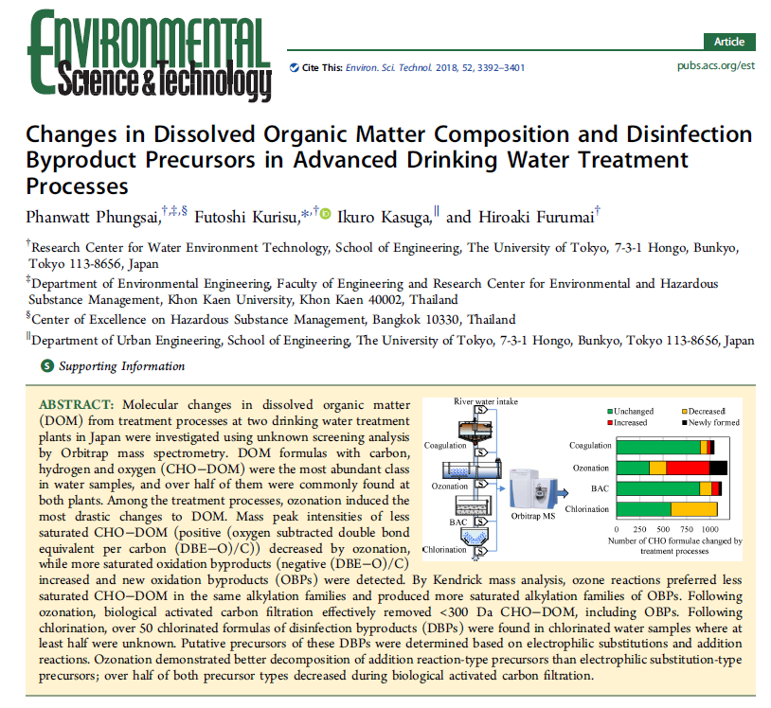
Reference 7

Slide 11
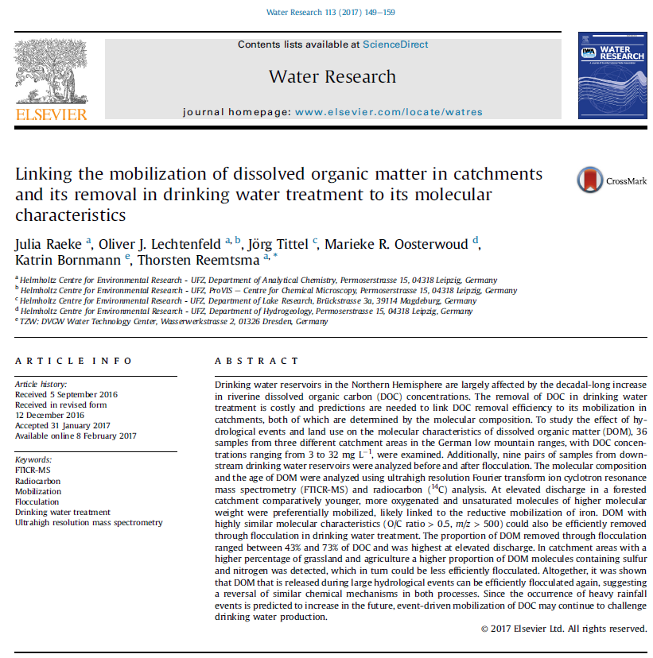
Reference 8

Slide 12
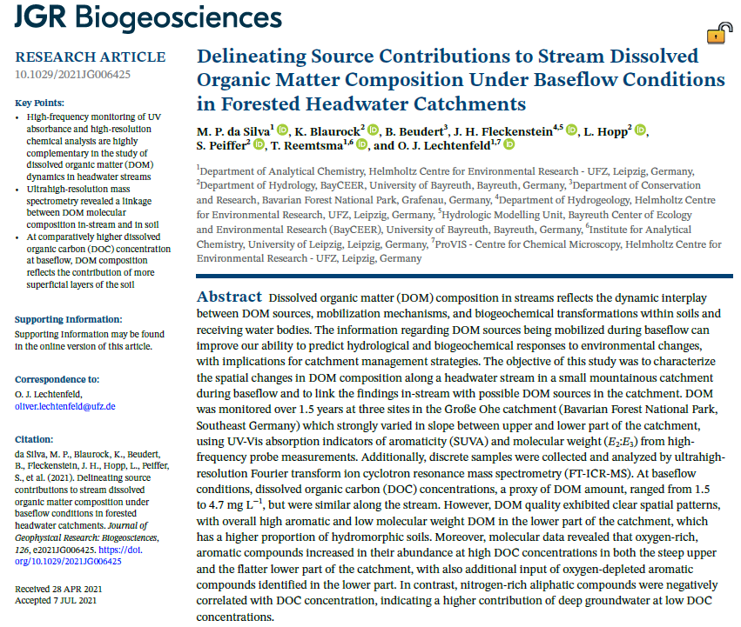
Reference 9

Slide 13

Reference 10

Slide 14
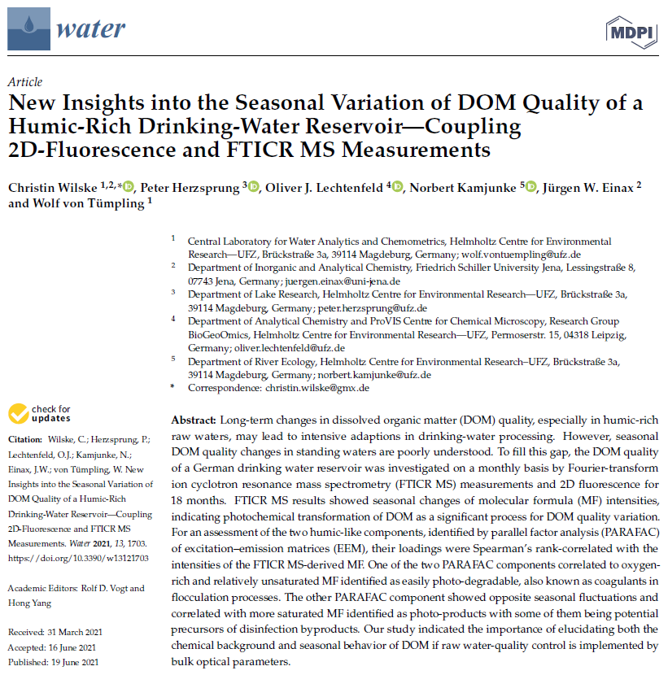
Reference 11

Slide 15
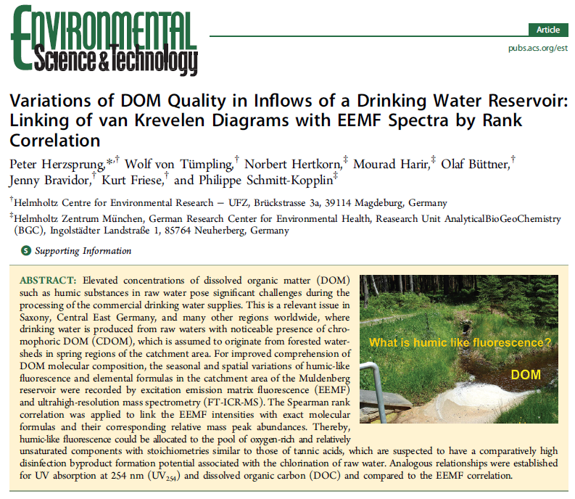
Additional Reference

