Slide 1
Tracing N₂O formation in full-scale wastewater treatment with natural abundance isotopes
Team Empa: Joachim Mohn, Kerstin Zeyer
Team Eawag: Wenzel Gruber, Eberhard Morgenroth, Adriano Joss
Team University of Basel: Paul Magyar, Moritz F. Lehmann
Team ETH: Luzia von Känel, Daniel Braun
Funded by FOEN, SNSF, cantons: Bern, Basel-Landschaft, Thurgau, Zürich,
companies: TBF+Partner AG Consulting Engineers, Holinger AG, Hunziker Betatech AG, Alpha Wassertechnik AG, arabern WWTP , REAL Luzern WWTP, Cham WWTP (GVRZ), ERZ Zürich, Giubiasco WWTP, Entsorgung St. Gallen and Uster WWTP.

Slide 2
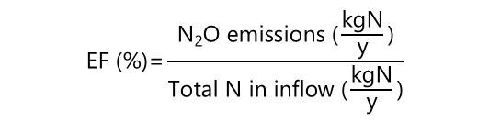
Relevance of N₂O emissions from wastewater treatment
Introduction:
Nitrogen removal in WWTP: Microbial conversion of N-input (NH₄⁺, R-NH₂) to N₂
Problem: Co-emissions of N₂O; emission factor
IPCC emission factors based on few campaigns and not treatment specific.
$$\text{EF}\text{ (\%)=}\frac{\text{N}\text{2}\text{O} \text{emissions}\text{ (}\frac{\text{kgN}}{\text{y}}\text{)}}{\text{Total} \text{N} \text{in} \text{inflow}\text{ (}\frac{\text{kgN}}{\text{y}}\text{)}}$$
Research questions:
Provide N₂O emission estimates for treatment processes (relevant for CH)?
Identify microbial processes and parameters relevant for temporal variations?
Develop strategies for emission reduction?

Slide 3
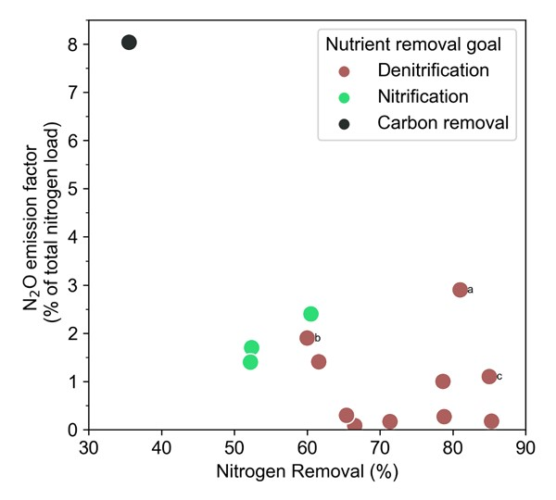
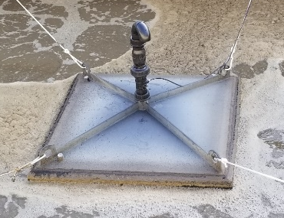
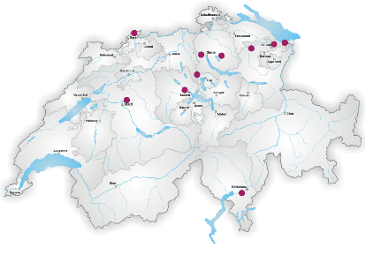
Specific N₂O emission factors for treatment processes
Techniques
Sampling via multiple floating flux chambers and central analytics
Campaigns
Campaigns at 10 different WWTP in Switzerland
From EF (N₂O) to Swiss emissions
Nutrient removal categories:
Carbon removal: 0-1 – 8%
Nitrification only: 1.8%
Denitrification: 0.9%
x N-load per category
= 410 – 1690 t N2O-N/yr-1
≈1% Swiss GHG emissions
What are responsible microbial processes?
W. Gruber et al. (2020), Science of the Total Environ., https://doi.org/10.25678/0003WD
W. Gruber et al. (2021), Water Research X, https://doi.org/10.1016/j.wroa.2021.100122

Slide 4
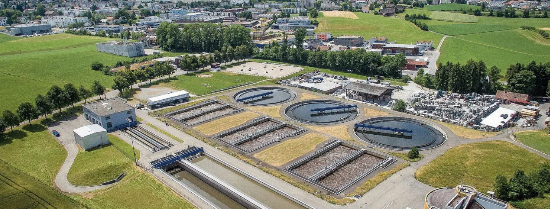
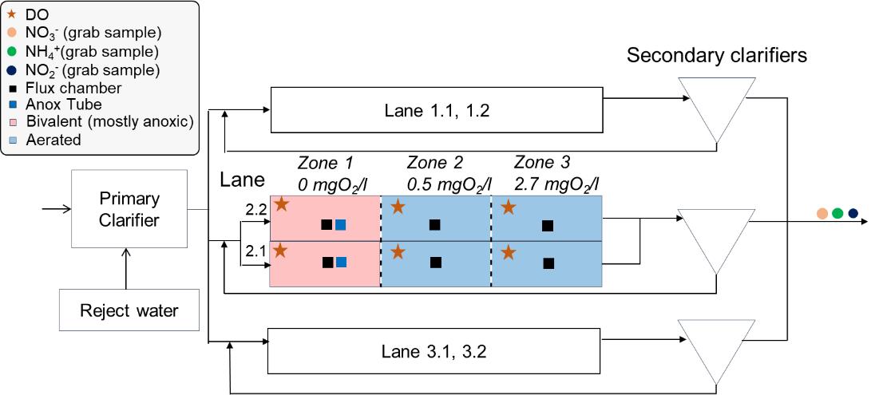
Isotope study: St. Gallen - Hofen WWTP
W. Gruber et al. (2022), Water Research X, https://doi.org/10.1016/j.wroa.2022.100130

Slide 5
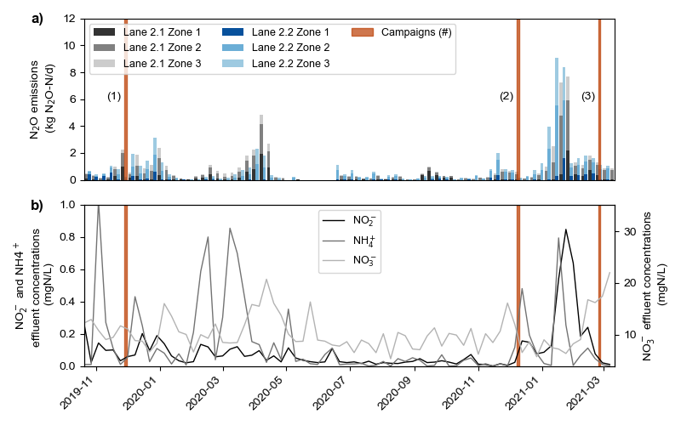
Temporal patterns and driving parameters
Average emissions rather low, EF (N₂O): 0.2%
Highest emissions in “cold season” controlling EF (N₂O) – all lanes fully aerated!
Emissions correlated with NO₂⁻ / NO₃⁻ in effluent (and anti-correlated with N-removal efficiency)
W. Gruber et al. (2022), Water Research X, https://doi.org/10.1016/j.wroa.2022.100130

Slide 6
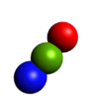
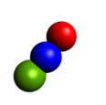
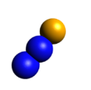
Isotope campaigns
N₂O isotopomer analysis
Bag sampling and TREX-QCLAS analysis
SP=δ¹⁵N^{α}-δ¹⁵N^{β}, δ¹⁵N, δ¹⁸O
Isotope analysis of N species
NH₄⁺: δ¹⁵N by hypobromite method
NO₂⁻: δ¹⁵N, δ¹⁸O by azide method
NO₃⁻: δ¹⁵N, δ¹⁸O by denitrifier method
δ¹⁸O of water
high temperature carbon reduction (TC/EA) and IRMS analysis
W. Gruber et al. (2022), Water Research X, https://doi.org/10.1016/j.wroa.2022.100130

Slide 7
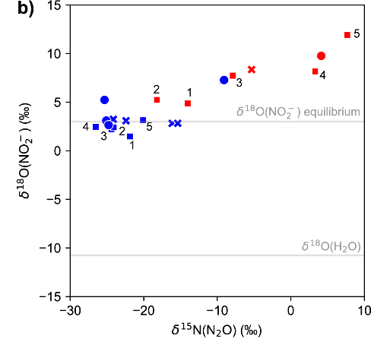
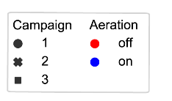

Microbial process attribution by isotopes (exemplary results)
Reactive N-species
(NO₂⁻)
δ¹⁸O(NO₂⁻) - δ¹⁸O(H₂O) ≈ 13‰
Complete oxygen exchange of nitrite with water
δ¹⁸O(H₂O) good proxy for δ¹⁸O(NO₂⁻)
For anoxic conditions (aeration off)
δ¹⁸O(NO₂⁻) increased due to enhanced consumption
N₂O isotopomers
Aerated conditions: low SP values indicate nD or hD as main N₂O production pathway,
no contribution of Ni
Anoxic conditions: increasing SP values indicate partial N₂O reduction
Ni
nitrification
nD
nitrifier
denitrification
hD
denitrification
W. Gruber et al. (2022), Water Research X, https://doi.org/10.1016/j.wroa.2022.100130

Slide 8
Conclusions / Reduction strategies / Future plans
N₂O from WWTP relevant GHG source (≈ 1% Swiss GHG emissions)
Highest emissions mostly occur in cold season, when NO₂⁻ accumulates
Isotopes indicate emissions mainly by (heterotrophic) denitrification
Reduction strategies
Maximize N₂O reduction
by optimizing reject water dosage (to diurnal variation of organic substrate)
avoiding aeration of zone 1 (which reduces N₂O reduction / increases emissions)
Future
On-line isotope analyses for qualitative N₂O pathway identification
To develop targeted N₂O mitigation strategies for individual WWTPs
Thank you for listening!
If you are interested check publications of Wenzel Gruber (Eawag)

