Slide 1






Water dynamics in karst soil: Modelling matrix and preferential flow using reservoir cascade scheme approach
Mirna Švob^{1*}, David Domínguez-Villar², Kristina Krklec¹
1University of Zagreb, Faculty of Agriculture, Zagreb, Croatia
2University of Salamanca, Faculty of Sciences, Salamanca, Spain
*msvob@agr.hr
Acknowledgments: This work is part of the research project “Inter-comparison of karst denudation measurement methods” (KADEME, IP-2018-01-7080) and “Young Researchers’ Career Development Project – Training New Doctoral Students” (DOK-2018-09-5748) financed by Croatian Science Foundation

Slide 2
Reservoir cascade scheme
Precipitation
Preferential flows!!!
Atmosphere
FC 1
FC 2
Evapotranspiration
Soil
Percolation
Evapotranspiration
Percolation
Carbonate bedrock

Slide 3
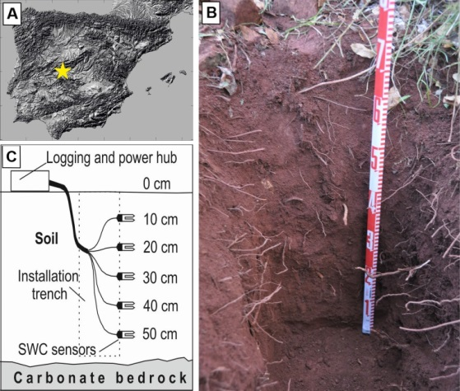
Simulation of soil water content and recharge
0.6 m deep soil profile on dolomite marbles, central Spain
cave system
six soil layers
simulation of soil water content and recharge

Slide 4
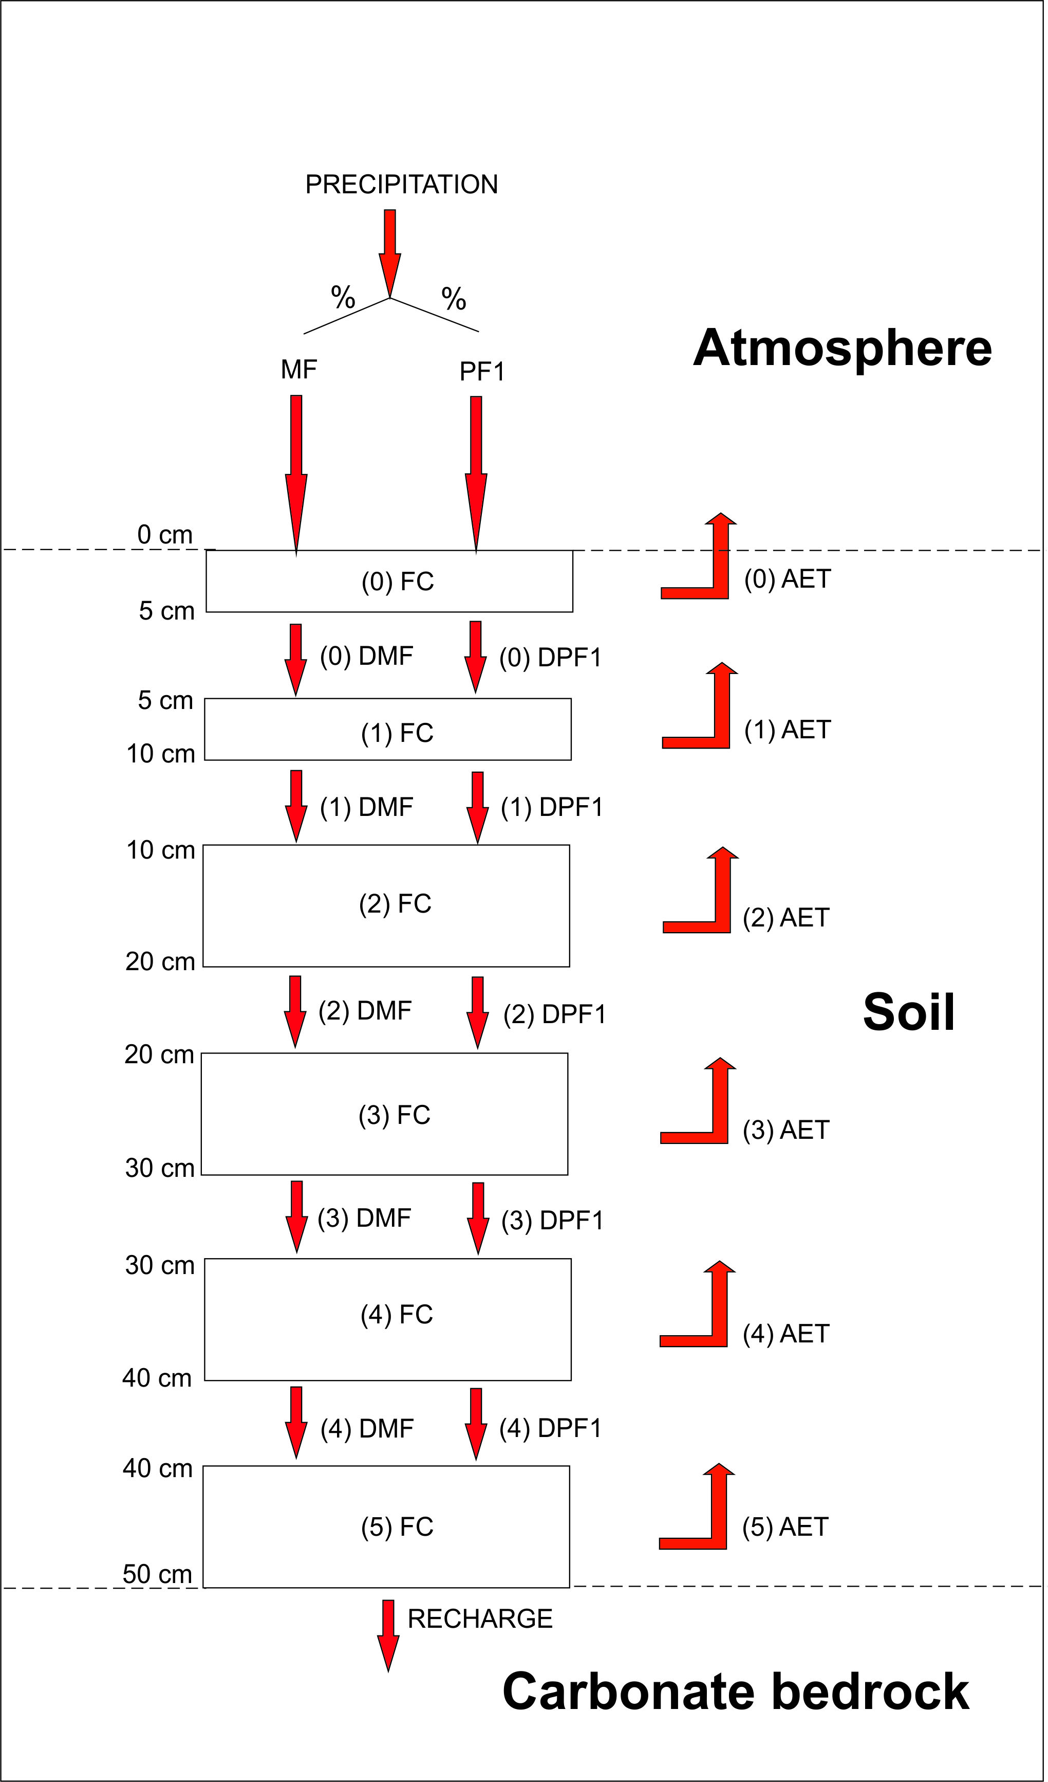
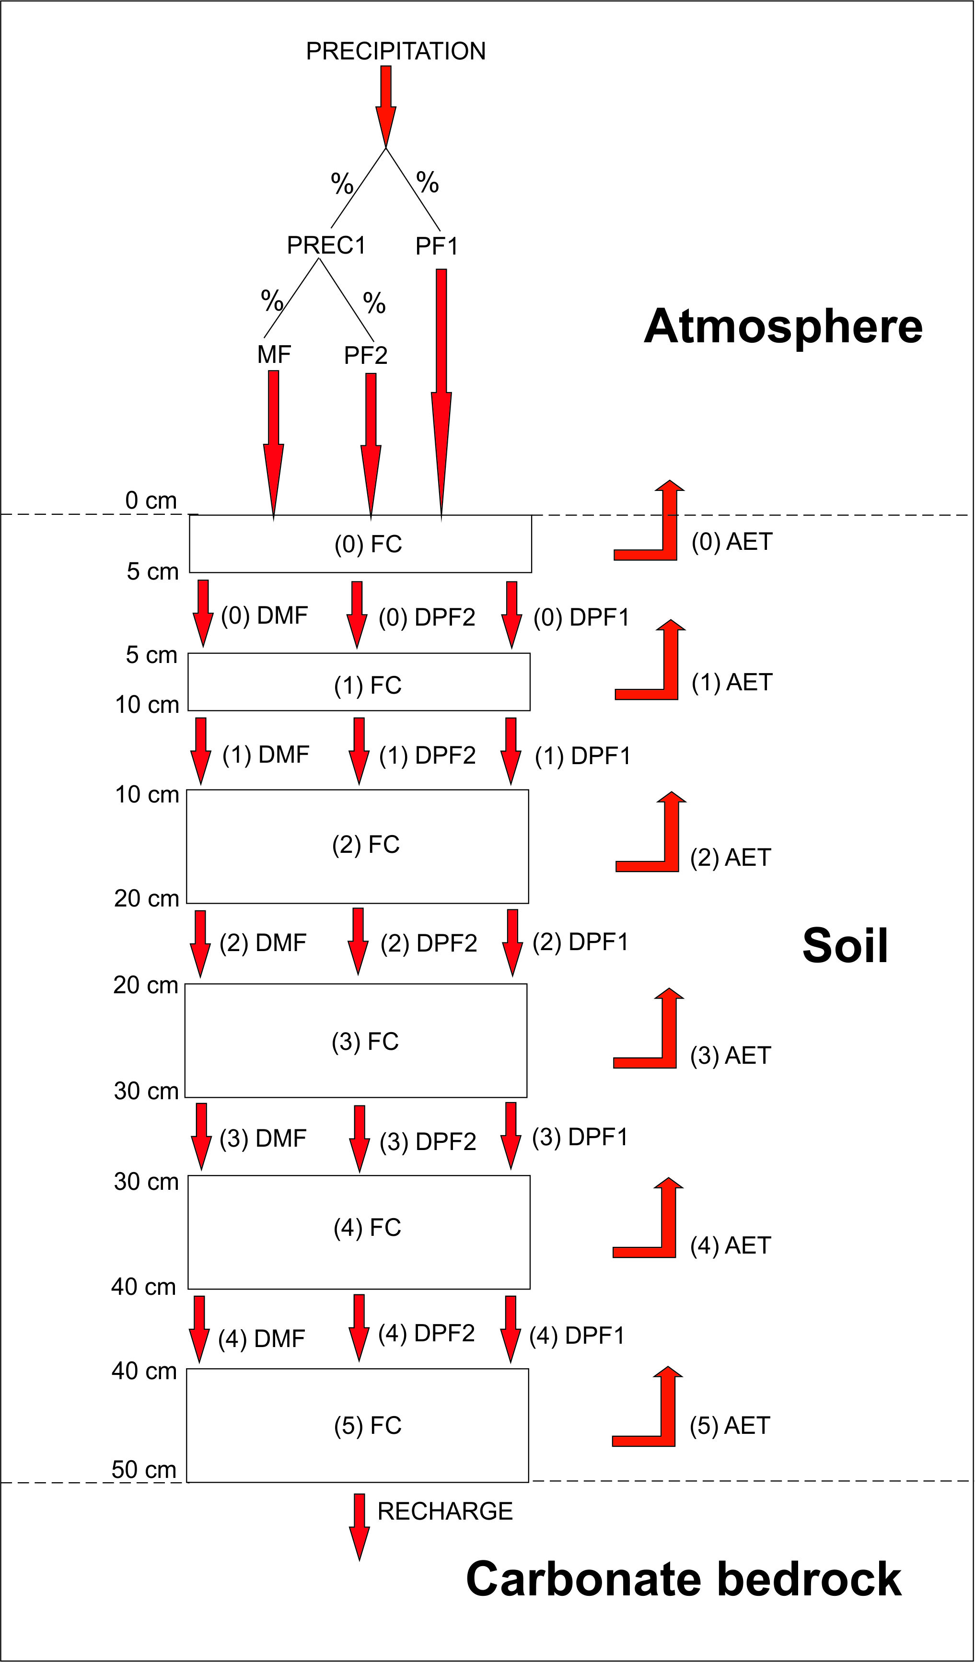
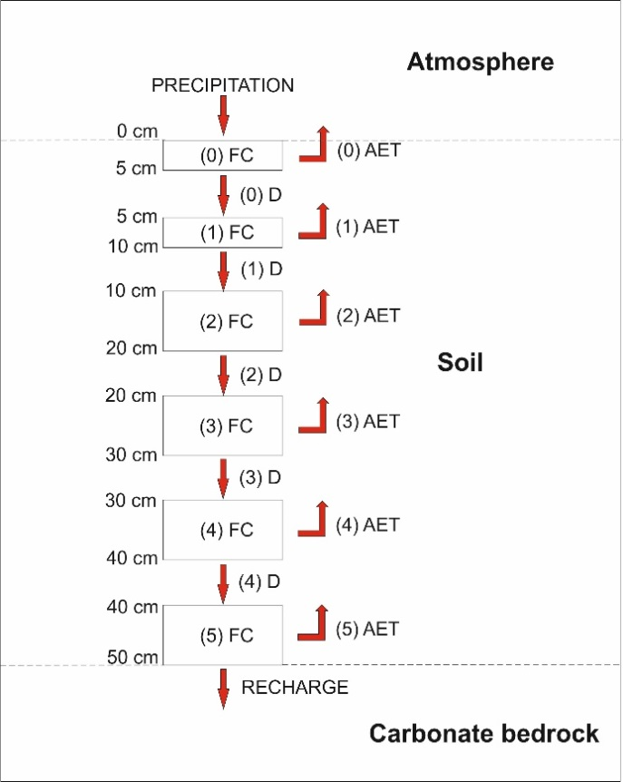
Model configurations

Slide 5
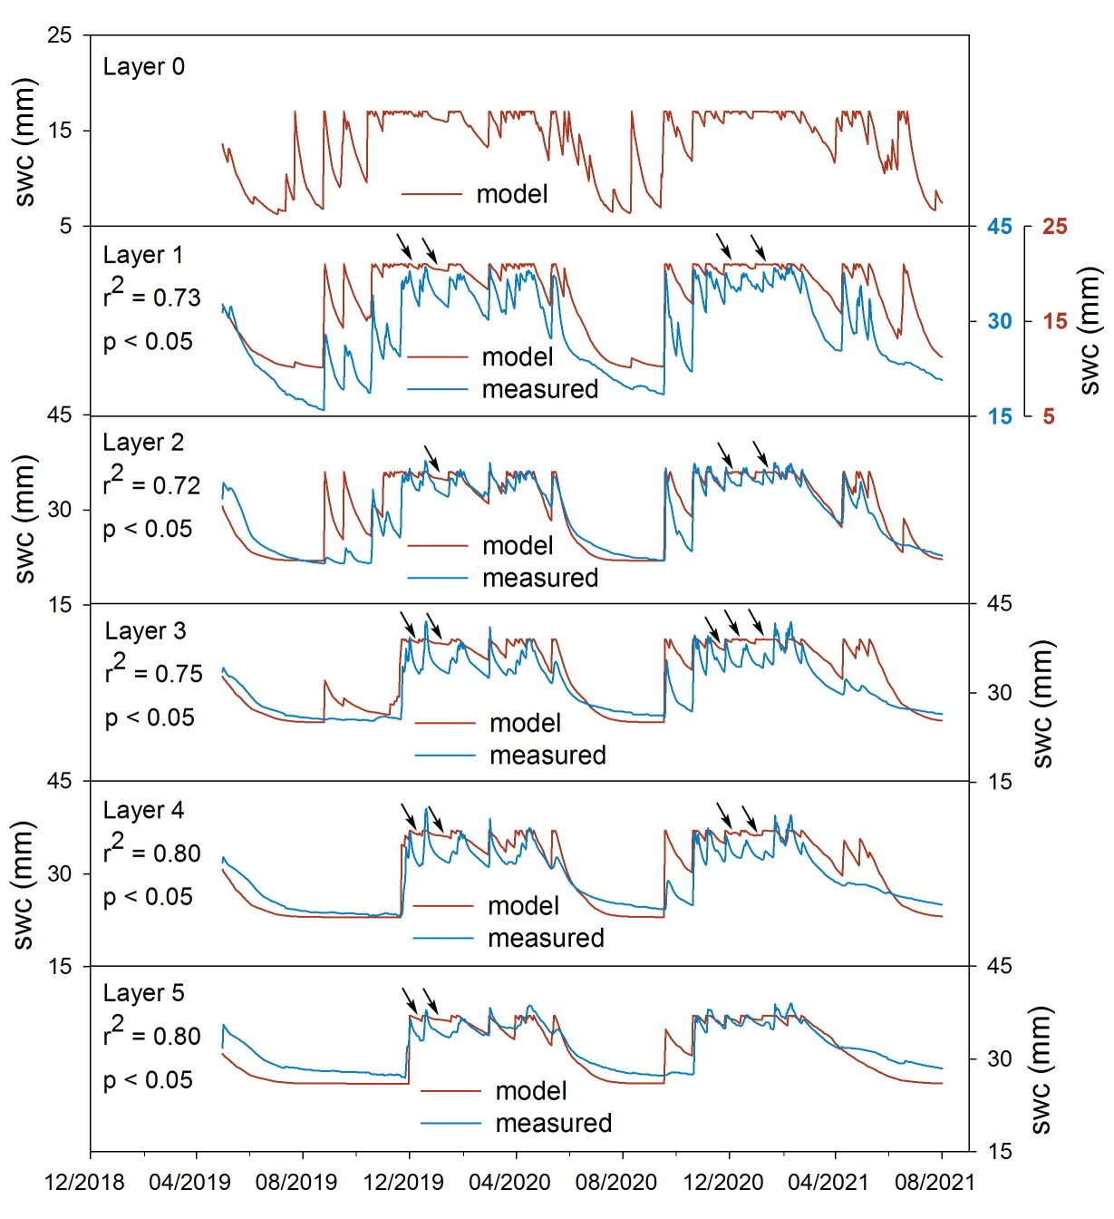
Configuration 1

Slide 6
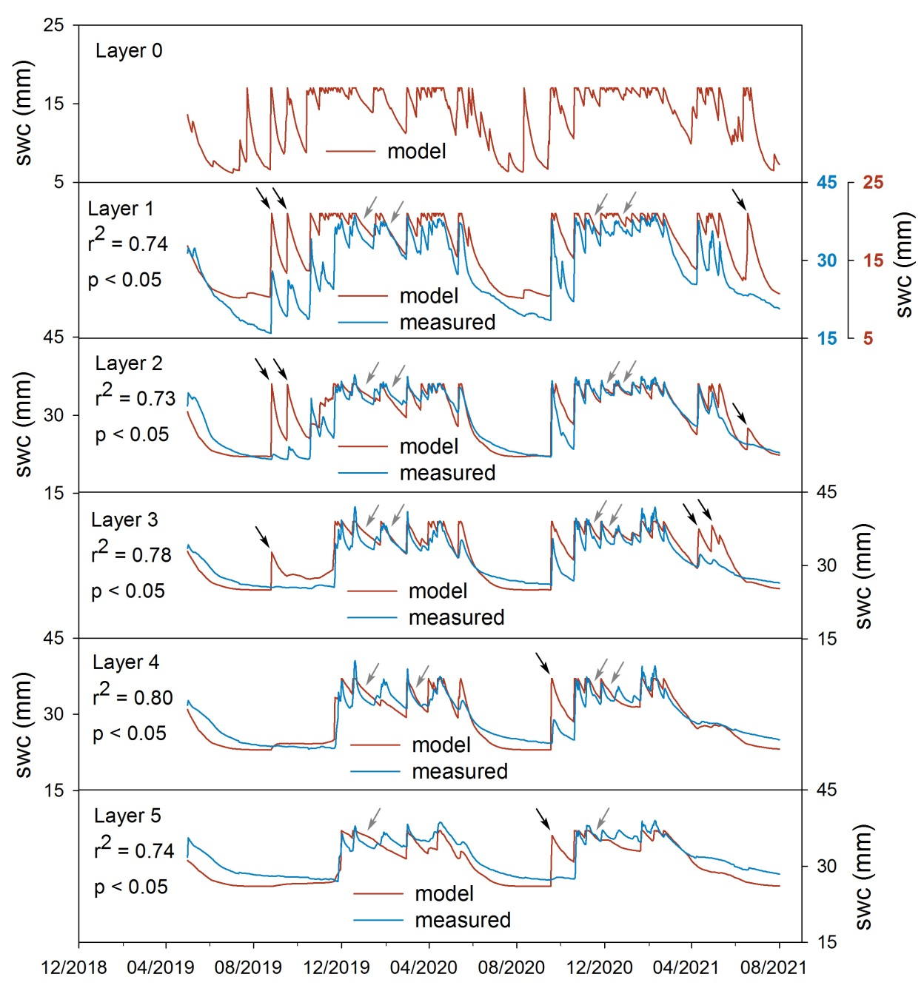
Configuration 2

Slide 7
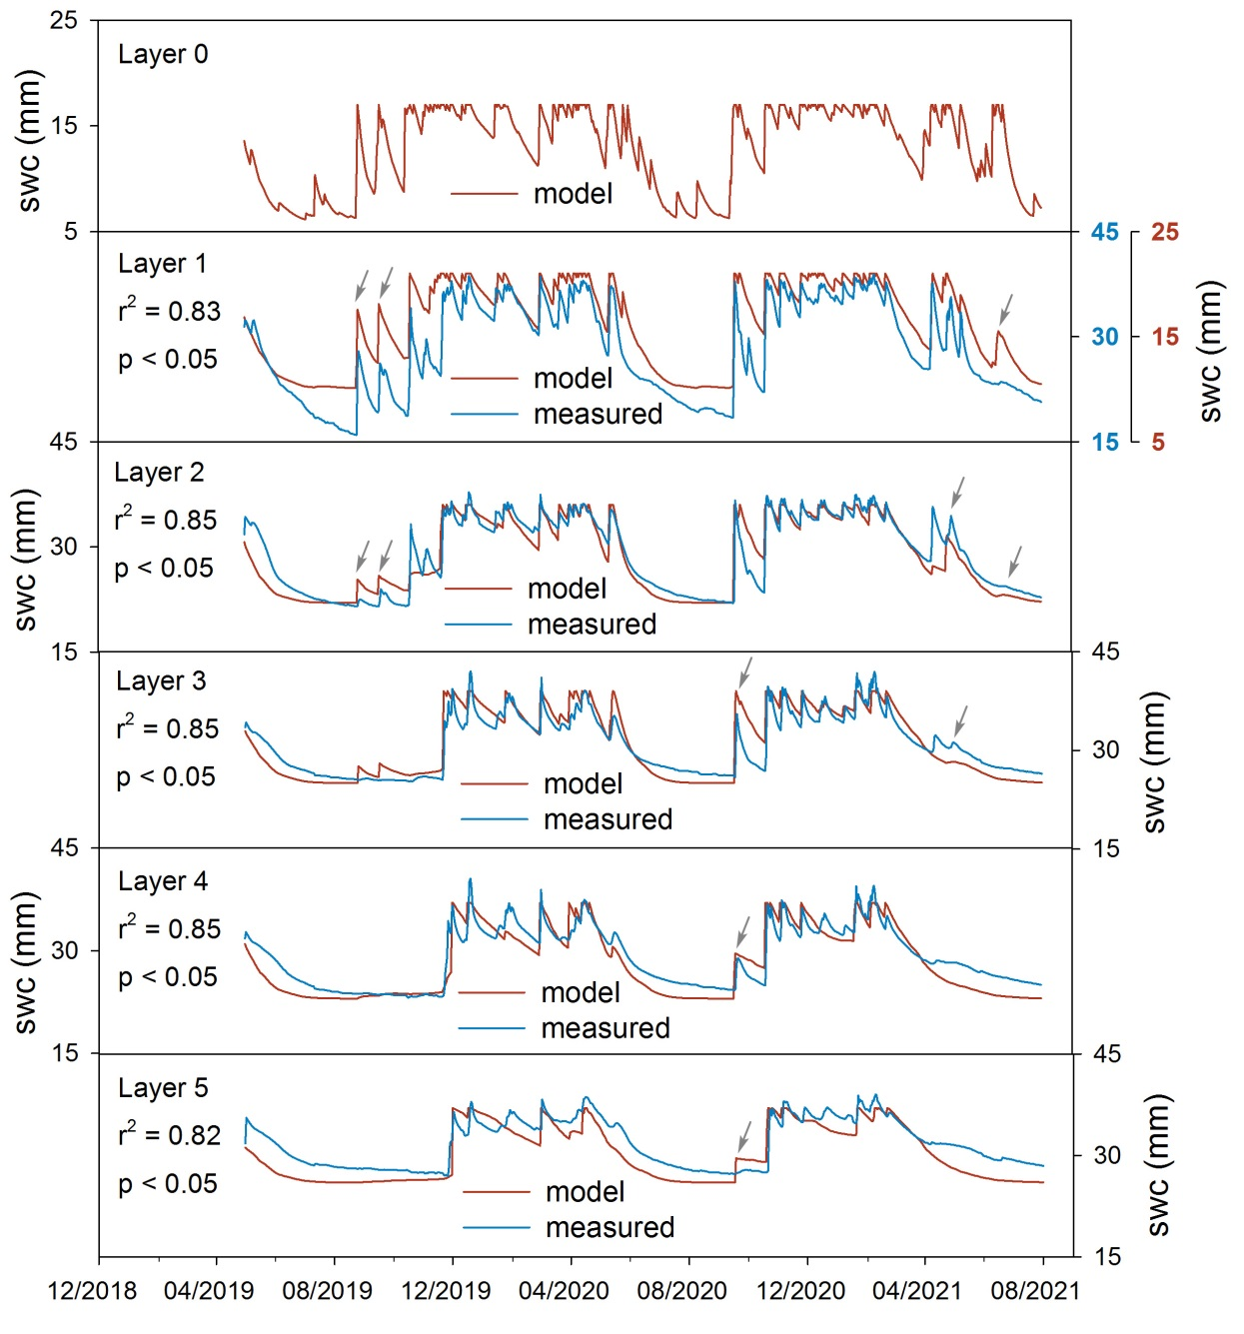
Configuration 3

Slide 8
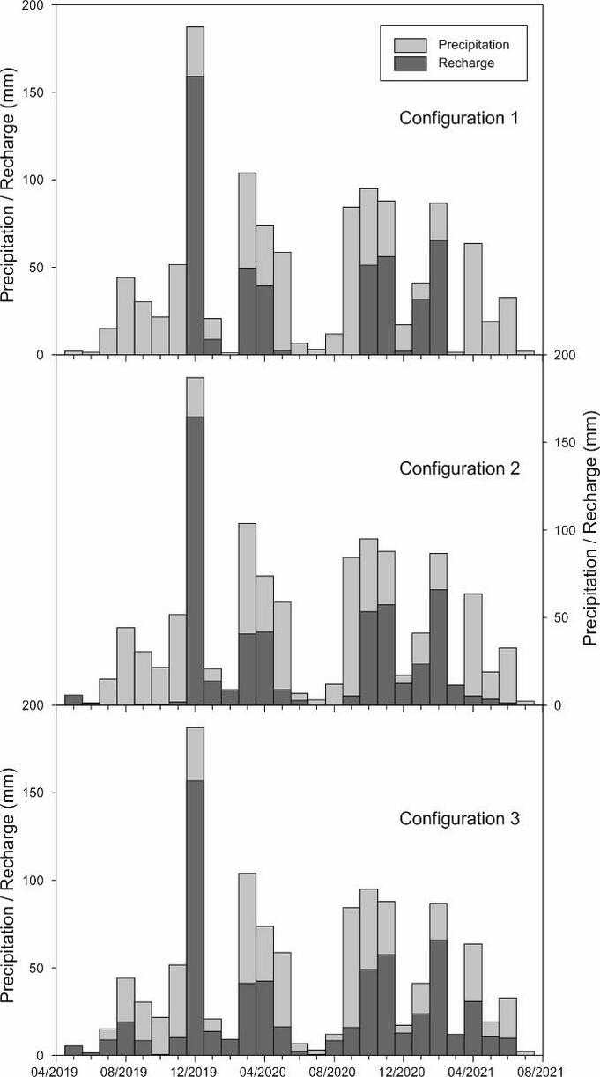
Recharge estimation

Slide 9
Conclusions
Configuration 3 provides the best results
3 types of water flow – matrix flow + continuous preferential flow + discontinuous preferential flow
preferential flows significantly contribute to recharge

