Slide 1
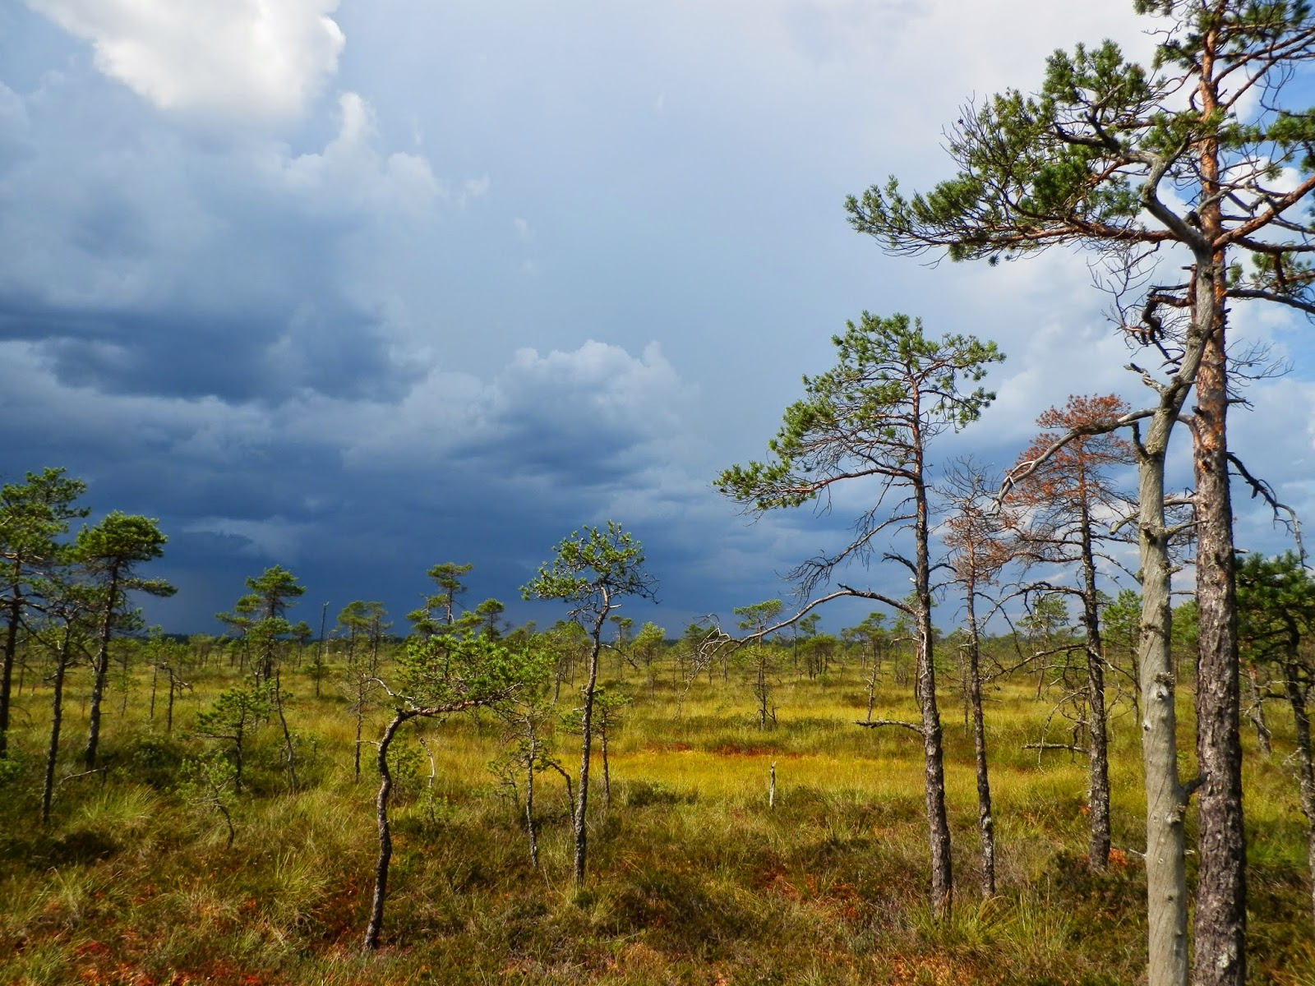


Reliability of Sentinel-1 InSAR distributed scatterer (DS) time series to estimate the temporal vertical movement of ombrotrophic bog surface
Tauri Tampuu, Francesco De Zan, Robert Shau, Jaan Praks, Marko Kohv and Ain Kull

Slide 2
Is radar satellite (SAR) reliable in estimating bog surface height changes?

Slide 3
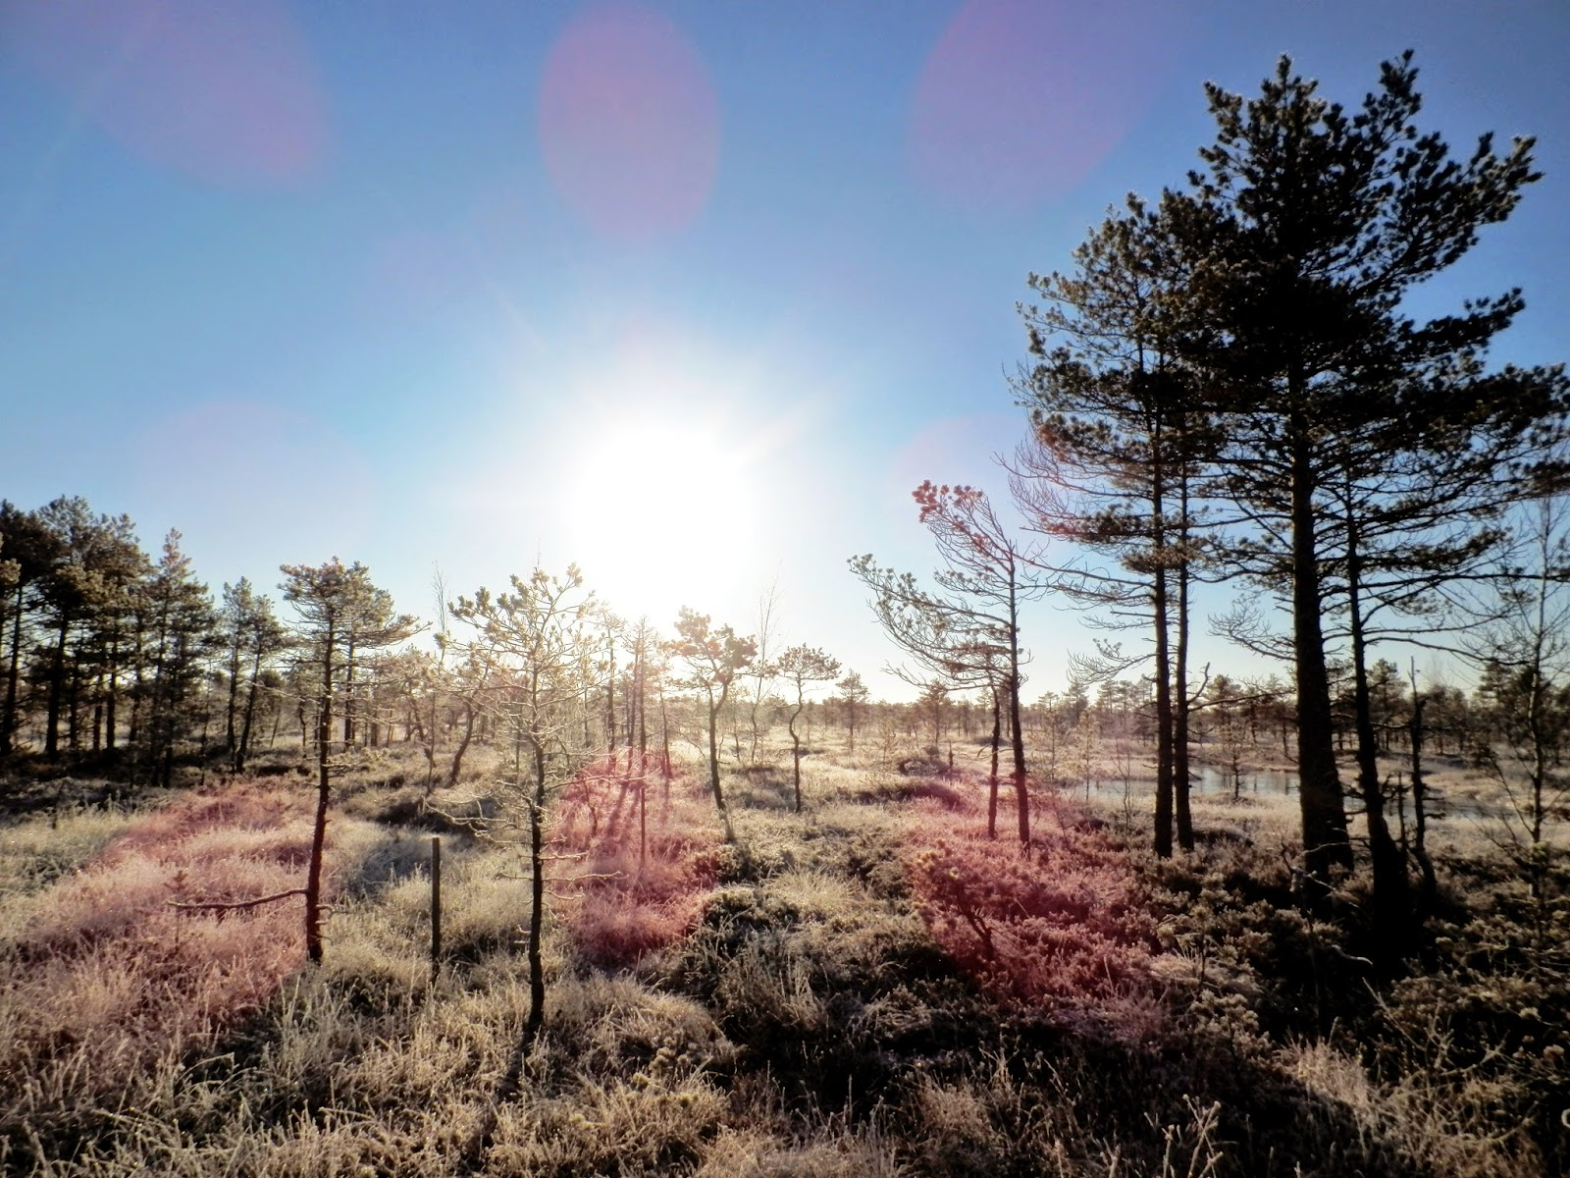
Peatland soils contain 0.5 x carbon in the atmosphere

Slide 4
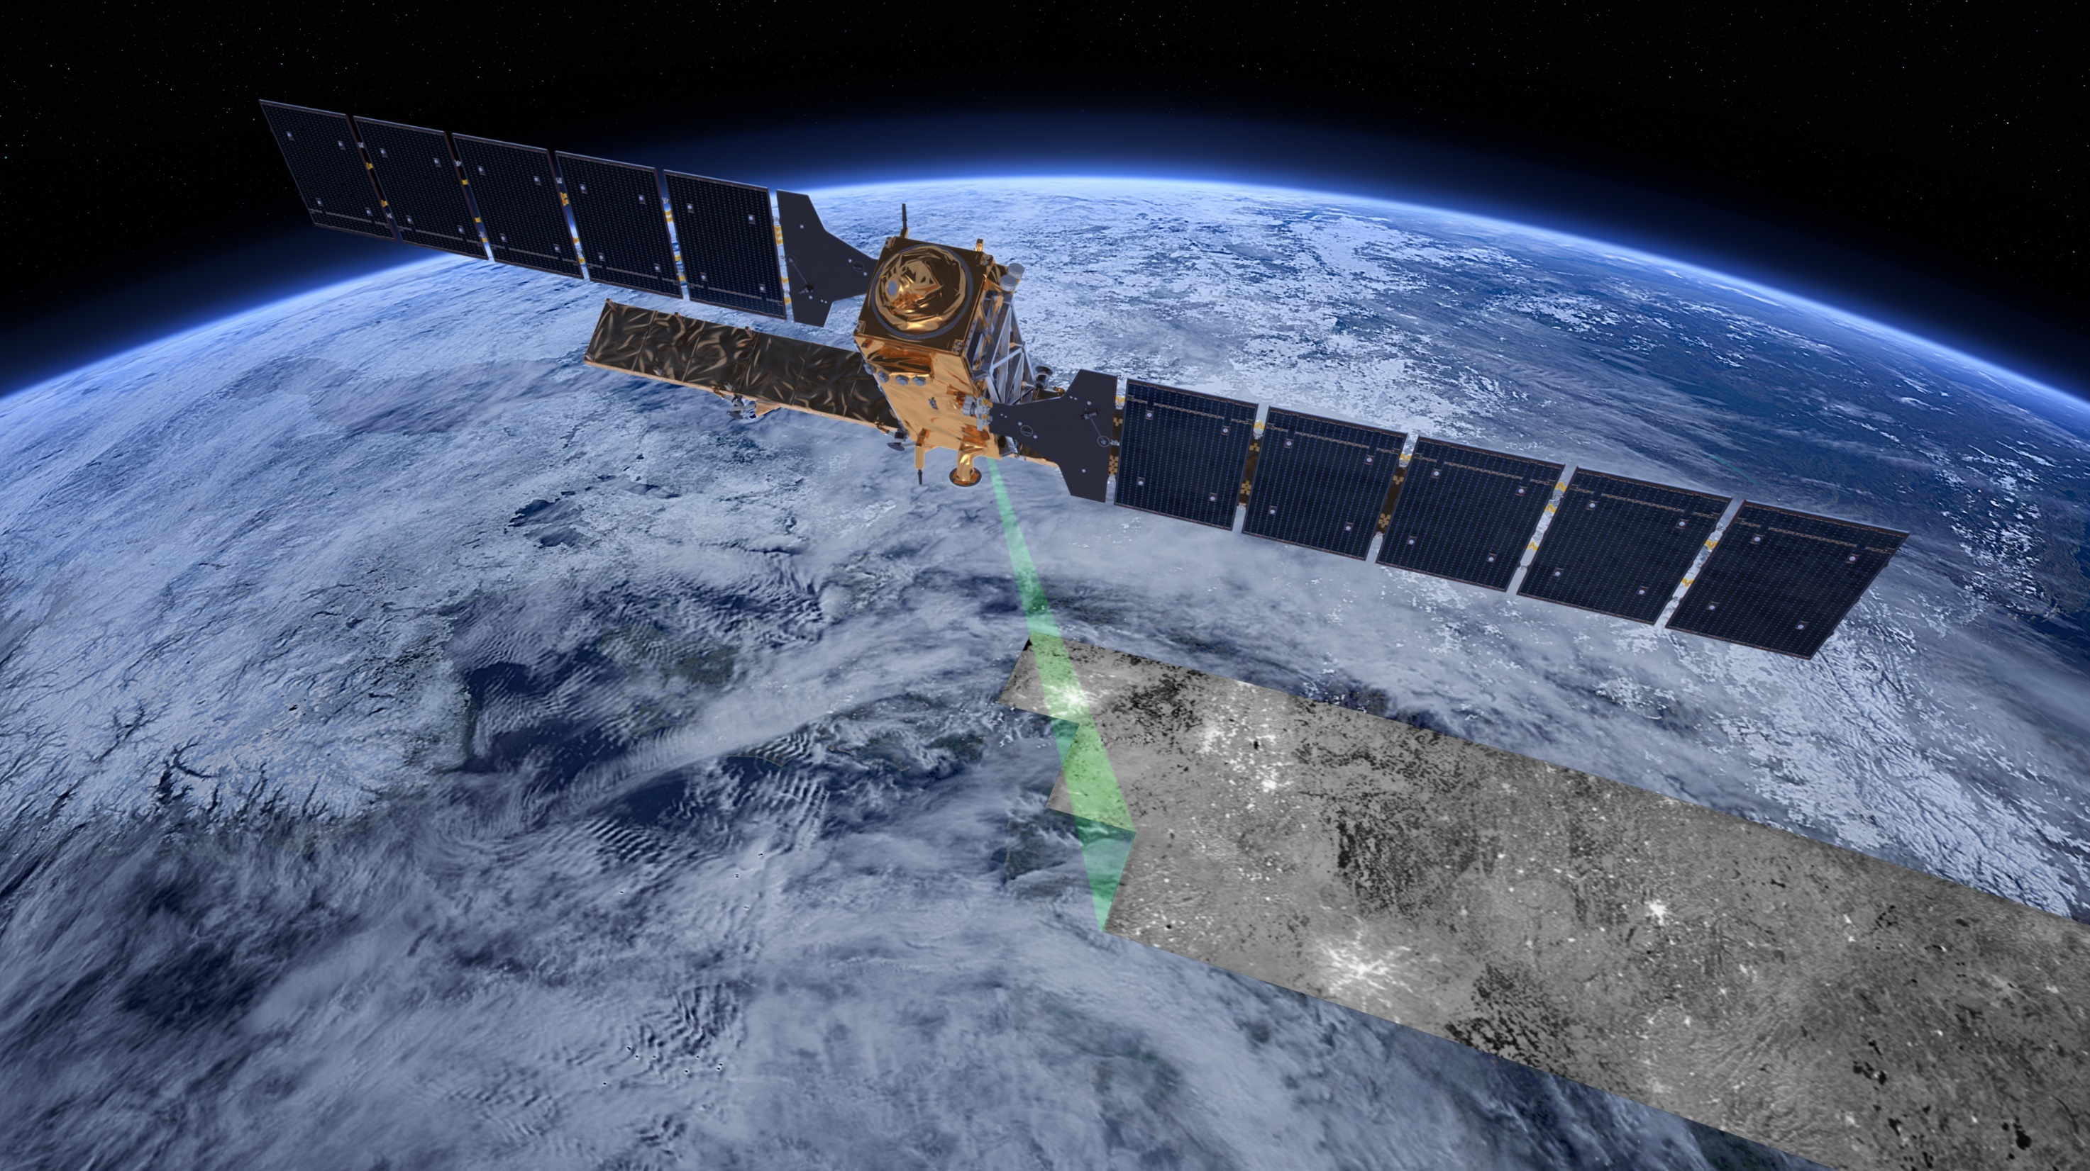

SAR satellite Sentinel-1
Peatland surface height changes (Bog breathing) proxy for peat wetness
Penetration of clouds
Penetration of vegetation
Direct measurement of surface height changes

Slide 5
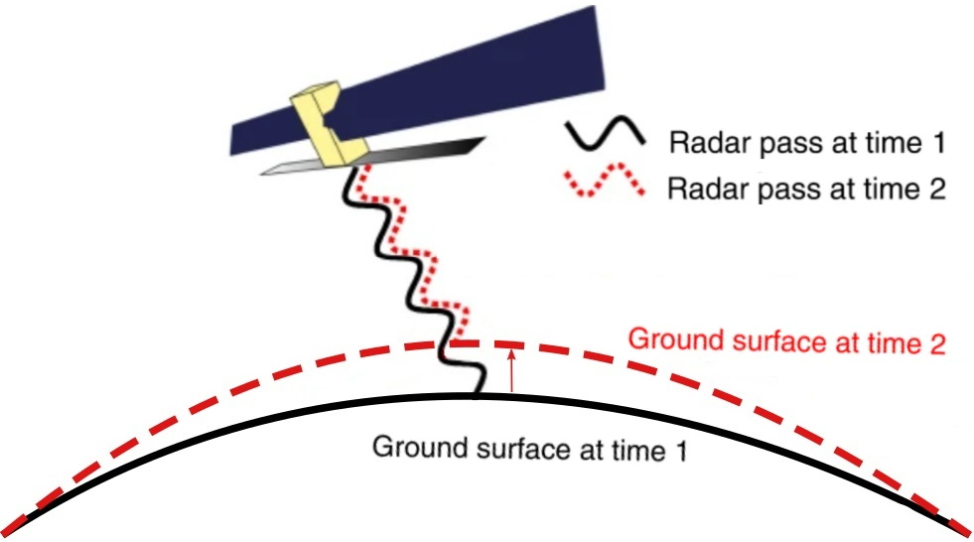
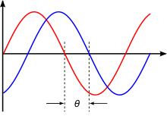
SAR Differential Interferometry (DInSAR)
Phase difference due to ground motion
Adapted from:
Biggs, J., Wright, T.J. (2020) How satellite InSAR has grown from opportunistic science
to routine monitoring over the last decade. Nature Communications, 11(1), 3863.
Peppergrower, CC BY-SA 3.0 <https://creativecommons.org/licenses/by-sa/3.0>, via Wikimedia Commons

Slide 6
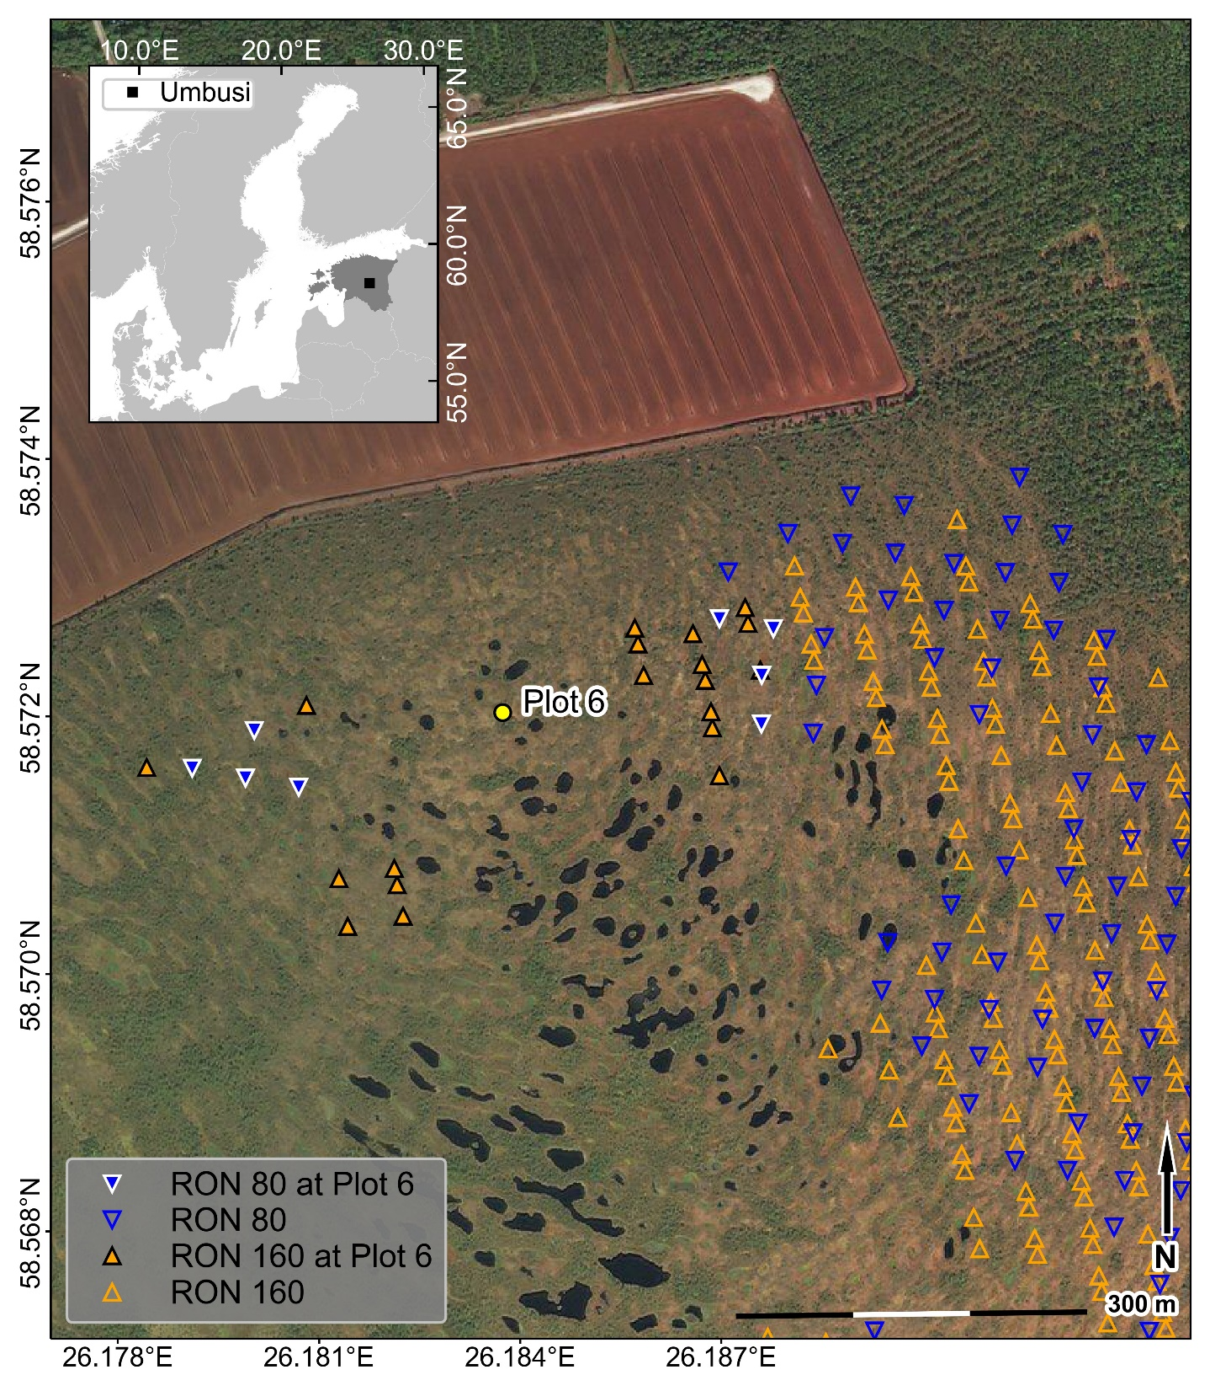
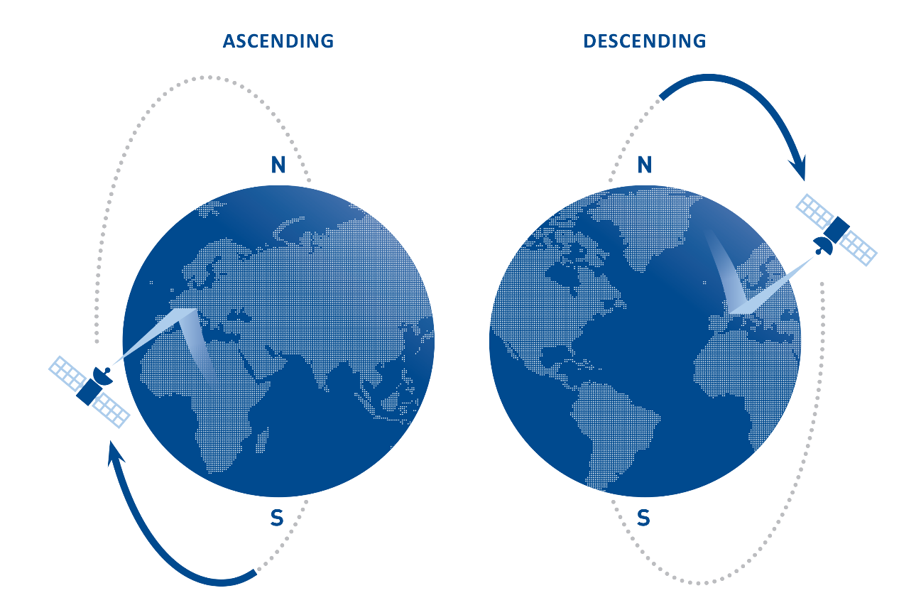
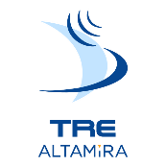
InSAR distributed scattere (DS) time-series method

Slide 7
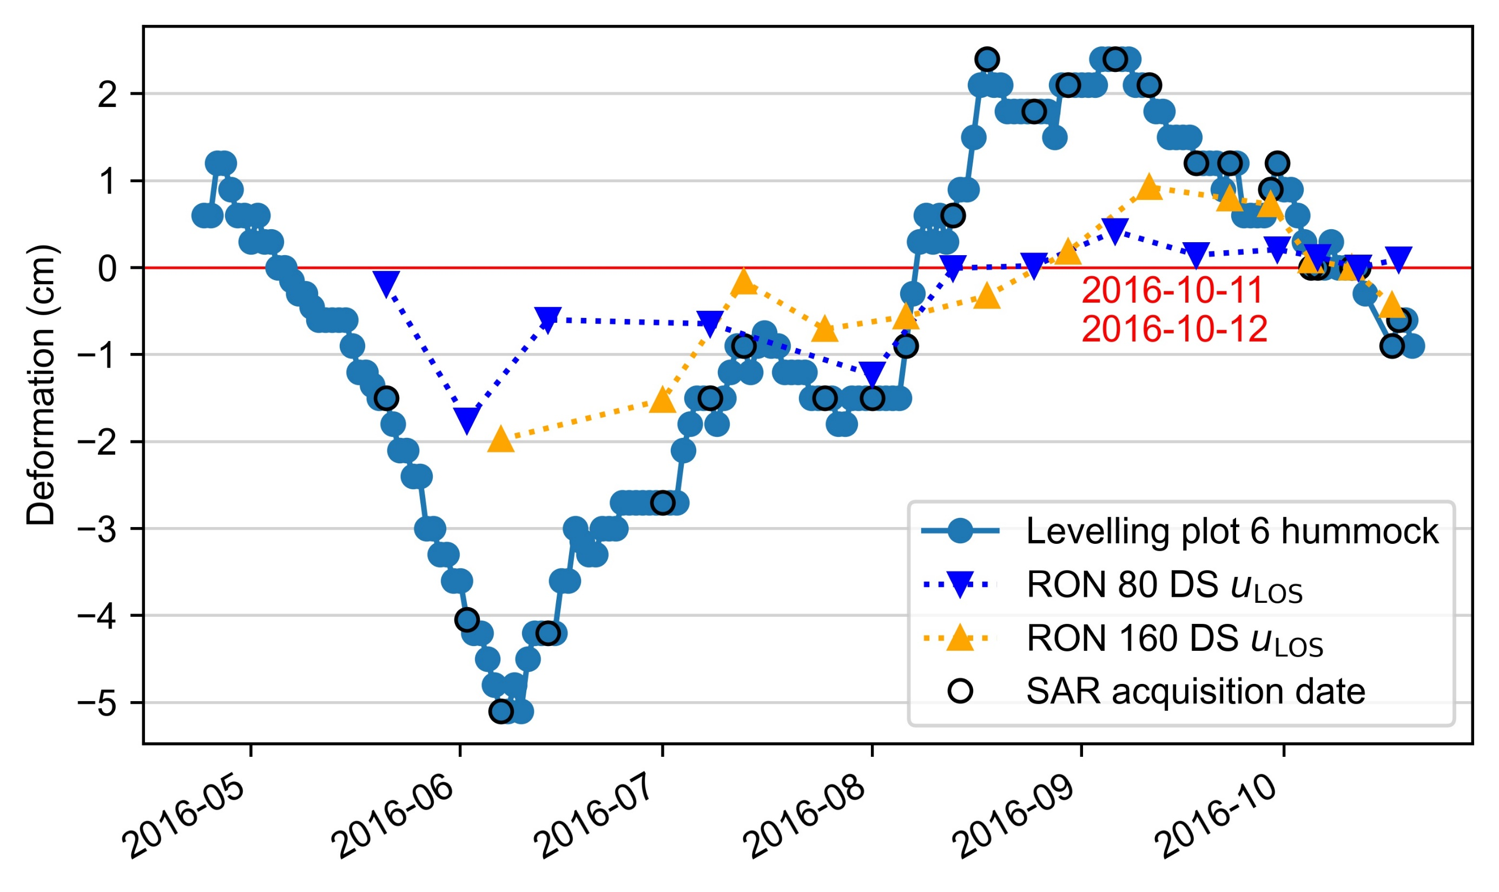

Slide 8
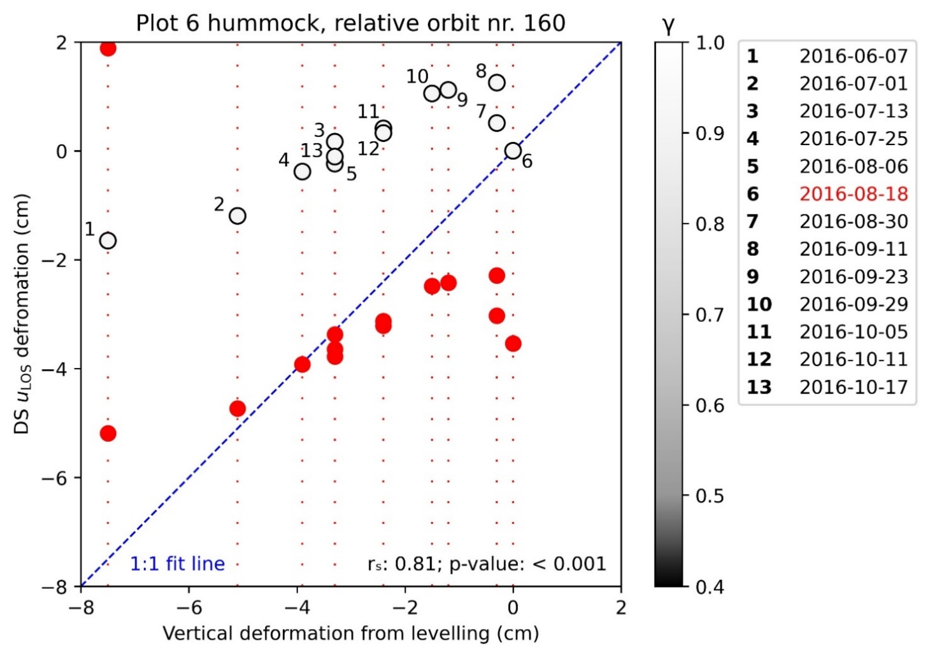
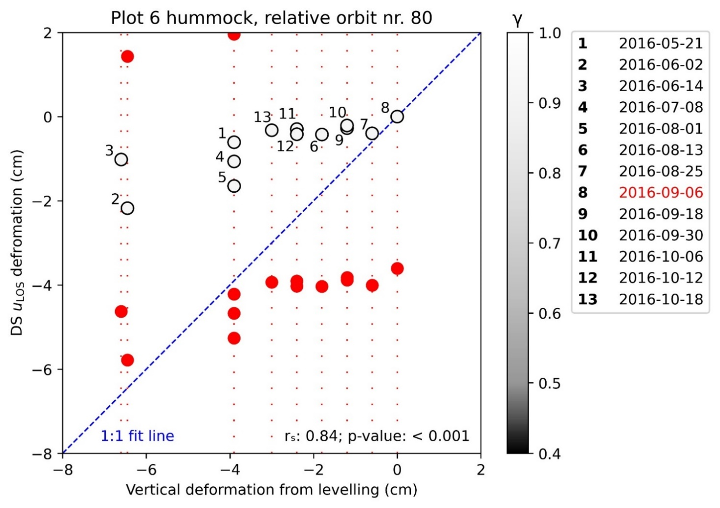
Deformation from a common reference date
Other possible resolutions for phase ambiguity

Slide 9
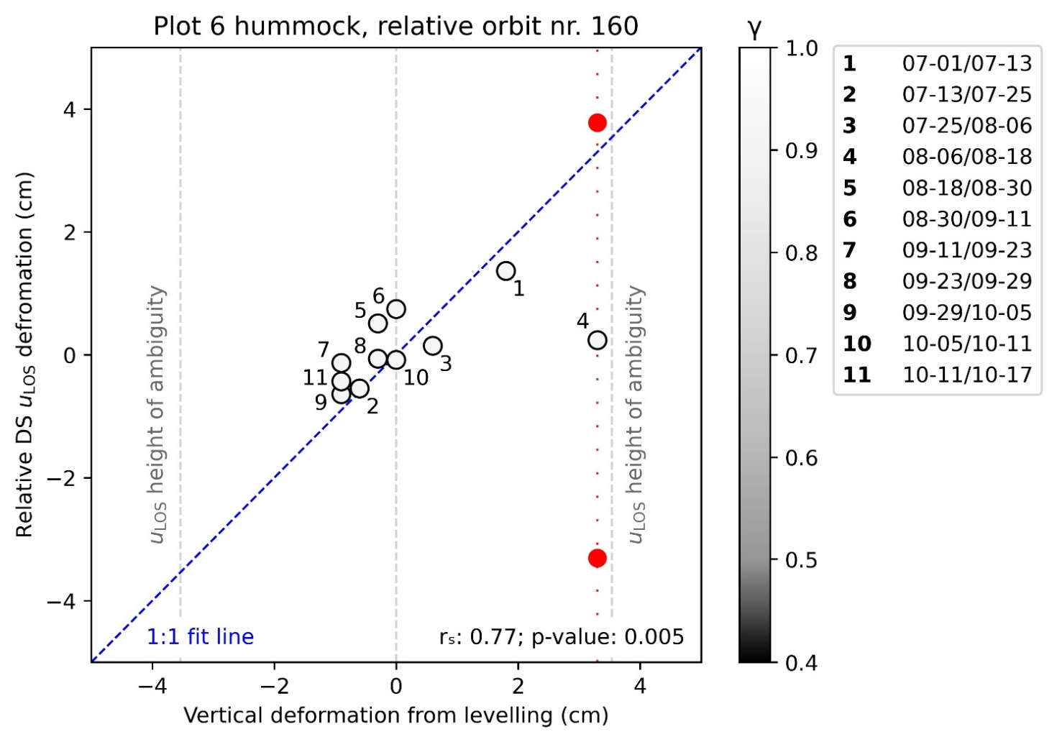
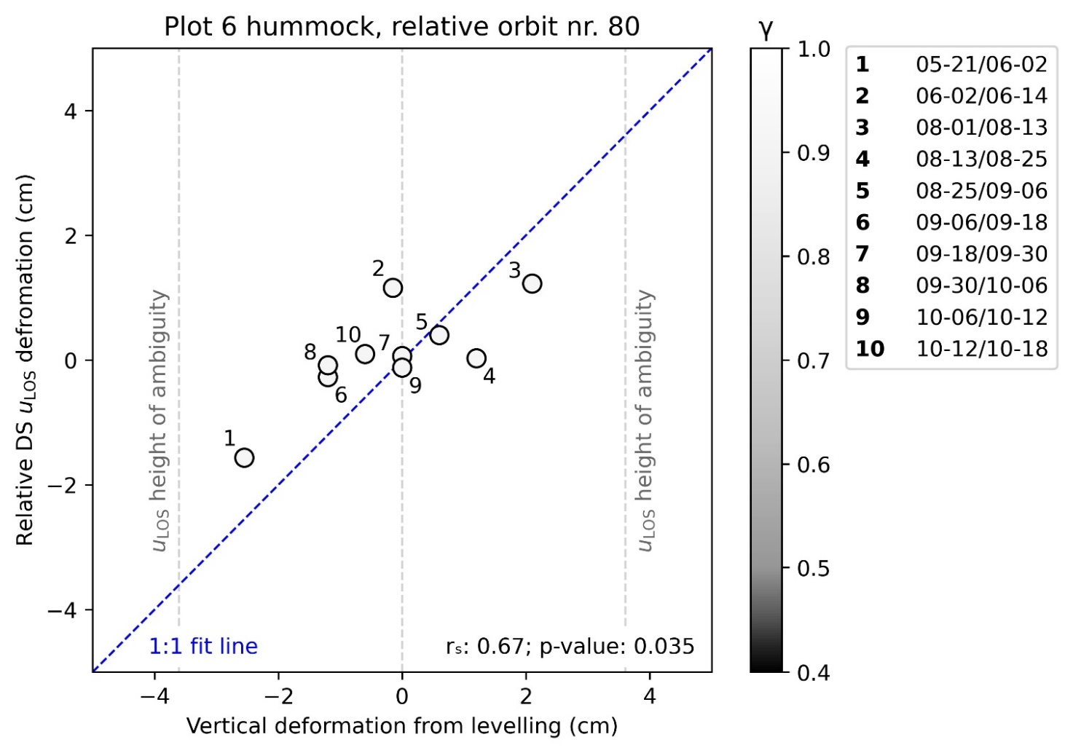
Deformation between consecutive dates
Other possible resolutions for phase ambiguity

Slide 10
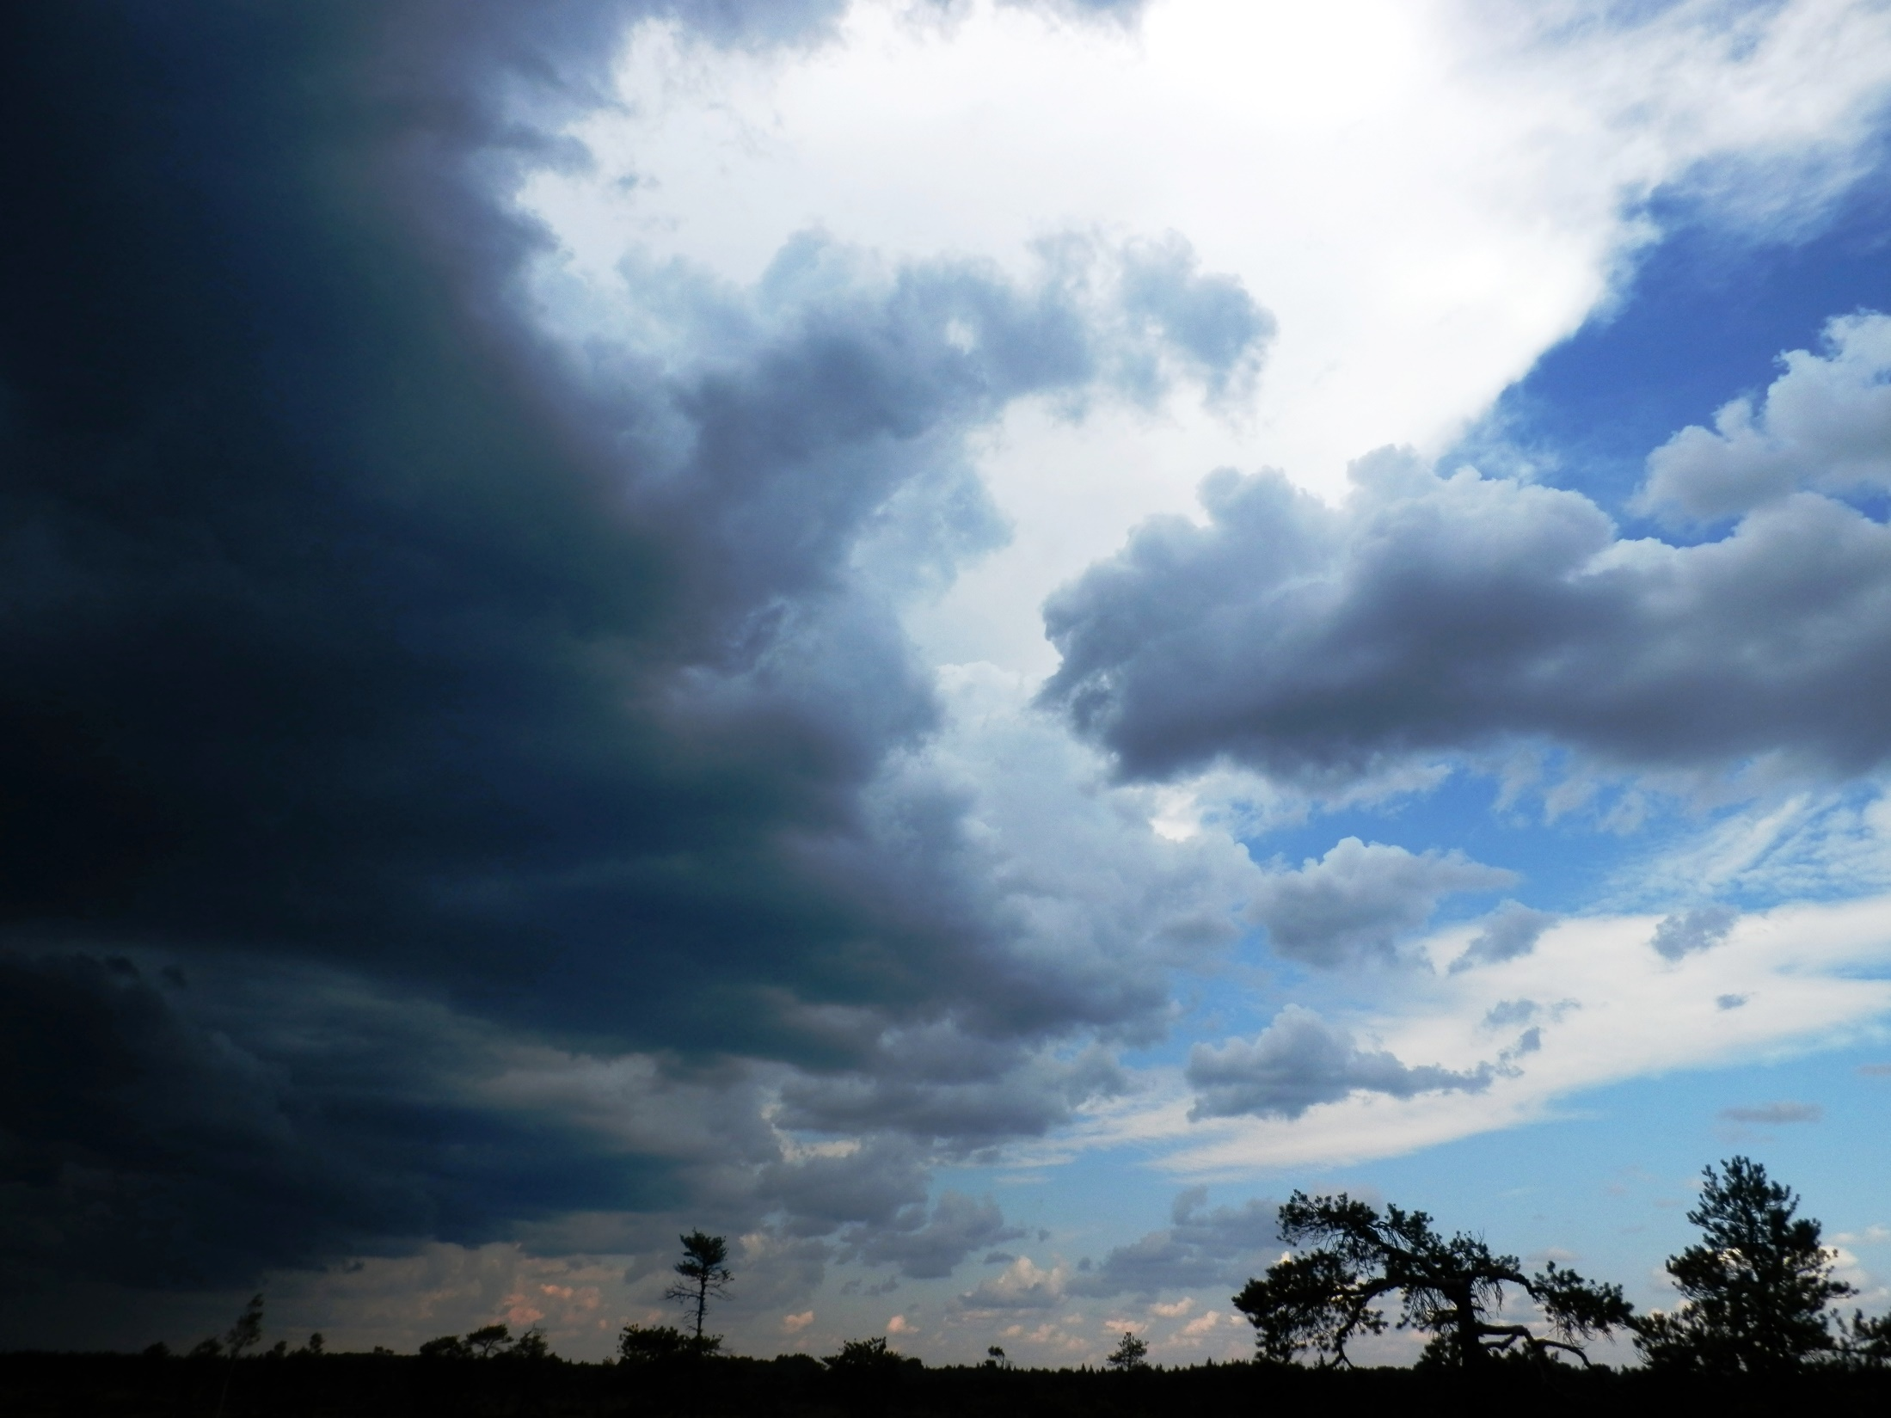
Conclusions
Sentinel-1 DS deformation time-series unreliable
Severe underestimation (at wavelength 5.6 cm)
Though, useful deformation signal contained
6-day surface changes relatively small
ambiguity resolution often not needed
Near-future long wavelength (24 cm) InSAR missions

Slide 11









