Slide 1


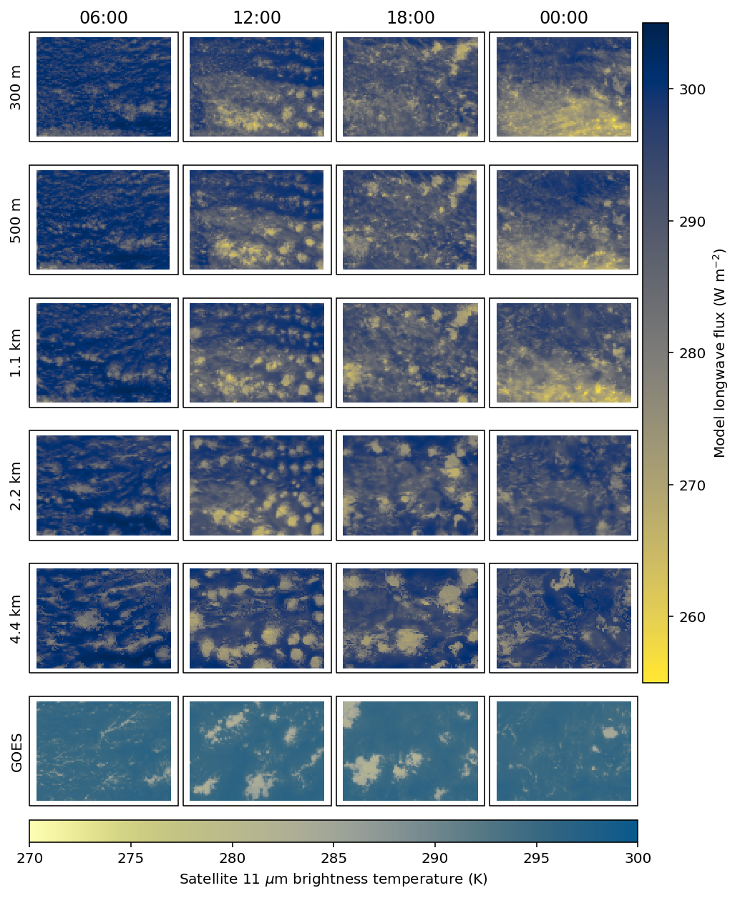
2nd Feb Simulations
Kilometre-scale simulations reproduce observed variation in cloud organisation
Clouds still look wrong
  Too blobby
  Too much cloud
l.saffin@leeds.ac.uk

Slide 2
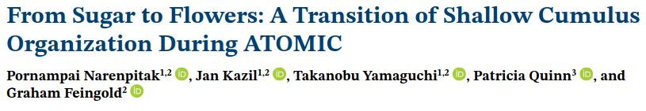
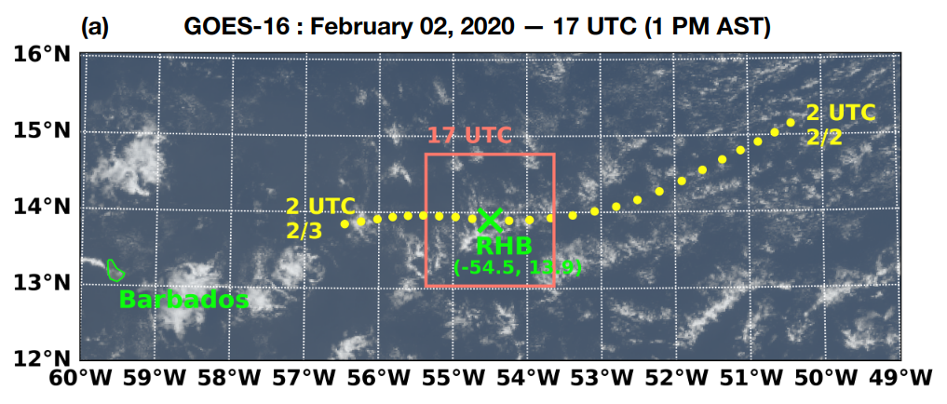

Slide 3
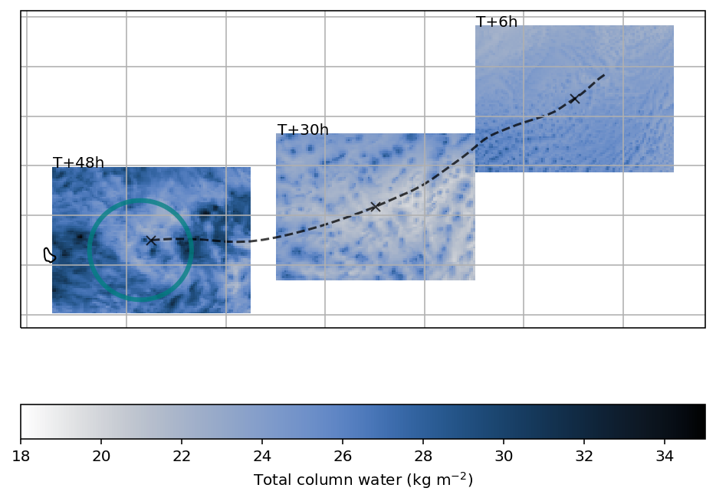
UM “Lagrangian” Domain
Follow trajectories to follow cloud development
Extract subdomain following boundary-layer trajectory
Looks sort of like a Lagrangian LES
l.saffin@leeds.ac.uk

Slide 4
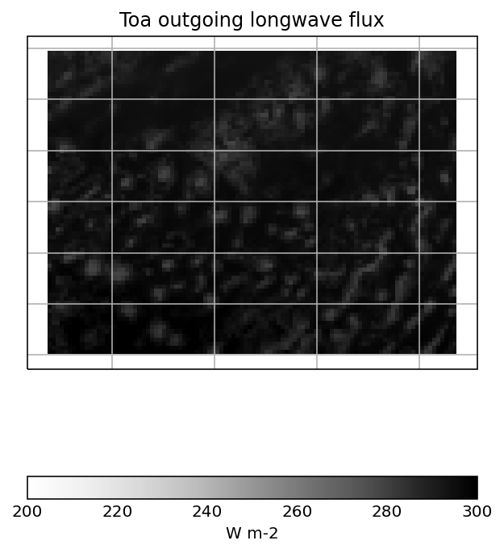
UM “Lagrangian” Domain
Follow trajectories to follow cloud development
Extract subdomain following boundary-layer trajectory
Looks sort of like a Lagrangian LES
l.saffin@leeds.ac.uk

Slide 5
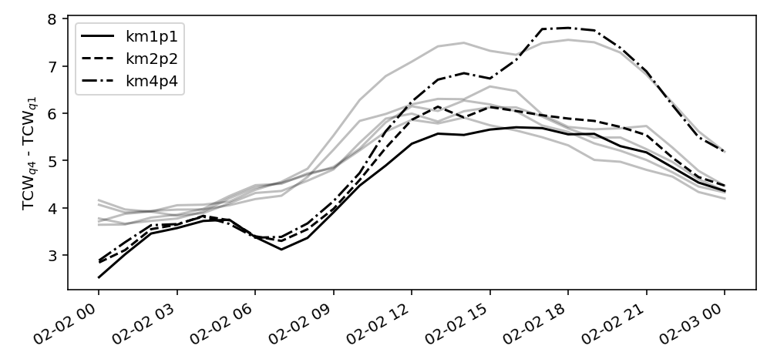
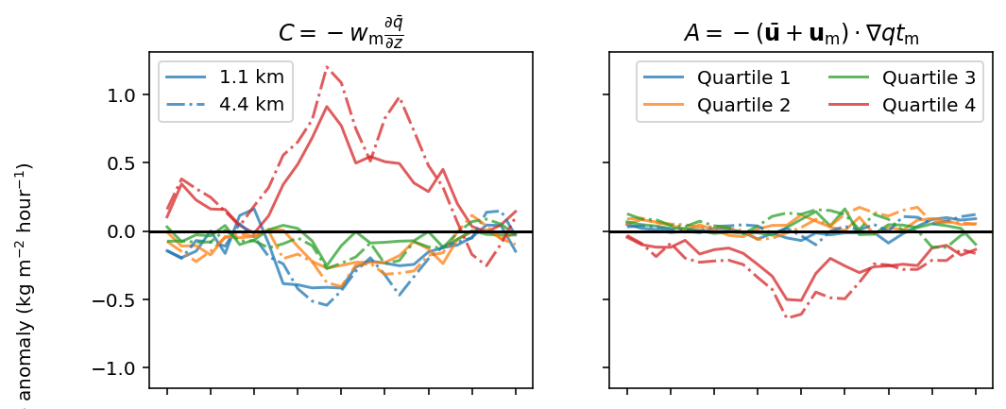
Mesoscale Aggregation
Mesoscale aggregation rapidly increases
  Stronger and earlier than LES
Driven by mesoscale vertical velocity
  Consistent with LES
l.saffin@leeds.ac.uk

Slide 6
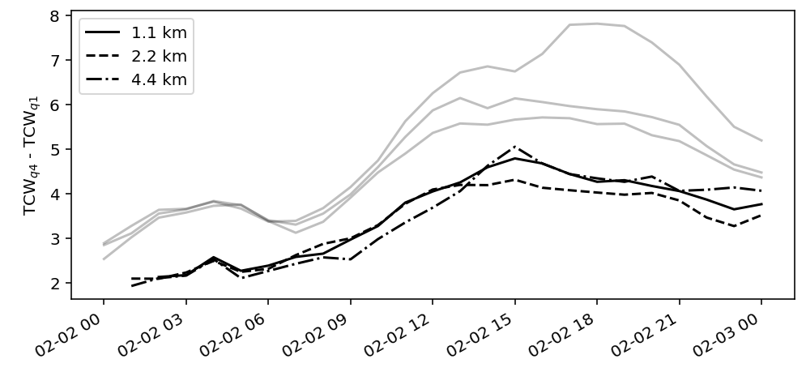
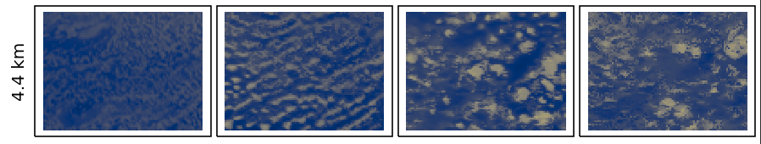
Sensitivity to Spin Up
Later start time to see if smoothing initial structures slows down aggregation
Weaker aggregation but timing is the same
  Large-scale forcing drives the transition to flowers
l.saffin@leeds.ac.uk

