Slide 1



An HBV-model based approach for studying the effects of projected climate change on water resources in Slovakia
Roman Výleta, Patrik Sleziak, Kamila Hlavčová, Michaela Danáčová, Milica Aleksić, Ján Szolgay, Silvia Kohnová
EGU, Vienna, Austria & Online | 25 May 2022

Slide 2
Introduction
The changing climate is a concern with regard to sustainable water resources.
Projections of the runoff in future climate conditions are needed for long-term planning of water resources and flood protection.
Objective
To develop a calibration strategy based on the selection of the most suitable decade in the observation period for the parameterization of a rainfall-runoff model for modelling runoff in future climate conditions.

Slide 3
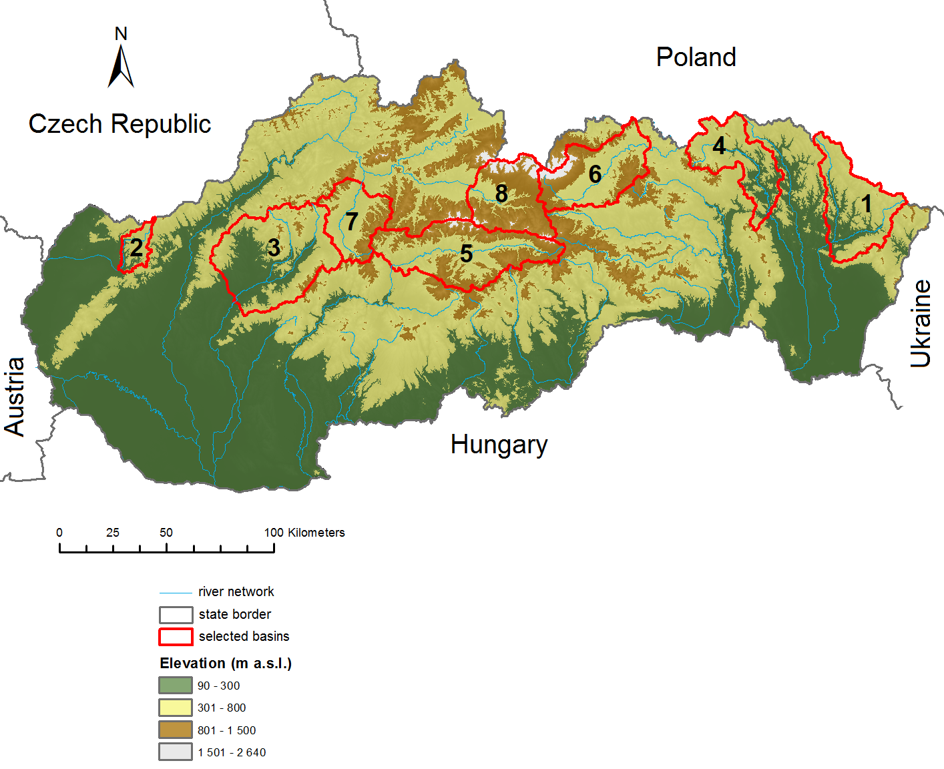
Study area
Slovakia
- 8 pilot river basins,
- 2 groups: basins with mean elevation > 435 m a.s.l. and < 435 m a.s.l.
Slovakia – eight pilot river basins.
River | Station | Area (km²) | Elevation (m a.s.l.)
1. Laborec | Humenné | 1272.4 | 421.7
2. Myjava | Jablonica | 238.4 | 361.7
3. Nitra | Nitrianska | 2093.7 | 419.5
4. Topl’a | Hanušovce | 1050.0 | 435.4
5. Hron | Banská B. | 1766.4 | 844.4
6. Poprad | Chmel’nica | 1262.4 | 878.1
7. Turiec | Martin | 827.0 | 716.0
8. Váh | Lipt. Mikuláš | 1107.2 | 1090.1

Slide 4
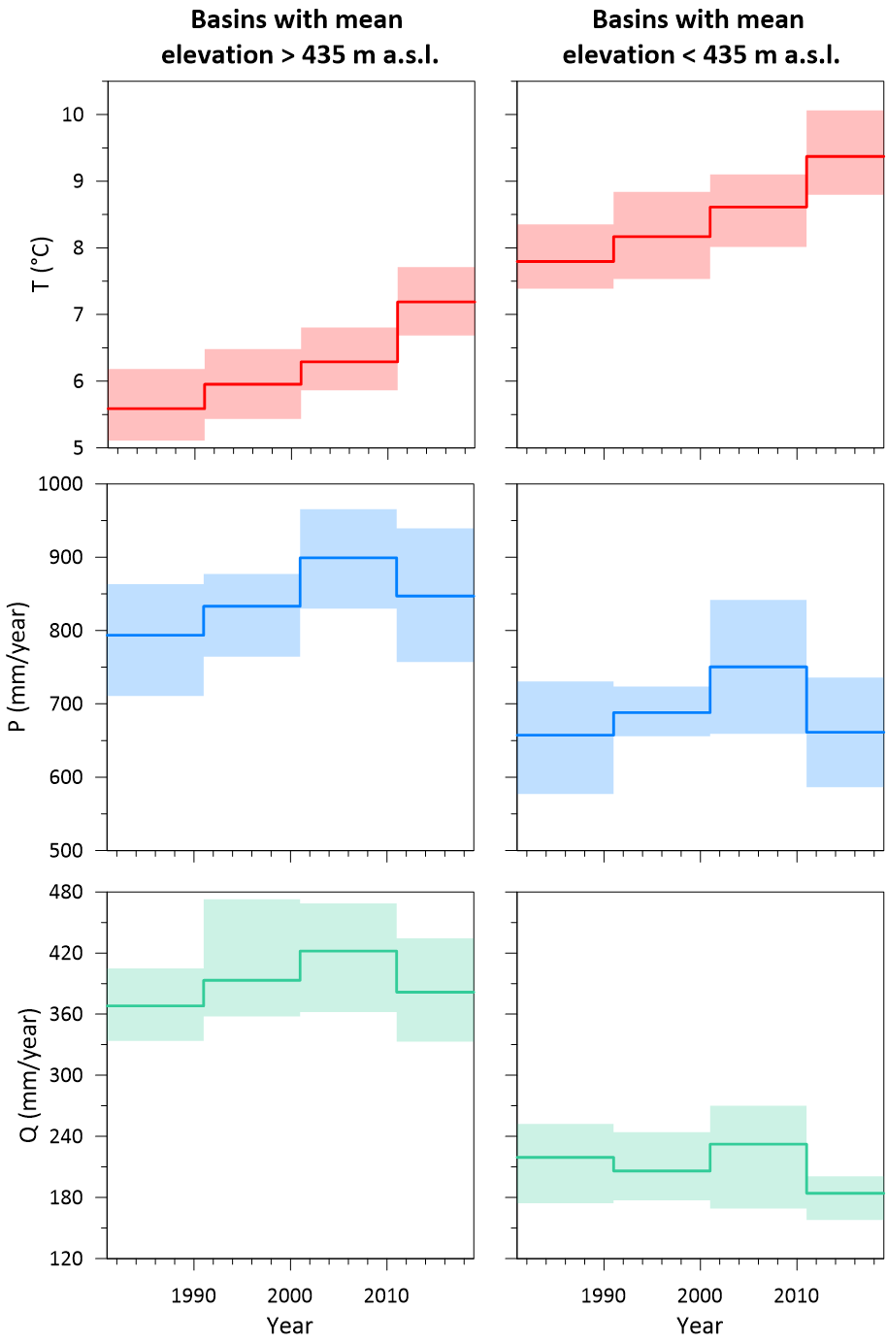
Data
a) SHMI database,
- P, T, PET, Q (1981-2019),
b) Climate scenarios,
P, T, PET (1981-2100).
Basins with mean elevation > 435 m a.s.l.
- T: 5,6 – 7,2 °C
- P: 794 – 847 mm/year
Basins with mean elevation < 435 m a.s.l.
- T: 7,8 – 9,4 °C
- P: 657 – 661 mm/year

Slide 5
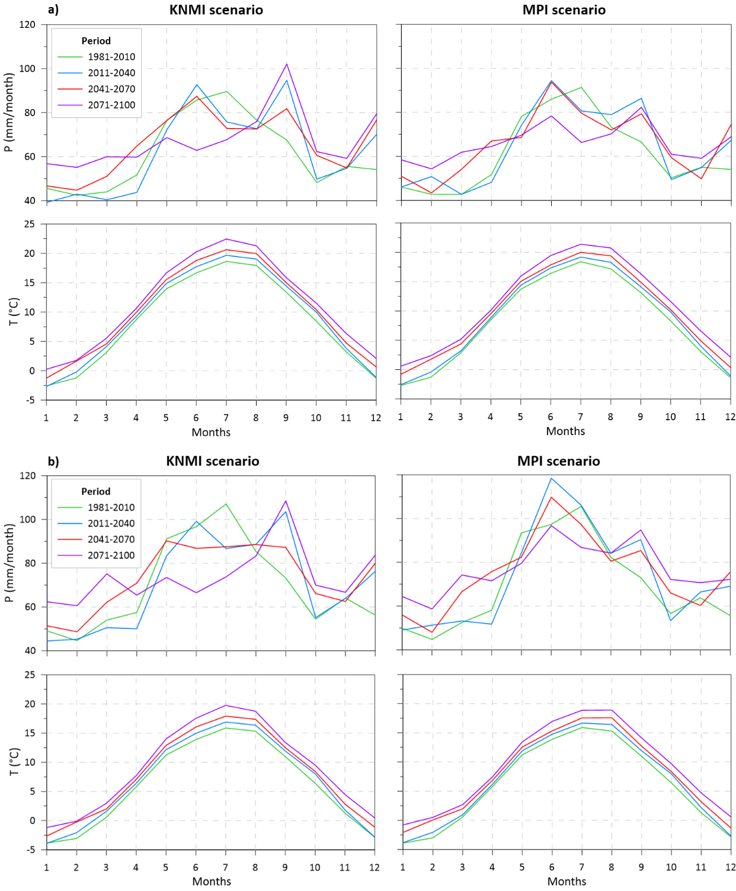
Climate change scenarios
KNMI, MPI scenarios for the river basins with lower (a) and higher (b) mean elevations.
During the spring, autumn, and winter periods, an increase in P can be expected.
T will rise with the future time horizons.

Slide 6
Modelling
Lumped conceptual r-r model (TUW model)
The model was calibrated/validated consecutively for four 10-year periods between 1981–2019.
For simulating the future runoff conditions, we choose parameters from the recent calibration period (2011–2019, similar to recent/warmer climate).
Simulations of runoff for the current state (1981–2010) and three future time horizons (2011–2040, 2041–2070, 2071–2100).

Slide 7
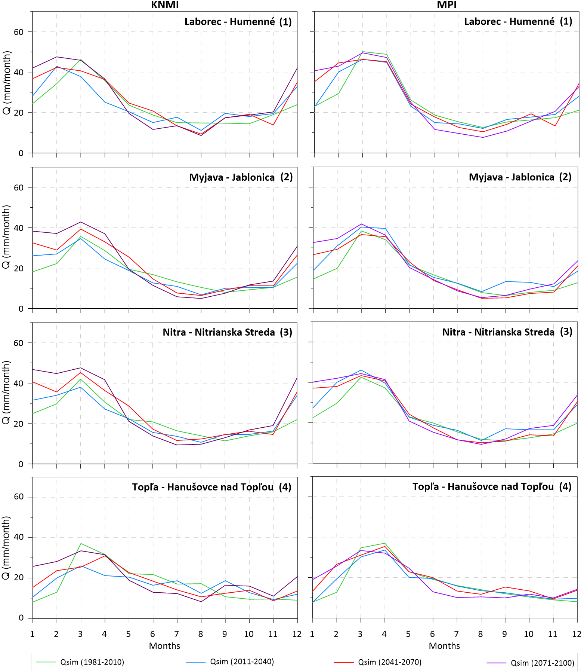
Results
River basins with lower mean elevations
Impact of climate change on runoff
An increase in the winter runoff (December–February) with a maximum increase in the period 2071–2100.
In the summer season (June–August), the runoff will react in reverse.

Slide 8
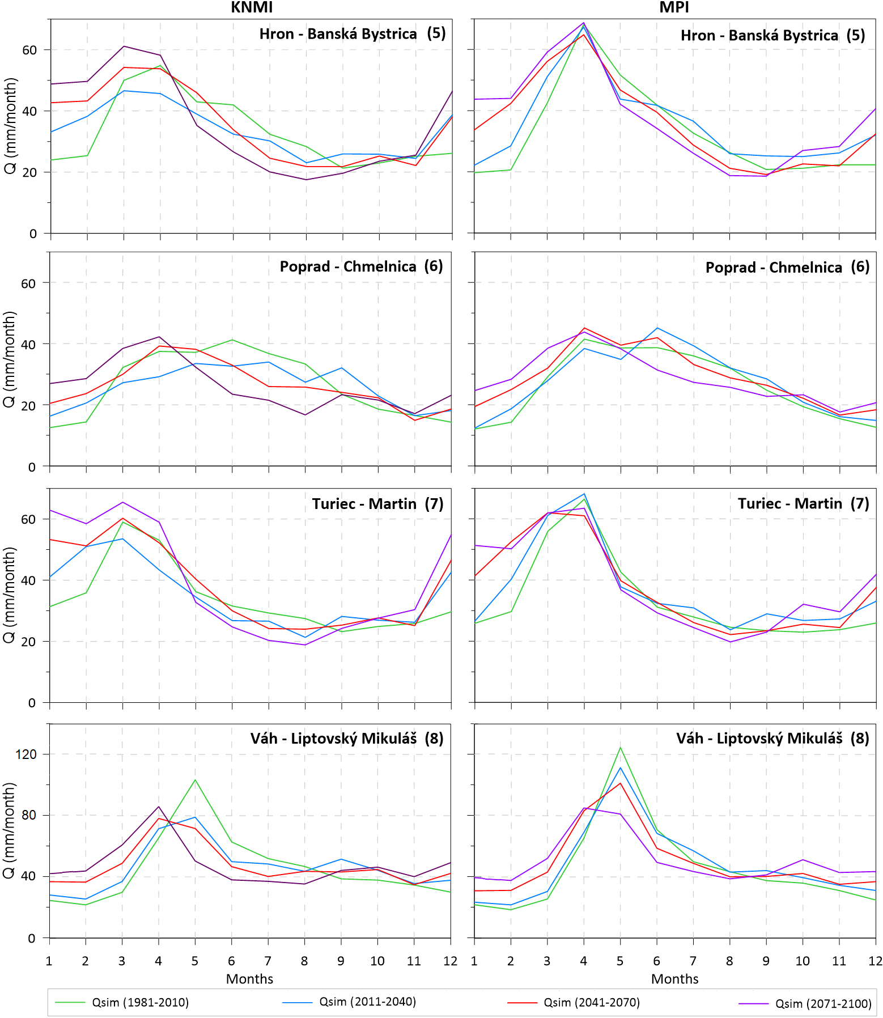
Results
River basins with higher mean elevations
Impact of climate change on runoff
Both climate scenarios predict similar seasonality changes:
Increase in runoff in the winter/spring and a decrease in the summer due to changes in the precipitation regime and an increase in the air temperature.

Slide 9
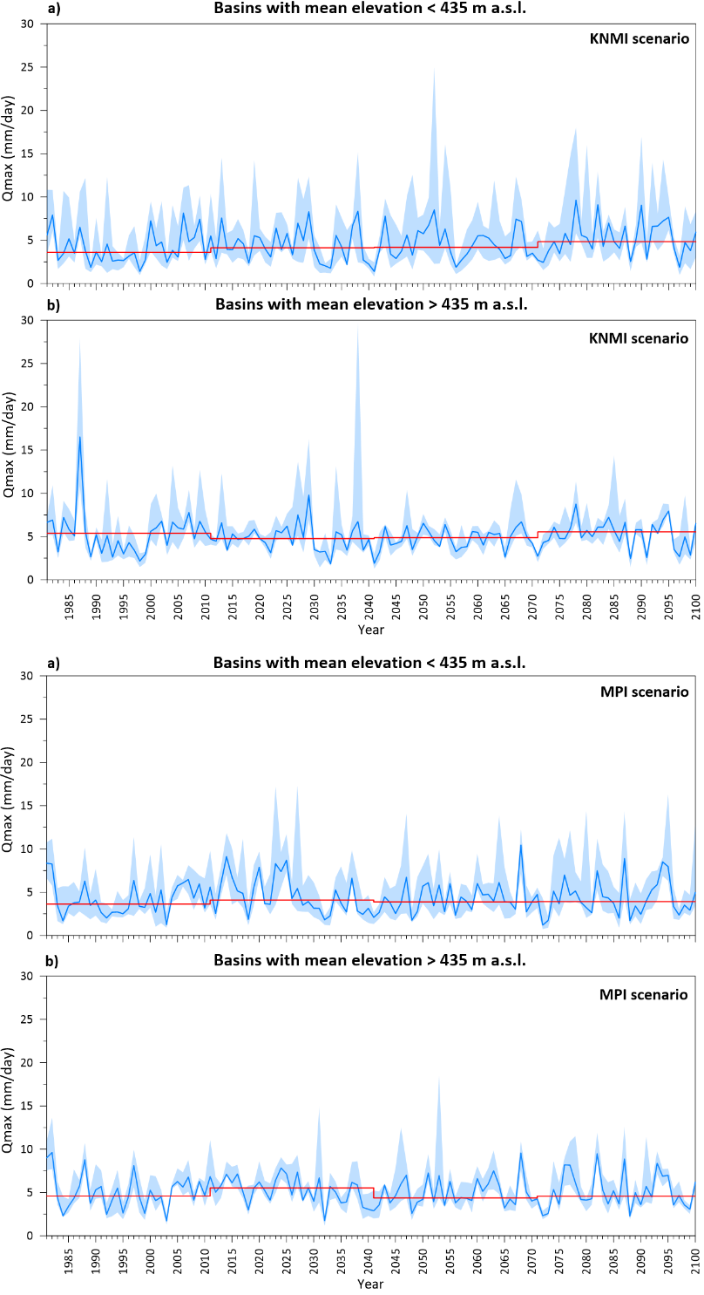
Results
The maximum annual daily runoff
In the basins with lower mean basin elevations, the values of maximum annual daily runoff (MADR) are higher in size and frequency.
A few very extreme values of MADR were simulated in the basins with higher mean basin elevations.

Slide 10
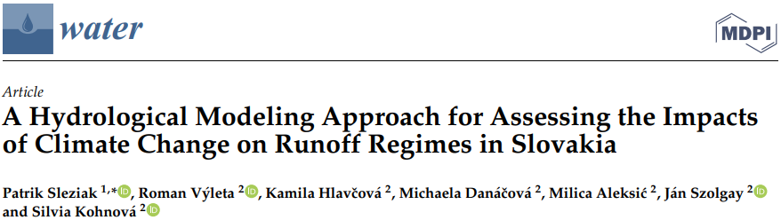
Conclusions
The monthly runoff is predicted to increase during winter periods and decrease during summer seasons. These changes are expected to be more extreme for the later time horizons.
The maximum annual daily runoff also could be more extreme for the last time horizon.
More information can be found in:

