Slide 1
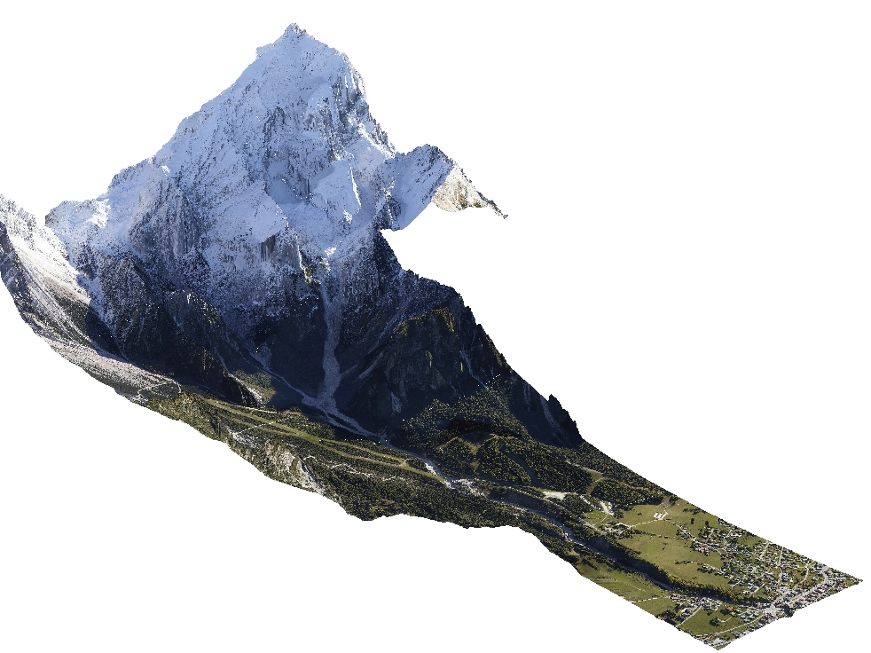
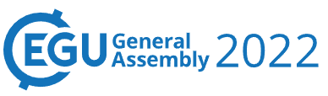


Seismic data as an additional layer of information for large rockslide modelling through back analysis
Giulia Bossi
Ricarda Gatter
Stefano Crema
Marco Cavalli
giulia.bossi@irpi.cnr.it Wed, 25 May 2022

Slide 2


Any data matters
Low resolution topographic data
No pre or post event topographic data
Large uncertainties in the volume estimates
No information on travel times
[obviously, rheology]
Data scarcity

Slide 3
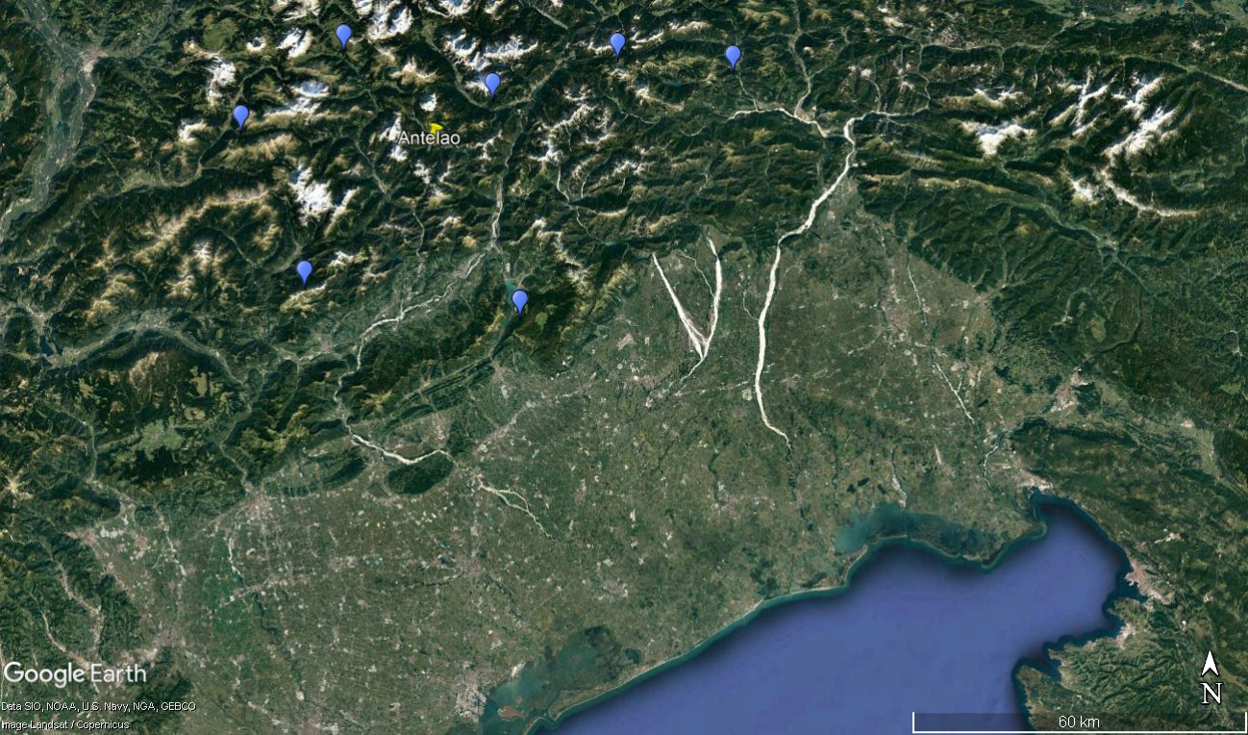
How can seismic data help back analyisis
(low resolution
low quality topographic data)
Widespread network
↓
Fill the gap
↓
Duration of the event - velocities
INDIPENDENT SOURCE

Slide 4
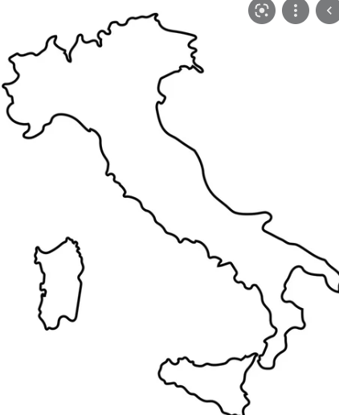
The case study (Le Laste – Antelao landslide)

Slide 5
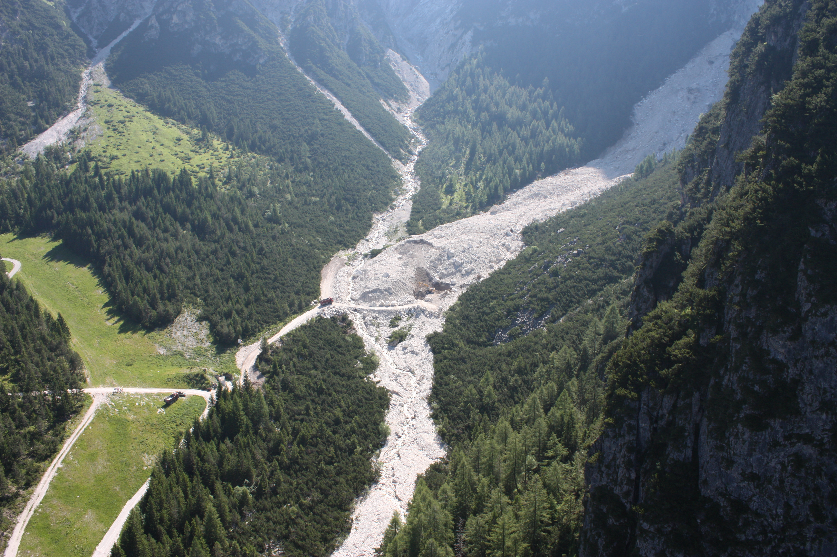
The case study (Le Laste – Antelao landslide)
3080 m
1380 m
1000 m

Slide 6
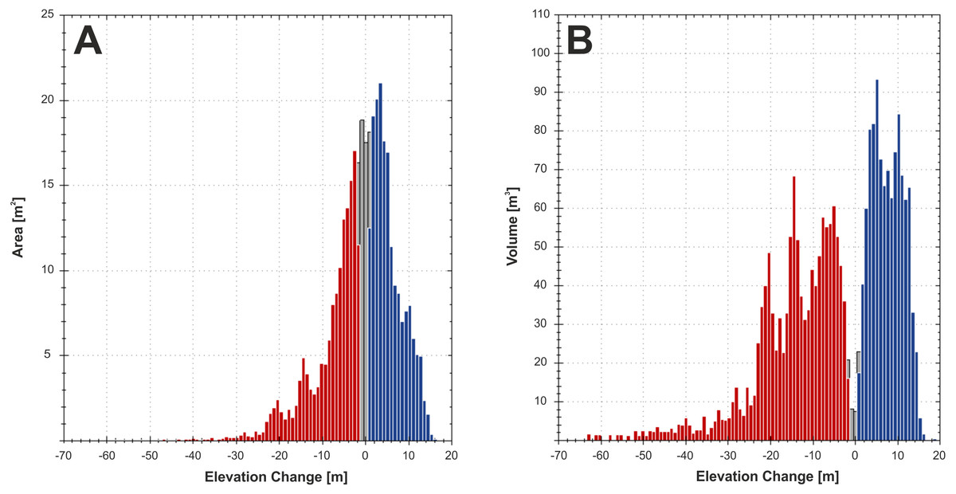
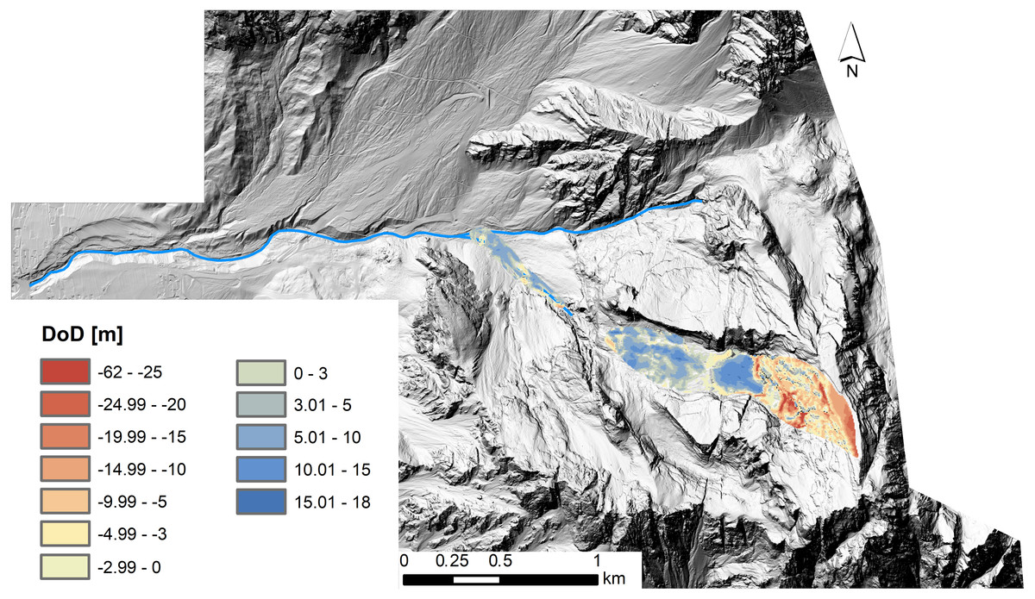
DoD
initial failure volume of 365,000 ± 13,463 m³
total deposit volume 680,000 m³

Slide 7
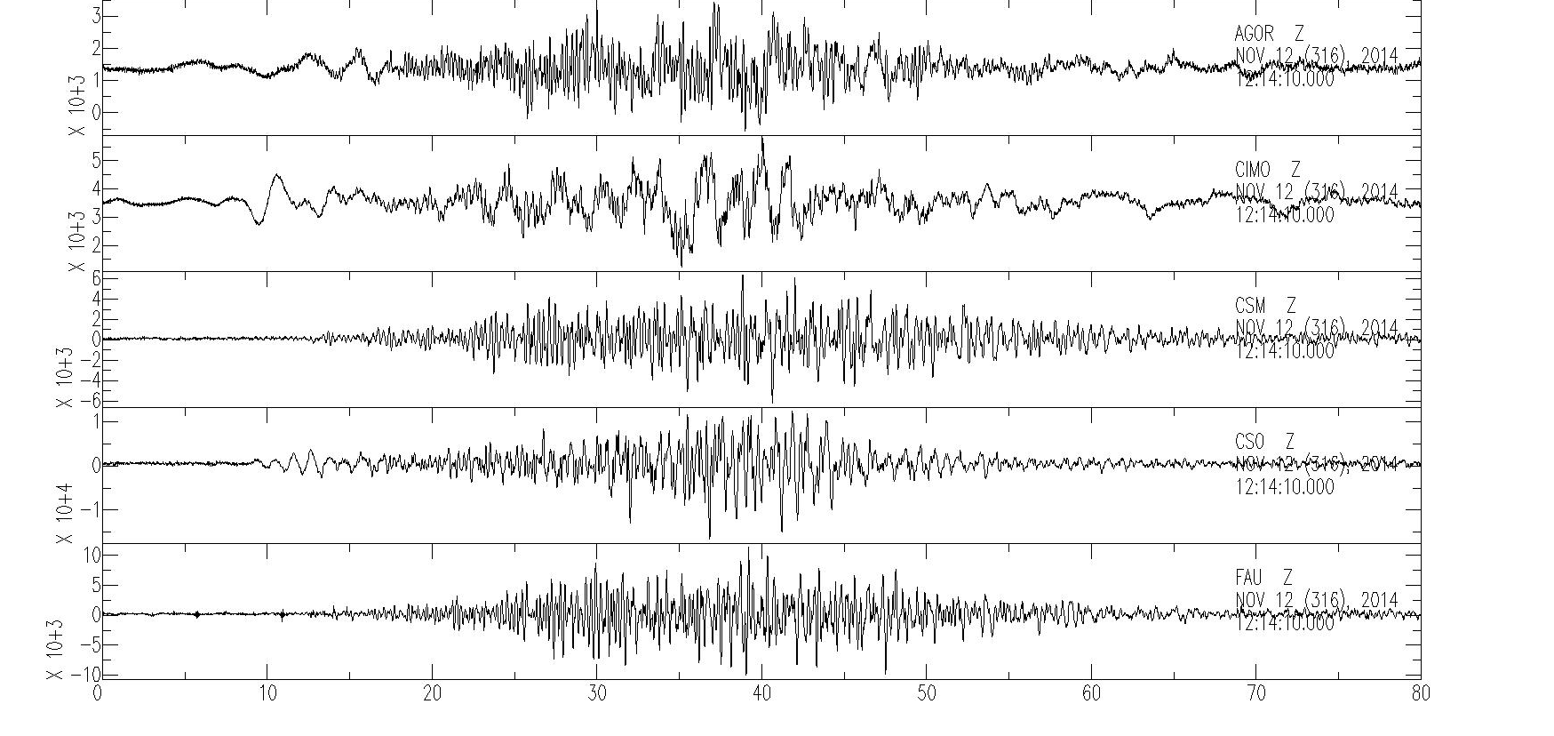
Seismographs
Main event lasted 40 seconds

Slide 8
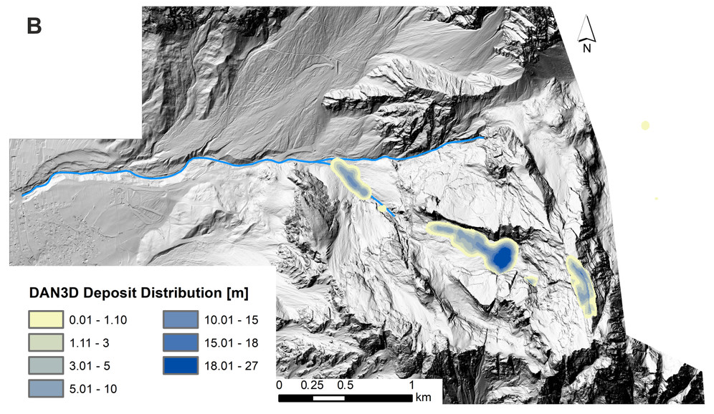
Modelling – DAN3D
Back analysis constrained by DoD and velocity of the event

Slide 9
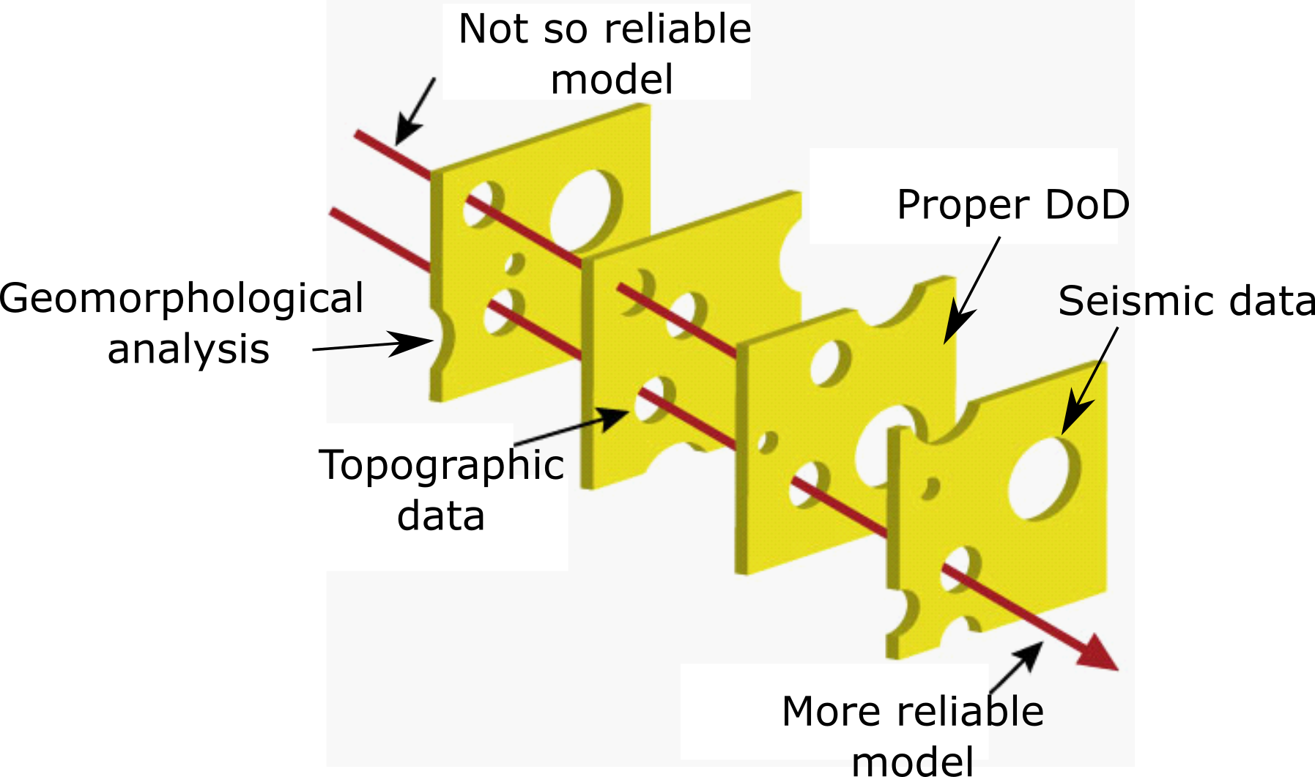
Conclusions
Risk Assessment and Mitigation

Slide 10
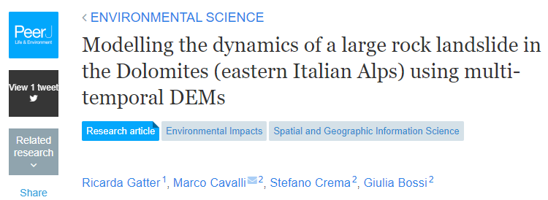
Seismic data as an additional layer of information for large rockslide modelling through back analysis
Inserisci immagine
Giulia Bossi
Ricarda Gatter
Stefano Crema
Marco Cavalli
Thank you
Questions? Collaborations? giulia.bossi@irpi.cnr.it
Wed, 25 May 2022

