Slide 1
Very-high resolution WRF mesoscale urban-modeling for a coastal complex terrain metropolitan area
Dorita Rostkier-Edelstein^{1,2}, Sigalit Berkovic¹, Fima Roter³, Alexandra Chudnovsky³, David Avisar¹
¹ IIBR
² The Hebrew University of Jerusalem
³ Tel Aviv University

Slide 2
Motivation and aim
Urban-weather forecasts are necessary for well-known applications such as air pollution, urban comfort, urban air traffic.
Need for high-resolution numerical weather-forecasts including the effect of the urban canopy.
While CFD and LES provide flow at the street level, mesoscale forecasts provide their initial and boundary conditions.
This work presents very-high resolution (500-m grid size) WRF simulations over a coastal complex terrain metropolitan area, Haifa, Israel, which is prone to high pollution events.

Slide 3
Assessment of the impact of the urban canopy within WRF simulations
Detailed local urban-canopy for the Haifa metropolitan area derived with GIS tools used in:
Bulk parameterization: default MODIS land-use categories of WRF with 1 urban category.
The single-layer urban canopy (SLUCM) parametrization (3 urban categories)
The multi-level layer urban- canopy parameterization with building energy model (BEP-BEM. 3 urban categories).
Due to the lack of specific anthropogenic-heat information for the Haifa area we used:
crude estimations of the timing and desired temperatures for air-conditioning usage in the BEP-BEM parameterization
a typical diurnal cycle of anthropogenic heat for the SLUCM parameterization (following literature for cities in similar climate zones and population).

Slide 4
Simulations configurations and selected events
6 events with a variety of synoptic-scale conditions that, among others, can lead to or worsen high pollution events.
ERA5 reanalysis for initial and boundary conditions.
Initialization at 18 UTC (LT=UTC+2(3))
Sensitivity to 2 planetary boundary layer parameterizations: YSU and Boulac.
Sensitivity to the urban canopy modeling: bulk, single layer, multi-layer

Slide 5
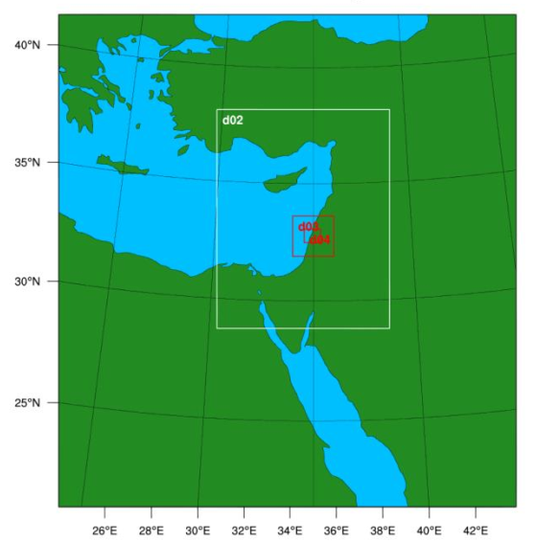
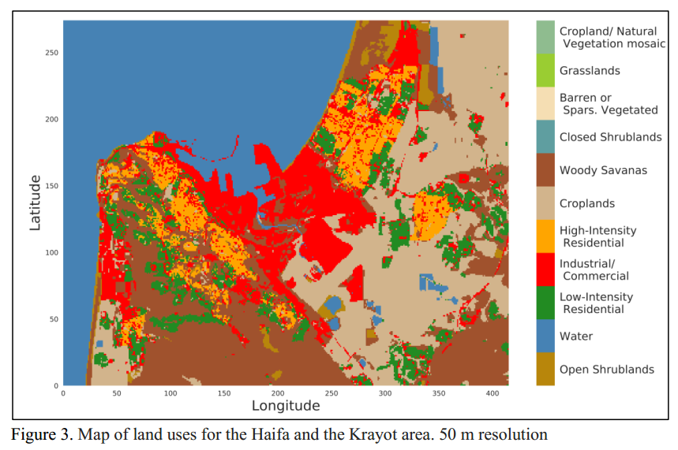
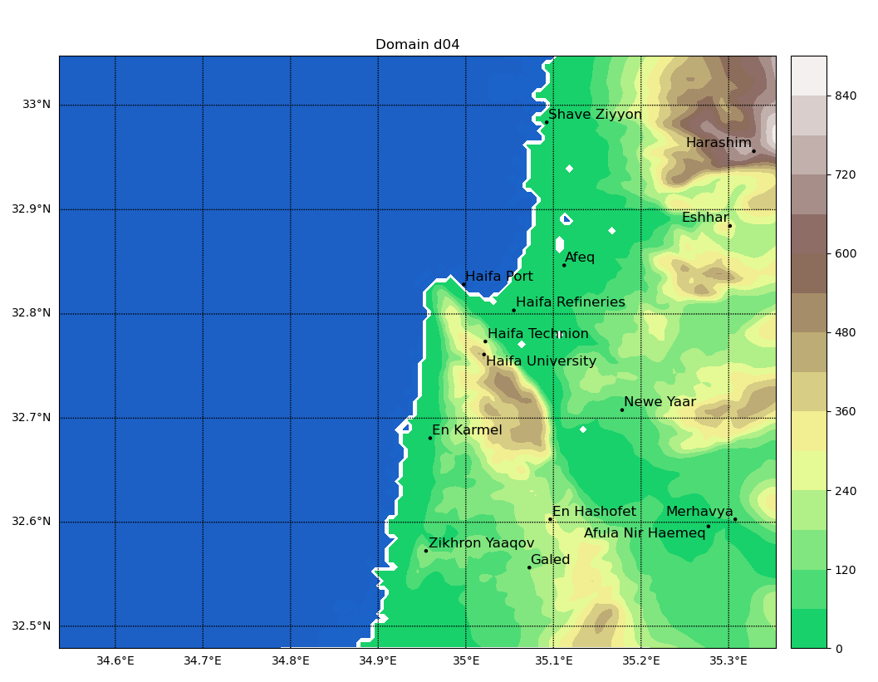
Haifa metropolitan area complex landuse
4 nested domains
Most inner domain complex terrain
surface stations for verification

Slide 6
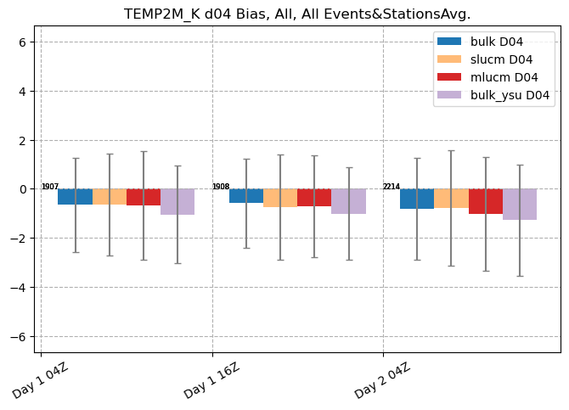
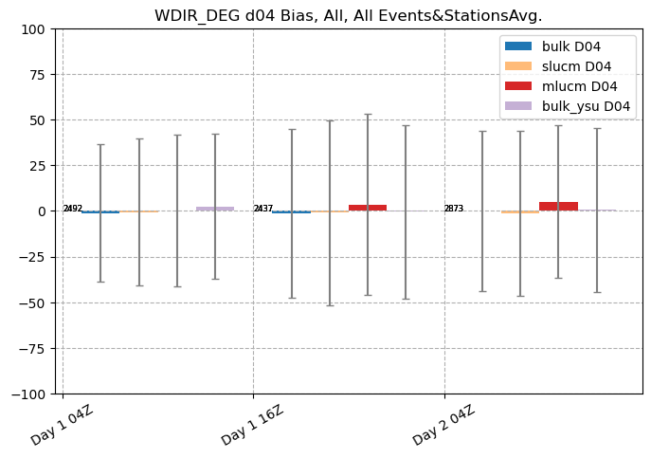
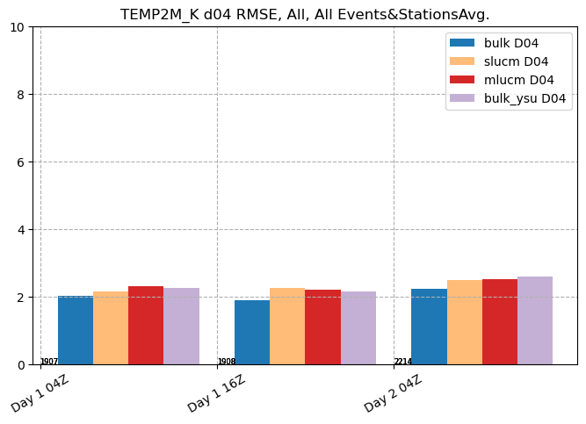
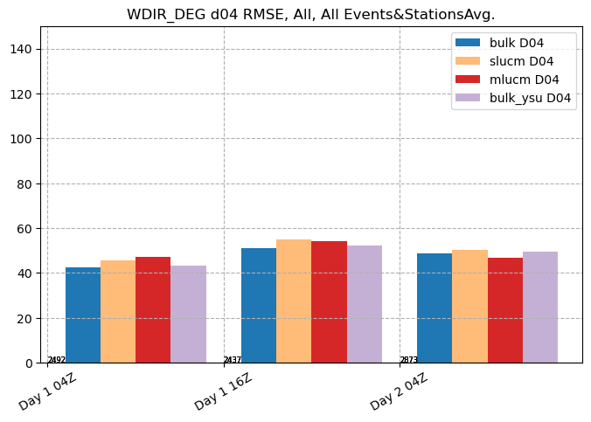
Boulac
Boulac
Impact of urban parameterizations without specific information on the anthropogenic-heat, is limited.
Small error growth with lead time
Very small bias
Boulac
Boulac
04-16 UTC (first day) 16-04 UTC(night) 04-18 UTC (second day)
04-16 UTC (first day) 16-04 UTC(night) 04-18 UTC (second day)

Slide 7
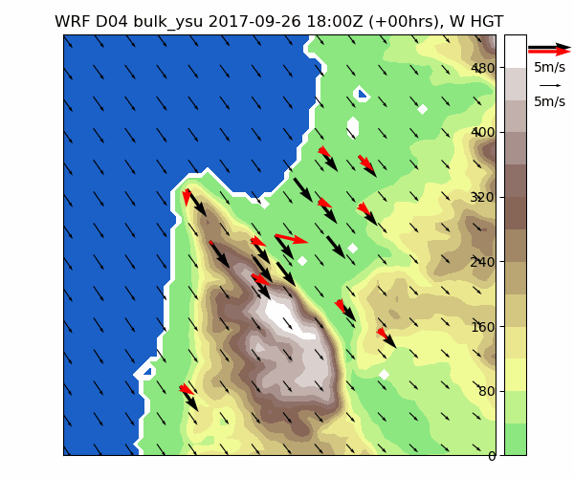
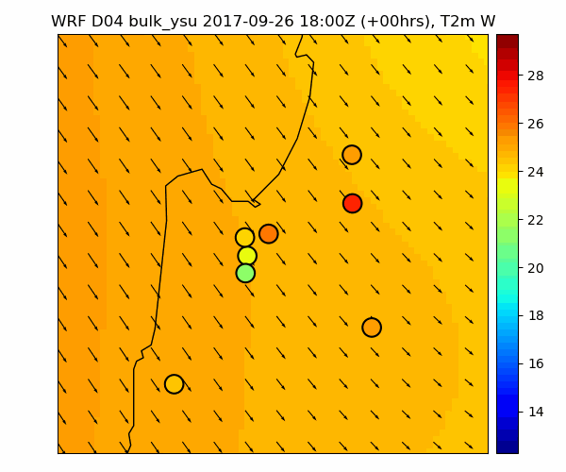
Verification: 26-28 September, 2017
Synoptics: Persian trough.
Pollution: anthropogenic pollution lower layer- up to 1500 m, Lidar ratio of 60-70 (http://polly.rsd.tropos.de/?p=home)
10-m winds and terrain
Successful reproduction of the diurnal cycle of and impact of terrain and of urban landuse on 10-m winds and 2-m temperatures
Sea breeze, land breeze, katabatic winds
Calm night winds
2-m temperature
(Observations in red)

