Slide 1


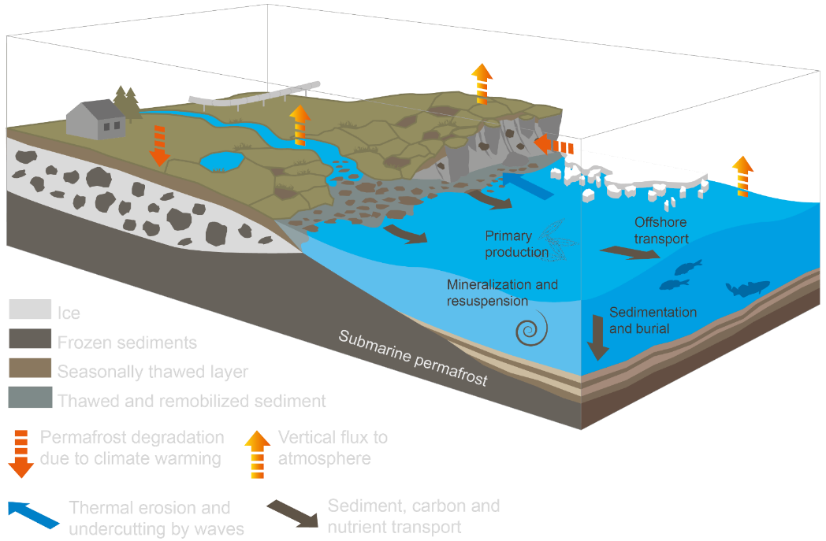


The fast-changing coast of Tuktoyaktuk Peninsula (Beaufort Sea, Canada): geomorphological controls on changes between 1985 and 2020
Bernardo Costa (1)
Gonçalo Vieira (1, 2)
Dustin Whalen (3)
(1) Institute of Geography and Spatial Planning, University of Lisbon, Lisbon, Portugal
(2) Centre of Geographical Studies, University of Lisbon, Lisbon, Portugal
(3) Natural Resources Canada, Dartmouth, Nova Scotia, Canada
https://www.nunataryuk.org/
Notes:
Arctic’s Coastlines comprise of permafrost w/ high carbon content in this frozen stasis has been a hindrance for the decomposition of organic matter built up over hundreds to thousands of years
Coastal Erosion enhances permafrost thaw through its decohesion
Climate warming is inducing the subaerial degradation of permafrost and increasing land to sea sediment transportation. Thus, through the upscale of these local and regional coastal studies, it is possible to better understand the dynamics of Arctic permafrost coasts, helping to constrain Earth System and Climate Models.

Slide 2
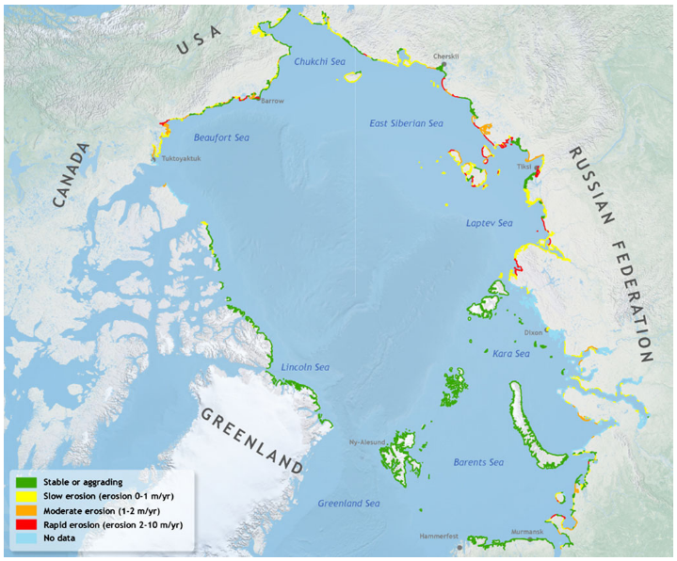
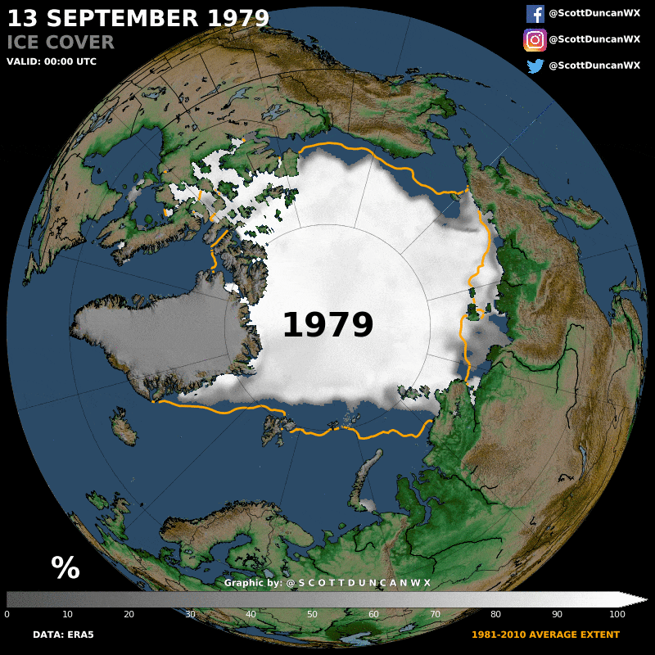
Motivation
Sea ice reduction, increasing open water periods, storminess, air and sea surface temperatures and relative sea level rise are some of the factors which enchance coastal change processes.
Circum-Arctic map of coastal erosion rates. (Lantuit et al., 2012)..
30% of Global Coastlines – One of the most impacted environments on earth
Circum-Arctic sea ice covered area at 13 September 1979-2020. https://scottduncanwx.com/arctic-sea-ice-minimum-2020/
Notes:
Arctic permafrost coasts comprise more than 30% of Earth's coastlines. Under current climate change predictions, Arctic coastlines are likely to become one of the most impacted environments on Earth. Coastal retreat is widespread along coastlines throughout the Arctic Ocean, being one of the main processes degrading permafrost and releasing large amounts of sediment, organic matter, and nutrients to the ocean and the atmosphere
Recent coastal change processes are enhanced by reduction of sea ice extent, subsiding and warming permafrost landscapes, along with increasing open water periods, storminess, air and sea surface temperatures and absolute and relative sea level rise.

Slide 3
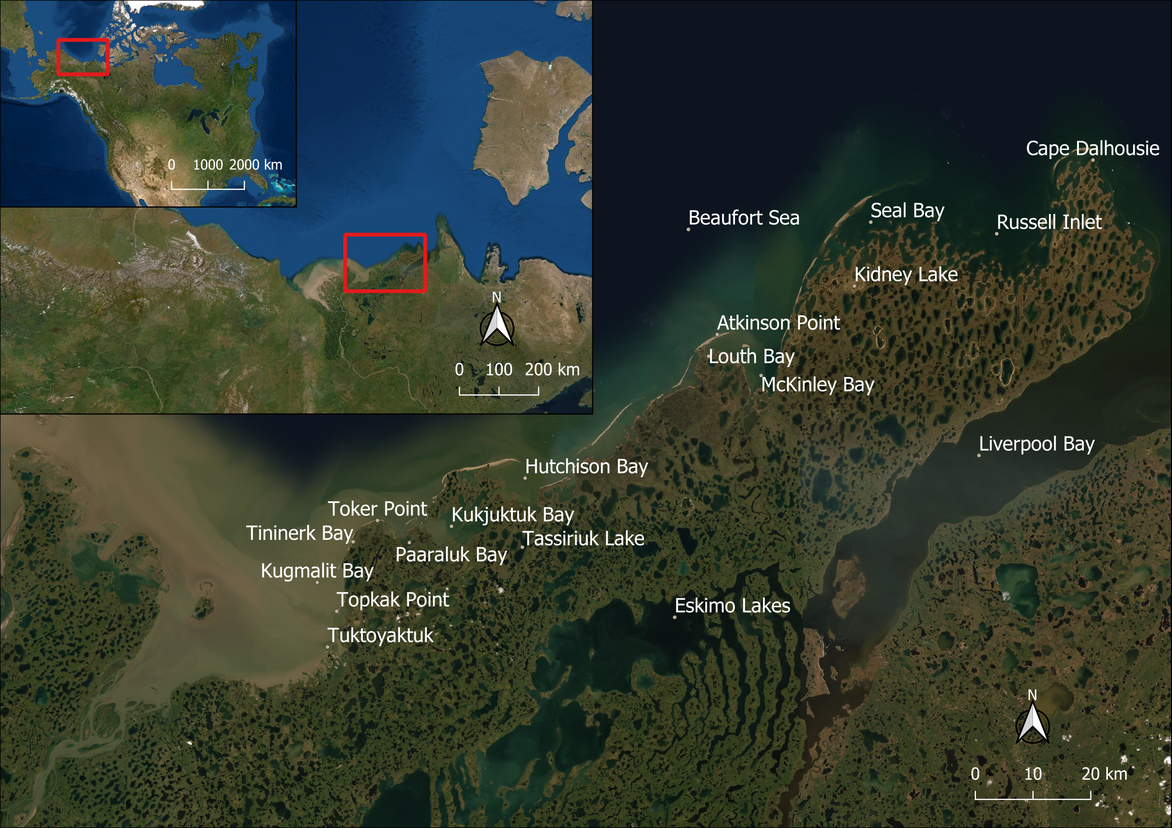
Study Area
Notes:
The Tuktoyaktuk Peninsula is located in the Inuvik Region of the Northwestern Territories of Canada, in the Inuvialuit Settlement Region.
Kugmalit Bay to the west, Beaufort Sea Coast to the north, Liverpool Bay to the east and Eskimo lakes to the south
Lowland composed of Holocene to Late Pleistocene (Wisconsinan Glaciation) sediments, overlaying continuous ice-rich permafrost.
High ground Ice content, being more vulnerable to thaw and erosion as temperature increases
Thermokarst lakes expanded from ancient river channels, abandoned throughout the Laurentide deglaciation and partially layered by eolian sand formations during the last glacial and early Holocene.
Study area from Tuk Harbour to Cape Dalhousie (Kugmalit Bay and Beaufort Sea coast)

Slide 4
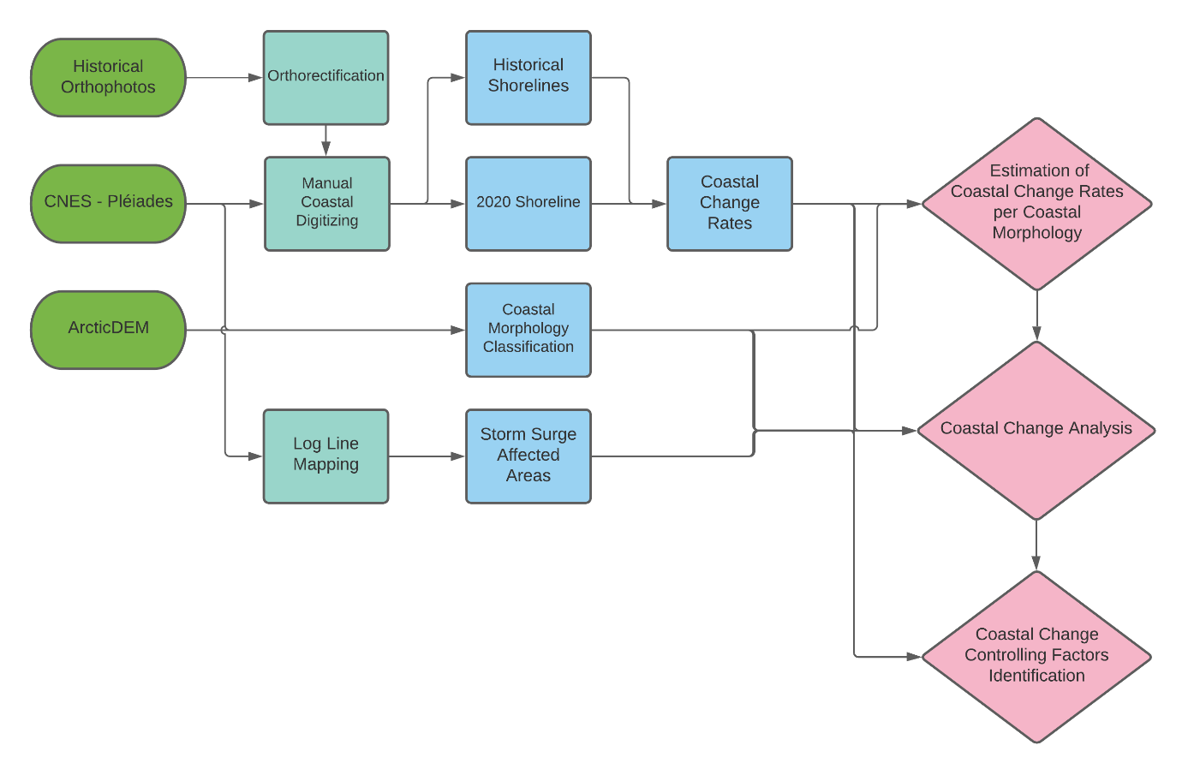
Methods
Shoreline Proxy: Wet-dry line
Coastal Morphology:
Foreshore
Beach
Tundra Flats
Active Cliffs/Bluffs
Backshore
Tundra Cliffs (further divided by height and ice wedge occurrence)
Tundra Flats (further divided by foreshore intertidal lakes existence)
Barrier Beaches and Sandspits
Notes:
Airbus CNES/Pleaides 2020 Imagery: its persistent-mode enables sequence image capturing over 12 images, 8 s apart with 0.5m resolution at a regional scale; this level of detail has allowed to study the Arctic’s coastlines in a further detail and accuracy.
The Historical Photos were provided by the Natural Resources Canada, on which an orthorectification was made (0.76m).
The Coastal Change Rates from 1985 to 2020 were calculated using the DSAS version 5.0 software package and classified by End Point Rate (m/yr).

Slide 5
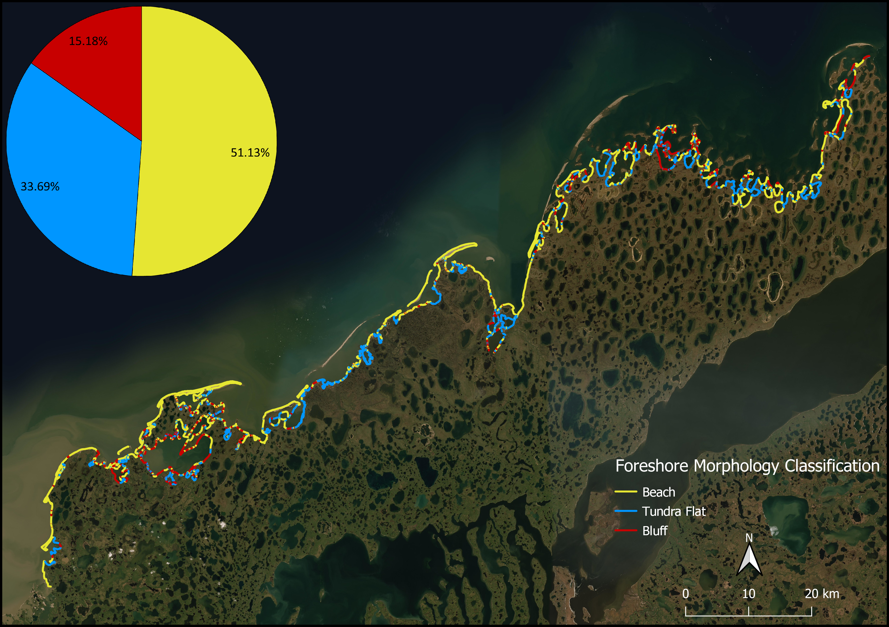
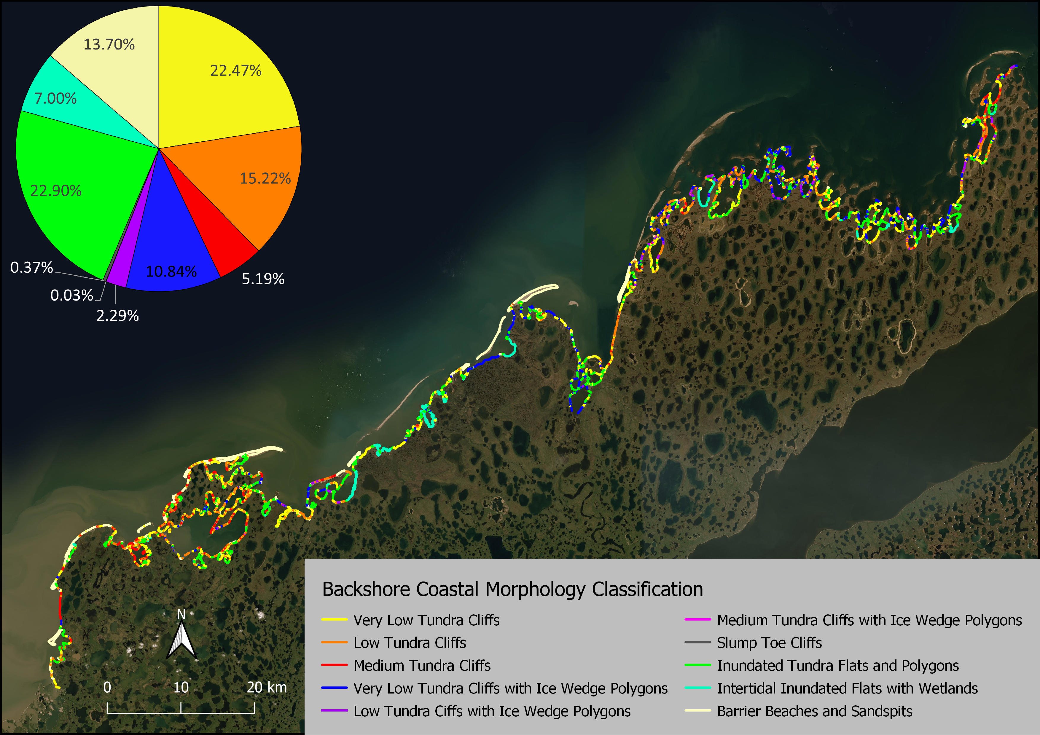
Coastal Geomorphology of the Tuktoyaktuk Peninsula
Notes:
Inundated Tundra Flats and Wetlands and Very Low Tundra Cliffs are the prevailing Backshore Coastal Morphology with similar values each (c. 23%).
Low Tundra Cliffs (15%), Barrier Beaches and Sandspits (c. 14%) and Very Low Degrading Ice Wedge Polygon Network (c. 11%) are the remaining five most extensive classes.
Beach (51%) is the predominant Foreshore Morphology in the Tuktoyaktuk Peninsula.
~34% of the seaward edge is Tundra Flats.
Active Bluffs compose 15%.

Slide 6
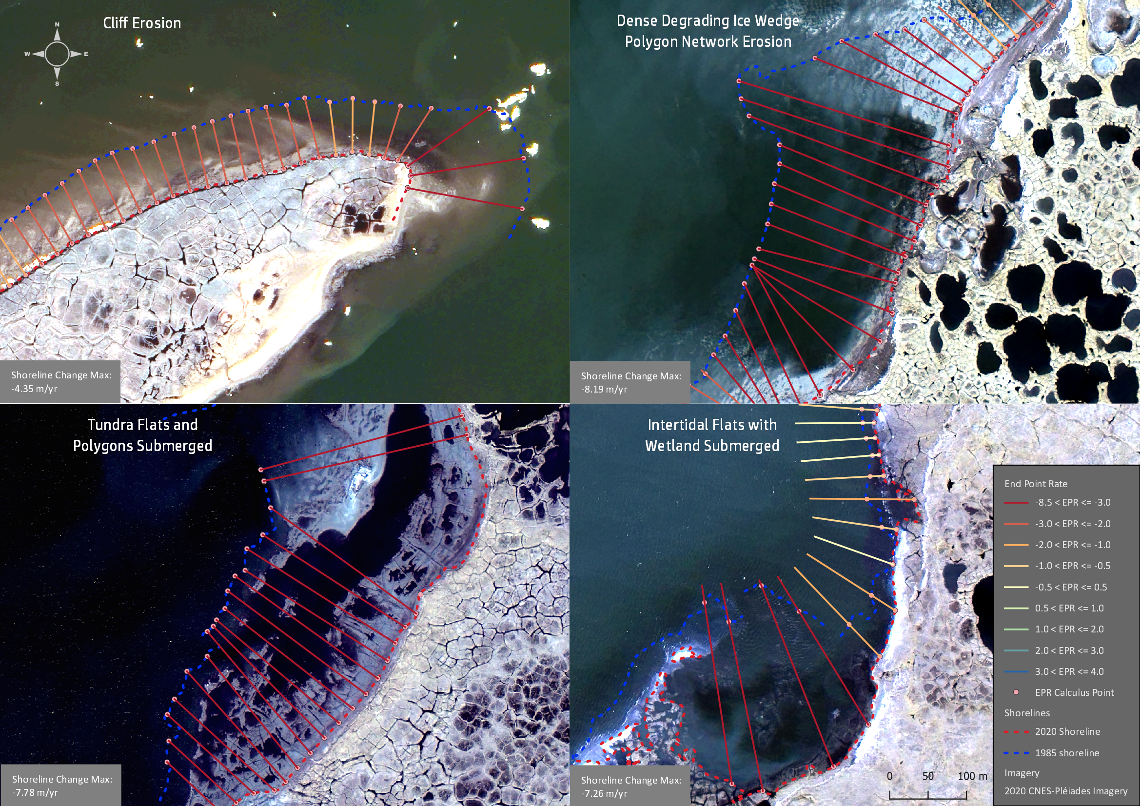
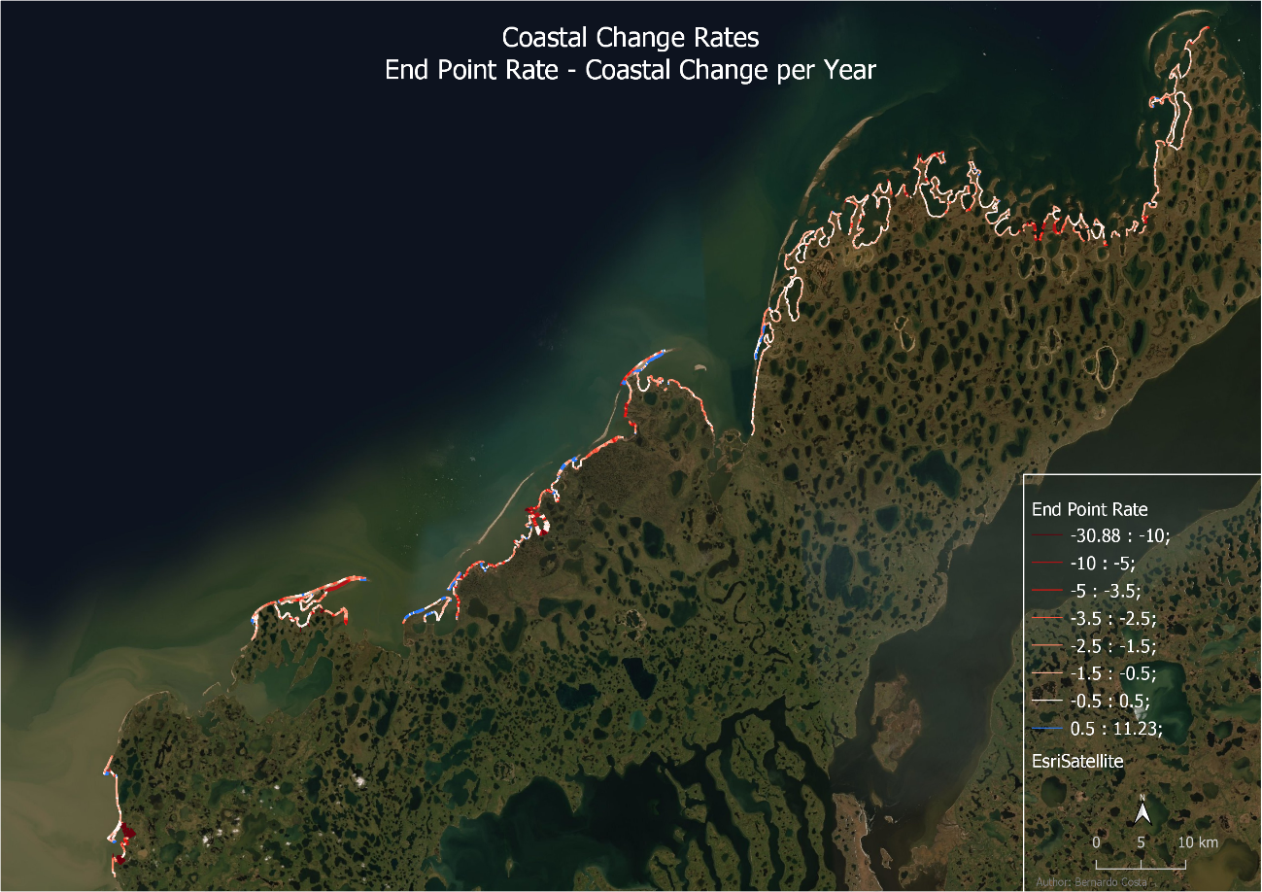
Coastline Change Analysis
EPR Average: -3.4 m/yr
EPR Average: -4.1 m/yr
EPR Average: -3.8 m/yr
EPR Average: -10m/yr
Notes:
Average EPR Value: -1.06 m/yr between 1985 and 2020
EPR ranging between -30.9 and 11.2 m/yr
Submersion represent 65% of retreat cases above 4 m/yr – High shoreline retreat do not necessarily suggest volume losses and carbon emitted.

Slide 7
Coastline Change Analysis
Notes:
Backshore Morphology:
Intertidal Inundated Flats with Wetlands is the class with the highest average EPR value: -2.10. m/yr – Submersion
Medium Tundra Cliffs, Inundated Tundra Flats with Wetlands, Barrier Beaches and Sandspits and Very Low Dense Degrading Ice Wedge Polygon Networks all have values above average (-1.06 m/yr).
Tundra Flat morphologies are the ones in which the shoreline retreats more on average (-1.66 m/yr) – mostly submersion.
Foreshore Morphology
Foreshore beaches may have a hindrance effect to retreat, when comparing with Active Tundra Bluffs and Tundra Flat foreshore.
Tundra Flats present no barrier to incoming storm surges and sea level rise – promoting submersion and permafrost thaw.

Slide 8
Conclusions
Average EPR: -1.06 m/yr between 1985 and 2020. EPR ranging between -30.9 and 11.2 m/yr.
The Tuktoyaktuk Peninsula has been losing 48 ha/yr for the past 35 years.
The results point to the influence of coastal morphology and geomorphologic factors in coastal change – Tundra Flats have the highest EPR values (in backshore and foreshore). Ice wedge polygons existence in cliffs is a local factor enhancing coastal retreat. – Local factors determine the rate of change and impact of coastal processes
Distinction between erosion and submersion is of major significance: different dynamics and impacts (e.g. carbon fluxes), but this is still lacking in automated coastal delineation.

Slide 9
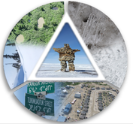

Acknowledgements
This research is part of the Nunataryuk project funded under the European Union's Horizon 2020 Research and Innovation Programme under grant agreement no. 773421.
This research has also been funded by the Climate Change Preparedness in North Program, from the Government of Canada.
The Pleaides imagery acquisition had the contribution of the WMO Polar Space Task Group.
Pleiades imagery: PLEIADES © CNES, 2020, distribution Airbus DS.
A special appreciation to the Community of Tuktoyaktuk and the Inuvialuit People for giving us the continued support to work and to better understand coastal landscape change on their lands.
ArcticDEM were provided by the Polar Geospatial Center under NSF OPP awards 1043681, 1559691 and 1542736.

