Slide 1

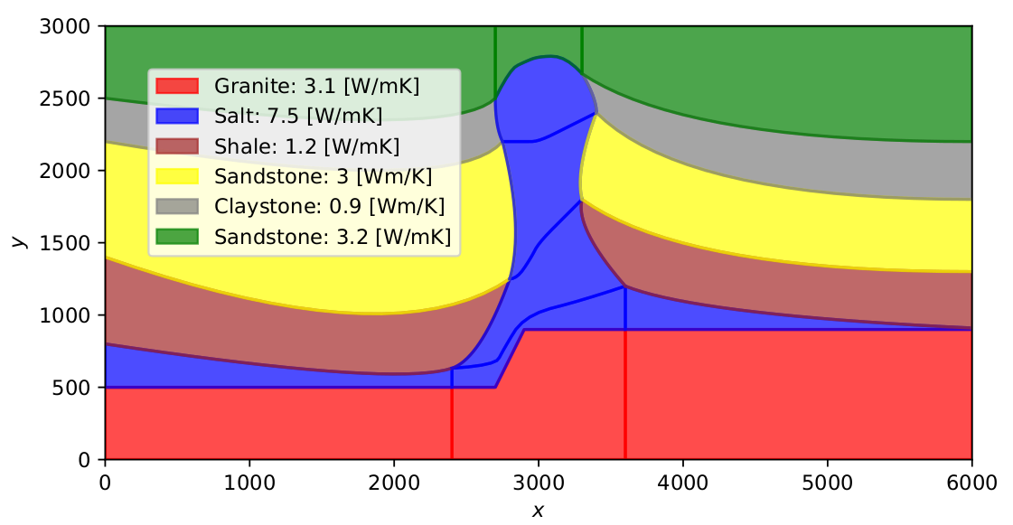
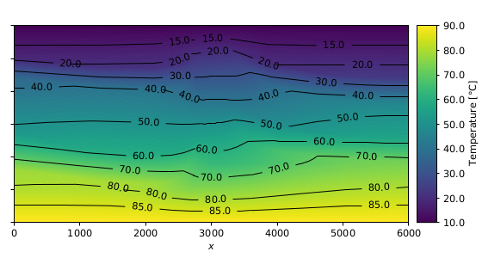
Making sense of Isogeometric Analysis for geothermal applications Parametric geomodeling (NURBS) for fast model construction, simulation and adaptation
Authors:
Daniel Escallón¹, Denise Degen² , s.Mohammad Moulaeifard³, Florian Wellmann²
¹Exploration and Environmental Geophysics, ETH Zürich, Sonneggstrasse 5, 8092 Zürich
²Computational Geoscience and Reservoir Engineering, RWTH Aachen University, Wüllnerstraße 2, 52062 Aachen
³Engineering Geology and Hydrogeology, RWTH Aachen University, Lochnerstraße 4-20, 52056 Aachen
EGU 2022 | Vienna, Austria | 23.05.2022 | Daniel Escallon
1
Authors:
Daniel Escallón¹, Denise Degen² , s.Mohammad Moulaeifard², Florian Wellmann²
Notes:
Thank you for the invitation today and for the award. Today I am going to show you my Master thesis that I finished last March.
My title of the thesis is Making sense of Isogeometric Analysis for geothermal applications. Subtitle,
Parametric geomodeling for fast model construction, simulation and adaptation.
But what do I mean with this:

Slide 2
Research question?
How to solve partial differential equations (PDE) based on a geologic model (geometry)?
How do we create geological models?
How do we transfer this information using finite elements (FE)?
Isogeometric Analysis (IGA)
EGU 2022 | Vienna, Austria | 23.05.2022 | Daniel Escallon
2
Notes:
The main research question is: How to solve partial differential equations (PDE) based on a geologic model (geometry)?
Which a common procedure is to solve this equations using finite differences, or finite elements. But for complex geological models (talking about geometry) this becomes a problem.
So there is a new method called: Non-Uniform rational B-splines (NURBS) based iso-geometric Finite Element Method (FEM) or in short Isogeometric Analysis (IGA).
That basically will look into 2 main questions:
How do we create geological models?
How do we transfer this information using finite elements (FE)?

Slide 3
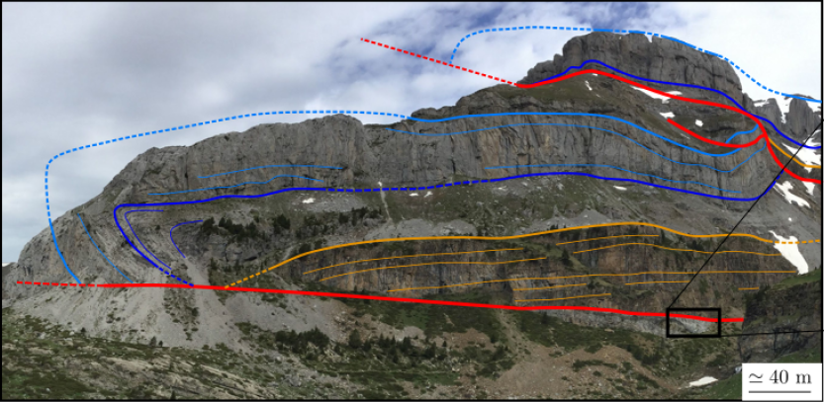
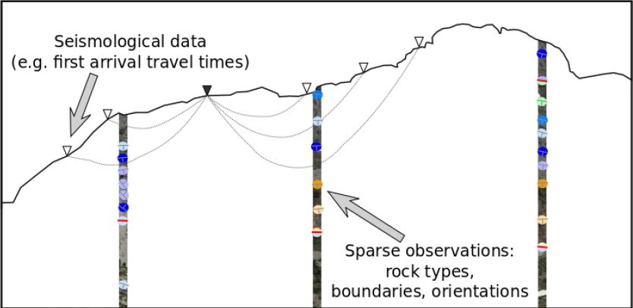
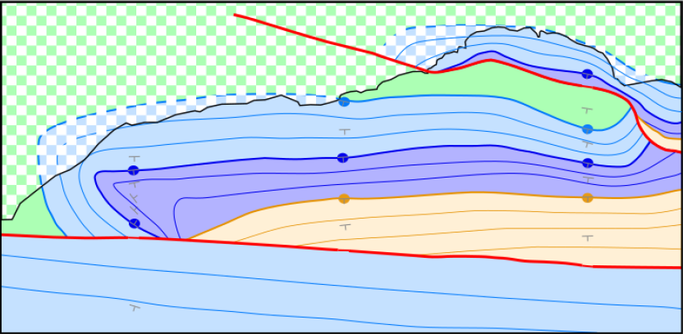
Implicit modeling vs Explicit modeling in Geosciences
Explicit modeling
Implicit modeling
What if we can not see the geometry? How can we create a model?
Interpolation of data (surface points and orientations)
Co-kriging
Figures taken from Wellman, F., and Caumon,G. (2018)
EGU 2022 | Vienna, Austria | 23.05.2022 | Daniel Escallon
3
Notes:
So, as brief introduction. There are 2 types of modeling in geosciences, explicit and implicit. Explicit being what you can literally see, you go to the field and you are able to put your finger in the interface between 2 different layers. From this we can create a model, previously was by pen and paper, but now we can draw it on computers or tablets and end up with a geometric model with clear interfaces.
But then, what if we can not see the geometry? How can we create a model? For this we will use surface points, orientation measurements, and geophysical data to obtain point data, and by use of fancy interpolation methods create a 3-D geological model. This is an Implicit model, which is nothing more than a mathematical construction of a model.

Slide 4
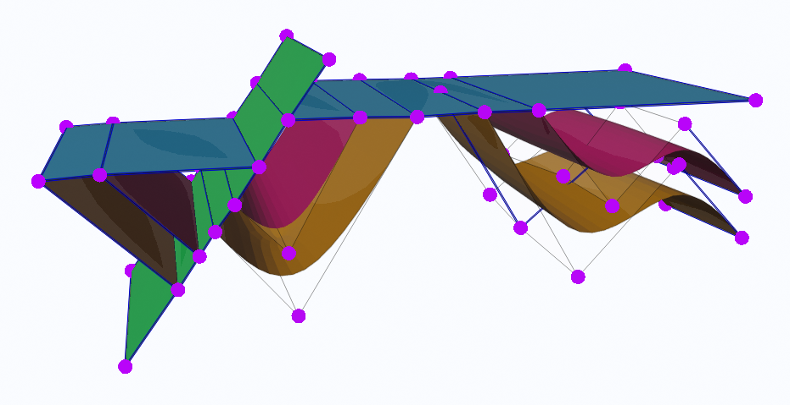
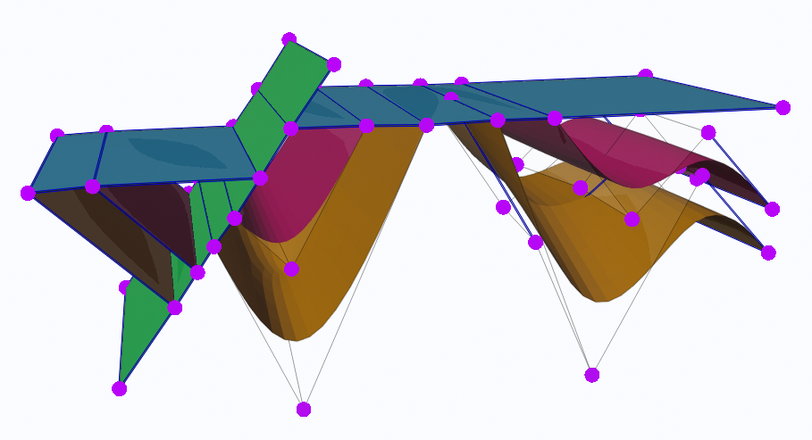
Advantages vs disadvantages
Controllable model with just 54 Control Points
Cp.
Cp.
Taken from M. Moulaeifard , F. Wellmann (2021)
EGU 2022 | Vienna, Austria | 23.05.2022 | Daniel Escallon
4
Notes:
On top of that. The explicit model is a controllable model. We can take a control point, and pulling it down, changing the geometry in this section, while preserving the other parts of the model intact. So now we have a system to manually modify the model as we want.
So now the question is how we can use this for doing any sort of simulation. The normal approach is doing a mesh of the geometry but I’m going to present to you a different approach.

Slide 5
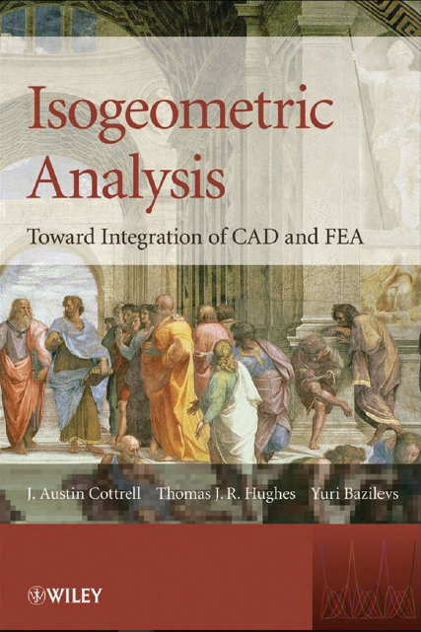
Analysis, simulation, Modeling and Design
What is IGA?
Hot-Topic: Compatible Spatial Discretizations for Partial Differential Equations
Conservation of Geometry in analysis
CAD: Computer-Aided Design
FEM: Finite Element Method
VS
CAD geometry is replaced by FEM geometry (“mesh”)
CAD geometry is exact
(e.g. NURBS)
Mesh generation is time consuming
The mesh is an approximate geometry
EGU 2022 | Vienna, Austria | 23.05.2022 | Daniel Escallon
5
Notes:
So lets start with what is IGA?
Iga comes from a hot-topic titled: Compatible Spatial Discretizations for Partial Differential Equations, wich in other words is trying to solve the problem of conserving the geometry during analysis.
There is a dual point of view of geometry. The computer aided design geometry and the Finite element method geometry. In CAD, the geometry is exact as a lot of disney pixar animations. While in FEM the CAD geometry is replaced by a FEM geometry that we will call a “mesh”.
So first, the mesh is time consuming to generate for the user. You need supervision during this process and it can be fairly easy with simple models, but when we introduce several faults or unconformities to the model it becomes more complex to generate a mesh.
Also the mesh is still an approximation of the geometry.
So here Isogeometric analysis plays an important role because it will allow us to perform analysis and simulations combined with modeling and design. All simultaneously.

Slide 6
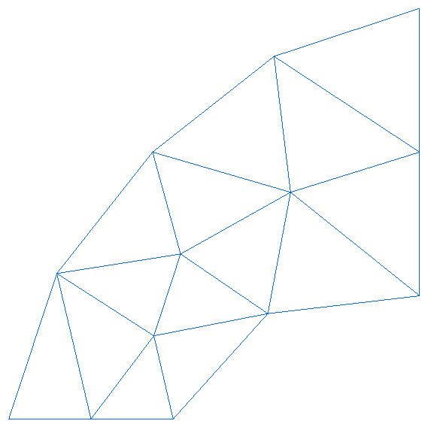
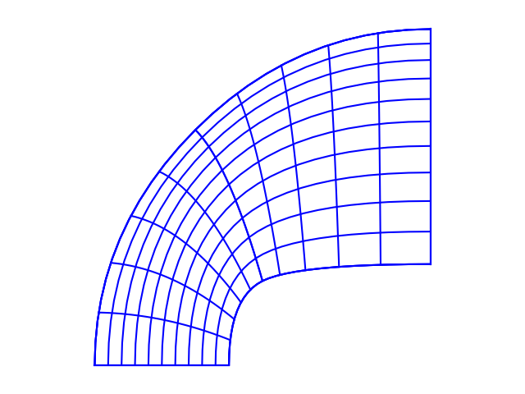
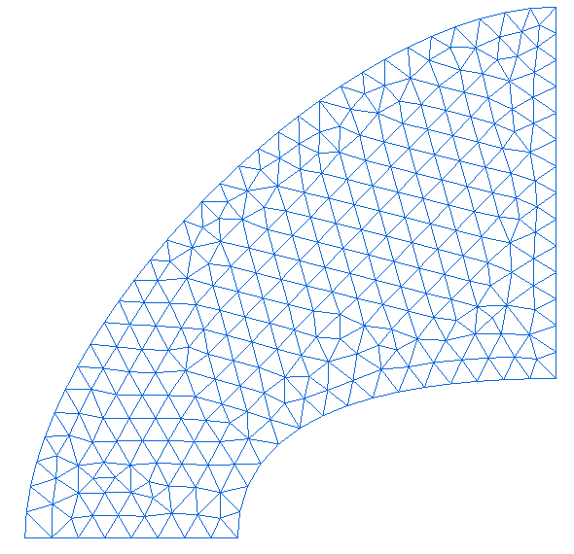
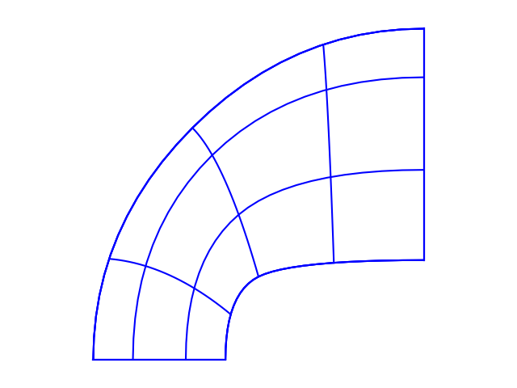
FEM mesh vs IGA mesh
Finite Element Method (FEM)
Simple elements (triangles, tetrahedra…)
Geometry approximation
Isogeometric Analysis (IGA)
Geometry map (splines, NURBS,…)
Use exact CAD geometry
Refinement
Refinement
EGU 2022 | Vienna, Austria | 23.05.2022 | Daniel Escallon
6
Notes:
Lets have a quick look to the mesh in the FEM.
This input file is the discretization of the geometry, so in other words the mesh file. For FE this is a geometric approximation using typically triangles. On the other hand, IGA uses the same CAD file geometry and still provide us with all the information needed. Notice that the geometry on the left is a very bad approximation of the true geometry, so we need to do a refinement of the mesh.
Now we see that the mesh starts to look like the geometry we want to represent, but still have errors, since curve section cannot be described using triangles, while IGA if we refine the geometry does not change at all.

Slide 7

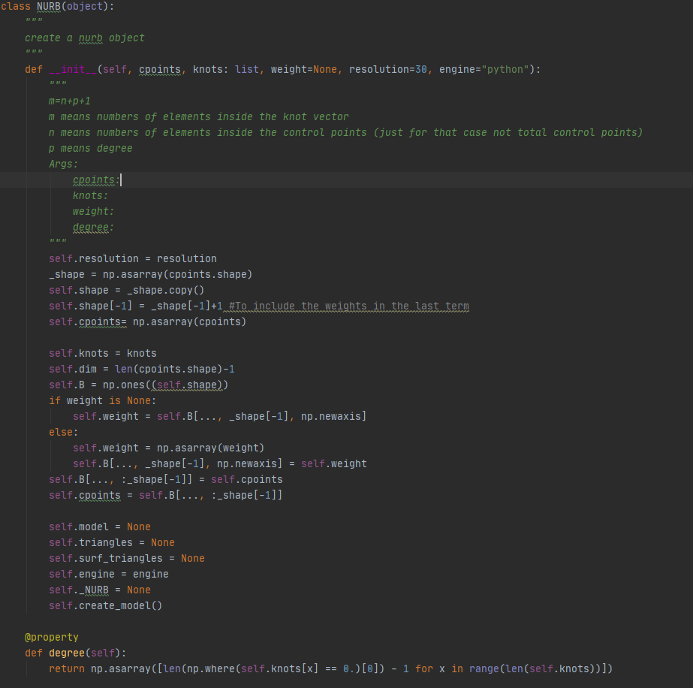
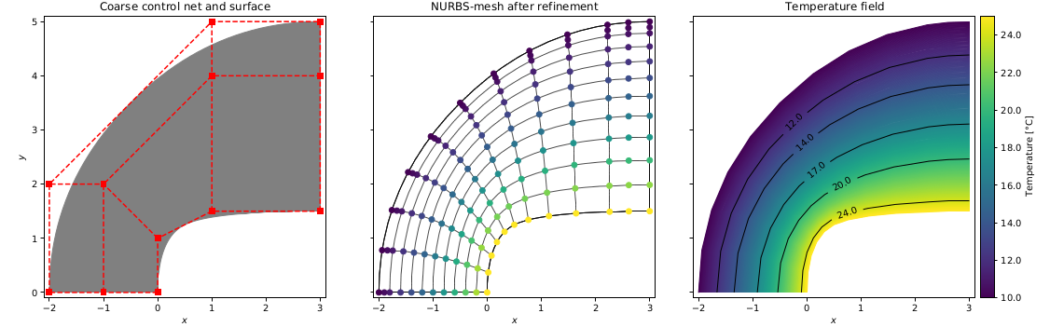
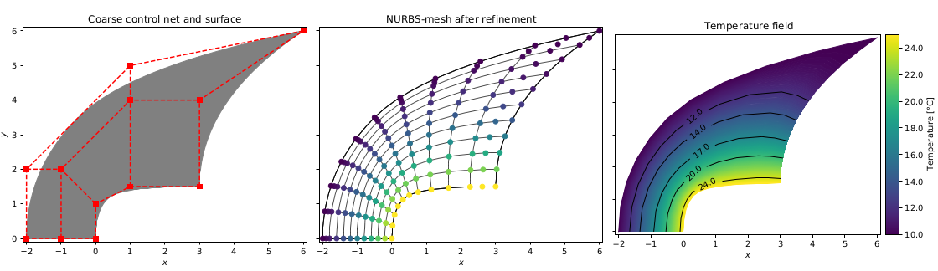
pyGeoIGA: Open-source IGA Multi-patch implementation in python
https://github.com/danielsk78/pygeoiga
EGU 2022 | Vienna, Austria | 23.05.2022 | Daniel Escallon
7
Notes:
So what is my contribution? I wrote a pyhton code that implements everything that I have been talking so far, plus it account for different subdomains. So I’m using just numpy and scipy libraries for the calculations, matplotlib and pyvista for all the plotting. And the best is that I just need as an input control points and knot vectors, and this is what I get from gempyexplicit or other commercial softwares.

Slide 8
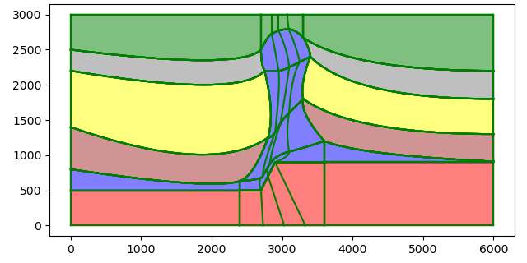
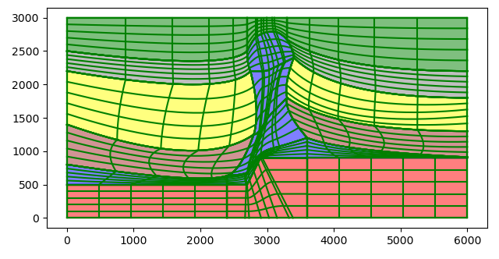
pyGeoIGA: Salt Dome example
red = 3.1 # W/mK Granite blue = 7.5 #W/mK Salt brown = 1.2 # 1.05–1.45 W/mK, shale yellow = 3 # 2.50–4.20 W/mK Sandstone gray = 0.9 #0.80–1.25 W/mK Claystone-Siltstone green = 3 # 2.50–4.20 W/mK Sandstone
Making sense of Isogeometric Analysis for geothermal applications
Parametric geomodeling (NURBS) for fast model construction, simulation and adaptation
Daniel Escallon | 03.12.2021 | Heitfeld-Stiftung
8
Notes:
We can do this now for more complex examples like a salt dome, that have thin layers, unconformities and faulting. The refinement again comes naturally and we can directly do simulations.

Slide 9
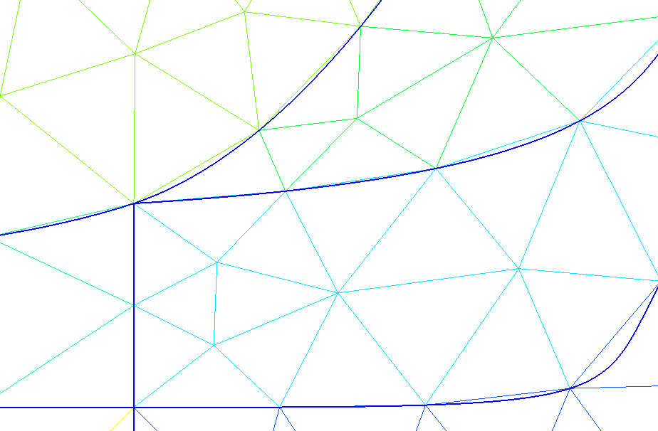
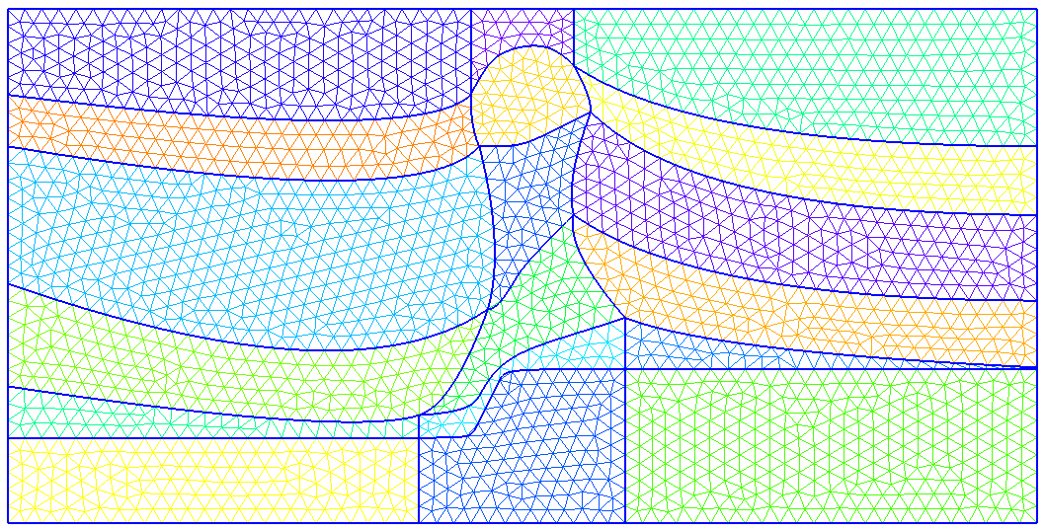
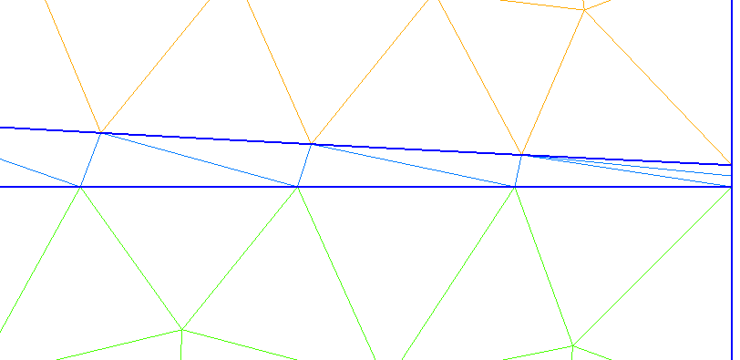
Mesh comparison
EGU 2022 | Vienna, Austria | 23.05.2022 | Daniel Escallon
9
Notes:
If we compare the meshes. On the top one, the natural mesh represents better the boundaries and have also better resolution on elements that are smaller on thinner. While the normal finite element mesh m¿by doing a global refinement, we can spot some problems.
In this boundary we are trying to represent a curve with a triangle, and this is not correct, introducing errors in the calculation. So we need to create smaller triangles in this area to account completely for the geometry.
We can see that for thin layers, there is only 1 element, therefore we would need to increase the amount of triangles in this area to have better resolution.

Slide 10
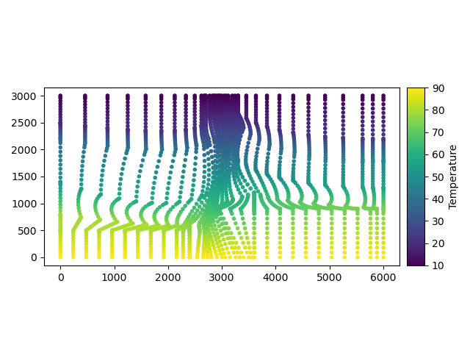
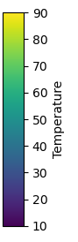
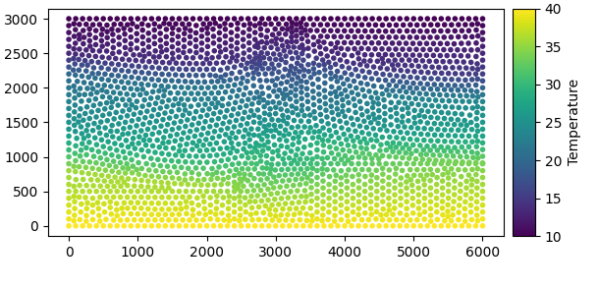
Verification
Salt dome model
FEM: 2381 DOF
IGA: 2681 DOF
EGU 2022 | Vienna, Austria | 23.05.2022 | Daniel Escallon
10
Notes:
While in IGA, the boundary is perfectly represented even at lower degrees of fredoom because of the natural mesh that this geometry have. And notice that if we do the global refinement, this boundaries become more and more exact.

Slide 11
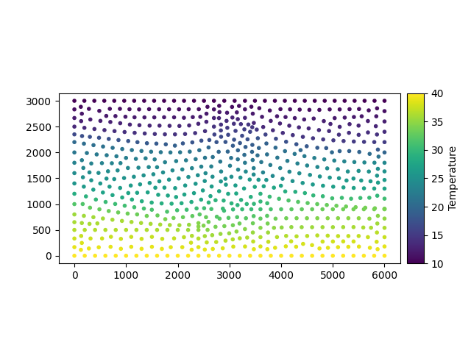
Conclusions
FEM
IGA
Geometry is just an approximation
Geometry is exact
Need further refinement: Increase the dof
+ Computational time
Less amount of dof to resolve areas of interest
- Computational time
EGU 2022 | Vienna, Austria | 23.05.2022 | Daniel Escallon
11
Notes:
So as preliminary conclusions. The traditional finite element method uses approximation of geometries while in IGA we use exact geometries.

Slide 12

Thank you!
Questions?
EGU 2022 | Vienna, Austria | 23.05.2022 | Daniel Escallon
12
Notes:
So as preliminary conclusions. The traditional finite element method uses approximation of geometries while in IGA we use exact geometries.

