Slide 1
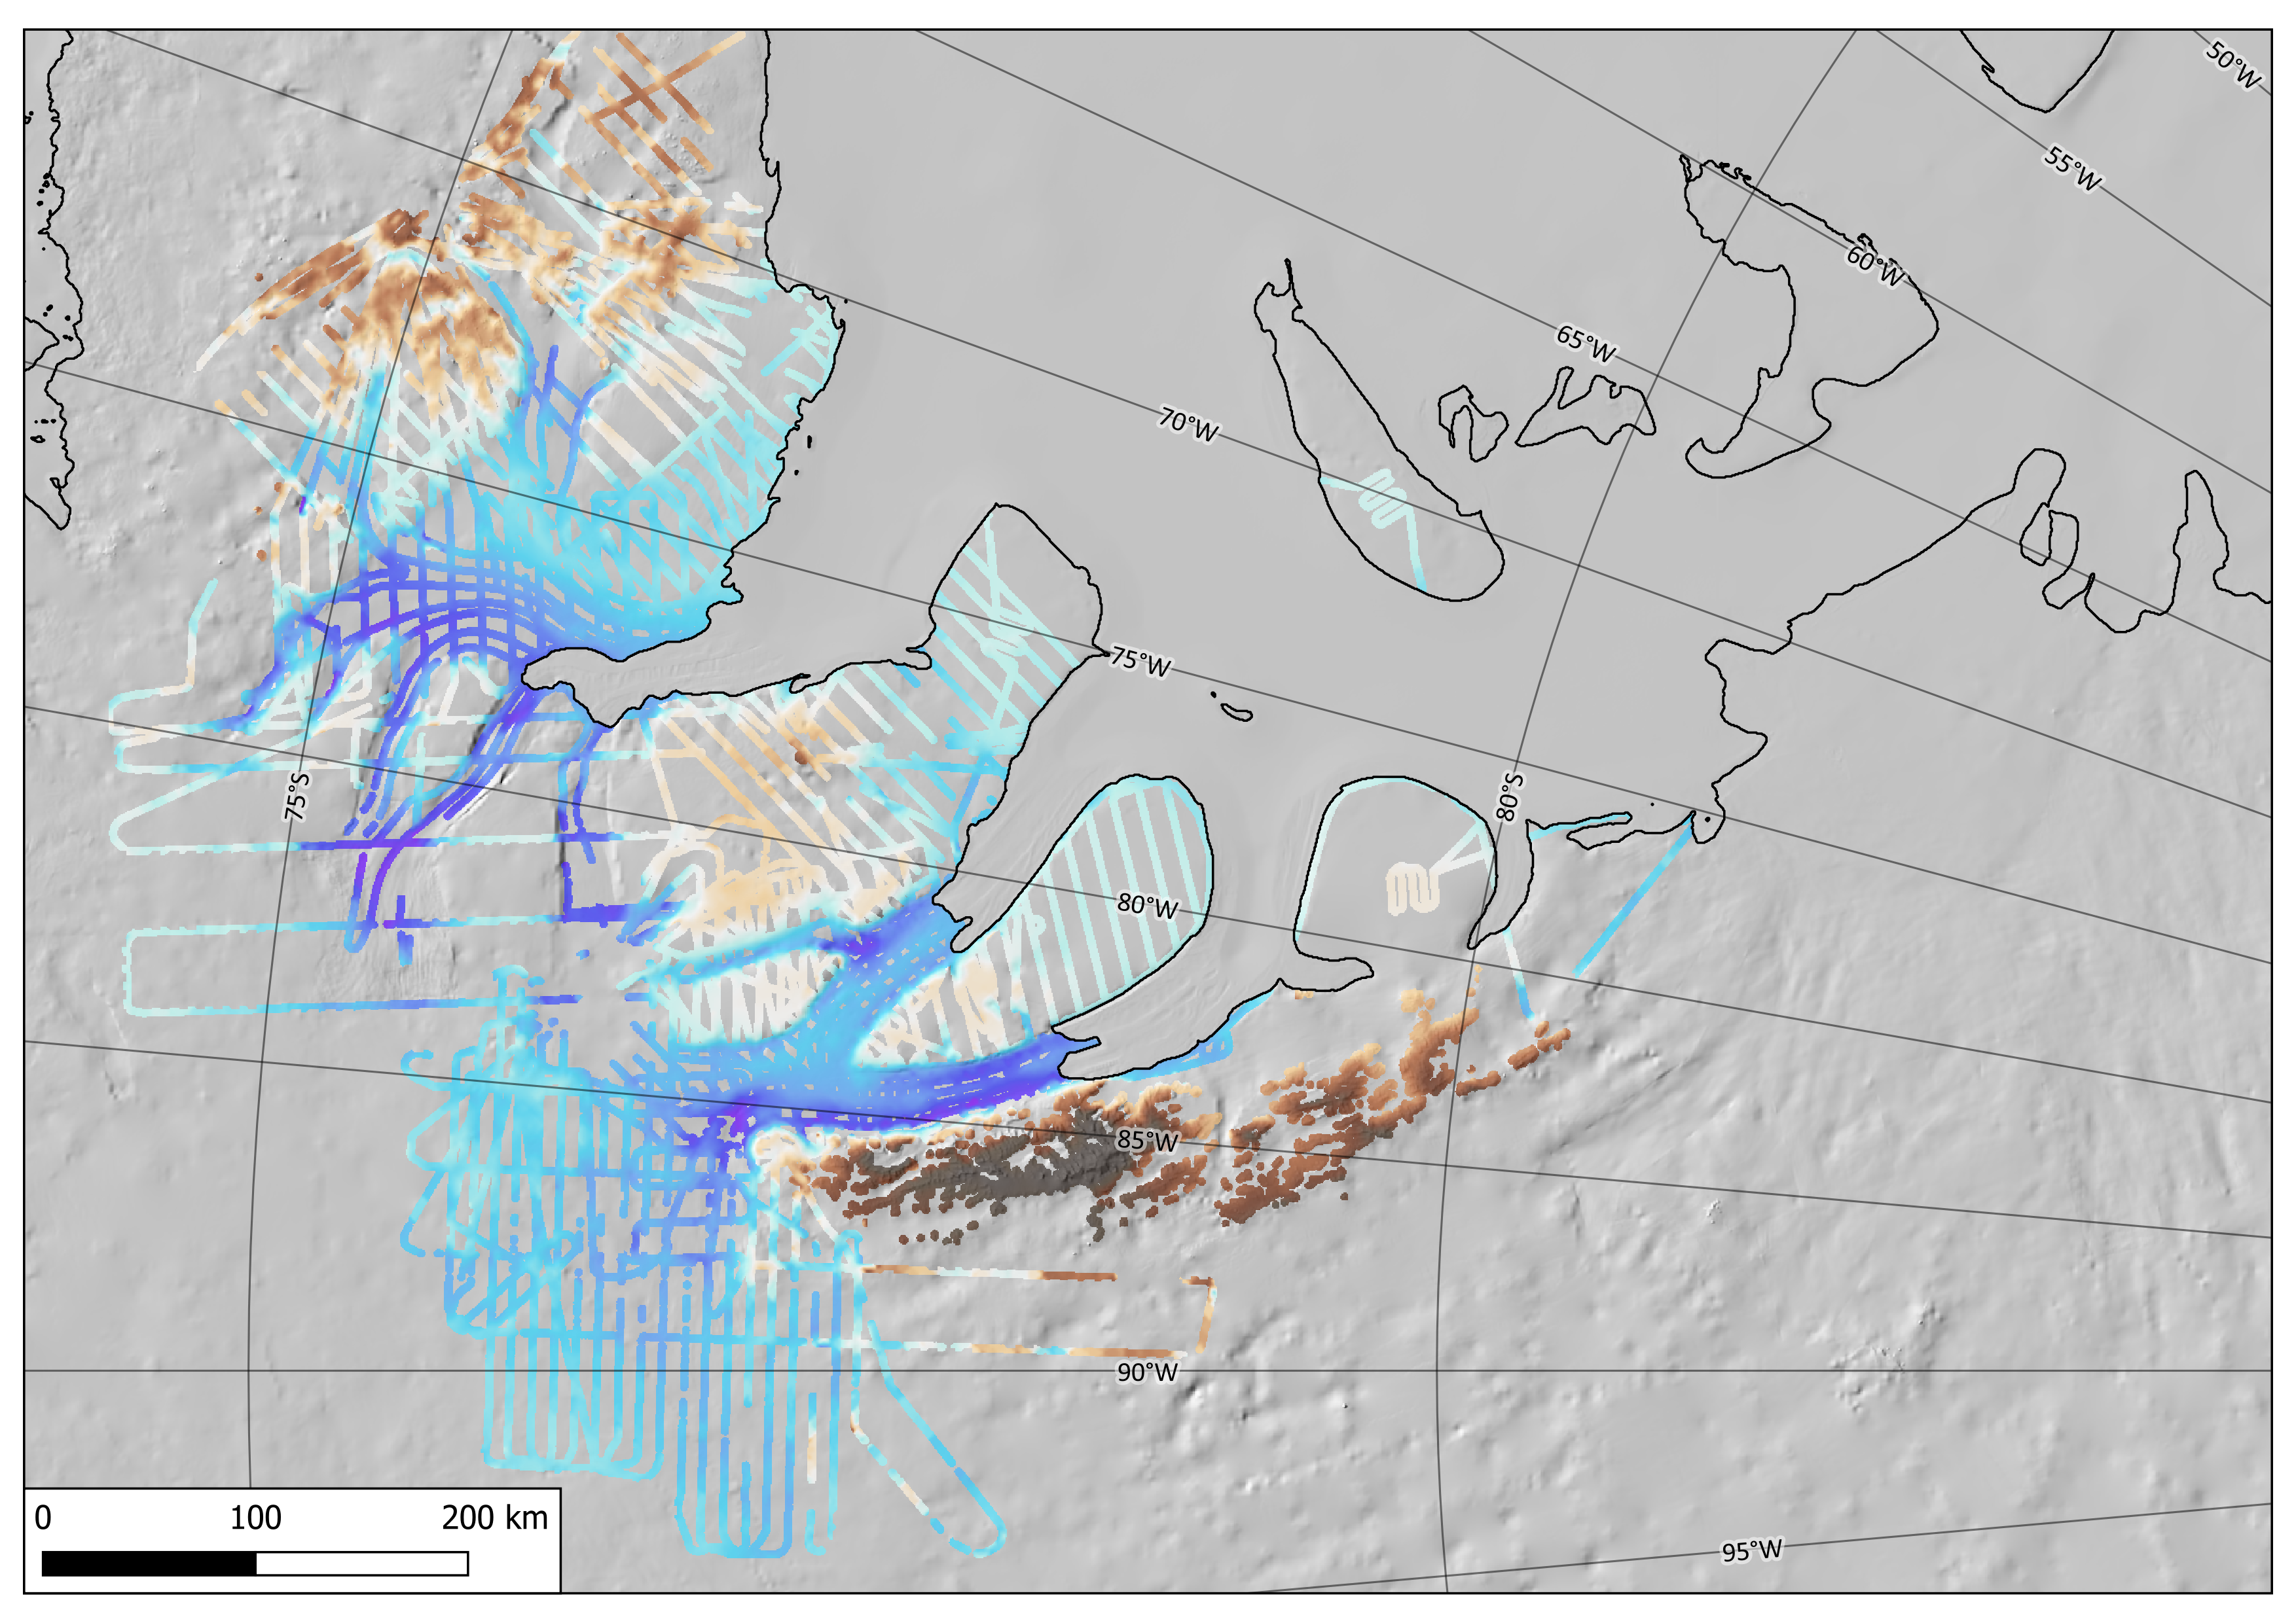


Subglacial topography and landscape evolution from radio-echo sounding data in the Evans-Rutford Region, southern Antarctic Peninsula
Charlotte Carter¹, Michael Bentley¹, Stewart Jamieson¹, Neil Ross², Tom Jordan³, and Julien Bodart⁴
Contact author: Charlotte Carter (charlotte.m.carter@durham.ac.uk)
¹Department of Geography, Durham University, UK
²School of Geography, Politics and Sociology, Newcastle University, UK
³British Antarctic Survey, UK
⁴School of Geosciences, University of Edinburgh, UK

Slide 2
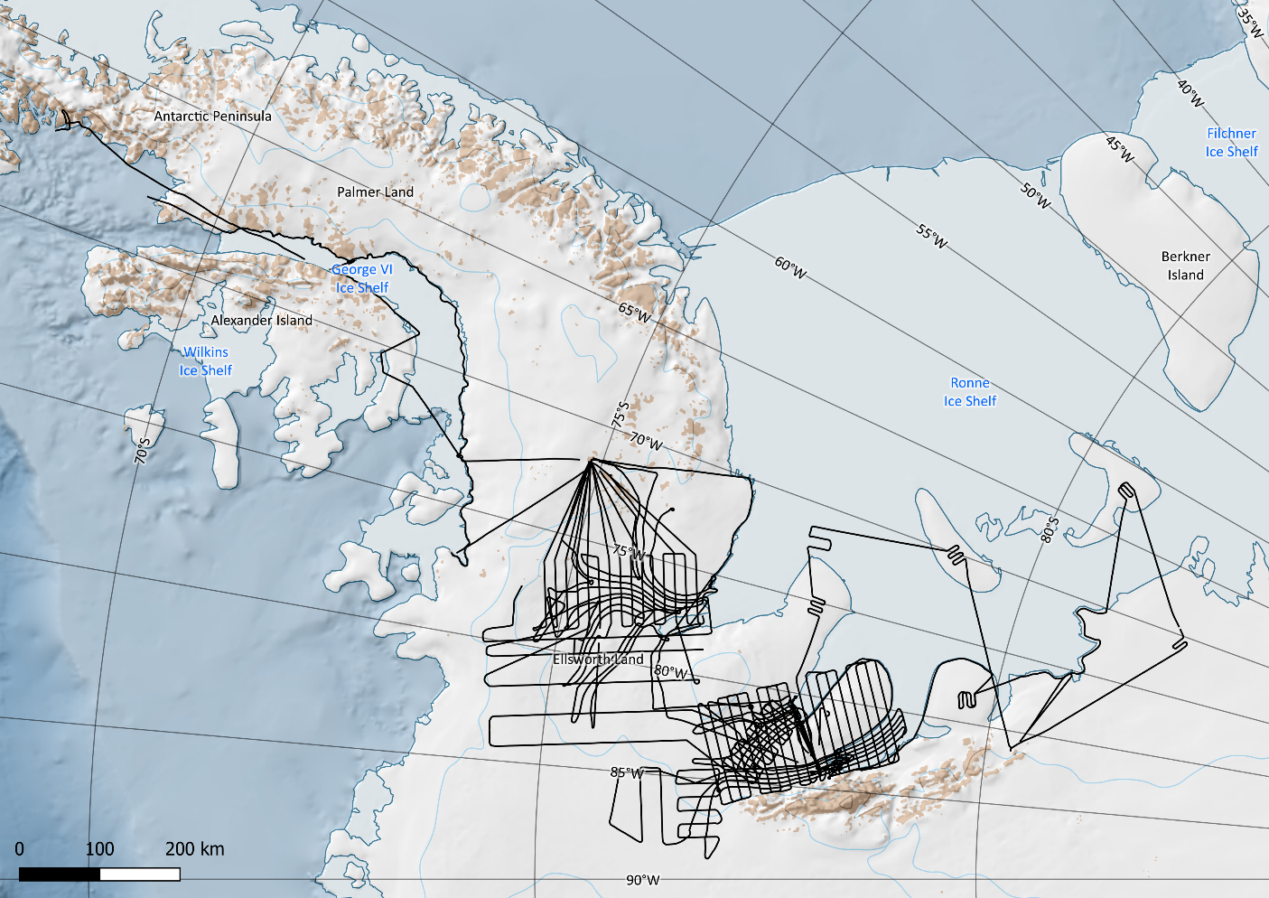
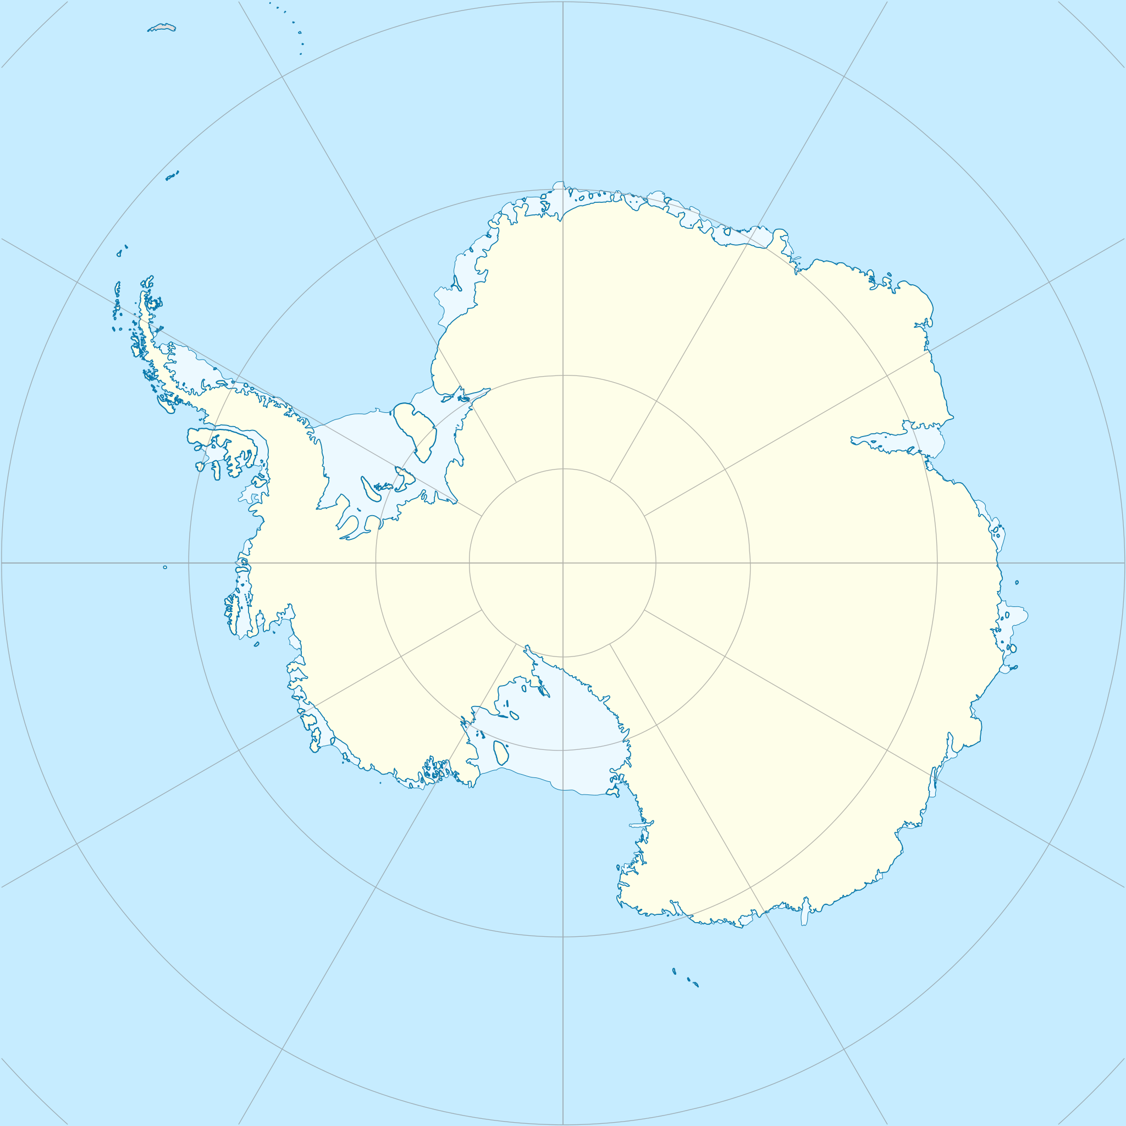
Aim: To infer the landscape evolution and ice history of the Evans-Rutford Region (ERR) of the southern Antarctic Peninsula using radio-echo sounding data.
Objectives:
Compile available RES and other datasets relevant to the ERR
Map subglacial topography
Morphometric analysis of bed topography
Infer landscape evolution of the ERR
Rationale:
We want to understand how the subglacial landscape might have evolved, and how it exerts control on ice flow in this region.
Antarctic Peninsula
Evans Ice Stream
Rutford Ice Stream
Ellsworth Mountains
Multiple RES surveys of the region (GRADES-IMAGE (illustrated by black line), TORUS, Evans 1994/95) with a total of 48,550 line km of data.
Not all of these surveys are included in BedMachine.
Charlotte Carter – EGU22-2467
Notes:
To introduce my study region: the Evans-Rutford Region is located south of the Antarctic Peninsula, and above the Ellsworth mountains. The main areas of focus are the Evans and Rutford ice streams, which flow into the Ronne ice shelf.
Detailed studies of the subglacial topography of the whole of the region are limited, however, there have been smaller scale glaciological investigations into the dynamics of the Rutford ice stream.
This study arose from the release of the legacy GRADES-IMAGE radar dataset, the flightlines of which are displayed on this map.
We aim to infer the landscape evolution and ice sheet history of the region, with the objectives of mapping the subglacial topography and conducting morphometric analysis of the bed.
This is with a view to understanding how the subglacial topography might have a control on ice flow.

Slide 3
A new Digital Elevation Model interpolated for Evans-Rutford Region
DEM interpolated using Cubic Spline Approximation in QGIS
Repicked some sections of automatic bedpicks of GRADES-IMAGE survey data
Includes elevations of bedrock topography in REMA, TORUS, and Evans 1994/95 bed picks
Key features:
Improved clarity of topography at base of Peninsula
Flat plateaus at similar elevations
Reaffirms deep troughs in which current and past ice has flowed
Some asymmetry in the floor of Carlson Inlet and Evans Ice Stream
Ronne Ice Shelf
Evans Ice Stream
Carlson Inlet
Rutford Ice Stream
km
-2.5 0 2.5
Charlotte Carter – EGU22-2467
Notes:
Using the GRADES-IMAGE bed elevation picks, we have interpolated a new DEM of the region, using cubic spline approximation.
We repicked some sections of the automatic bedpicks to remove data gaps as it struggled in some areas, which was most commonly, deep troughs and their steep sides weren’t picked up accurately, and side echoes in areas of alpine topography disrupted the bed picks.
To increase the spatial coverage and point density, the DEM also includes bed elevation points from the TORUS and Evans 1994/95 legacy radar datasets, as well as exposed bedrock datapoints derived from the REMA dataset.
Key features that we’ve seen within the DEM are:
Improved clarity of the alpine topography at the base of the Peninsula
Flat plateaus at similar elevations that are spread across the region
It reaffirms deeply incised troughs containing current and past ice flow that have abrupt linear margins, some of which potentially have tectonic controls
Have seen some asymmetry in the Carlson Inlet, which is deeper on the north side than the south, as well as the Evans Ice Stream, which seems shallower in the north than the south and ice flow is faster in the north

Slide 4
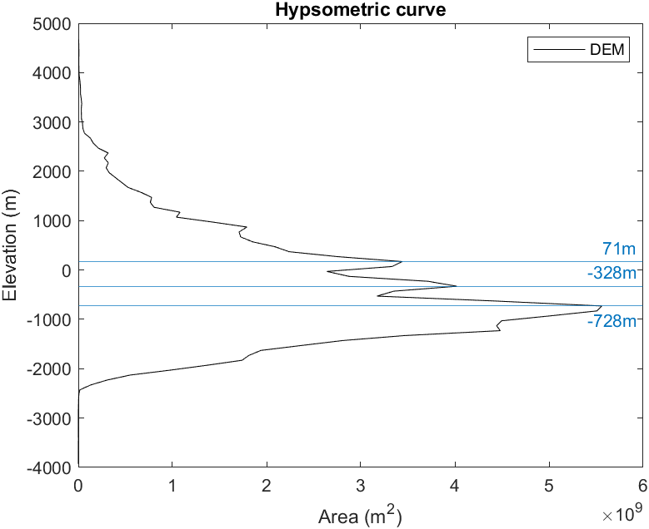
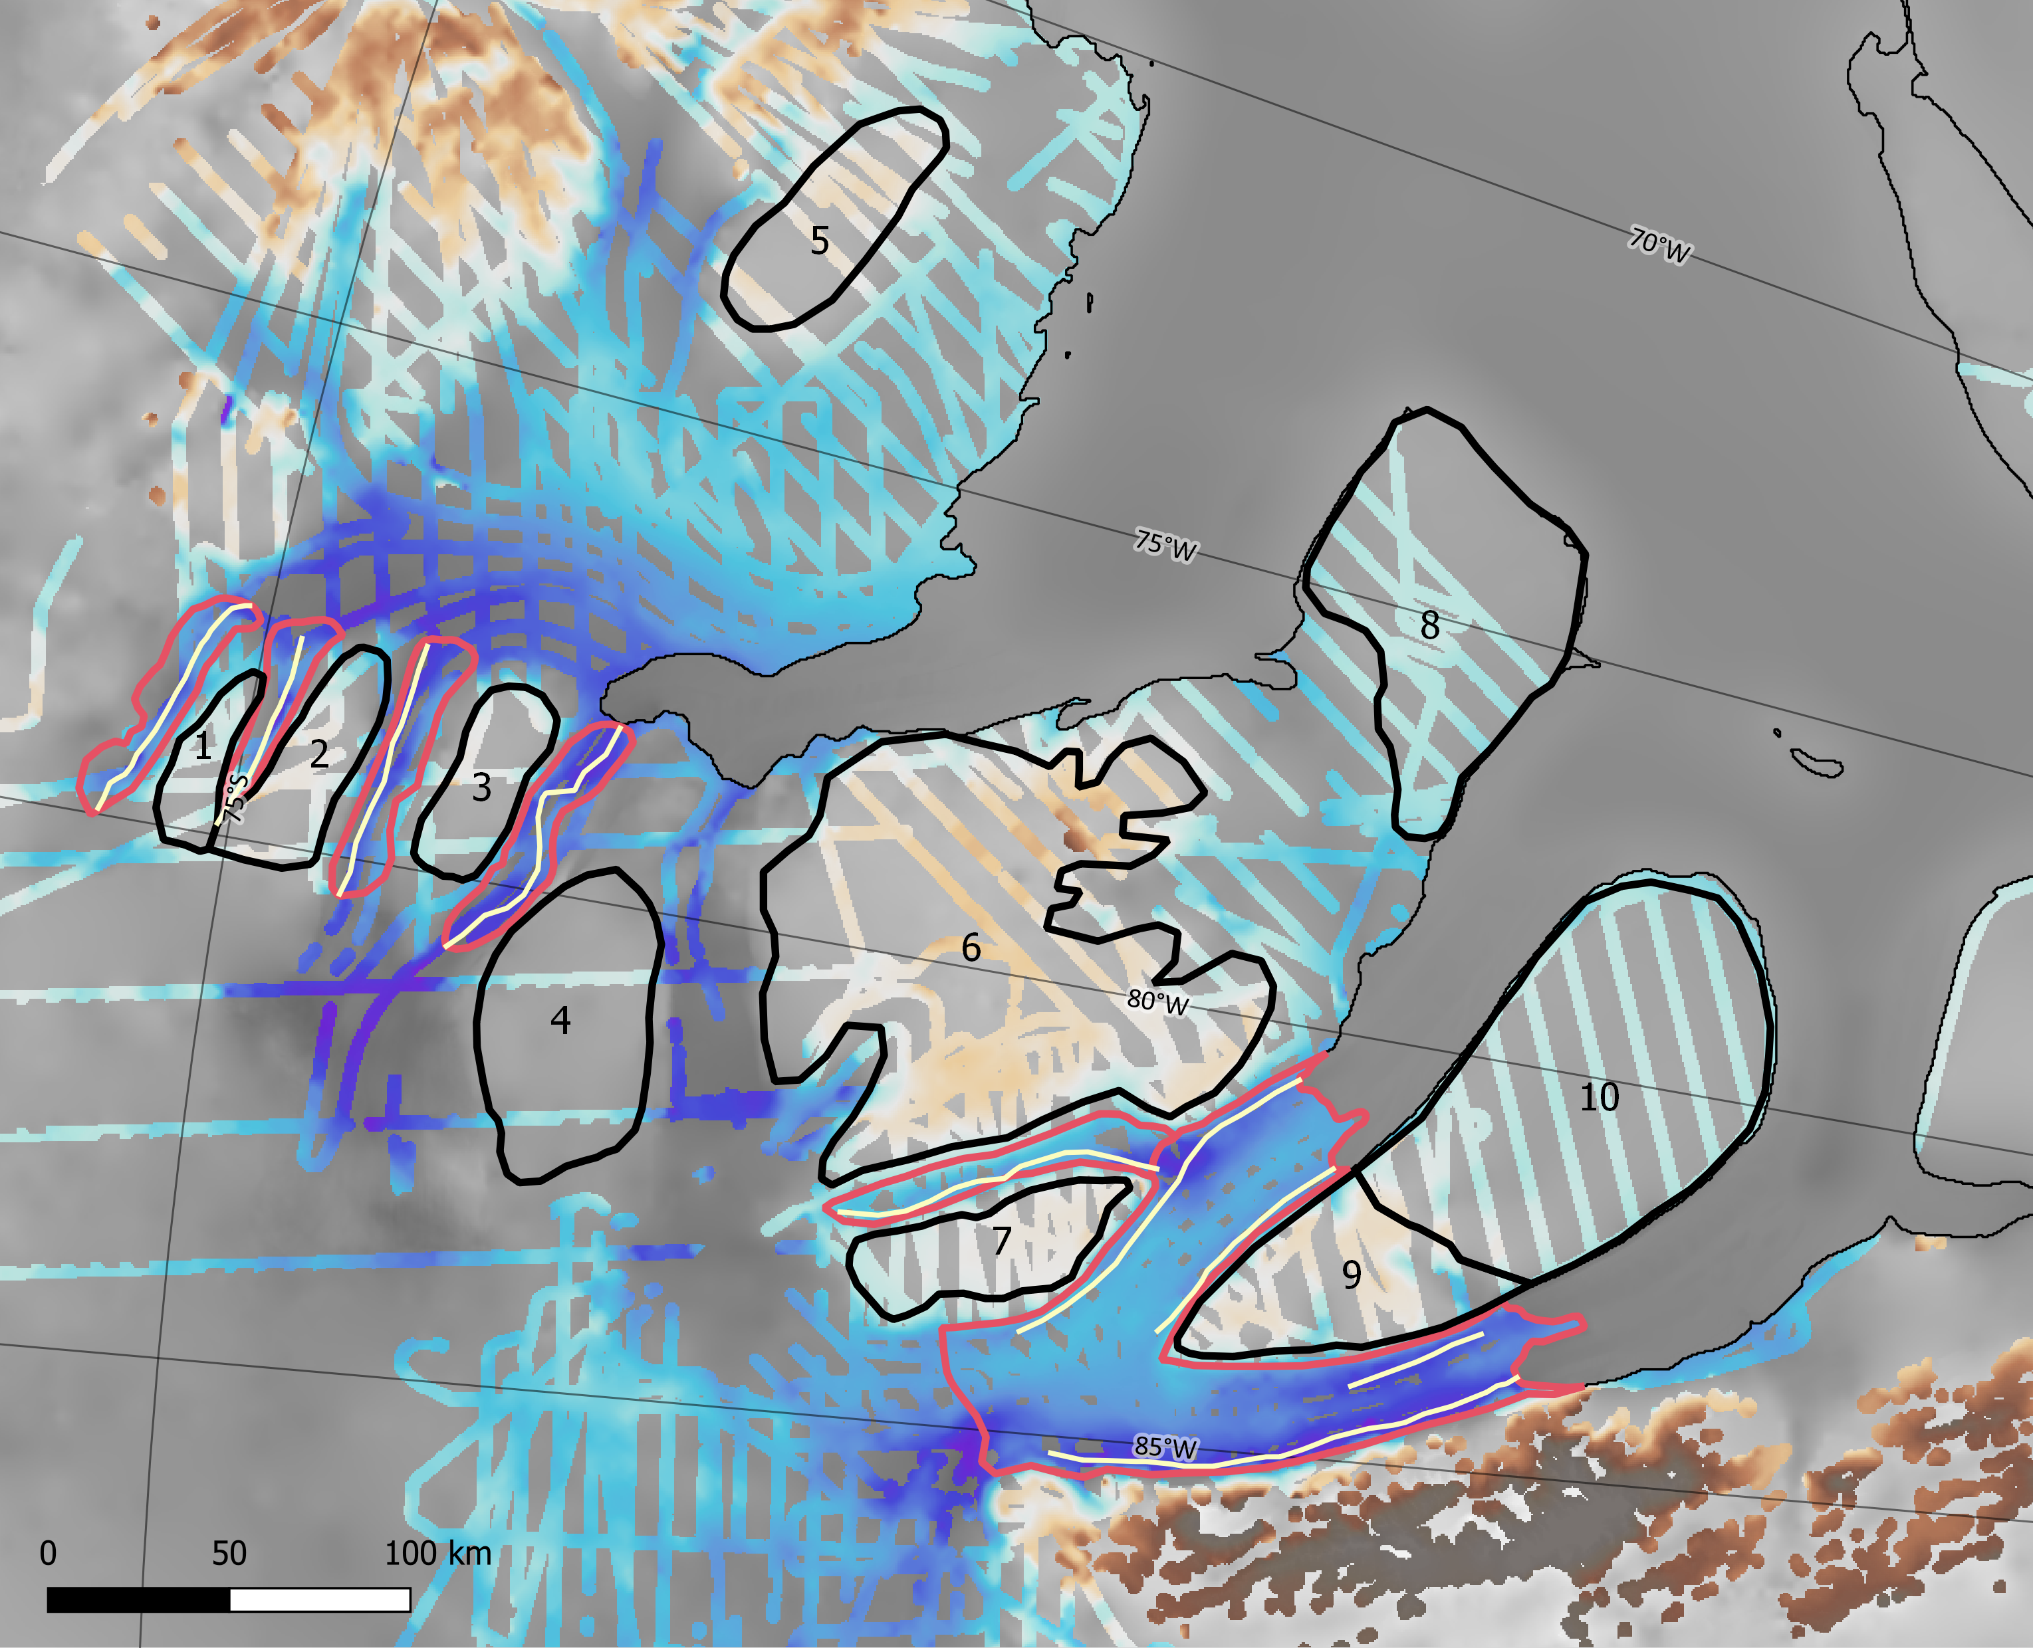
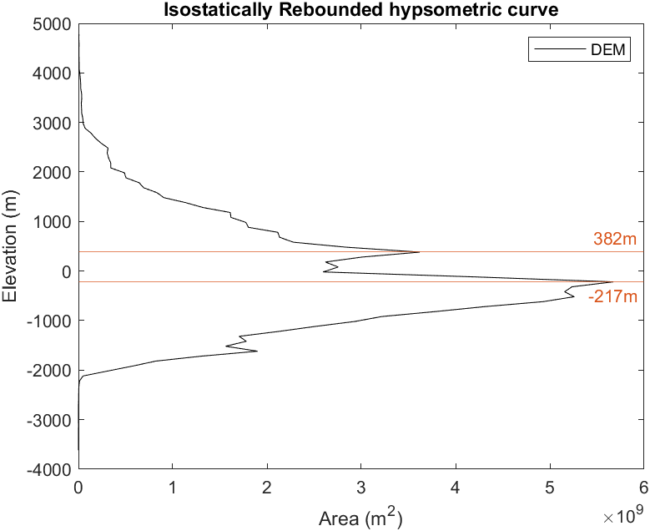
Landscape classification of flat plateaux and incised troughs
Plateaux outlined in black
Troughs outlined in red with thalwegs in yellow
Ronne Ice Shelf
Evans Ice Stream
Carlson Inlet
Fletcher Promontory
Rutford Ice Stream
km
-2.5 0 2.5
Charlotte Carter – EGU22-2467
Notes:
One of the main features that we would like to discuss are the series of flat plateaus spread across the region, outlined in black on the map.
Multiple plateaux sit at very similar elevations, suggesting a regionally coherent surface.
A set of higher plateaux is evident, for example, 5, 6, 7 and 9, and sets of lower plateaus e.g. 1, 2, and 3
The plateau elevations of 8 and 10 line up with the surfaces found under present day ice rises within the Ronne Ice Shelf.
However, some of these plateaus have variations within the surface
For example, plateau 9, on the Fletcher Promontory, includes interesting V shaped channels radiating from the centre.
The hypsometric curve on the top right has 3 evident peaks in elevation, highlighting the plateau surfaces within the landscape
The peak at 728m below sea level pertains to the troughs containing the ice streams, particularly the broad trough underlying Evans.
Between plateaus 1 to 4, and 6 and 7, are asymmetric V shaped troughs that have been incised into the landscape, with the thalwegs tending to one side of the channel.
Around plateau 9, the troughs containing the Rutford Ice Stream and Carlson Inlet have a potential tectonic control. The deep erosion into the base of the trough walls indicates potential fault bounding, similar to that seen in the George VI Sound.
We have also used a flexural isostatic rebounding model to reconstruct the land surface with ice having been removed.
The hypsometric curve produced from this only demonstrates two significant peaks in elevation
Deeper areas with thicker ice have rebounded to an elevation that is comparable to some shallower areas with thinner ice, and have converged such that 3 peaks have become 2

Slide 5
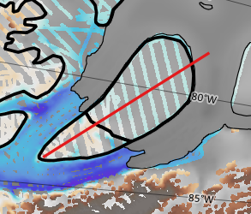
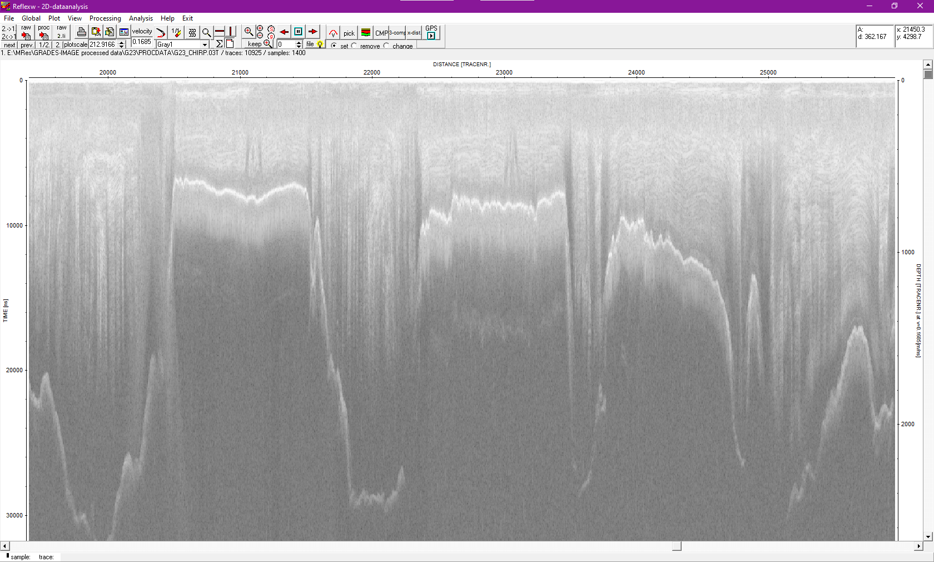
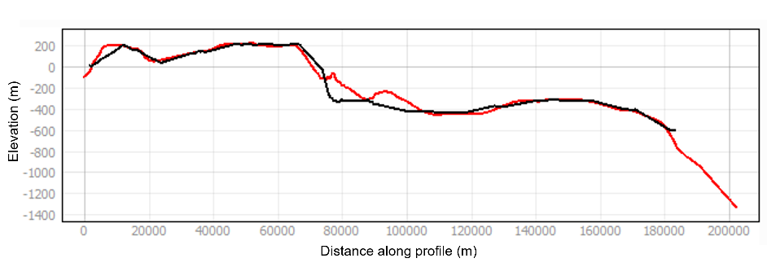
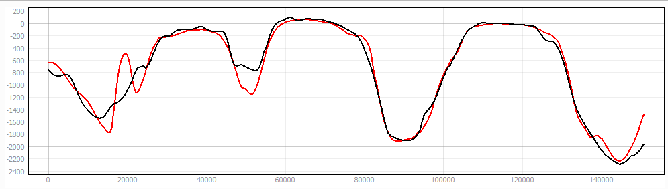
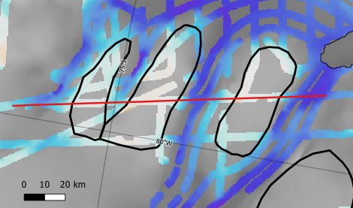
Example radargram of plateau surfaces
0
23.5km
Carlson Inlet
10
1000
Rutford Ice Stream
9
Start
Depth (m) at v = 0.1685[m/ns]
1
2
3
2000
Evans Ice Stream
The Fletcher Promontory plateau (above) divided into two surfaces.
Plateaux south of Evans (left) display evidence of flexure as result of trough incision
Elevation (m)
3
1
2
Start
Distance along-profile (m)
Interpolated profiles from DEM (black line) and BedMachine (red line).
Charlotte Carter – EGU22-2467
Notes:
This is an example radargram of plateaus 1, 2 and 3, and demonstrates how well the DEM represents the direct data measurements from the radar.
This cross profile along the plateaus shows the flat surfaces and how they sit at almost the exact same elevation. This indicates that there may be a regionally coherent surface that has been latterly incised by ice sheet flow.
They also display evidence of flexure at the margins, as a result of trough incision.
You can also see from the profile how it compares to BedMachine, which is the red line on the graph.
This level of accuracy means that we can draw long profiles of the plateaus where direct data measurements aren’t present.
From this, we have seen that the Fletcher Promontory plateau between Carlson and Rutford, contains two separate surfaces with a distinct step between them, where the lower surface (10) is cut into the higher one (9).
The geometry of the surrounding troughs may also suggest some tectonic influence in controlling ice flow patterns.

Slide 6
Conclusions
Interpolated a new DEM of the Evans-Rutford Region from legacy RES data
Mapping of subglacial landscape
Found a series of flat plateaus with incised troughs showing different phases of landscape evolution/erosion
Morphology of some trough margins is indicative of fault bounding
Next steps
Timing of plateau formation
Assessing tectonic influence on trough boundaries and ice sheet behaviour
Further questions? charlotte.m.carter@durham.ac.uk
Charlotte Carter – EGU22-2467
Notes:
So to conclude: we have interpolated a new DEM of the Evans-Rutford Region, and have found a series of flat plateaus with incised troughs showing different phases of landscape evolution.
The morphology of some of the trough margins is also indicative of fault bounding.
Continuing with the project, we are going to look at potential timing of the plateau formation.
We also will be investigating the influence of tectonics on the trough boundaries and how this might have impacted ice sheet behaviour in this region.
Thank you so much for listening, and if you have any questions, my email is on the slide.

