Slide 1

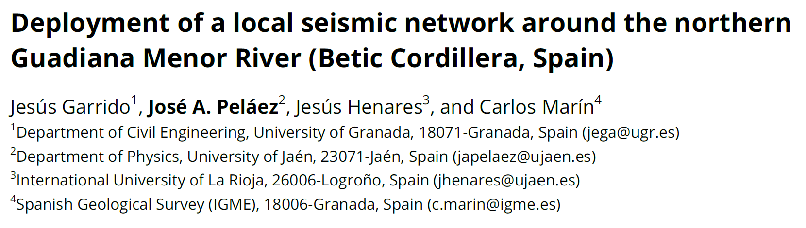
Programa Operativo FEDER Andalucía 2014‐2020.
Call made by the University of Jaén, Spain, 2018.

Slide 2
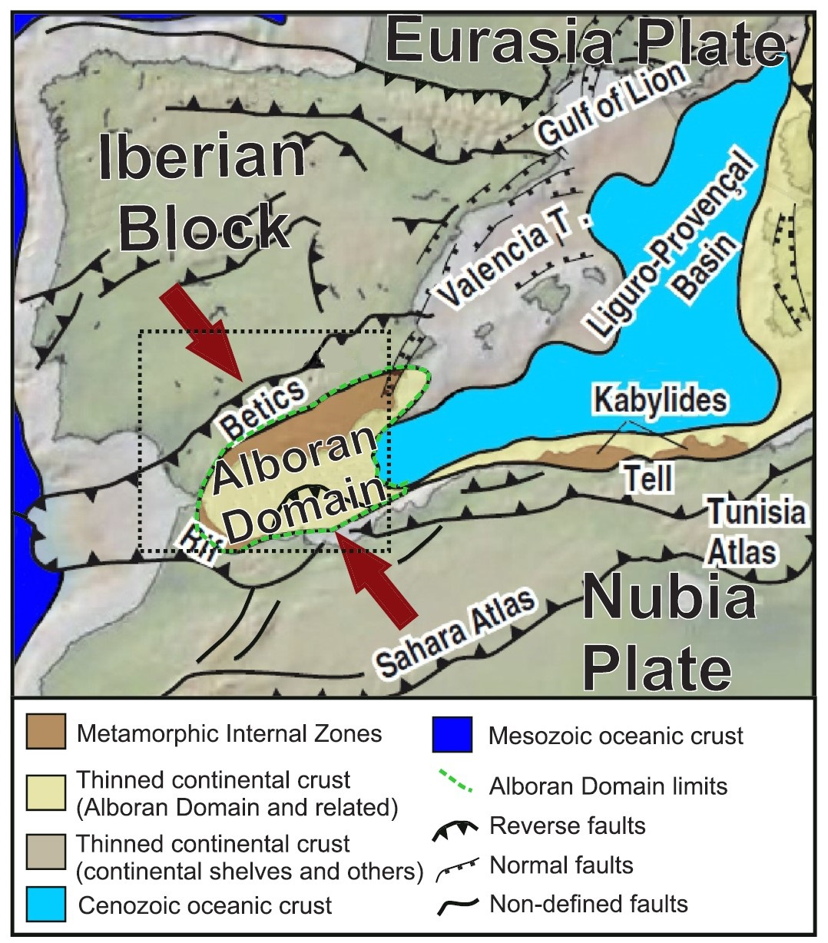

Slide 3
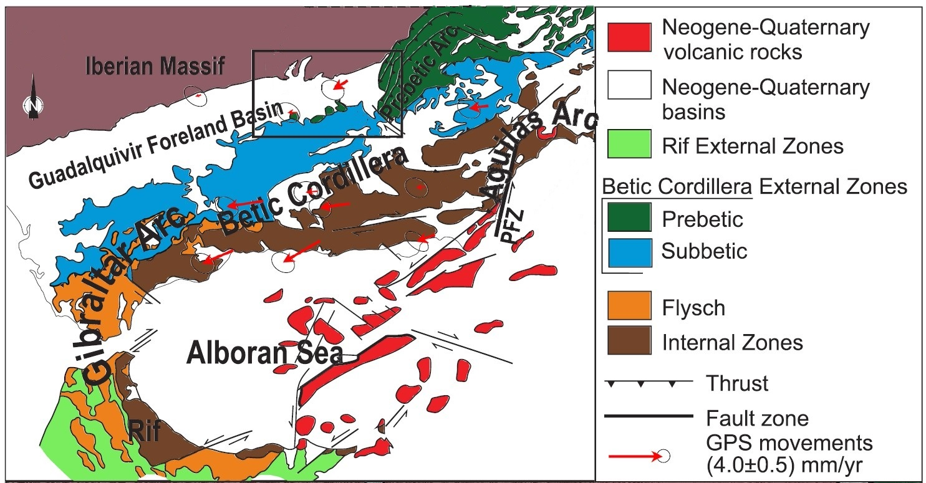

Slide 4
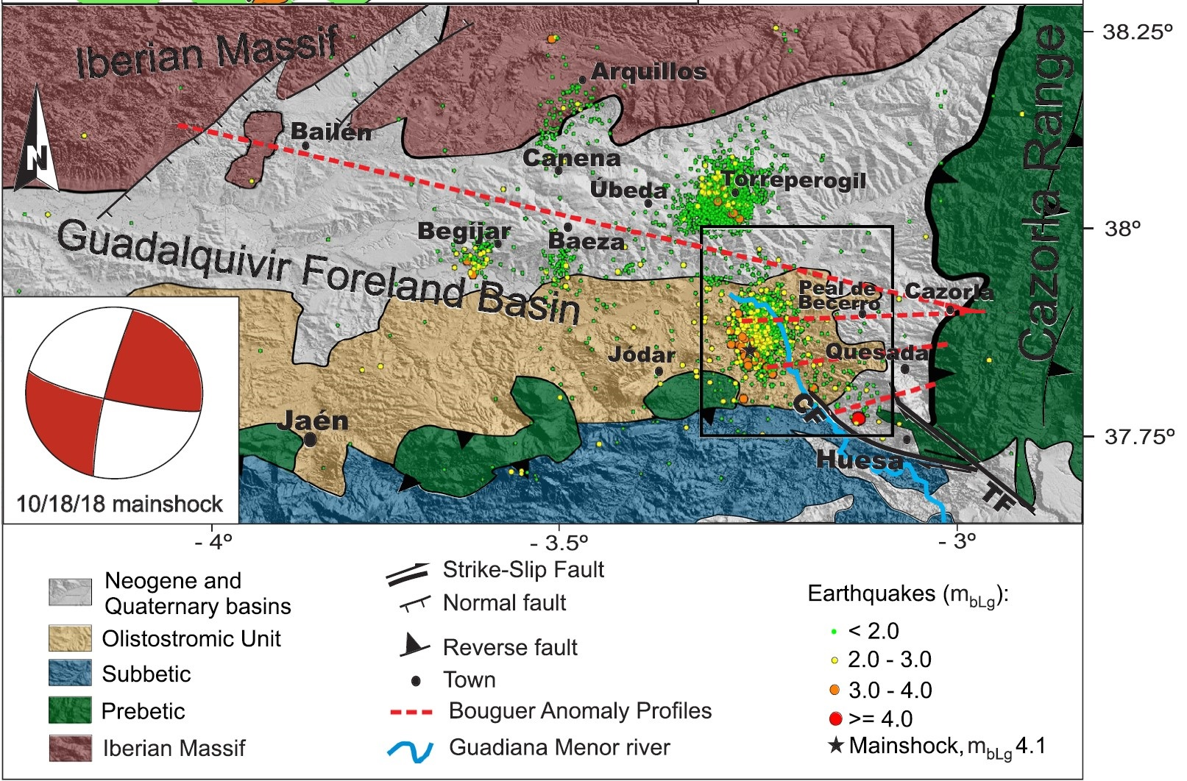

Slide 5
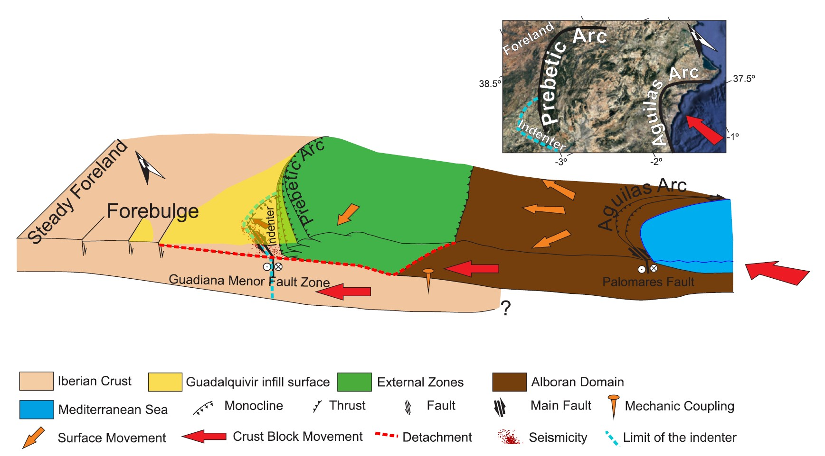

Slide 6
Torreperogil series
October 2012 - May 2013
m_{bLg} 3.9
2.0 - 5.0 km
Guadiana Menor
series
April 2016 - 2019
m_{bLg} 4.1

Slide 7
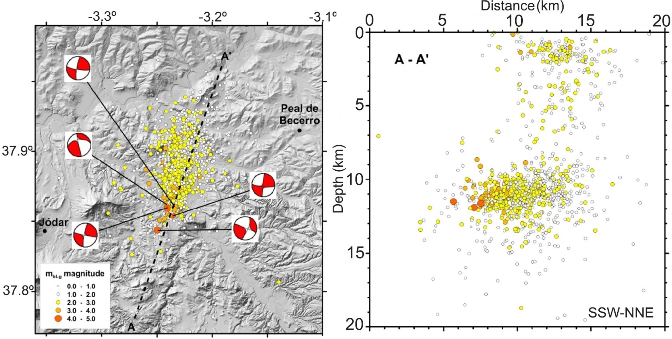
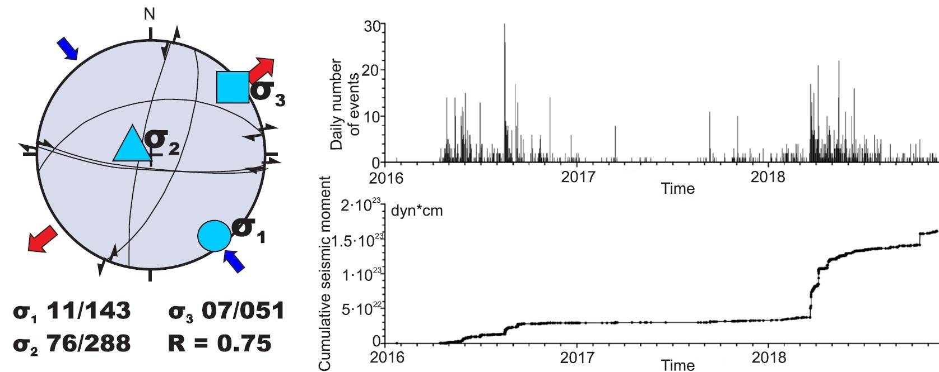

Slide 8
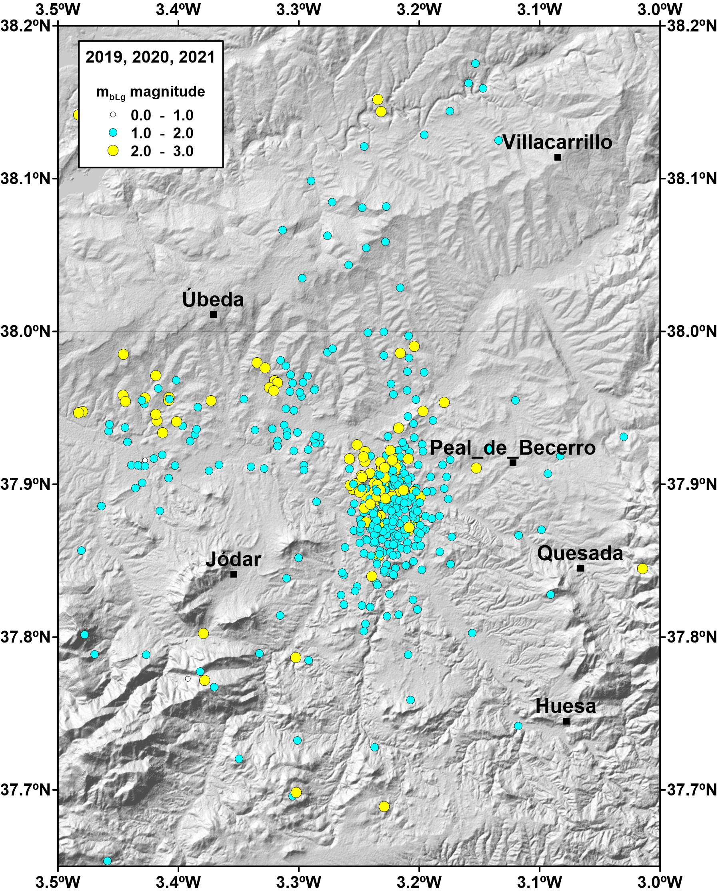

Slide 9
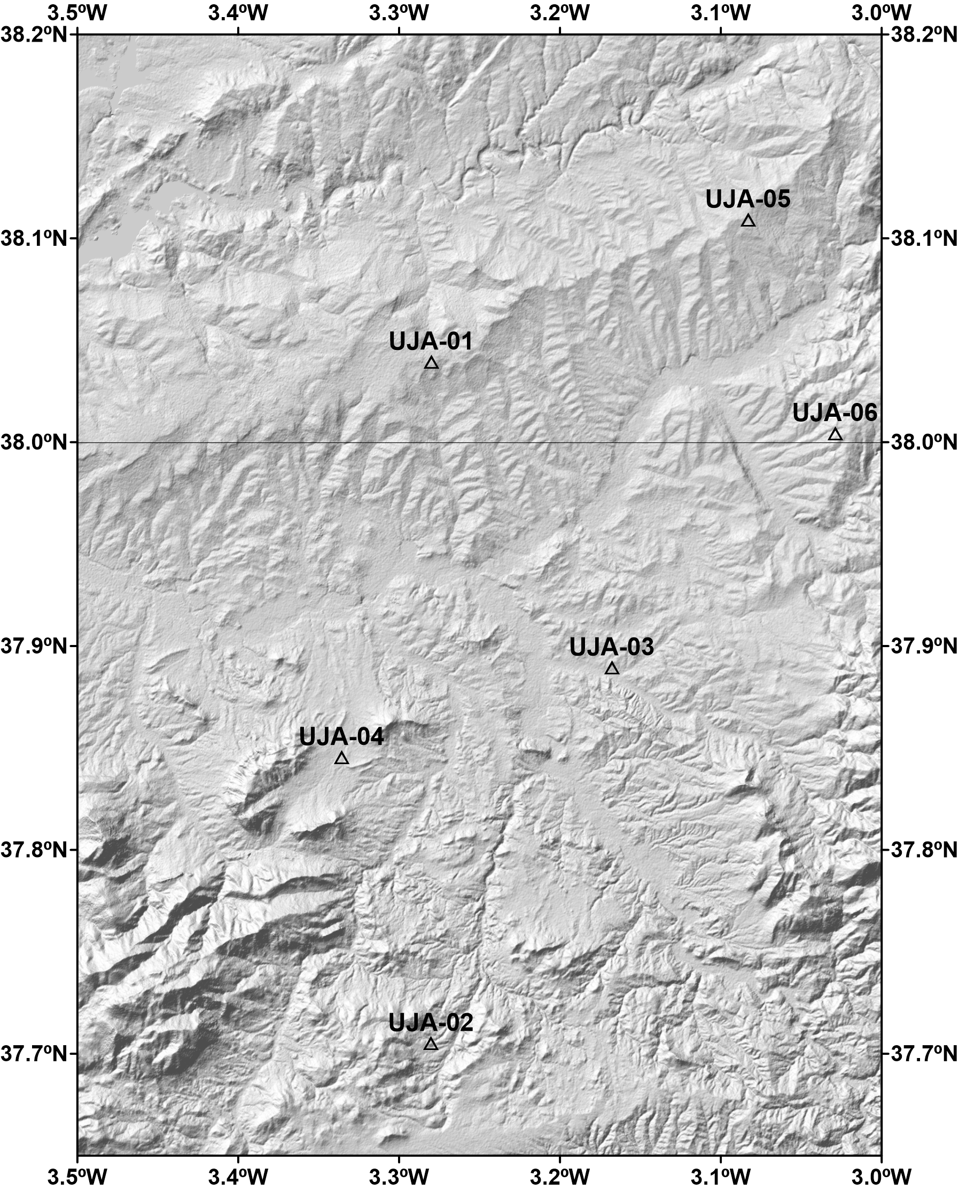

Slide 10
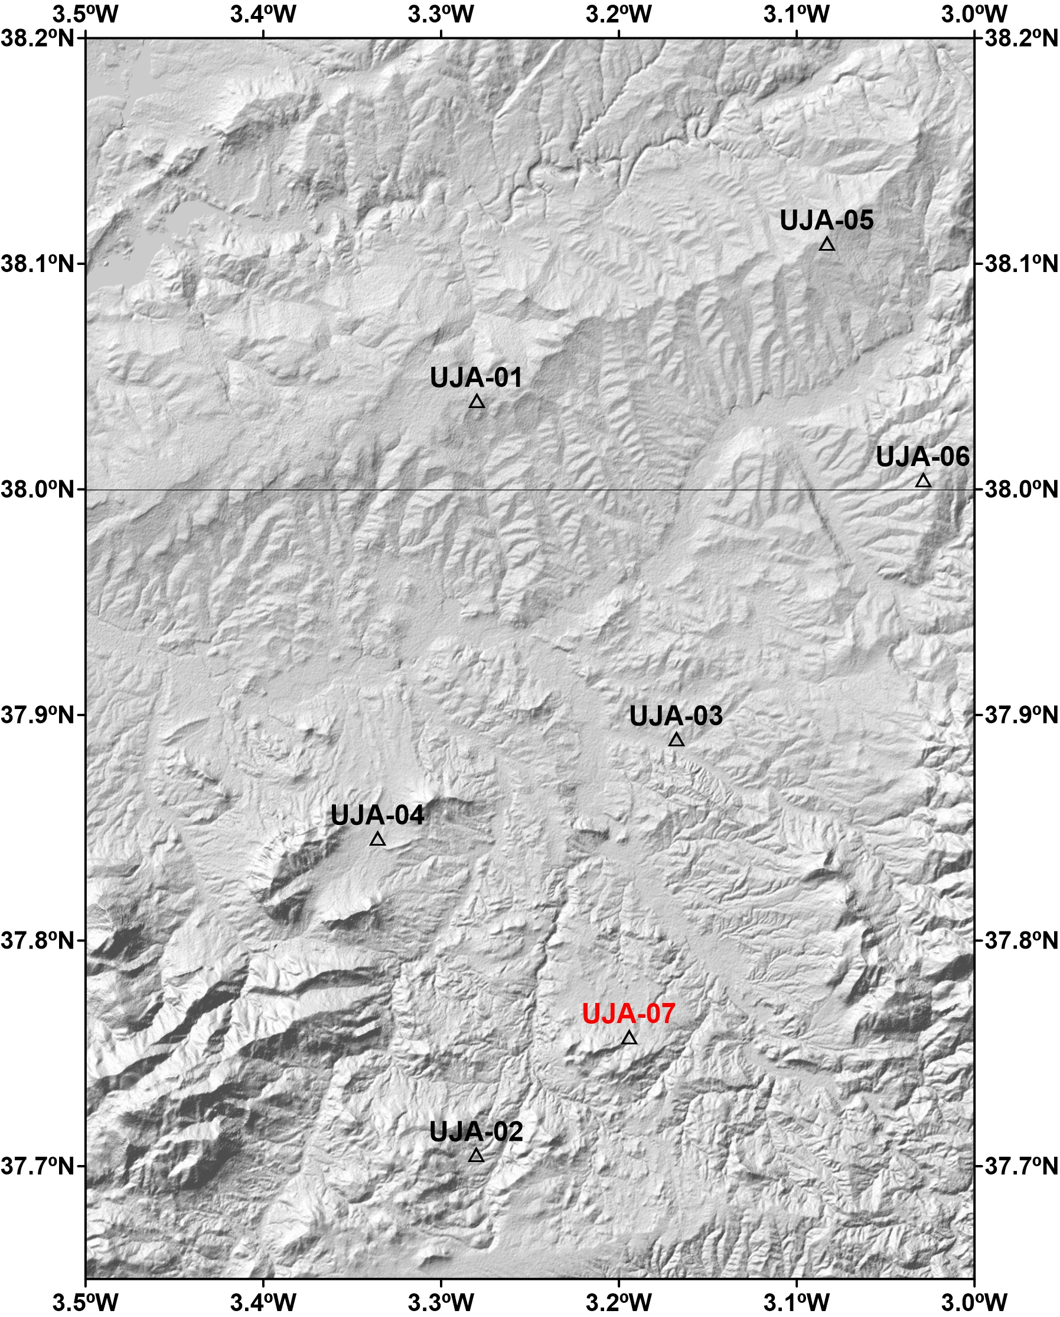

Slide 11
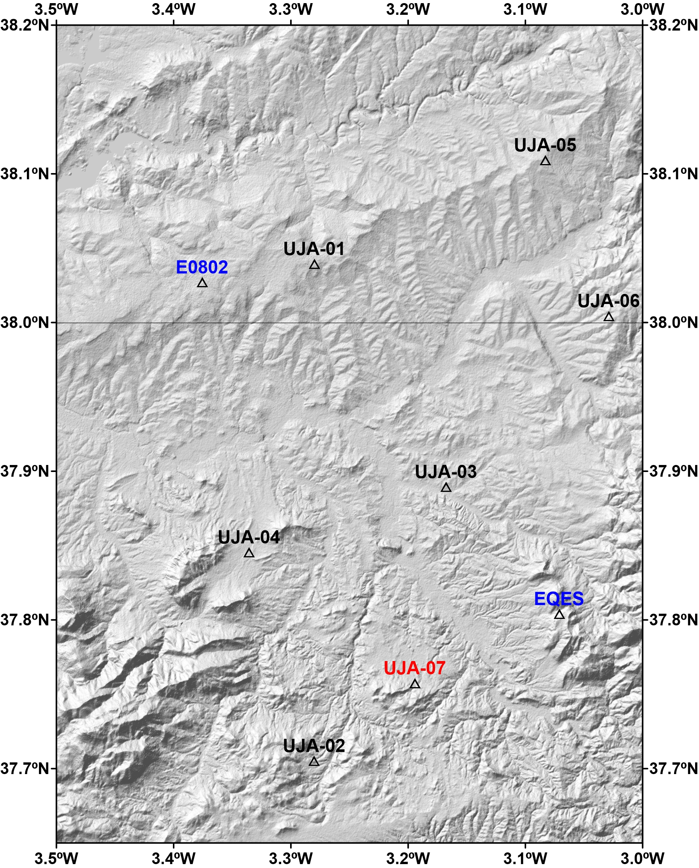

Slide 12
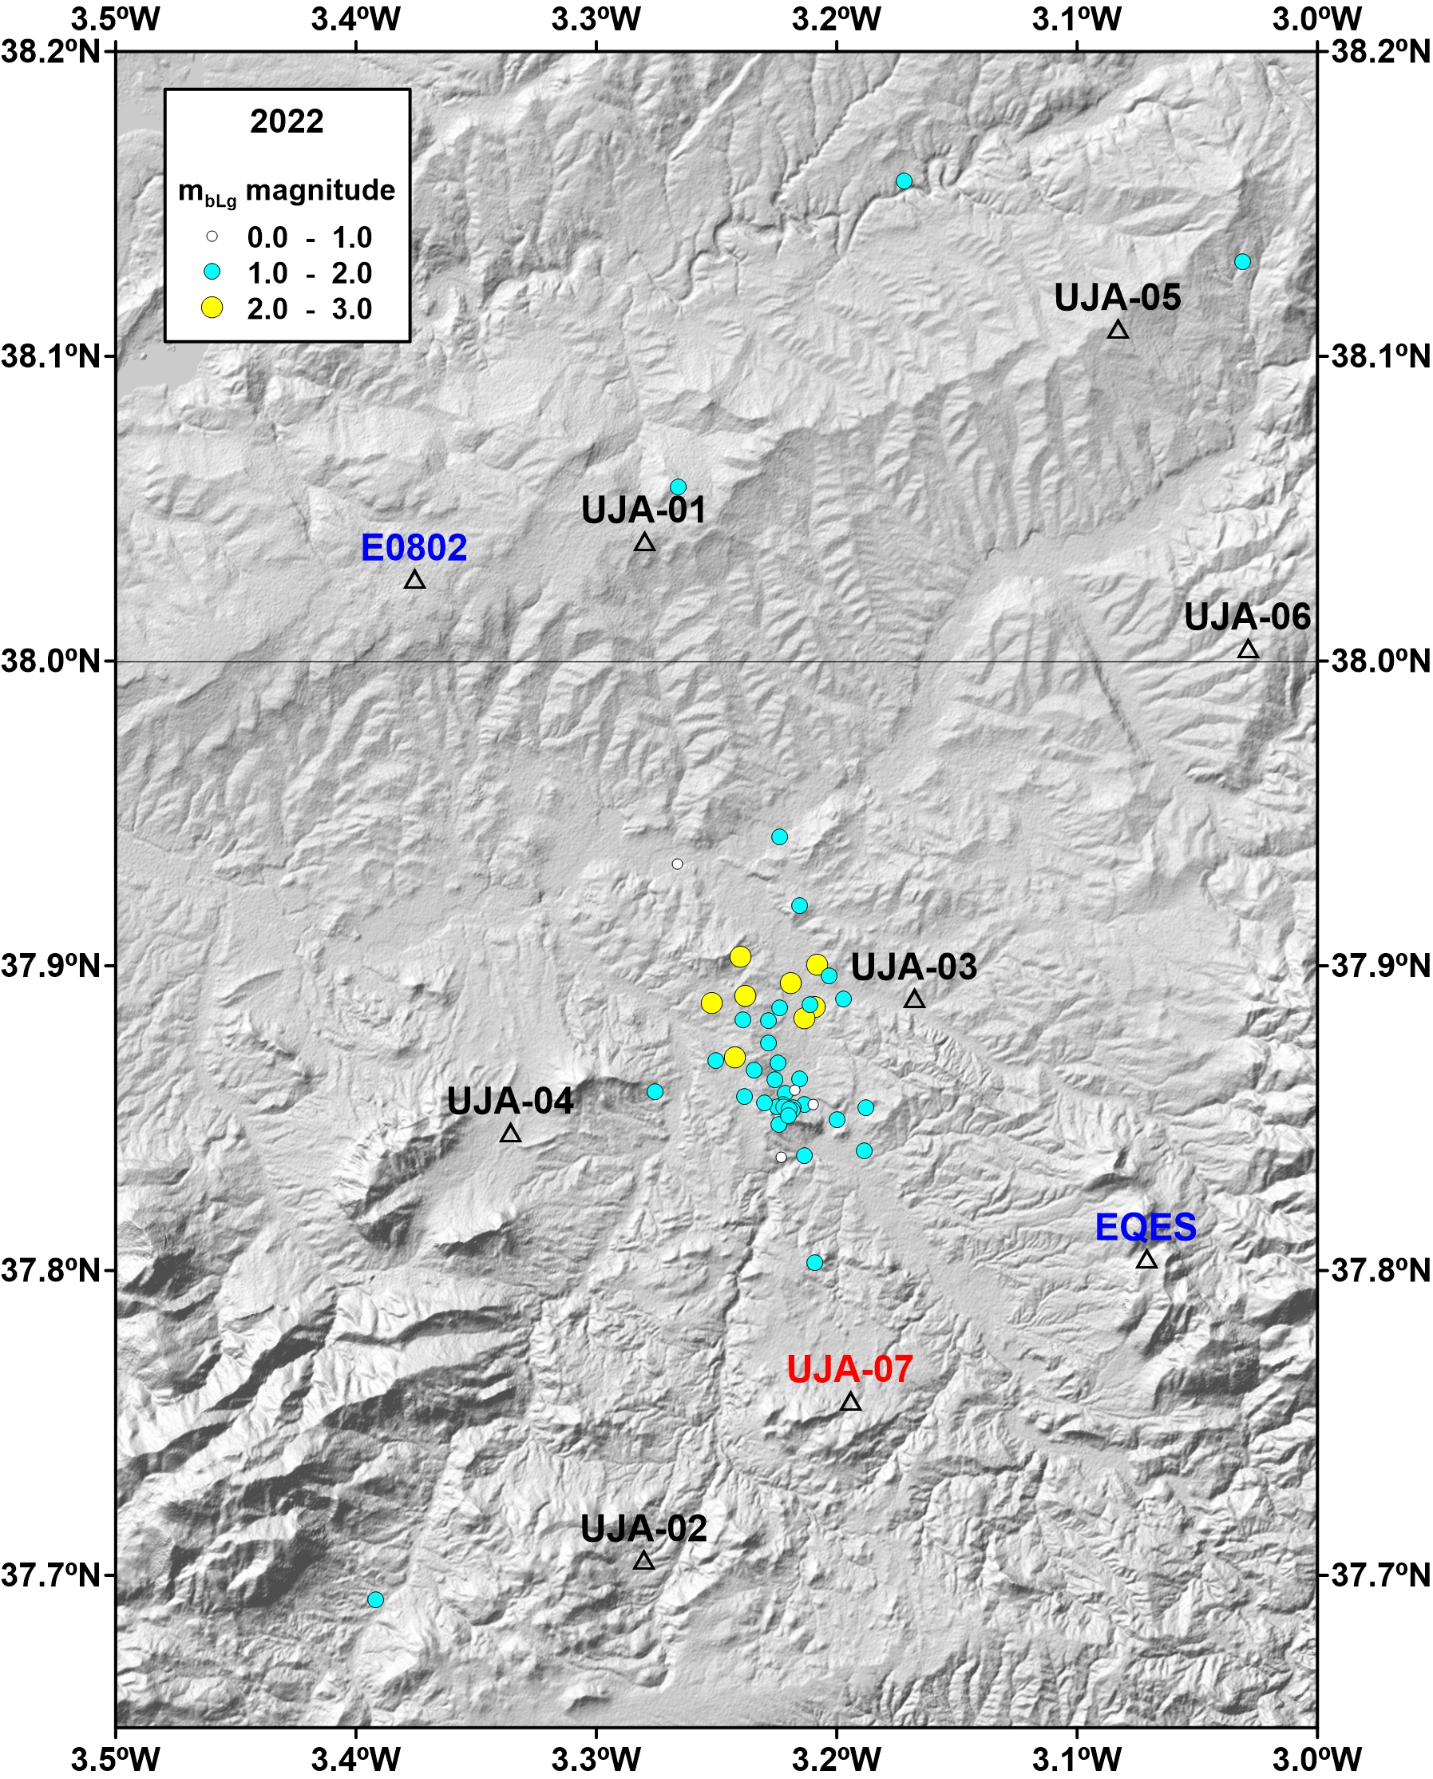

Slide 13
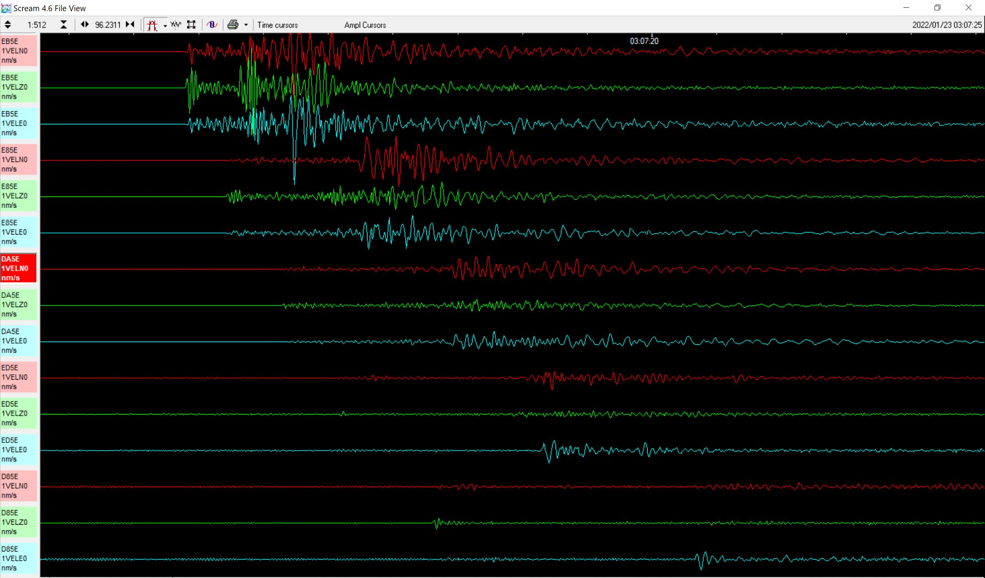

Slide 15
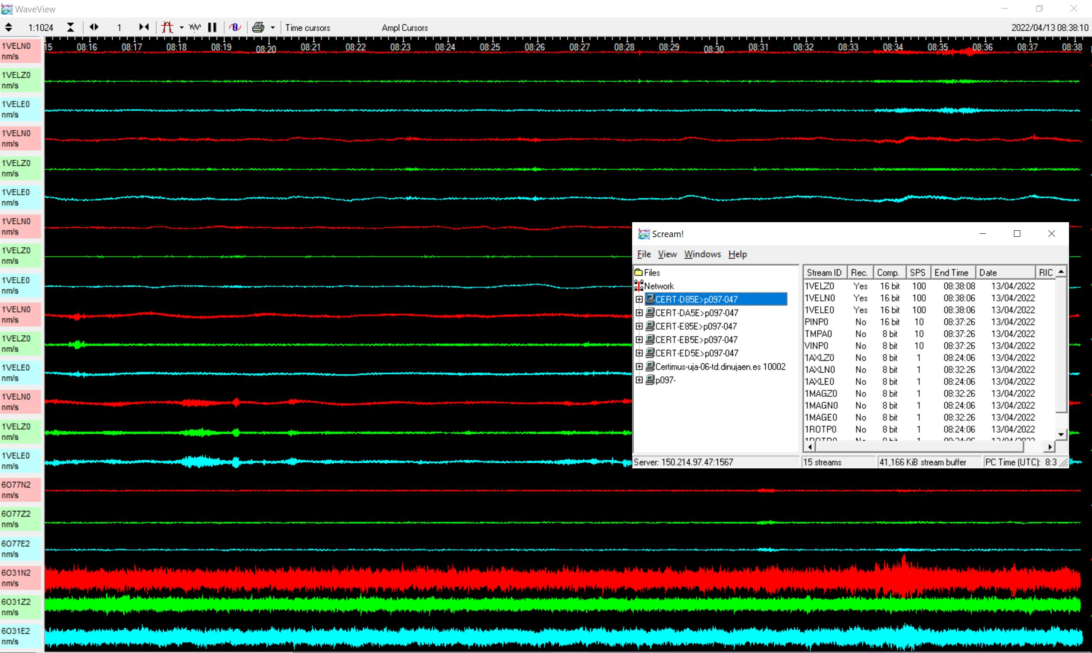
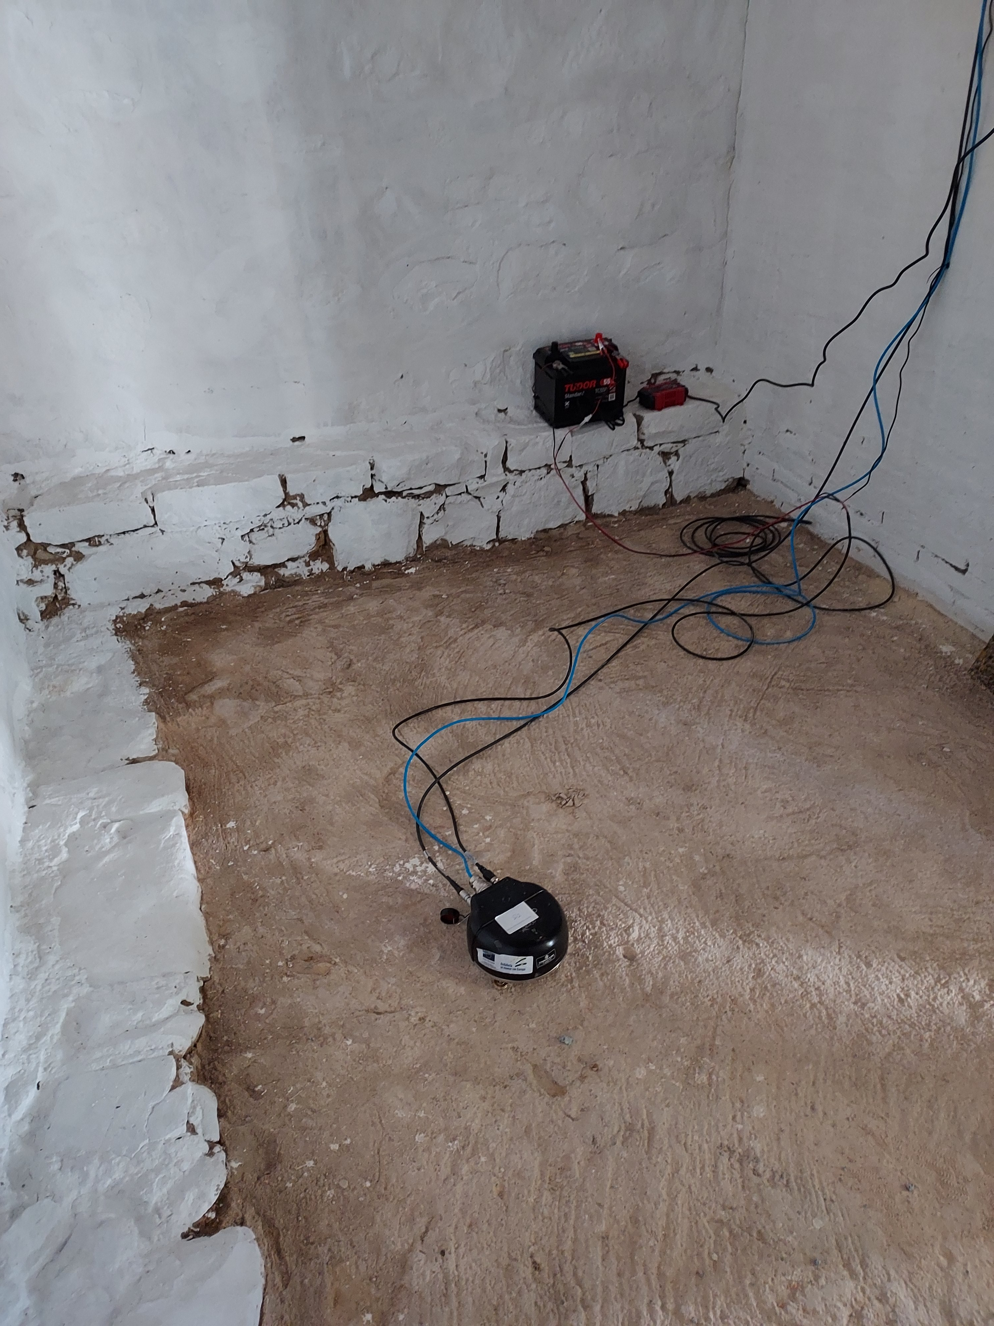
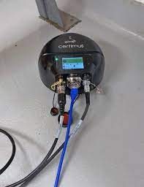

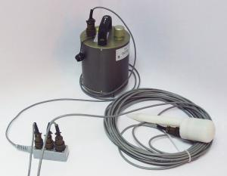
Certimus
CMG-6TD

Slide 16
Programa Operativo FEDER Andalucía 2014‐2020.
Call made by the University of Jaén, Spain, 2018.

