Slide 1

Stability analysis of check dam impacted by intermittent surges
Daochuan Liu（Ldaochuan@163.com）
26 May，2022
Notes:
1
Every one. I’m Daochuan Liu. My report is “Stability analysis of check dam impacted by intermittent surges”.

Slide 2
PART 01 Introduction
CONTENTS
PART 02 Fluctuation and decaying of surges movement
PART 03 Stability of check dam impacted by intermittent surges
PART 04 Cases analysis
PART 04 Discussion and Conclusion
Notes:
This report contents part 01~04.

Slide 3
彭州至汶川高速方案研究
成都经济区环线高速公路彭州连接线工可
Part 01
Introduction
CONTENTS
Notes:
Prat one is introduction.

Slide 4
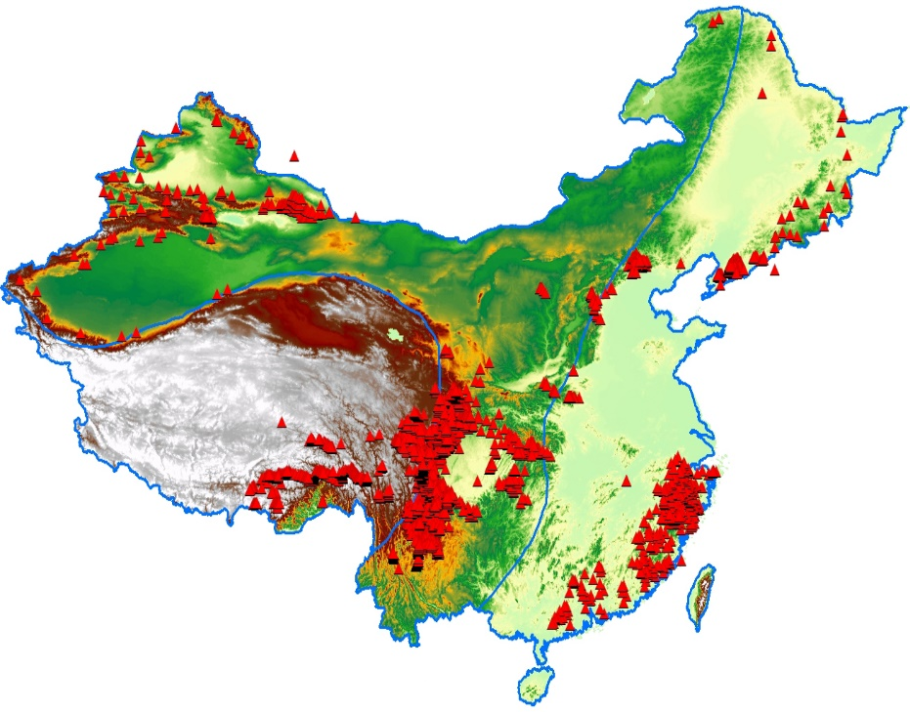
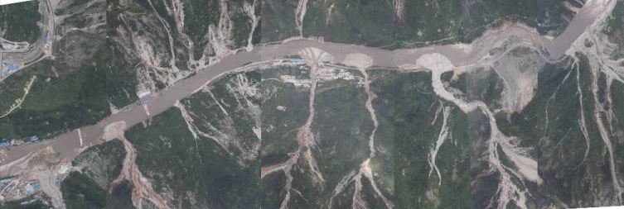
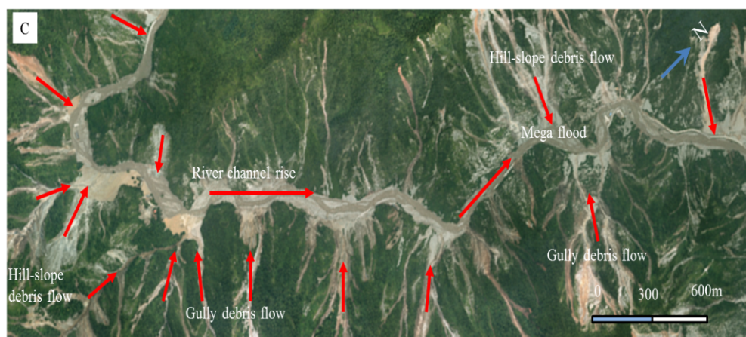
Part 01
Wenchuan-Yingxiu Disaster chain
Debris flows in Mingjiang river valley
Active geological structure
Frequent earthquakes
Great difference of elevation
Abundant rainfall
Yu-zi river Disaster chain
Notes:
As we all know, because of active geological structure, Frequent earthquakes, Great difference of elevation and Abundant rainfall, a large number of natural disasters have occurred in western China. Such as Wenchuan-Yingxiu disaster chain, Debris flows in Ming-jiang river valley, Yu-zi river disaster chain.

Slide 5
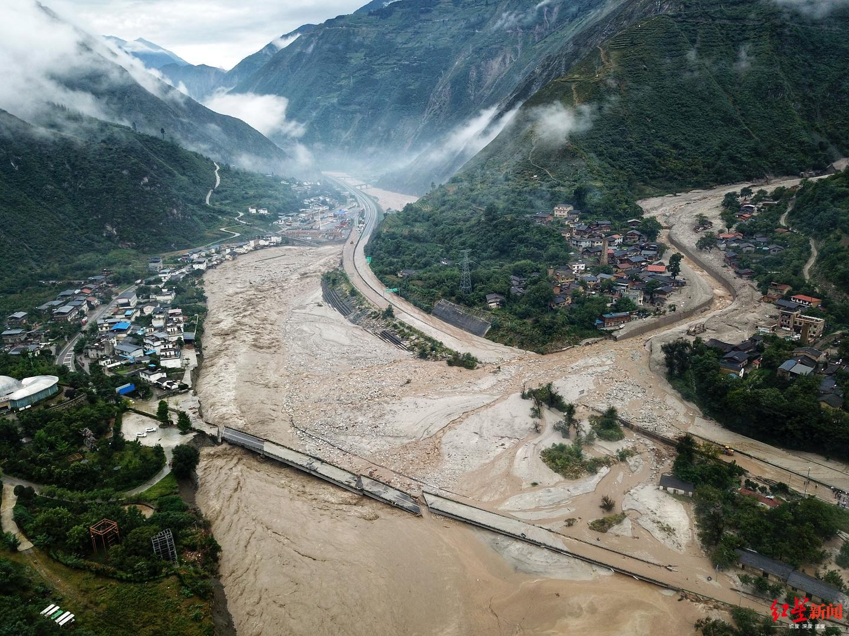
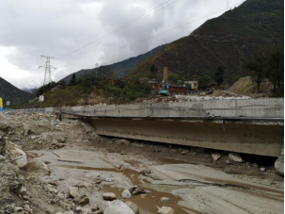
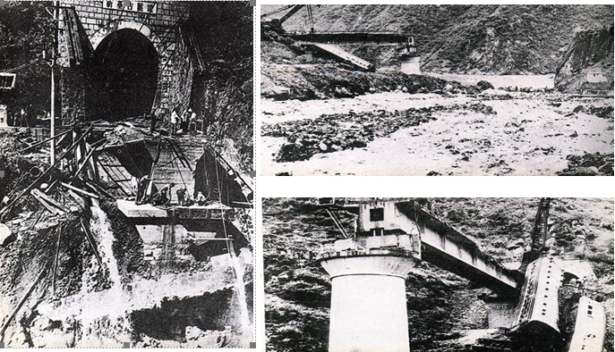
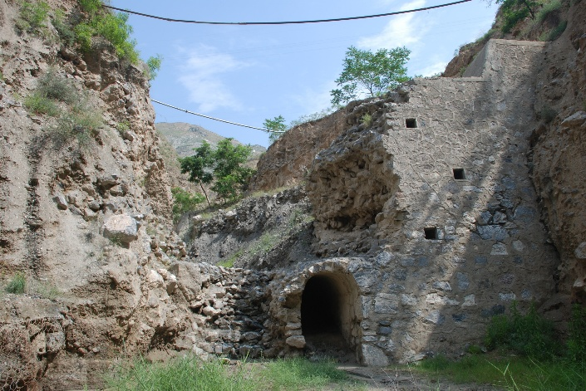
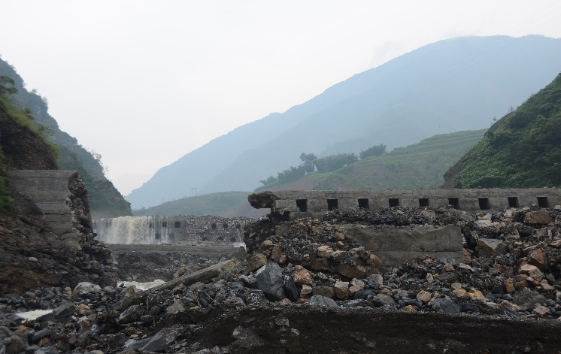
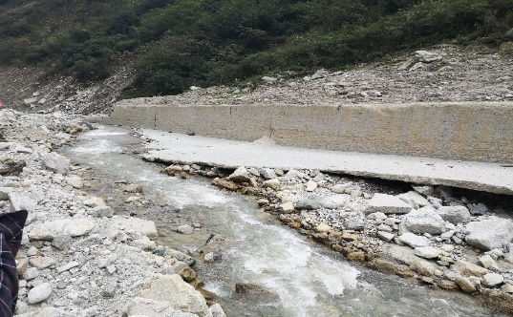
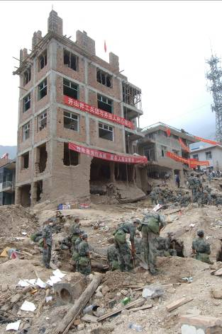
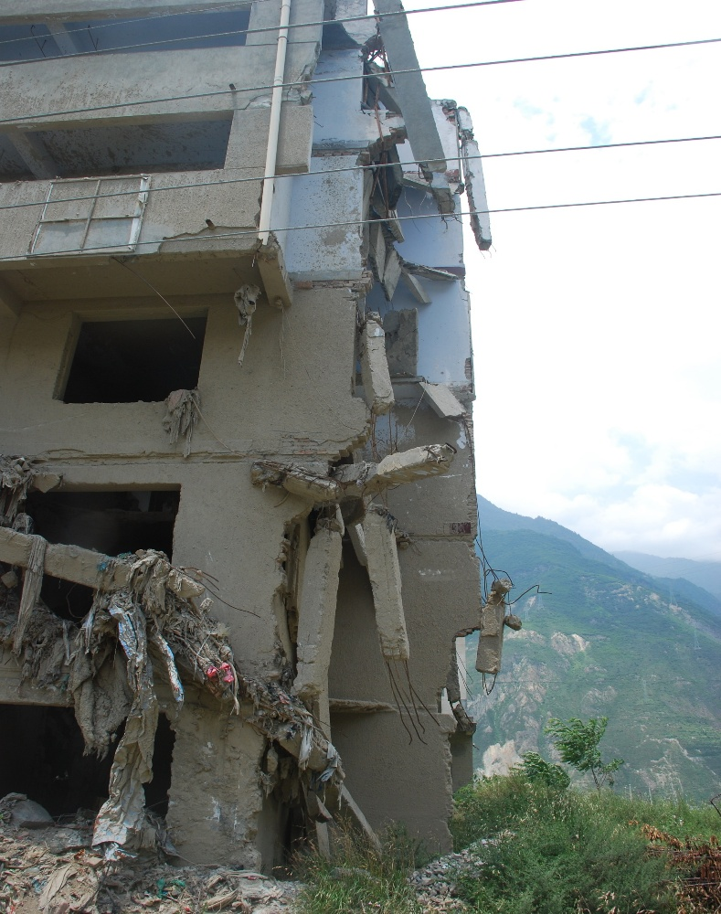

Part 01
Linear engineering
Expressway, Railway, Pipeline
Prevention engineering
Check dam, silt dam, drainage channel
Building engineering
Multi-story building, Steel building
Notes:
According to the field investigation, debris flow has great damage to linear engineering, prevention engineering and build engineering in the form of impact. Actually, viscose debris flows always move in the manner of intermittent surges and show obvious fluctuation. The impact of single surge has on the check dam was the only factor to be taken into consideration in the traditional design of debris flow control engineering, whereas stability variation of the check dam impacted by intermittent surges was always neglected.

Slide 6
彭州至汶川高速方案研究
成都经济区环线高速公路彭州连接线工可
Part 02
Fluctuation and decaying of surges movement
CONTENTS
※ Observation and data collection
※ Fluctuation and decaying characteristics
Notes:
So this report initially discusses fluctuation and decaying characteristics of intermittent surges based on the material of the Jiangjia Gully (JJG).

Slide 7
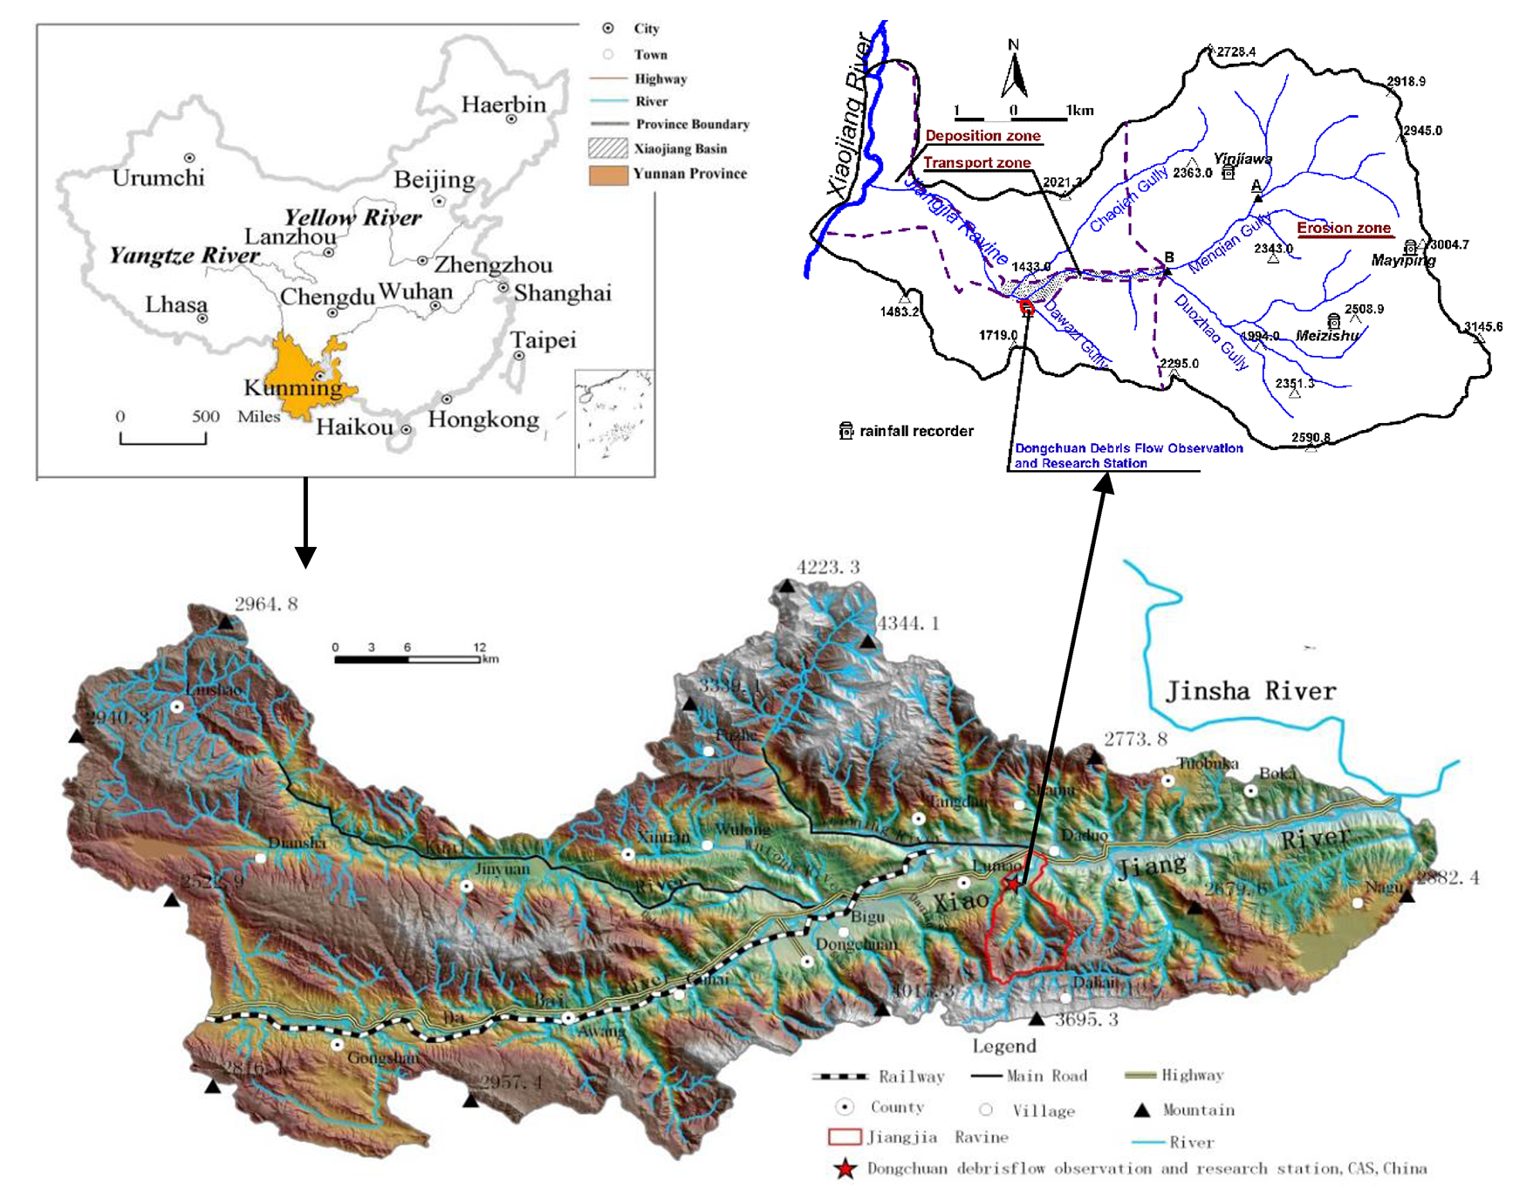
Part 02
Observation and data collection
Area of 48.7 km² ,channel length of 13.9 km
v was measured by two cross section
H was measured by ultrasonic sensors
Q, F, L can be estimated by v and H
Notes:
Firstly, observation and data collection could be described. The JJG is on the right bank of the Xiaojiang River, with area of 48.7km² and channel length of 13.9 km. Each year, about ten debris flows are observed in the last 60 years, and each event consists of tens to hundreds of surges. Real-time monitoring of debris flow in JJG is carried out every rainy season, which contains velocity, depth, discharge and so on.

Slide 8
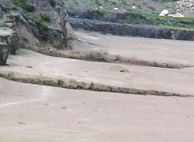
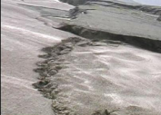
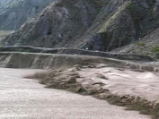
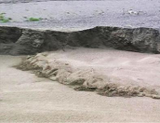
Part 02
Fluctuation and decaying characteristics
2nd surge
1st surge
Ligule form
Arrow form
Palm form
Notes:
These pictures shows the movement process of intermittent surges in the channel. The head is accompanied by strong turbulence while the body and tail are dominated by laminar flow. The head of different surges also shows different forms, such as ligule form, arrow form, and palm form.

Slide 9
Fluctuation and decaying characteristics
X ~H, v, ρ, Q, etc.
α ~ Decaying coefficient
Fluctuation with the surge process
Finally decays in a power law
α of v and H are 0.05~0.25 and 0.1~0.4
Nonlinear dynamic of surge series
Notes:
From a macro perspective, debris flow event can be regarded as a surge series . X is the parameters observed in real time, such as depth (H) velocity (v), flow density (ρ), flow discharge (Q), etc.
As we can see from these two pictures, it can be clearly seen that the velocity and depth fluctuate with the surge process and their mean curve < X > finally decays in a power law form. According to the results, the decaying coefficient α of the flow velocity and depth series are respectively 0.05~0.25 and 0.1~0.4, indicating that the intermittent surges present nonlinear dynamic behavior.

Slide 10
彭州至汶川高速方案研究
成都经济区环线高速公路彭州连接线工可
Part 03
Stability of check dam impacted by surges
CONTENTS
※ Empty‑storage reservoir condition
※ Half‑storage reservoir condition
Notes:
From the above analysis, we can see the difference between single surge and intermittent surges, also shows different impact process of debris flow.
Then, the stability of the check dam under the impact of intermittent surges were discussed with empty and half storage reservoir conditions.

Slide 11
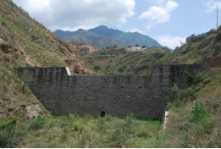
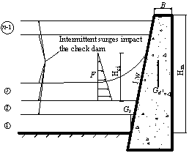
Part 03
Empty‑storage reservoir condition
Considering run up in formula
3~5th was rapid decay area
Rapid decay area
Rapid decay area
Ky=1
Kc=1
Hci = Hi + Hp
Notes:
Under the condition of empty-storage reservoir, when the intermittent surges impact on the check dam, the loads on the check dam are the self-weight of dam body, static pressure, side pressure and the impact force of surges. Especially, the value of the impact force in this report has considered the run-up phenomenon of surges. The result showed that K_{c} and K_{y} both decrease with the evolution of the surges under the condition of the empty-storage reservoir, and the decaying rate of the former 3~5 surges were the fastest.

Slide 12
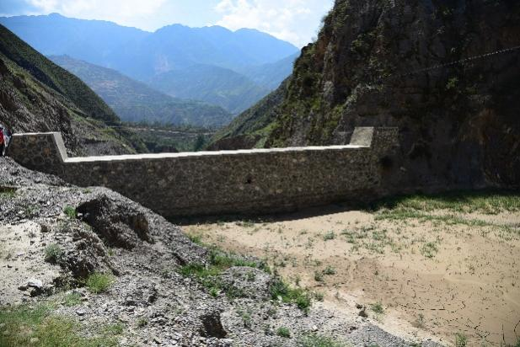
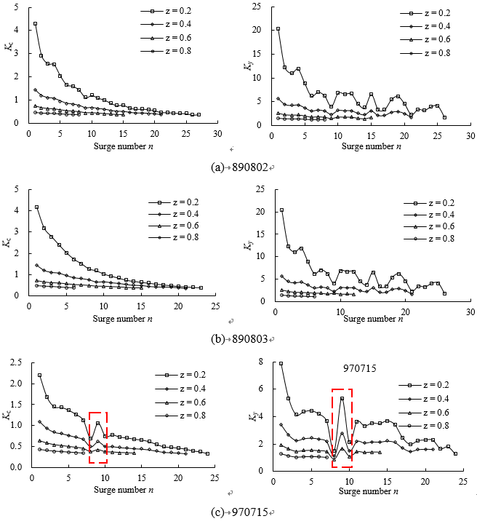
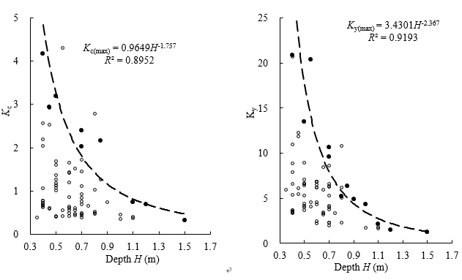
Part 03
Half‑storage reservoir condition
Considering run up in formula
3~5th was rapid decay area
Envelope relationship between depth and stability coefficient
Hci = Hi + Hp
Notes:
Compared with empty condition, the biggest difference is that the half-storage reservoir has a large amount of deposition before the check dam. So these two formula should consider the deposition pressure. As we can see the pictures, K_{c} and K_{y} both decreased with the evolution of surges, which was very similar to the case of the empty condition. In addition, results showed the relationship between surge depth and K_{c} and K_{y}. It was obvious that there was an envelope relationship between depth and stability, thus directly explaining the infuence of depth on dam stability.

Slide 13
彭州至汶川高速方案研究
成都经济区环线高速公路彭州连接线工可
Part 04
Dissussion and Conclusion
CONTENTS
※ Comparison and discussion
※ Conclusion

Slide 14
Part 04
Comparison and discussion
Sun et al. 2018
Sun et al. 2018
Jiang et al. 2019
Jiang et al. 2019
Jang et al. (2019) have not given the trend of the whole process of K_{c} and K_{y}
Sun et al. (2018a) assumed that the discharge and depth in each surge was equal and only showed the smooth decay process of K_{c} and K_{y}
Results differently found out the influence of variation parameters on the stability change process
Notes:
We compared our results with Sun et al. (2018a) and Jang et al. (2019), which showed the similar decay rule of the Kc and Ky when intermittent surges impact on the check dam. However, Jang et al. (2019) have not given the trend of the whole process of Kc and Ky because of a few simulation data. Sun et al. (2018a) assumed that the discharge and depth in each surge was equal and only showed the smooth decay process of Kc and Ky (Fig. 11), whose results diferently found out the infuence of variation parameters on the stability change process.

Slide 15
Part 04
Conclusion
Intermittent surges showed strong fluctuation characteristics in the moving process. The decay coefficients of velocity and depth were 0.05 ~ 0.25 and 0.1 ~ 0.4, respectively. This was different from the random series, meaning that the intermittent surges show strong nonlinear behavior.
Regardless of the working conditions, the anti-slip stability coefficient K_{c} and anti-overturning stability coefficient K_{y} both decreased with the variation of surges, and the decaying rate of the former 3~5 surges were the fastest. Moreover, the stability coefficient decreased with the increase of deposition height.
There is an envelope relationship between depth and stability coefficient, which makes the change of depth restrict the development of dam stability coefficient, thus indicating that the stability coefficient of anti-slip and anti-overturning are very sensitive to the change of the flow depth of the surges.
Notes:
Based on the research, There are three conclusions. Firstly, secondly, finally.

Slide 16

Thanks For Your Attention！

