Slide 1
Copernicus for Urban Resilience in Europe: Intermediate results from the CURE project
Νektarios Chrysoulakis, FORTH
25 May 2022
EGU 2022

Slide 2
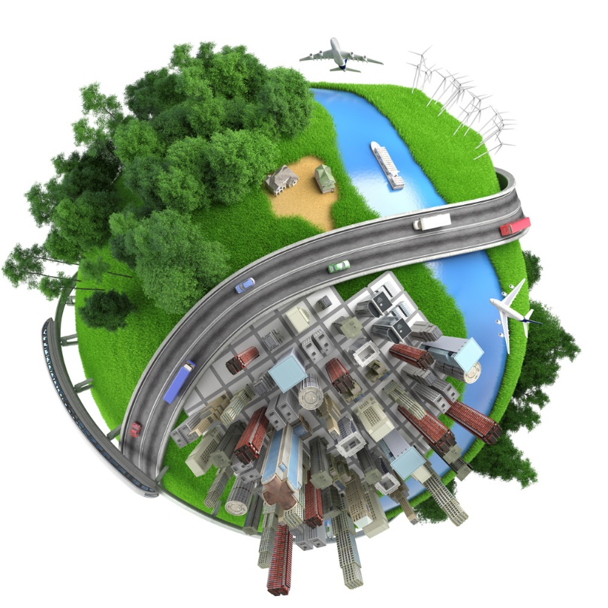

Why CURE?
Urban environment is multidimensional: information from more than one Copernicus Core Services is needed.
To address urban resilience spatially disaggregated information at local (neighbourhood) scale is necessary.
Such information is not yet available from Copernicus Core Services.
CURE: Cross-cutting applications among Core Services, capable of coping with the required scale, exploiting also third-party data, in-situ observations and modelling.

Slide 3
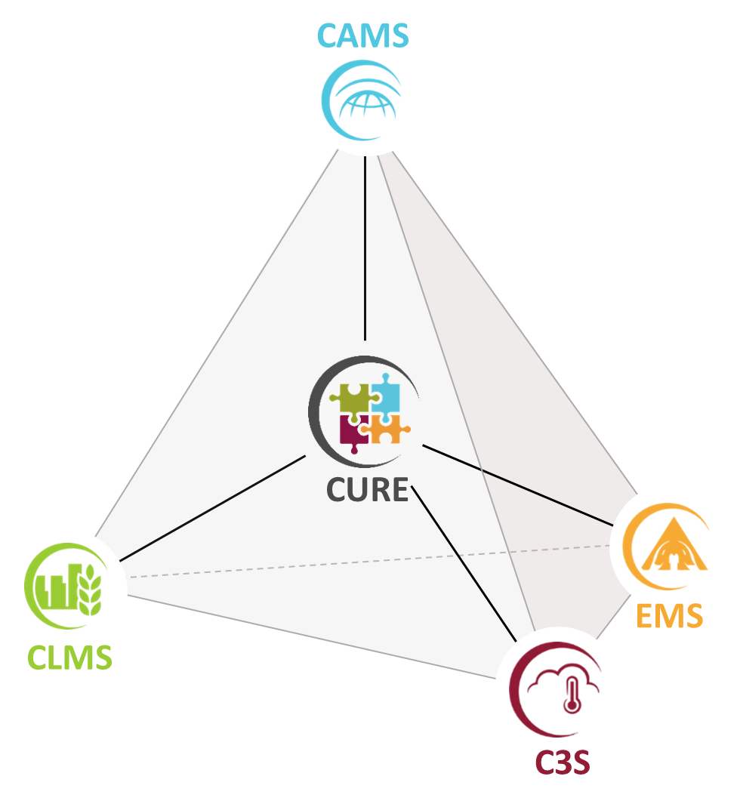
The CURE Concept
H2020-Space
Provides the means to cope with the EO data under-exploitation in the domain of sustainable and resilient urbanization, by combining products from from CAMS, CLMS, C3S and EMS.
Introduces novel ideas on how to develop applications across CCS in the domains:
  climate change adaptation & mitigation
  healthy cities and social environments
  energy and economy

Slide 4
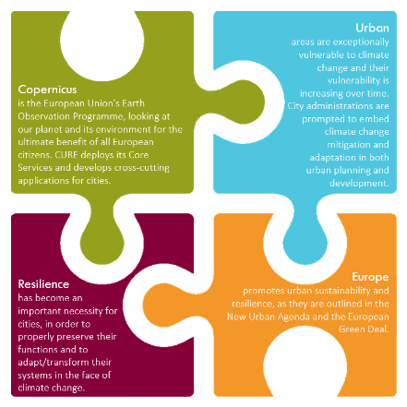
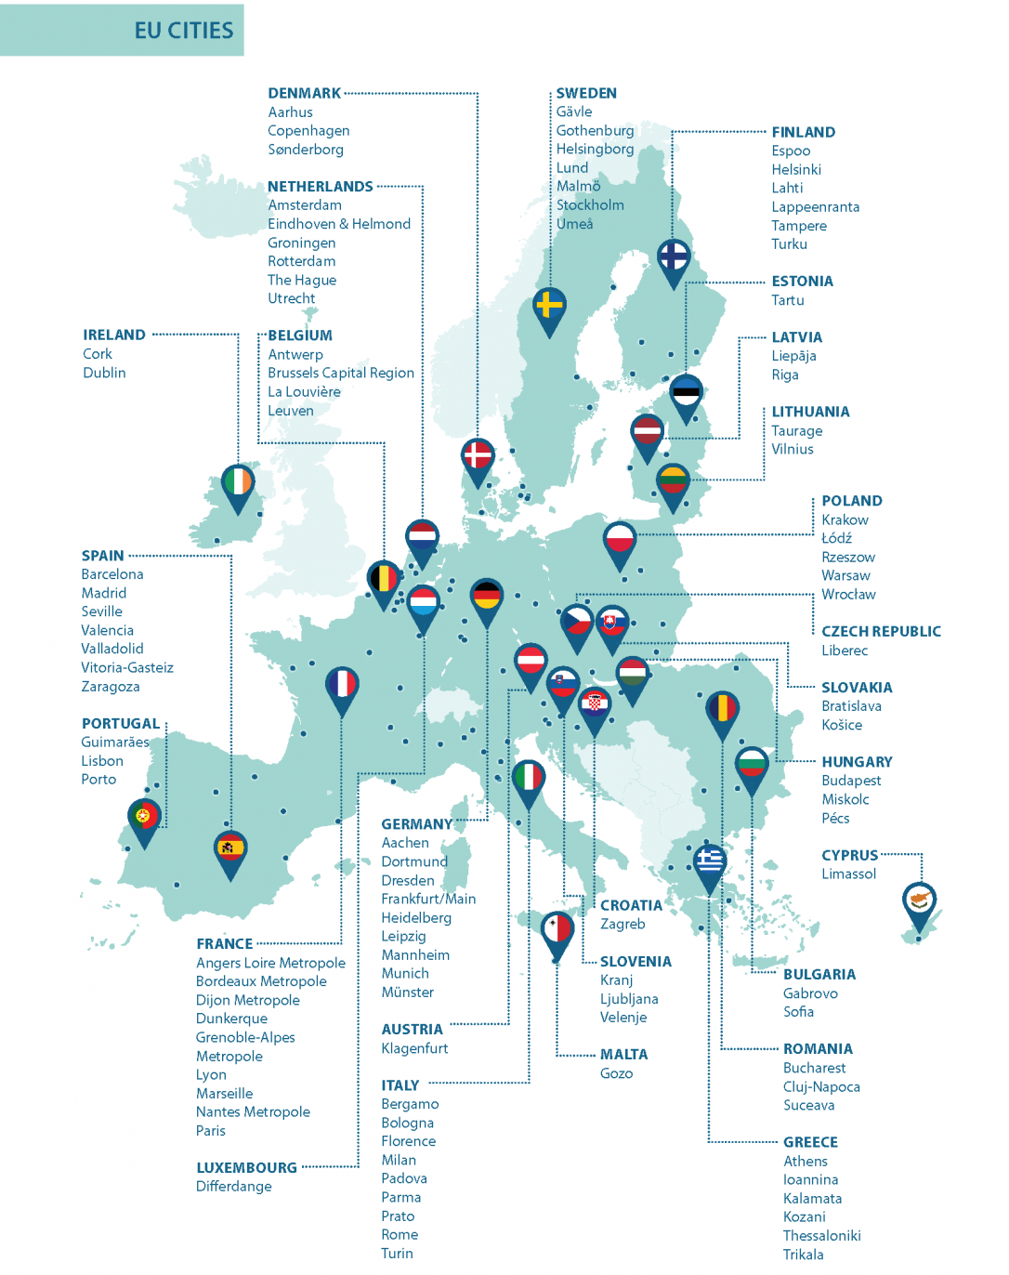
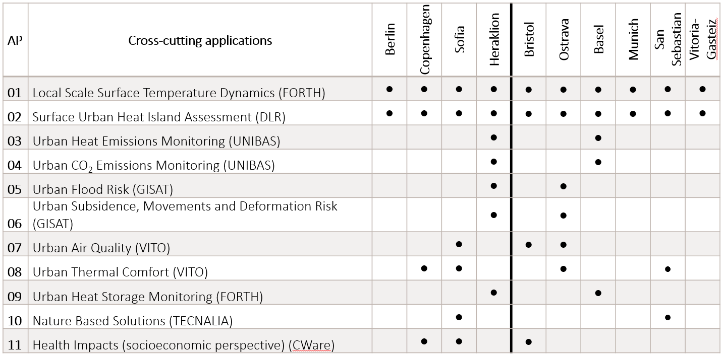
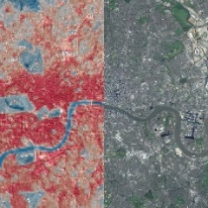
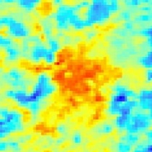
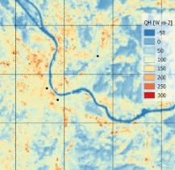
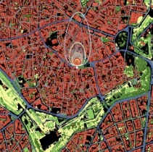
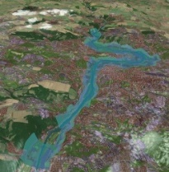
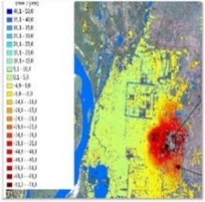
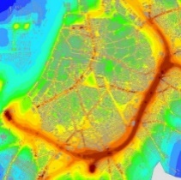
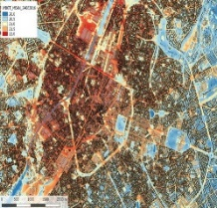
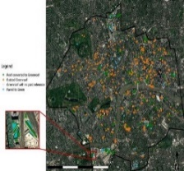
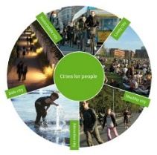
Users Engagement

Slide 5











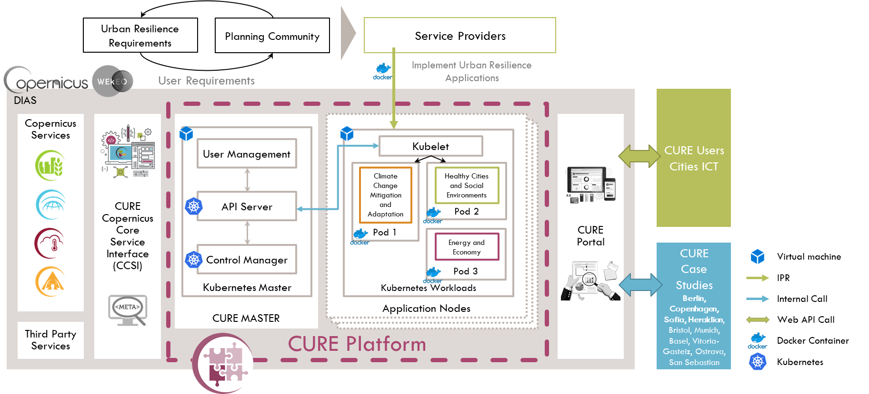
The CURE System

Slide 6

Main Outcomes
Online platform for combining CCS to support urban resilience.
Uniform data for large samples of urban areas across Europe
Consistent measurements across European cities, including synergies between Copernicus core products and third-party data
Different approaches and models for better information on urban from and function at different spatial and temporal scales
Assimilation of users’ knowledge with technical data and benchmarking

Slide 7




The Vision
Become a focused evidence-based toolkit for assisting current and future policy making in the field.
Short term: integrating specific CURE products into the Copernicus Operational Service Portfolio.
Long term: developing a Copernicus Urban Service.
http://cure-copernicus.eu

Slide 8

17 - 19 May 2023

