Slide 1








GRACE-derived groundwater storage estimation: Lake/Reservoir storage controls across Canada.
European Geosciences Union General Assembly 2022
Vienna 23 – 27 May 2022
Mohamed Akl^{1,2}, Brian F. Thomas¹, and Jon Mills¹
⁽¹⁾School of Engineering, Newcastle University, Newcastle upon Tyne, NE1 7RU, UK. (m.a.a.akl2@newcastle.ac.uk)
⁽²⁾Faculty of Engineering, Tanta University, Tanta, Egypt.
*The researcher, Mohamed Akl, is funded by a full scholarship from the Ministry of Higher Education of the Arab Republic of Egypt.

Slide 2
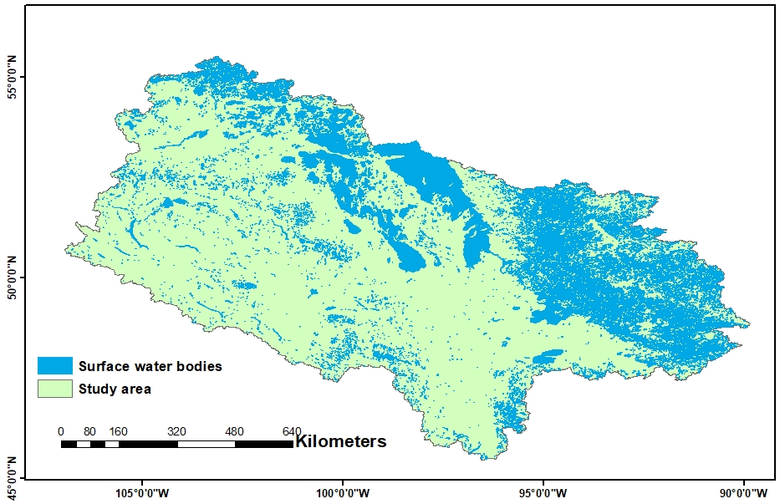
Research Aim & Limitations:
To understand the spatial influence of lake/reservoir storage change on GRACE-derived groundwater storage estimation, using data-driven experiments, based on independent information of recorded lake/reservoir water level.
Fig. 1. surface water bodies distribution across study area.

Slide 3
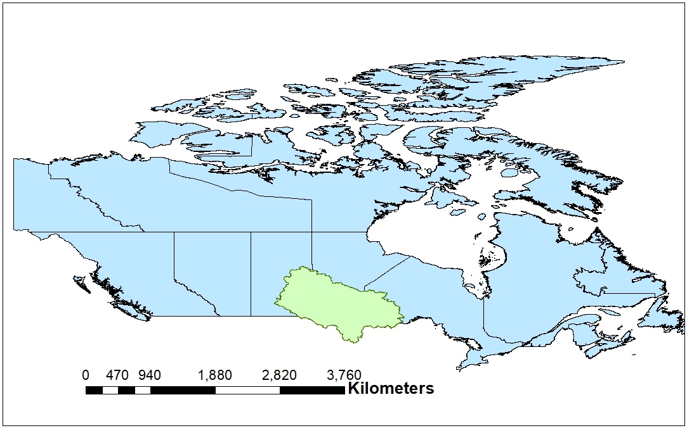
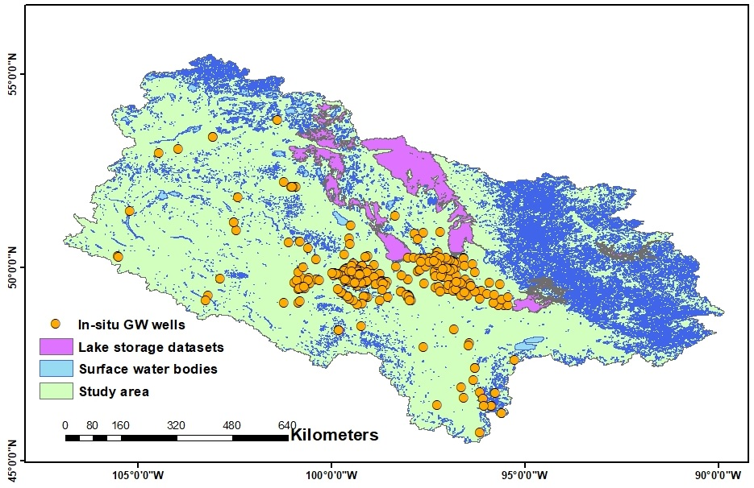
Study area:
a)
b)
Fig. 2. Site map illustrating (a) the location of the study area (673354 km2) in relation to Canada and the distribution of groundwater observation wells, (b) surface water bodies distribution over study area.

Slide 4
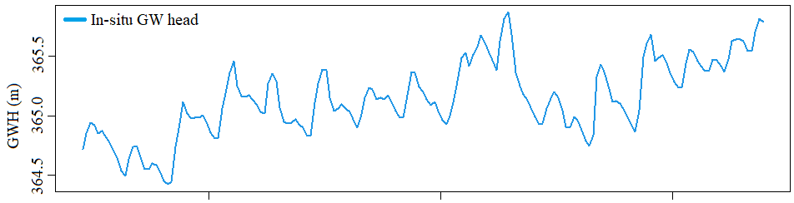
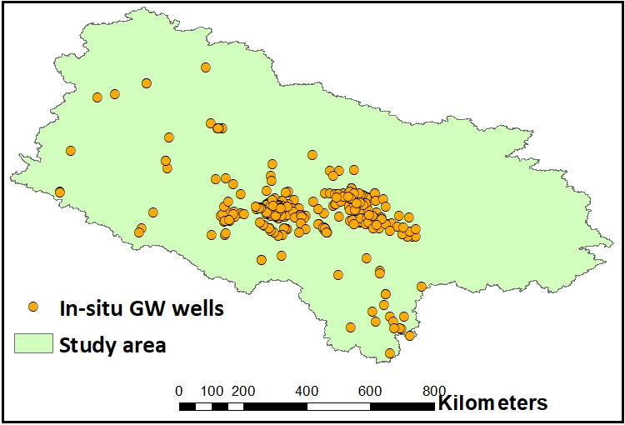
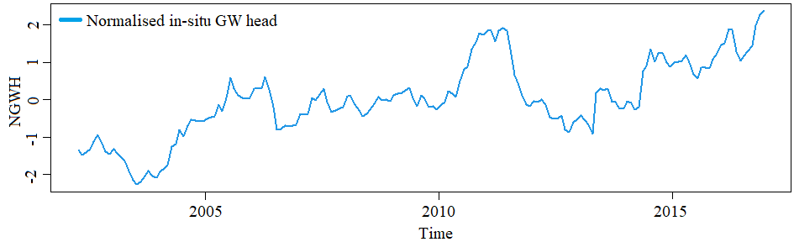
Data & Methods:
a) In-situ groundwater data
b)
a)
c)
Fig. 3. Well data across study area (a), time series of (b) interpolated in-situ groundwater head across the basin over the study period (2002-2016), and (c) normalized groundwater head deviations.

Slide 5
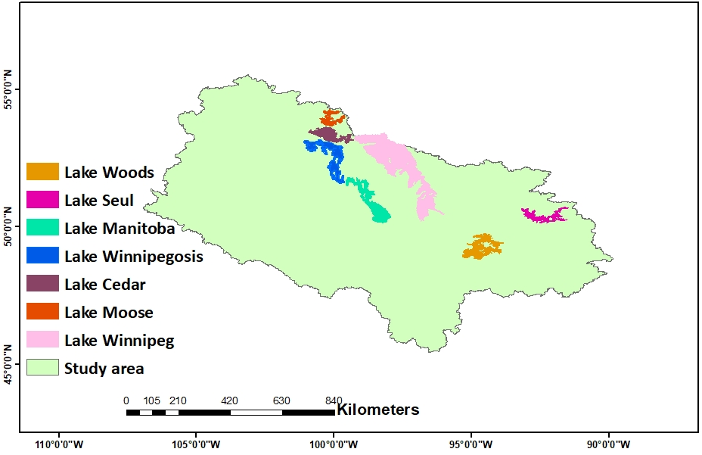


Data & Methods:
b) GRACE and auxiliary data
Available products
GRACE | 5
Snow | 7
Soil moisture | 5
175 experiments
GWA = TWSA – SWEA – SMA - SWA
GRACE-GW
In-situ GWH
Correlation test
Spatial influence of Lake/reservoir storage changes on GRACE-GW
Fig. 4. Data-driven experiments combined available products of water budget components with accounting of Lake/ reservoir storage changes, considering comparisons between GRACE-GW & GWH.
4

Slide 6
Results
Fig. 5. Correlation coefficients between GRACE-GW & In-situ-GW (before and after accounting of Lake/reservoir storage changes).

Slide 7

Thanks Questions……
m.a.a.akl2@newcastle.ac.uk

