Slide 1
Biological sulfate reduction in deep subseafloor sediment of Guaymas Basin
Toshiki Nagakura, Florian Schubert, Jens Kallmeyer, and
IODP Exp. 385 Shipboard Scientific Party

Slide 2
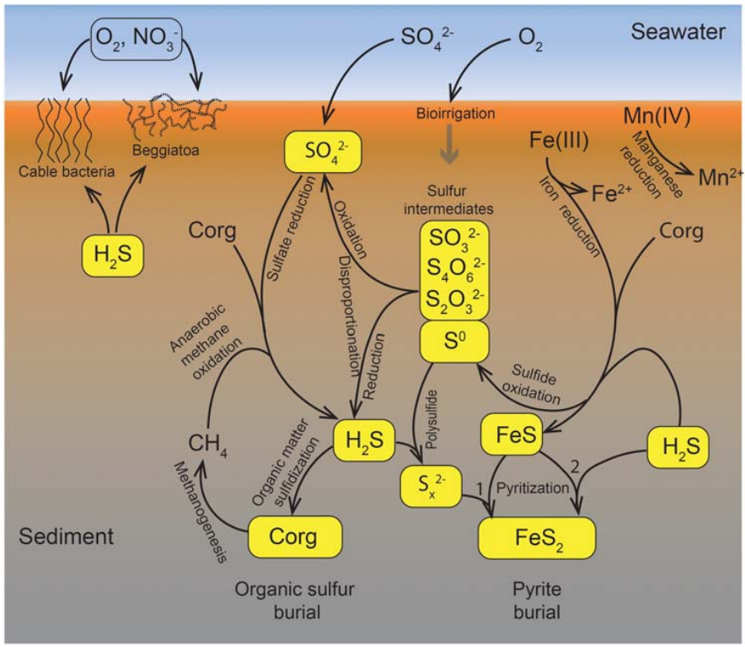
Microbial sulfate reduction
Predominant anaerobic degradation pathway for organic matter in marine sediment
Plays an important role in carbon and sulfur cycling
Jørgensen et al. (2019)

Slide 3
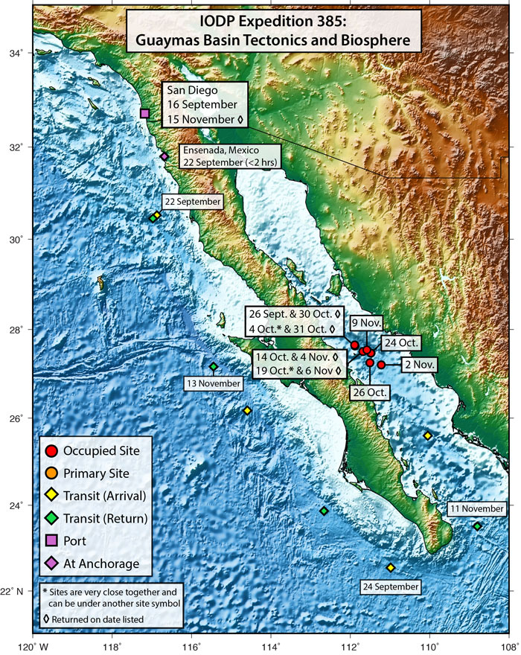
Guaymas Basin
(Gulf of California, Mexico)
Young marginal ocean basin
Active seafloor spreading
Rapid organic-rich sediment deposition
Hydrothermal sediment

Slide 4
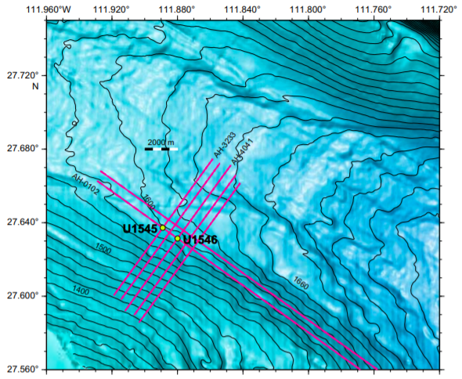
Thermal gradients
Site U1545
225°C/km
Site U1546
221°C/km
Global ave. geothermal gradient → 25°C/km

Slide 5
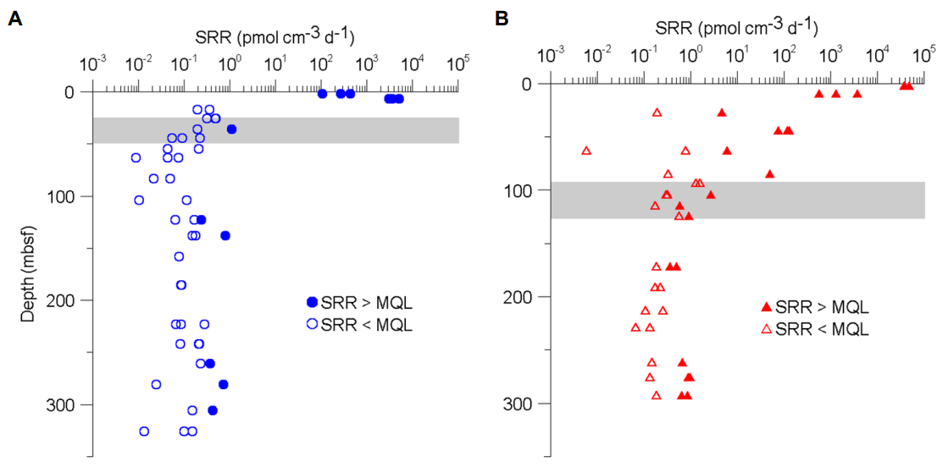
Results (SRR vs. Depth)
U1545
U1546
Highest SRR near the seafloor
SRR drops over depth
→ Depth of SMTZ
Still active at 300 mbsf

Slide 6
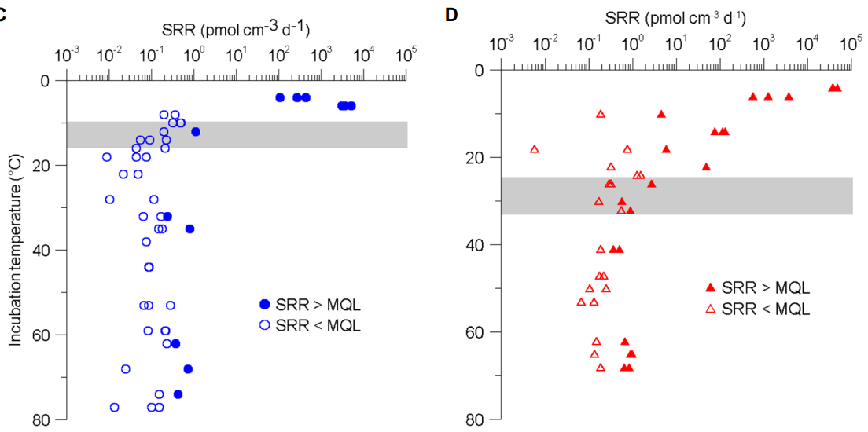
Results (SRR vs. temperature)
U1545
U1546
SRR < MQL between ca. 40 and 60ºC
→ Shift from mesophilic range to thermophilic range

Slide 7
Conclusion
Sulfate reduction was detected down to ca. 300 mbsf
Microbial communities range from psychrophiles to thermophiles
Shift from mesophilic to thermophilic communities accompanied with massive decrease in microbial activity
Notes:
X axis exponential, colour change

Slide 8
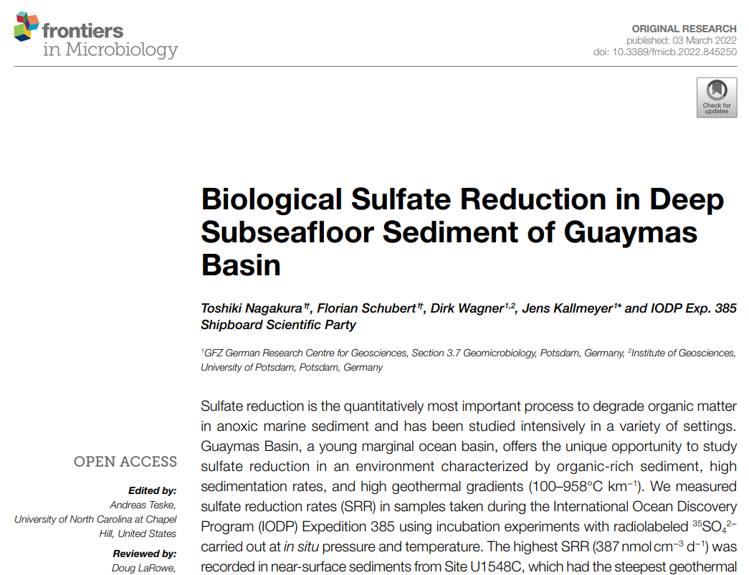

Slide 9
Thank you for your attention

