Slide 1



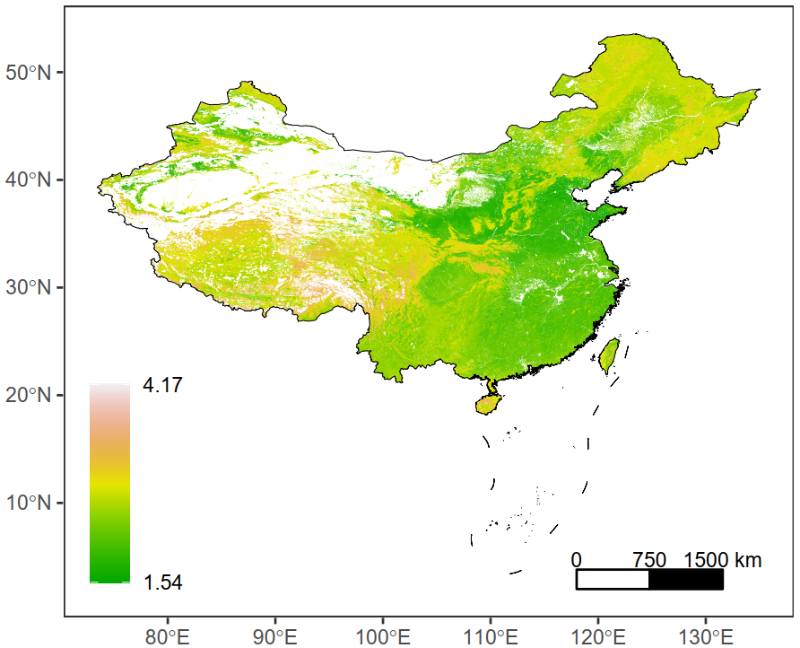
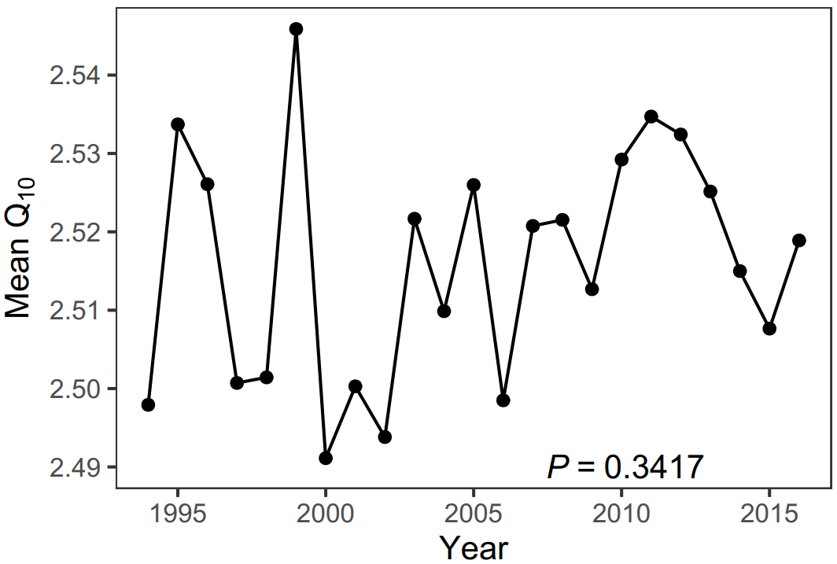
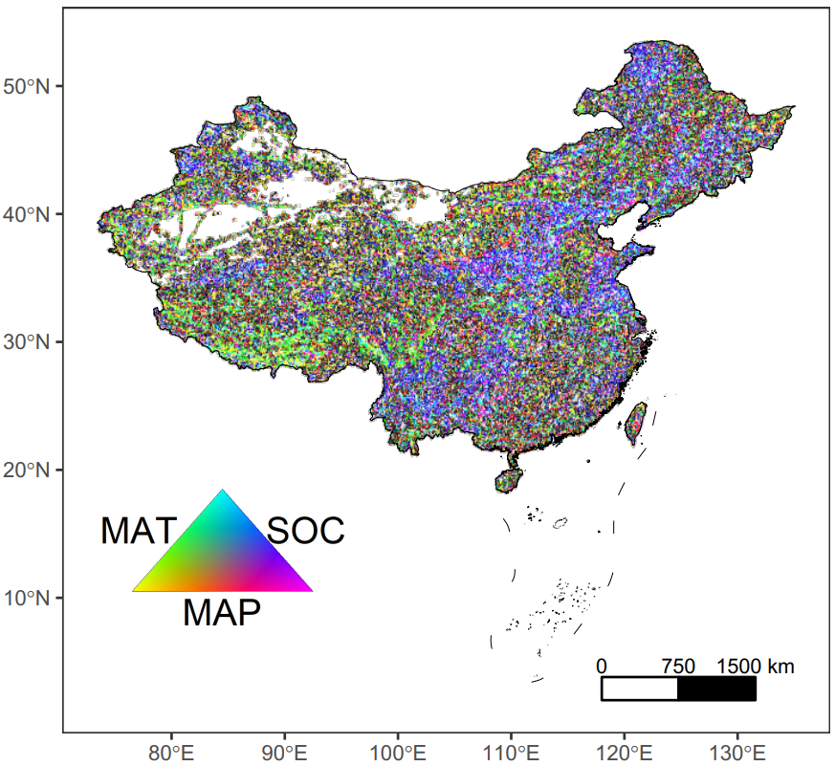
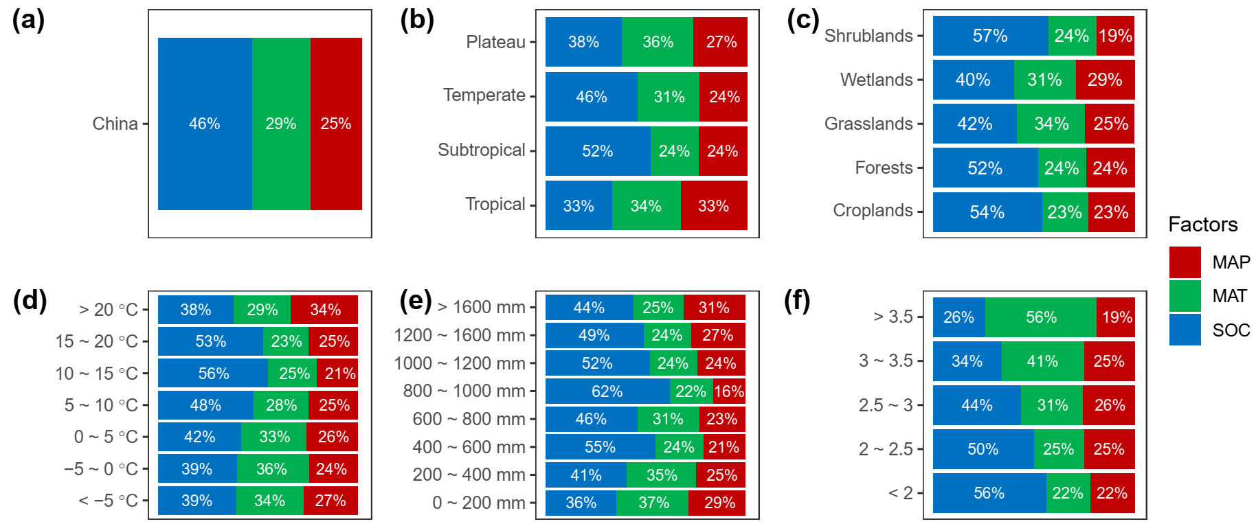
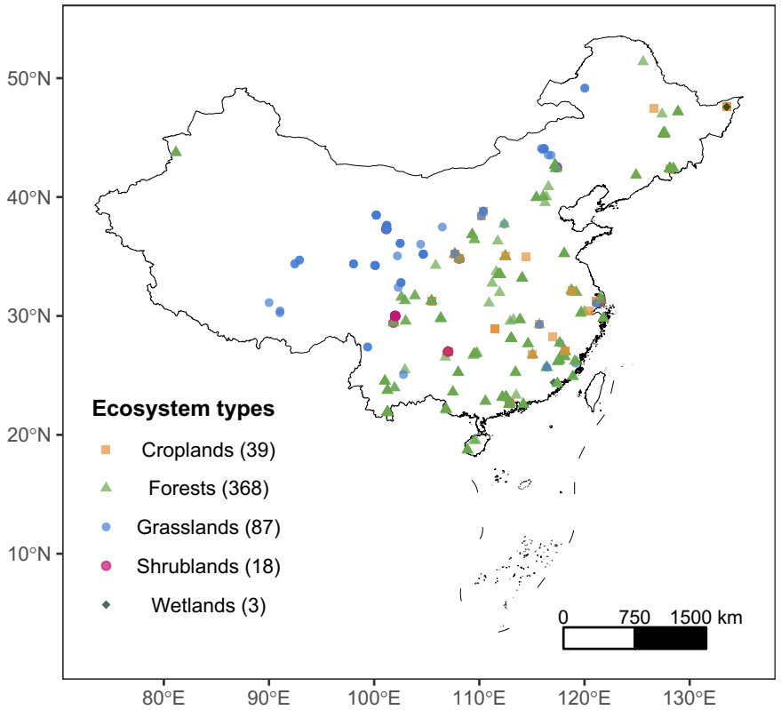
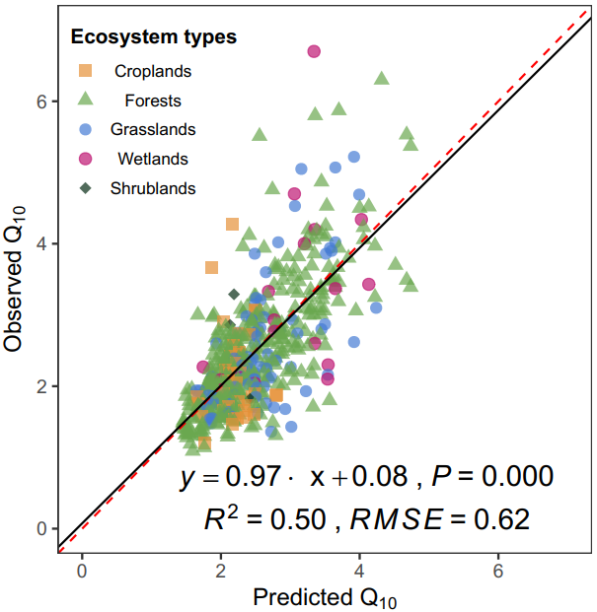
EGU General Assembly 2022 “Geoinformation Technologies in Sustainable Soil Management”
a College of Earth Science, Chengdu University of Technology, Chengdu 610059, China (993572587@qq.com)
b College of Ecology and Environment, Chengdu University of Technology, Chengdu 610059 Sichuan, China (lxtt2010@163.com)
c State Environmental Protection Key Laboratory of Synergetic Control and Joint Remediation for Soil & Water Pollution, Chengdu University of Technology, Chengdu 610059, China (lxtt2010@163.com)
Various dominant factors of temperature sensitivity of soil respiration across China
Zhihan Yangª, Xiaolu Tang^{b,} ^{c,} *, Tao Zhouª, Xinrui Luoª
Introduction
As a crucial process of global carbon cycle, soil respiration (RS) is one of the largest out flux of carbon dioxide from terrestrial ecosystems to atmosphere. The temperature sensitivity of RS (Q₁₀) was considered as a benchmark in describing terrestrial soil carbon-climate responses. However, the spatiotemporal and dominant factors of Q₁₀ were not explored well.
Results:
(3) Dominant factors of Q₁₀ showed a strong spatial heterogeneity, and SOC was the most important dominant factor.
(1) Q₁₀ ranged from 1.54 to 4.17 with an average of 2.52.
(2) Q₁₀ did not differ significantly from 1994 to 2016 (p = 0.34).
Method
We developed gridded long-term Q₁₀ datasets at 5 cm soil depth with a spatial resolution of 1 km from 515 field observations using a Random Forest (RF) algorithm with the linkage of climate, soil and vegetation variables (model efficiency = 0.5).
To quantify the temporal trend of Q₁₀, the Theil-Sen linear regression method were used.
To study the dominant factors on Q₁₀, we used local partial correlation analysis (a 3 × 3 moving window) on annual mean temperature (MAT), annual mean precipitation (MAP) and soil organic carbon (SOC).
Figure 2 Spatial patterns of mean value of data-derived Q₁₀ from 1994 to 2016.
Figure 3 Annual change of mean predicted Q10 value across China from 1994 to 2016. The p value was the result from Theil-Sen linear regression.
Figure 4 The spatial patterns of dominant factors dominant factors controlling Q₁₀.
(4) In colder regions (as higher Q₁₀), the MAT influenced Q10 more significantly.
Conclusion
Spatiotemporal pattern
Q₁₀ varied a lot, and were generally higher in cold regions. The annual change of Q₁₀ was not significant from 1994 to 2016.
Dominant factors
Dominant factors has a strong spatial pattern, SOC was the most important dominant factor across China. MAT influenced Q₁₀ more significantly in colder regions, which indicated that future Q₁₀ variations in cold regions may be more notable than in warm regions in a warming climate.
(a)
(b)
Corresponding author at: College of Ecology and Environment, Chengdu University of Technology, Chengdu 610059 Sichuan, China; State Environmental Protection Key Laboratory of Synergetic Control and Joint Remediation for Soil & Water Pollution, Chengdu University of Technology, Chengdu 610059, China. E-mail address: lxtt2010@163.com (X. Tang)
Figure 1 Distributions and ecosystem types of 515 field observations (a). Comparison of observed Q₁₀ and predicted Q₁₀ from Random Forest by 10-fold cross-validation (b).
Figure 5 The percentage of areas dominated by MAP, MAT and SOC for (a) whole China, (b) climatic zones, (c) ecosystem types, (d) MAT gradients, (e) MAP gradients, (f) Q₁₀ gradients.

