Slide 1

Space for Zoom video!
Dynamical propagation and growth mechanisms for convectively coupled equatorial Kelvin waves over the Indian Ocean
Adrian Matthews
University of East Anglia
Abstract id EGU22-2538
European Geophysical Union Conference, Vienna, Austria. 25 May 2022

Slide 2
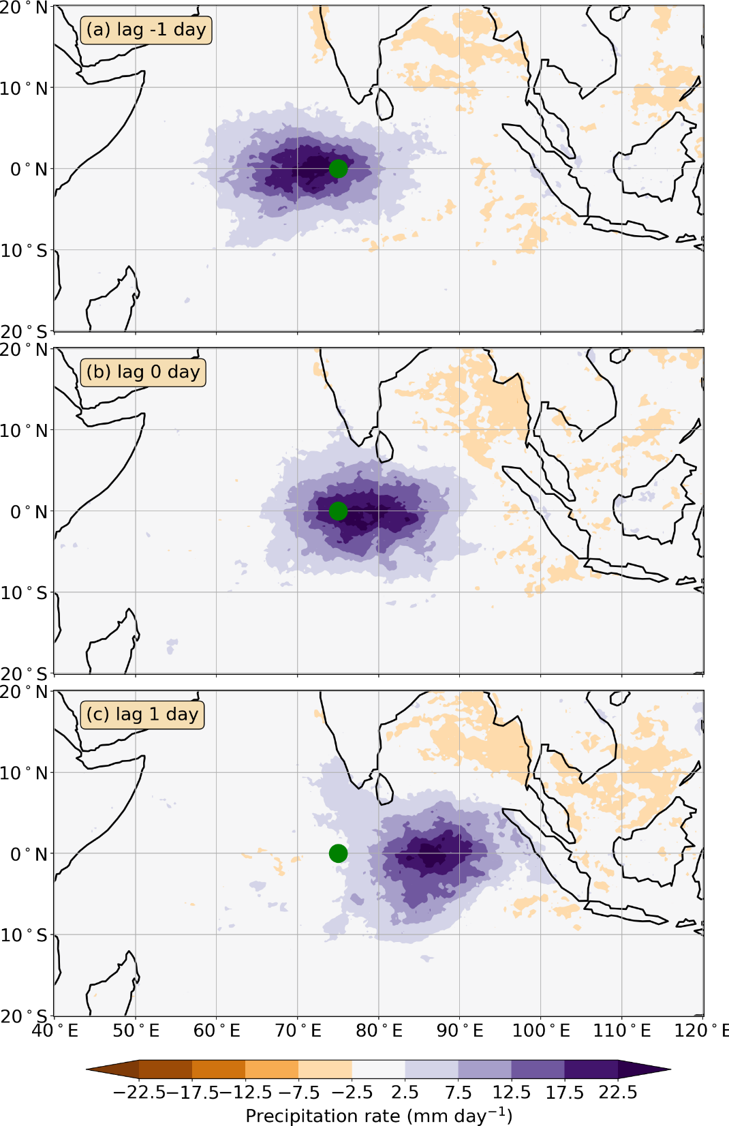
Convectively coupled Kelvin wave (CCKW) Eastward propagating weather system
Space for Zoom video!
Importance
Bring extreme precipitation to Maritime Continent and elsewhere
Component of MJO
How do CCKWs propagate eastward?
Same mechanism as theoretical equatorial Kelvin wave?
How do CCKWs grow?
Theoretical equatorial Kelvin waves are neutral (no growth)

Slide 3
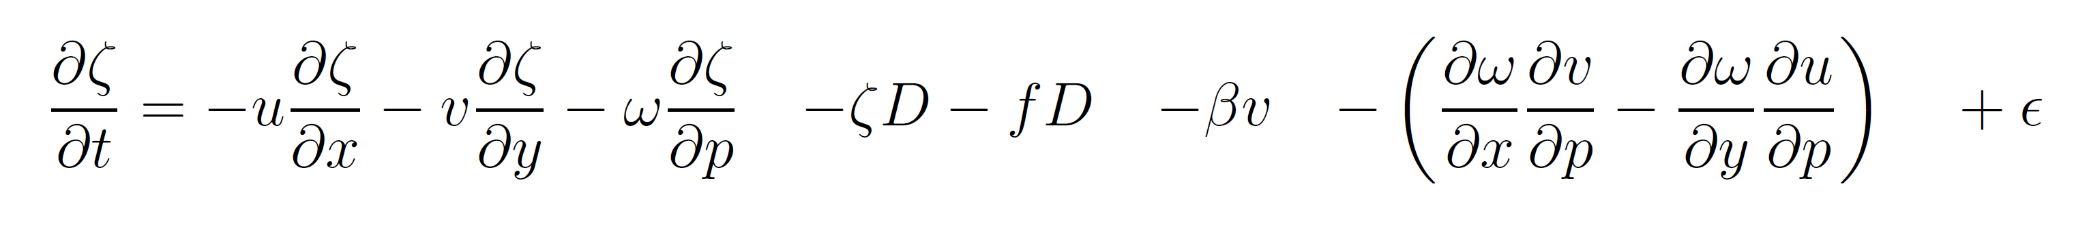
Vorticity equation
Space for Zoom video!
Source terms S
Vorticity
tendency
Advection of relative vorticity
Vortex stretching
Advection of planetary vorticity
Vortex tilting/twisting
Residual
+
subgridscale
Source term for theoretical equatorial Kelvin wave (EKW)

Slide 4
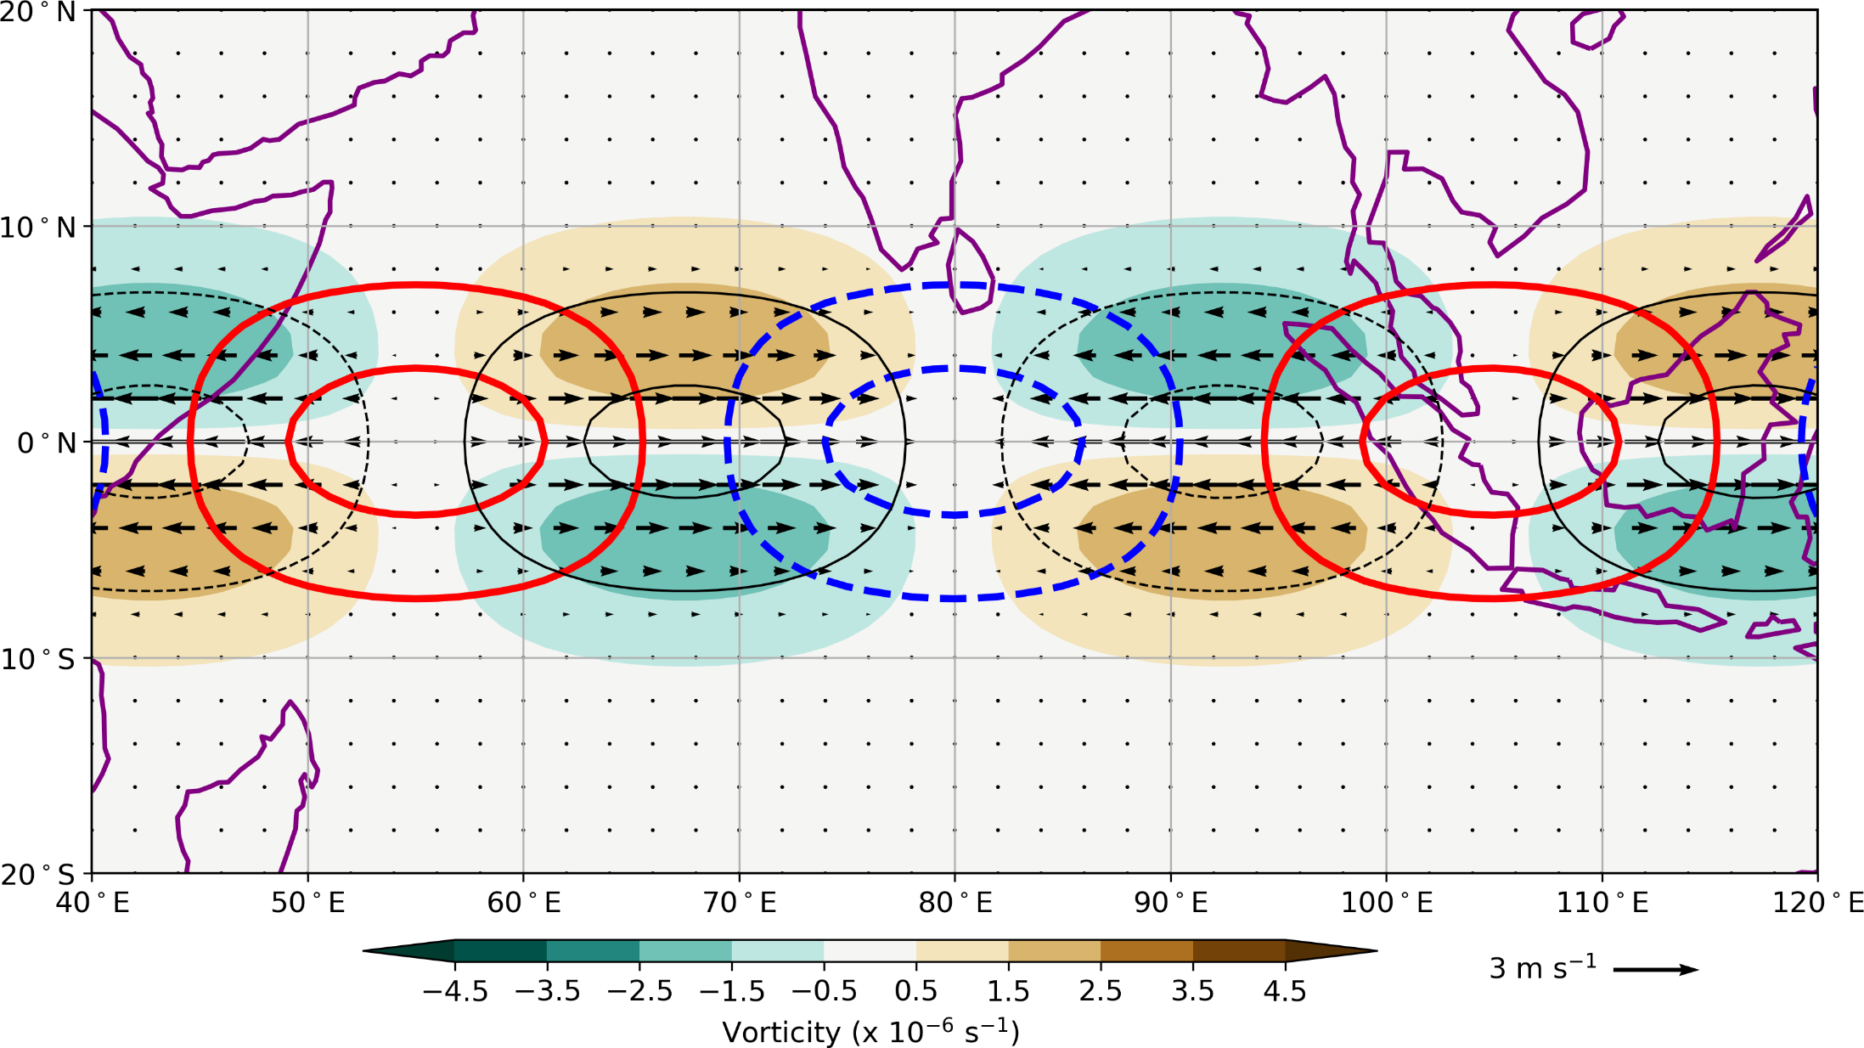
Theoretical equatorial Kelvin wave Dynamical structure
Space for Zoom video!
Cyclonic vorticity pair
Convergence

Slide 5
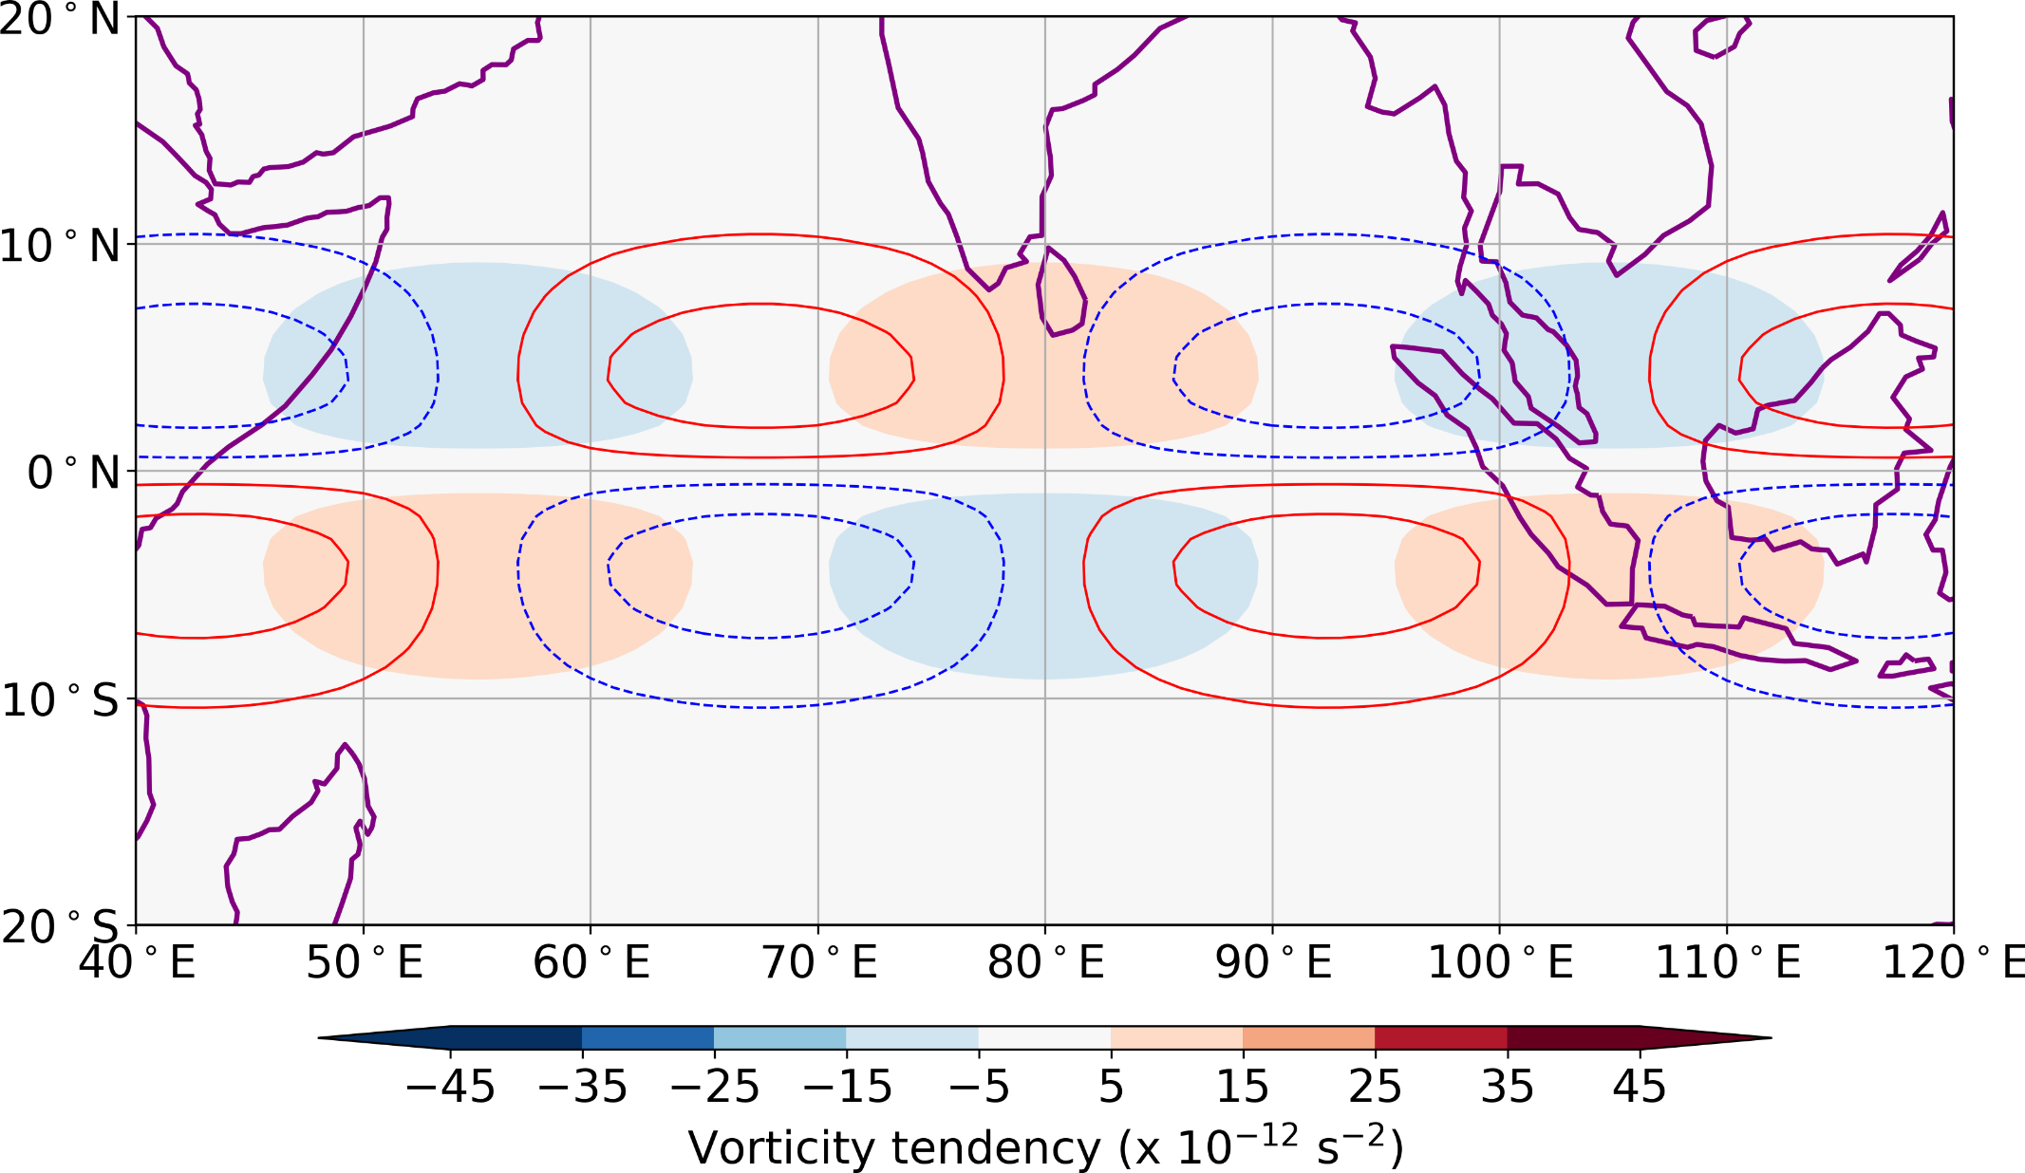
Theoretical equatorial Kelvin wave Eastward propagation mechanism
Space for Zoom video!
Cyclonic vorticity pair
Vortex stretching (–fD)

Slide 6
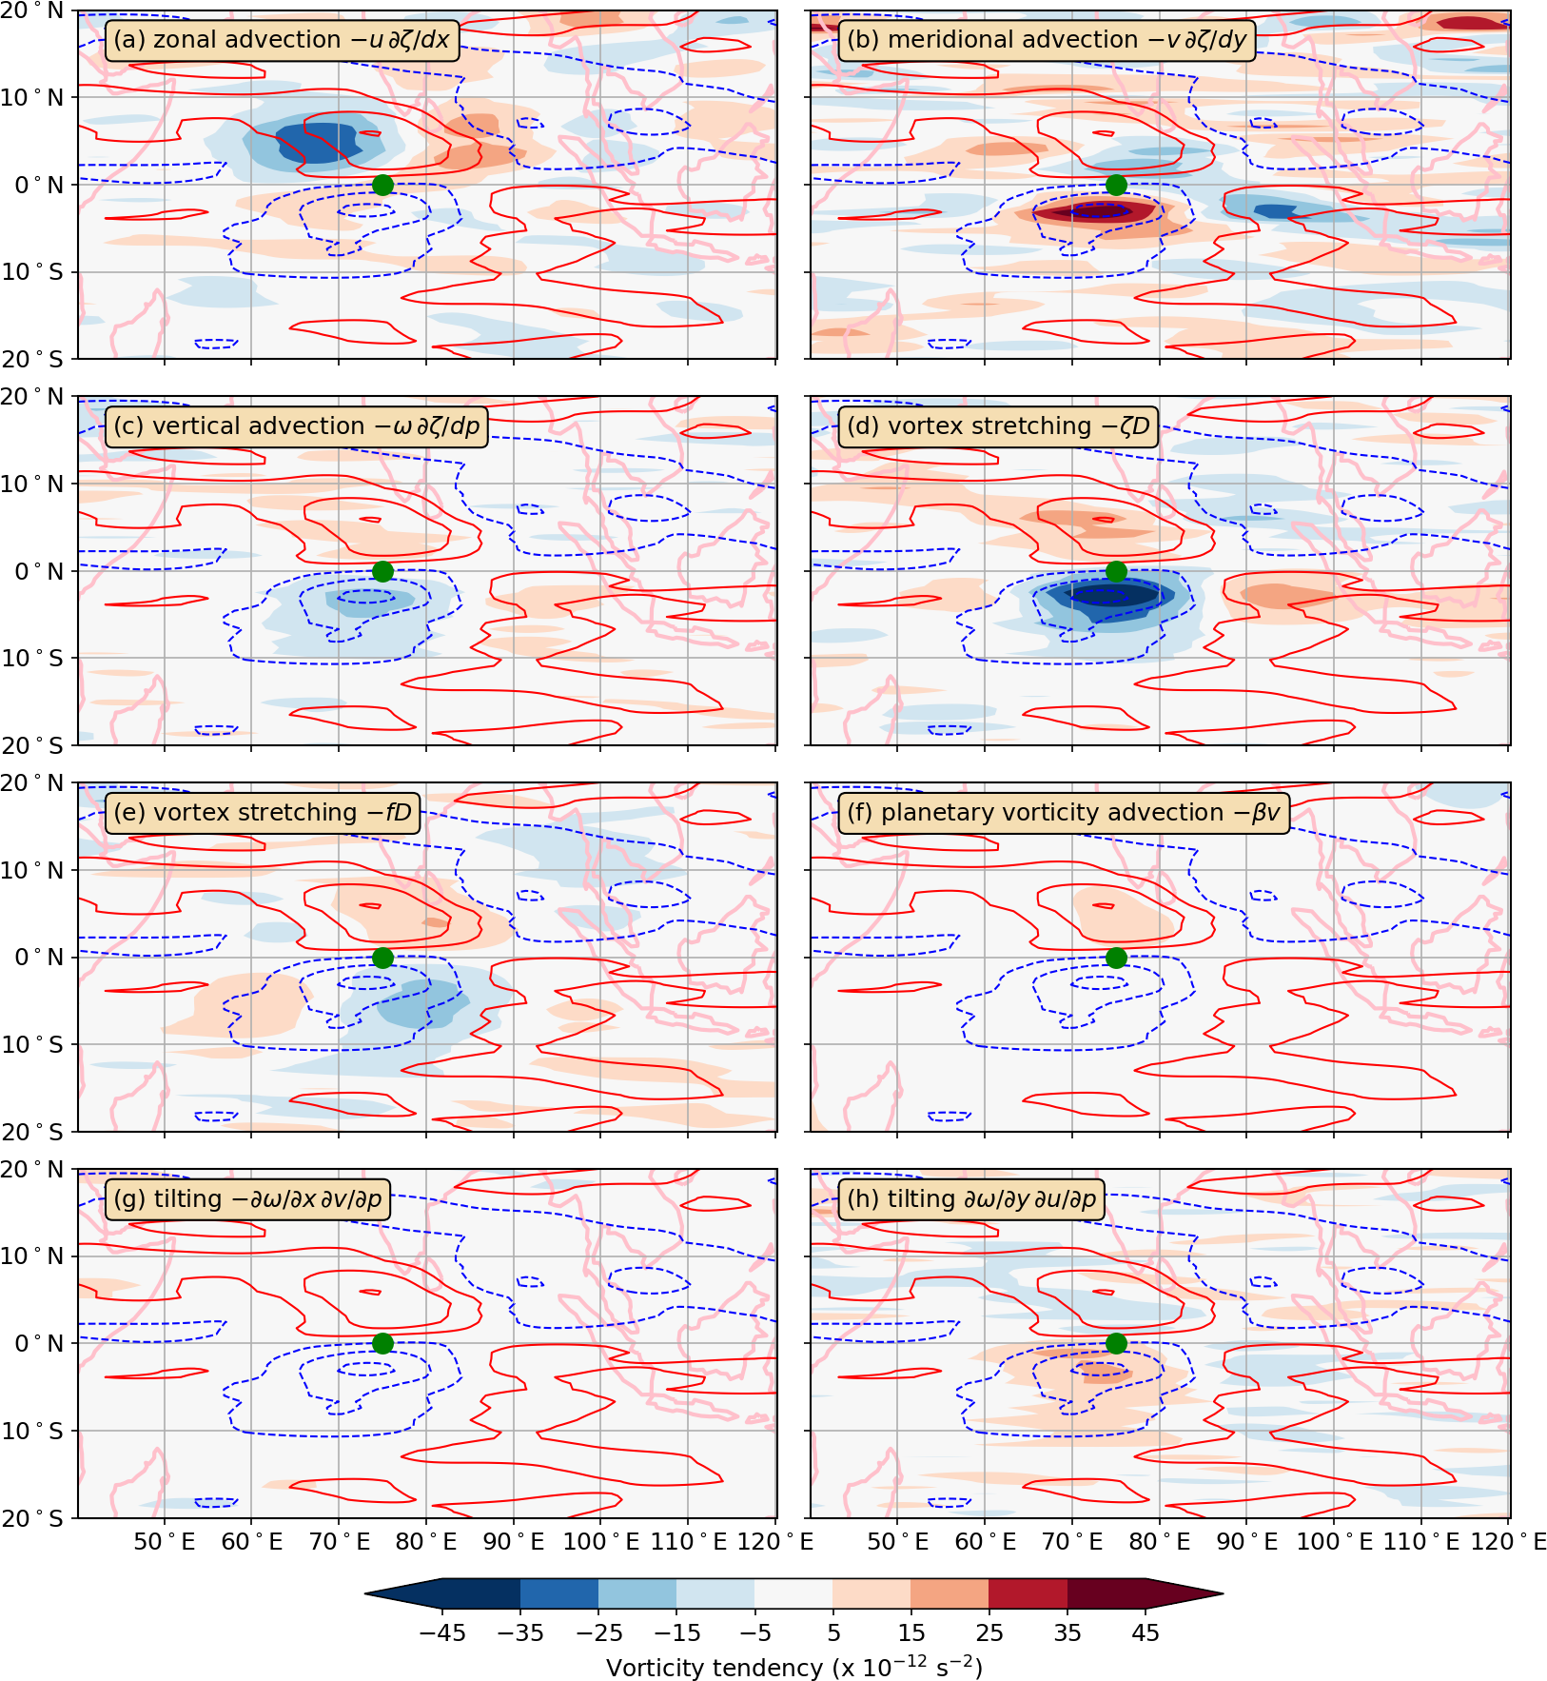
CCKW vorticity source terms Lower troposphere 850 hPa
Space for Zoom video!
Calculate composite maps (ERA-Interim) of each source term in vorticity equation
If observed CCKW propagation mechanism is same as theoretical Kelvin wave then only the –fD term would be non-zero!
Evaluate phasing between each source term and vorticity anomaly

Slide 7
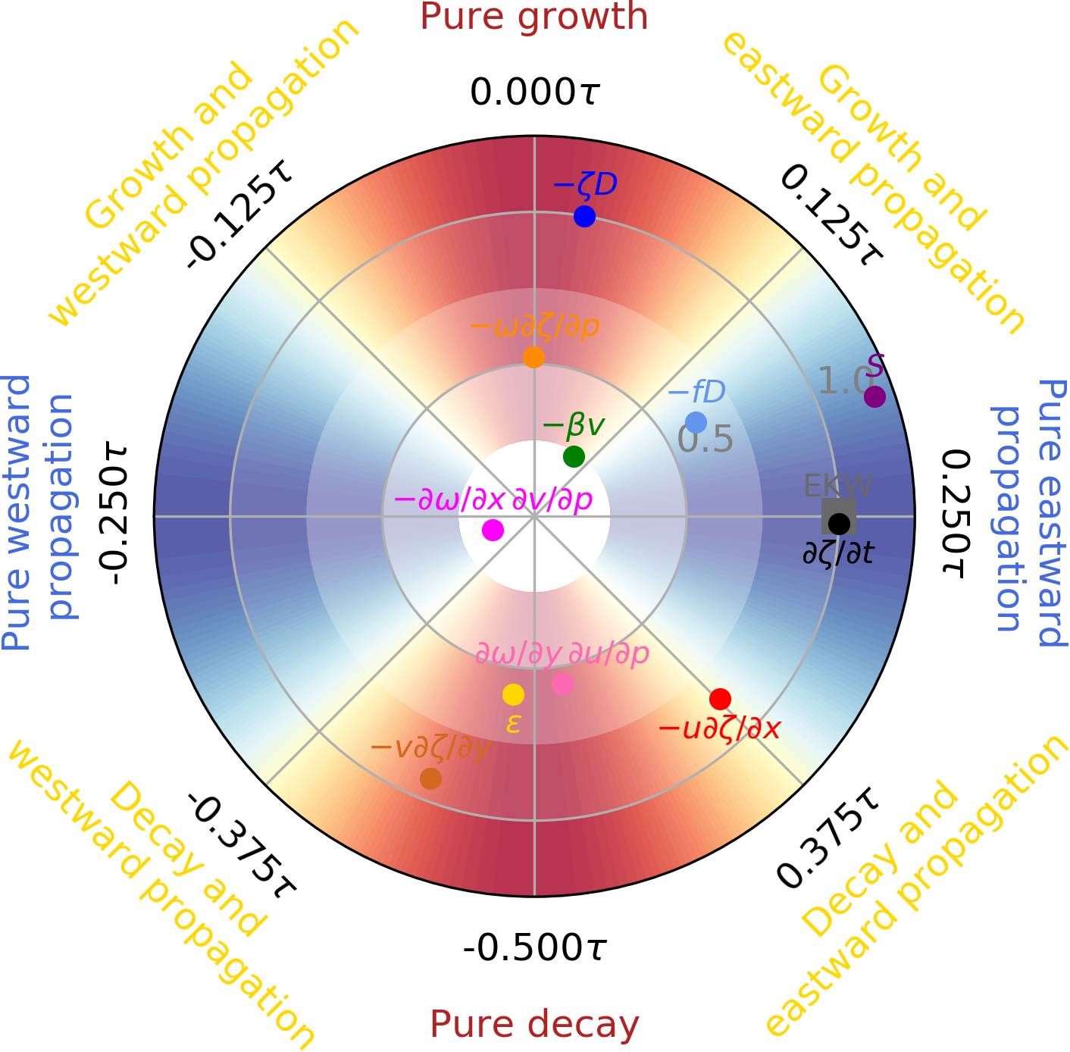
CCKW vorticity source terms Propagation – growth polar diagram
Space for Zoom video!
Eastward propagation of CCKW due to:
Vortex stretching –fD
as in theoretical EKW.
Zonal advection
from background and wave u wind
Growth of CCKW due to:
Vortex stretching –ζD
Due to exact phasing between vorticity and divergence from u wind structure
Countered by (decay):
Zonal advection –u dζ/dx
Meridional advection –v dζ/dy
Total source S gives eastward propagation and slight growth

Slide 8
CCKW vorticity source terms Propagation – growth polar diagram
Space for Zoom video!
Eastward propagation of CCKW due to:
Vortex stretching –fD
as in theoretical Kelvin wave.
Zonal advection
from background and wave u wind
Growth of CCKW due to:
Vortex stretching –ζD
Due to exact phasing between vorticity and divergence from u wind structure
Countered by (decay):
Zonal advection –u dζ/dx
Meridional advection –v dζ/dy
Total source S gives eastward propagation and slight growth

Slide 9
CCKW vorticity source terms Propagation – growth polar diagram
Space for Zoom video!
Eastward propagation of CCKW due to:
Vortex stretching –fD
as in theoretical EKW.
Zonal advection
from background and wave u wind
Growth of CCKW due to:
Vortex stretching –ζD
Due to exact phasing between vorticity and divergence from u wind structure
Countered by (decay):
Zonal advection –u dζ/dx
Meridional advection –v dζ/dy
Total source S gives eastward propagation and slight growth

Slide 10
CCKW vorticity source terms Propagation – growth polar diagram
Space for Zoom video!
Eastward propagation of CCKW due to:
Vortex stretching –fD
as in theoretical EKW.
Zonal advection
from background and wave u wind
Growth of CCKW due to:
Vortex stretching –ζD
Due to exact phasing between vorticity and divergence from u wind structure
Countered by (decay):
Zonal advection –u dζ/dx
Meridional advection –v dζ/dy
Total source S gives eastward propagation and slight growth

Slide 11
CCKW vorticity source terms Propagation – growth polar diagram
Space for Zoom video!
Eastward propagation of CCKW due to:
Vortex stretching –fD
as in theoretical EKW.
Zonal advection
from background and wave u wind
Growth of CCKW due to:
Vortex stretching –ζD
Due to exact phasing between vorticity and divergence from u wind structure
Countered by (decay):
Zonal advection –u dζ/dx
Meridional advection –v dζ/dy
Total source S gives eastward propagation and slight growth

Slide 12
CCKW vorticity source terms Propagation – growth polar diagram
Space for Zoom video!
Eastward propagation of CCKW due to:
Vortex stretching –fD
as in theoretical EKW.
Zonal advection
from background and wave u wind
Growth of CCKW due to:
Vortex stretching –ζD
Due to exact phasing between vorticity and divergence from u wind structure
Countered by (decay):
Zonal advection –u dζ/dx
Meridional advection –v dζ/dy
Total source S gives eastward propagation and slight growth

Slide 13
Conclusions
Space for Zoom video!
Dynamically, CCKWs act as modified theoretical equatorial Kelvin waves
Forecasting of CCKWs in NWP, and simulation in climate models, will depend on correct propagation/growth mechanisms and vorticity balance
Future work
Incorporate thermodynamical and moisture balances into this model
Apply to other locations (e.g., Pacific with different basic state)
Applications
Apply this process-based diagnostic analysis to NWP and climate model output to understand model errors
Apply technique to other phenomena (equatorial Rossby waves, mixed Rossby-gravity waves, MJO)
Matthews AJ, 2021: Dynamical propagation and growth mechanisms for convectively coupled equatorial Kelvin waves over the Indian Ocean. Quart. J. Roy. Meteorol. Soc., 147, 4310-4336, doi: 10.1002/qj.4179

