Slide 1





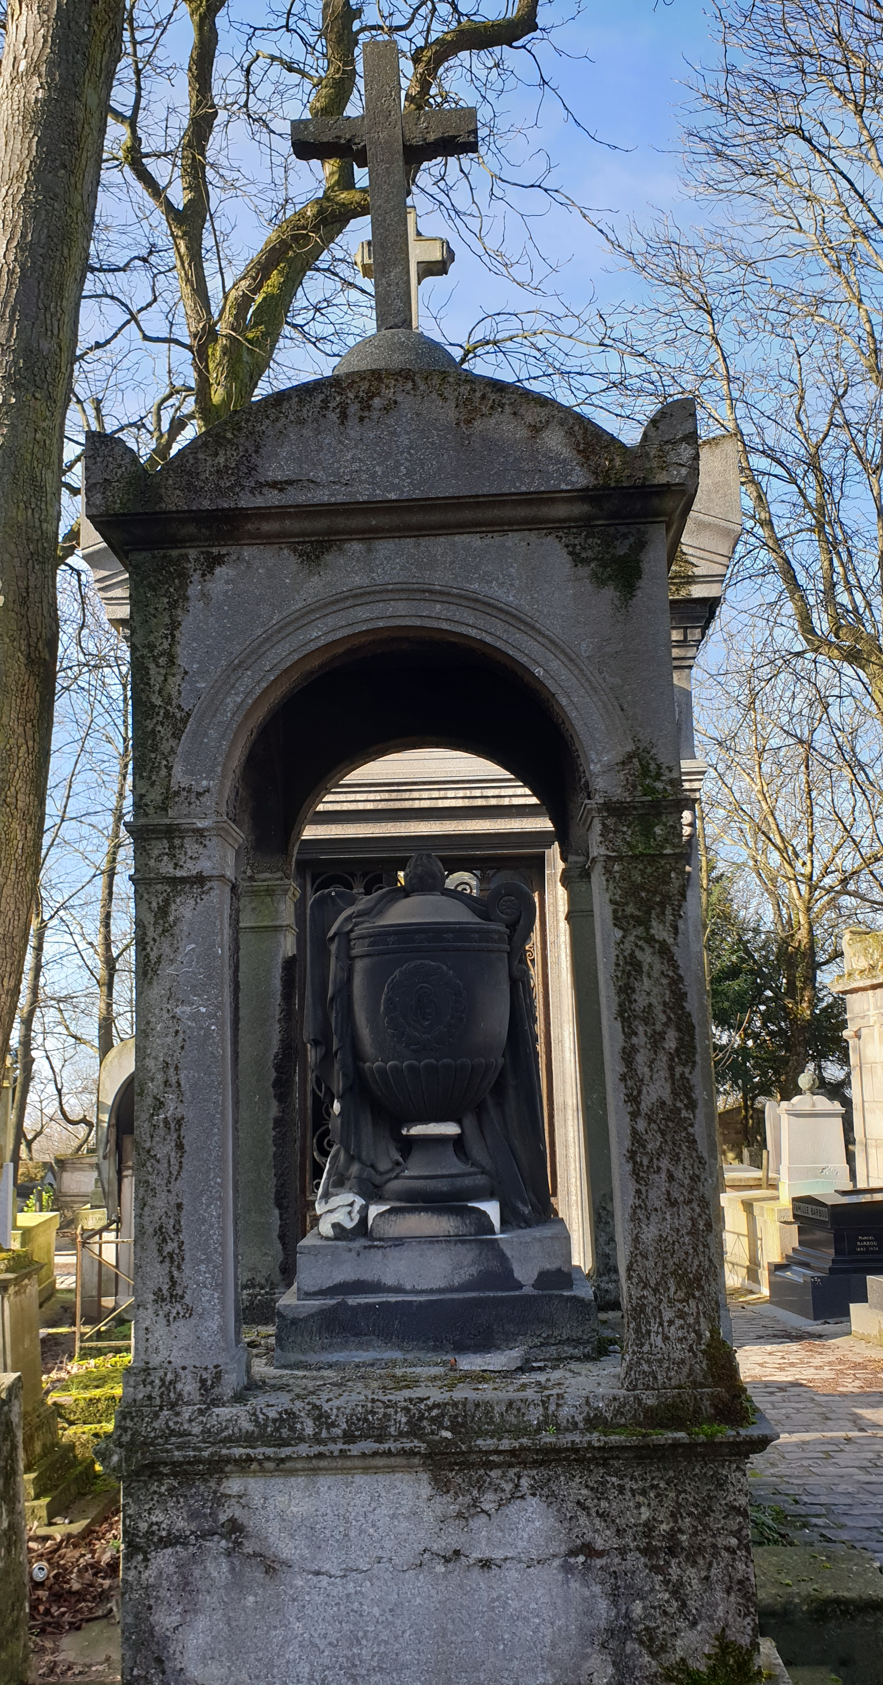
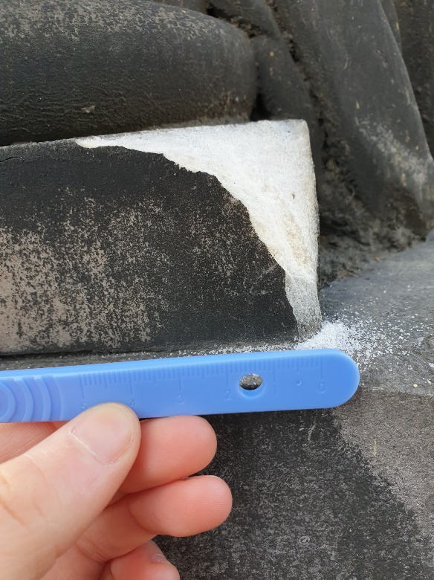
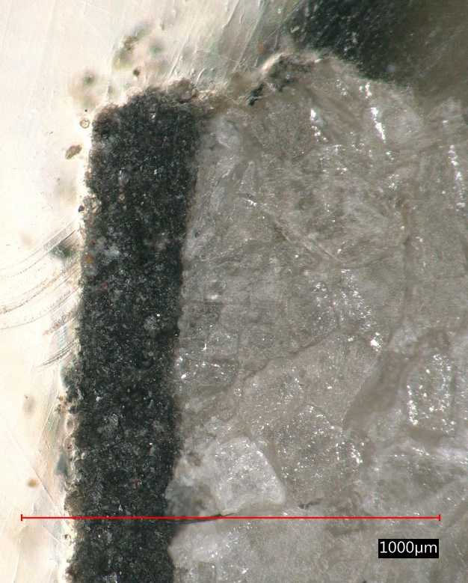
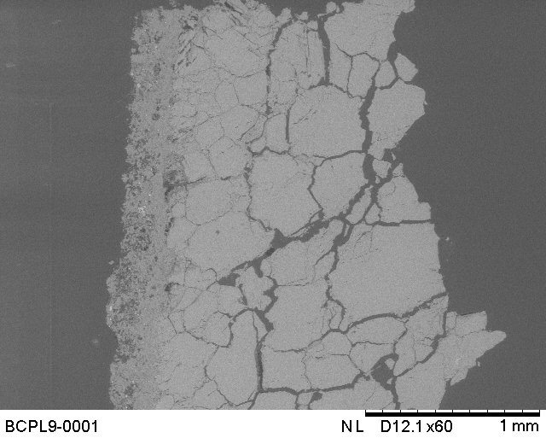
Black crusts as past air pollution archives
ERE 1.4 Climate change and cultural heritage: impact, vulnerability, adaptation – Environmental changes & observed weathering
Ropiquet mathilde¹, verney-carron aurelie¹, chabas anne¹
Laboratoire interuniversitaire des systemes atmospheriques CNRS umr 7583 – Universite paris-est creteil val-de-marne paris 12 – faculté des sciences et technologie 61 avenue du général de gaulle 94140 creteil cedex france

Slide 2
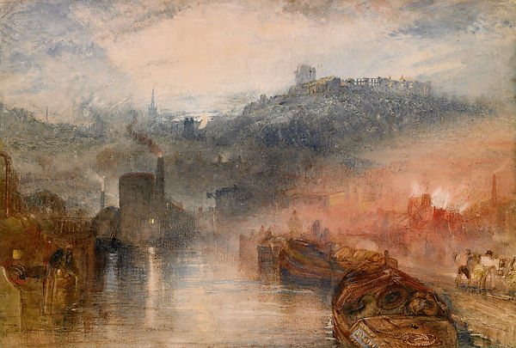
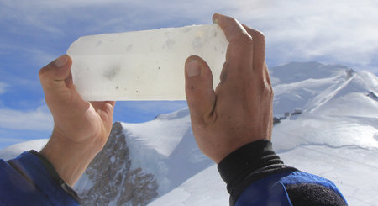
ERE 1.4 Climate change and cultural heritage: impact, vulnerability, adaptation – Environmental changes & observed weathering
Impacts of pollution
Weathered monument – Venise, XVIIIe century
L’Arsenal – Bernado Belotto (1740)
Industrial city - England, XIXe century
Dudley, Worcestershire – J.M.W Turner (1832)
Ice core
Boutron and Patterson, 1986

Slide 3
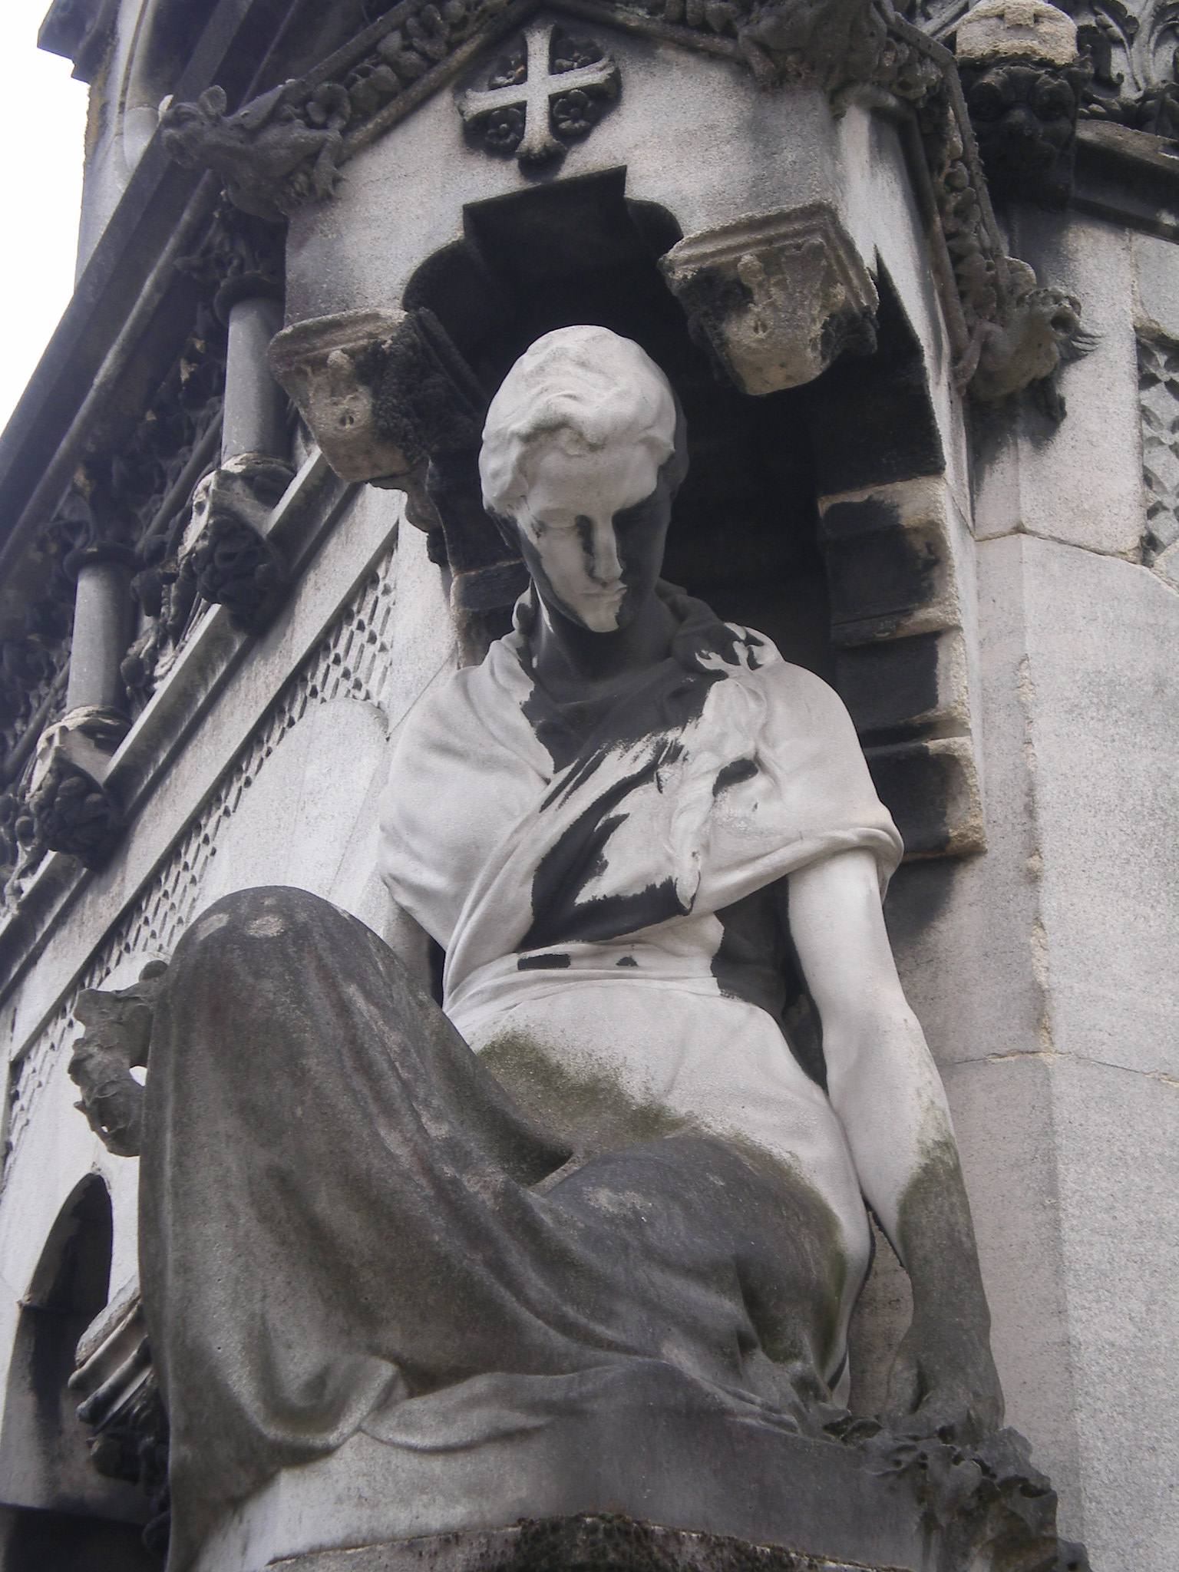
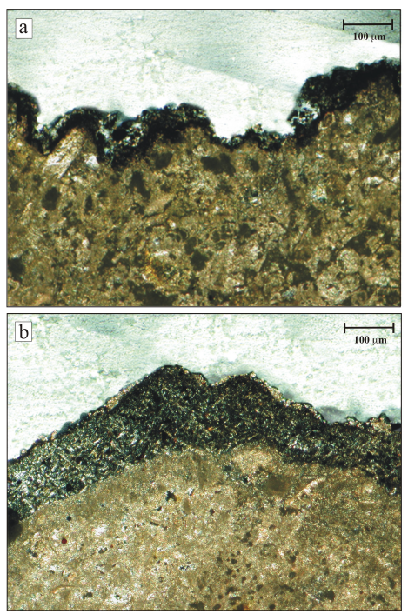
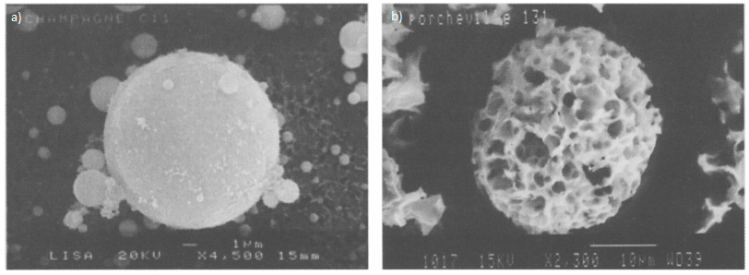

ERE 1.4 Climate change and cultural heritage: impact, vulnerability, adaptation – Environmental changes & observed weathering
Accumulation area on monuments : black crust
Black crust formation : reaction between calcite & SO2
$${CaCO}_{3}+ H_{2}{SO}_{4}+ H_{2}O → {CaSO}_{4}.{2H}_{2}O+ {CO}_{2}$$
Skoulidikis and Papakonstantinou-Ziotis, 1981
Coal combustion fly-ash
Oil combustion fly-ash
Black crusts from St-Benoît basilica (Catania)
Barca et al., 2011
Lefèvre and Ausset, 2002

Slide 4
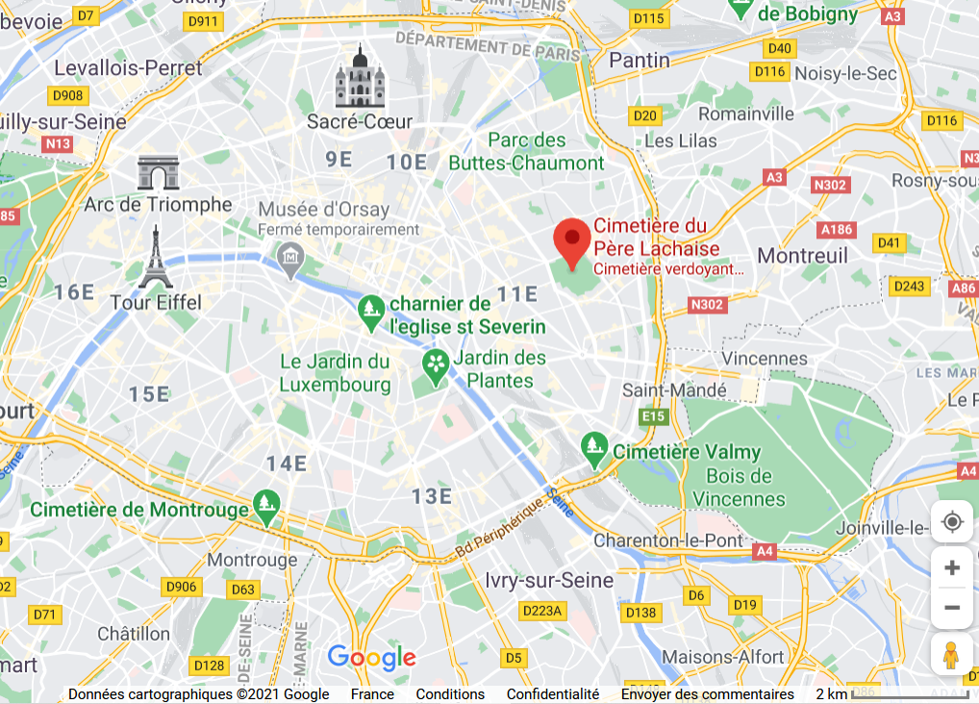
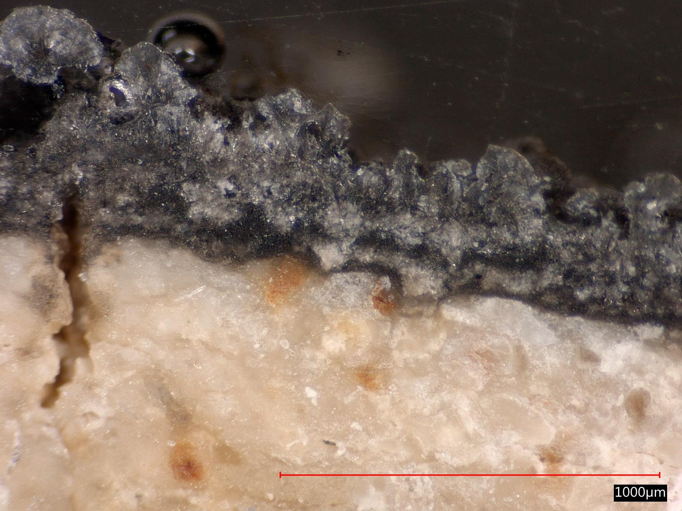
ERE 1.4 Climate change and cultural heritage: impact, vulnerability, adaptation – Environmental changes & observed weathering
Black crusts as past air pollution archives – Methodology
Deposit age
Père Lachaise cemetery localisation
Optical microscope view of a Père Lachaise black crust

Slide 5
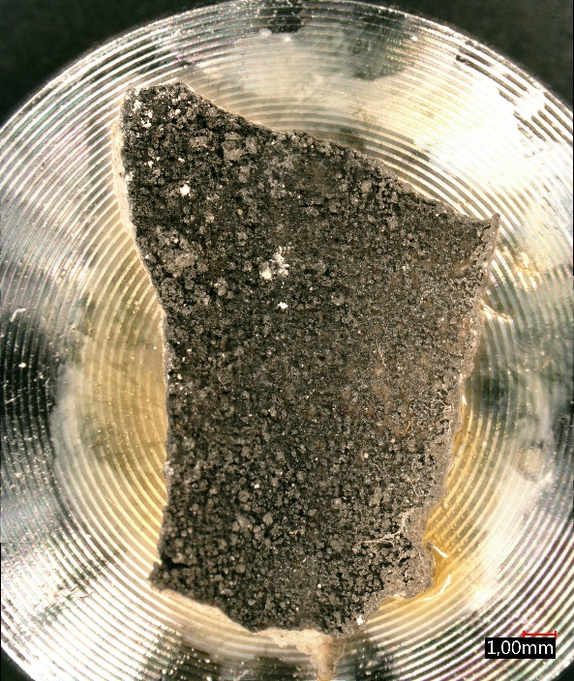
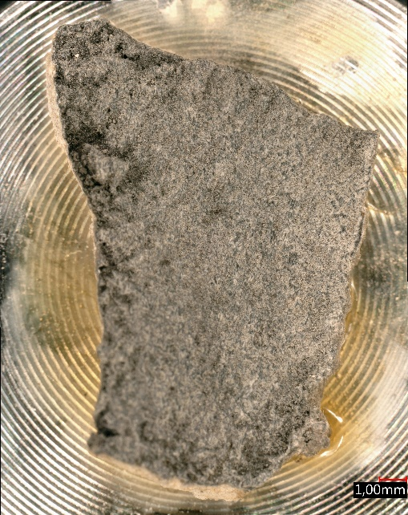
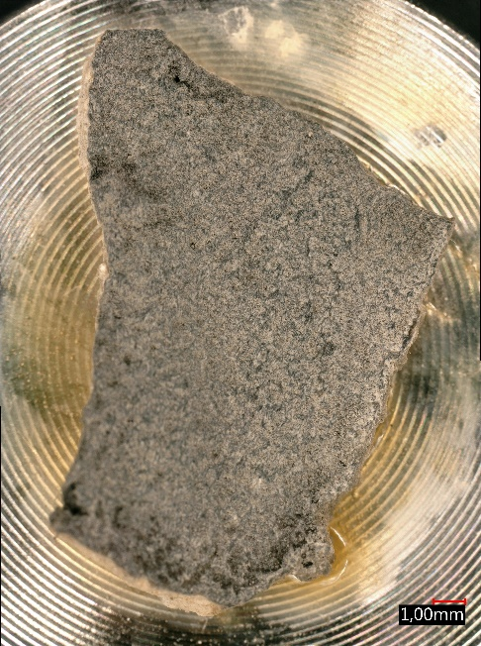
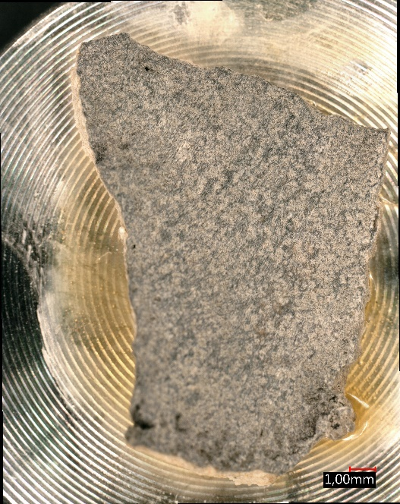
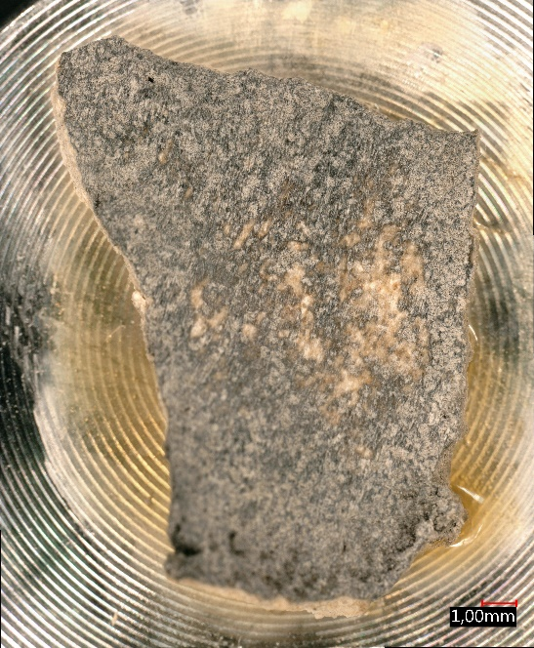
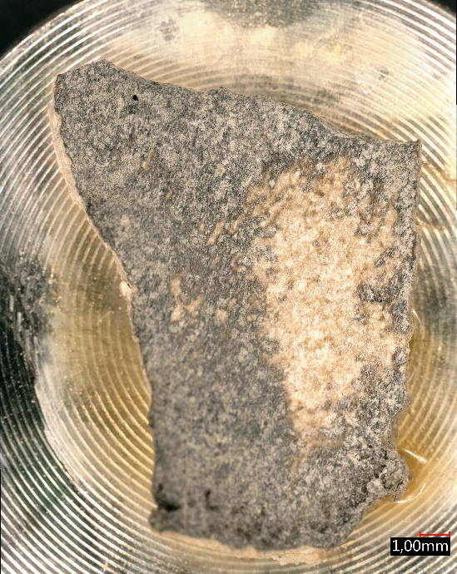
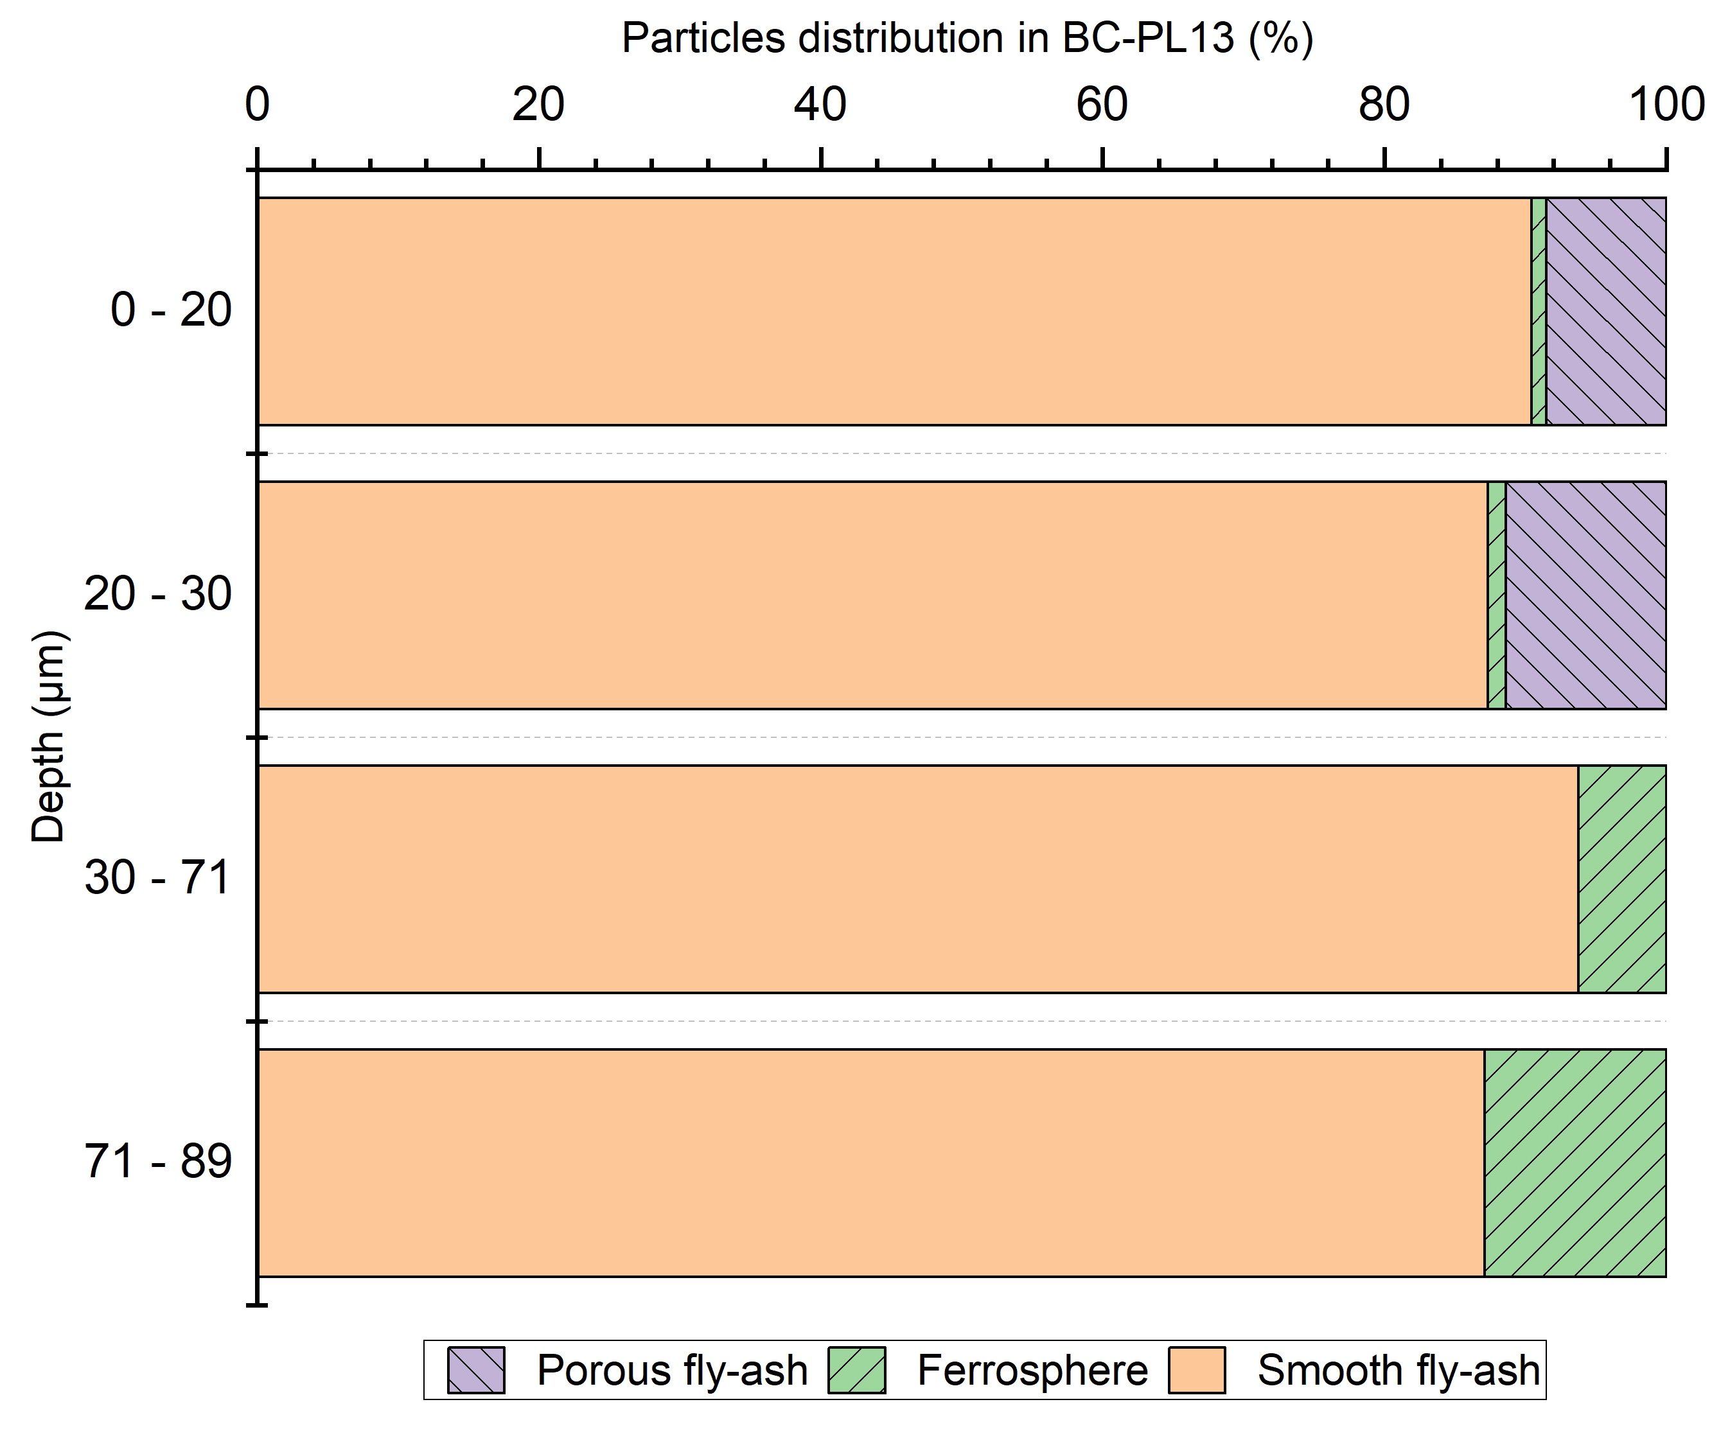
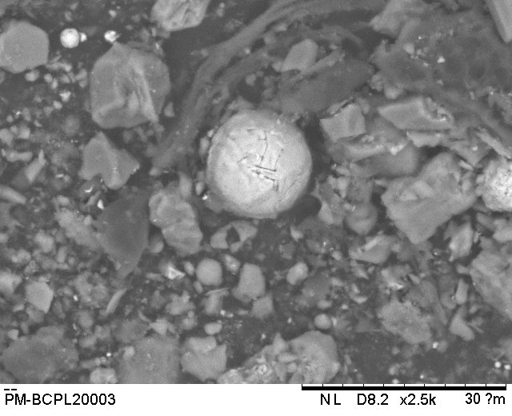
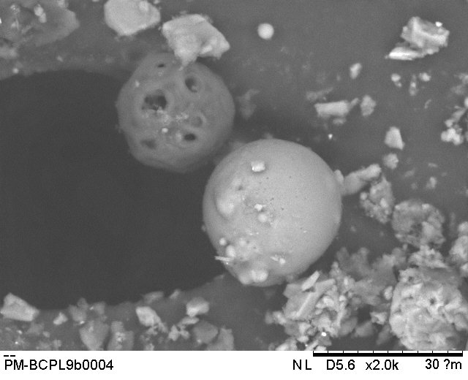
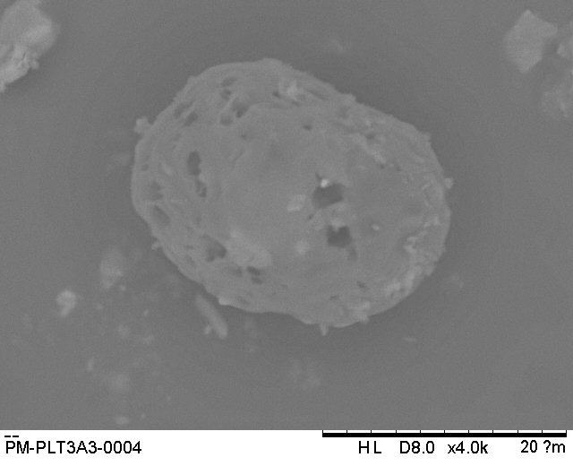
ERE 1.4 Climate change and cultural heritage: impact, vulnerability, adaptation – Environmental changes & observed weathering
Identification of stratigraphy in Père Lachaise cemetery black crusts – Evolution of airborn particulate matter
Progressive abrasion of the black crust
Ferrosphere
Fe
Smooth fly-ash
Si, Al
Porous fly-ash
C, S
Evolution of particulate matter inside a Père Lachaise black crust
COAL COMBUSTION
OIL COMBUSTION

Slide 6
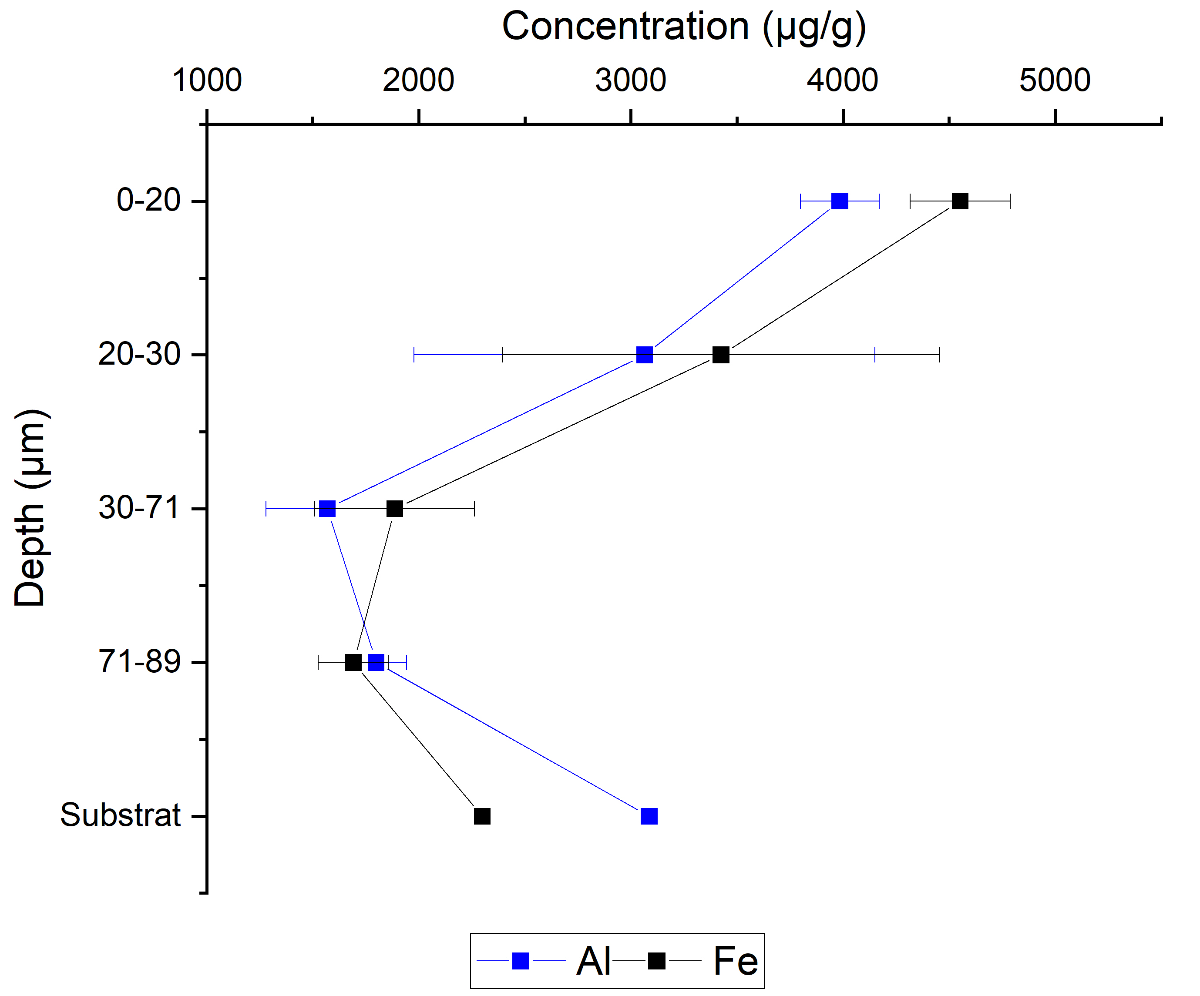
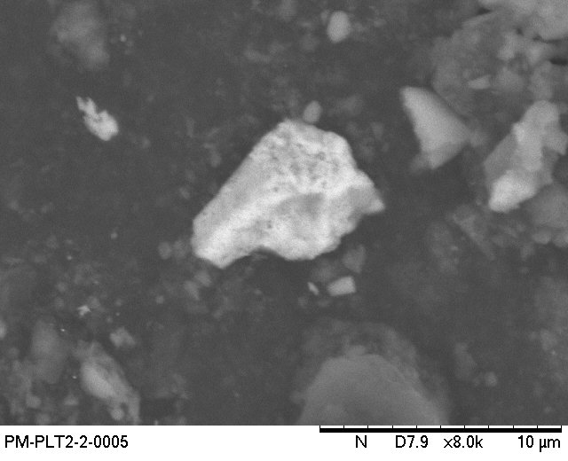
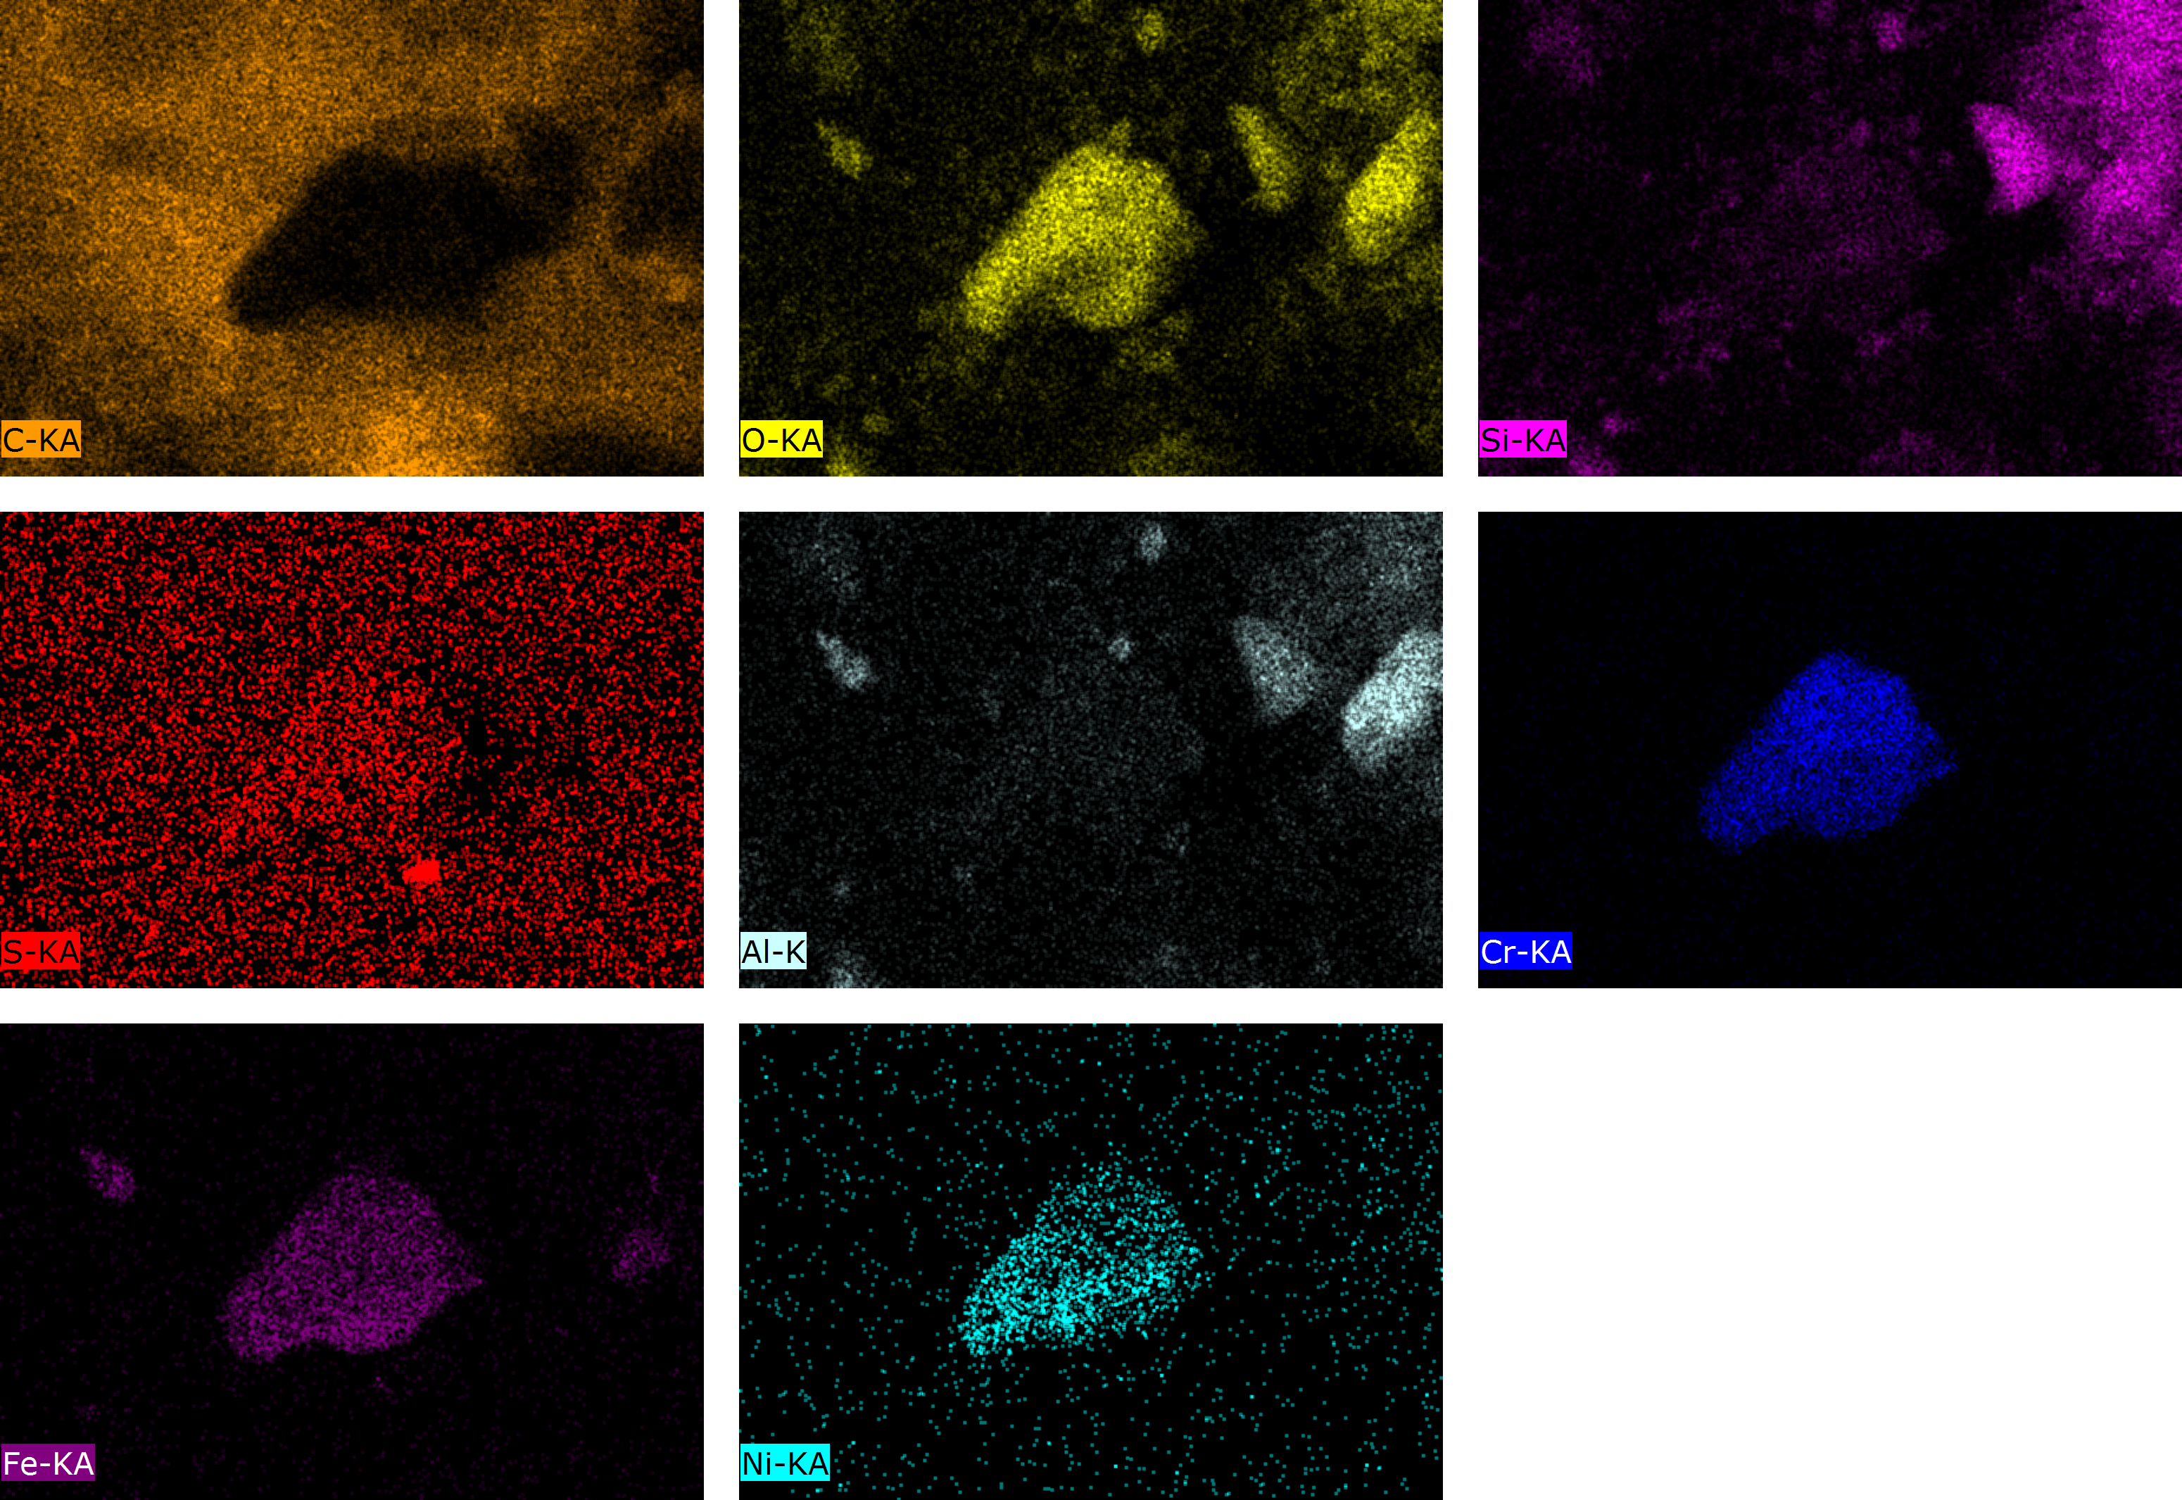
ERE 1.4 Climate change and cultural heritage: impact, vulnerability, adaptation – Environmental changes & observed weathering
Identification of stratigraphy in Père Lachaise cemetery black crusts – Evolution of metallic elements
a)
b)
Fe-Cr-Ni rich fragment
SEM observation
EDS mapping
Evolution of Aluminium and Iron in the depth of a Père Lachaise black crust (ICP-AES)

Slide 7
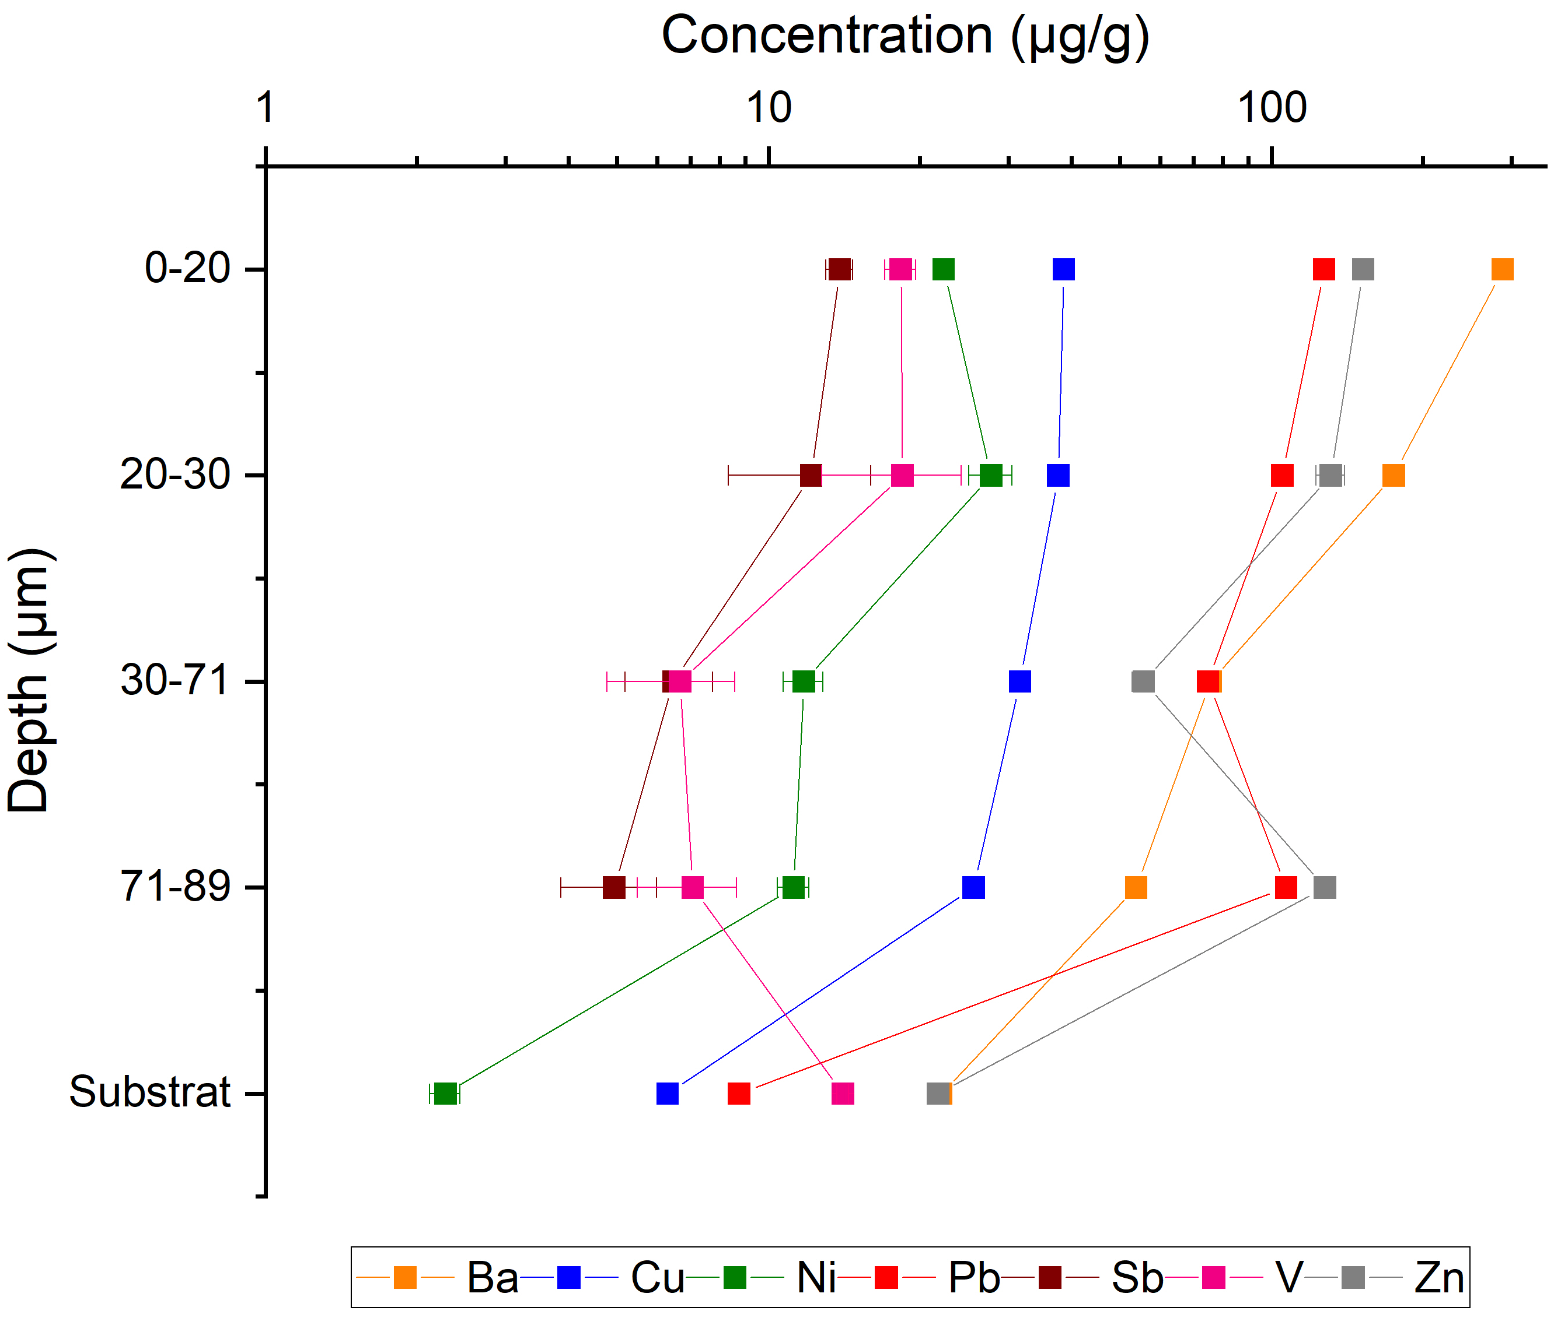
ERE 1.4 Climate change and cultural heritage: impact, vulnerability, adaptation – Environmental changes & observed weathering
Identification of stratigraphy in Père Lachaise cemetery black crusts – Evolution of metallic elements
→ Metal enrichment in the black crust
Pollution source | Elements
Fossil fuel combustion | As, Ni, Pb, V, Zn
Brake wear | Ba, Cu, Sb
Tire wear | Zn, Cd
Evolution of metals concentration in the depth of a Père Lachaise black crust (ICP-MS)

Slide 8
ERE 1.4 Climate change and cultural heritage: impact, vulnerability, adaptation – Environmental changes & observed weathering
Identification of stratigraphy in Père Lachaise cemetery black crusts – Key points
→ Stratigraphy of particulate matter inside black crusts
→ Evolution of metal concentration in the depth of the black crust
→ Complementary analyses in progress
Stone
Deposit age
Coal combustion fly-ash
Oil combustion fly-ash

Slide 9
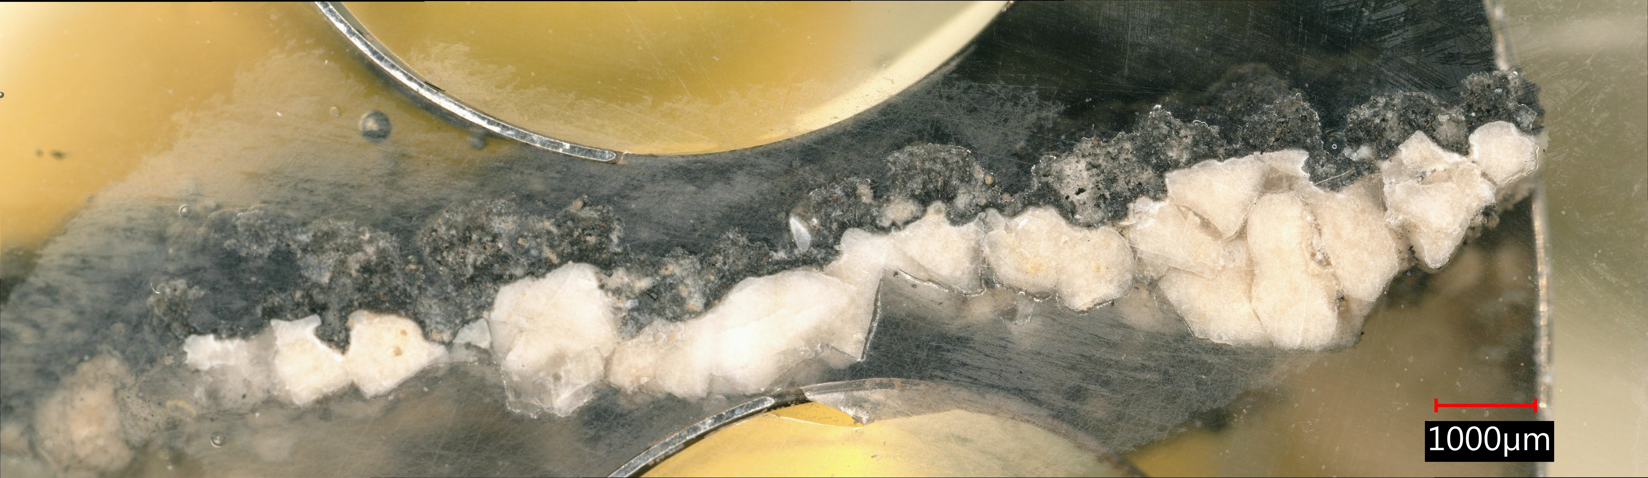
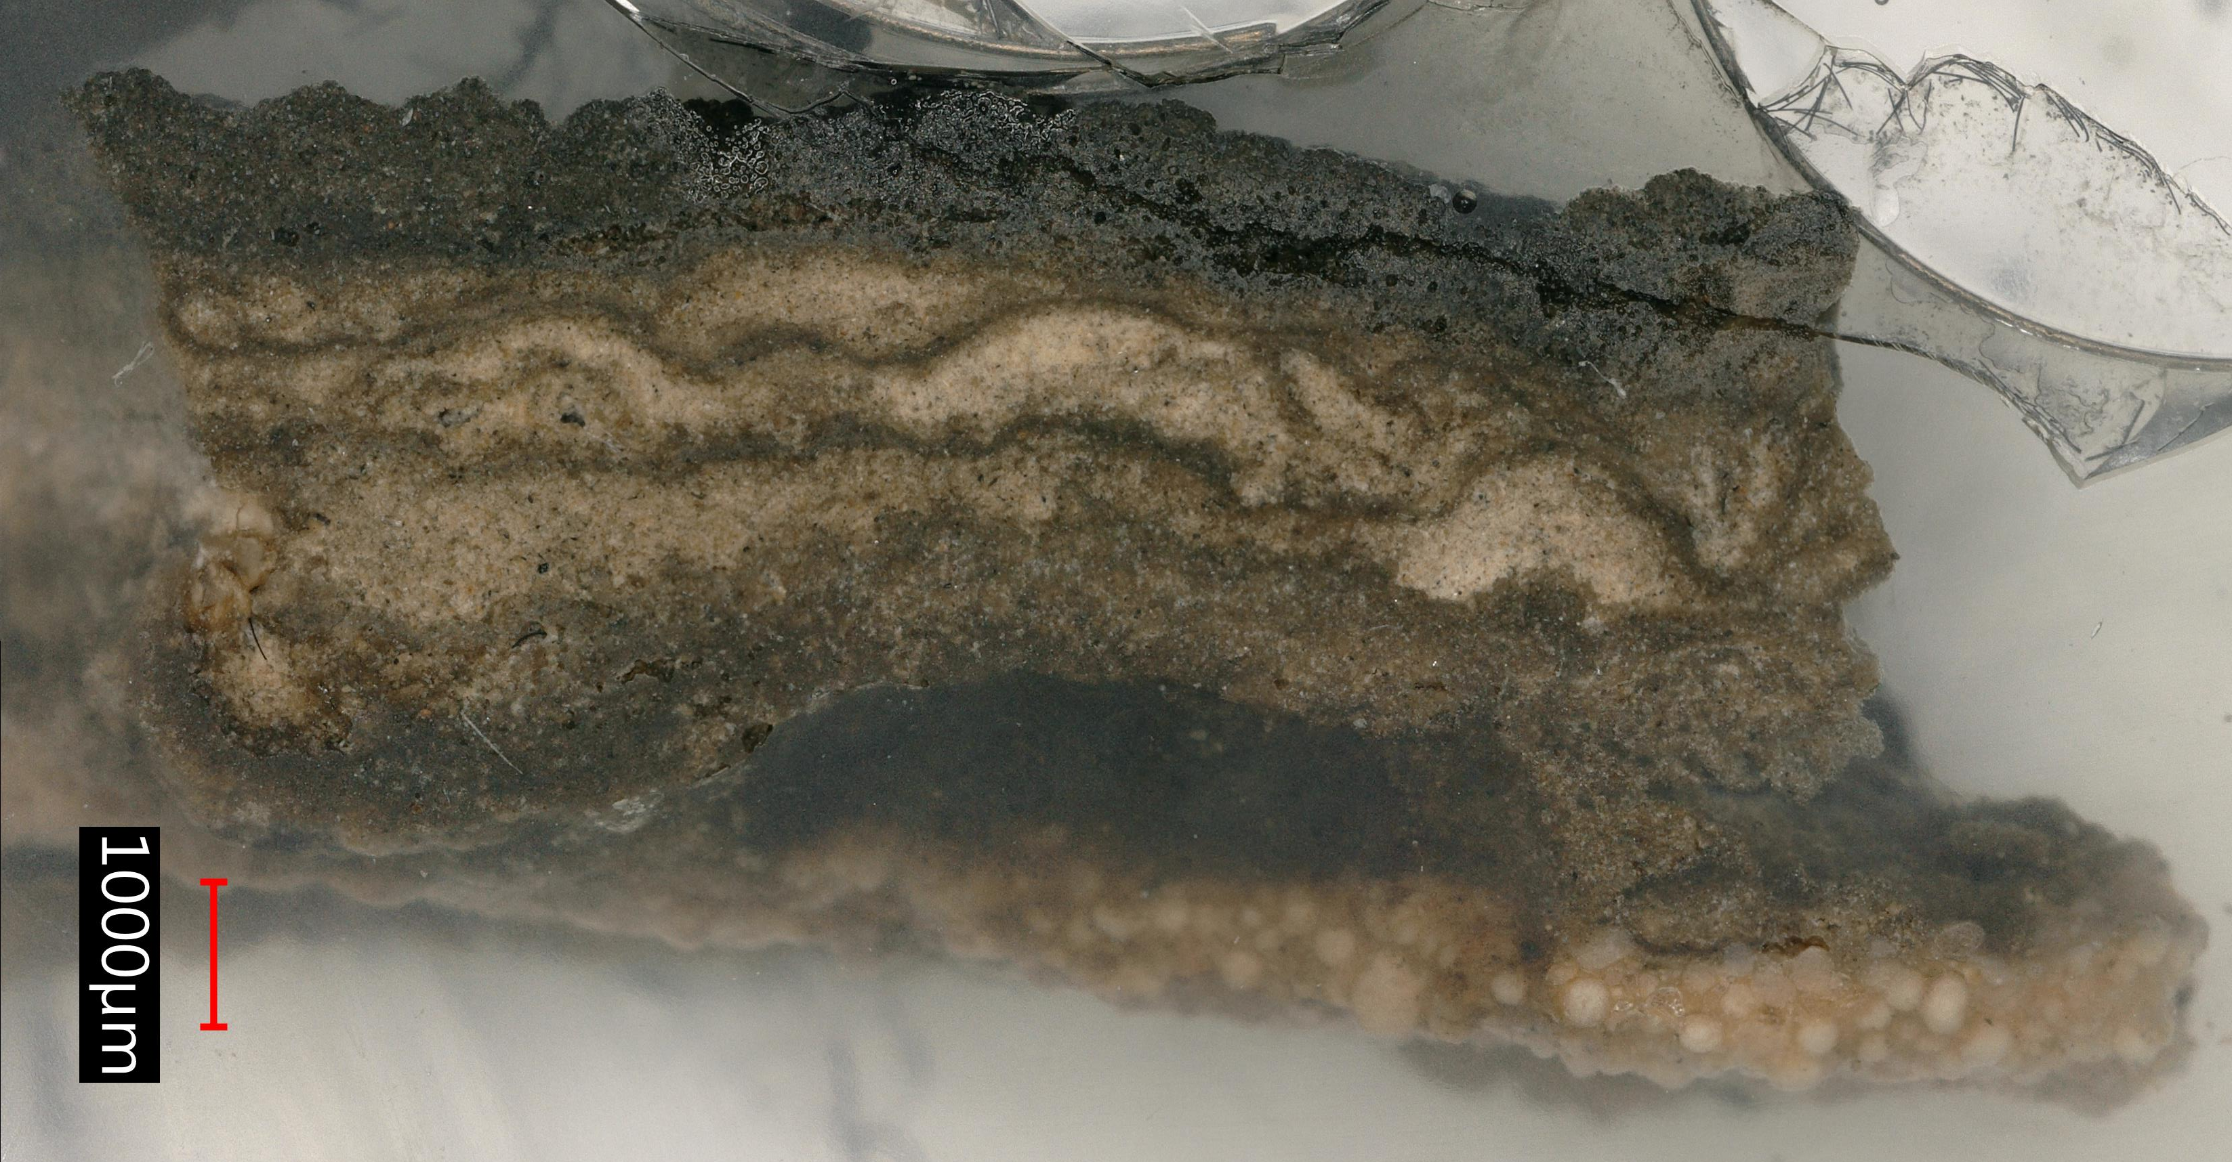
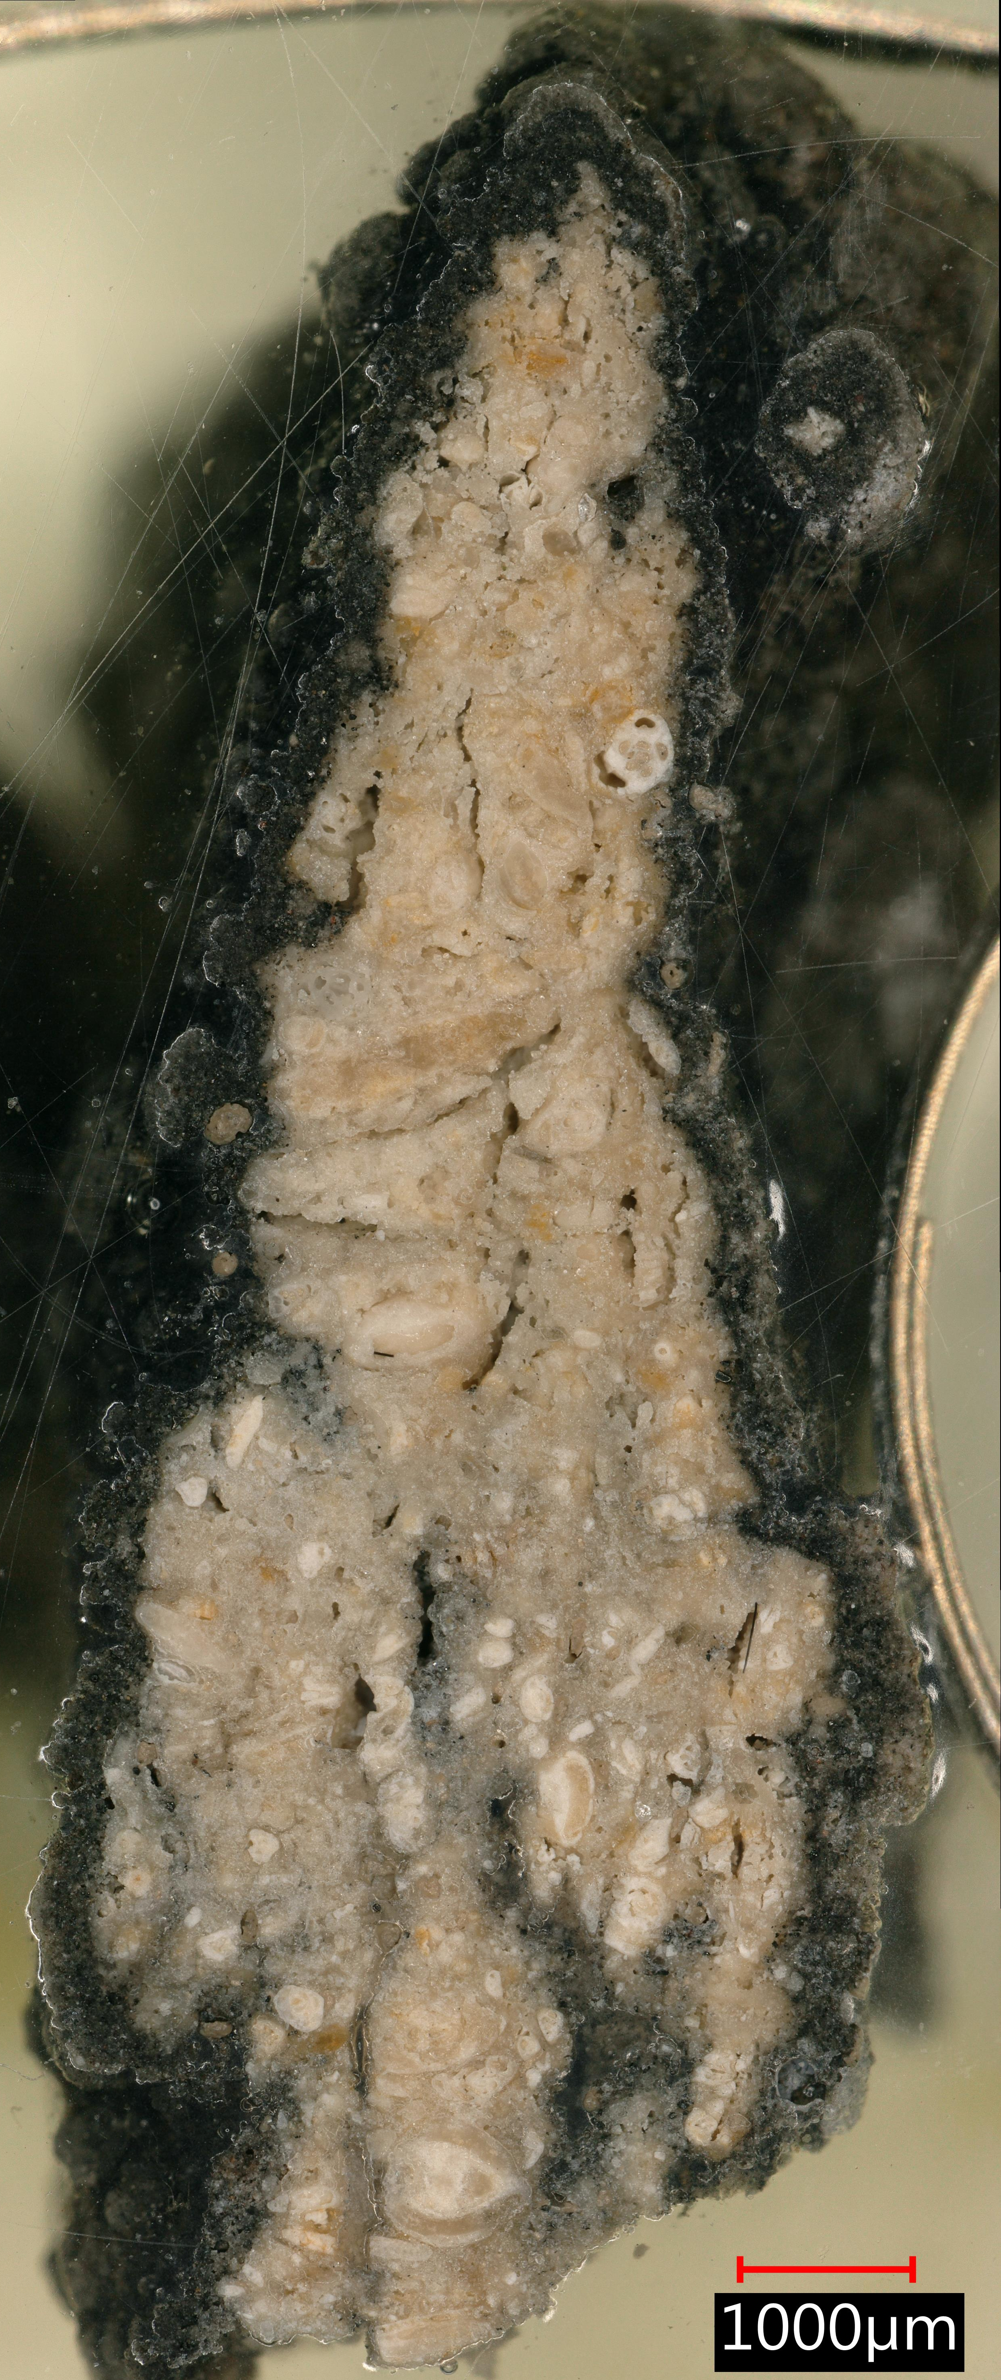
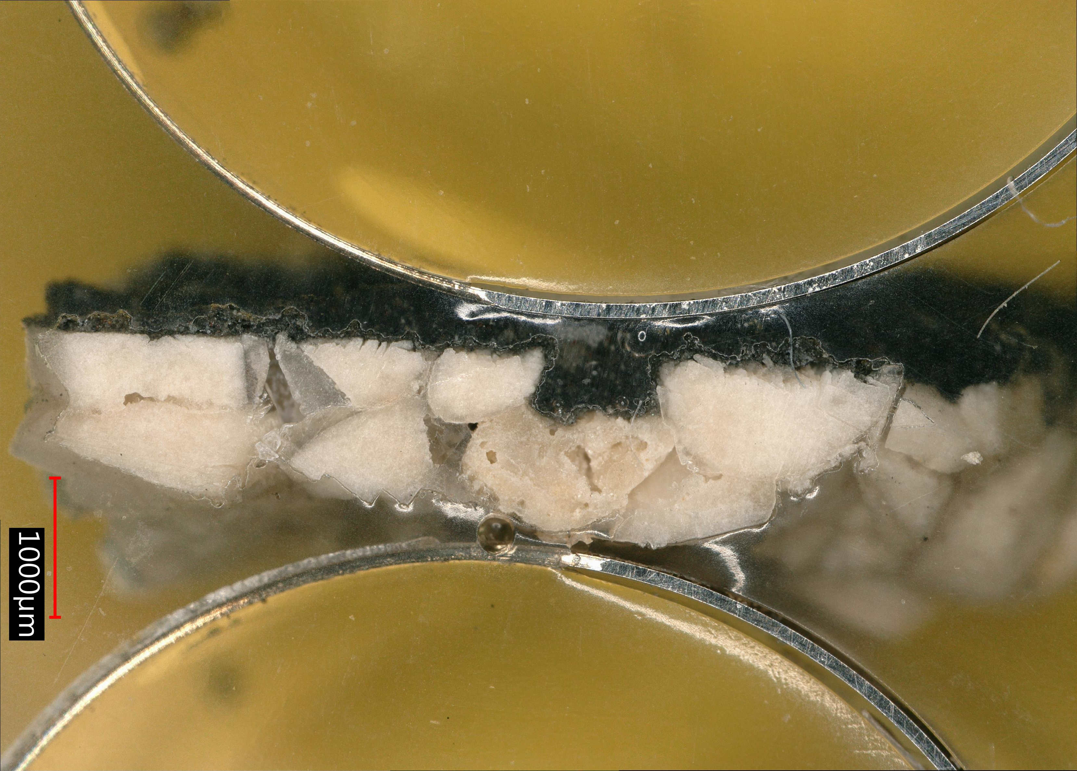
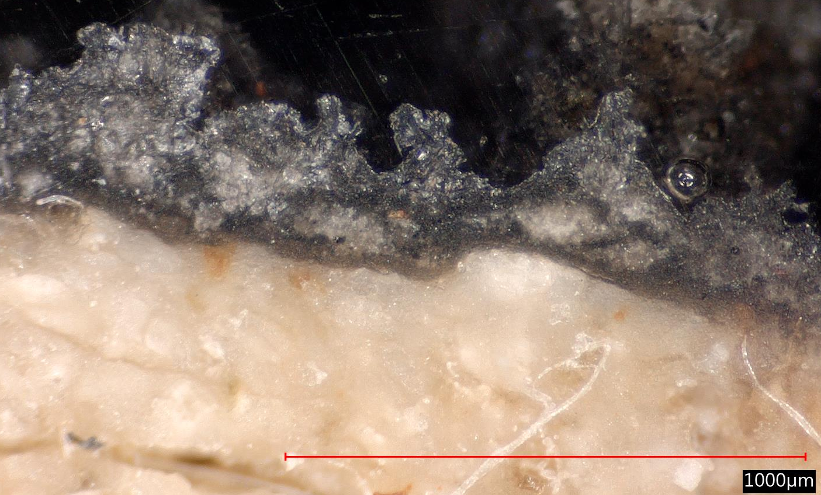
ERE 1.4 Climate change and cultural heritage: impact, vulnerability, adaptation – Environmental changes & observed weathering
Thank you for listening !
Any question ?
→ mathilde.ropiquet@lisa.ipsl.fr

