Slide 1

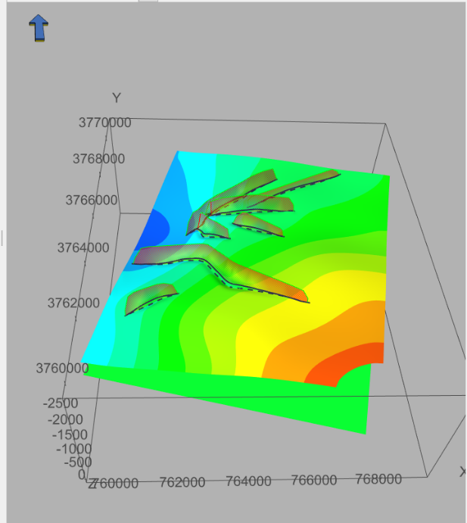
HS8.2.4/GM13.1/NH10.16 Field, modeling, and laboratory approaches for the assessment of hydrogeological and engineering problems in karst - Characterization, mapping and simulation of karst features
EGU22-2572
Identification of fast preferential flow distribution in a complex snow-governed karst system based on an inference of secondary faults, doline distribution, and tracer tests experiments: An application to Mount Lebanon
Joanna Doummar¹, Ariel Almendral Vazquez²
¹American University of Beirut- Geology Department- P.O. Box 11-0236- Riad El-Solh, Beirut 1107 2020,
E-mail: jd31@aub.edu.lb; 00961-1-35000, Ext 4165
²Norwegian Computing Center, P.O.Box 114 Blindern, N-0314 Oslo, Norway
Ariel.Almendral.Vazquez@nr.no
European Geophysical Union Doummar and Almendral 2022 May 23, 2022

Slide 2
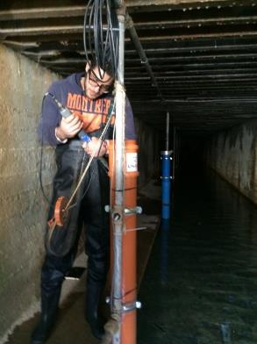
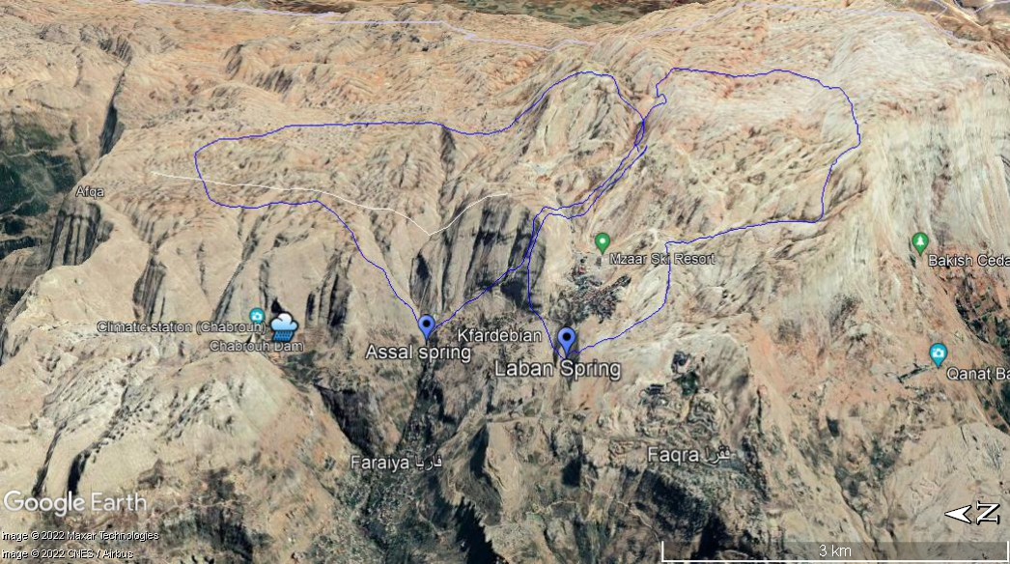
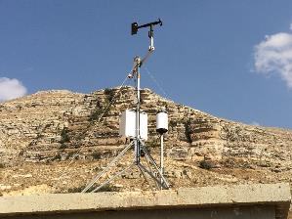
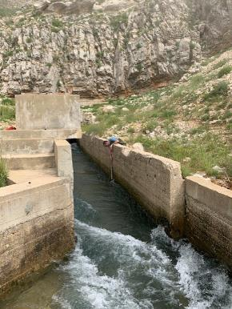
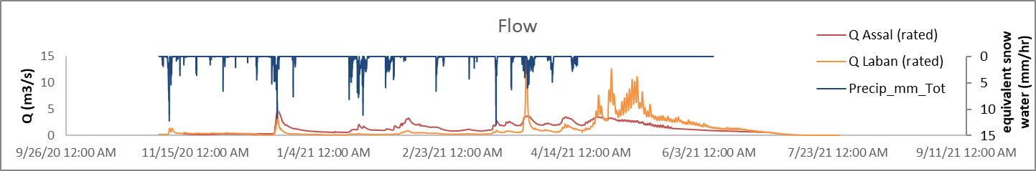
Field Site: Assal and Laban Catchment areas: Mount Lebanon
Snow governed springs originating from the Cenomanian rock sequence (Limestone and dolostones)
Assal
Vt=15-30 Mm³
Laban
Vt=15-25 Mm³
European Geophysical Union Doummar and Almendral 2022 May 23, 2022

Slide 3
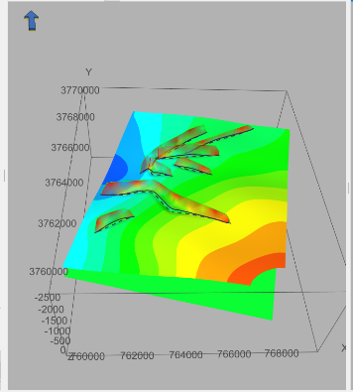
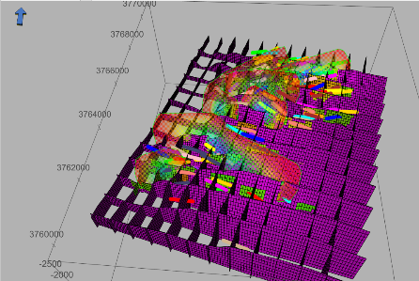
Methodology and workflow
The methodology involves the usage of Havana (Norsk Regnesentral; SAND 2021) for the structural and geological model and generation of anisotropic permeabilities in combination with a distributed numerical model for flow simulations
Lineaments and fault identification
Doline mapping
3-D geological and structural model
Secondary faults simulation (truncated fractal distribution with probability density function, d=2)
Assign different permeabilities according to the secondary faults
Identify doline orientation within a range in relation to a distance to Faults (Kriging)
Assign permeabilities according to faults honoring sampled (doline- faults)
Use the generated permeability grid in an existing karst distributed integrated model (Mike she)
Analysis of model output in relation to tracer experiments and discharge simulations
European Geophysical Union Doummar and Almendral 2022 May 23, 2022

Slide 4
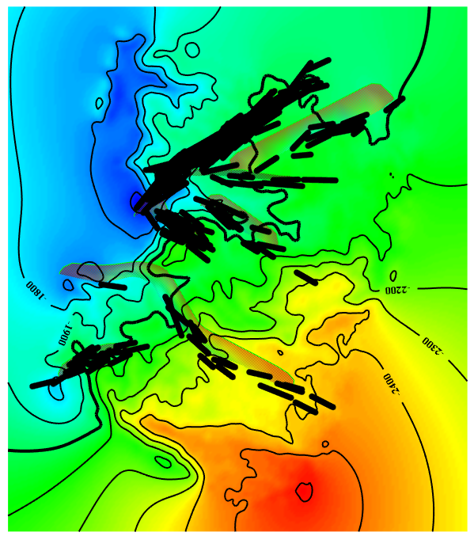
Secondary faults simulation (truncated fractal distribution)
1. The number of simulated faults that is assigned to each primary fault depends on the displacement of the primary fault.
2. The larger displacement, the higher number of secondary faults attached.
3. For each secondary fault a maximum displacement value is drawn from a truncated fractal distribution

Slide 5
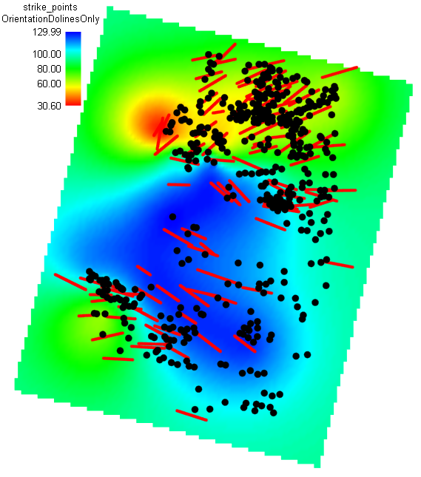
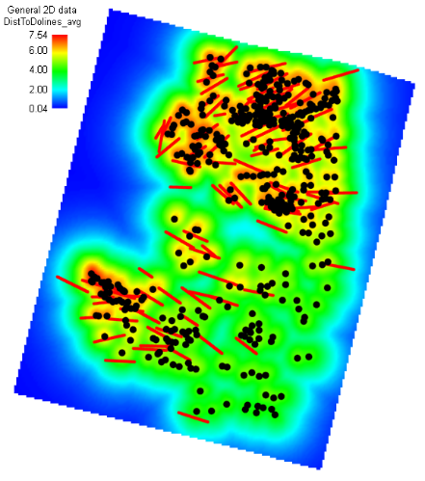
Conditionning of faults to dolines
To generate faults associated with dolines, we use orientation map and displacement intensity map.
1) Orientation map: Using fault strike as data on fault center points, make a map using Kriging: Dolines close to a major fault will ‘inherit’ the orientation of the fault.
2) Displacement intensity map: Given D the distance to the doline points. Make a new map Displacement = 10 * exp^(-D/R), where R = 500 m.
A simulated annealing algorithm iterates until simulated faults honor these two maps.

Slide 6
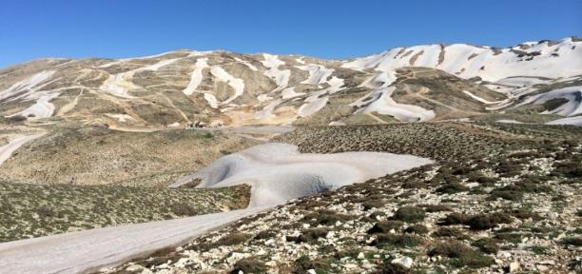
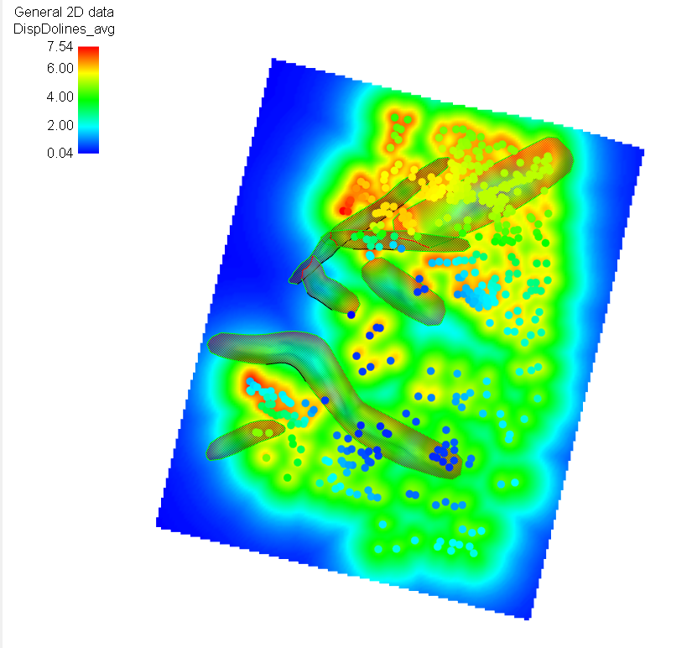
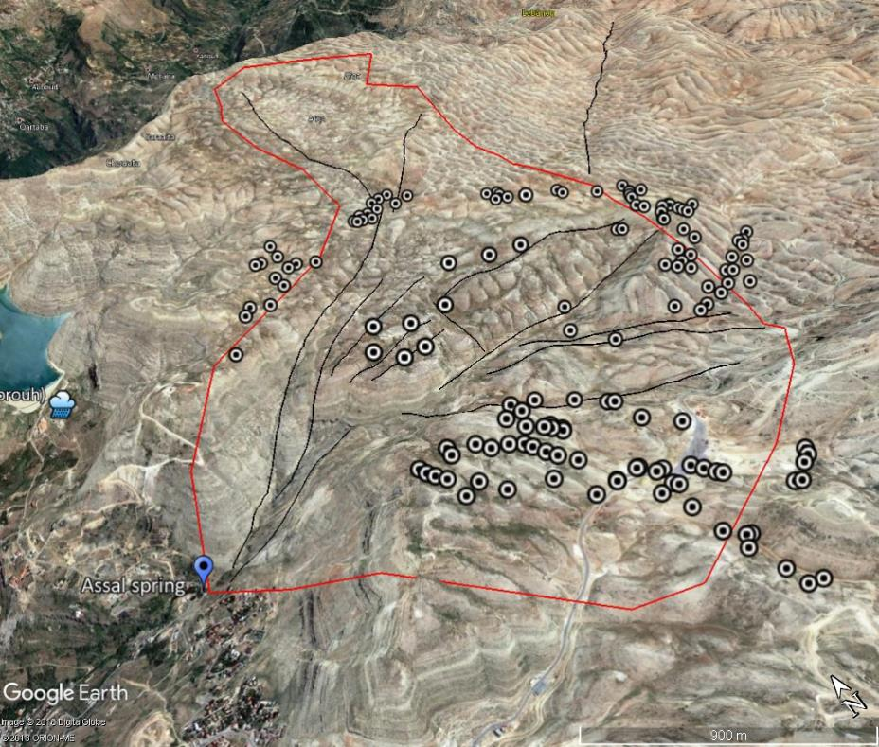
Doline buffering based on distance to fault
European Geophysical Union Doummar and Almendral 2022 May 23, 2022

Slide 7
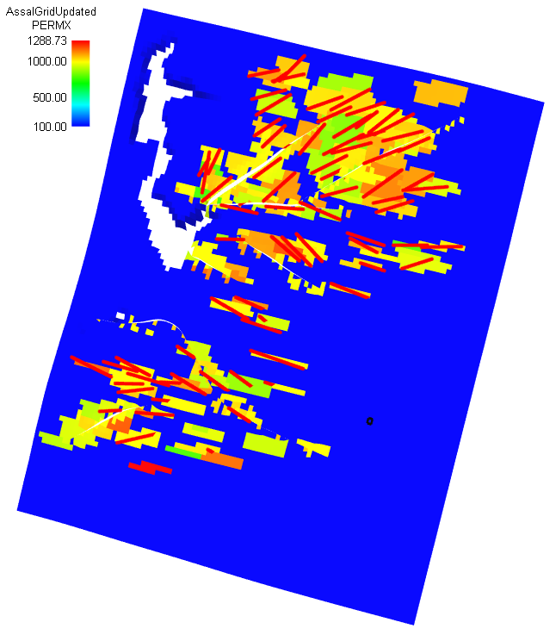
Populate permeability on simulated surfaces
The permeability has two control:
The fault surface effect (of the simulated fault, either secondary or doline associated-fault). The cells crossed by the surface of the fault are modified. The fault simulated thickness plays a role. The permeability value is drawn from a distribution (here normal with mean 1000 mDarcys +/- 100 mD)
The displacement effect. Little in this case due to small assigned max displacement on doline (10).

Slide 8
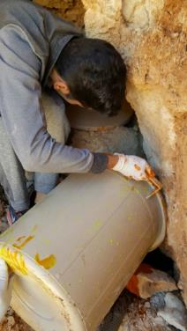
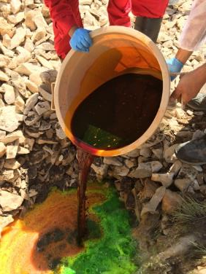
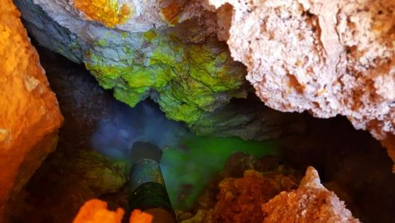
Correlation with tracer tracer experiments results
Dye tracers were injected in dolines on the Assal catchment and Laban Catchment (low flow periods)
European Geophysical Union Doummar and Almendral 2022 May 23, 2022

Slide 9
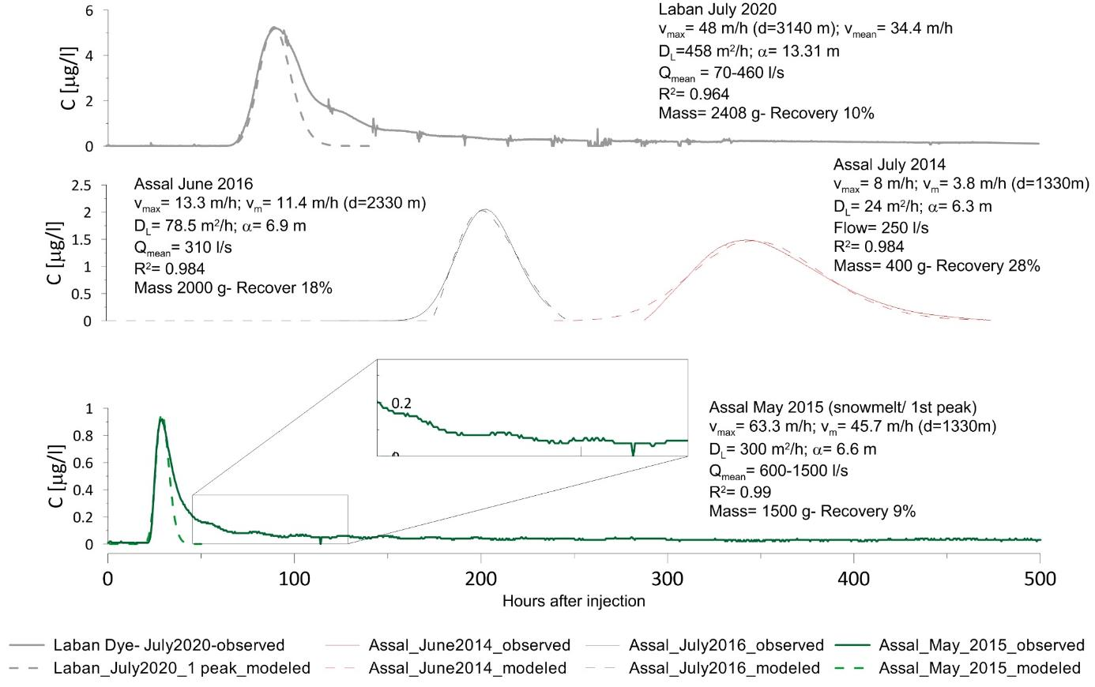
Tracer test analysis (first peak- Advection Dispersion Model)
LABAN
ASSAL
ASSAL
European Geophysical Union Doummar and Almendral 2022 May 23, 2022

Slide 10
Preliminary Results
Identification of Preferential flow based on faults and dolines
Secondary faults were inferred from lineament orientation and displacement
Doline-lineaments are produced based on doline spatial distribution and primary faults
Parameterization of the preferential flow path
Based on the obtained grid, permeability fields and anisotropy were assigned differentially within a fissured karst aquifer that behaves like an equivalent porous medium
The output geometry and parametrization was used in an exiting integrated flow model to outline the effect of geometry change and variable permeability on model output
Catchment delineation and tracer experiments
The final output reveals distinct areas that can be attributed to different boundary conditions of the catchment areas of the two springs. The results can be combined with a limited number of tracer experiments to delineate the limit between the catchment of the two springs.
European Geophysical Union Doummar and Almendral 2022 May 23, 2022

Slide 11
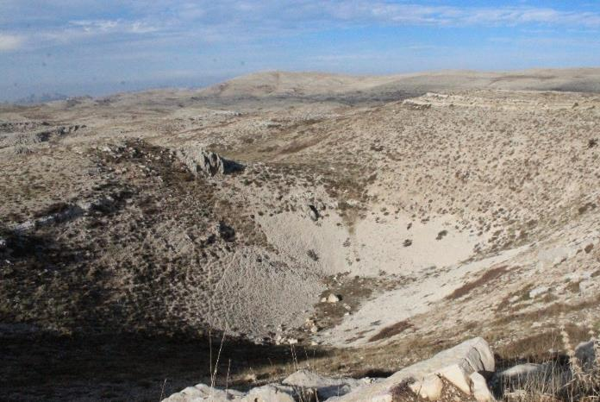
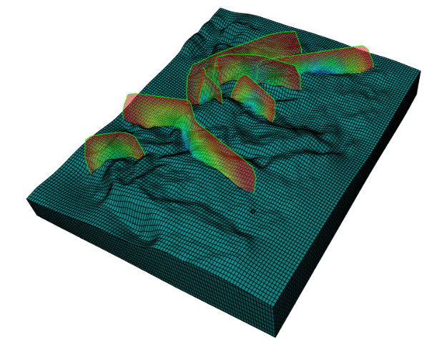
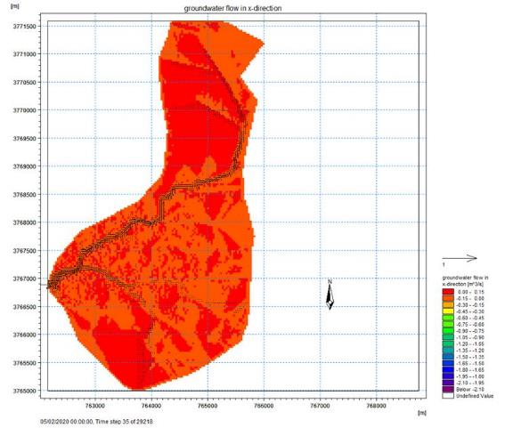
Outlook and further work
Produce different realization of the structural model with doline distribution with a variation of parameters (fractal dimension, weighting of displacement, distribution of permeability, distance range, etc…)
Use the model in an existing flow simulation (distributed integrated model) (in preparation)
Identify the sensitivity of model output to a variation of geometry and parametrization
Prepare an uncertainty envelop of the likelihood of a given point to be included in the catchment based on different realization
Doummar et al 2018b
European Geophysical Union Doummar and Almendral 2022 May 23, 2022

