Slide 1
Geomorphic characterization of the Lower Niger River using Google Earth Engine
Adeyemi Olusola¹, Richard Boothroyd^{2,3} and Samuel Adelabu¹
¹ Department of Geography, University of the Free State, Bloemfontein, South Africa
² School of Geographical and Earth Sciences, University of Glasgow, United Kingdom
³ School of Geography, Earth and Environmental Sciences, University of Birmingham, United Kingdom

Slide 2
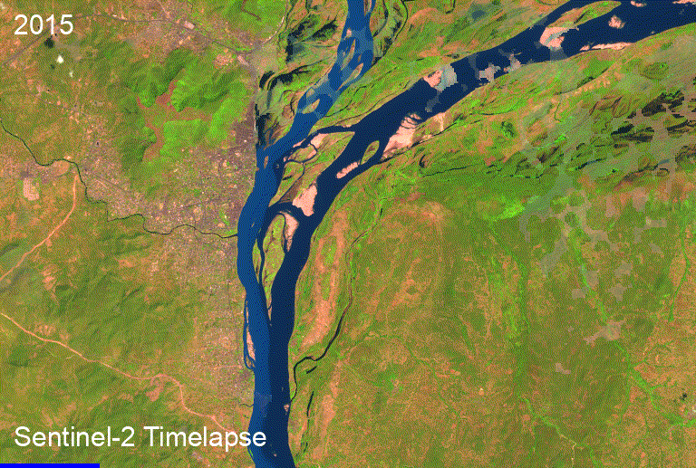

Background
The Niger River is the third-largest river on the African continent.
It has a length of about 4,200 km.
Niger River is a major transboundary river that flows through 9 countries.
It is a mainstay of the economy in West African countries with over 20 million people directly or indirectly depending on it for their livelihoods.

Slide 3
Problem Statement
Although the geomorphology of the Niger Delta is well studied, comparatively little is known about the fluvial portions of the Niger River system, despite their considerable value to local communities.
This study aims to assess changes in river planform by applying semi-automated satellite imagery analyses.

Slide 4
Methodology
~100 km braided segment of the Lower Niger River located between Lokoja and Idah.
The hydrogeomorphology of the segment is largely controlled by the Kainji Dam (Niger tributary) and the sediment supplied from the Benue catchment (Ogunjo et al., 2022a, b).
Ogunjo, S., Olusola, A., Fuwape, I., & Durowoju, O. (2022a). Temporal variation in deterministic chaos: the influence of Kainji dam on downstream stations along lower Niger River. Arabian Journal of Geosciences, 15(3), 1-11.
Ogunjo, S., & Olusola, A. (2022b). Signature of teleconnection patterns in river discharge within the Niger Basin. Meteorology and Atmospheric Physics, 134(2), 1-15.

Slide 5
Methodology cont’d
We use the cloud computing platform Google Earth Engine (GEE) to analyse multi-temporal collections of Landsat satellite imagery acquired between 1984 and 2021.
We use the HSV colour model of the RGB imagery, combined with conventional multispectral indices (Boothroyd et al., 2021a, b) to classify the active river channel (including water and exposed alluvial deposits).
Boothroyd, R. J., Williams, R. D., Hoey, T. B., Barrett, B., & Prasojo, O. A. (2021a). Applications of Google Earth Engine in fluvial geomorphology for detecting river channel change. Wiley Interdisciplinary Reviews: Water, 8(1), e21496.
Boothroyd, R. J., Nones, M., & Guerrero, M. (2021b). Deriving planform morphology and vegetation coverage from remote sensing to support river management applications. Frontiers in Environmental Science, 9, 146.

Slide 6
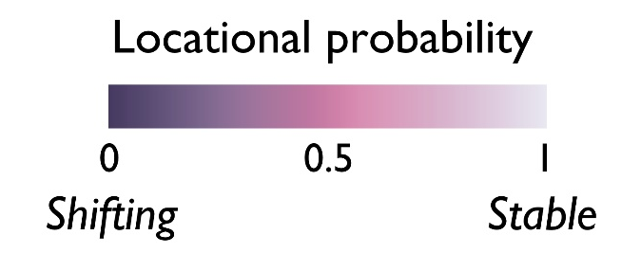

Results

Slide 7

Results
We identify shifts in the position of the active channel – results indicate the complex and active morphodynamics.
Combined with building footprint data (Sirko et al., 2021) we can start to assess geomorphic hazards to individual buildings.
Sirko, W., Kashubin, S., Ritter, M., Annkah, A., Bouchareb, Y.S.E.., Dauphin, Y., Keysers, D., Neumann, M., Cisse, M., Quinn, J.A. (2021). Continental-scale building detection from high resolution satellite imagery. arXiv:2107.12283.

Slide 8
Conclusion
Semi-automated satellite imagery analyses can be useful for assessing the erodible corridor/freedom space of large rivers.
Opportunities to combine remote sensing outputs with additional information (e.g., land-use data or building footprints) to offer new insights into geomorphic hazards in data-scarce environments.

Slide 9
THANK YOU!

