Slide 1





Source quantification of PM2.5 using δ¹³C values along with corresponding organic carbon, elemental carbon, and select inorganic ions over two COALESCE network locations
Aerosol Characterization and rEceptor modelling
Presented by: Kajal Yadav
Earth and Environmental Sciences Department,
Indian Institute Of Science Education And Research, Bhopal, India
kajal18@iiserb.ac.in

Slide 2

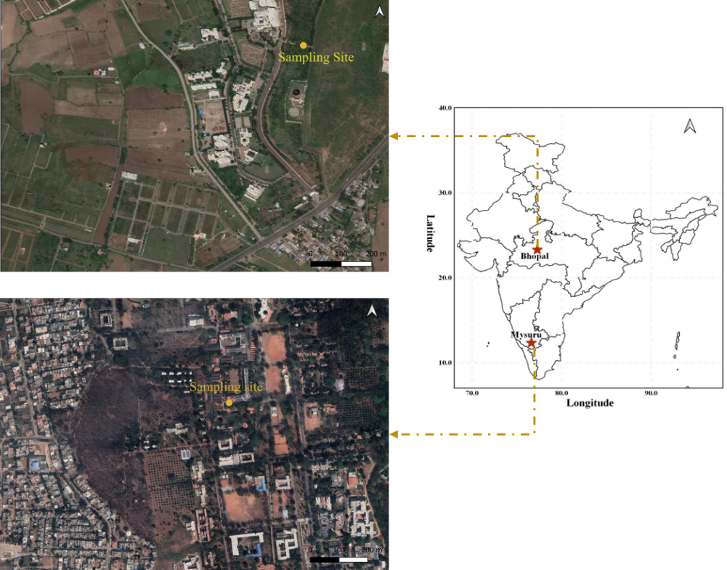
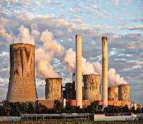
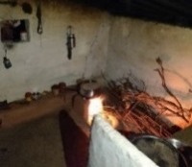
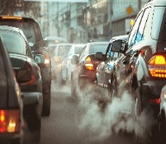
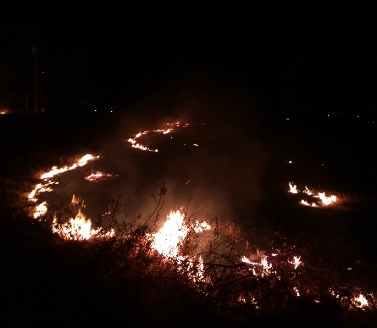
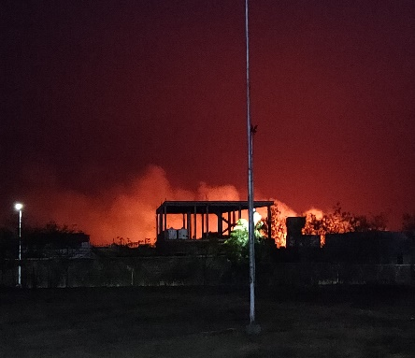
Introduction and Background
Fresh SOA
Loss of ¹²C
δ¹³C
Secondary OC
Aged aerosols
δ¹³C
Atmospheric processing
δ¹³C
Fresh POA
VOCs
Loss of ¹²C
δ¹³C
Emission
Emission
reproduced from Haiyan, 2011
δ¹³C: -24.2 to -23.1 ‰
δ¹³C: -28.8 to -6.6 ‰
Figure 1. Map showing the location of receptor sites in Bhopal (Indian Institute of Science Education and Research, IISER) and Mysuru (Sri Jayachamarajendra College of Engineering), India.
Emission Sources
δ¹³C: -28.3 to -26.5 ‰
C₃ - plant δ¹³C: - 32 ‰ to -20 ‰
C₄ - plant δ¹³C: - 17 ‰ to -9 ‰
C₃ - plant δ¹³C: - 32 ‰ to -20 ‰
C₄ - plant δ¹³C: - 17 ‰ to -9 ‰
Two Regional representative sites were chosen (Lekinwala et al.,2020)
One year long (2019) measurements was conducted at both the sites.
Photo courtesy: Google Images
Photo courtesy: Diksha Haswani, Ravindra Sharma, IISER Bhopal

Slide 3
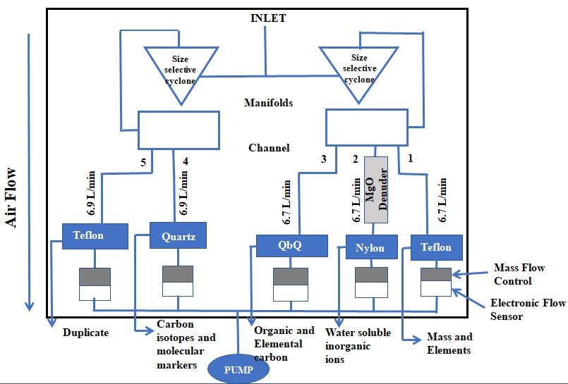
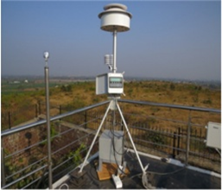
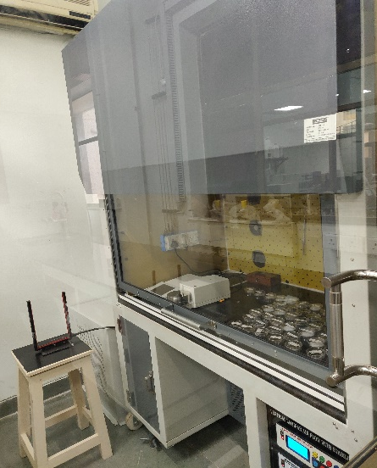
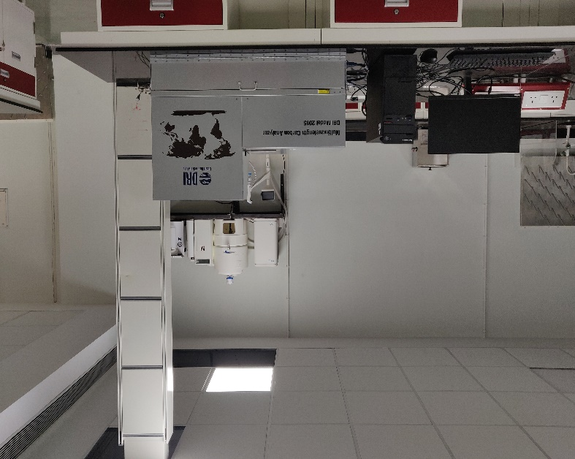
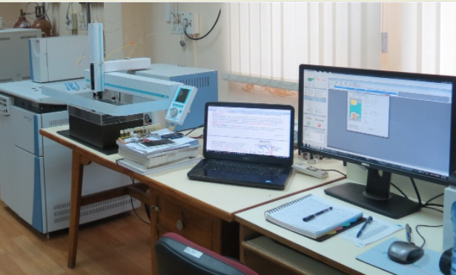
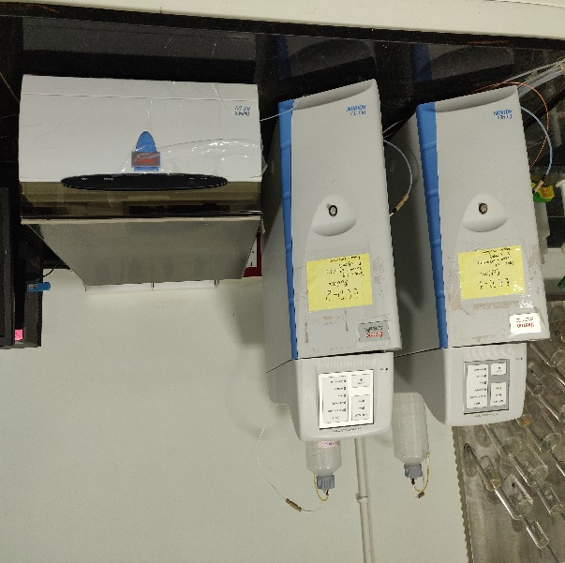
Methodology
Ambient PM2.5 Sampling
Sartorius Cubis Microbalance (MSU6.6S-000-DF)
Gravimetrically PM2.5 mass collected on filters
Speciation Air Sampling System (SASS)
Thermo Scientific Dionex Aquion Ion Chromatography System
Cations: K⁺, Ca²⁺, and Na⁺
Anions: SO₄²⁻, NO₃⁻, Cl⁻
Multi-Wavelength Thermal/Optical Carbon Analyzer (DRI Model 2015)
Quantification
of OC and EC fractions on ambient PM2.5 samples.
Thermo Scientific Delta V advantage IRMS; Flash EA-2000
Stable carbon isotope (δ¹³C)

Slide 4
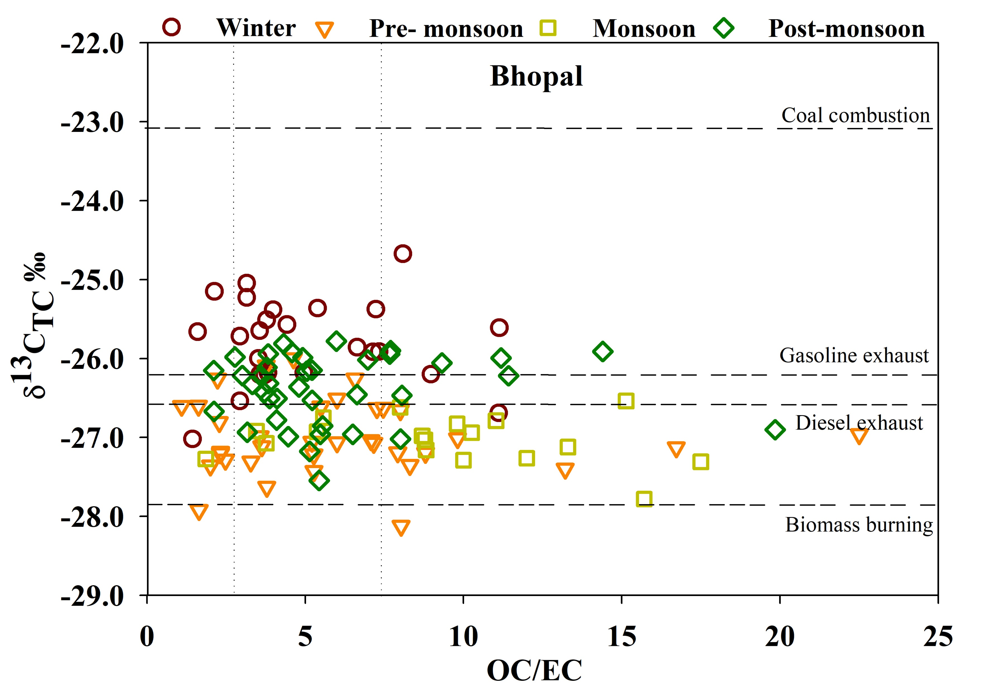
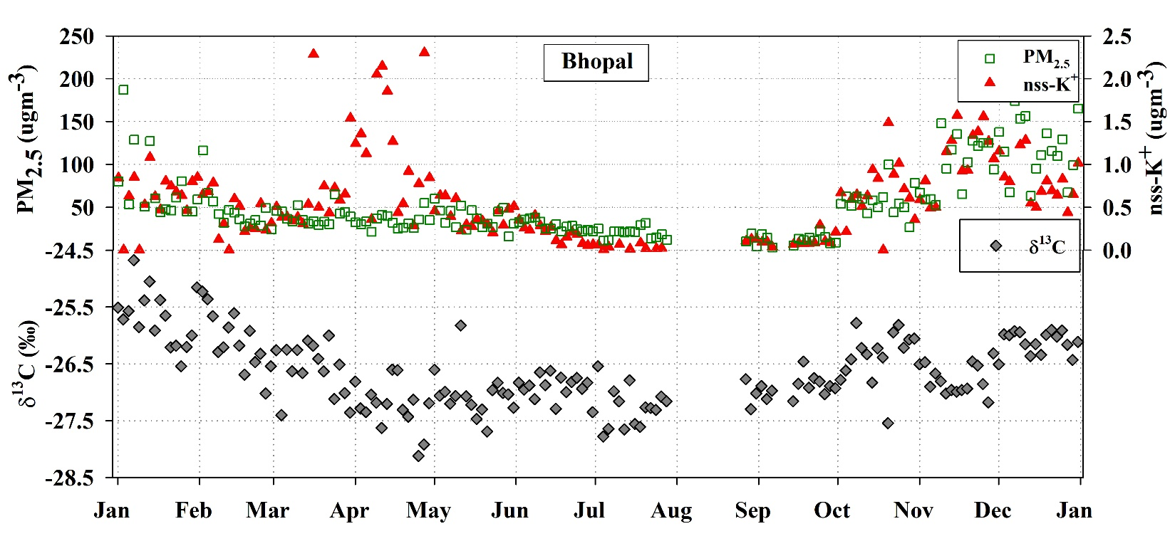
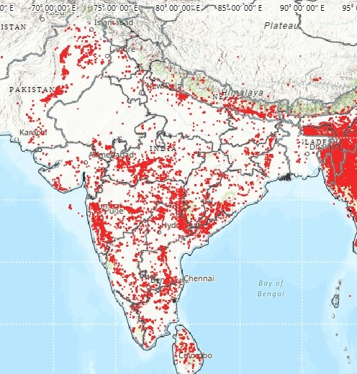
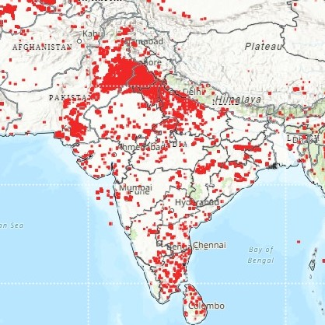
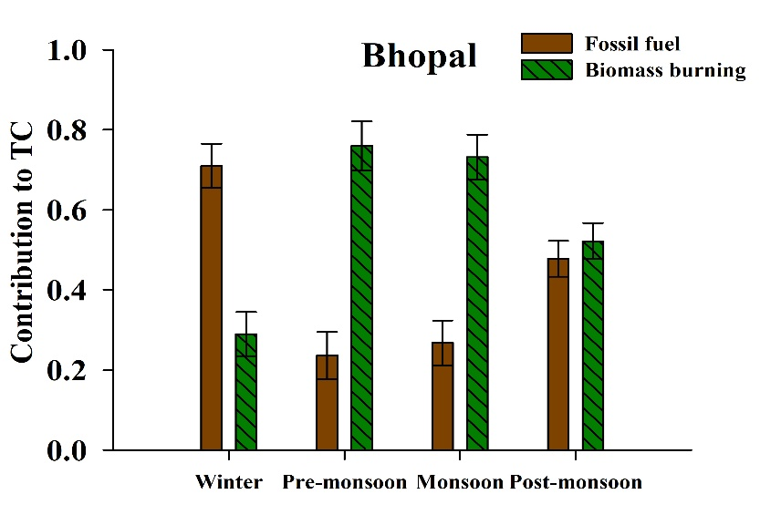
Results and Discussion
Figure 3. δ¹³C values of TC vs the reciprocal concentrations of OC/EC observed at Bhopal in 2019.
Figure 4. Temporal variability of PM_{2.5} and biomass burning marker and their co-variability with δ¹³C values of Bhopal
Stubble burning at Indo-Gangetic Plains
Figure 6. MixSIAR model outputs of proportional contributions of two potential source categories of PM_{2.5} TC (mean value, ±SD) and its seasonal variability in Bhopal during 2019
Stubble burning at Central part of India
Figure 5. MODIS fire counts during biomass burning periods (a) Pre-Monsoon, 2019 (b) Post-Monsoon, 2019

Slide 5
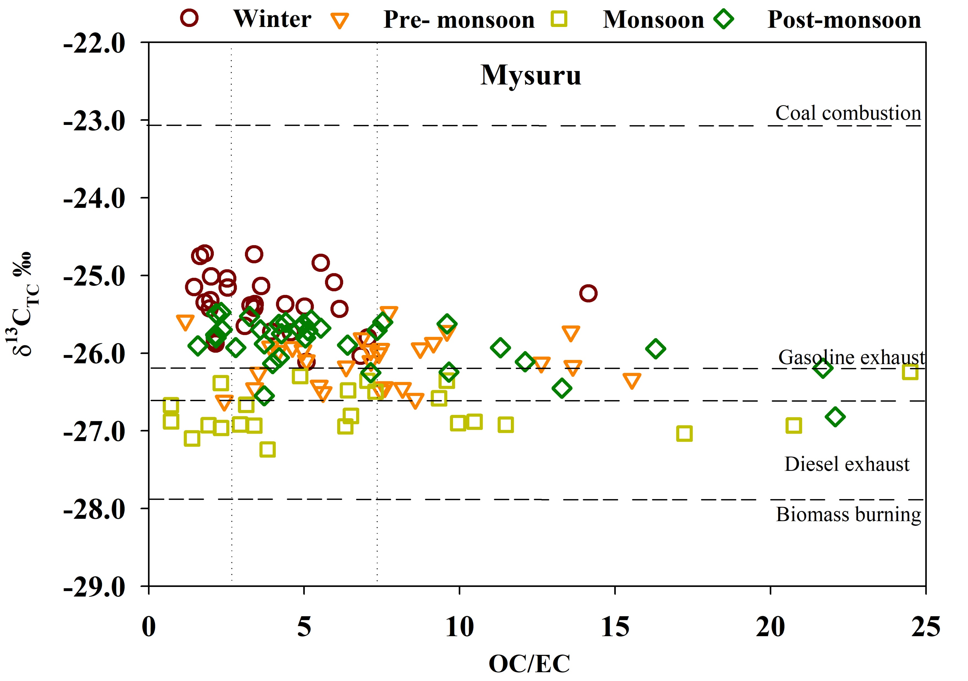
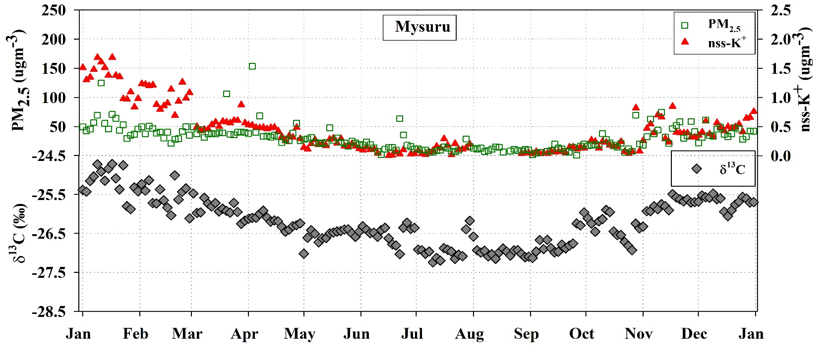
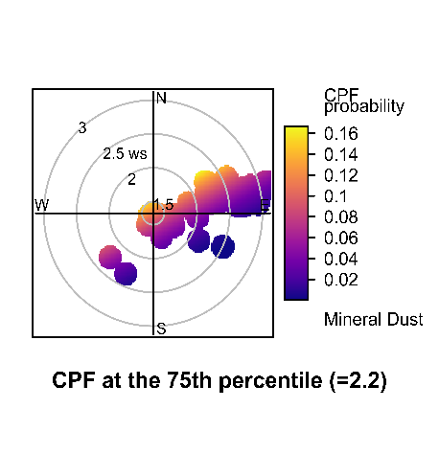
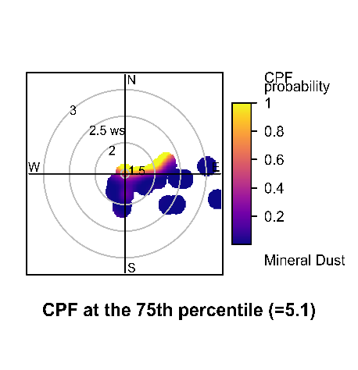
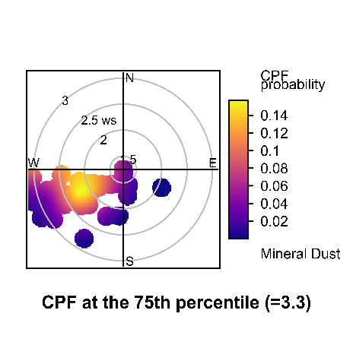
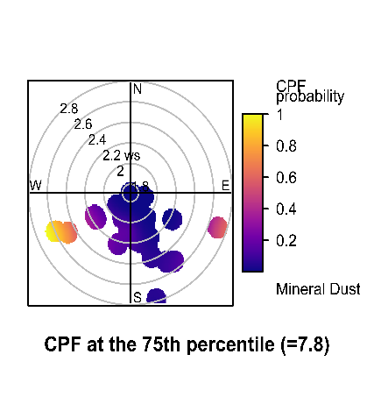
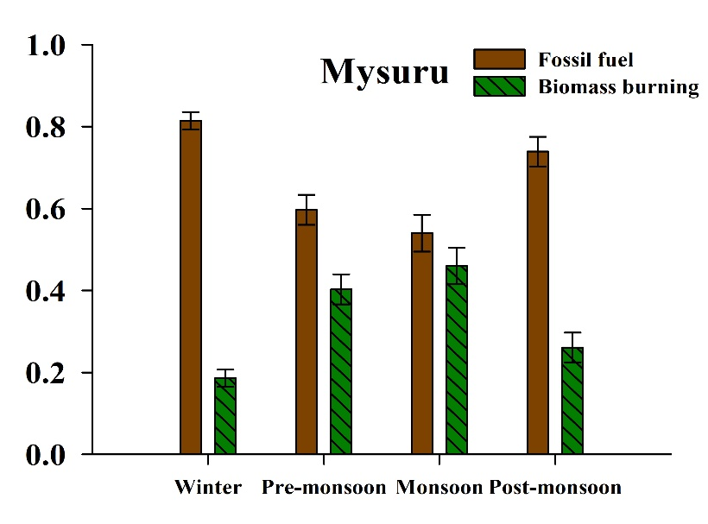
Results and Discussion
Figure 8. Temporal variability of PM_{2.5} and nss-K⁺ and their co-variability with δ¹³C values at Mysuru
Figure 7. δ¹³C values of TC vs the reciprocal concentrations of OC/EC observed at Mysuru in 2019
Figure 10. MixSIAR model outputs of proportional contributions of two potential source categories of PM_{2.5} TC (mean value, ±SD) and its seasonal variability in Mysuru
Figure 9.CBPF plots for Mineral dust for (a) winter, (b) pre-monsoon, (c) monsoon, (d) post-monsoon, Mysuru

Slide 6

Findings and Conclusion
Striking seasonal patterns in δ¹³C values were observed at both the sites, with the highest value observed during the winter season and the lowest during the monsoon season.
Different δ¹³C values indicate different chemical composition of carbonaceous aerosols and/or rather different sources of aerosol carbon origin during the year.
The δ¹³C values (average −26.6 ± 0.6 %) in Bhopal were predominantly influenced by biomass burning and fossil fuel combustion sources. In contrast, δ¹³C values observed in Mysuru suggest the consistent influence of liquid fuel emissions (road traffic and vehicular exhaust) throughout the year, signifying the dominance of proximal sources in influencing TC concentrations.
MixSIAR resolved, Fossil fuel combustion emissions accounted for 47 ± 19 % and 62 ± 22 % of the TC at Bhopal and Mysuru, respectively.

